Slide 1
Blackburn Primary School
Celebration Assembly
Friday the 8th of May 2020
Blackburn Primary, a school family, growing, learning and succeeding.

Slide 2
Shout outs from staff………..
We all miss you
Teaching staff
Miss Clarkson
Mrs McCarney
Mrs Topping
Mrs Bryce
Miss Hamill
Mrs McLuckie
Miss Miller
Mr Riding
Mrs Brodzka
Miss Anderson
Support staff
Miss Robertson
Mrs Wilmott
Mrs Smith
Miss Meikle
Mrs Anderson
Mrs Gilbert
Mrs Butler
Mrs Hamilton
Mrs McMillan

Slide 3
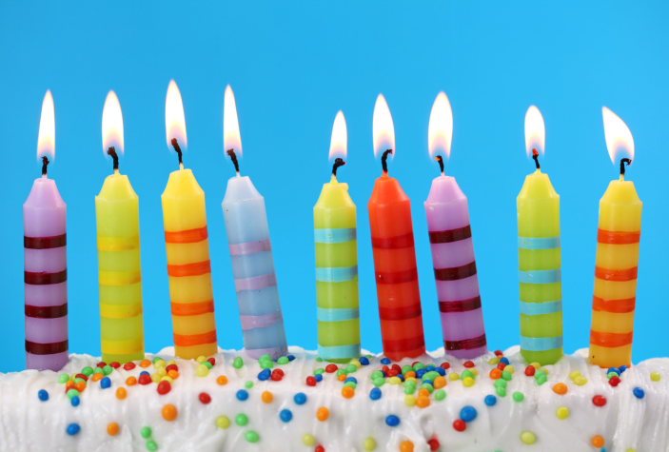
Happy Birthday Grace
Happy Birthday Grace who was 9 this week.
Many happy returns we hope you had a lovely day

Slide 4
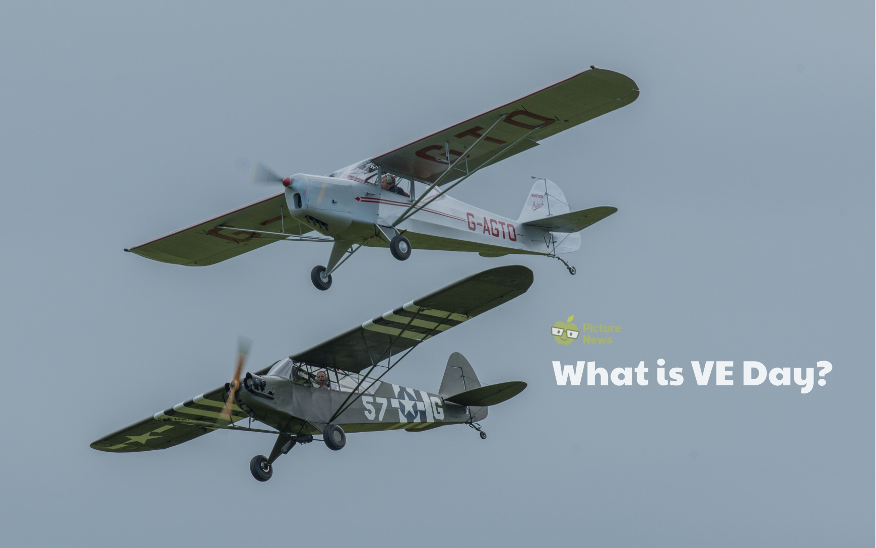
What is VE Day?

Slide 7
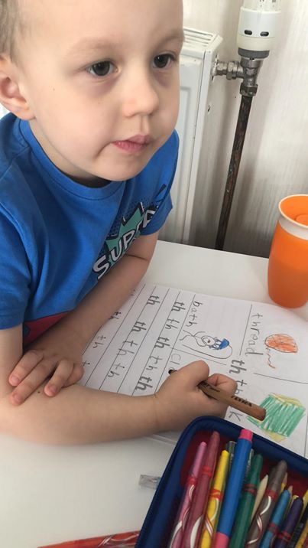
Well done to our P1 pupil for working hard to complete all the work in his school closure pack

Slide 8
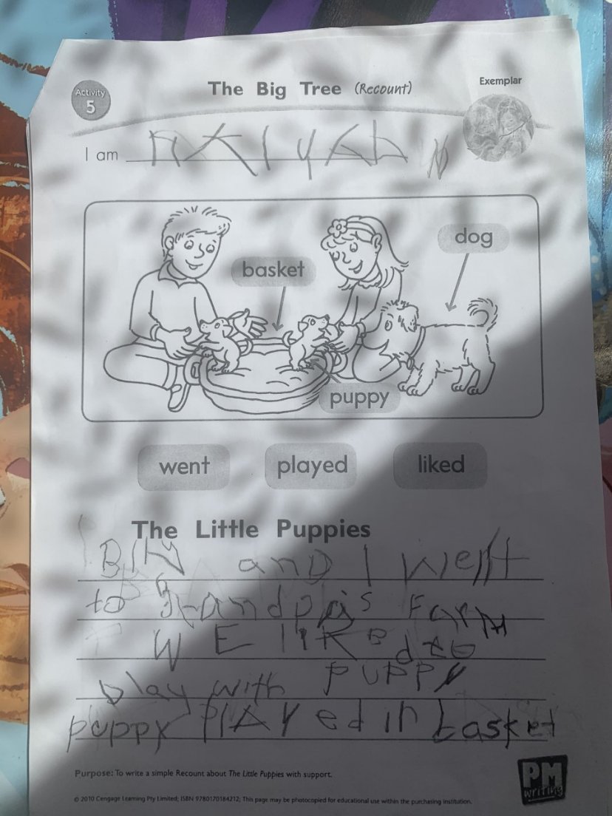
Well done to our A1 pupil who wrote a lovely recount about ‘The Little Puppies’ for his PM writing task this week and he has been working hard at reading his tricky word cards!

Slide 9
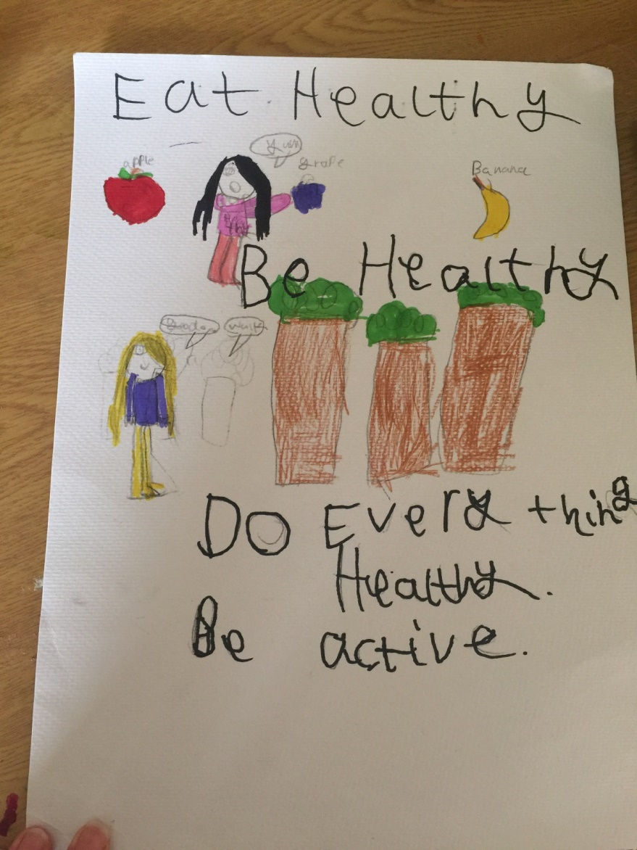
Excellent work from Hollie who created a healthy eating poster for their topic which is The Human Body!

Slide 10
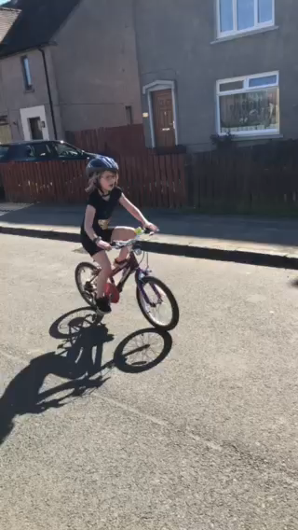
Well done to one of our P4/5 girls who has learned to ride her bike!

Slide 11
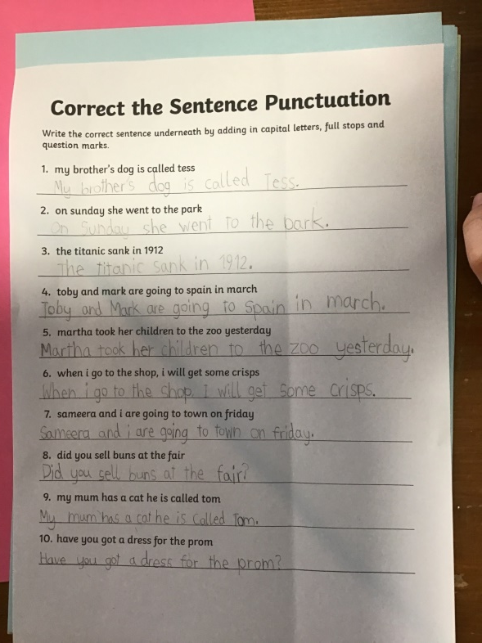
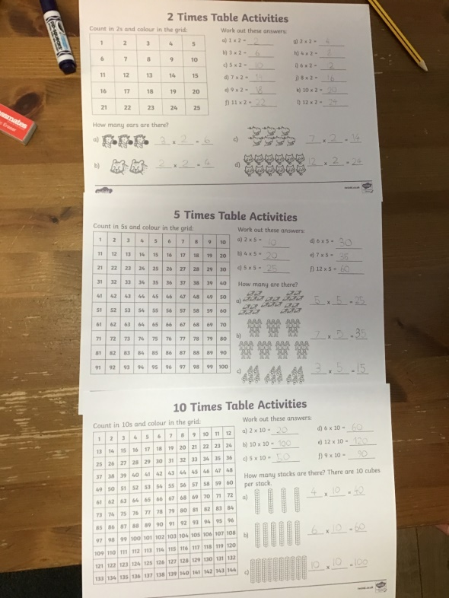
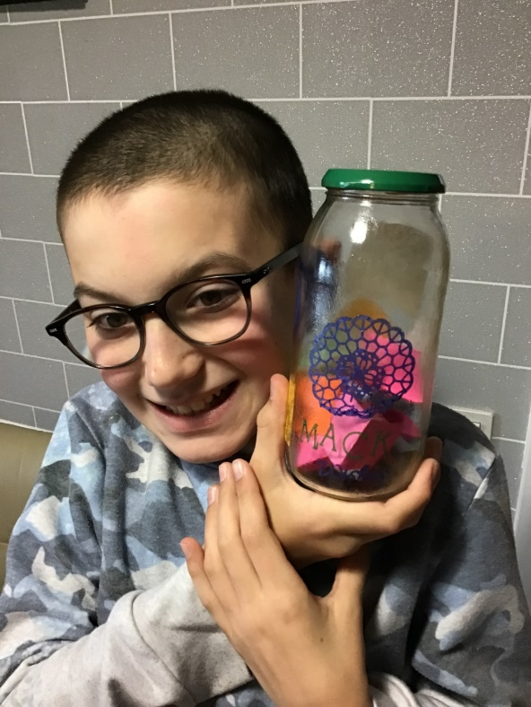
Well done to one of our A2 pupils for always completing his work. This week he has been working on his times tables, punctuation and health and wellbeing. He has also made a jar with ‘things he is looking forward to’!

Slide 12

Well done to one of our A2 boys who made a fantastic video for the Planet Soccer Facebook page.

Slide 13

Well done to Julia for creating a simple machine from the West Lothian Council Be Inspired task!

Slide 14
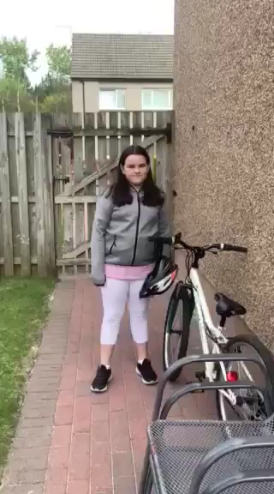
Well done to one of our P5/6/7 girls for becoming a content producer and creating her own fitness video – Joe Wicks watch out!

Slide 15
Well done to Morgan who created an amazing PowerPoint about Tom Moore.
Well done to Ryan for staying focused and using some of his time at home to explore his personal interest in coding.

Slide 16
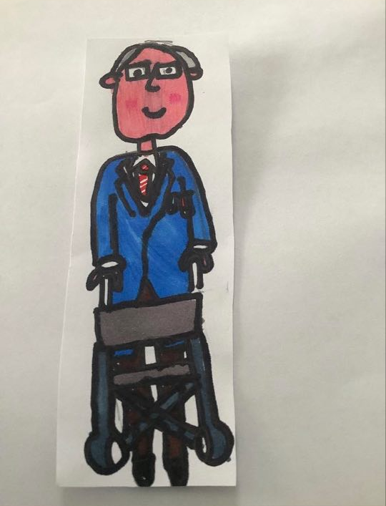
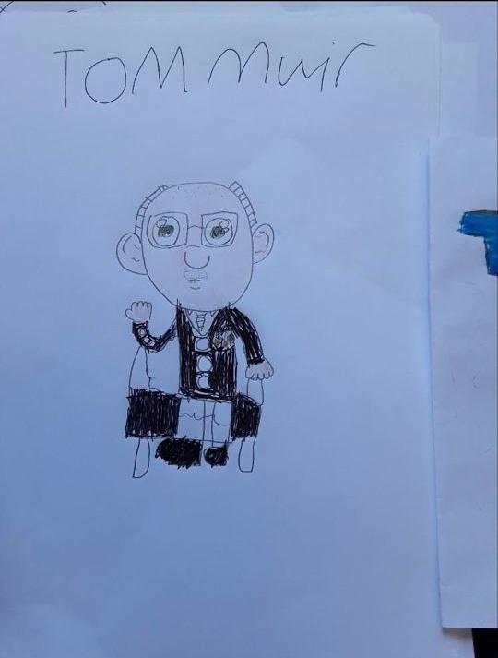
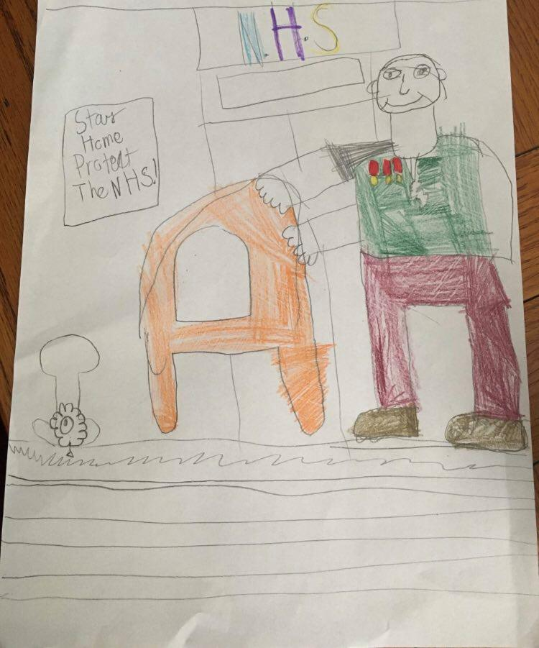
Well done to Ellie, Scott and Jack for making wondering pictures of Tom Moore

Slide 17
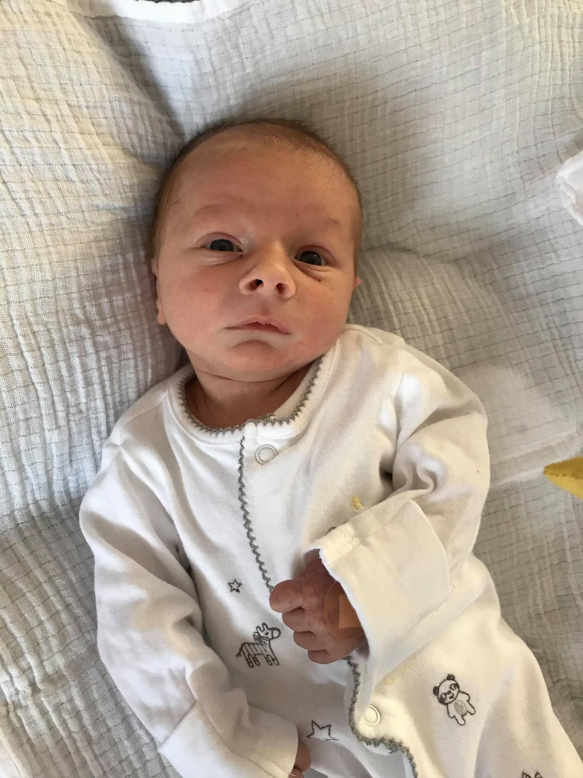
We also want to wish Mrs Lund a huge congratulations on the arrival of baby Noah Arthur Lund who was born 5th April 2020 at 11:17am weighing 7lbs 11oz!

Slide 18

Take care and stay safe
We all miss you and look forward to when we will see you all again from all the staff at Blackburn Primary School
Have a lovely weekend and we will be back in touch on Monday

