Slide 1
French Early Level
Colours
Wednesday 5th May

Slide 2
Activité 1
Listen to the French vocabulary by clicking on the colours and repeat the colour words.

Slide 4
Activité 2
C’est de quelle couleur?
Notes:
What colour is it?

Slide 5
C’est de quelle couleur?
Children have to look at the following pictures and say what the colour is in French using “C’est” + the colour.

Slide 6
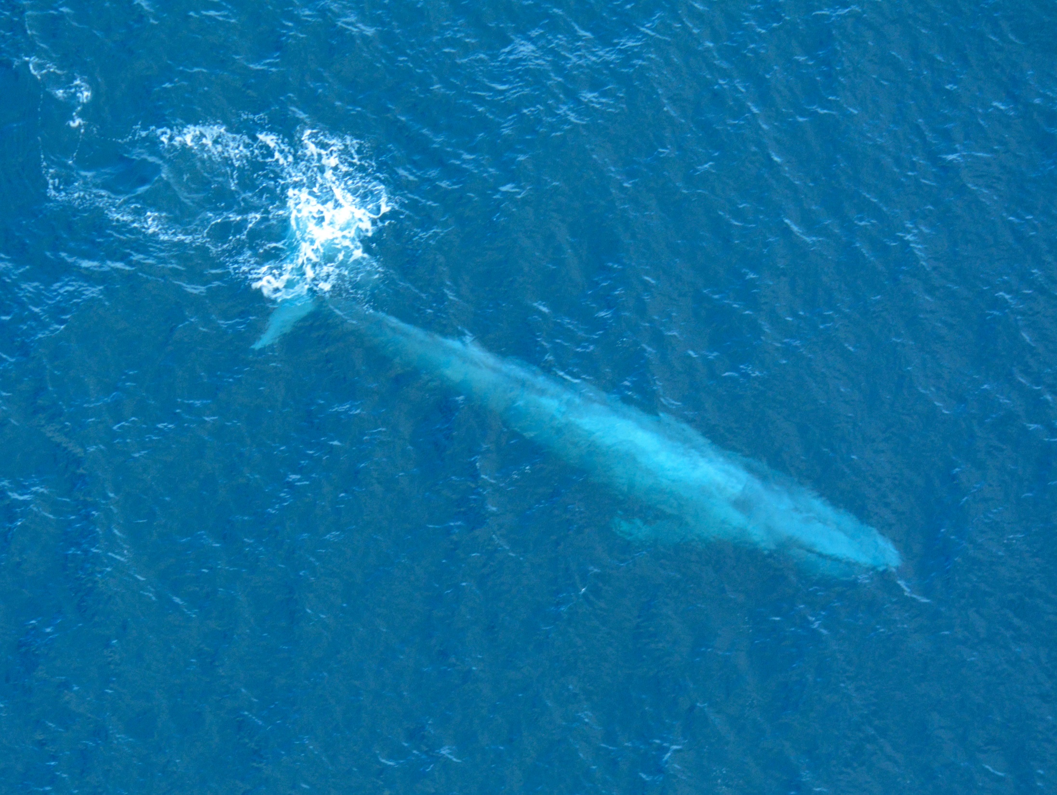
C’est de quelle couleur?
C’est bleu!

Slide 7
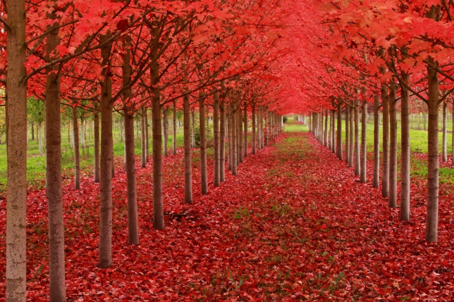
C’est de quelle couleur?
C’est rouge!

Slide 8
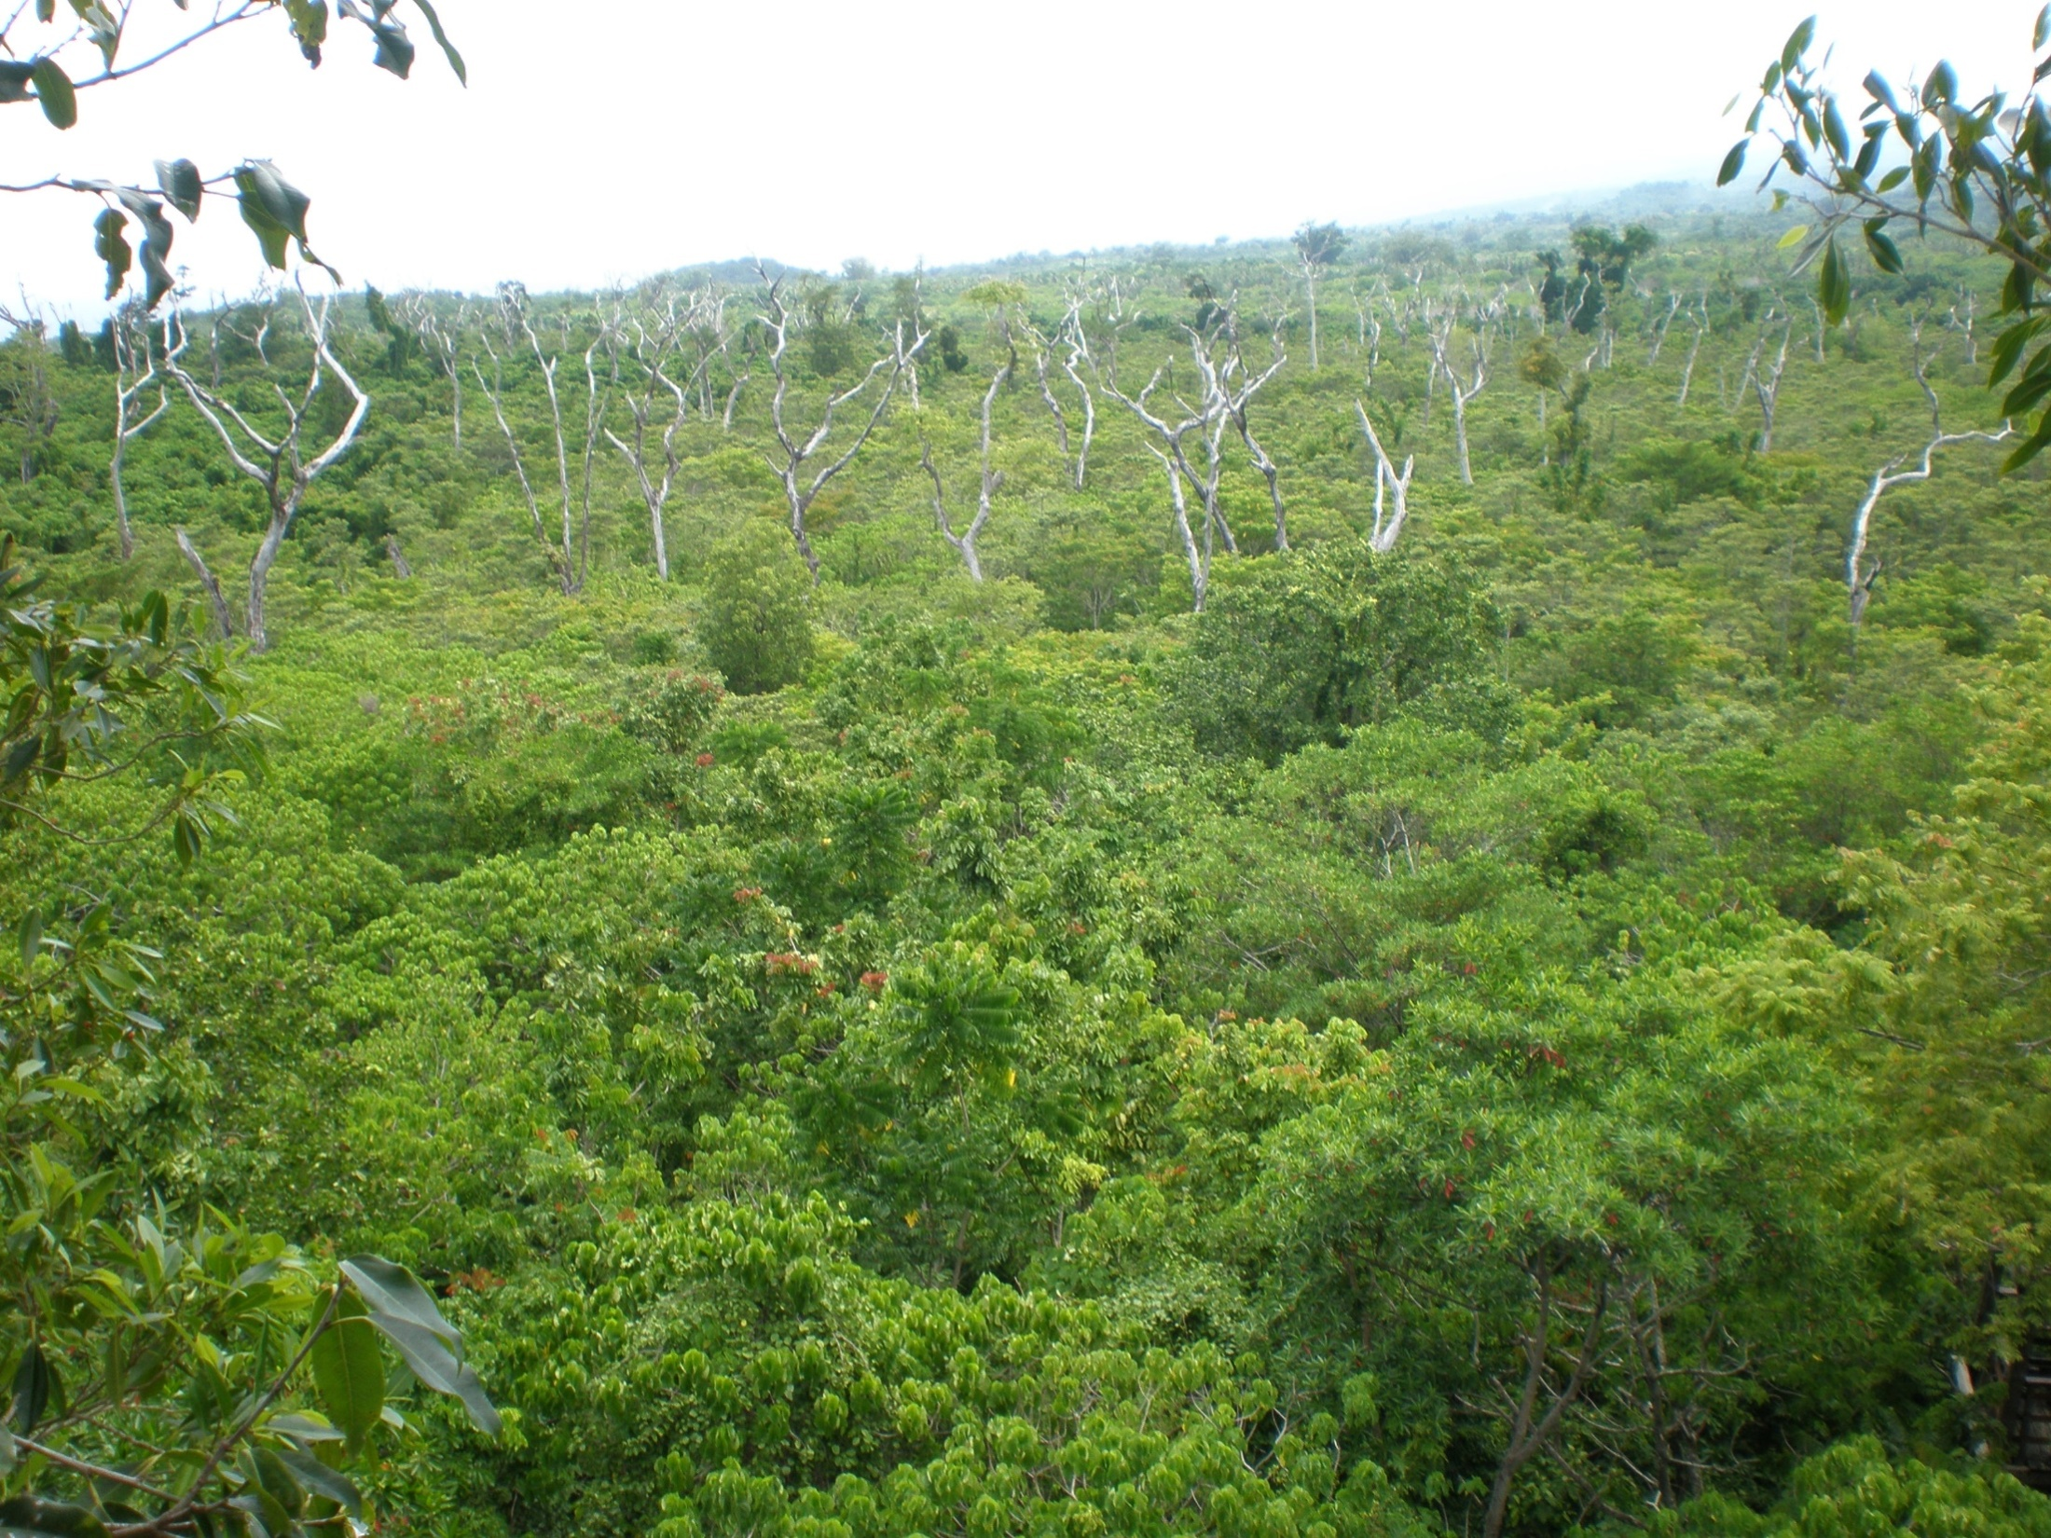
C’est de quelle couleur?
Oui! C’est vert!

Slide 9
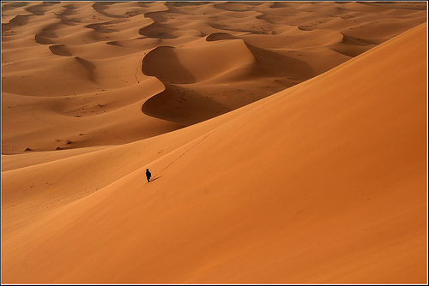
C’est de quelle couleur?
C’est orange!

Slide 10
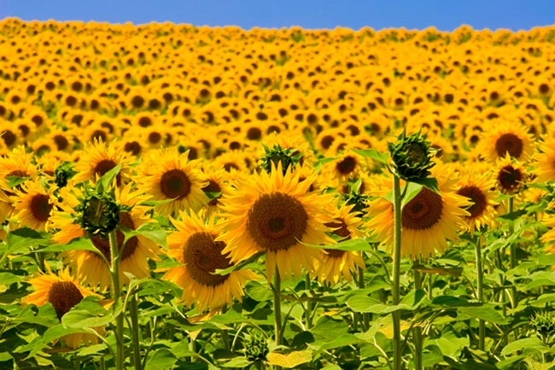
C’est de quelle couleur?
Super! C’est jaune!

Slide 11
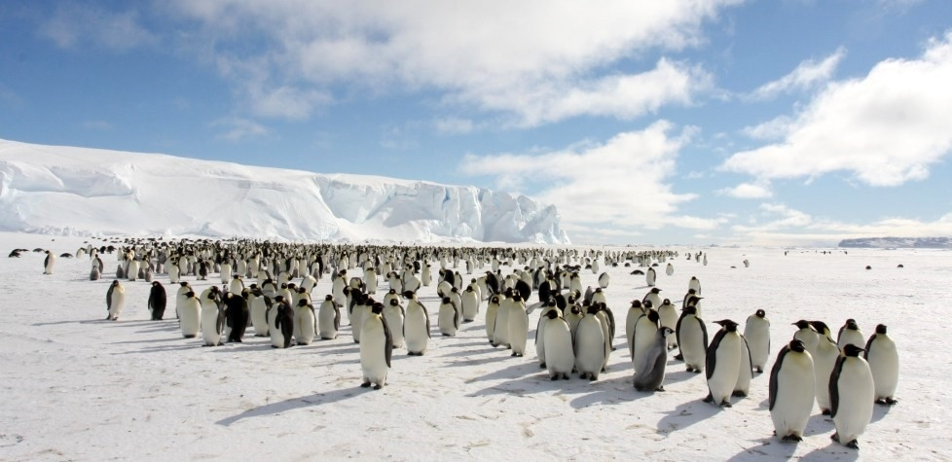
C’est de quelle couleur?
Oui! C’est blanc!
Notes:
Regarde des pingouins! Means oh look, penguins!

Slide 12
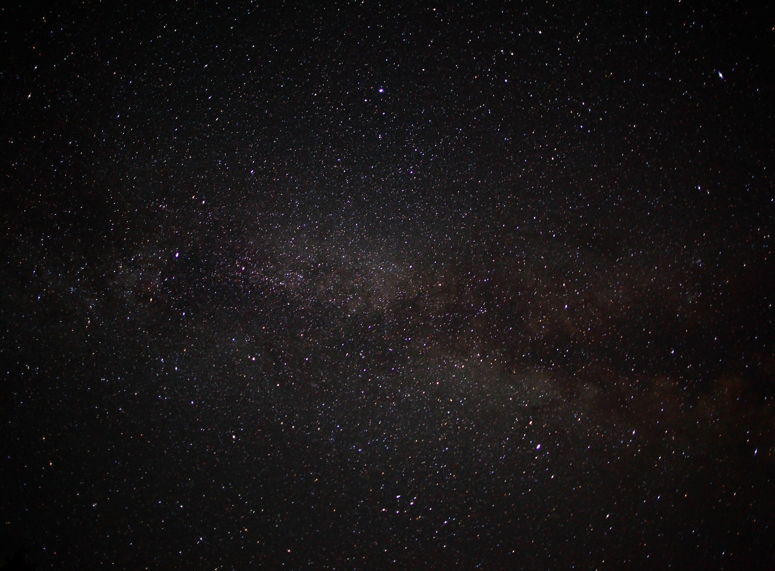
C’est de quelle couleur?
C’est noir!

Slide 13
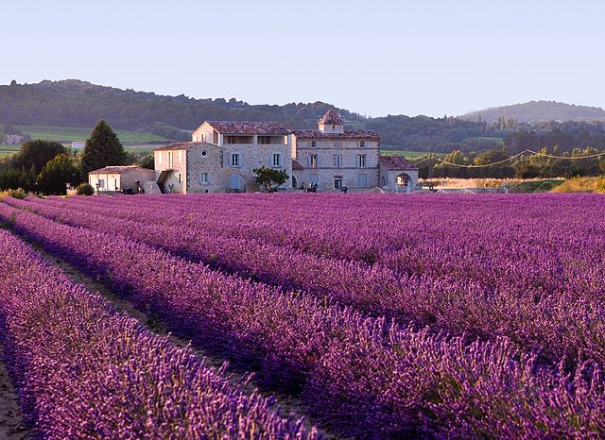
C’est de quelle couleur?
C’est violet!

Slide 14
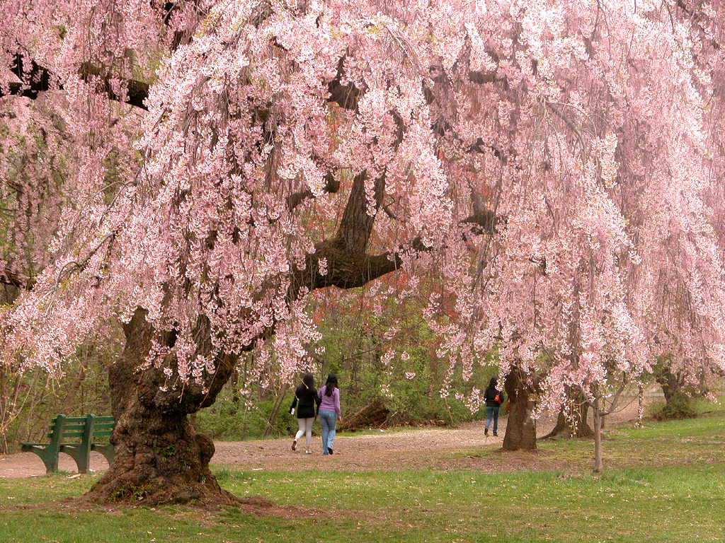
C’est de quelle couleur?
Très bien! C’est rose!

Slide 15
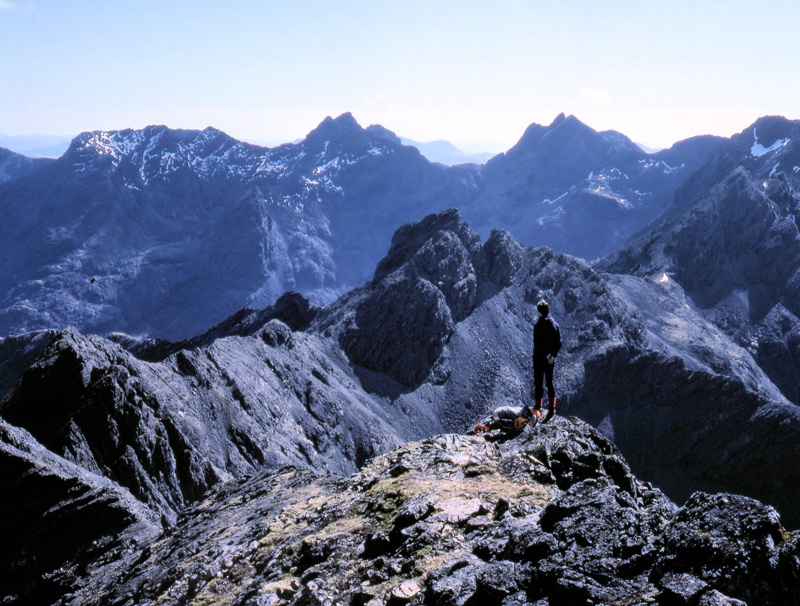
C’est de quelle couleur?
C’est gris!

Slide 16
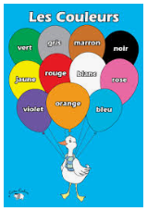
Activité 3
Next, try the simple colours song on the next slide to the tune of “Frere Jacques”.
Notes:
What colour is it?

Slide 17
Couleurs (to tune for Frère Jacques)
Bleu, blanc, jaune, vert
Bleu, blanc, jaune, vert
Violet
Violet
Orange, gris et marron
Orange, gris et marron
Rouge, noir, rose
Rouge, noir, rose
Notes:
Once pupils are confident as a group with this song, you can give them colour cards in groups (e.g. one group would have bleu, violet and orange and another group would have a different set of colours). They can then hold up their colour cards as they sing their own colour part of the song.
Another sample activity would be to have colour cards on pupils desks so they could point to each colour as they sing or listen and put them into the correct order of the song.

Slide 18
Au revoir!

