Slide 1
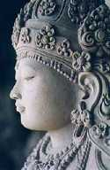
Aim: To find out about the life of Siddhartha Gautama.
Siddhartha Gautama was born about 583 BC.
He was born in or near what is now Nepal.
His father, King Suddhodana, was leader of a large clan called the Shakya.
His mother, Queen Maya, died shortly after his birth.

Slide 2
Aim: To find out about the life of Siddhartha Gautama.
When Prince Siddhartha was a few days old, a holy man prophesied the Prince would be either a great military conqueror or a great spiritual teacher.
King Suddhodana wanted his son to be a great military conqueror and prepared his son accordingly. He raised the boy in great luxury and shielded him from knowledge of religion and human suffering. The Prince reached the age of 29 with little experience of the world outside the walls of his opulent palaces.

Slide 3
Aim: To find out about the life of Siddhartha Gautama.
The 4 Passing Sights
One day, overcome with curiosity, Prince Siddhartha asked a charioteer to take him on a series of rides through the countryside. On these journeys he was shocked by the sight of an aged man, then a sick man, and then a corpse. The stark realities of old age, disease, and death seized and sickened the Prince.
The prince returned to his life of luxury back in the palace.

Slide 4
Aim: To find out about the life of Siddhartha Gautama.
The Prince leaves the Palace
For a time the Prince returned to palace life, but he took no pleasure in it. Even the news that his wife Yasodhara had given birth to a son did not please him.
One night he wandered the palace alone. The luxuries that had once pleased him now seemed grotesque. Musicians and dancing girls had fallen asleep and were sprawled about, snoring and sputtering. Prince Siddhartha reflected on the old age, disease, and death that would overtake them all and turn their bodies to dust.
He realized then that he could no longer be content living the life of a prince. That very night he left the palace, shaved his head, and changed his prince's clothes for a beggar's robe. Then he began his quest.

Slide 5
Aim: To find out about the life of Siddhartha Gautama.
The Prince leaves the Palace
Siddhartha began by seeking out renowned teachers, who taught him about the many religious philosophies of his day as well as how to meditate. One day Siddhartha sat beneath a sacred fig (Ficus religiosa), known ever after as the Bodhi Tree, and settled into meditation.
Siddhartha became known as the Buddha, and started his teaching about relaxing the mind and meditation. He found that this bought him happiness, not all the luxuries of palace life.

Slide 6
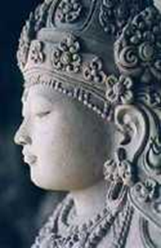
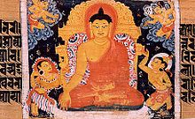
5 important events of Siddhartha’s life
The birth of Siddhartha Gautama. | Siddhartha was born in 583 BC. His mother died shortly after his birth. His father was called Suddhodana and was the lead of a great clan.
The prophet visits Siddhartha and his father. | A prophet predicts that Siddhartha will either be a great military conqueror or a spiritual teacher.
Suddhodana’s wish for his son. | Suddhodana wants his son to be a great military leader. Siddhodana prepares his son to be a great military leader.
Siddhartha leaves the palace. | Siddhartha leaves the palace that he lives in one night. He sees an elderly person, a sick person and a corpse. This makes him think about the true meaning of life.
Siddhartha becomes the Buddha. | Siddhartha listens to different religious teachings. He sees the importance of meditating and clearing the mind of different thoughts. He becomes a spiritual teacher.

