Slide 1
Guess the Nursery Rhyme and story Part 2
Click here to take the quiz

Slide 2
WHO AM I?
I have eight legs
I climbed up the water spout
But sadly the rain washed me back out
Hickory Dickory Dock
Incy Wincy Spider
Humpty Dumpty
I’m a little Teapot

Slide 3
CORRECT
Next

Slide 4
WRONG, TRY AGAIN
Back

Slide 5
Fill in the blank
Hickory Dickory Dock,
The mouse ran up the ____
Wall
Door
Clock
Stairs

Slide 6
CORRECT
Next

Slide 7
WRONG, TRY AGAIN
Back

Slide 8
WHO AM I?
I’m short and stout
I have a handle
I get steamed up
You can tip me over and pour me out
Three Little Pigs
Humpty Dumpty
I’m a little teapot
Little Bo Peep

Slide 9
CORRECT
Next

Slide 10
WRONG, TRY AGAIN
Back

Slide 11
Guess the story
I’m a little girl
I visited a house that didn’t belong to me
I ate some of their porridge and slept in the smallest bed
What story am I?
Little Red riding hood
Hansel and Gretel
The Three Little pigs
Goldilocks and the three bears

Slide 12
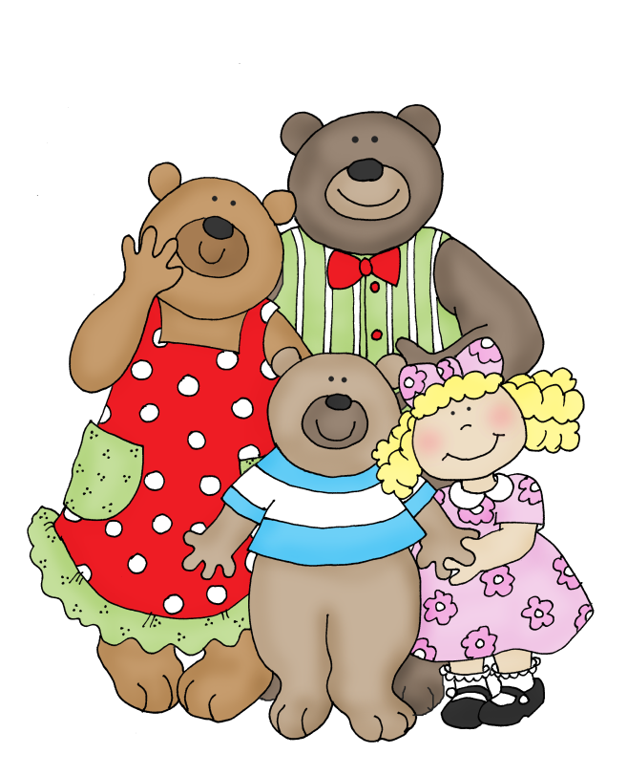
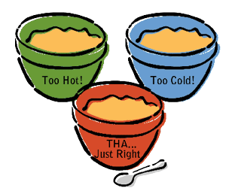
CORRECT
Next

Slide 13
WRONG, TRY AGAIN
Back

Slide 14
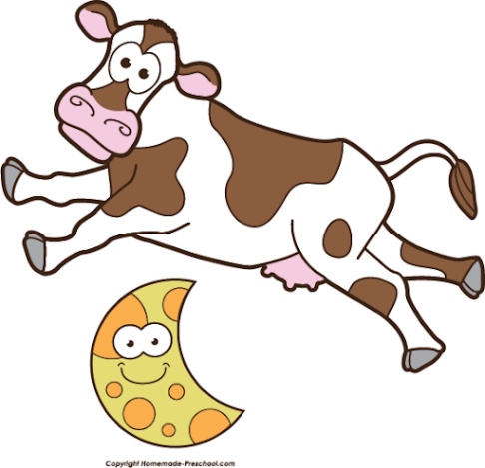
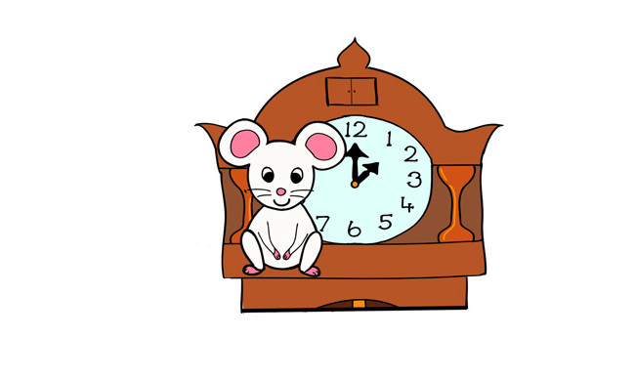
Well done!!!

