Slide 1

City of Edinburgh
French Early Level
Colours

Slide 2
Activité 1
Look at the colour of each animal/object
Listen to the vocabulary in French
Repeat the vocabulary

Slide 3


C’est de quelle couleur?
Notes:
What colour is it?

Slide 4

C’est bleu

Slide 5

C’est blanc

Slide 6

C’est rouge

Slide 7

C’est vert

Slide 8

C’est jaune

Slide 9

C’est rose

Slide 10
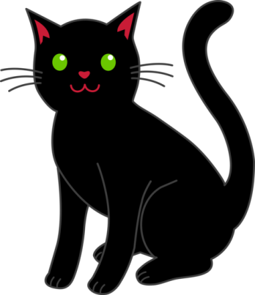
C’est noir

Slide 11

C’est orange
Notes:
Note that you pronounce the T on the end of C’est when it’s followed by a vowel!

Slide 12

C’est gris

Slide 13

C’est violet

Slide 14


C’est marron

Slide 16

Poème des couleurs
C’est rouge?
Oui, c’est rouge!
C’est vert?
Oui, c’est vert!
C’est orange?
Oui! C’est orange!
C’est jaune?
Oui, c’est jaune!
Qu’est-ce que c’est?
C’est un arc en ciel!
Notes:
Qu’est-ce que c’est means What is it? And C’est un arc en ciel means it’s a rainbow! You can further develop this poem by adding in more colours and asking pupils to add them in as they know them. It could also be used as a display with pupils own rainbows alongside it ☺

Slide 17
Couleurs (to tune for Frère Jacques)
Bleu, blanc, jaune, vert
Bleu, blanc, jaune, vert
Violet
Violet
Orange, gris et marron
Orange, gris et marron
Rouge, noir, rose
Rouge, noir, rose
Notes:
Once pupils are confident as a group with this song, you can give them colour cards in groups (e.g. one group would have bleu, violet and orange and another group would have a different set of colours). They can then hold up their colour cards as they sing their own colour part of the song.
Another sample activity would be to have colour cards on pupils desks so they could point to each colour as they sing or listen and put them into the correct order of the song.

Slide 18
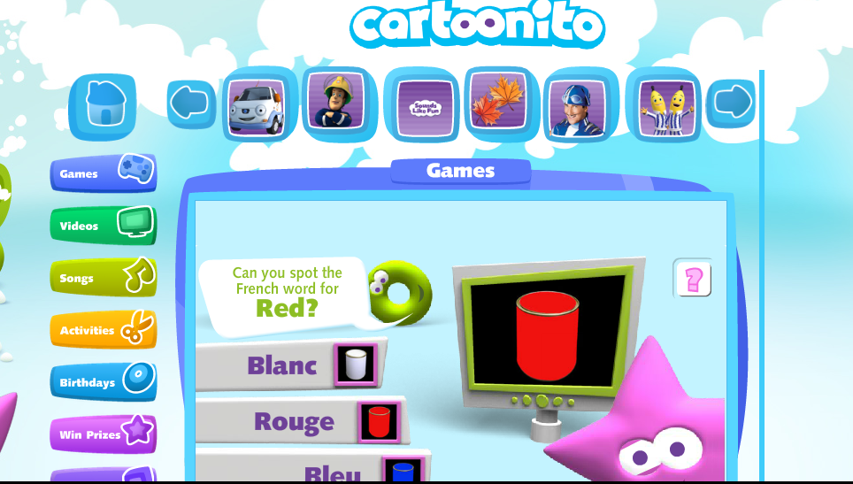
Cartoonito
Notes:
http://www.cartoonito.co.uk/games/french-word-fun-colours

Slide 19
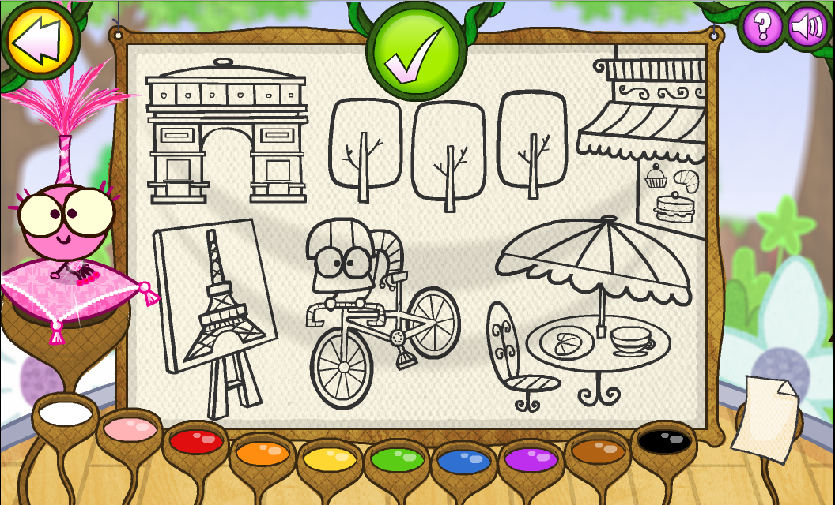
The Lingo Show
Notes:
http://play.bbc.co.uk/play/pen/grvkng8fy4?exitGameUrl=http%3A%2F%2Fwww.bbc.co.uk%2Fcbeebies%2Fgames%2Flingo-show-bigbugshow

Slide 20

Au revoir!

