Slide 1
Blackburn Primary School
Celebration Assembly
Friday the 24th of April 2020
Blackburn Primary, a school family, growing, learning and succeeding.

Slide 2
Shout outs from staff………..
We all miss you
Teaching staff
Miss Clarkson
Mrs McCarney
Mrs Topping
Mrs Bryce
Miss Hamill
Mrs McLuckie
Miss Miller
Mr Riding
Mrs Brodzka
Miss Anderson
Support staff
Miss Robertson
Mrs Wilmott
Mrs Smith
Miss Meikle
Mrs Anderson
Mrs Gilbert
Mrs Butler
Mrs Hamilton
Mrs McMillan

Slide 3
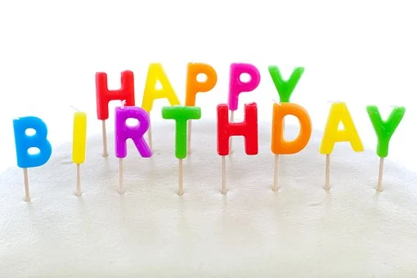
Shouts Out for pupils
Happy birthday Ewan we all hope you have a lovely day. We are sending lots of love and best wishes and truly wish we could eat some birthday cake with you!

Slide 4
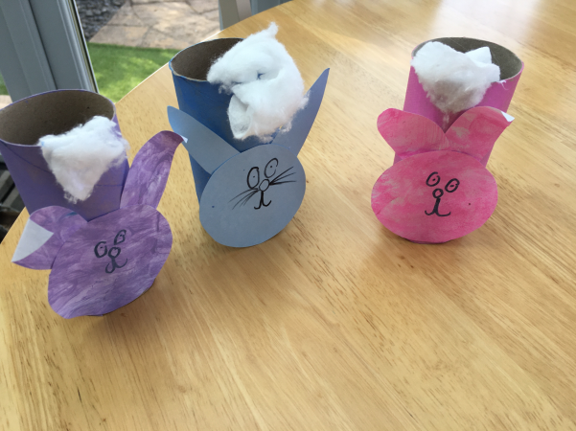
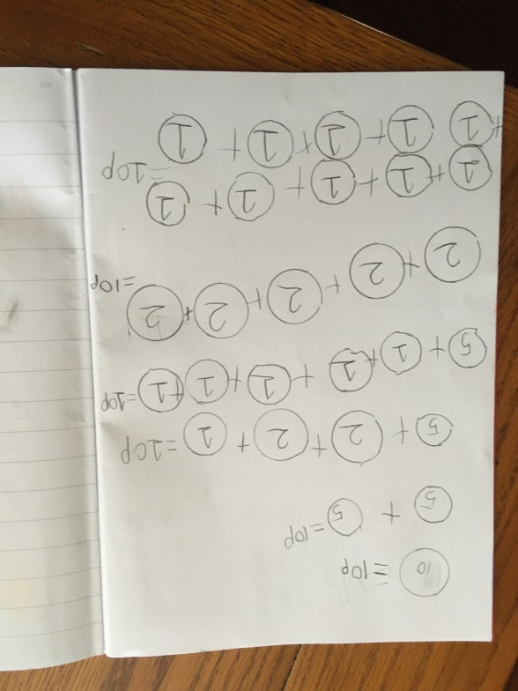
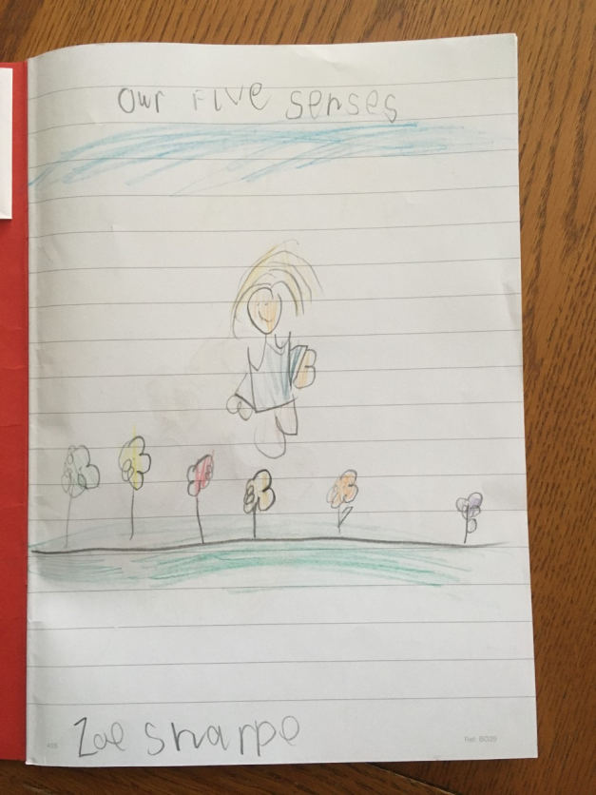
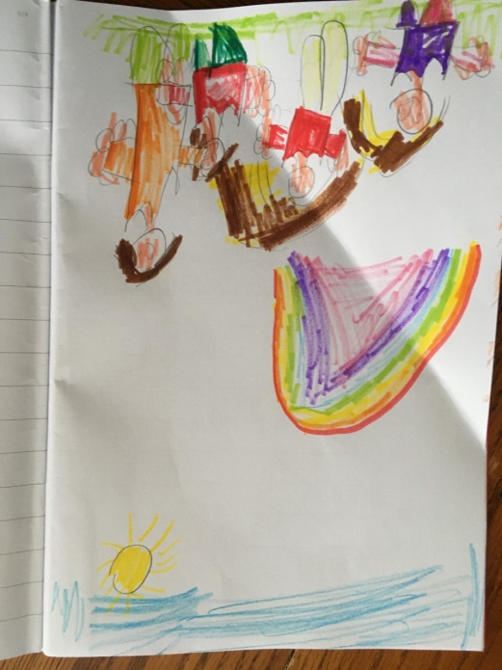
Well done Katie in P1 for all your creative work over the last few weeks. You have been very busy!

Slide 5

Well done to Shaun and Raiyaan for completing all of their study ladder tasks

Slide 6
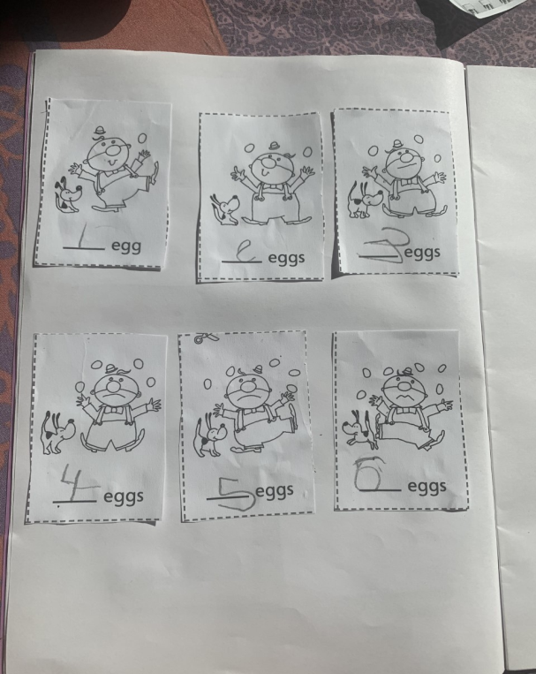
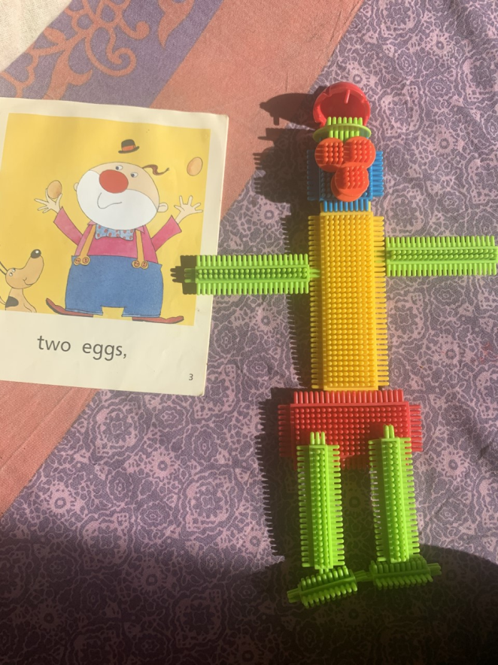
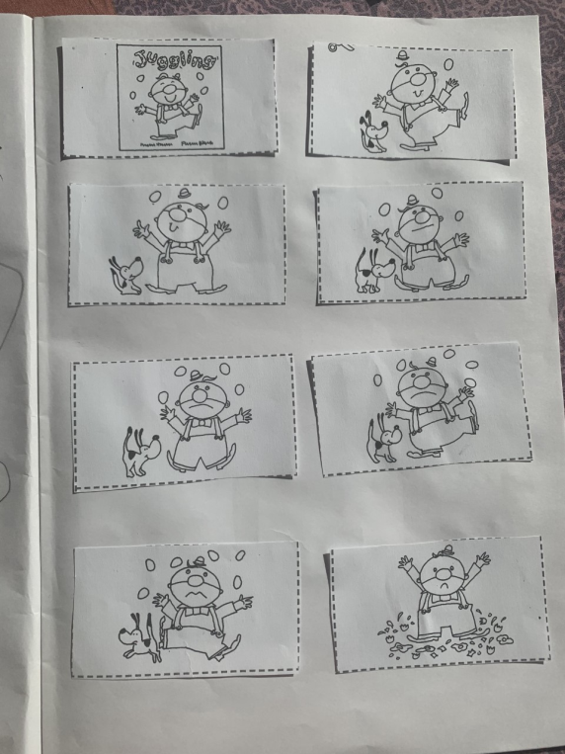
Well done to Raiyaan in A1 for working so hard at home to complete his numeracy and literacy tasks

Slide 7
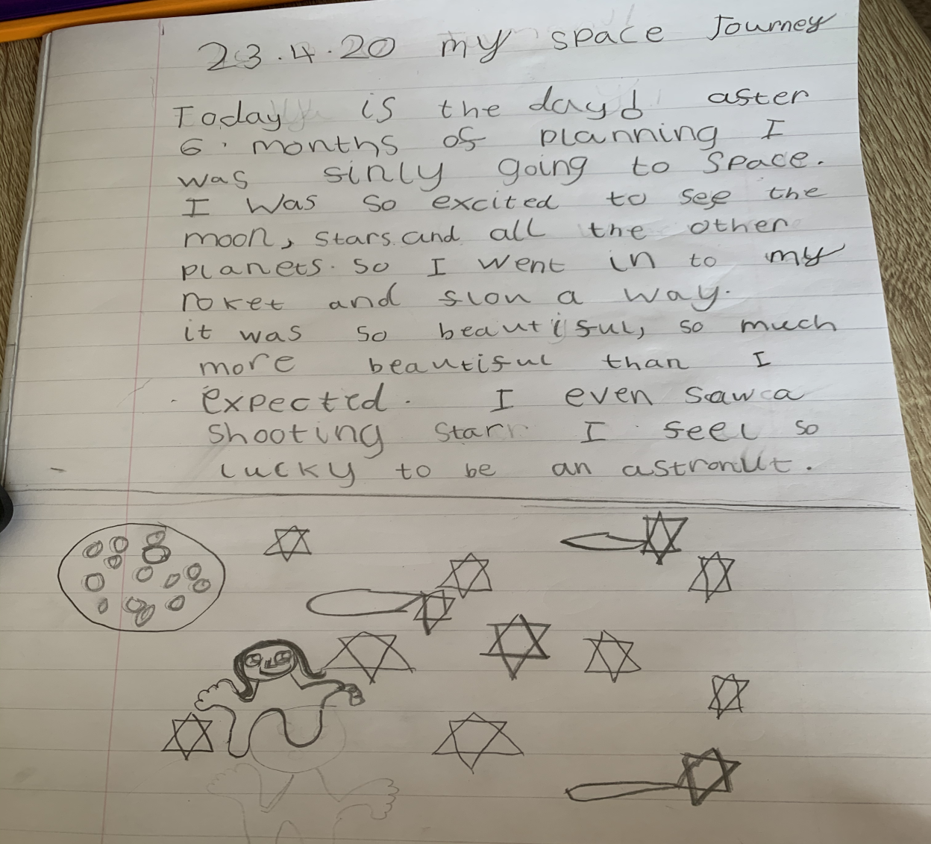
Excellent work from Ria in P2/3 writing about going into Space!

Slide 8
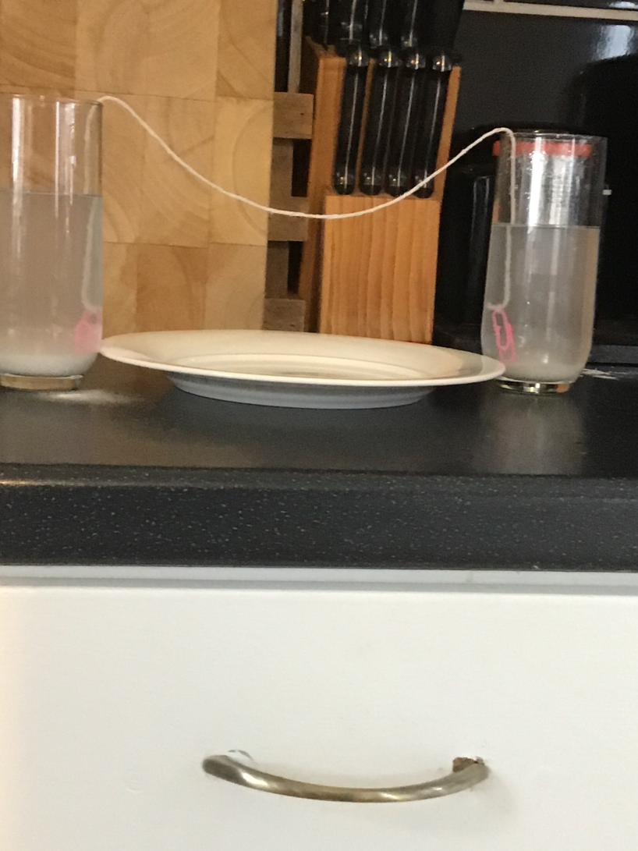
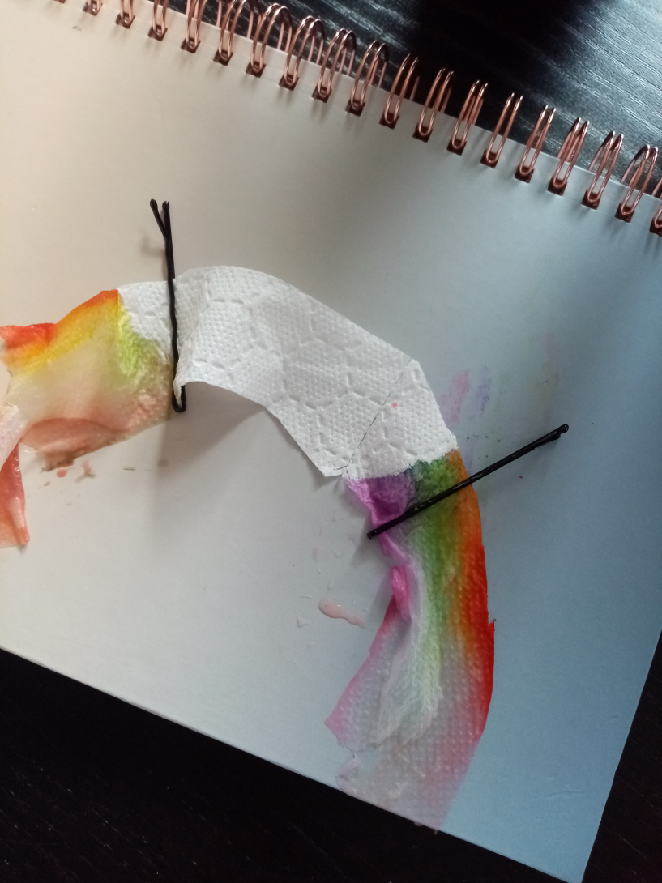
Well done Grace in P4/5 and younger brother Dylan for your rainbow and volcano experiment

Slide 9
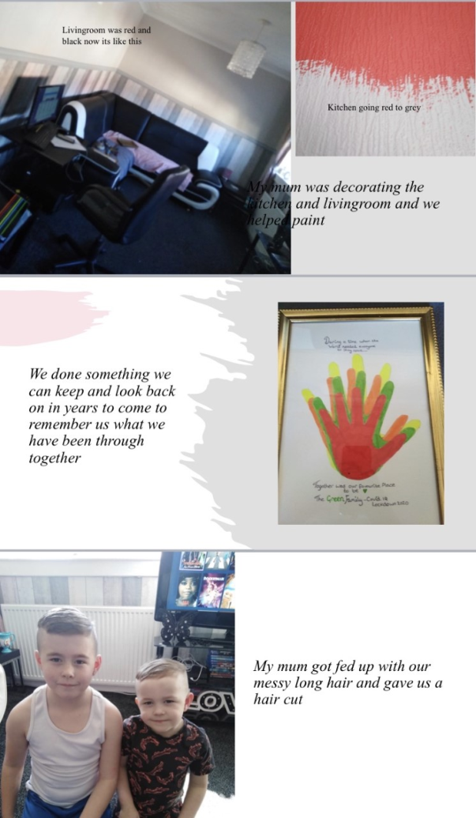
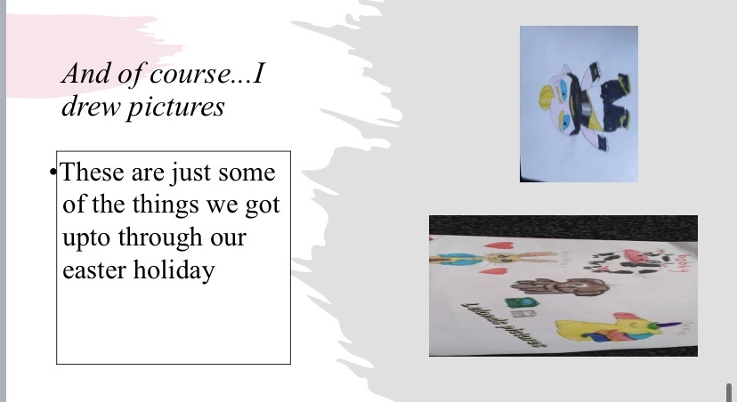
Well done to one of our families for their wonderful power point on what they did over the Easter Holidays

Slide 10
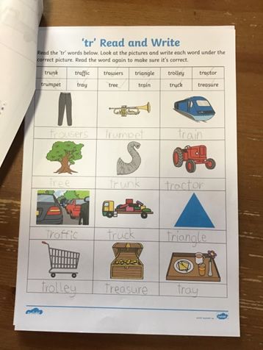
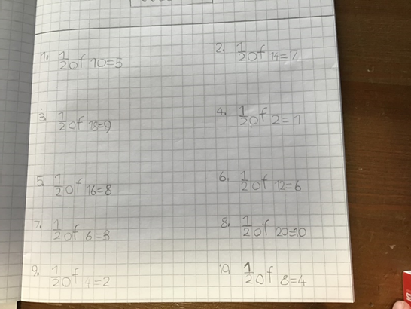
Well done to Mack for always being ready and working hard this week on sounds and fractions.

Slide 11
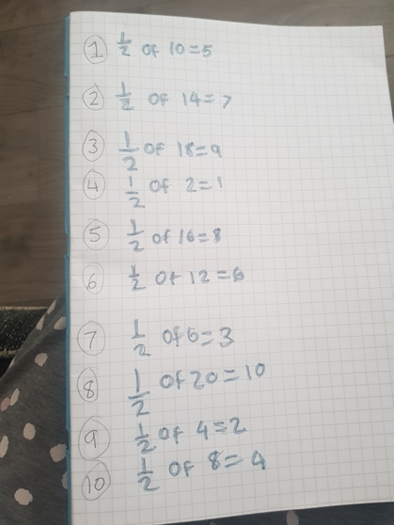
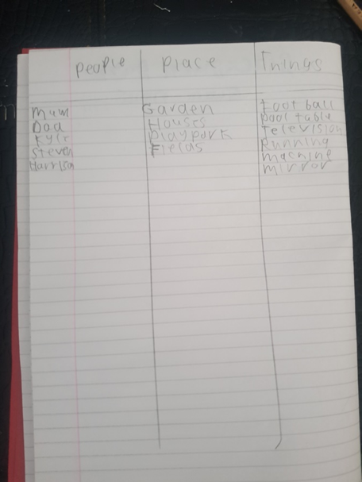
Well done to Ewan for working hard on fractions and grammar skills.

Slide 12
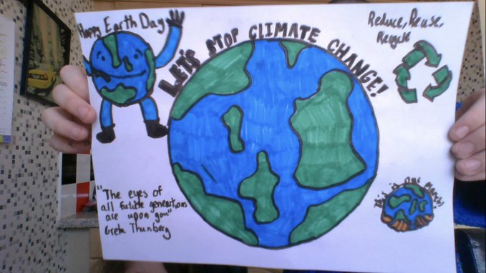
Well done to our pupils in P5/6/7 for celebrating World Earth Day

Slide 13
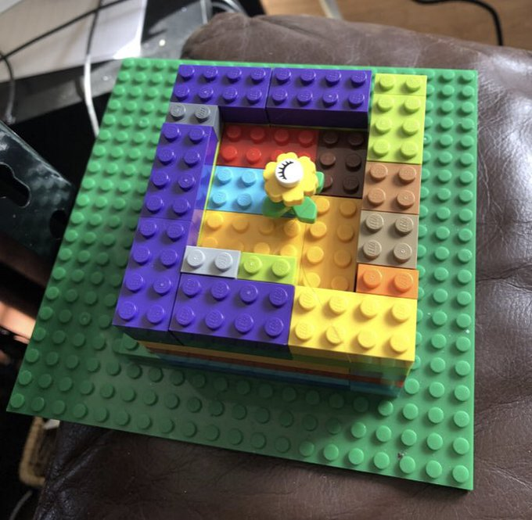
Ellie B for her excellent Jupiter Art Land Lego Structure called Rebirth

Slide 14
World day video from pupils in p5/6/7
https://twitter.com/i/status/1252994511736889344

Slide 15
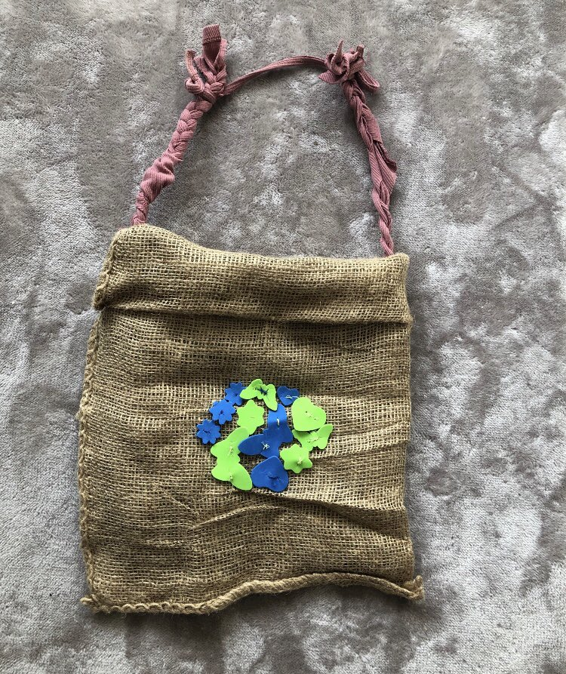
World Earth Day from pupils in P5/6/7

Slide 16
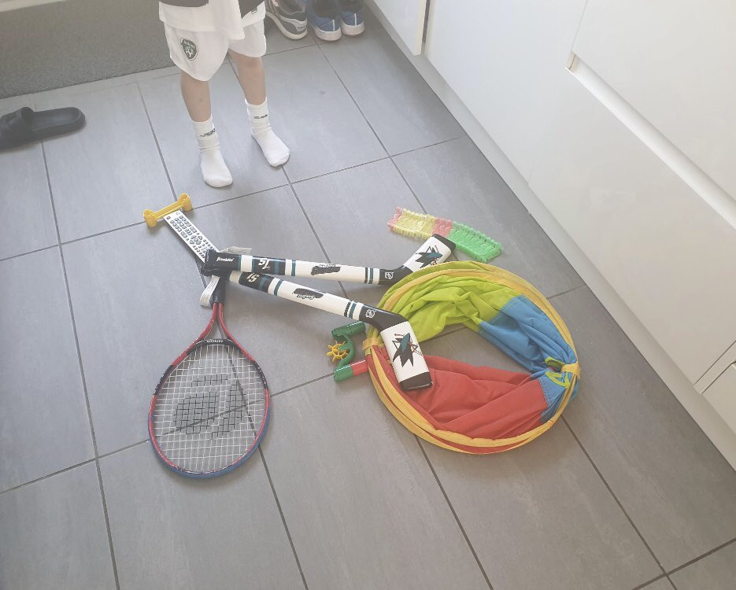
Bike Art from pupils in P5/6/7

Slide 17
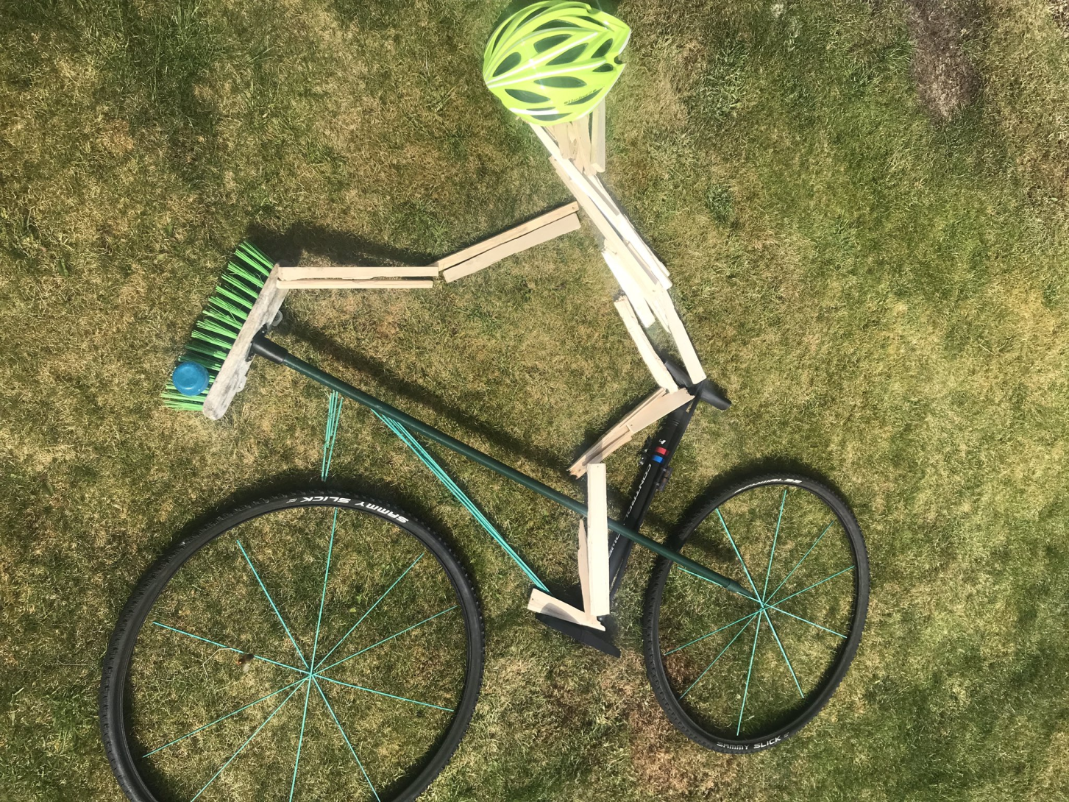
Bike Art from pupils in P5/6/7

Slide 18
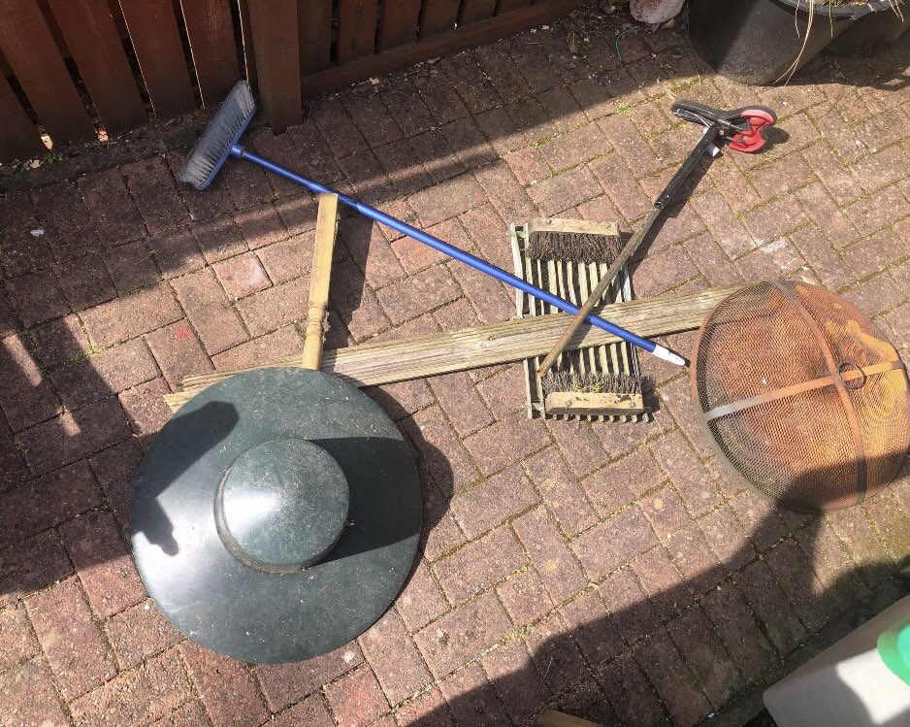
Bike art from pupils in P5/6/7

Slide 19
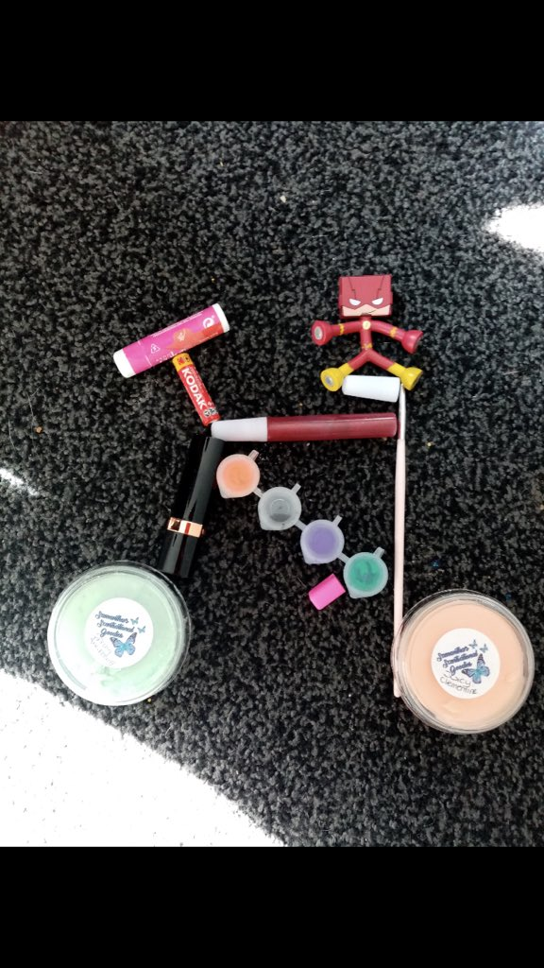
Bike Art from pupils in P5/6/7

Slide 20
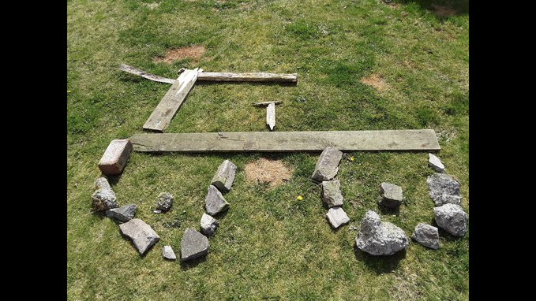
A Bike from the Stone Age from pupils in P5/6/7

Slide 21
Excellent work from P5/6/7
Jack for his writing about his favourite band 'System of a Down'
Sydney for her various messages and photos sent to cheer everyone up and keep us all connected.
Ryan came up with some really interesting concepts in photography.
Eilidh and Sara for their excellent baking
Austin for his fabulous animation efforts

Slide 22
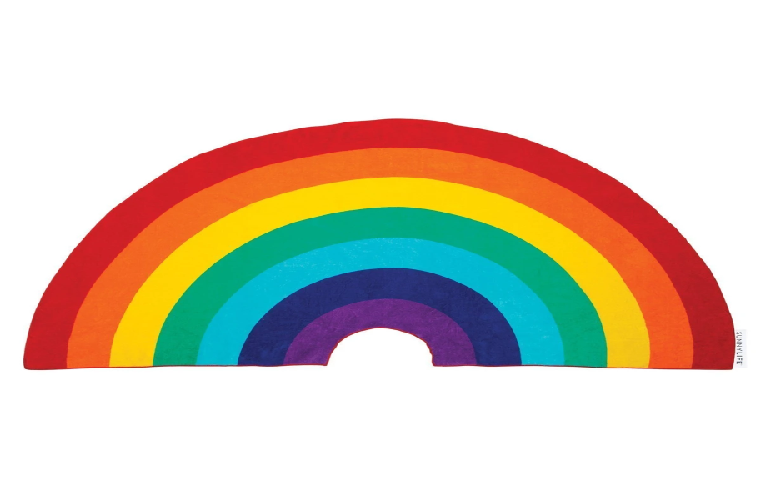
Take care and stay safe
We all miss you and look forward to when we will see you all again from all the staff at Blackburn Primary School
Have a lovely weekend and we will be back in touch on Monday

