Slide 1
Guess the Nursery rhyme
Click here to take the quiz

Slide 2
WHO AM I? I sit on a wall I had a great fall The kings horses and men couldn’t fix me
Twinkle Twinkle little star
Humpty Dumpty
Jack and Jill went up a hill
Hey Diddle Diddle

Slide 3
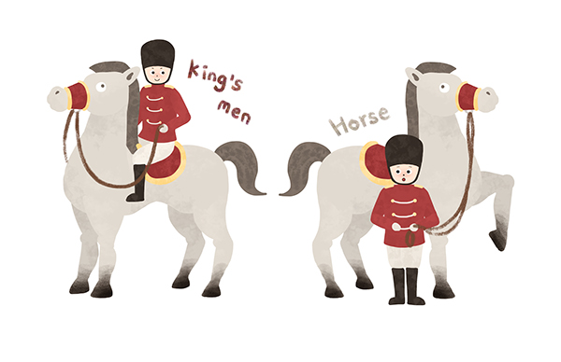
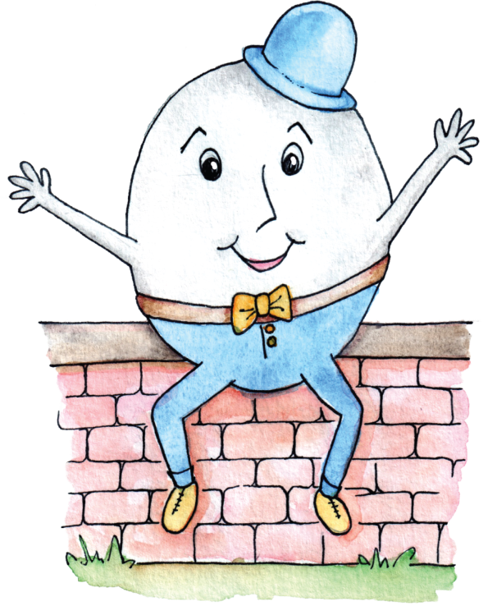
CORRECT
Next

Slide 4
WRONG, TRY AGAIN
Back

Slide 5
Baa Baa Black Sheep, have you any wool? Yes sir, Yes sir…
How many bags full?
1
2
3
4

Slide 6
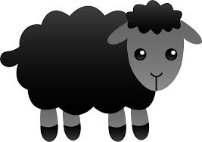
CORRECT
Next

Slide 7
WRONG, TRY AGAIN
Back

Slide 8
WHO AM I? I live in the sky I twinkle so bright I always wonder what you are
Can you guess who I am?
Mary had a little Lamb
Hickory Dickory Dock
Humpty Dumpty
Twinkle Twinkle little star

Slide 9
CORRECT
Next

Slide 10
WRONG, TRY AGAIN
Back

Slide 11
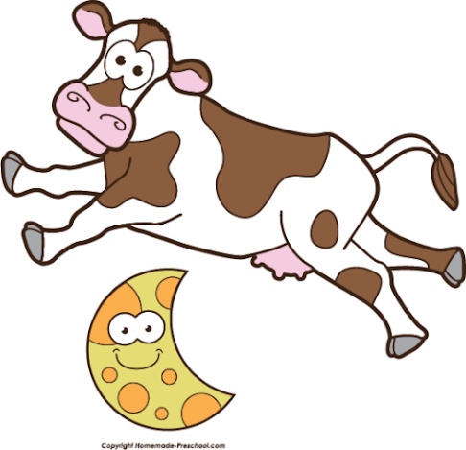
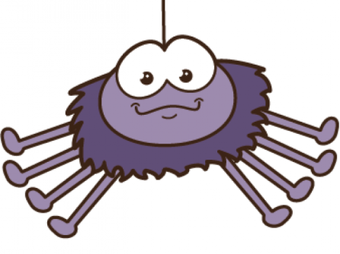
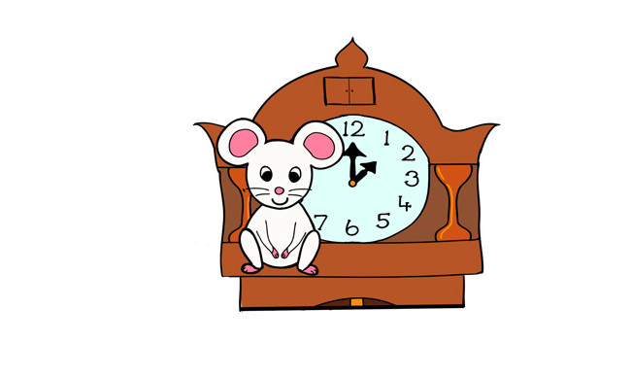
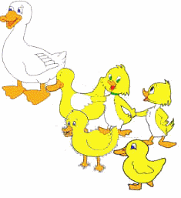
Well done!!!

