Slide 1
Blackburn Primary School
Easter Assembly
Friday the 3rd of April 2020
Blackburn Primary a school family, growing, learning and succeeding.

Slide 2
Shout outs from staff………..
We all miss you
Teaching staff
Miss Clarkson
Mrs McCarney
Mrs Topping
Mrs Bryce
Miss Hamill
Mrs McLuckie
Miss Miller
Mr Riding
Mrs Brodzka
Miss Anderson
Support staff
Miss Robertson
Mrs Wilmott
Mrs Smith
Miss Meikle
Mrs Anderson
Mrs Gilbert
Mrs Butler
Mrs Hamilton
Mrs McMillan

Slide 3

Shouts Out for pupils
Robbie as it was his birthday yesterday and he turned 12
Happy Birthday this will be one you will never forget!

Slide 4
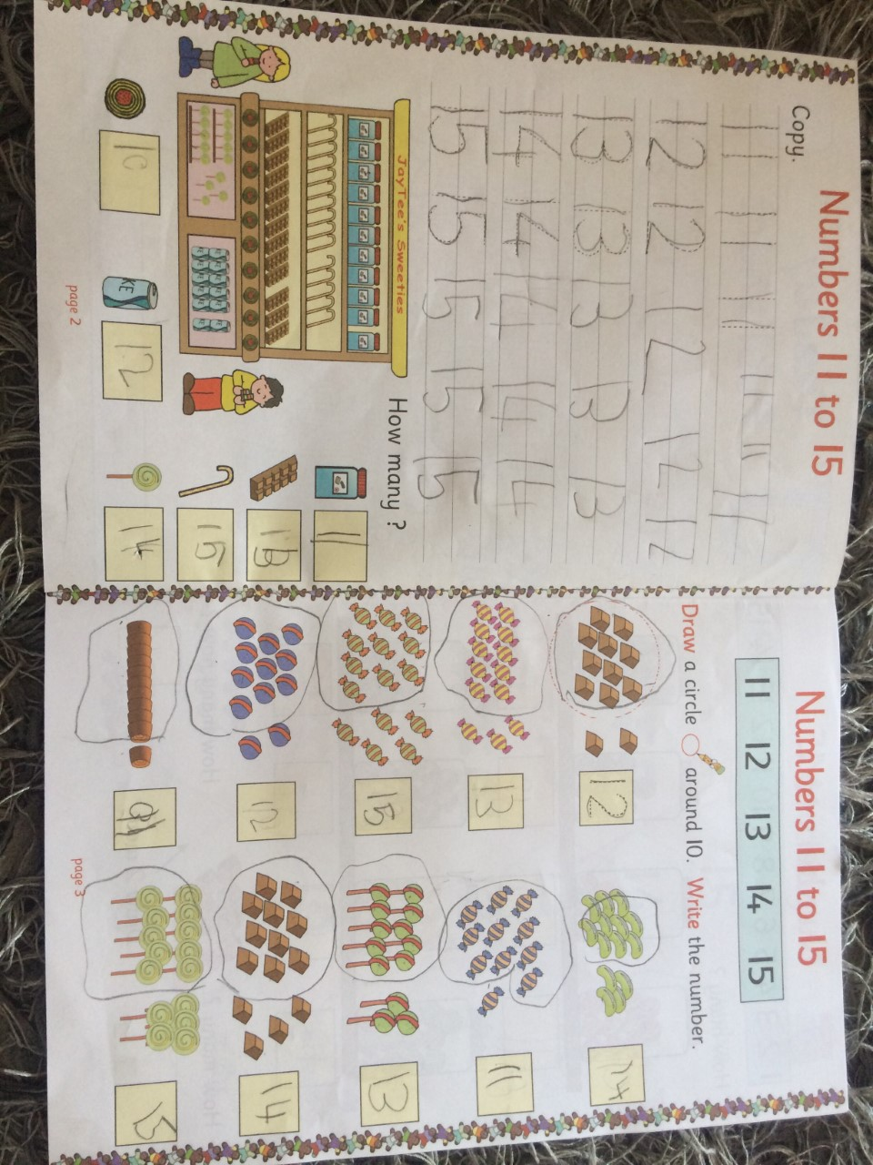
Excellent work
Well done Melisah for excellent number work for number 11 to 15

Slide 5
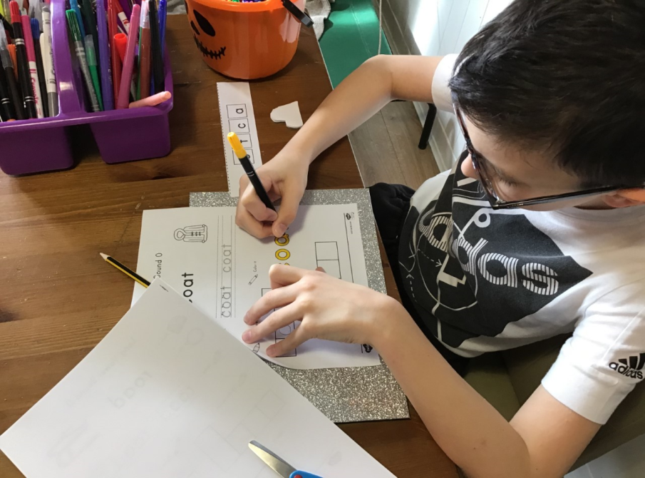
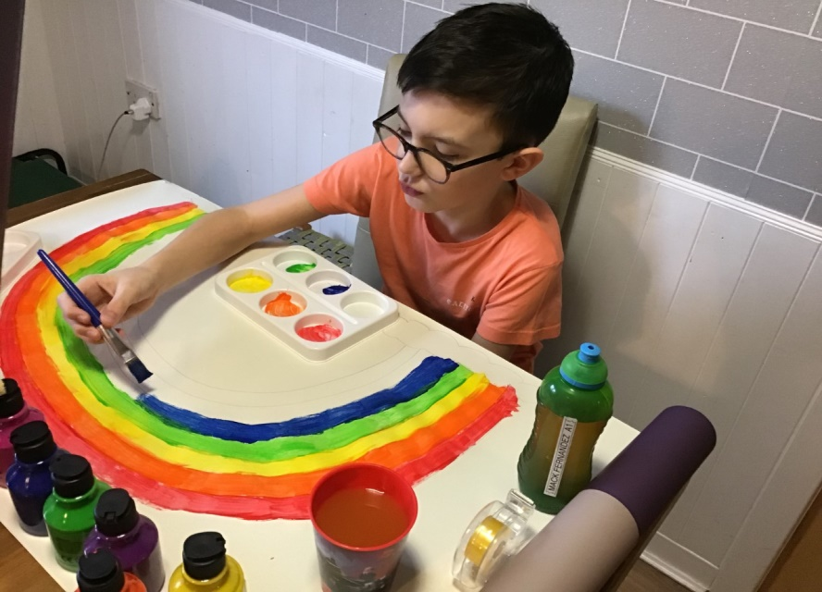
Well done to our A1 pupil for completing every single task that has been set to him by either Mrs Brodzka and Mrs Bryce
We are all in support of the wonderful work that our NHS staff are doing in this difficult time.
We salute you and thank you from all of us at Blackburn Primary School

Slide 6
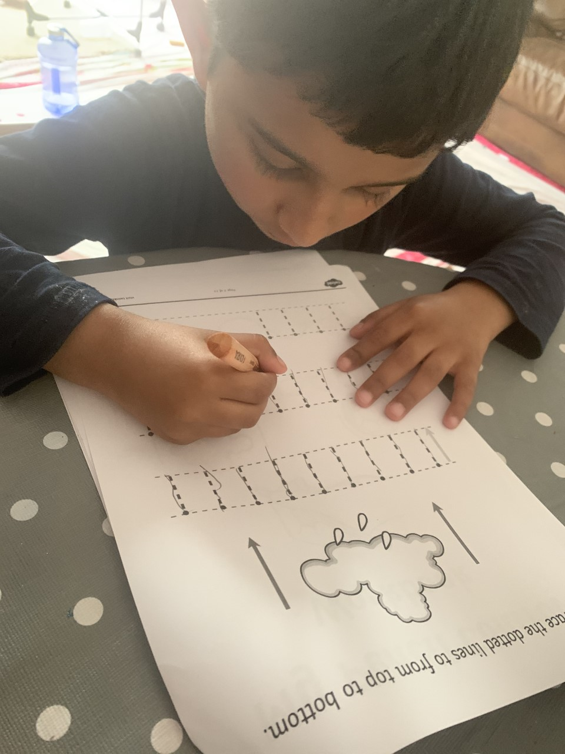
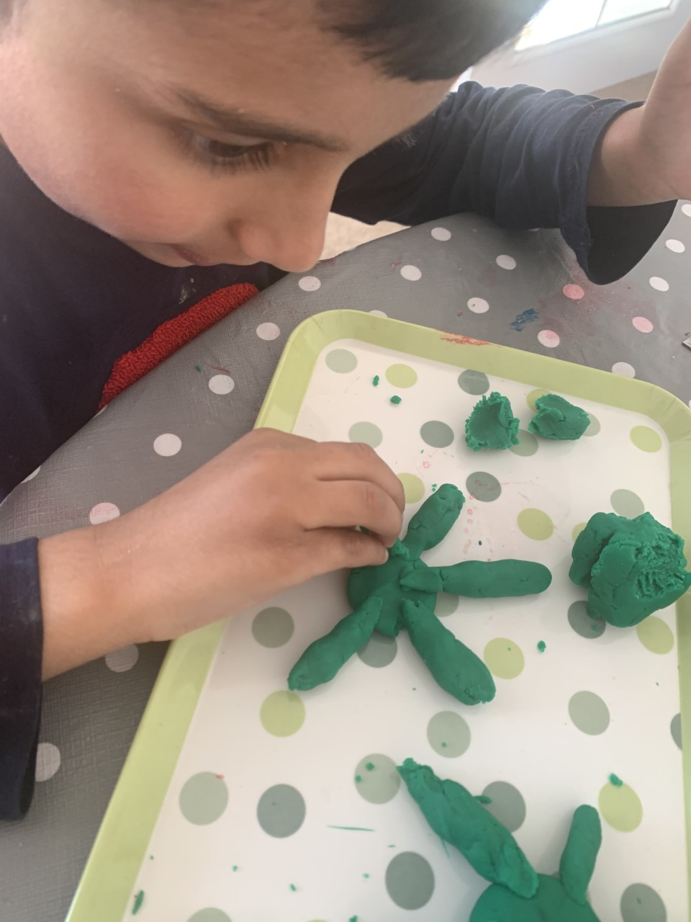
Well done to our A1 pupil for working so hard at home to complete his numeracy and literacy tasks

Slide 7
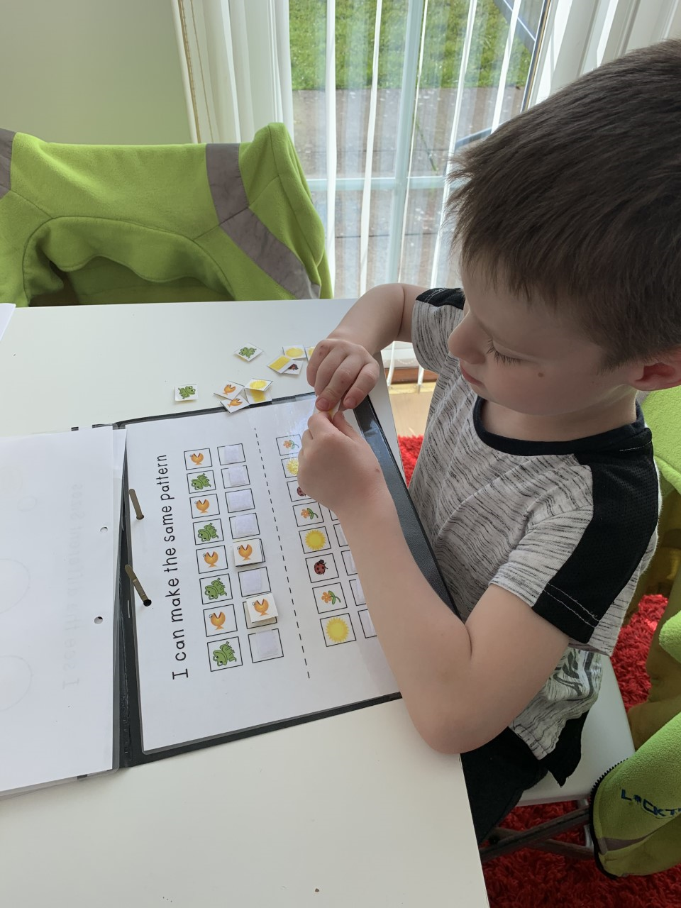
Well done for our A1 pupil for engaging with tasks from his school closure learning pack

Slide 8
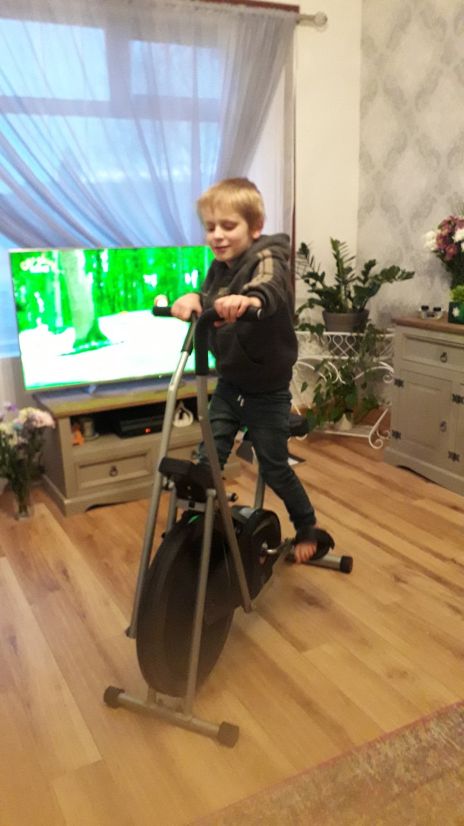
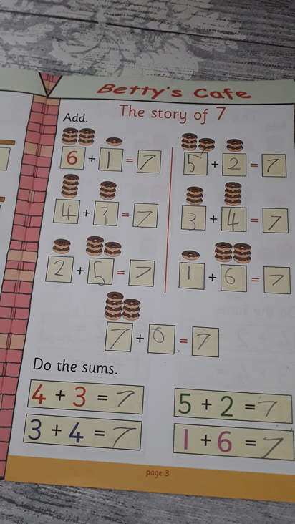
Well done to our A1 pupil for keeping his fitness levels up during lockdown as well as working on his Literacy and Numeracy Tasks at his new homemade workstation.

Slide 9
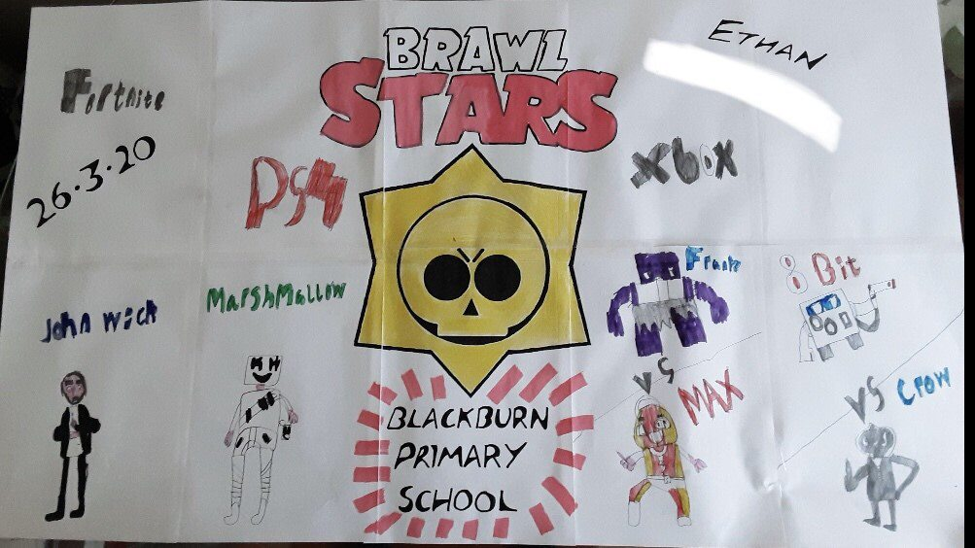
Ethan for his excellent work completed alongside his dad

Slide 10
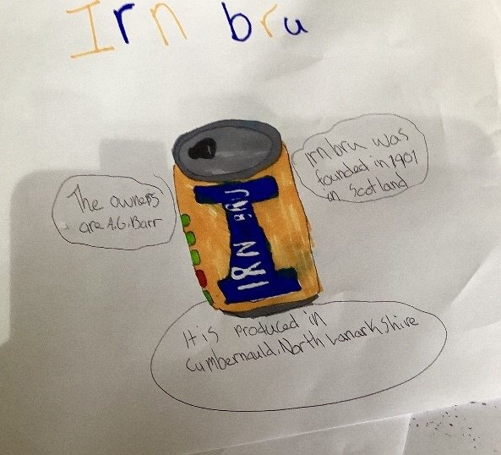

Slide 11
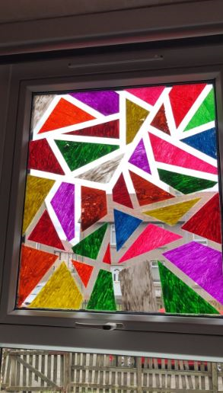
Window artwork from Kieran, street art from Scott M leading to some research on Banksy

Slide 12
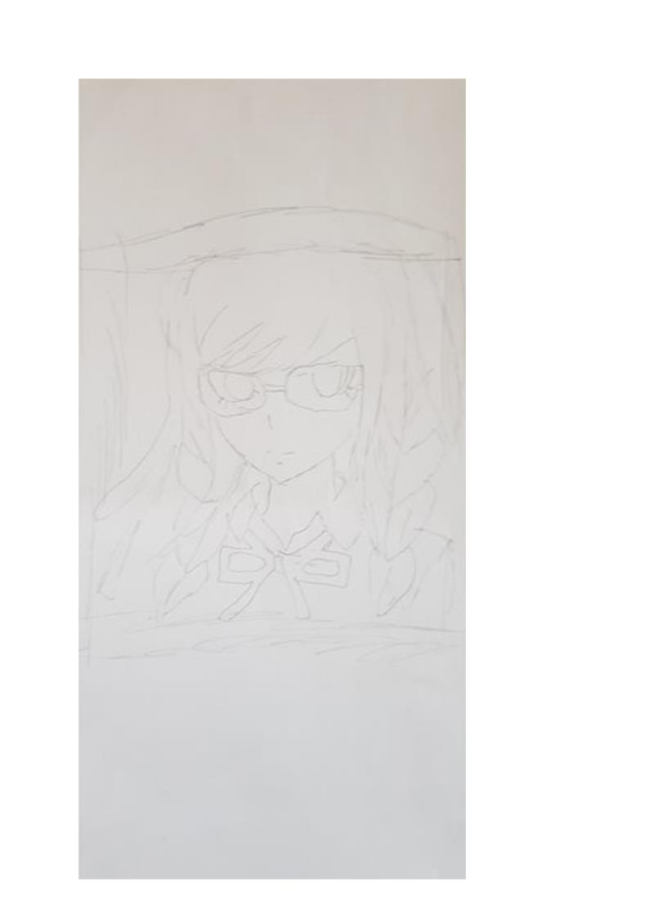
Artwork from Kanza.

Slide 13
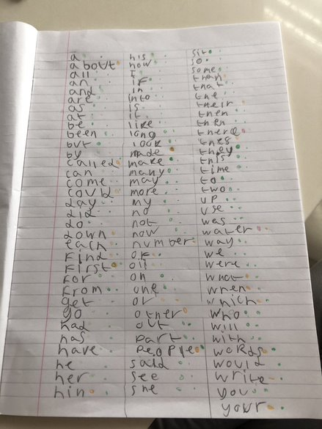
Summer for her work in spelling - she decided to self assess her spelling using a RAG system.

Slide 14
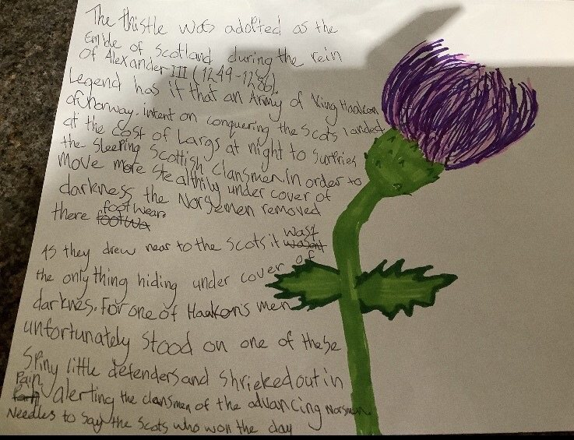
Well done Ellie

Slide 15
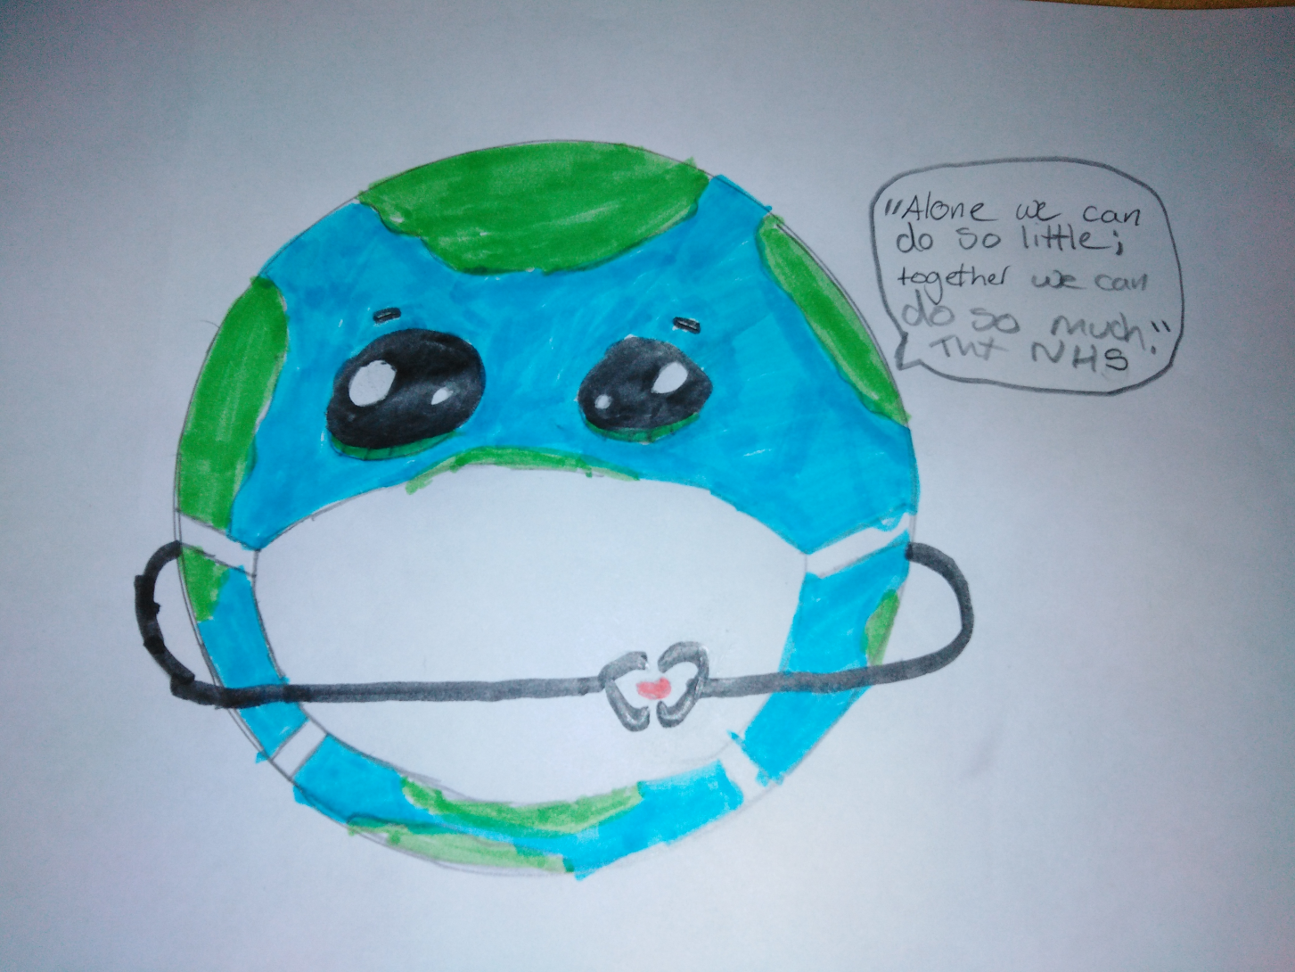
Acknowledging the great work of the NHS
Morgan for her lovely efforts to promote kindness in Blackburn - NHS poster and offering to help other residents with shopping.

Slide 16
Excellent work fro P5/6/7
Kay for writing a super story called 'Grace Hills and the Wicked Witch of the Woods' story.
Julia and her story about the UFO.
Jack for his writing about his favourite band 'System of a Down'
Sydney for her various messages and photos sent to cheer everyone up and keep us all connected.
Ryan came up with some really interesting concepts in photography.
Eilidh and Sara for their excellent baking
Austin for his fabulous animation efforts

Slide 17
Excellent work P5/6/7
Ellie R for the creation of a Scotland Topic
Eilidh for her fantastic efforts in Scotland reads with Mrs H and Miss B
Igor for his efforts in gardening and trying to grow his own tomatoes!
Ellie B for her French work and then asking for more French resources to teach the rest of her family

Slide 18
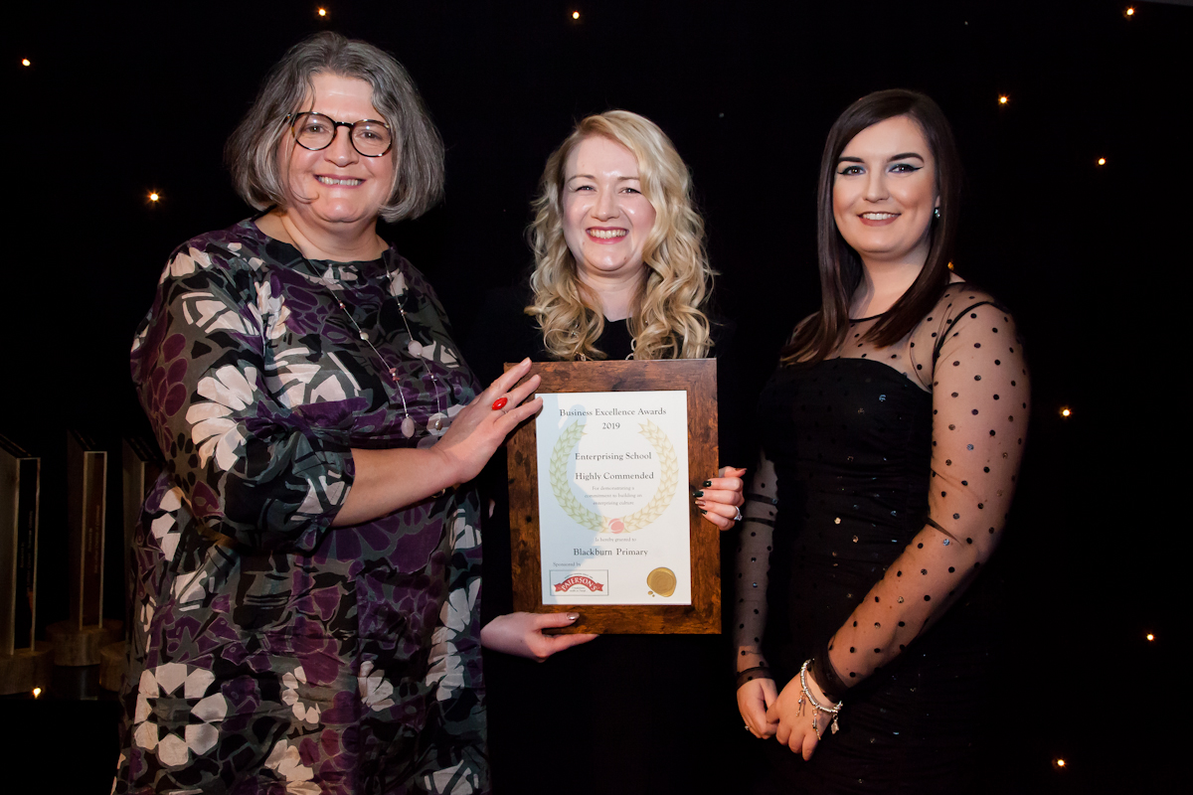
Miss Anderson has been super impressed with the work that you have completed over the last two weeks

Slide 19
P4/5 Well done
Nathan, Leland and Aiden for completing all of their work from home and truly impressing Miss Miller and Mr Riding

Slide 20

Take care and stay safe
We all miss you and look forward to when we will see you all again……………….

