Slide 1
P2/3 Modern Languages Assembly
Hello and welcome to our modern languages assembly.
We are going to tell you about some of the modern languages we have been learning in class.

Slide 2
I taught the class some Latvian and we made a book for our Latvian and taught the class some words – Kruze and Kakis. Then we had a map of Latvia to show everyone.

Slide 3
Me and Sofija speak Latvian. We taught the class some Latvian. Svelki -that means hello. Kakis – that means cat. Sunis – that means dog. Sofija is so good at Latvian and I am also good at Latvian.

Slide 4
Erika and Sofija taught us Latvian. A word Sunis which means dog, svelki is hello. Kakis is cat. Skola is school. I will even tell you some Polish. Potvor is monster.

Slide 5
I taught the class some Arabic. In Morocco they have lots of ants and they always have sun. Only one day they had snow and the country has shops that have lots of things. Their flag is red and has a star in the middle. The west side has more money than the east side.

Slide 7
Viktor’s mum came in and taught us about Poland and Viktor and Anetta came too. We got sticks that you can eat and Viktor’s mum read a book to us and it was in Polish. I liked when Viktor’s mum gave us the sticks, they were nice and I loved them.

Slide 8
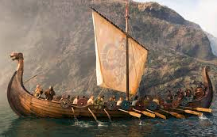
Viking Song – Starka Varna
We have also been learning to sing in Norn. We hope you like our viking song.
Notes:
http://www.scotssangsfurschools.com/apps/podcast/podcast/329156

Slide 9
We have also been learning some scots in class.
We will now perform a play called ‘Wee Reid Ridin Hood’.

Slide 10
The Scottish flag has a big white cross in the middle and the rest is blue. My favourite sang was murder in the chip shop. A boy hit a big dug with a tattie scone and the boy almost split his sides with laughing when he saw his auntie Sara screwing off her wooden leg.

Slide 11
We are going to sing the song ‘Murder in the Chip Shop’. I think its good because its in Scots and it is funny.
Notes:
http://www.scotssangsfurschools.com/apps/podcast/tags/136590

Slide 12
Our class is learning about the weather in French. Sunny is il soleil, rainy is il pleut, icy is il gele, thunder is il y a de l’orage and cloudy is il fait gris.

Slide 13
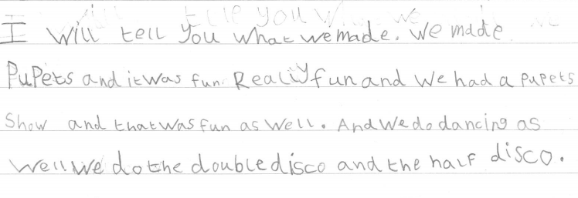

Slide 14
I would like to tell you about my puppet. His name is Tugboat and he is crazy because he shouts his name all of the time. It especially drives me crazy but even though he is really annoying he is also really kind and caring.

Slide 15
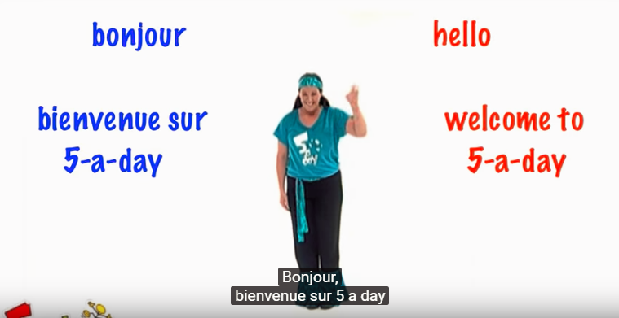
I would like to tell you about the puppets we made. I put rainbows on my puppet and we put on a puppet show with our puppets in French.
This is how we warm up in French. Children and adults can join in too.
Notes:
https://youtu.be/KVhfIgghOPw

