Slide 1
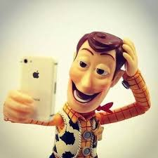
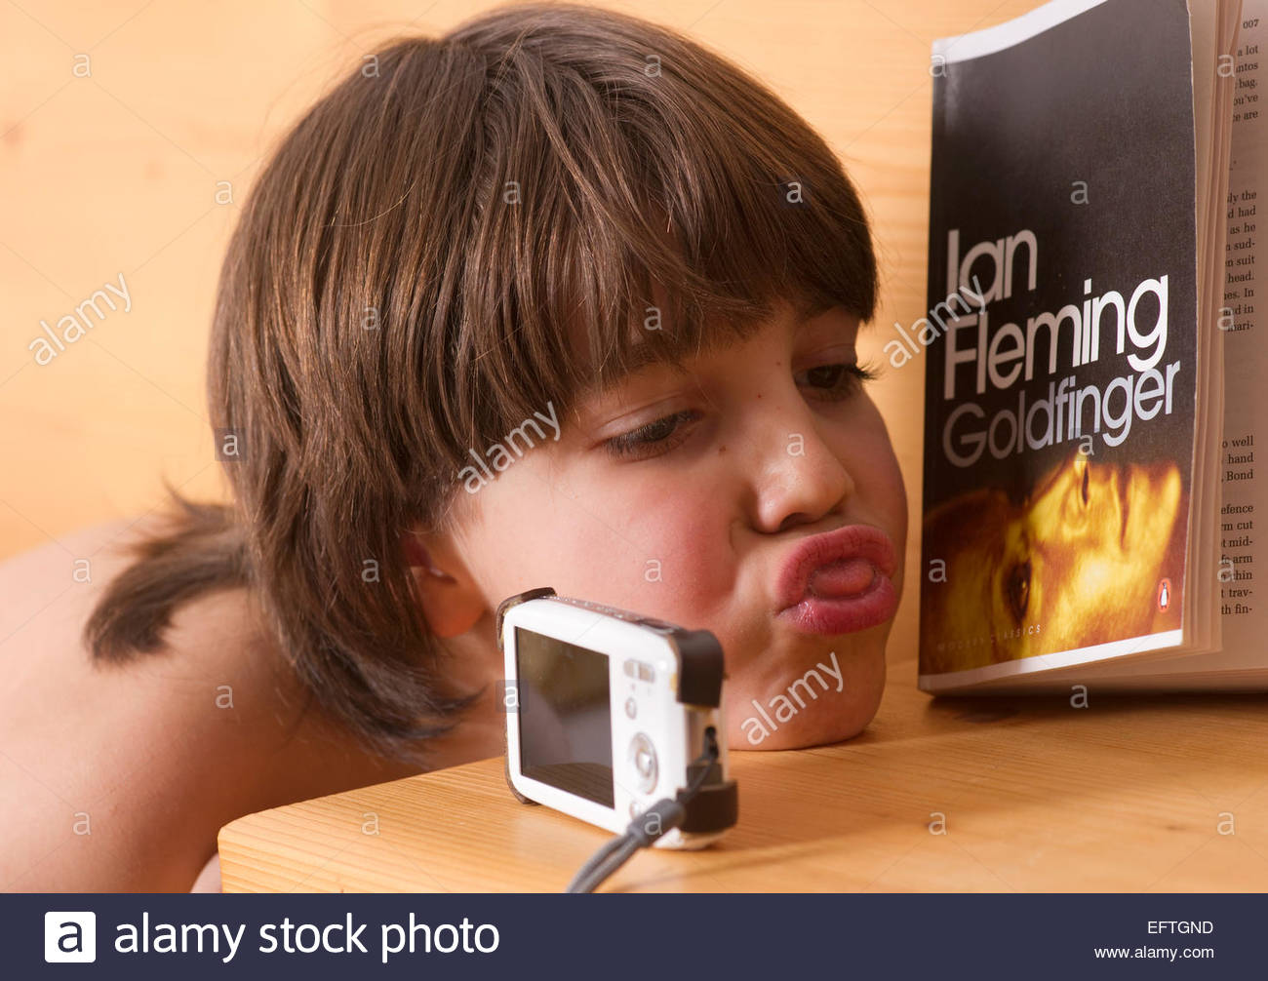
Reading Selfie Challenge
To be completed by 8th March 2018

Slide 2

Do you read in the garden?

Slide 3

Do you read to your brother or sister?

Slide 4
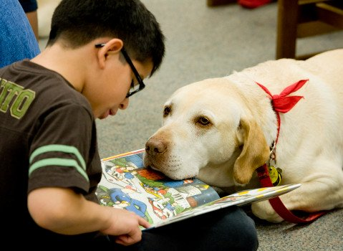
Do you read to your dog?

Slide 5
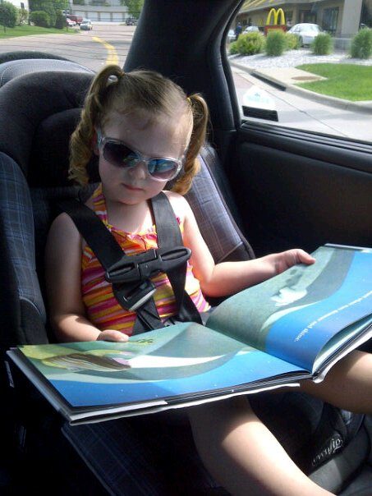
Do you read in the car?

Slide 6
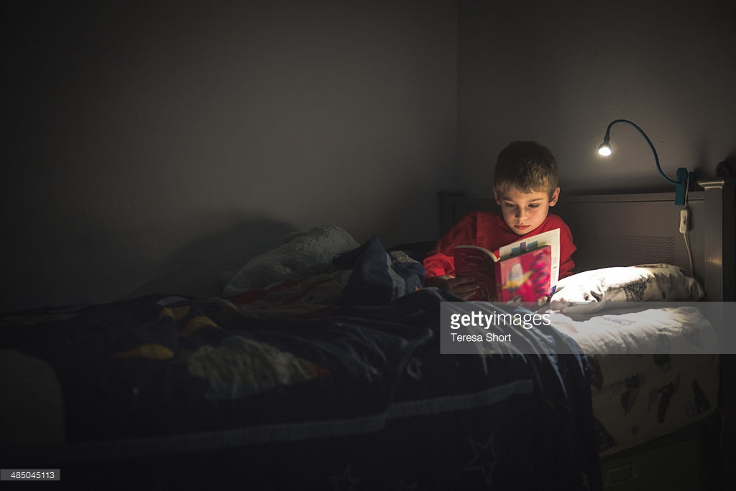
Do you read in bed?

Slide 7

Do you read at the Library?

Slide 8
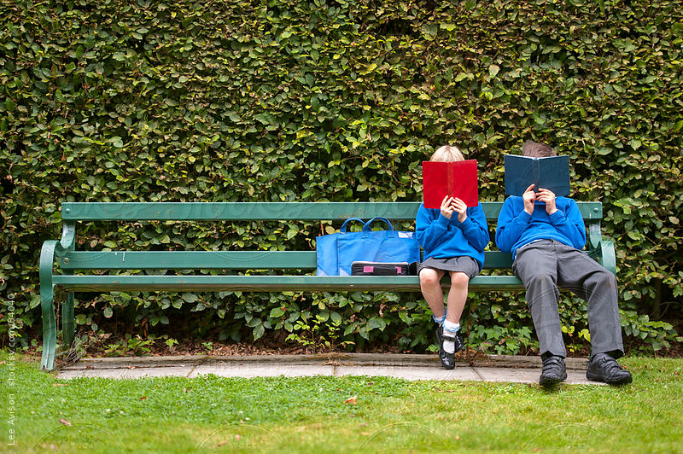
Do you read at the park?

Slide 9
Reading Selfie Challenge
Take a selfie of you reading
Bring it into school or post it on the blog
The best selfie will win a prize

