Slide 1
Day 100 School Challenge

Slide 2
Write to a school 100 miles away
L.I. We are learning to use the internet to find useful information. We are learning to write correspondence in a real life context.
Do some research to find a school 100 miles away
Write to the school.
Tell them about yourself and about Day 100.
You can choose from writing a letter, email, postcard or making a card.
Wait to see if they write back!

Slide 3
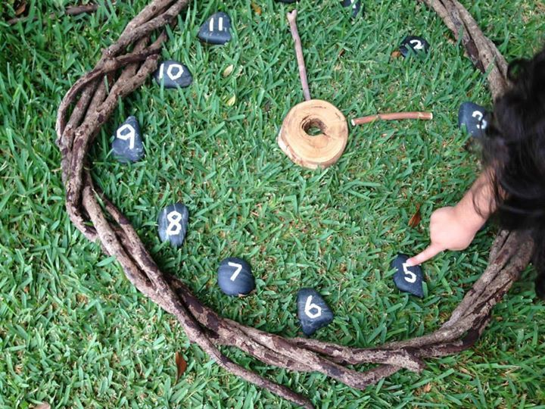
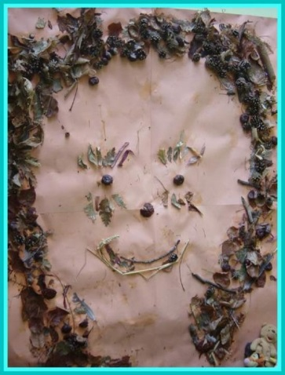
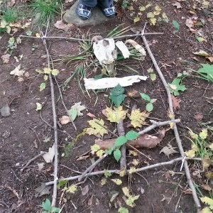
100 Item Sculpture
L.I. We are learning to discover and choose ways to create images or objects using a variety of materials.
Collect 100 things outside and make a sculpture that represents your 100 days in school.
You can work in groups or on your own.
Take a photo of your sculpture for Miss Clarkson to judge.
There will be a winner chosen from each class.

Slide 4
100 Piece Class Jigsaw
L.I – We are learning to work in a group to solve a problem.
Class Teachers to take photos of each class.
Photo to be enlarged to poster size.
Photo to be cut up into 100 pieces (shape/size of pieces can be decided by class teachers).
Children to work in groups to put their class photo back together.

Slide 5
Be Creative!!!

