Slide 1
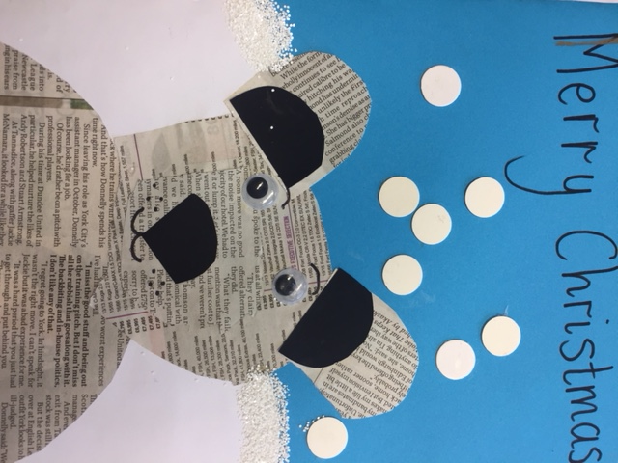
Sending Warm Wishes
This Christmas Time!
From Miss Clarkson, Miss Dick and all the Pupils and Staff at Blackburn Primary School and Hopefield Nursery Class

