Slide 1
Blackburn Primary
Breakfast around the World
5 days, 5 countries
30th May 2016 – 4th June 2016

Slide 2
Choosing our Countries
We discussed the different countries and voted to have breakfast from the following 5 countries:-
Pakistan because one of our P7 pupils family originally comes from Pakistan.
Spain as we are learning this countries language in the upper school.
Australia because it is so far away.
France as we are learning this countries language in the lower school.
America as everyone loves pancakes.
When we had chosen our countries we work in teams and used ipads to find out what foods came from each country which we could try.

Slide 3










Decorations!
We researched the countries flags and coloured them in to decorate our breakfast club.

Slide 4
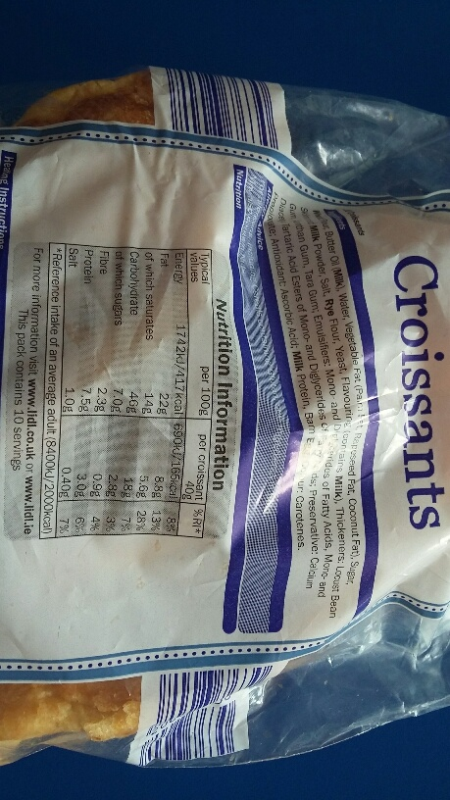
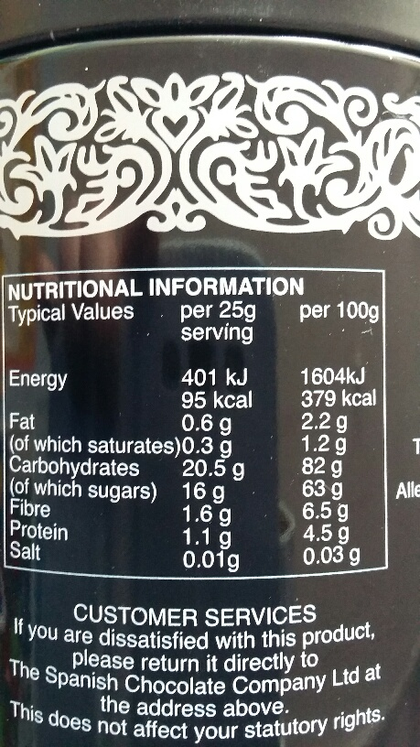
Collecting Information
We looked at each item of foods packaging to find the fat, sugar and salt content of each and recorded the information on a spreadsheet.

Slide 5
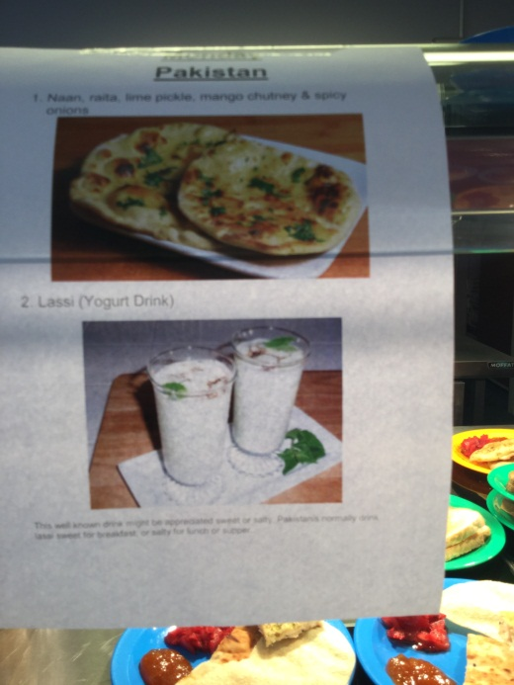
Monday - Pakistan
Menu – Naan, Poppadom, Spicy Onions and Mango Chutney with a Banana & Mango Lassi (yogurt drink).

Slide 6
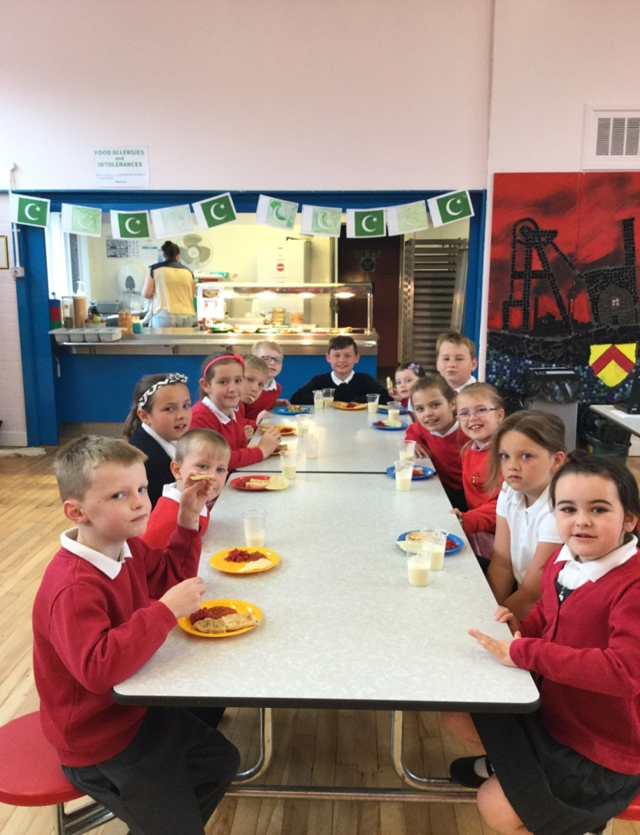
Monday - Pakistan
“I liked trying something different!”
“I didn’t like the Lassi, it was yucky.”
“The bread stuff was the best!”

Slide 7
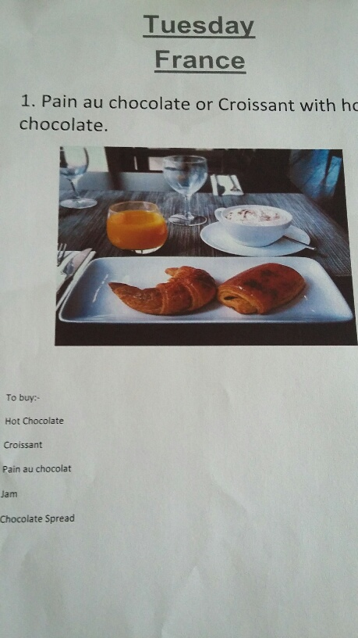
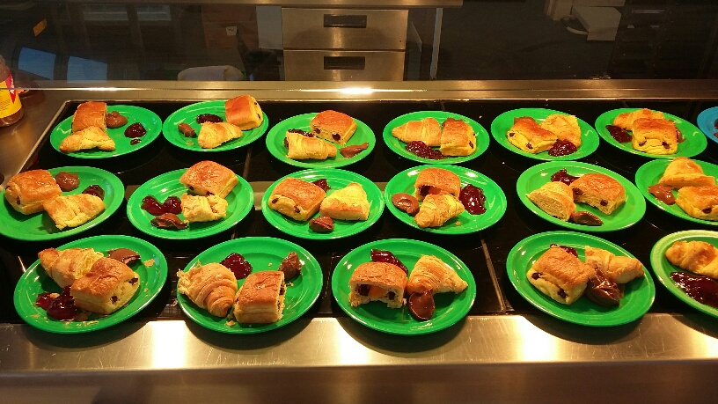
Tuesday - France
Menu – Pain au chocolate or croissant served with chocolate spread or strawberry jam with a hot chocolate drink

Slide 8
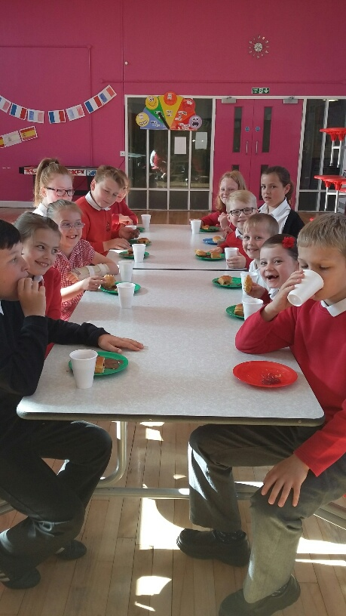
Tuesday - France
“I loved the croissant”
“I like this one better than yesterdays.”
“I don’t like the chocolate but the square thing is yummy.”

Slide 9
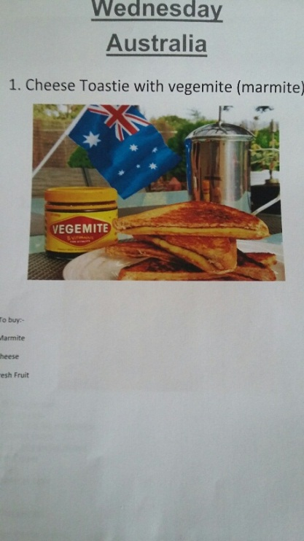
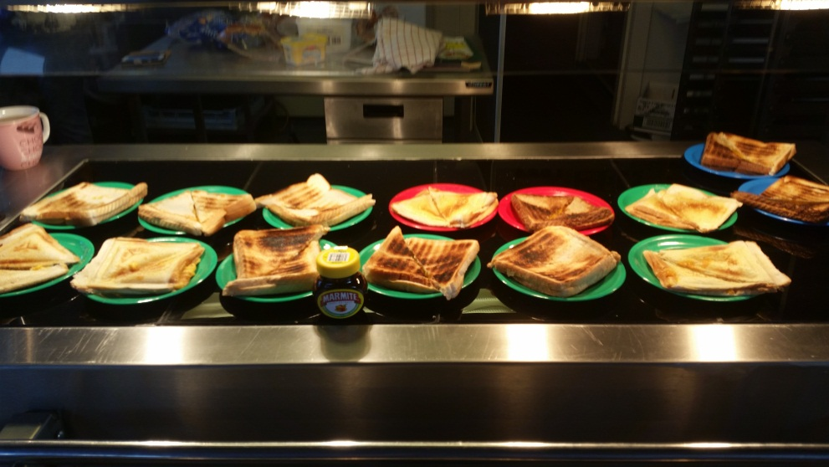
Wednesday - Australia
Menu – Vegemite Sandwich (Cheese toastie with marmite)

Slide 10
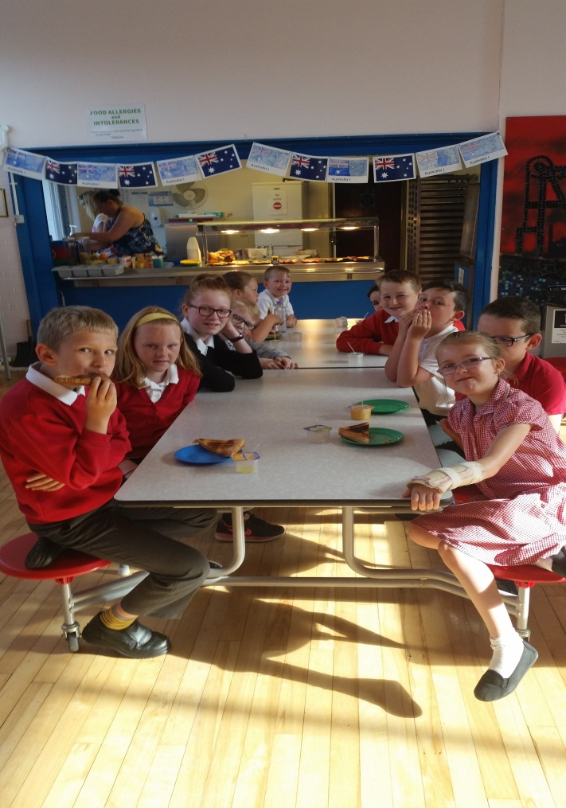
Wednesday - Australia
“That smells horrible” about the marmite
“I love cheese toasties. They are the best.”

Slide 11
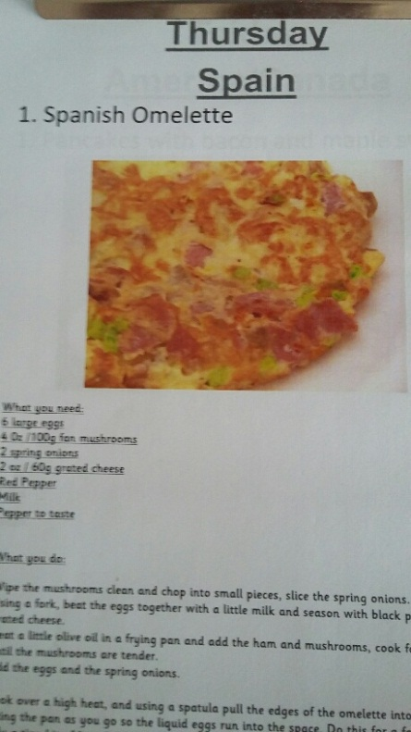
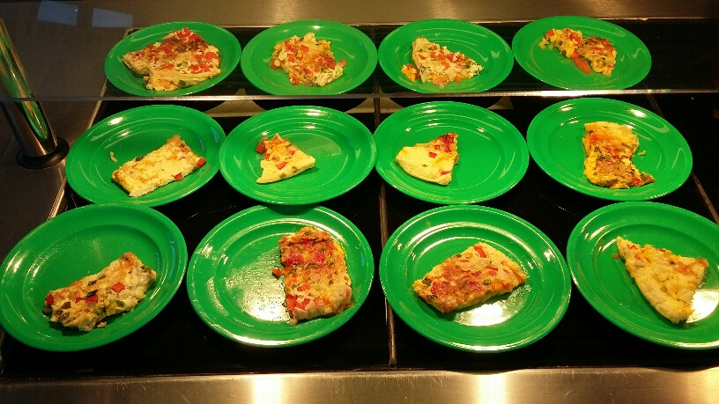
Thursday - Spain
Menu – Spanish Omelette (Spring Onions from our School Sensory Garden, red peppers, cheese and Ham)

Slide 12
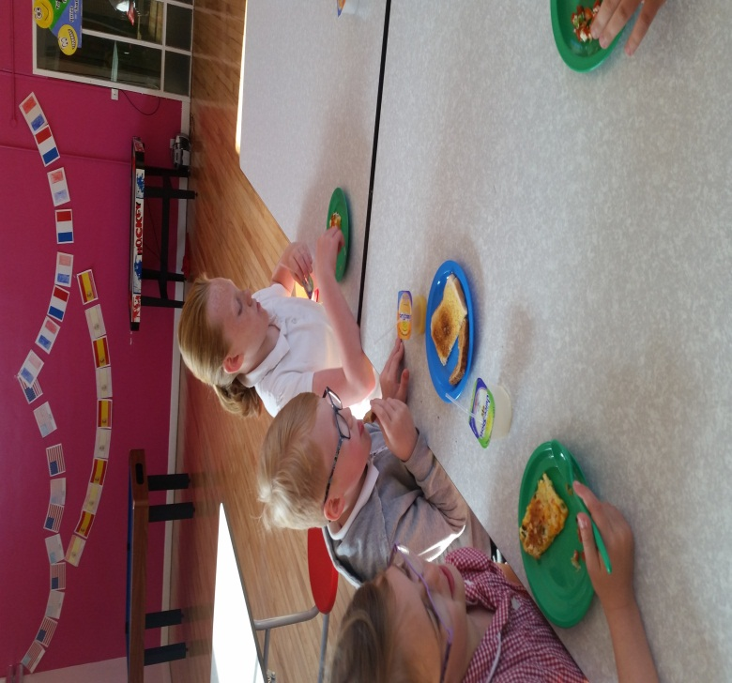
Thursday - Spain
“Eww what are the green bits in it?” Charlie asked and then had seconds once he tried it.
Even the teachers came in for breakfast today

Slide 13
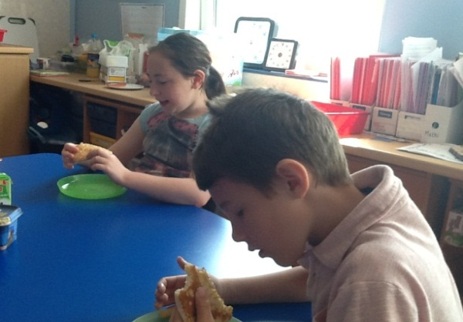
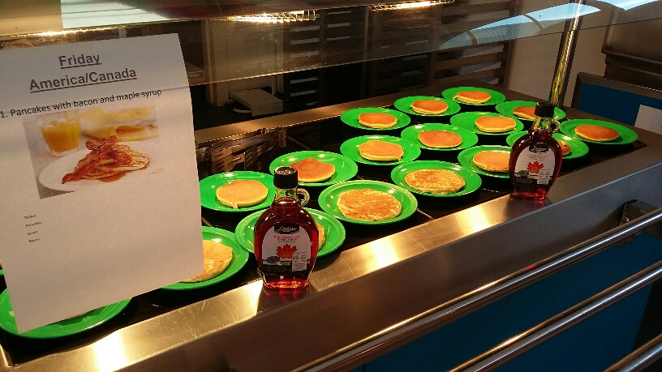
Friday - America
Menu – Pancakes served with maple syrup and bacon (optional)

Slide 14
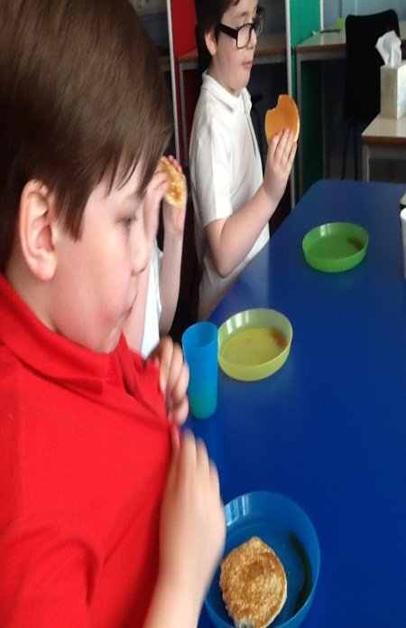
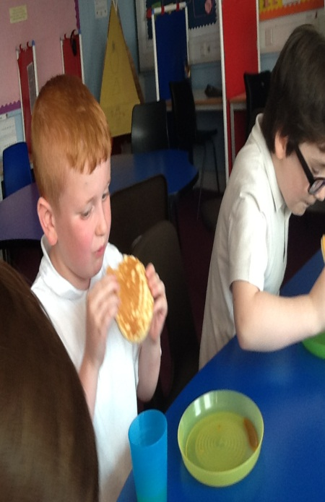
Friday - America
Our ASD pupils loved the American breakfast the best.
Every one liked this days breakfast the best.

Slide 15
The science bit

