Slide 1
Helping Your Child With Reading & Writing Homework in P1-3

Slide 2
Reading with your child is vital. Research shows that it's the single most important thing you can do to help your child's education.

Slide 3
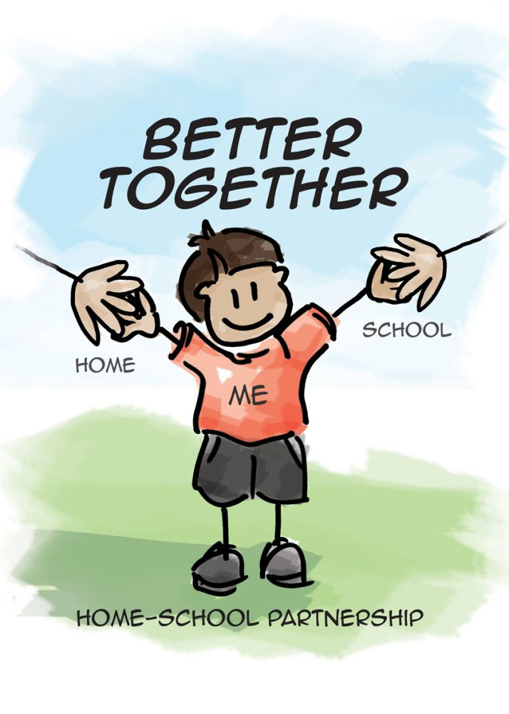
We can work in partnership to make your child the best they can be. You can encourage your child to explore literacy in a fun way both outdoors and at home.

Slide 4
Reading Homework
Practise reading every night
Using your pointing finger when reading
Remember to discuss the text and pictures
Ask questions – use the inside covers for ideas
Encourage your child to think of some questions to ask
Please sign diary every night – your practise really makes a difference!

Slide 5
How Can You Help?
Include your child in everyday tasks and make them fun!- baking, i-spy, rhyming words
Practise tricky/ORT words, treasure hunt, looking for words in newspapers/books etc.
Read together – they are never to old for a bedtime story! **Bankton Reading Challenge**
Look at magazines and football scores
Look at signs outdoors
Use new and familiar words to extend and enrich your child’s vocabulary
www.readwritecount.scot
http://www.familylearning.org.uk/phonics_games.html

Slide 6
Writing Homework
Practise writing formation –
Use whiteboard/sand/rice/mud to practise forming all letters correctly!
Generate rhyming words – throwing a ball
Real & Nonsense words - bin it or win it
Spelling – fun ways, rainbow writing, bubble writing, on backs, chalks etc

Slide 7
Questions/Explore Resources
Useful documents on Bankton Blog
Resources - have a look at/play with
Questions/Suggestions

