Slide 1
Growth and Fixed Mindset
From over three decades of research into motivation, Carol Dweck has been working to answer the question:
Why do some people achieve their potential while equally talented others don’t?
From this she has devised two ways to view life and learning –
The Growth and Fixed Mindset

Slide 2
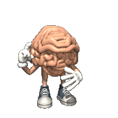
The Brain
Your brain grows very fast during the first ten years of your life. This is the magic decade when you can help your brain grow faster and be more powerful.
Learning new things helps strengthen your brain.
‘Your Fantastic Elastic Brain’
>> The Learning Brain <<

Slide 3
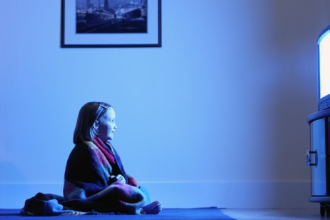
What is a Growth mindset? Hare and Tortoise

Slide 4
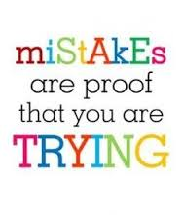
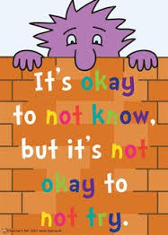
Mistakes are good as long as we learn from them. They support our learning journey. “If you don’t make mistakes, you’re not learning.” Zoe
Marvellous Mistakes

Slide 5
Fixed Mindset
Growth Mindset
Avoids Challenges | Loves Challenges
The world is fixed | The world can change
Ignore Feedback | Use feedback
Hate criticism | Learn from criticism
Hate making mistakes | Learn from mistakes
Threatened by others success | Inspired by other success
Intelligence stays the same | Intelligence can be developed
Gives up easily | Keep going
Effort is pointless | Effort is important
See setbacks as failure | Learn from setbacks
Putting in effort shows you’re not smart | Putting in effort makes you smart
Achieve less | Achieve more

Slide 6
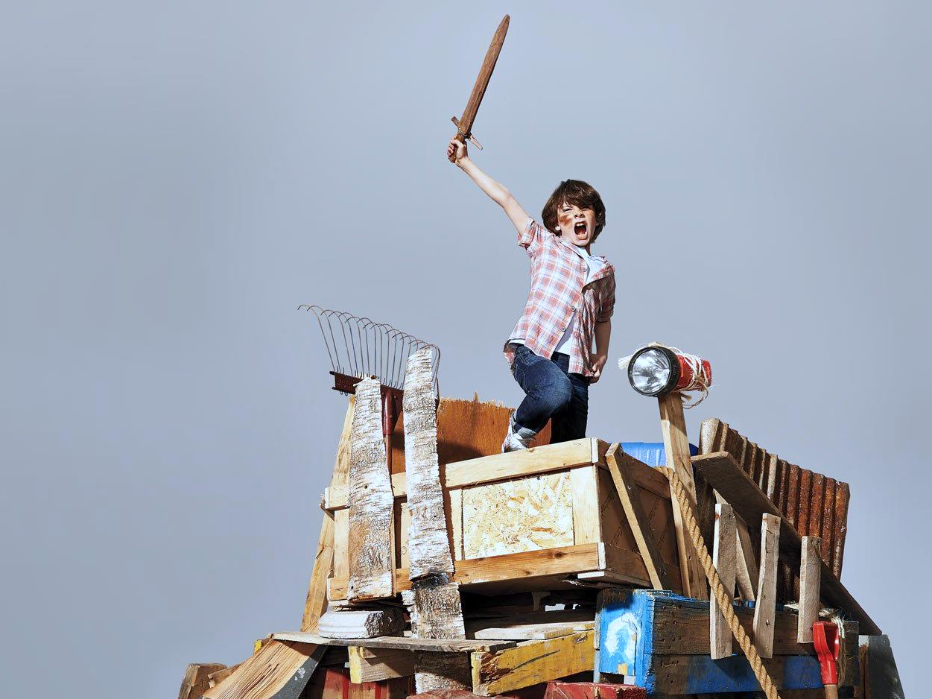
Why do it?
People might display evidence of both Mindsets at times, but Mindsets can be altered when they occur simply by understanding the theory, language and behaviour.
Through our awareness of the theory, we are in a position to change. Children are able to become independent learners and avoid learned helplessness.
Growth Mindset will give children a want and thirst to learn which is at the forefront of successful education. Confidence and self esteem will be a knock-on effect.
YET…….. YET is a powerful and significant little word; it means so much in relation to learning.

Slide 7
Please take a leaflet to show ways to support your child at home….

