Slide 1
Welcome to charlotte and max’s
Prevention on France
Helped by Neve

Slide 2
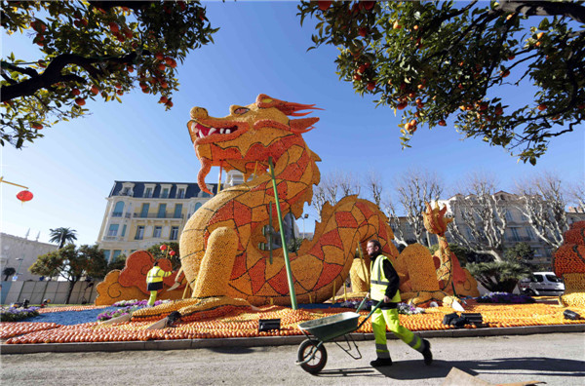
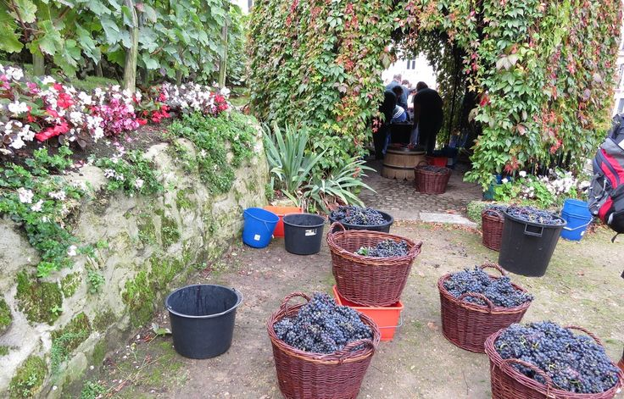
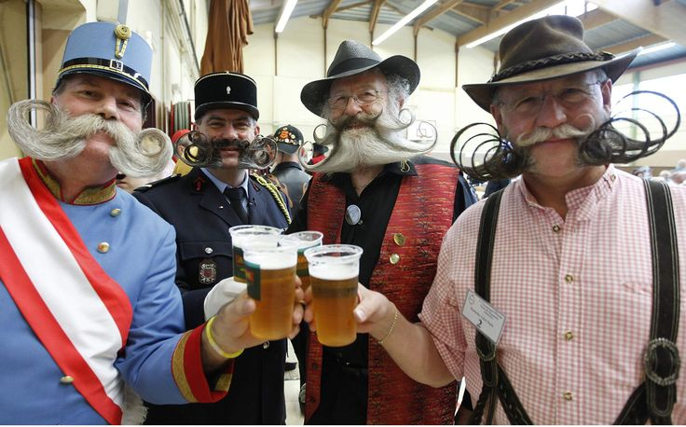
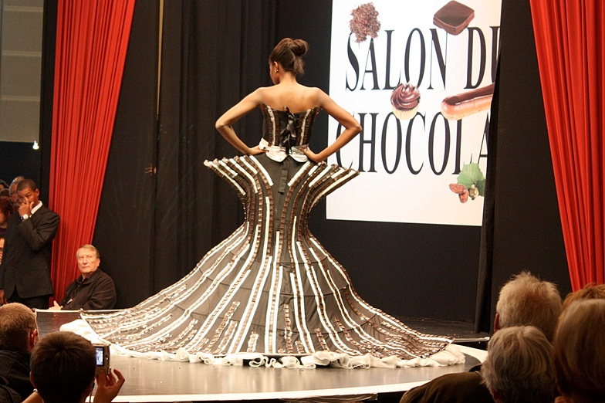
All festival

Slide 3
Dragon festival
Information
In June
Million of people in France
Come along to the most famous festival in France
The dragon festival people
Make dragon floats they have a big party at night :/

Slide 4
Grape festival
In October
Thar is a grape festive they Stomp on the grapes then they put it in a barrow at the end of the squshing they us a tap a fillter tap skin leaves and stumps all gone then make lots of bottle

Slide 5
Bear festival
In November
There is a beer festival they make beer only for men over 18 and girls to only over 18 they make beers in France it costs nothing :]

Slide 6
Choclate dress festvial
Chocolate lovers who visit paris at the end october can enjoy the delights of dozens of chocolaties and see how choclate is produced from the picking of the cocoa beans to the end product and its for 3 the dress is pure choclate by dark light and milk! In october

Slide 7
The end bye:]

