Slide 1
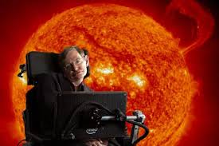
SPACE
Galiexes
And
AILENS

Slide 2
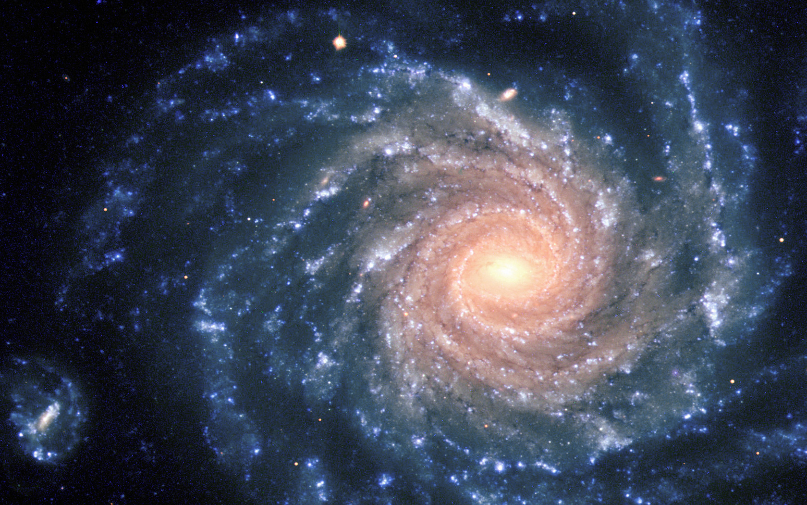
What Is a Galaxy
When the stars are together the create there own gravities
Is a fantastic world of stars that are gas and dust . The word galaxy is a Greek name with means milky way .In the galaxy have 10000 of stars.

Slide 3
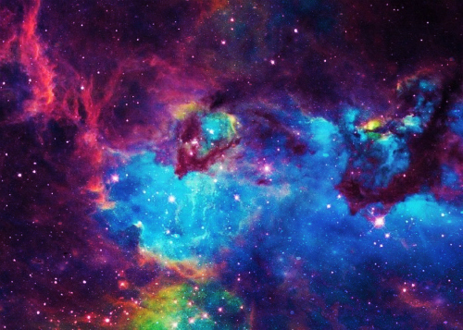
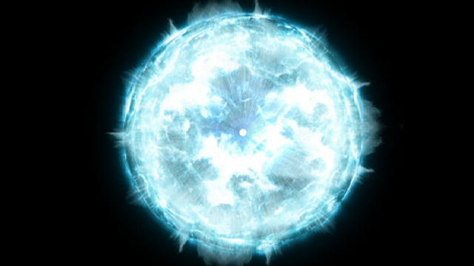
A fact about our galaxy
people say that galaxies were born when vast clouds of gas and dust collapsed under gravitational pall.

Slide 4
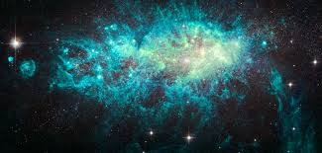
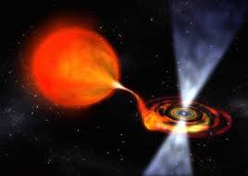
zombie stars
What are they
A zombie star is the result of a supernova which leaves behind a remnant star, rather than completely dispersing the stellar mass stay but have a lower ejection velocity and Lowe gamma,
the binary system consist of a white dwarf and a companion star, the white dwarf strips away material from its companion. Normally then white dwarf will eventually reach a critical mass, and fusion reactions would make it explode and completely dissipate

Slide 5
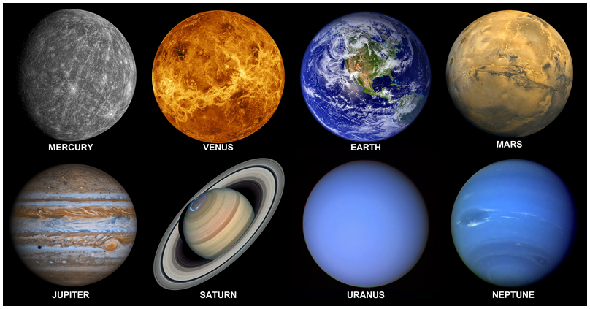
Different planets
The order of the planets from closest to the Sun outwards is; Mercury, Venus, Earth, Mars, Jupiter, Saturn, Uranus and finally Neptune.
It takes Neptune 164.8 Earth years to orbit the Sun.
Neptune was discovered by Jean Joseph Le Vernier.

Slide 6
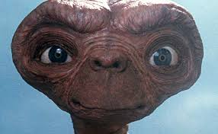
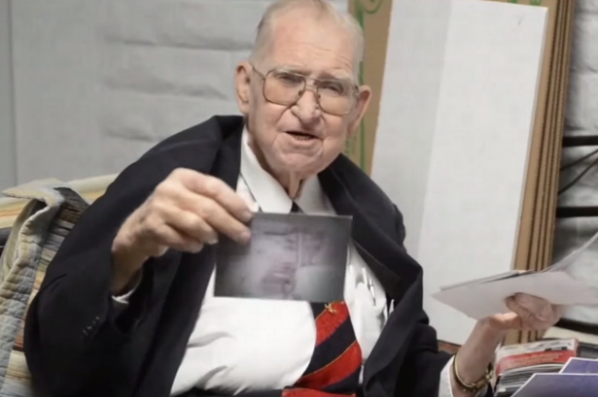
Are aliens real? No ;/
Dr Boyd
Some people think they are real because a scientist called Dr Boyd said he done a document s about aliens just before he died. And after many years later people found his documents.

Slide 7
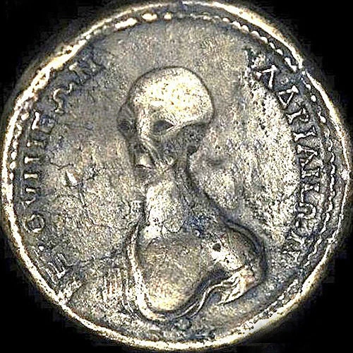
More proof aliens exist
The eygiption coin
This coin was found in 2009 by a acarologist in the Egyptian desert
This is leading theorists to thinking that aliens helped the Egyptians build there monumental pyramids.

Slide 8


Thank you for watching
Thank you for watching our PowerPoint. We hope it has given you more information on aliens and also galaxy's bye

