Slide 1
What is the solar system
By Jura, Wiktoria, Hannah and Ryan
Notes:
Our notes are facts that we put on the presentation.

Slide 2
There are nine planets in the solar system
Don’t look at the sun even with sunglasses because it can make you blind.
The core of the sun is 14000000 degrees hot.
There is something called gravity that keeps us on the ground and keeping the planets together.

Slide 3
Is it true that
All planets have one moon.
The sun has spots on it.
Venus is bigger than the earth.
There was life on earth from the start.

Slide 4
answers
False. Many of the planets have more than one moon .
Yes it is true. All over the sun it has different colours.
False. Venus is not that much smaller than earth.
False. When the earth was first created it was to hot for living life and there was no oxygen to breathe.

Slide 5
Names of the planets
Mercury
Venus
Earth
Mars
Jupiter
Saturn
Uranus
Neptune
Pluto

Slide 6
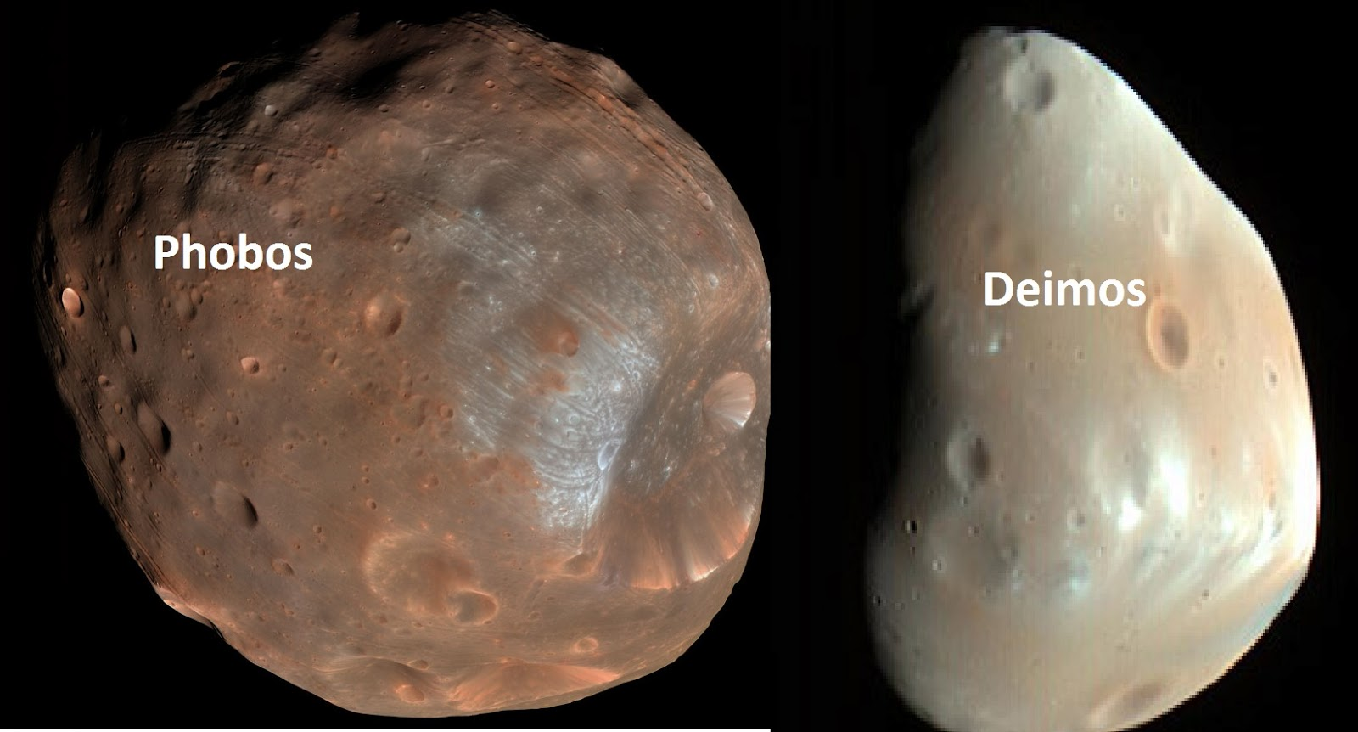
A day on Venus takes 243 earth days but a year is only 225 earth days.
When the earth spins around once that is one day on earth. The earth spins 365 times a year.
The moon doesn't change when it moves around the earth. It looks like it.
Mars had lots of ice on it a long time ago.
Mars has two moons Phobos and Deimos.

Slide 7
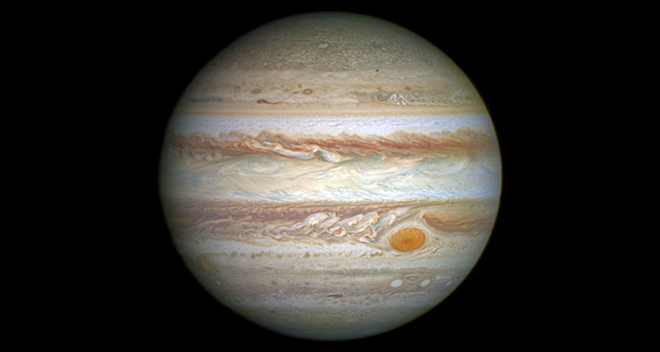
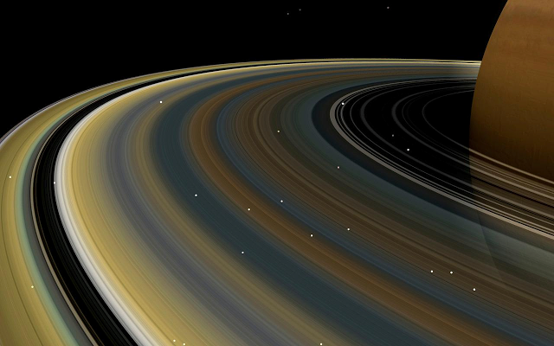
Jupiter is the biggest planet in the solar system.
There is a never ending storm on Jupiter.
Jupiter smells like rotten eggs.
Saturn’s rings are not solid they are made of millions of chunks of ice and rock.

Slide 8
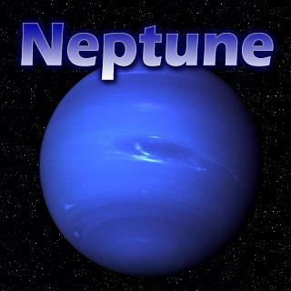
NEPTUNE
On Neptune you can see pink snow.
Neptune is almost 4.5 billion km away from the sun.
Neptune is always very windy and rainy.

Slide 9
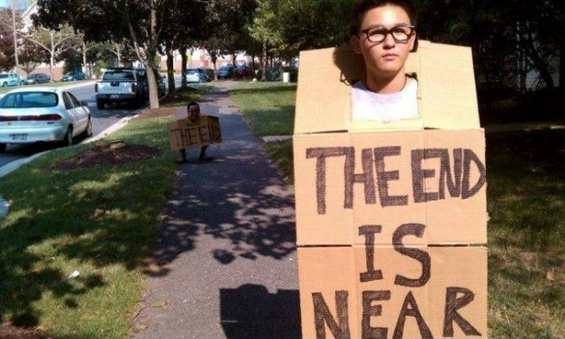
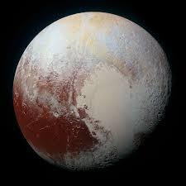
Pluto
It takes Pluto 248 years to orbit the sun once.
An American named Jim Christy discovered Pluto’s moon in 1978.

Slide 10
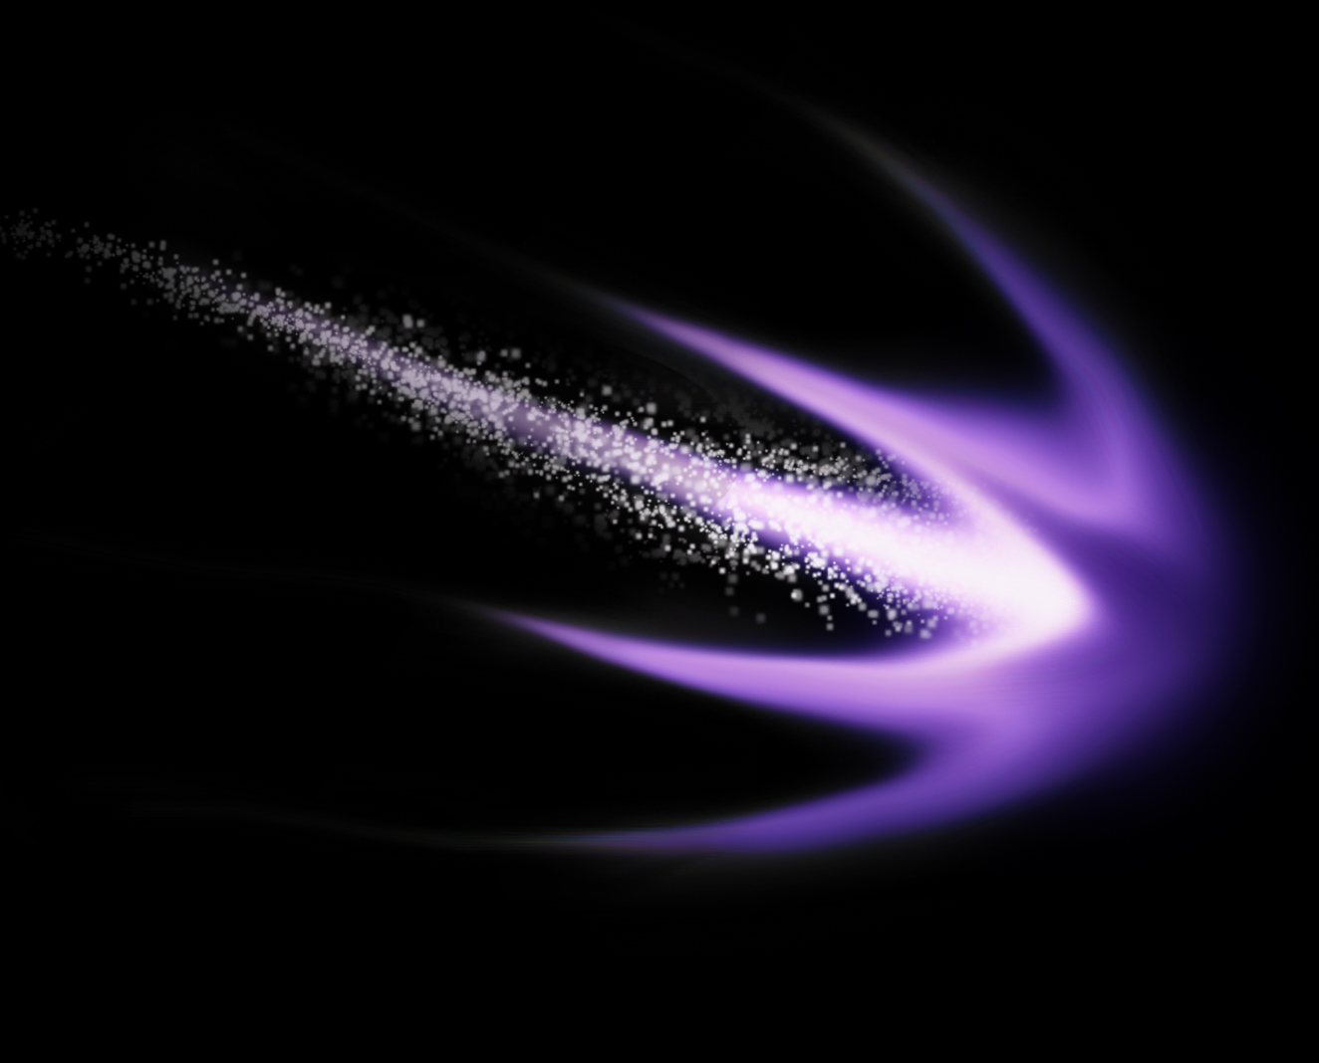
A shooting star is a falling meteor or a comet.
Most shooting stars disappear before hitting the ground.

Slide 11
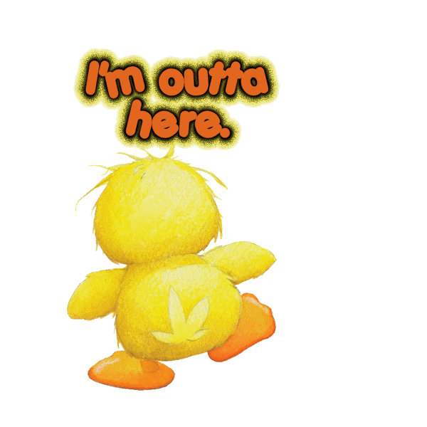

Slide 12
