Slide 1
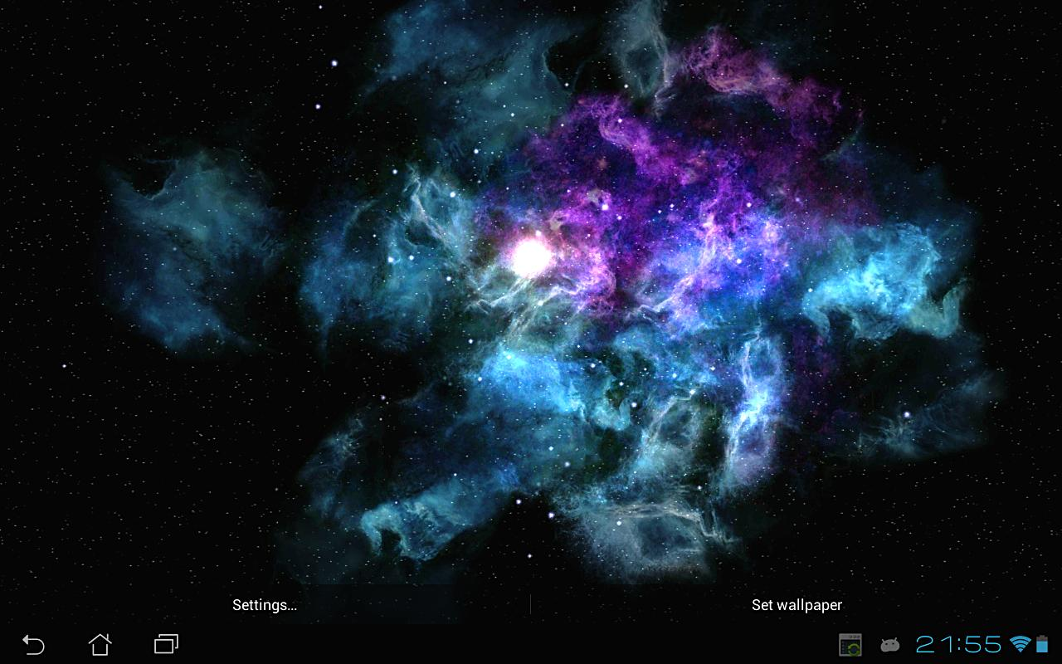
THE SOLAR SYSTEM AND FURTHER
By josh Brodie Mhari Amy H

Slide 2
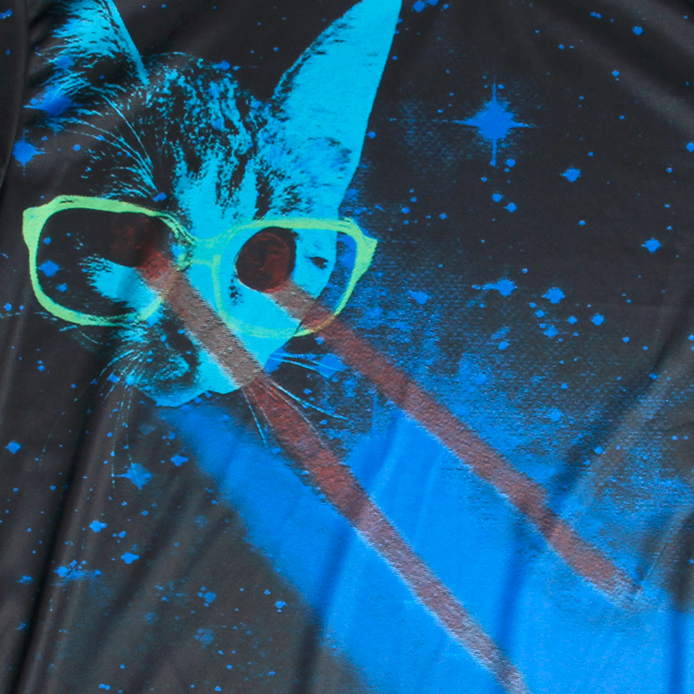
Facts
Computers are used to change the pattern of radio waves coming from space into pictures. These radio pictures are quite different from ordinary light pictures
The parkes radio telescope in Australia Gathers radio waves from stars and galaxies.
Astronomers call glowing gas cloud the Lagoon Nebula

Slide 3
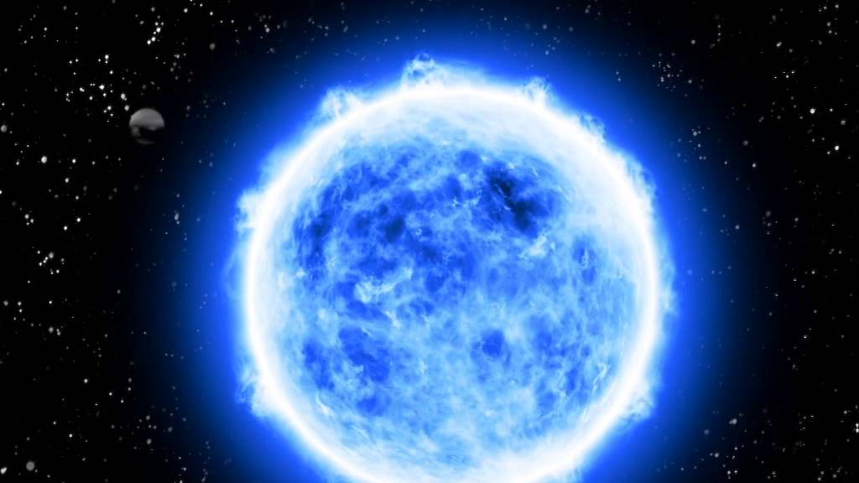
Facts:
The first ever photo of the solar system was taken in 1996.
The black whole in the centre of our galaxy Sagittarius A.
The nearest stars to us are 90,000,000,000,000 (90 million million) km away!
Through their telescopes astronauts can see millions galaxies and space make up what we call the universe.

Slide 4
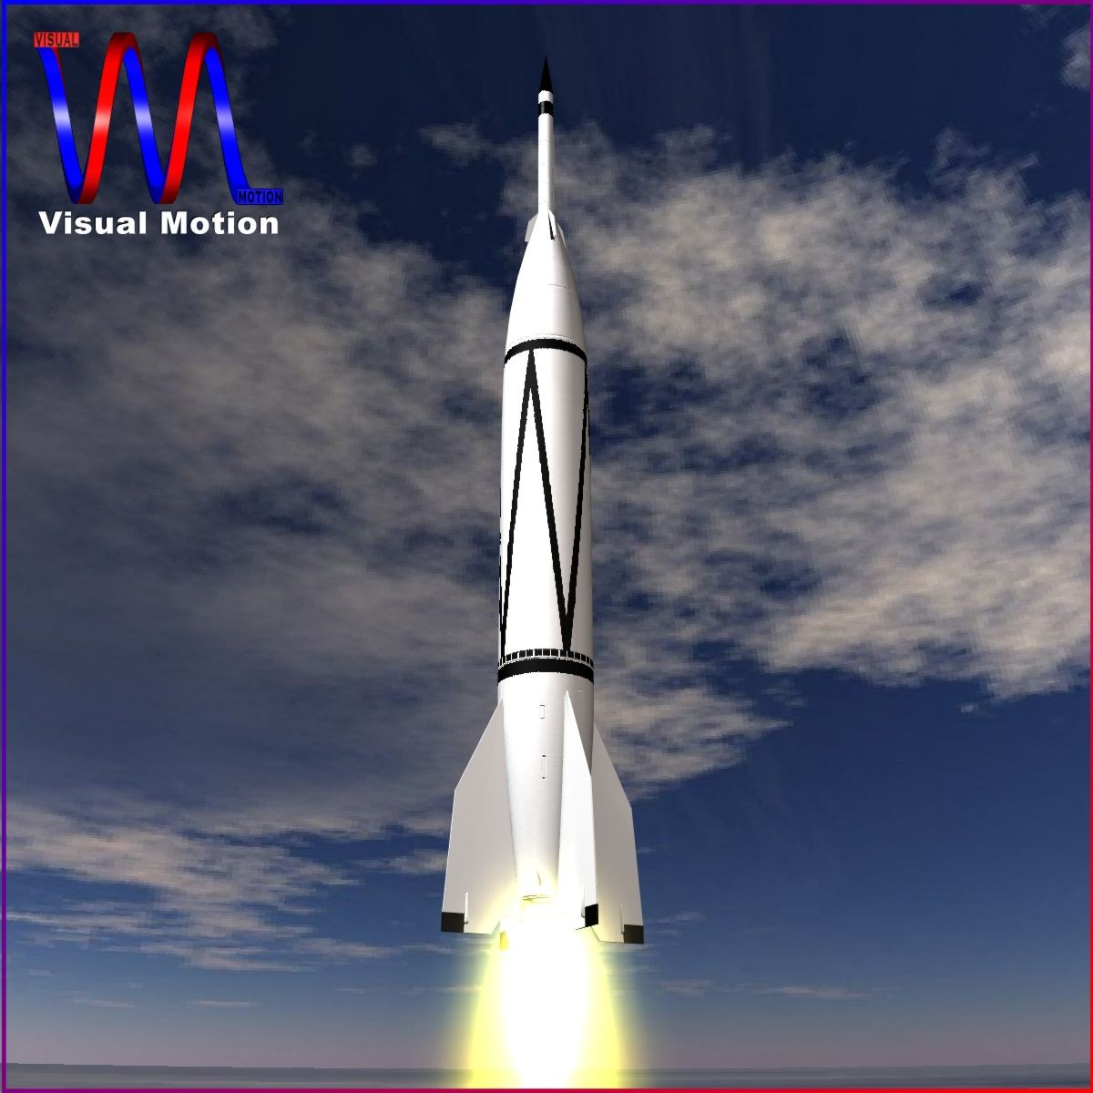
More facts
On the 24 of July 1950 this bumper rocket became the first to lunched from Kennedy space
Neil Armstrong was the first American to fly to space!
Our sun is 1,400,000km big! Over 100 times the size of this planet!!!!!

Slide 6
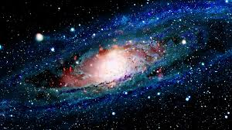
Even more facts
There are 4 different kinds of suns
They are : yellow dwarfs, red giants,
Blue giants and supergiant's.
All for space is completely
Silent.
There are a number of unknown stars and planets in this known universe.
99% of the solar system is taken up by the sun

Slide 7
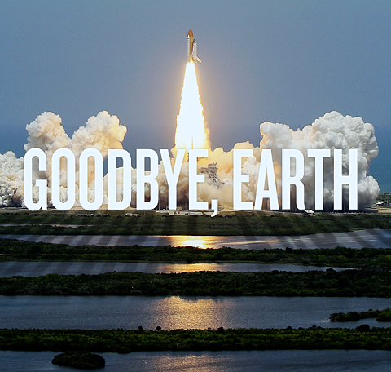
Hope you enjoyed our powerpoint presentation

