Slide 1
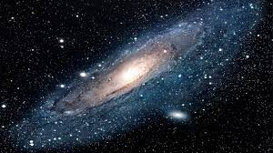
Milky way
By Blake and Lenny and Aimee Laura
The Milky Way
By Laura, Aimee, Blake and Lenny

Slide 2
Facts
The milky way is full of dust and gas.
Most large galaxies have a super massive black hole at the centre of it.
The milky way has been around for about 13.6 billion years .
The milky way is shaped like a huge whirlpool that rotates once every 200 million years .
It is made up of 100 to 400 billion stars also dust and gas.
The centre of the galaxy is quiet hard to see because clouds of gas and dust blocks the view.

Slide 3
Fun Facts
There are more than 200 billion stars in the galaxy.
The oldest star in the milky way is 13.2 billion years old.
Did you know there are black holes in the milky way. The milky is almost as old as the universe.

Slide 4
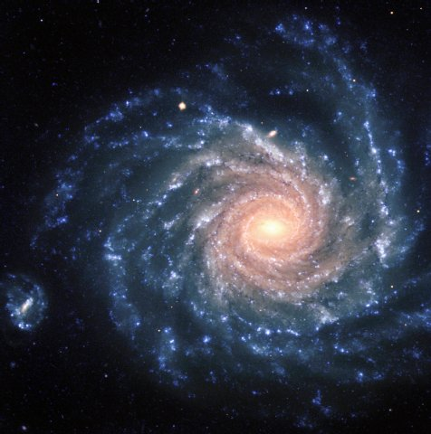
How long will it take to go around the milky way
It takes 230 million years to travel all the way around the milky way

Slide 5
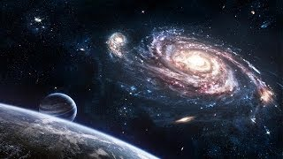
Photo and Facts
In the 1920s Edwin Hubble discovered that there was other galaxy's around and still living today.

Slide 6
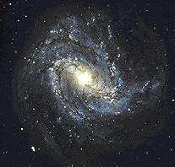
The Milky Way Is Not Alone
The Milky Way is not by it’s self. There is 54 galaxies and dwarf galaxies in total. So really the Milky Way has lots of neighbours beside it!

Slide 7
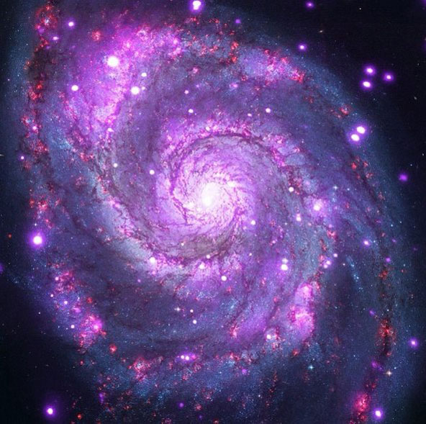
The Milky Way Can Be Different
Colours
The Milky Way can be all different colours like:
Blue
Dark Blue
Orange
Purple
Pink
And more!

Slide 8
Some More Facts
Did you know that the Milky Way is the galaxy which contains our Solar System.
did you know that the milky way was made from other galaxies.
The milky way galaxy is our home galaxy in the universe.
Did you know that in china they call the milky way ,the silver river.

Slide 9

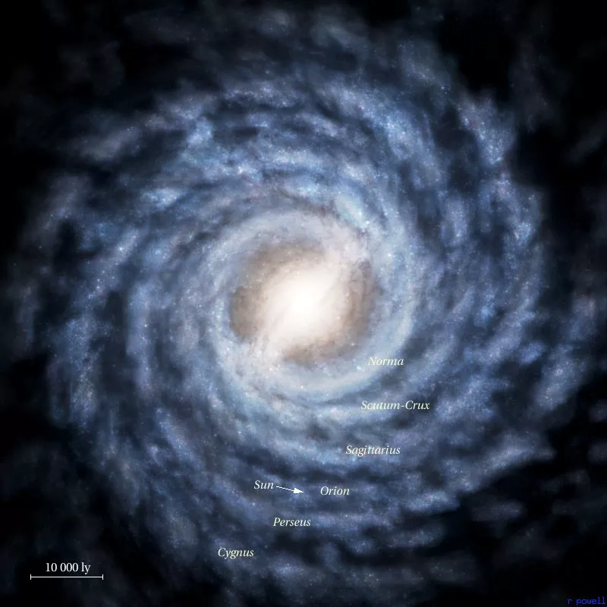
How it was named
The romans named the milky way because
it looked like a milky patch in the sky above the earth and night

Slide 10
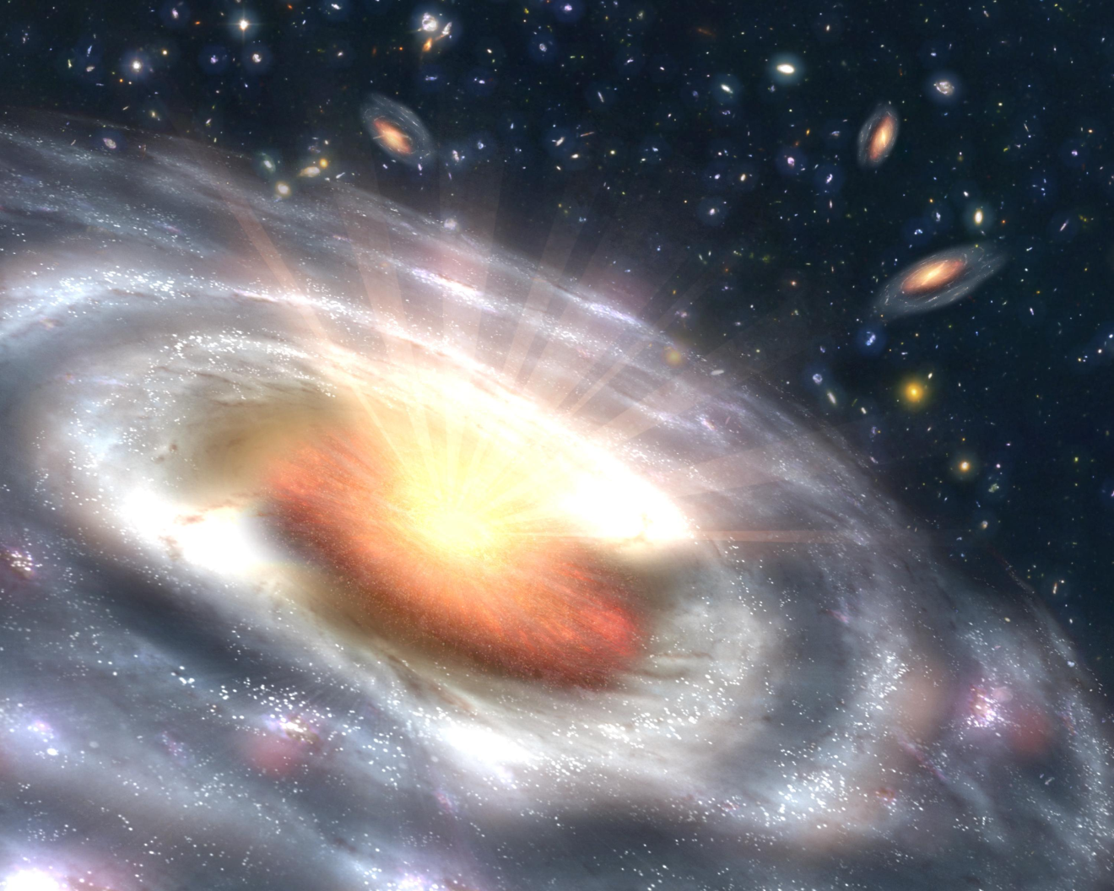
Can the milky way disappear
Some people say that the milky way will disappear but others say it will stay for ever and ever

Slide 11

Does the milky way spin
Some people say that the milky way moves while spinning
But It is quite confusing because some scientist say that that It does move and spin but others say it only moves witch one is it

Slide 12

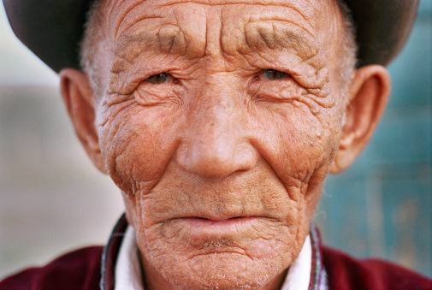
How old is the milky way
facts
Old but not as old as the milky way
The milky way is 13.21 billion years old IMAGINE THAT
That’s older than this

Slide 13
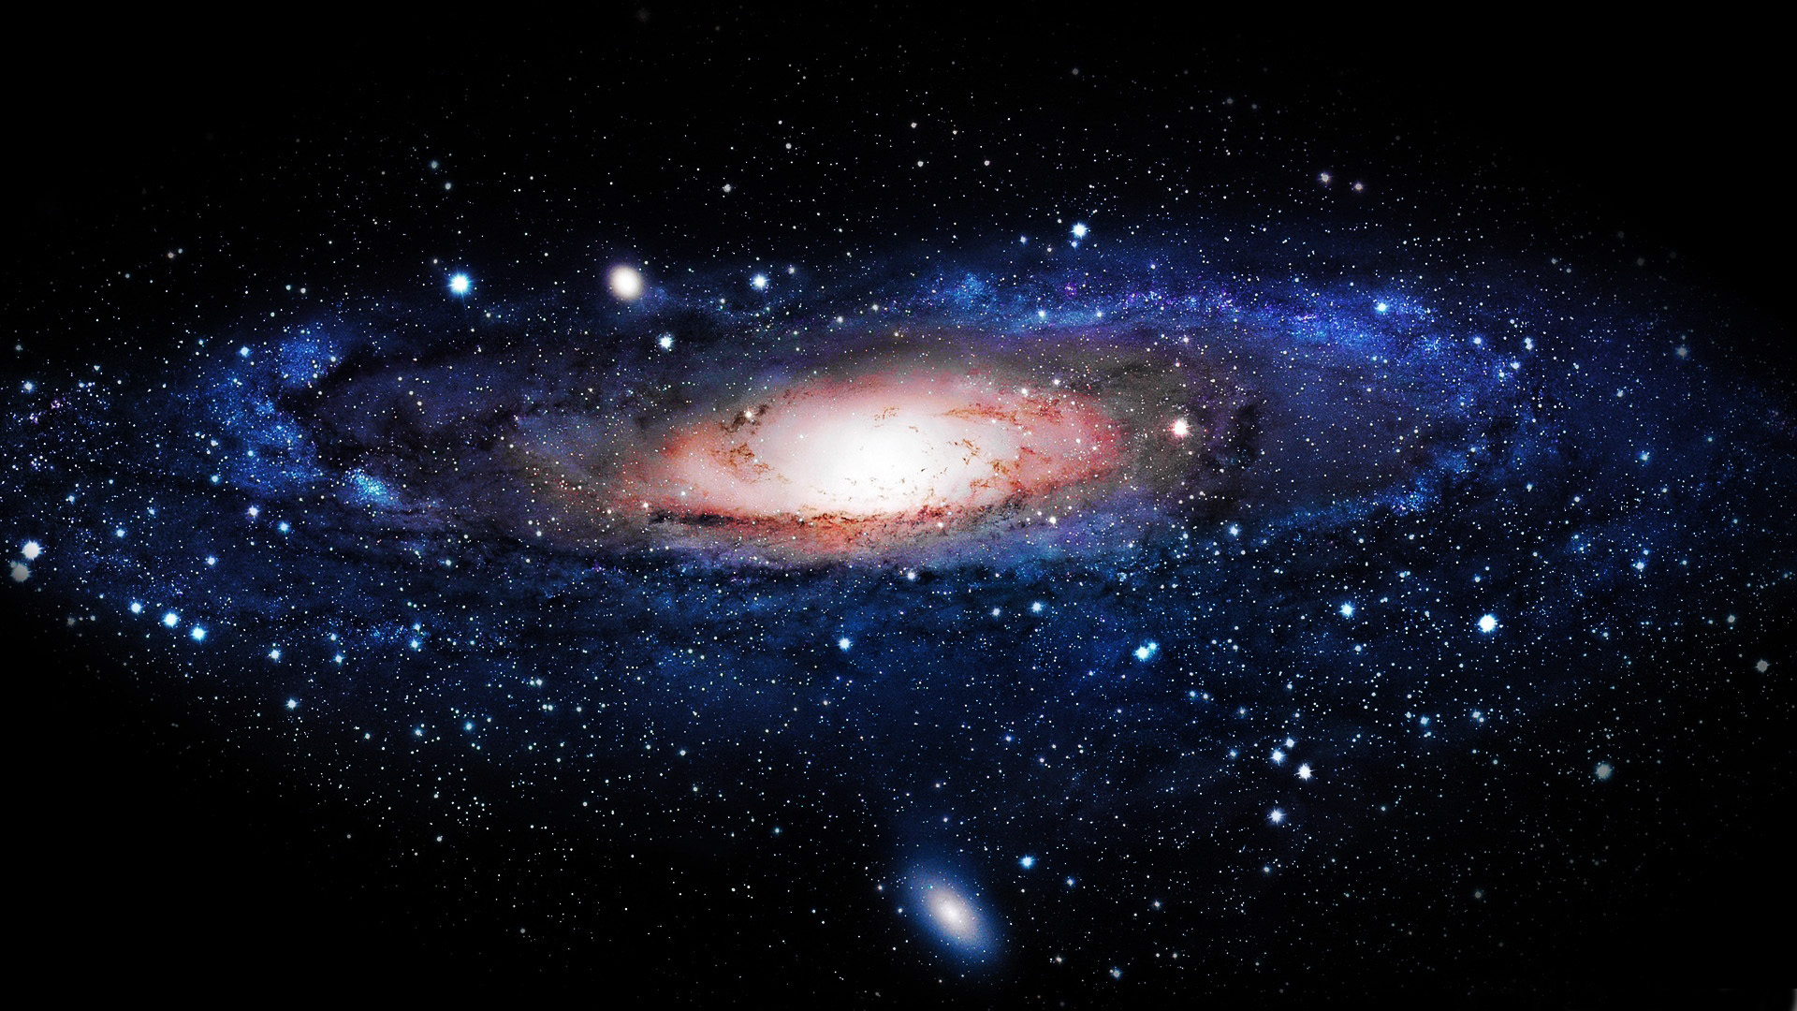
The Milky Way Is Still
Dangerous
The milky way is still dangerous but beautiful because it has a black hole in the middle!
No one has ever went anywhere near the Milky Way since it is dangerous!

Slide 14


Thanks for wacthing

