Slide 1
Big Big Balbardie Blether Achieve, Believe & Celebrate
Good Learning
(What does this look like?)
Parent/Child Workshop Evening
Thursday 15th May 2014

Slide 2
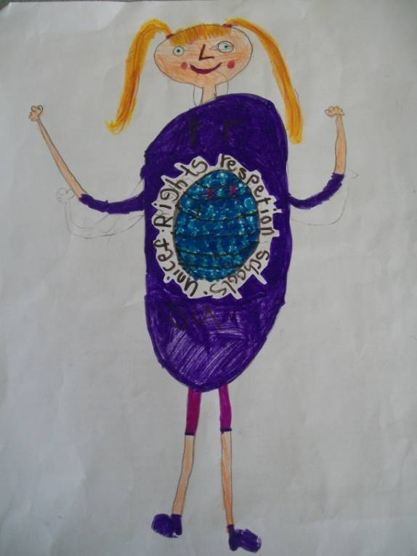
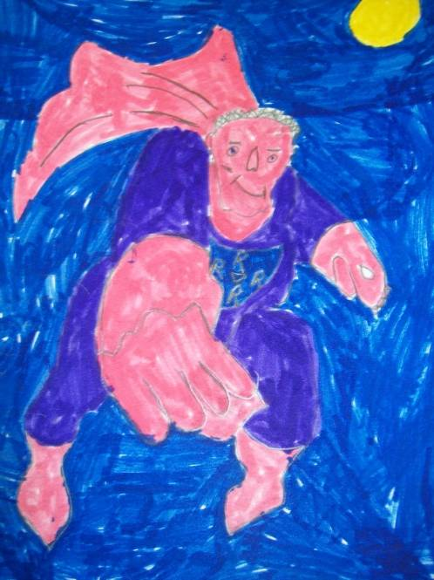
All of our children have the right to a good quality of education and it is our role as teachers to ensure that we plan for motivating and stimulating learning which engages our children in their learning.
Well done!
Keep respecting everyone’s rights!
Article 28
You have the right to a good quality education. You should be encouraged to go to school to the highest level you can.
Article 28
You have the right to a good quality education. You should be encouraged to go to school to the highest level you can.

Slide 3
Big Big Balbardie Blether
Parents
With your child/ren think back to when you were at school:
What did good learning look, sound and feel like?
How did you know you were doing well in your learning?
Take a few minutes to at each question to discuss this with your child/ren and write down your thoughts on the pink sheets provided.

Slide 4
Big Big Balbardie Blether
Children
With your child/ren think about how they learn at school:
What does good learning look, sound and feel like in 2014?
How do your children know they are doing well in their learning?
Take a few minutes to at each question to discuss this with your child/ren and write down your thoughts on the green sheets provided.

Slide 5
Big Big Balbardie Blether
Similarities & Differences
Take a few minutes in your group to discuss:
The similarities between good learning now and when you (parents) were at school.
The differences between good learning now and when you (parents) were at school.
The differences and similarities between how you knew you were doing well (parents) and how your children know they are doing well in their learning in 2014.

Slide 6
Big Big Balbardie Blether Planning for Good Learning
To ensure good quality learning takes place teachers:
Plan for the year (yearly overviews)
Plan for each term (medium term planning) – Learning Across the Curriculum & Discrete Planning
Plan using the Curriculum for Excellence Experiences and Outcomes
Plan using progression pathways in Literacy & Numeracy (developed during Session 2012-2013)
Plan using the seven design principles of Curriculum for Excellence (breadth, depth, coherence, relevance, personalisation & choice, challenge & enjoyment and progression)
Plan for Overarching Themes (sustainability, literacy, numeracy, health & wellbeing, eco, enterprise, creativity, global citizenship)
Ensure all outcomes are covered using backward mapping
Plan for assessment
Plan daily taking into account assessment evidence and next
steps in learning

Slide 7
Big Big Balbardie Blether Lesson Planning
To ensure good quality learning takes place teachers take the following into account when planning learning experiences:
Assessment evidence (diagnostic, observational, professional judgement, summative, formative)
Mission to Learn (being developed this session) – the structure of a learning experience
Learning Intentions
Success Criteria
Effective questioning
Assessment methods (self/peer/teacher) (write/say/make/do)
Resources
Learning to Learn strategies
Play experiences
Individual needs/Differentiation
Independent learning experiences (fast finishers)
Follow up tasks
Research findings (how they inform learning and teaching)
Professional development
Balance between individual, group, class learning experiences
Reflection/Plenary

Slide 8
Big Big Balbardie Blether
Core Learning & Teaching Policy (2014)
(informs practice across the school)

Slide 9
Big Big Balbardie Blether Good Learning
Questions?

