Slide 1
Getting Ready to Write
St Ninians Nursery
Based on the book by Alistair Bryce-Clegg

Slide 2
“Being able to write is not a fundamental need that our bodies are designed for. We have evolved a physical body that enables us to survive as hunter gatherers. So all of the physical movements that our body is accomplished at doing are there because we need them to be able to survive.”
Alistair Bryce-Clegg 2013

Slide 3
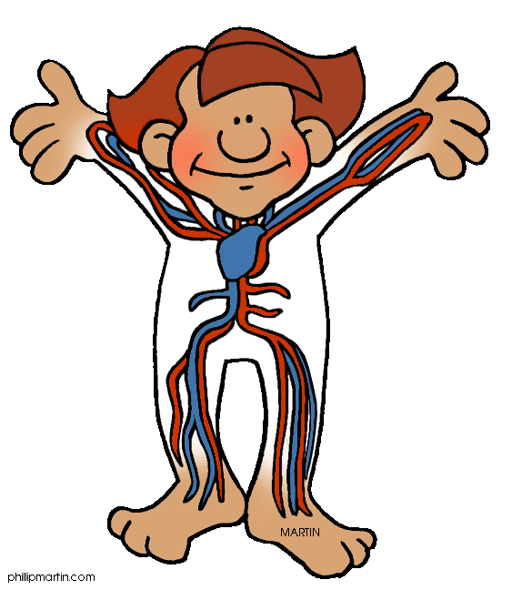
Children use their whole bodies for writing. To be able to write, all the muscles, pivots, body control and movement must be well established.
We have tiny pivots at the ends of our fingers, knuckles, elbows and shoulders. These provide a huge range of motion from the ability to pick up tiny objects to powerful throwing actions.
Our palms help us to grasp, hold and control a range of tools for a variety of uses.
Our brain and senses are constantly working to help us to process all the information we are bombarded with.. This helps us to balance, judge distance, move appropriately in the space that we have (proprioception)
Our feet are flat on the floor to help us balance while we use a range of motion on our upper body

Slide 4
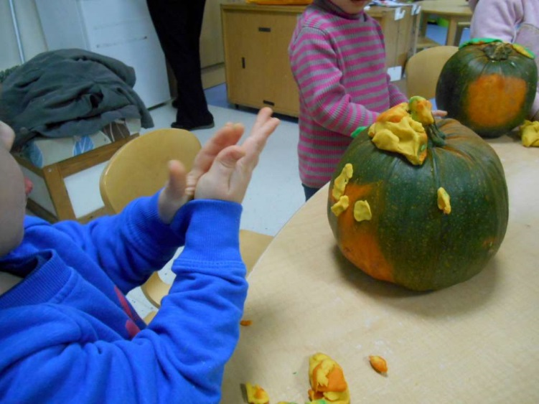
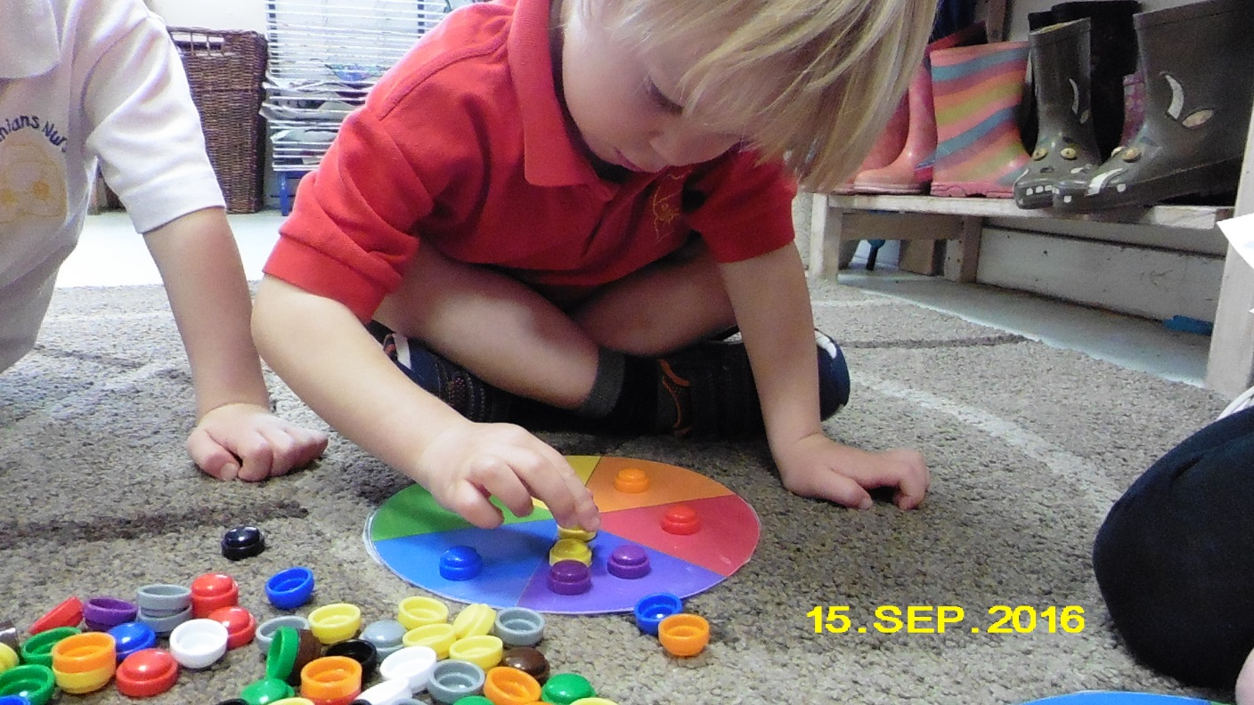
“Humans are not born writers. The physical ability to write requires great dexterity and muscle control, which in turn takes practice”
Alistair Clegg-Bryce

Slide 5
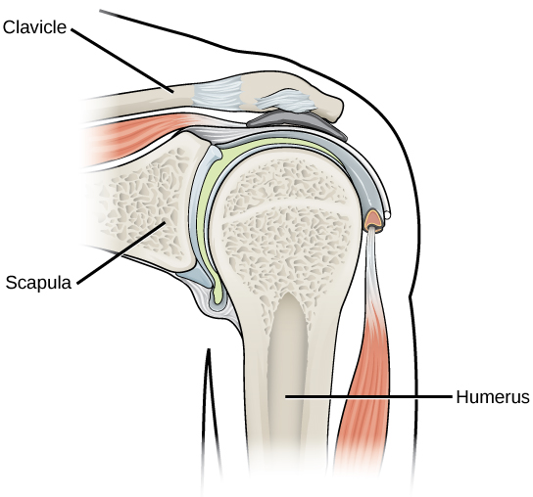
SHOULDER PIVOT
Children will have developed a grasp which will allow them to hold an object tightly without letting go. This is called a palmar supinate grasp. (palmar meaning use of the palm, supinate meaning turning the palm upwards and grasp meaning grip)
The muscles of the back, chest and neck are the first to become well developed.
They have the most strength and therefore are the main muscles which help small hands to make their first emergent marks, with most of the movement coming from the shoulder. They will have a stiff wrist and a straight elbow.
Children will make big marks which will either be long and straight or large and circular as their ability to make marks will be restricted to the strongest muscle group.
Notes:
palmar= use of the palm
supinate= turning the palm upwards
grasp=grip

Slide 6
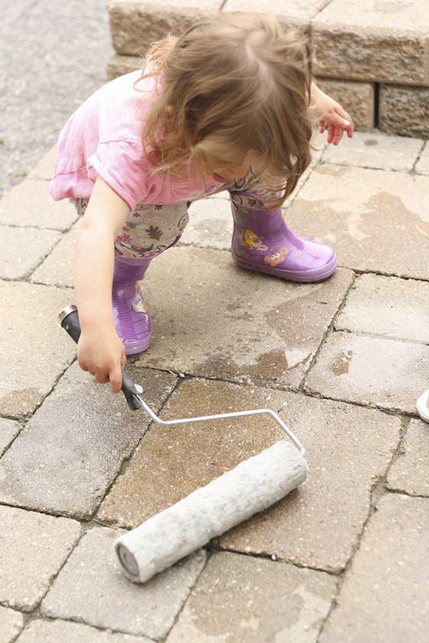
How to support the development of the shoulder pivots
Space to make large movements
Large boards at their height, walls, paper on fences, Perspex, shower curtains.
Opportunities to work in collaboration with other
Washing walls with soap and brushes
Painting with mops
Foam bike tracks big digging in sand and soil.
UPSIDE DOWN MARKING
This uses the same upper body movement as if the child was standing ion front of a board.
UPPER BODY WORK OUT
Plan for activities which involve the use of the shoulder pivot on horizontal and vertical surfaces. Children should be reaching, stretching, using the full circular motion of their shoulder joint.

Slide 7
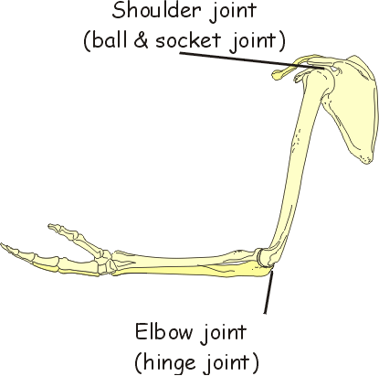
ELBOW PIVOT
Once the shoulder pivot is established, movement begins to travel down the arm to the next pivot, the elbow.
The elbows start to do more of the work and the shoulder takes a back seat.
Stage 1: Emergent
  The elbow bends allowing for greater range of movement, the shoulder is the dominant force to move the arm backwards and forwards.
Stage 2: Proficient
  Muscles of the upper and lower arm are used to swing their arm in and out from their body in a semi circular action, increasing the range of movement.
The wrist stays stiff and the grip is still palmar supinate.
Notes:
Stage 1 sawing motion
Stage 2

Slide 8
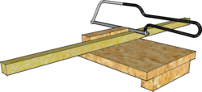
How to support the development of the elbow pivots
Children will need lots of space, indoor and outdoor, to move their arms up and own and side to side.
Use large brushes and rollers to develop the elbow pivot and continue to strengthen the shoulder pivot and balance.
Sawing wood, blackboard areas and large pieces of lining paper or flip chart support the development of the elbow pivot.
For a more secure elbow pivot, the development of the circular push and pull movement is important. Activities such as drawing circles on large paper, using lollipop sticks and sand in a tuff tray, ribbon/scarf twirling, throwing and catching using the elbows to push the hand forwards and sawing wood support this type of movement.

Slide 9
WRIST PIVOT
When the arm muscles and the childs sense of balance continues to develop, the pivot changes, allowing an even finer range of movements. The pivot now moves to the wrist.
When this happens, the lower arms, upper arms and the shoulders are now well developed. The childs overall movement and balance is more coordinated and less jerky.
With the wrist pivot, the childs grasp changes and they bend their wrist nearly 45 degrees, grip their mark making tool with three fingers and use their first finger to manipulate the end of their pencil.
This allows the child a more defined in a small scale range of movements alongside the larger elbow and shoulder movements and it is an indication that fine motor skills are developing.
Experiences which will support the next stage of development and grip are crucial as it is the palm grip which could possibly hinder the childs access to finer movements at this stage

Slide 10
How to support the development of the wrist pivots
Experiences which will encourage the whole range of wrist movement.
Using smaller resources which encourage finer movements
Thin strips of paper to encourage finer movements. This will encourage finer mark marking before the bigger pivots kick in.
Threading or weaving
Dabbing with sponges
Splatter painting
Finger gym activities

Slide 11
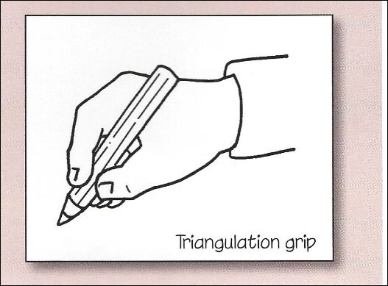
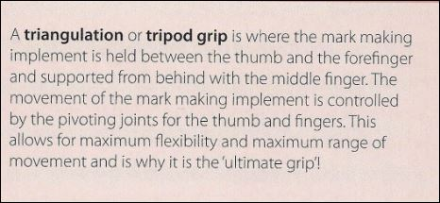
GRIP
Finally, we reach the last part of developing muscles and pivots so children can use that mark making tool with the last and smallest set of pivots.
Ours hands are made up of different joints and muscles groups which are all interconnected and work collaboratively to provide maximum dexterity.
We want to encourage children to use a tripod grasp when drawing, mark making and writing.

Slide 12
FORMING LETTERS
“When a child is beginning to form recognisable letters and linking those letter sounds to shapes, they are entering a crucial phase. Not only in their phonic development, but also in laying the ground rules for how those shapes are best formed and how their pencil is best held to give them a style of writing that will aid speed, comfort and flexibility as their writing develops.”
Alistair Bryce Clegg, p.22.

Slide 13
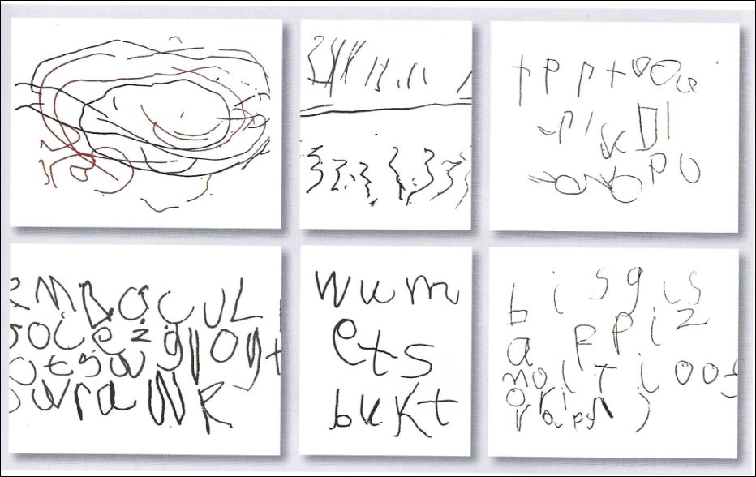
LETTER FORMATION
Most of the patterns children will eventually use in their hand writing will be related to 2d shapes so the more practise they have drawing circles, squares, semi circles, lines, zigzags the better. This freedom to explore shape through drawings and mark making is crucial. If this is not developed then children are not yet ready to write.
Take each pattern and use gross motor movements ( remember your pivots!) and teach the children how to form the shape in the air or by mark making.
When children come to write they have to think about a few things and internally talk themselves through it:-
  Where the pencil needs to go
  Which direction it needs to move first
  If they have rehearsed that process over and over and over again, they will not have to stop and think about what goes where as they will be well practiced.
Page 23: writing opportunities for children

Slide 14


What not to do!
Under/over writing or purchasing manufactured books which encourage this.
What to do
Give your child space and opportunities to practice using their pivots
Use materials that move, stretch, resist.
Give false praise
Link to your children's interests… find that hook!
Ask children to have a go and copy your writing
Make sure your mark making area (paper, board etc) is appropriate
Provide activities that are all show and no substance
Activities should be gross and fine motor movement based.
Relax!! Don’t stress if your child is not writing by the time they start P1, keep mark making and drawing

