Slide 1
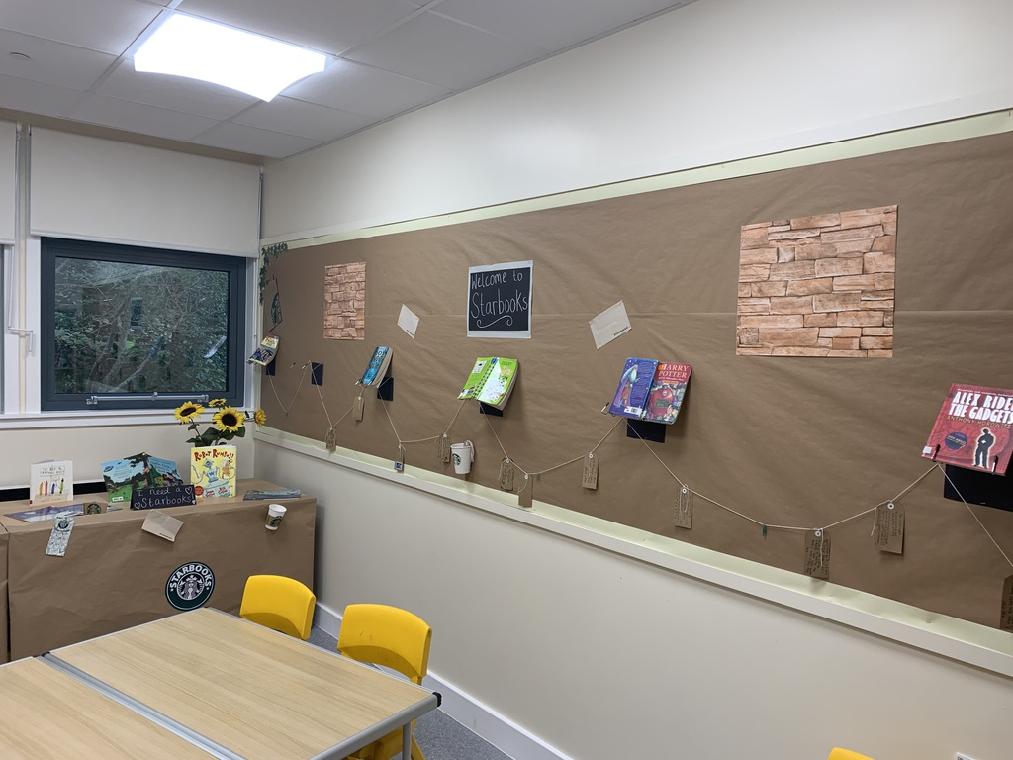
Introducing Strathyre Starbooks!

Slide 2
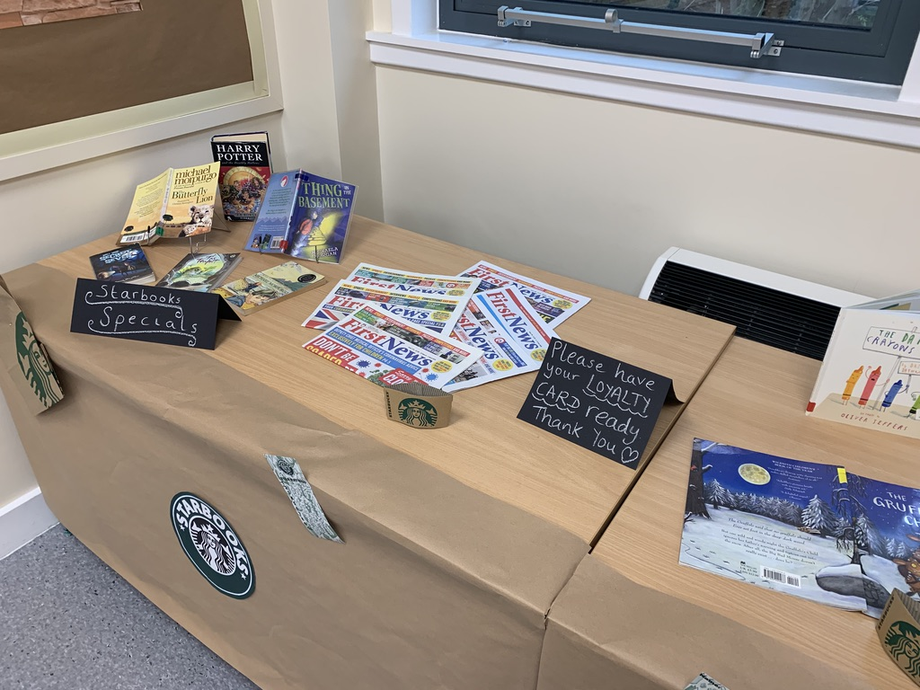
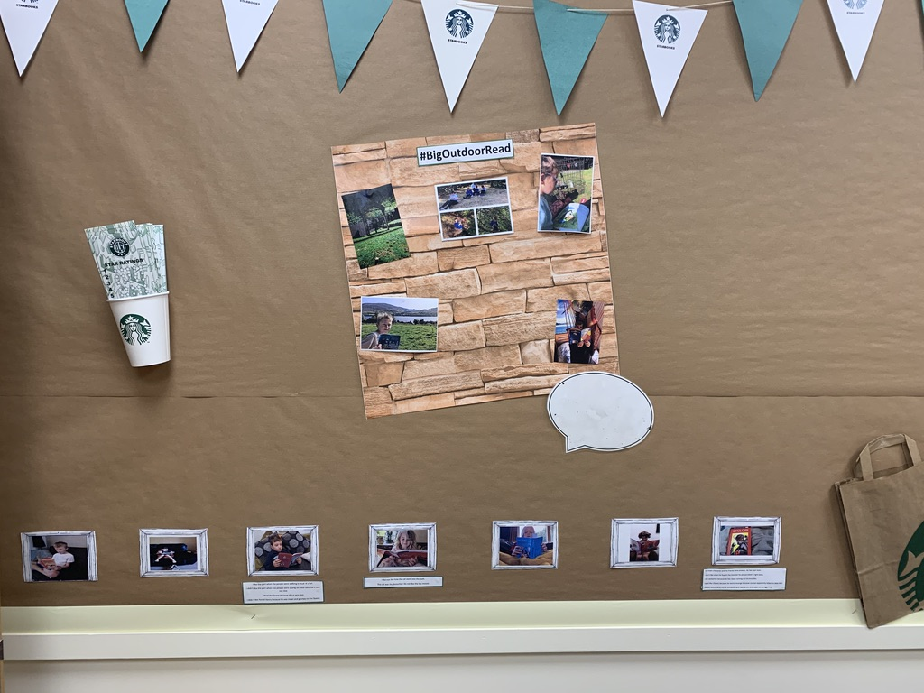

Slide 3
Mario
Luigi
Book Image & Link here
Riley
Kyle

