Slide 1
Circular Economy
What is it?

Slide 2
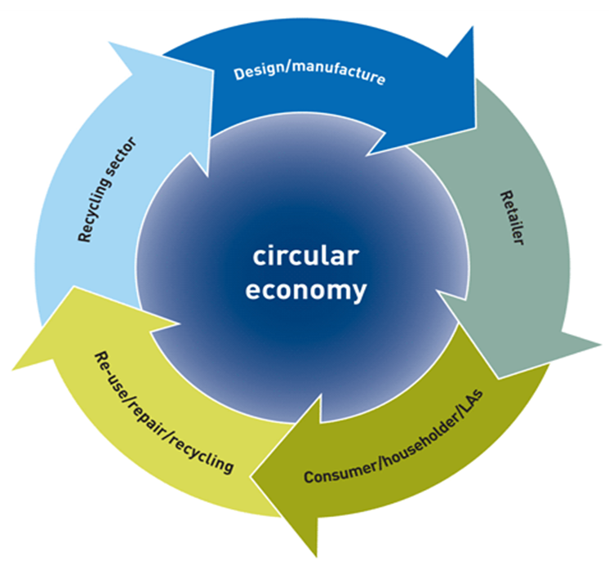
What is a ‘Circular Economy’
A circular economy is an alternative to a traditional linear economy (make, use, dispose) in which we keep resources in use for as long as possible, extract the maximum value from them whilst in use, then recover and regenerate products and materials at the end of each service life.

Slide 3
Why is circular economy important?
As well as creating new opportunities for growth, a more circular economy will:
reduce waste
drive greater resource productivity
deliver a more competitive UK economy.
position the UK to better address emerging resource security/scarcity issues in the future.
help reduce the environmental impacts of our production and consumption in both the UK and abroad.
https://youtu.be/zCRKvDyyHmI

Slide 4
How does CE link with LfS?
Circular Economy is based on preserving the value in resources
The goal is to keep materials functioning at their highest utility at all time, preventing would-be waste from reaching landfills
Social Responsibility
Sustainable Energy
Problem Solving
Responsible use of our planets resources
Waste Reduction
Systems Thinking

Slide 5

So how can I use this as a vehicle to approach LfS?
What ideas are there out there?

Slide 6

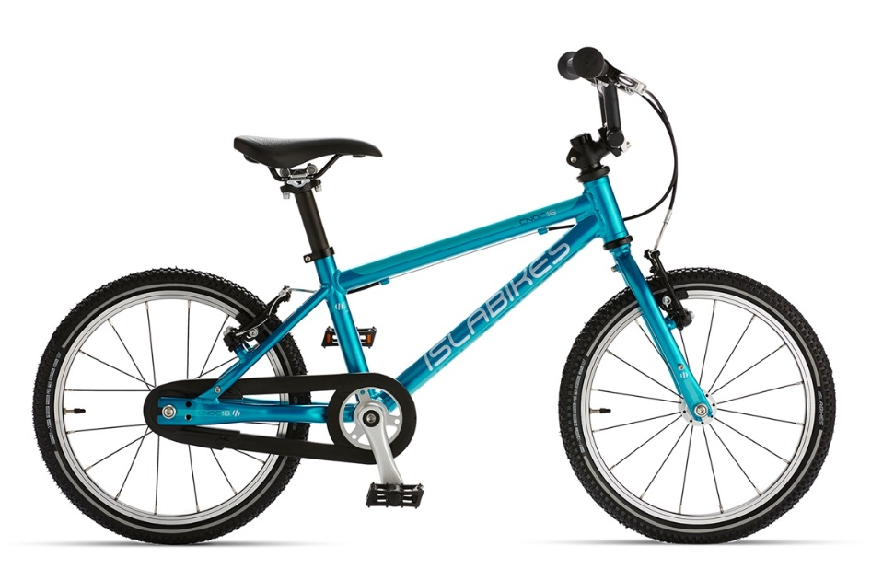
CE Examples…..
Speedo create their Eco Powerflex swimming suits from left over waste destined for land fill sites. The waste is remanufactured into nylon.
Isla Bikes promote a rental scheme, where bikes are leased until they become too small. Isla Bikes then refurbish and re-lease to others, reducing land fill waste and use of expensive vital resources.

Slide 7



Scotland - One of the worlds top CE Nations…..
CelluComp in Burntisland, Fife have developed industrial paint out of left over root vegetable waste.
Ogilvy Spirits of Forfar turn low grade potatoes which cannot be sold to supermarkets into premium quality vodka.
Jaw Brew in Glasgow are working in partnership with Aulds Bakers to create low alcohol beer out of left over morning rolls.

Slide 8
Teaching Links and Ideas

Slide 9
Lots of CE Resource Ideas and Links can be found at https://blogs.glowscotland.org.uk/st/stirlinglfs/resources

