Slide 1

Planning for progression in the Technologies
This is a professional learning resources that can be used at a local authority,
cluster and/or school level

Slide 2
Before you start
What should we have done before we use this resource?
Reading
  Principles and practice document for Technologies
  Experiences and Outcomes for the Technologies
  Assessing progress and achievement in the Technologies
  HGIOS4
Planning
  Have you used the Planning for assessment in the Technologies professional learning resources
  Who will be taking part in this work – LA – Cluster – school only?
  All SALs should be covered within a level – but not necessarily every year.

Slide 3
Do you know what learning has taken place before and after the learning you have planned?
Do you have the practitioners around the table that will be able to share this information with you?
If not, how can you get the right people around the table?
Are you using the same planning format? An example is shown on the next slide
Do you need to use the same format?

Slide 4
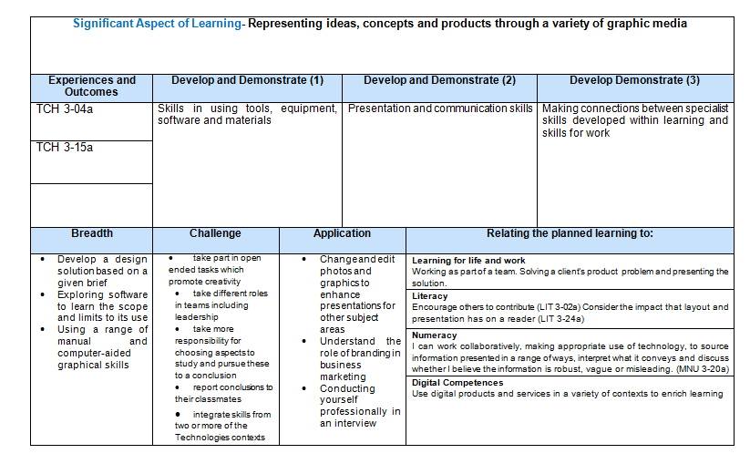
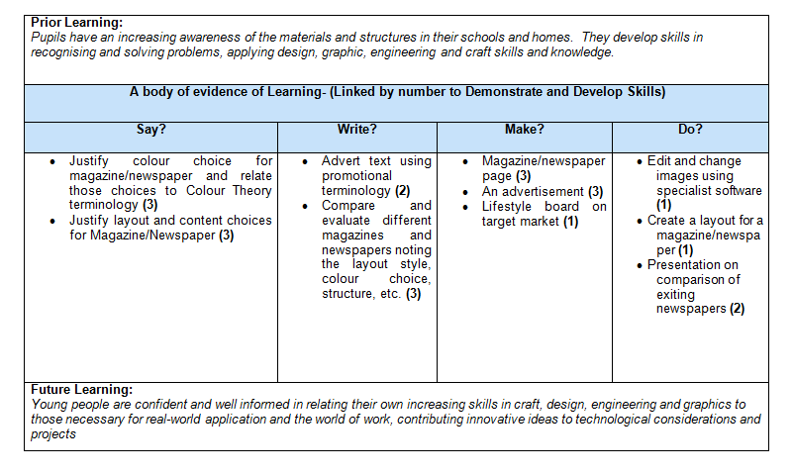
Planning example
For more examples contact the Technologies team at Education Scotland or click here for LA examples
Blank document

Slide 5
Do you know what evidence is being gathered to assess progress and achievement in the technology SALs?
Is evidenced being gathered to assess progress and achievement in all the Technologies SALs ?
Is it being gathered at all levels – early to fourth?
How is this evidence being shared?

Slide 6
What does holistic best fit assessment look like in the Technologies?
Can you identify best fit holistic assessment across all levels in the technologies SALs?
Can you identify what this would look like in the classroom? An example is on the next slide

Slide 7
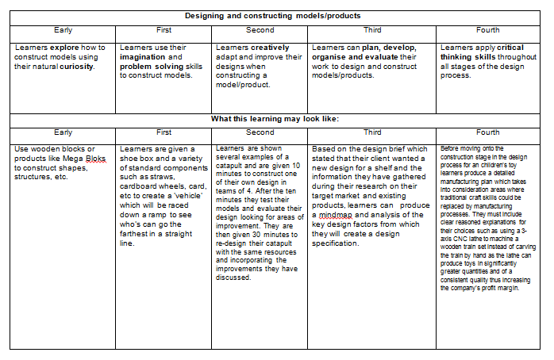
Progression framework example
For more examples contact the Technologies team at Education Scotland or click here fore LA examples
Blank document

