Slide 2
Nat 5 Plans
August – October:
Scottish Text
Folio 1 –
Due WB 21st Sept.
Texts
Scottish Text: Jackie Kay poetry
Critical Essay:
Ray Bradbury’s The Pedestrian

Slide 3
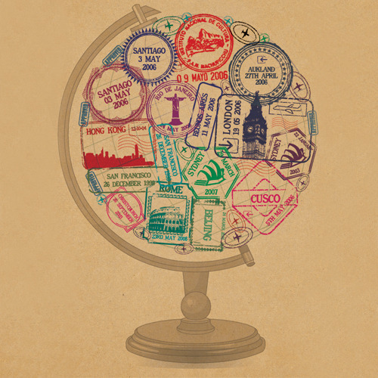
‘Gap Year’ by Jackie Kay

Slide 4
‘Gap Year’
What is it about?
Written in the voice of the poet and dedicated to her son, Matthew.
Describes his travels abroad and leads to reflections on her feelings about his childhood and newfound independence.
The poem explores themes of motherhood, closeness and distance, and the passage of time.

Slide 5
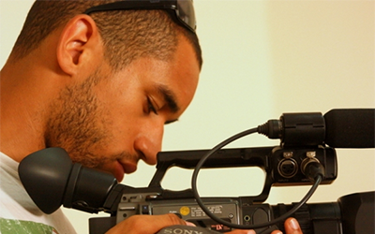
Matthew
Born in 1988.
Father is the writer Fred D’Aguiar.
He studied at the University of Guadalajara in Mexico.
Is now a film maker in London.

Slide 6
The Title
A gap year is usually a year taken off between finishing school and going to University or college.
Gap: a space or interval; a break in continuity.
literally a physical gap between mother and son.
Year: the period of 365 days.
suggests that the 18 years have felt like no time at all to his mother.

Slide 7
Form: Poem of Address
A poem which speaks to (or addresses) a particular person who is usually not the reader.
In ‘Gap Year’, Kay addresses her 18 year old son Matthew.
Which other poem that we have studied is an address poem?

Slide 8
‘Gap Year’ Stanza Overview
Written in 2 defined sections.
Section I:
describes her memories of the weeks before he was born
excited anticipation, the difficult birth
Section II:
describes the progress of his travels and her mixed feelings about his departure.
caught up in the romance and adventure of his travels in exotic places but misses him greatly.
his grandfather’s blunt advice reminds her of the very real dangers he might encounter.
disappointed when she discovers his plans change.
final stanzas: her mood changes to one of elation and pride when she looks at photos of her son ‘on top of the world’.

Slide 9
First Impressions on ‘Gap Year’
In pairs, discuss these questions:
What are your initial thoughts on the poem?
What language techniques does the writer use?
What is she trying to say by using these techniques?

Slide 10
Gap Year
Think about your relationship with your own parents.
How has it changed from when you were a small child until now?

Slide 11
The Important Bits
As we go over the poem, pay attention to:
the many parallels and connections between past and present – Matthew’s childhood and adulthood.
how the poem both celebrates and laments his independence.
the contrast between the speaker at home, and the son exploring and investigating.
how the Section II allows the reader to track his adventures as the speaker does.

Slide 12
Dual Structure Vocabulary
Parallels: similarities between people, things or situations.
Contrast: when oppositions between two things are highlighted to show their differences.
Connections: links between ideas.

Slide 13
I
I remember your Moses basket before you were born.
I’d stare at the fleecy white sheet for days, weeks,
willing you to arrive, hardly able to believe
I would ever have a real baby to put in the basket.
I’d feel the mound of my tight tub of a stomach,
and you moving there, foot against my heart,
elbow in my ribcage, turning, burping, awake, asleep.
One time I imagined I felt you laugh.
basket: framing device (repeated at the end)
M is absent
repeated:
shows intensity of longing
K: yearning/waiting
imagination – envisioning a baby
metaphor: image of a container vs. how M cannot be contained
alliteration mimics tightness
closeness – source of both joy and pain (mixed emotions)
list of baby’s actions – continuous and present vs. later absence.
synaesthesia – shows the closeness of his experiences and hers

Slide 14
Synaesthesia
Generally refers to a medical condition in which one of the five senses simultaneously stimulates another sense.
eg: a person with such condition may not only see alphabets but also associate them with particular scents.
In literature, synesthesia is a figurative use of words that intends to draw out a response from readers stimulating multiple senses.

Slide 15
peaceful
I’d play you Handel’s Water Music or Emma Kirkby
singing Pergolesi. I’d talk to you, my close stranger,
call you Tumshie, ask when you were coming to meet me.
You arrived late, the very hot summer of eighty-eight.
You had passed the due date string of eights,
and were pulled out with forceps, blue, floury,
on the fourteenth of August on Sunday afternoon.
I took you home on Monday and lay you in your basket.
oxymoron: physically close, but unknown (inverted at end of poem)
colloquial nickname - unknown
rhyme emphasises due date missed
rhyme repeated
unwilling to leave – compared to how he doesn’t want to come home
basket now full- circular structure
start of week – new beginning; end of first section of poem

Slide 16
like a parent checking on a child sleeping
repeated: echoes longing for basket to be filled
II
Now, I peek in your room and stare at your bed
hardly able to imagine you back in there sleeping,
Your handsome face – soft, open. Now you are eighteen,
six foot two, away, away in Costa Rica, Peru, Bolivia.
I follow your trails on my Times Atlas:
from the Caribbean side of Costa Rica to the Pacific,
the baby turtles to the massive leatherbacks.
Then on to Lima, to Cuzco. Your grandfather
links back, but now she finds it hard to imagine him there
South America: exotic; distant; exploration/adventure
affectionate description
repetition emphasises distance
role reversal – mother following child
British - contrast
reminds us of growing up
range and scale of his travels
enjambment: interrupts her romanisation of his travels

Slide 17
worry of grandfather – reminds her of the danger he could be in
rings: ‘Have you considered altitude sickness,
Christ, he’s sixteen thousand feet above sea level.’
Then to the lost city of the Incas, Macchu Picchu,
Where you take a photograph of yourself with the statue
of the original Tupac. You are wearing a Peruvian hat.
Yesterday in Puno before catching the bus for Copacabana,
you suddenly appear on a webcam and blow me a kiss,
you have a new haircut; your face is grainy, blurry.
discovering of new worlds like a conquistador
constantly moving – like as a child, but now there is distance
intended humour
change of culture – exploring new things
fleeting
contrast to face description earlier – increasing distance

Slide 18
webcam and parental scan compared
Seeing you, shy, smiling, on the webcam reminds me
of the second scan at twenty weeks, how at that fuzzy
moment back then, you were lying cross-legged with
an index finger resting sophisticatedly on one cheek.
You started the Inca trail in Arctic conditions
and ended up in subtropical. Now you plan the Amazon
in Bolivia. Your grandfather rings again to say
‘There’s three warring factions in Bolivia, warn him
comparison of past/present
distance in both situations
travels continue the image of him as an explorer
grandfather is the voice of caution and worry compared to his carefree plans
enjambment – jarring of warnings into her visions of him as an explorer

Slide 19
against it. He canny see everything. Tell him to come home.’
But you say all the travellers you meet rave about Bolivia. You want
to see the Salar de Uyuni,
the world’s largest salt-flats, the Amazonian rainforest.
And now you are not coming home till four weeks after
your due date. After Bolivia, you plan to stay
with a friend’s Auntie in Argentina.
Then – to Chile where you’ll stay with friends of Diane’s.
range of places travelled
mirrors being 4 weeks overdue
birth language
dash: she is struggling to keep up with his ever-changing plans

Slide 20
unsure; fluid shows how it can change
And maybe work for the Victor Jara Foundation.
I feel like a home-alone mother; all the lights
have gone out in the hall, and now I am
wearing your large black slippers, flip-flopping
into your empty bedroom, trying to imagine you
in your bed. I stare at the photos you send by messenger:
you on the top of the world, arms outstretched, eager.
Blue sky, white snow; you by Lake Tararhua, beaming.
pun on ‘home alone’ (usually a child) – role reversal
M as a source of light; darkness in his absence
onomatopoeia: pathetic, sad and lacking energy
enjambment shows her movements back and fourth
‘willing’ like at the start
like the empty cot
metaphor
like the blanket
continues symbolism at M as a source of light in her life
she longs for him to come home like she wanted the baby to be born

Slide 21
simile: shows joy and pride
with him through her love
My heart soars like the birds in your bright blue skies.
My love glows like the sunrise over the lost city.
I sing along to Ella Fitzgerald, A tisket A tasket.
I have a son out in the big wide world.
A flip and a skip ago, you were dreaming in your basket.
simile: reinforces idea of M as light
sad, blues songs: longing and sadness
children’s rhyme
proud statement – of both him and herself
long vowel sounds mirror how she thinks love can transcend great distances
tiny movements – feels that he has grown up too quickly
his dreams of travelling contrasted with hers of his return
frame ‘protecting’ poem in the same way she wants to contain/protect him

Slide 22
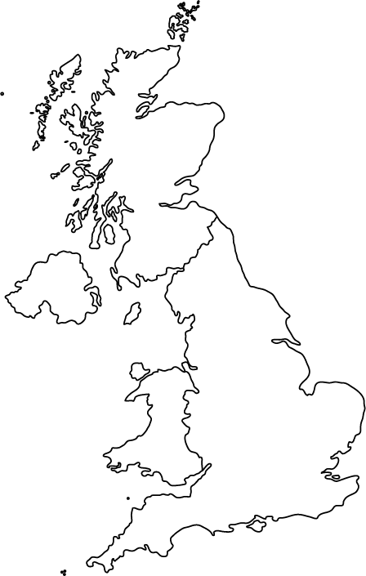
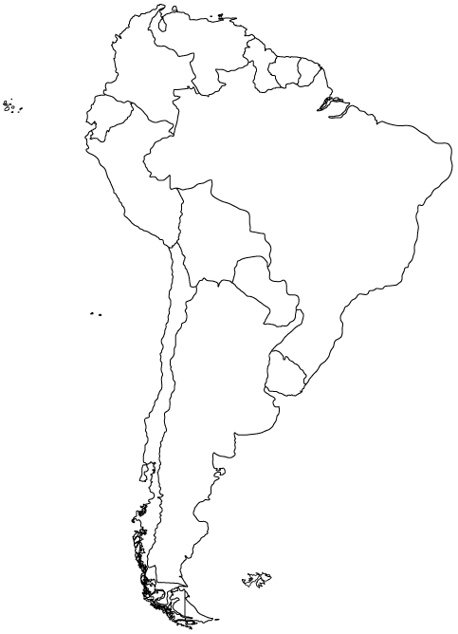
Home and Away
Learning objective: To explore the dual structure of ‘Gap Year’
In your pairs:
Identify the language used to describe ‘home’ (including Matthew’s birth) and ‘away’ (Matthew’s trip to South America).
Write the evidence you collect on individual post it notes and stick to the appropriate map.
Connect the ideas that seem to you paralleled or contrasted. Use a different colour for each.

Slide 23
Gap Year: Homework
1. Summarise the main points in lines 1-16. (4 marks)
2. How is a sense of longing established in lines 17-20? (4 marks)
3. By referring to ONE example, show how the writer uses language to emphasise her feelings of loss during her son’s gap year. (2 marks)
4. The last two stanzas signal a further mood change. Comment on the effectiveness of the language the poet uses to convey her feelings.(2 marks)
5. Kay often uses her poetry to explore relationships. Using one other poem show how she manages to do this effectively in her poems. (8 marks)

Slide 24
Word Choice Questions
One feature of language you could be asked about (for Scottish texts OR close reading!) is word choice. If asked about word choice you should:
Quote the word from the passage
Give its connotations (what the word suggests)
Explain why it has been used by the writer – try and be specific

Slide 25
Task One: Copy down the definitions and examples.
Denotation | The meaning of a word or image
Connotation | What is implied by the word or image
Denotation – dove/bird
Connotation - peace
Denotation – heart
Connotation – love/romance

Slide 26
Task Two: Read the statements and identify the effective piece of word choice
The boy was interrogated about his actions by his parents.
‘interrogated’ - This suggests the parents asked the boy lots of questions, possibly to catch him out.
We have been bombarded with numerous images.
‘bombarded’ - This suggests that there have been a lot of images, overwhelming.

Slide 27
Task Three: Select two quotes from the poem ‘Gap Year’ and explain why these are effective example of word choice following the three steps (full sentences).
Example: ‘I remember your Moses basket before you were born’. The word choice of ‘remember’ shows us she is reminiscing positively about her memories of the past and how she waited in anticipation for Matthew’s birth.
willing you to arrive, hardly able to believe
I’d feel the mound of my tight tub of a stomach
Now, I peek in your room and stare at your bed
Your handsome face – soft, open..
I feel like a home-alone mother
your empty bedroom, trying to imagine you in your bed
My love glows like the sunrise over the lost city

