Slide 1
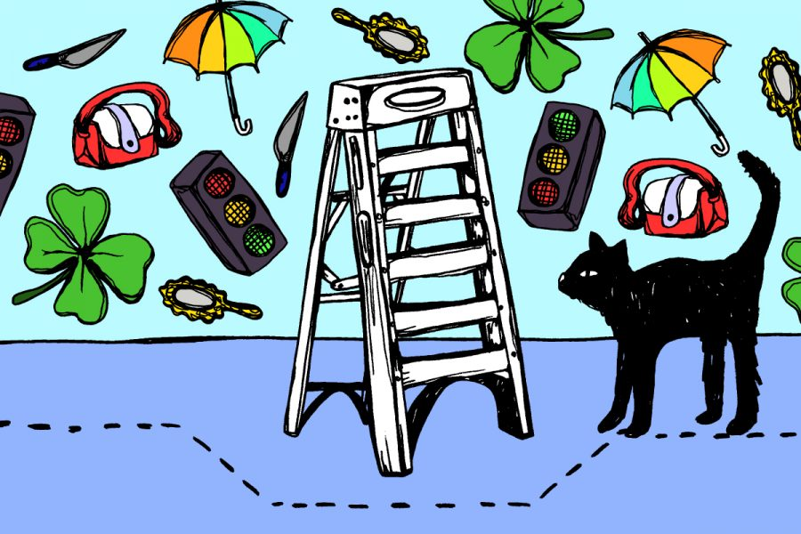
Superstitious Place

Slide 2
Superstitious Place
30 YEARS

Slide 3
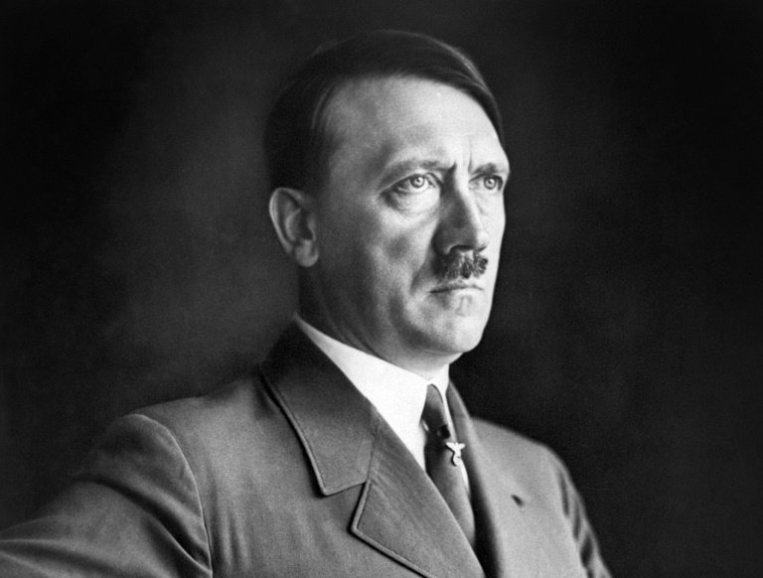
Not Popular

Slide 4
Shillings, Shillings, Shillings,
Shillings, Shillings, Shillings,
!0
Shillings, Shillings, Shillings,
10 SHILLINGS!

Slide 5
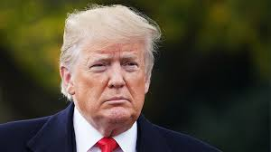
Better than everyone else

Slide 6
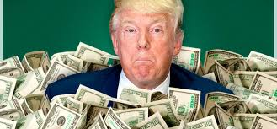
Saving and Scrimping

Slide 7
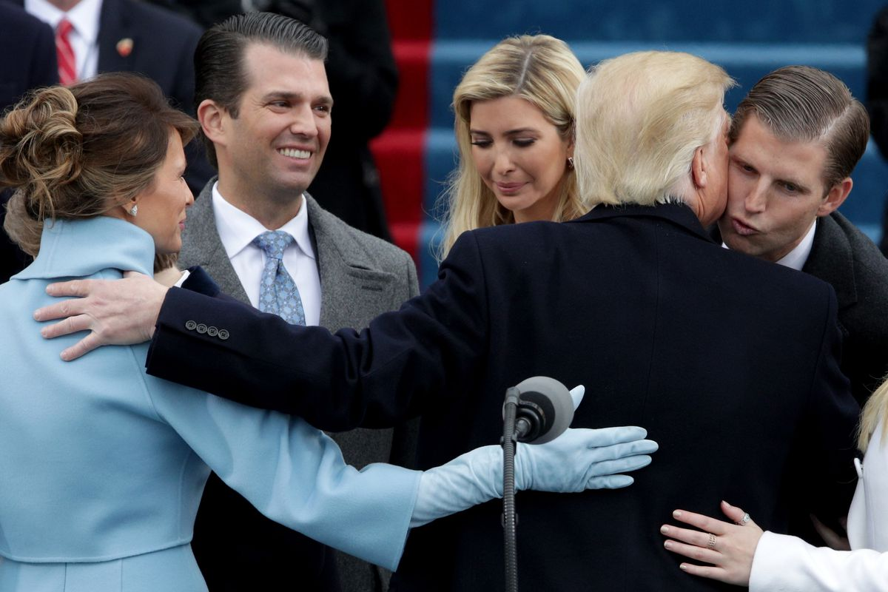
felt the arm of the thin woman around her shoulders

Slide 8
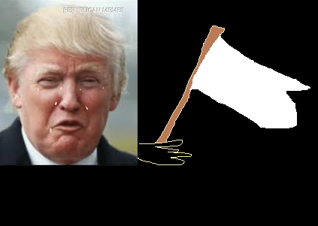
‘wasn’t going to cry or surrender’

Slide 9
‘the drowning of his own son’

