Slide 1
Read Write Inc. Phonics
Parents’ Meeting
“The greatest gift is a passion for reading”
Elizabeth Hardwick
Notes:
The aim of this morning is to give you an introduction to Read write inc, how it works and how your children are being taught and also give you ideas as to how best to support your child at home. Once we are finished here the hall you will then go along to the classrooms and see the children in action.

Slide 2
Aims of Today
To demonstrate how to support your child at home with Literacy and Numeracy.
To explain how we teach Literacy and Numeracy at Dunblane Primary School.
To explain how we are using play to enhance learning.

Slide 3
Teach a child to read
and keep that child reading [and talking]
and we will change everything.
And I mean everything.
Jeanette Winterson

Slide 4
What is Read Write Inc. Phonics?
Notes:
Read question.

Slide 5

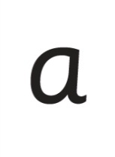

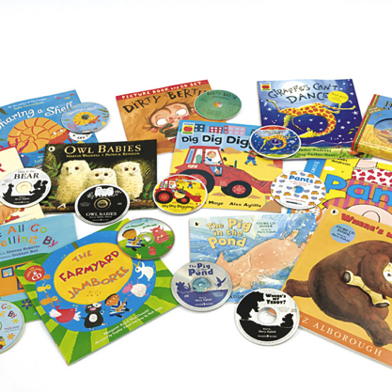




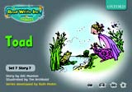
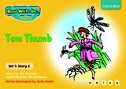
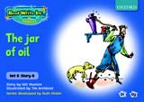
Systematic approach
sat
mat
p
d
sad
i
t
n
Notes:
Read Write Inc. Phonics is a programme that uses systematic phonics to teach all children to read.
Click – We teach the sounds first – in a specific order. (First – m a s d t )
Click – We then teach your children to blend those sounds together in order to read words
Click – The children read words in the matched Storybooks. Each Storybook is carefully matched to the sounds they can already read - setting them up for success.
Click – We read to children ‘real’ books’. Once they have learnt to read, they will be able to independently read these books for themselves.

Slide 6
English alphabetic code
26 letters
44 sounds
Over 150+ graphemes
One of the most complex alphabetic codes in the world.
Notes:
The English language is very complex.
Phonics is the method of teaching reading through the identification of sounds and graphemes.
In English we have more than 150 ways to represent 44 sounds, using the 26 letters in the alphabet.
This means we have to group letters together to write some sounds.
This makes our language one of the most complex in the world!

Slide 7
How does Read Write Inc. use phonics to teach reading?
Notes:
Read question.

Slide 8
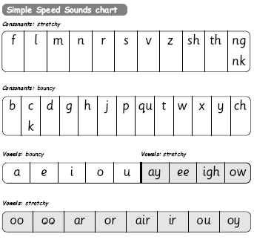
Simple Speed Sounds
Notes:
Phonics makes learning to read easy for children because we start by teaching them just one way of reading and writing every sound. Here they are on the Simple Speed Sounds chart.
We teach Set 1 sounds first - (sounds as far as a e i o u) and then Set 2 (the shaded sounds ay - oy).

Slide 9
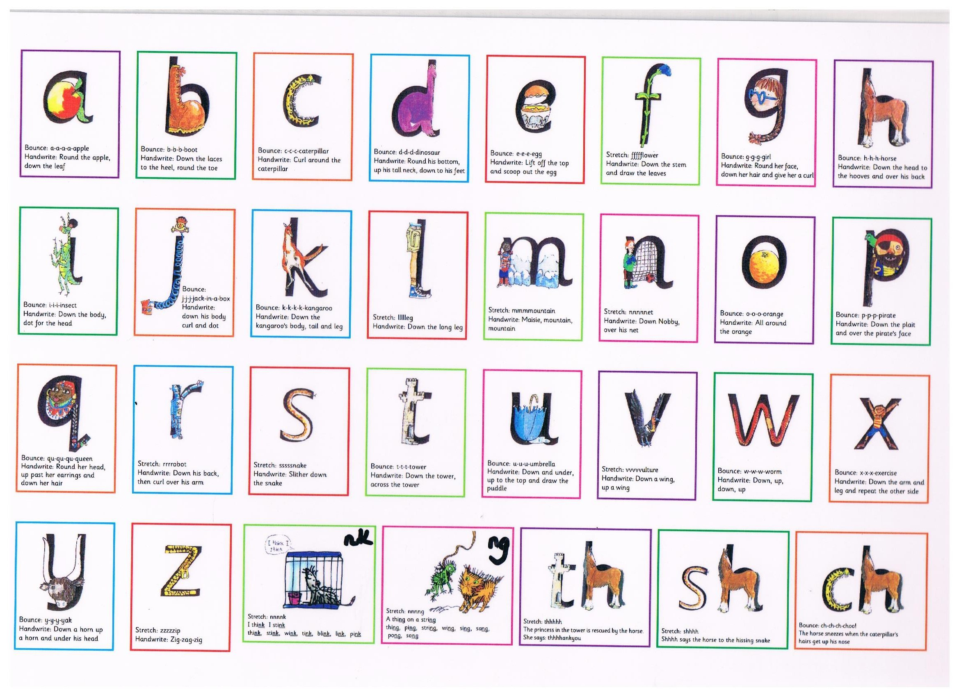
Bouncy sounds and Stretchy sounds
Notes:
The sounds are taught in two different groups bouncy sounds and stretchy sounds.
I’m going to show you quickly how this would be introduced and taught.
MT mmm YT mmm MT mmm YT mmm MT mmmmountain YT mmmmountain
Im going to draw you a picture of a little girl Maisie who lives beside two mountains
Down Maisie, mountain mountain. Look what is hiding under Maisie and the mountains, a m.
If I show you the m you say m if I show you the mountain you say mountain
Add to the pact of sounds you already know when you spot the m point to it and say m
Write the sound, airwrite first, then write on paper – down Maisie mountain, mountain
Trace, mmm, m as you finish
The same idea for the bouncy sounds but you bounce on to them d-d-d-d dinosaur
Round his bottom, up to his neck and down to his feet.

Slide 10
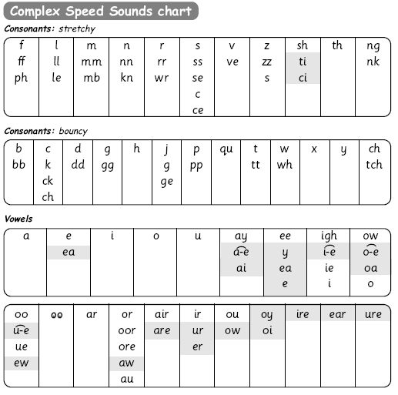
Complex Speed Sounds chart
Notes:
Once they can Fred Talk and blend sounds into words from the simple chart, we teach them Set 3 sounds on the complex chart – the other ways of reading and writing each sound so that they can soon read anything.

Slide 11
Blending using Fred Talk
p
sat
d
mat
i
t
sad
n
Notes:
Once the children know the pure sounds, we teach them to blend sounds to read words. We also teach children to spell the words they learn to read.
We use Fred Talk to help children read and spell words.

Slide 12
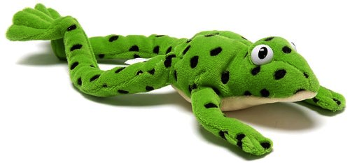
Fred Talk – Speak in sounds
Fred can only speak in sounds – we call this Fred Talk.
Fred can’t read tricky words (RED Words)
Notes:
This is Fred.
He is a frog who can only speak in sounds, and we call this Fred Talk. For example ‘m’ ‘a’ ‘t’, ‘l’ ‘u’ ‘n’ ‘ch’.
He helps children sound out words so they can read and spell.
MTYT some examples with the parents. For example ‘m’ ‘a’ ‘t’ mat, ‘s’ ‘a’ ‘t’ sat.
Fred can only read phonetic words, green words, feed Fred. Tricky words are called red words, these are colour coded in the books, you can’t Fred a red, the children know that the red words cannot be sounded out.

Slide 13
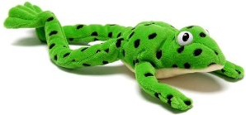
You can have fun with Fred Talk.
“What a tidy r-oo-m!”
“Where’s your c-oa-t?”
“Time for b-e-d!”
Notes:
Give a couple of examples e.g. Where is your c_oa_t? Time for b_e_d! Make sure your child can tell you what the word is.
Use only single syllable words (no Fred Talking multi-syllabic words) and only the last word in a sentence or it gets very silly! E.g. P_u_t o_n y_our b_l_ue c_oa_t (you’ll never get out!).

Slide 14
How does Read Write Inc. teach spelling?
Notes:
Read question.

Slide 15

Fred...
Fred helps children learn to spell too!
Children convert words into sounds
They press the sounds on to their fingers...
We call this Fred Fingers
Notes:
We use Fred Fingers to help children sound out words to spell easily.
It means they do not have to memorise lists of spelling words.
It is a tool so they will be able to spell any word.
Demonstrate how to use Fred Fingers.
Show how to use fingers to spell some of the words you have just blended. Use My Turn Your Turn with the parents – say “show me three fingers – the word is dog.” (or shop or wish or any 3 sound word) “Now put your sounds on your fingers!”
This is the reversibility principle of decoding for reading and encoding for writing.

Slide 16
What should my child read at home?
Notes:
Read question.

Slide 17
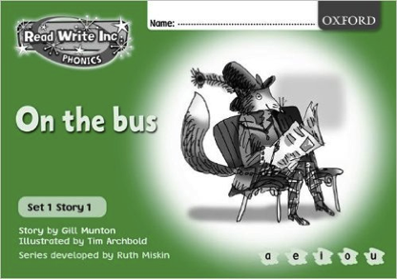
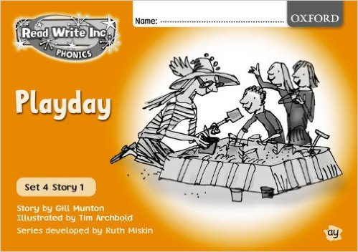
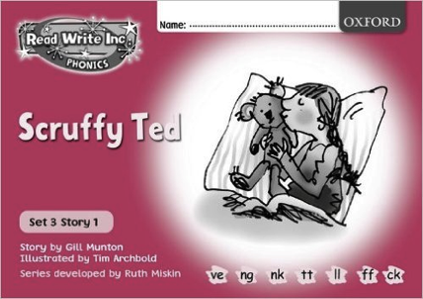
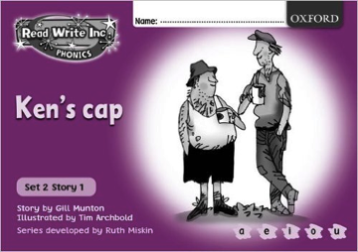

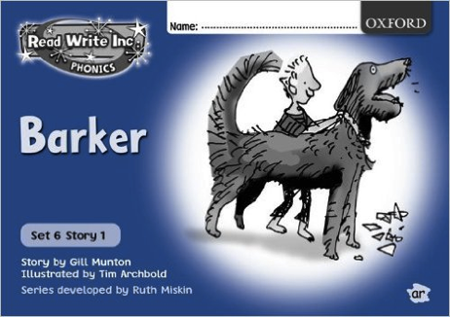
Read Write Inc. Storybooks
Notes:
Storybookswill be sent home for your children to read.
They will know all of the sounds used in the Storybook as they will bring home the book that they have already read three times in the classroom.
This means they will be able to read the text with fluency and confidence – like a storyteller. They will enjoy reading to you.
This does not mean the text is too easy for them – it means they are reading at the correct level.
We do not send texts home the children cannot read because we always want them to be set up to succeed in their reading.

Slide 18


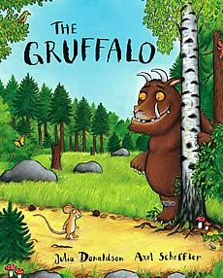
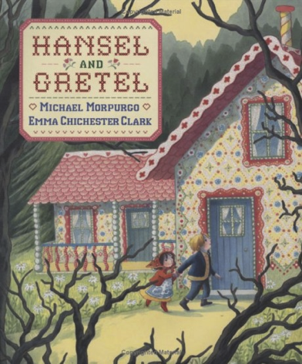
Picture books
Notes:
They will also bring home a picture book to share and enjoy with you at home.
This book has already been read to the class in school so they will care about the story and love hearing the story again and again.

Slide 19


Slide 20
How can I help at home?
Notes:
Read question.

Slide 21
Storytime
Read to your children
Ask lots of questions and share opinions
You're never too old, too wacky, too wild, to pick up a book and read to a child.
Dr Seuss
Notes:
One of the most important things you can do as a parent at home is read higher level texts to your child.
This helps develop an enjoyment for stories and the motivation for learning to read themselves.
Ask questions and share opinions about what you read to engage them in discussion, get them thinking about what they read and develop vocabulary.
Click and read.

Slide 22
Talking
Talk to your child as much as possible and ‘feed’ them new and ambitious vocabulary.
“Let’s eat our lunch now.”
“Let’s munch our lunch now.”
“Let’s scoff our lunch now.”
“Let’s devour our lunch now!”
You’re looking ... not just... but...
Notes:
Click through and read examples to parents.
Use ambitious vocabulary with your children and encourage them to use these words for themselves in both their speech and writing. Build interesting sentences with your child.
A rich vocabulary is essential for high levels of comprehension. The more words your child has in his/her head when they come to school, the quicker they will understand when they read, e.g.
“You’re looking pleased… not just pleased but delighted!” (thrilled/ecstatic/euphoric! Etc)

Slide 23
Vocabulary
Enrich conversations through description:
“Look at that rain. It looks like little diamonds sparkling on the window pane!”
Have fun with words and language.
“I’m as hot as a spud in a cooking pot!”
Praise your child for using new words or interesting phrases
Notes:
Help grow your child’s vocabulary by enriching conversations through description.
Click and read examples.
Give other examples if you want to.

Slide 24
Read Write Inc. lessons
Support how your child is learning to read and spell in school by:
Practicing the sounds
Using Fred Talk to help them blend words
Using Fred Fingers to help with spelling
Notes:
It really helps to be aware of how your child is learning in the classroom – pure sounds not letter names; Fred Talk when they are reading words and Fred Fingers when they are spelling words.
Encourage your child to discuss their Phonics lessons with you and to read and discuss their storybook with you at home.
We have shared the basics of Read Write Inc. Phonics and how you can help.
There are also some online resources that you can access for free. Click through to next slide.

Slide 25
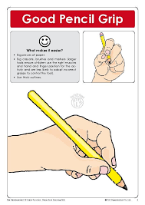
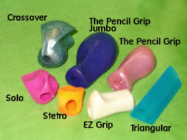
Pencil Grip

Slide 26
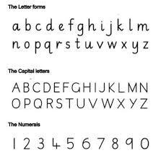

Handwriting

Slide 27
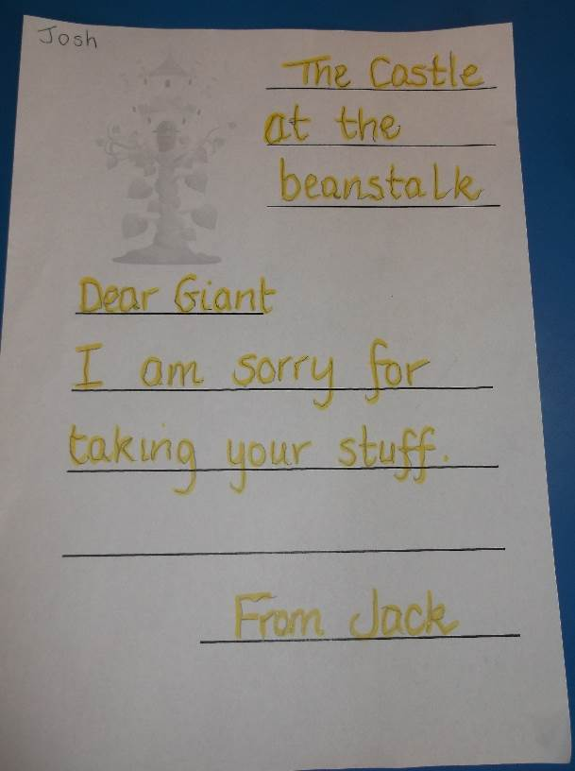
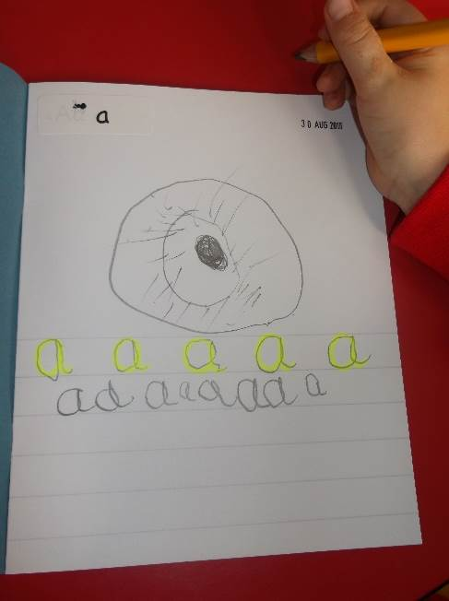
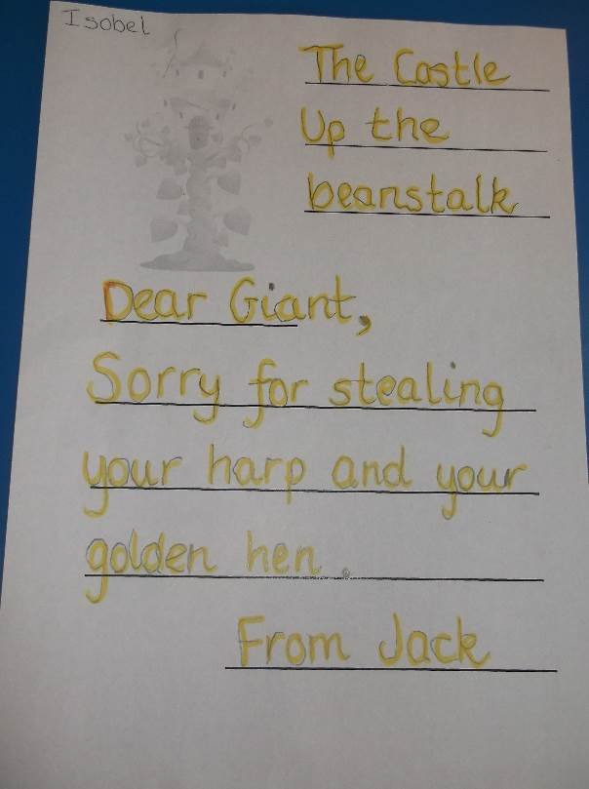
Writing
Teacher scribes a story which the child dictates. The child would draw a picture to go with this.
The child tells the teacher a story. The teacher writes with a highlighter and the pupil writes over this.

Slide 28
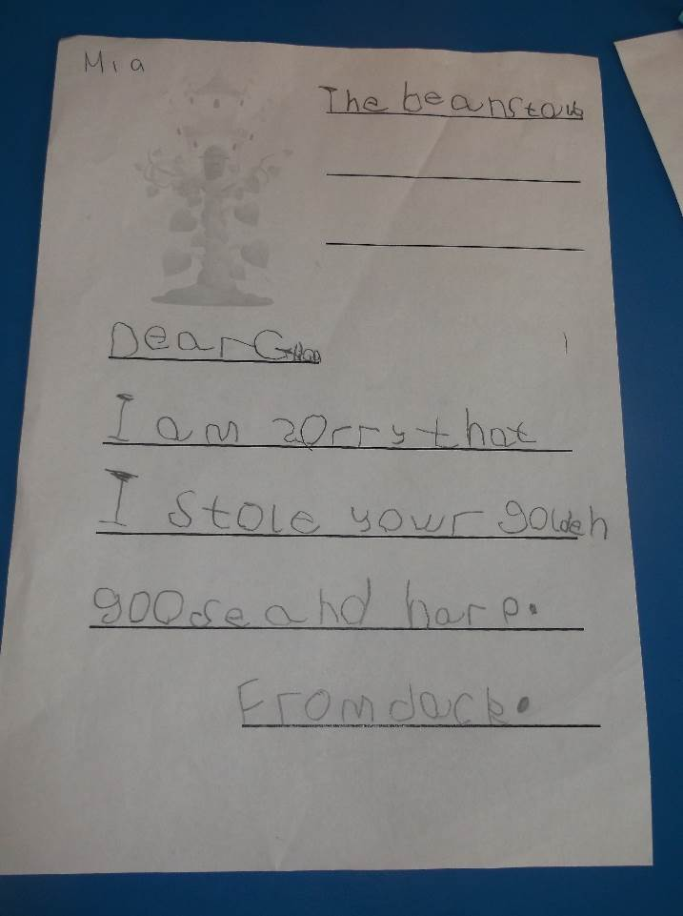
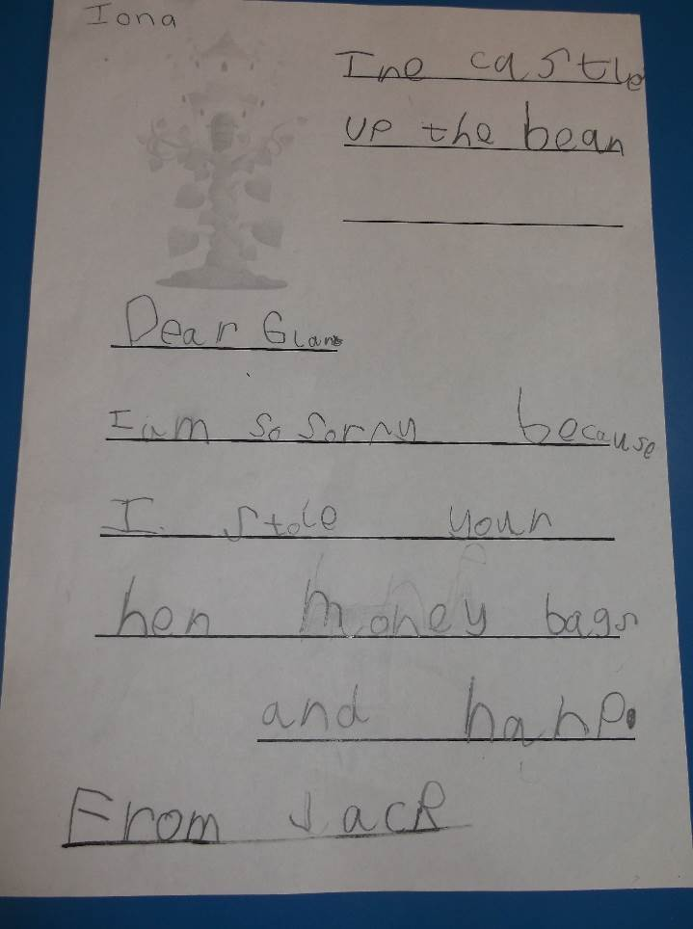
Writing
The child tells the teacher a story. The teacher writes the story, missing a line each time or on a white board. The child copies the teachers writing.

Slide 29
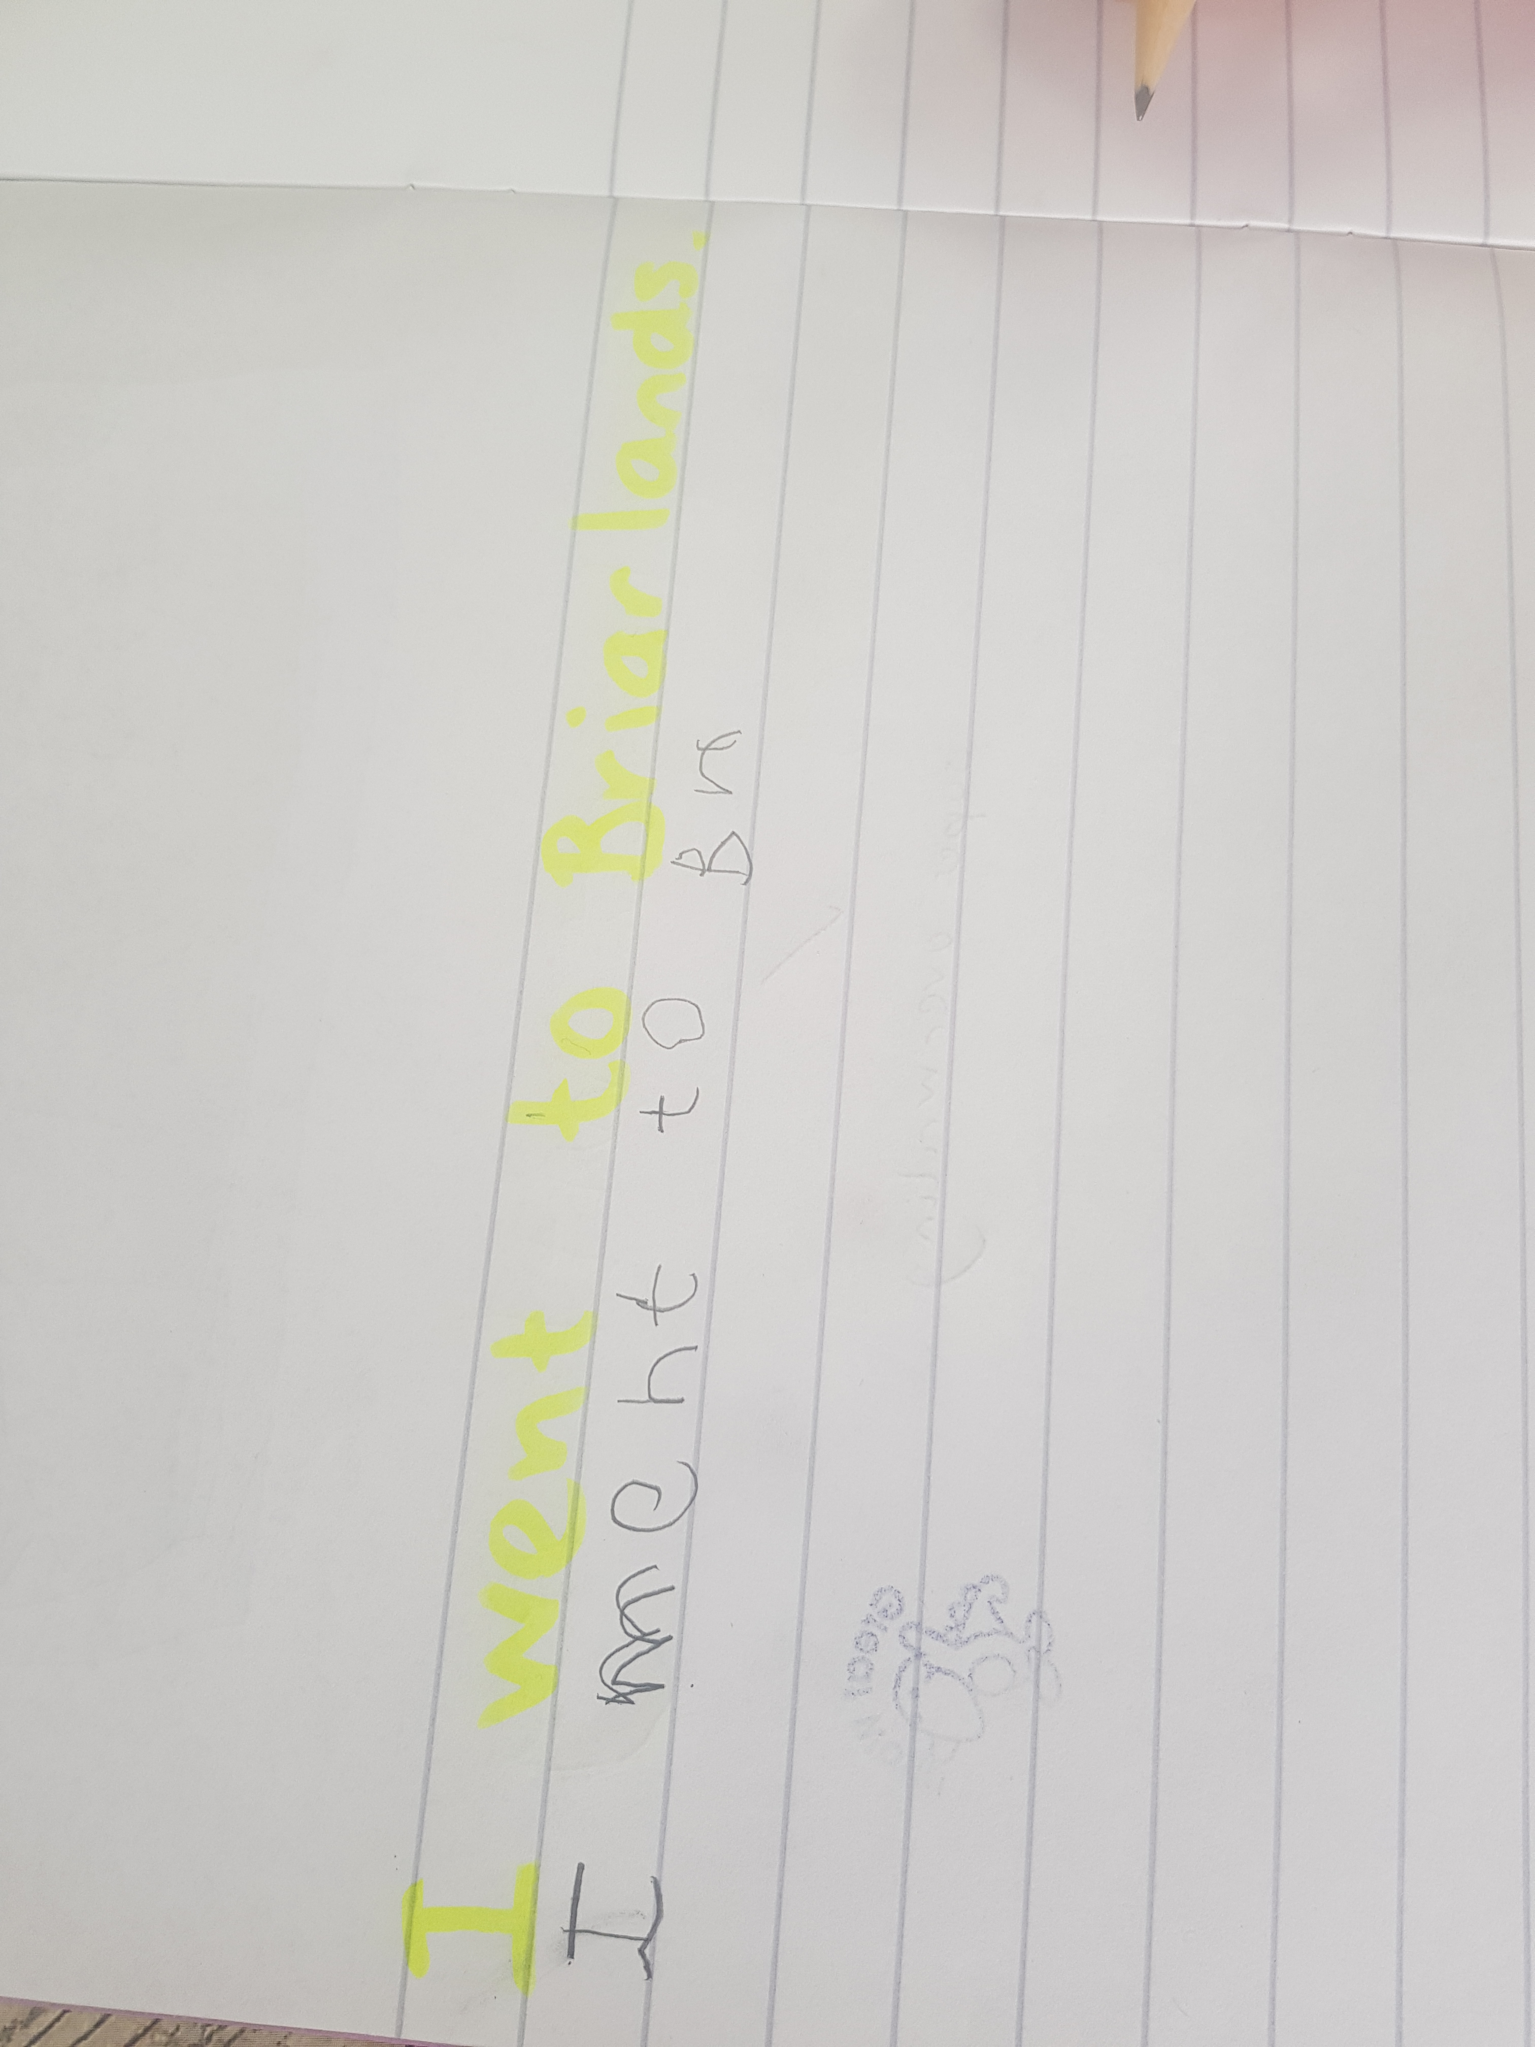
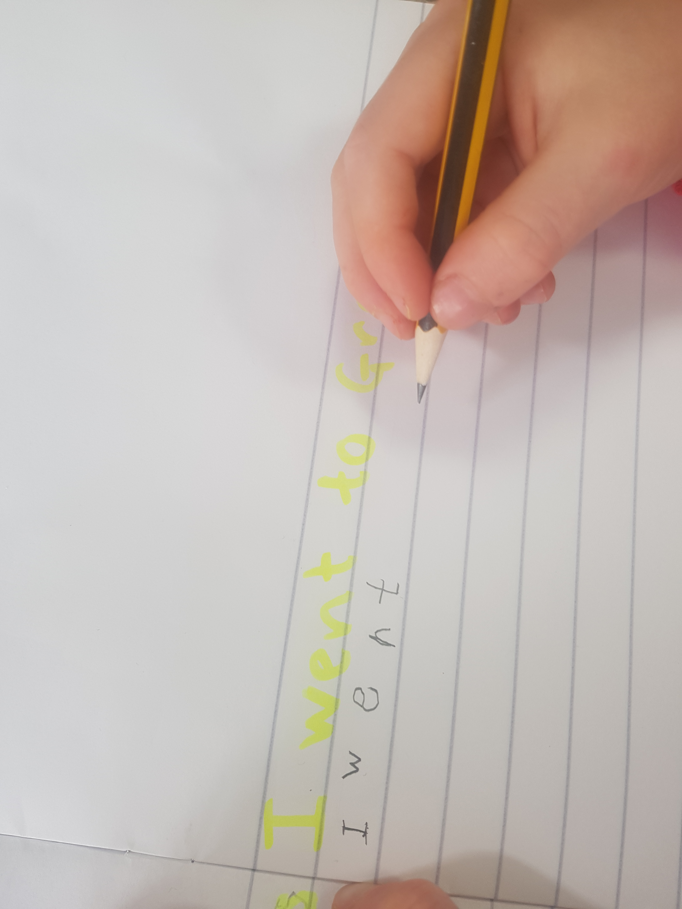
Current Primary 1’s (9/9/19)

Slide 30
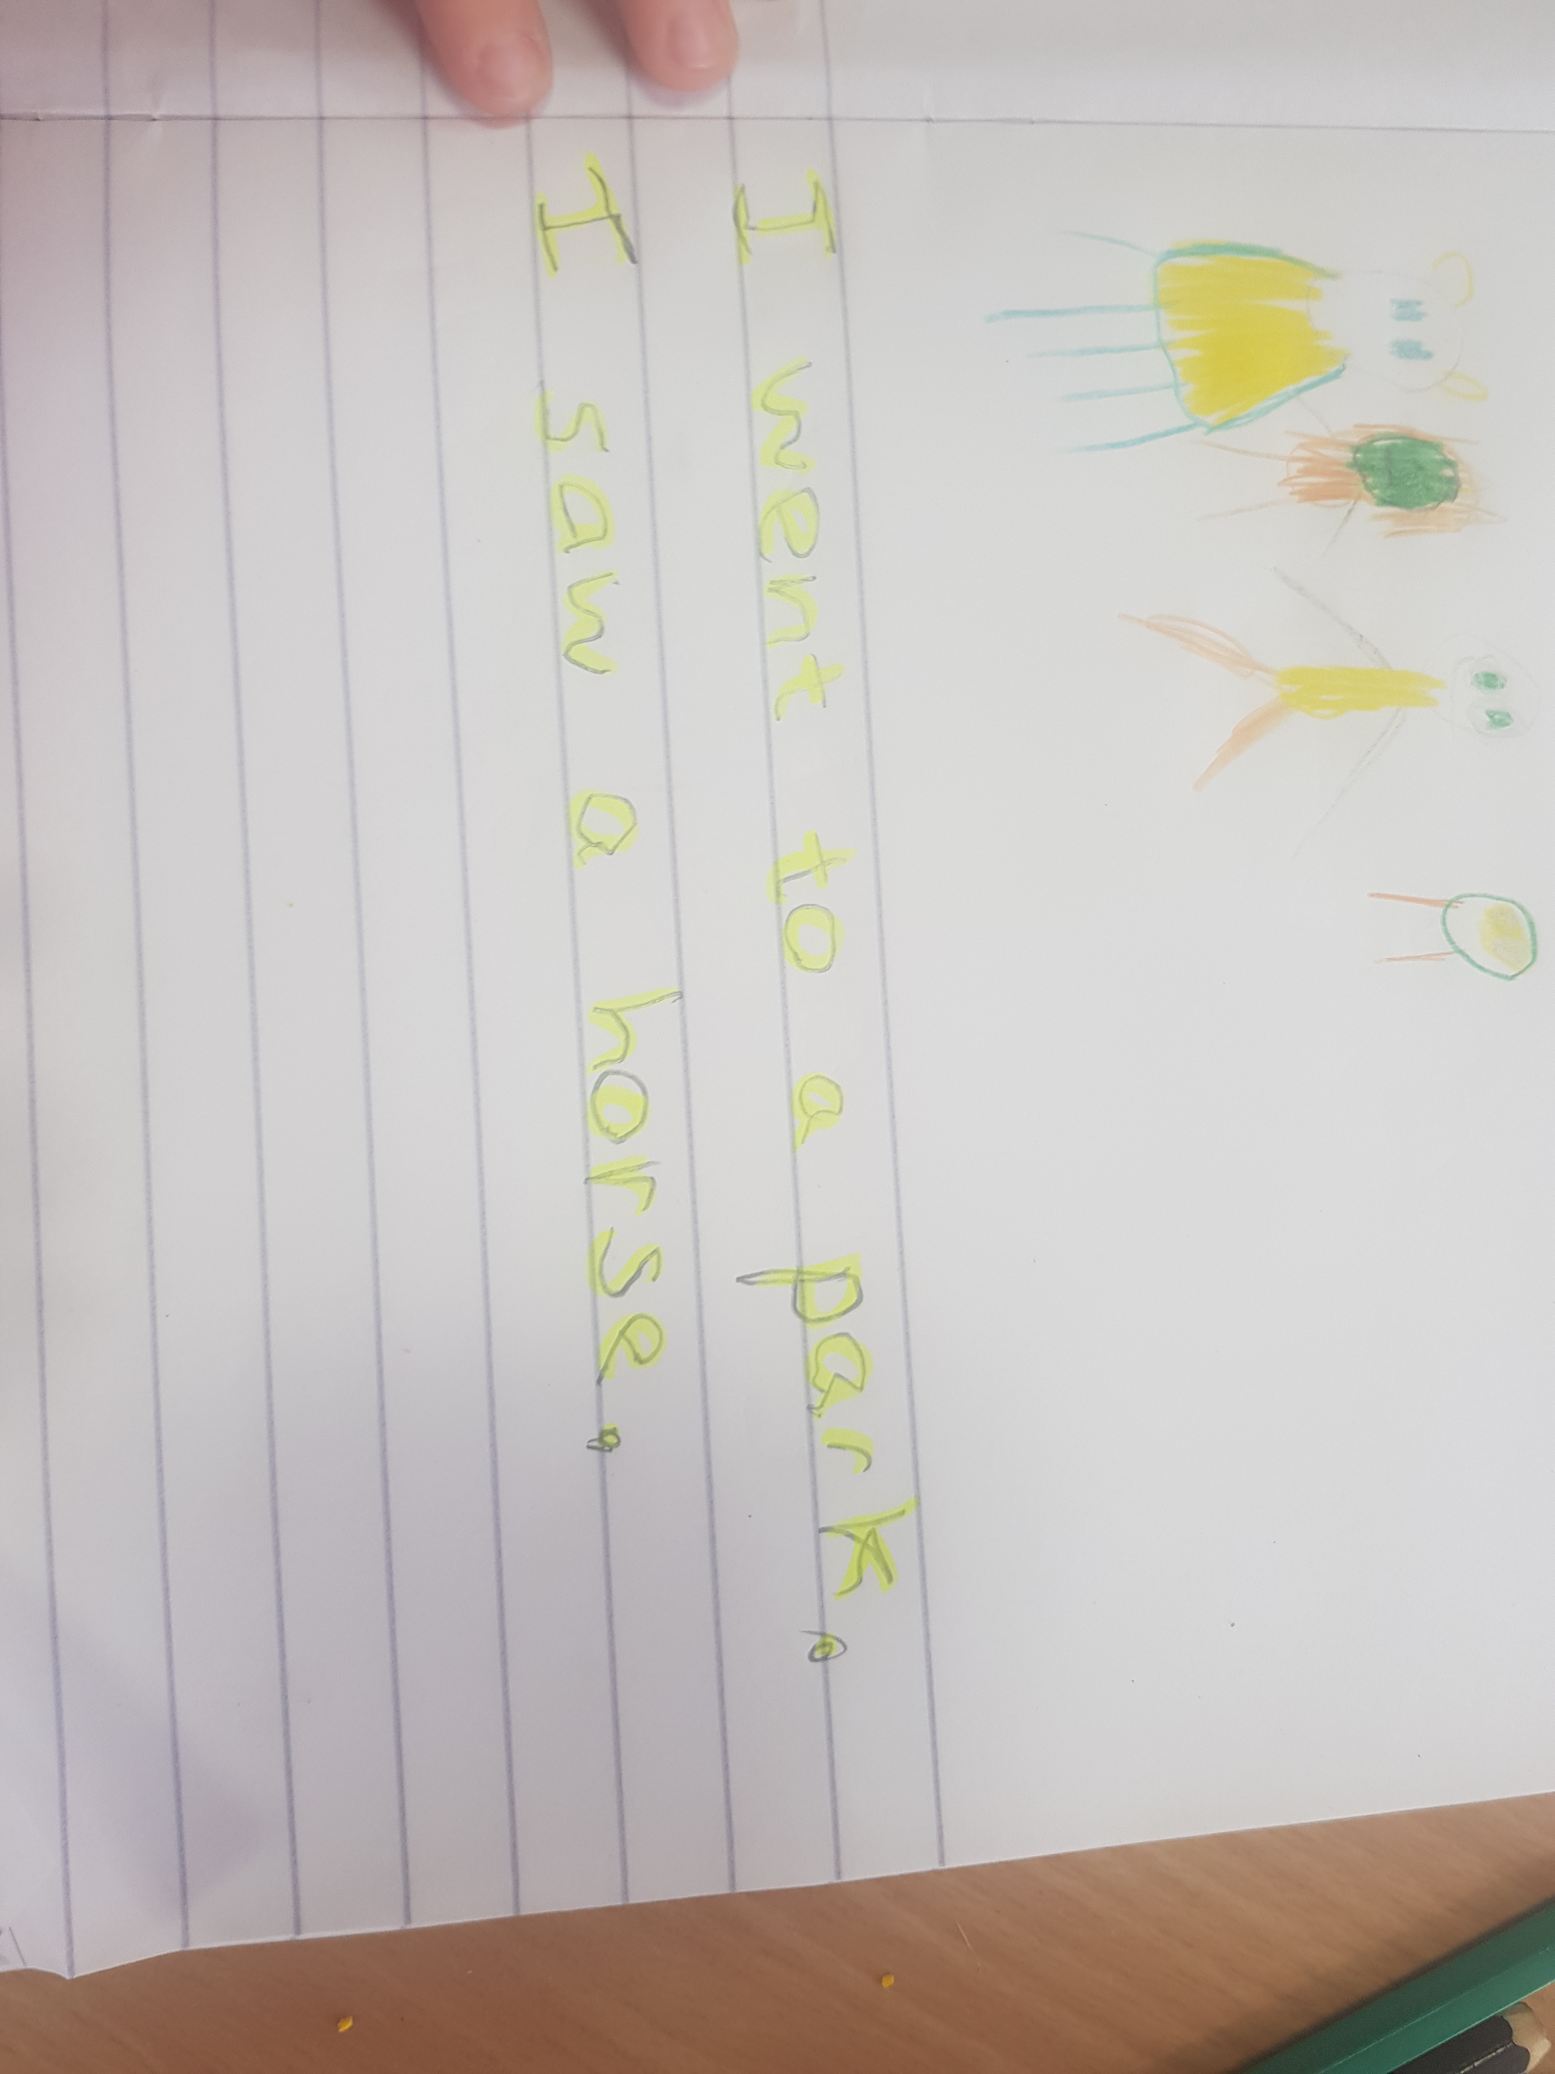

Slide 31
The child starts to write independently with a focus on –
Pencil Grip
Letter formation of taught sounds
Finger spaces
Sounding out of words (CVC)
Tricky words
Capital letters
Full stops

Slide 32
Maths at Dunblane Primary School
Big Maths and Ten Town
CARE & COMPASSION
FAIRNESS & EQUALITY
RESPECT
HONESTY
RESPONSIBILITY

Slide 33

0. The Zero pond: Start at the top, nice and slow. All the way round and there you go.

Slide 34
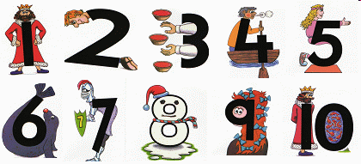
1. King One: Top to toe and there you go.

Slide 35
2. Tommy Two: Curve from his head to his knees, then straight across please.

Slide 36
3. Thieving Three: One hand, two hands, who's got the key?

Slide 37
4. Freddy Four: Down, across, or in the water.

Slide 38
5. Fiona Five: Down her back, round her knees. Back to the top, arms out please.

Slide 39

6. Seal Six: From the top of his tail to his little wet nose, King One will have very wet clothes.

Slide 40
7. Sir Seven: Start at his helmet, across to his hips. Down to his boots with the shiny tips.

Slide 41
8. Eric Eight: Eric Eight starts like a snake. Back to the top, he's easy to make.

Slide 42
9.Nicola Nine: Around her head and back to the top. Down to the ground and then you stop.

Slide 43
10. The Ten Town pond: Draw a one and then a zero, King One is the ten fish's hero.

Slide 44
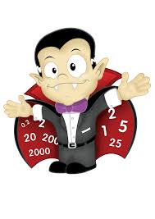
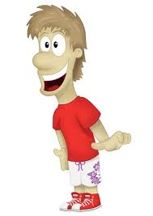
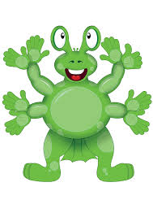
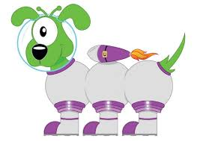
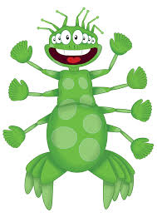
What is CLIC Maths?
Daily programme of mental maths with a strong emphasis on learning facts and developing mental agility
It develops core skills. All are taught in the same way, repeatedly, to embed these fundamental skills.
Big Maths highlights how small steps of progress with core numeracy follow on logically from one to the next.
Notes:
A new way of looking at the primary maths curriculum.
Maths is a logical subject that follows a sequence of progression, e.g. you can’t count to 40 before you can count to 30.
Core numeracy is separated from outer numeracy (the use of core numeracy skills across the rest of the curriculum) allowing children to become numerate.
Many children suffer from low confidence in maths. They either feel negative about it as a subject or about their own ability to cope with it, or both. Big Maths aims to address this by showing children that becoming numerate is easy. It is up to us as teachers to show the children how and why it is easy.
The main aim of Big Maths is to enable children to make connections and apply these connections successfully.

Slide 45
Why should we use Big Maths at Dunblane Primary School?
Clear progression from year to year
Consistent methods taught and language used throughout the school
Build on prior learning and ensure children are secure in their knowledge
Objectives are clearly matched to Curriculum for Excellence
Improve mental maths skills and general numeracy across the school

Slide 46
How does CLIC work?
CLIC is fundamental to Mathematical development as it is the learning sequence through which we all develop our numeracy skills.
CLIC provides a constant, daily drive to up-level their numeracy.
C Learn to count (Counting)
L Learn to remember totals as facts (Learn Its)
I Learn to apply those facts in new situations through ‘switching’ the ‘thing’ being counted (It’s Nothing New)
C Learn to structure all the previous 3 into a formal calculation (Calculation)

Slide 47
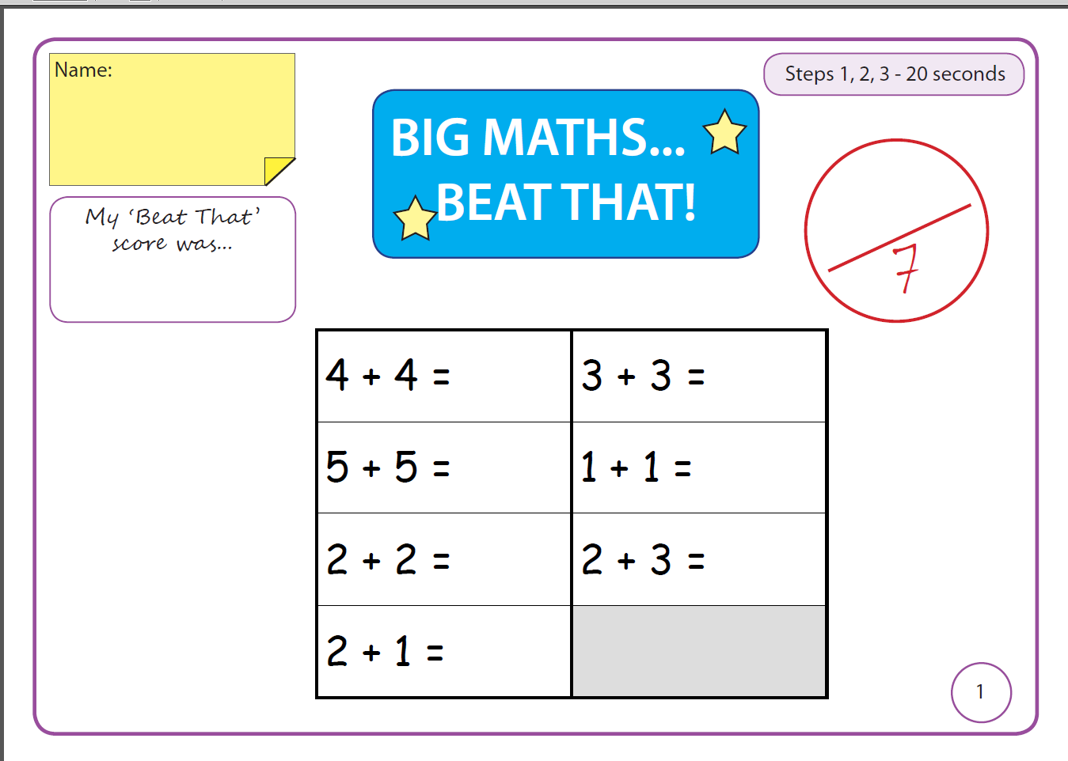

Slide 48
How can I support my child?
Help your child to practice their ‘Learn Its’ at home. In Primary 1 these are
Counting in 2’s, 5’s and 10’s
Number bonds to 10
Praise! Celebrate the successes.
Visit the publishers website:
http://www.andrelleducation.co.uk/courses/numeracy/big-maths/

Slide 49
Counting
Learn Its
Its Nothing New
Calculations

Slide 50
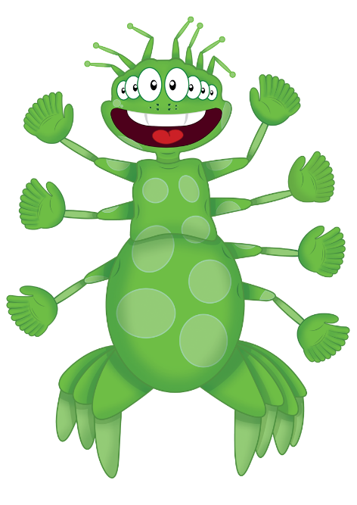
Step
5
I can count.
Remember to:
say one word as you touch each object in the pile
not miss any out
not count any twice

Slide 51

Step
5
I can count.

Slide 52

Step
5
I can count.
3
How many apples?
2
4
1
5
6

Slide 53
Step
5
I can count.
How many crayons?

Slide 54
Step
5
I can count.
How many crayons altogether?
1
2
3
4
5
6
7
8
9

Slide 55
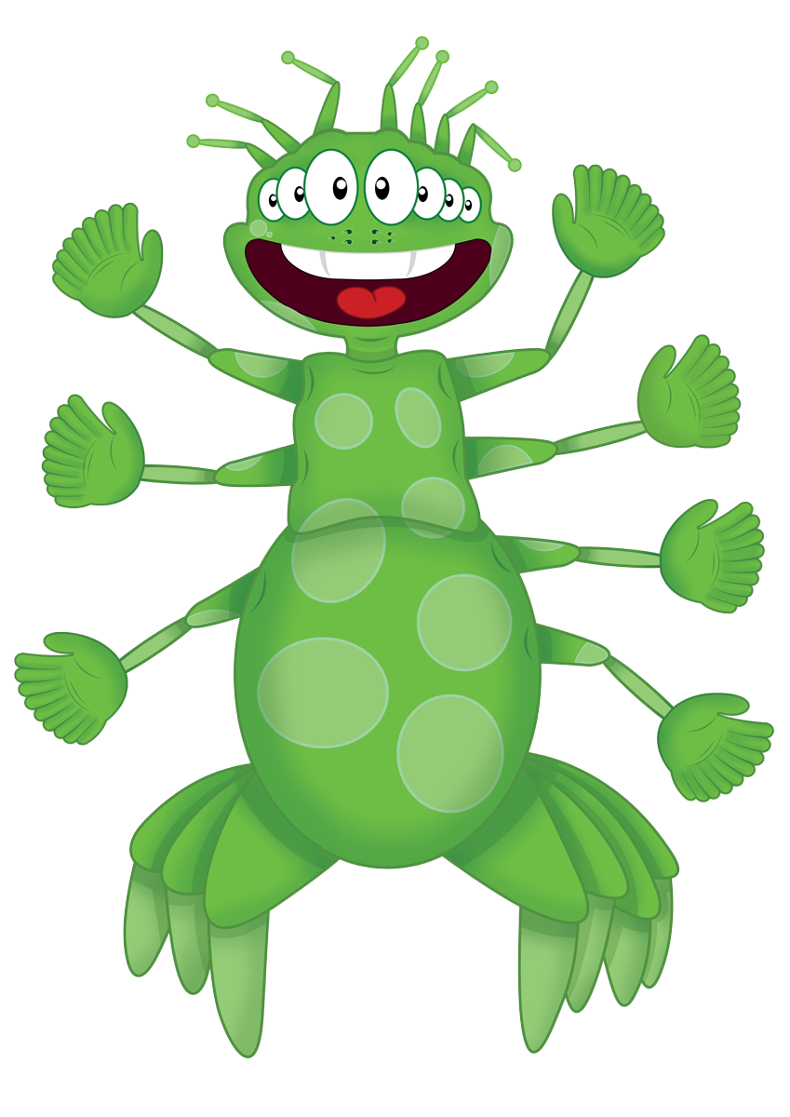
Well done!

Slide 56
Counting
Learn Its
Its Nothing New
Calculations

Slide 57

Learn Its
I know my doubles.
Step
1 & 2

Slide 58
Step
1 & 2
1 + 1 = 2
2 + 2 = 4
3 + 3 = 6
4 + 4 = 8
5 + 5 = 10
Doubles

Slide 59

Get your whiteboards ready!!

Slide 60
4 + 4 = 8

Slide 61
4 + 4 = 8

Slide 62
3 + 3 = 6

Slide 63
3 + 3 = 6

Slide 64

Well done!

Slide 65

Well done, you have now completed your CLIC session!

Slide 66
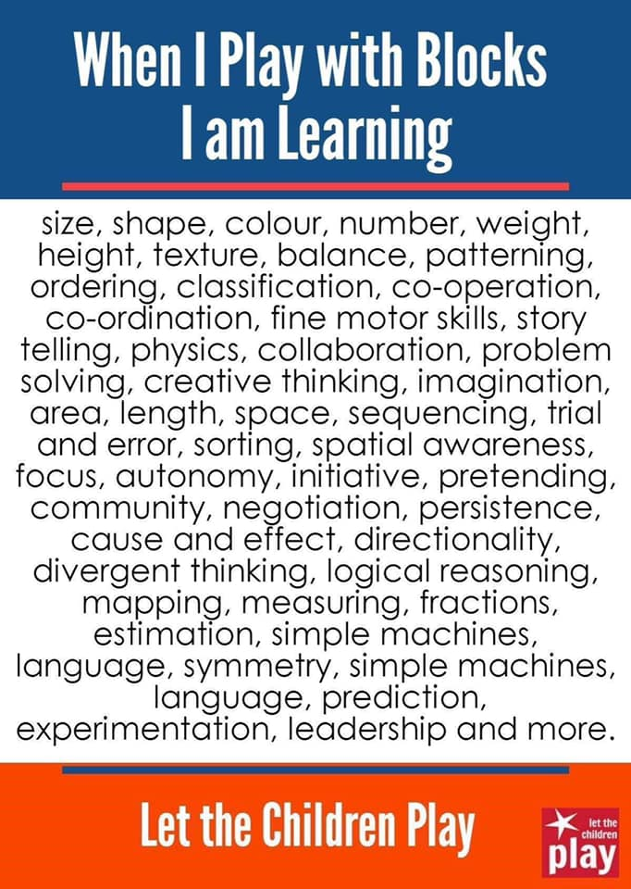

Slide 67
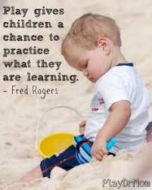
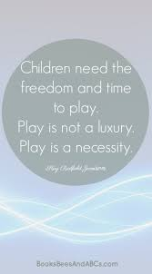
Play in Primary 1

Slide 68
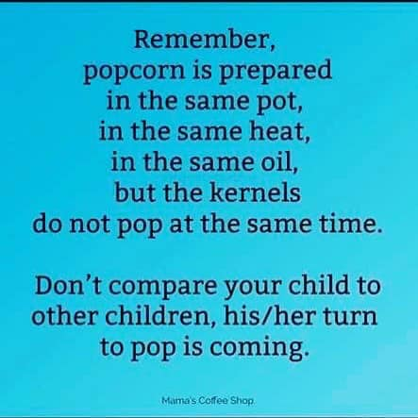

Slide 69
Fundraising Group
Meet in the Westlands Hotel
dpsfrg@gmail.com
Facebook – Dunblane Primary Fundraising Group
Parent Council
19th September 6.30PM in the school library.
It is usually 7PM but this is the AGM

