Slide 1
ICT Workshop for Parents
10th of March 2017
Dunblane Primary School Nursery Class

Slide 2
Aim of the workshop
To share with parents how we are taking digital technology forward within the nursery class.
To demonstrate how ICT resources are used within the nursery class.
To share with parents possible uses of digital technology at home
To raise parents awareness of internet safety
To support children with their learning in Primary 1.

Slide 3
Nursery School Improvement Plan
Children, staff and parents to be confident in the use of digital technology (iPads, PC, laptops, cameras, easy speak…) and to be able to use this safely as a tool for learning.
Outcomes (What do you want to achieve?) | Success Criteria
For all children, staff and parents to be confident in the use of digital technology. For children to use digital technology safely as a tool for learning. | Different resources used for different stages. Most staff to be confident using digital technology. Most children to be confident using digital technology. Most parents are aware of safe uses of digital technology.

Slide 4
WHY??? Technology – ICT to Enhance Learning
I explore software and use what I learn to solve problems and present my ideas, thoughts, or information. TCH 0-03a
I enjoy exploring and using technologies to communicate with others within and beyond my place of learning. TCH 0-04a
I enjoy taking photographs or recording sound and images to represent my experiences and the world around me. TCH 0-04b
I am developing problem-solving strategies, navigation and co-ordination skills, as I play and learn with electronic games, remote control or programmable toys. TCH 0-09a / TCH 1-09a

Slide 5
Use of ICT in the Nursery
2 IPads
2 PC’s
1 SMART board
1 tape recorder
4 Talking Clips
4 Cameras
3 Beebots

Slide 6
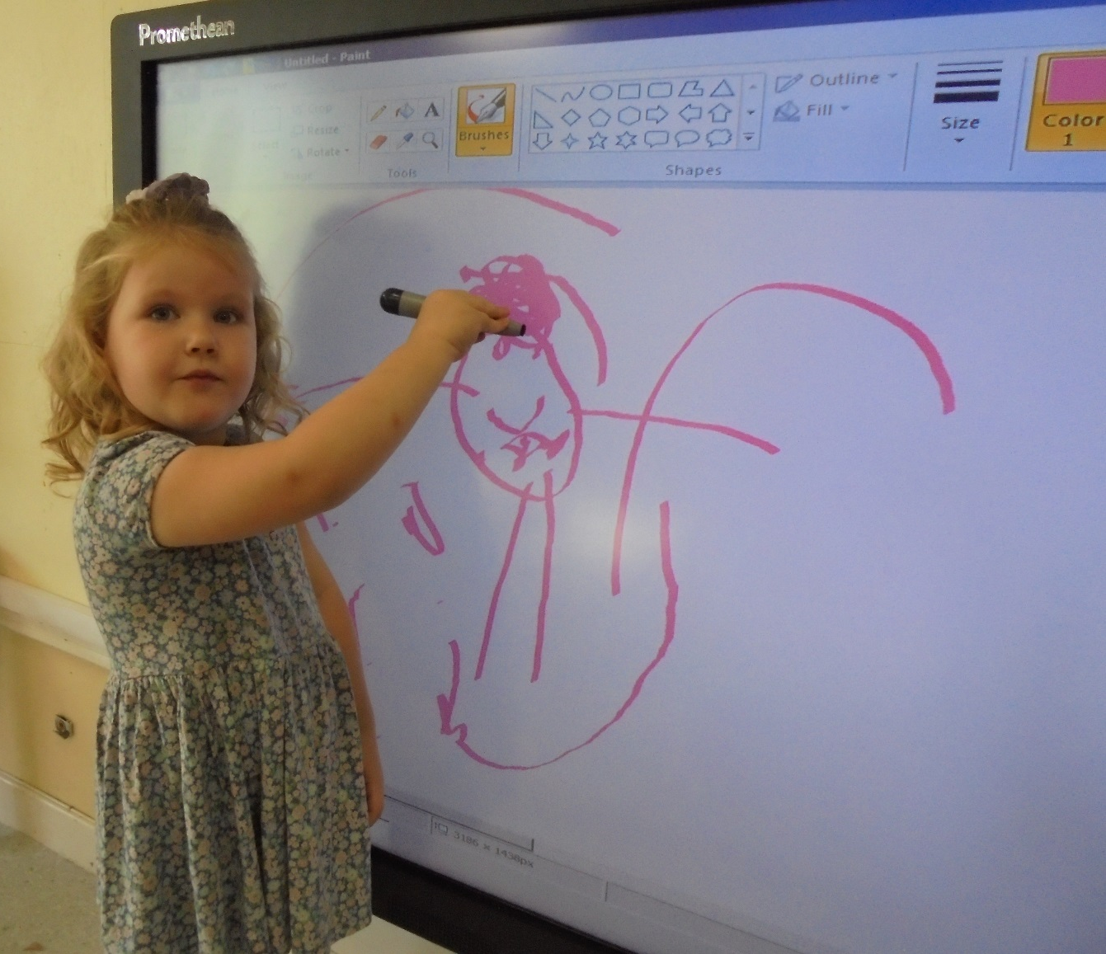
I'm drawing my mummy. She's pink.
Callie

Slide 7
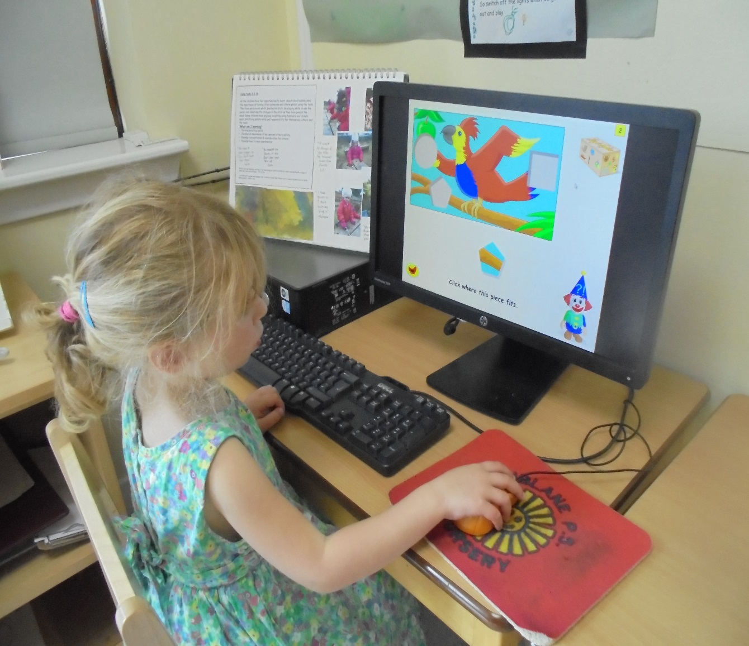
You move the bit in the shape then you see the picture.
Ruby J

Slide 8
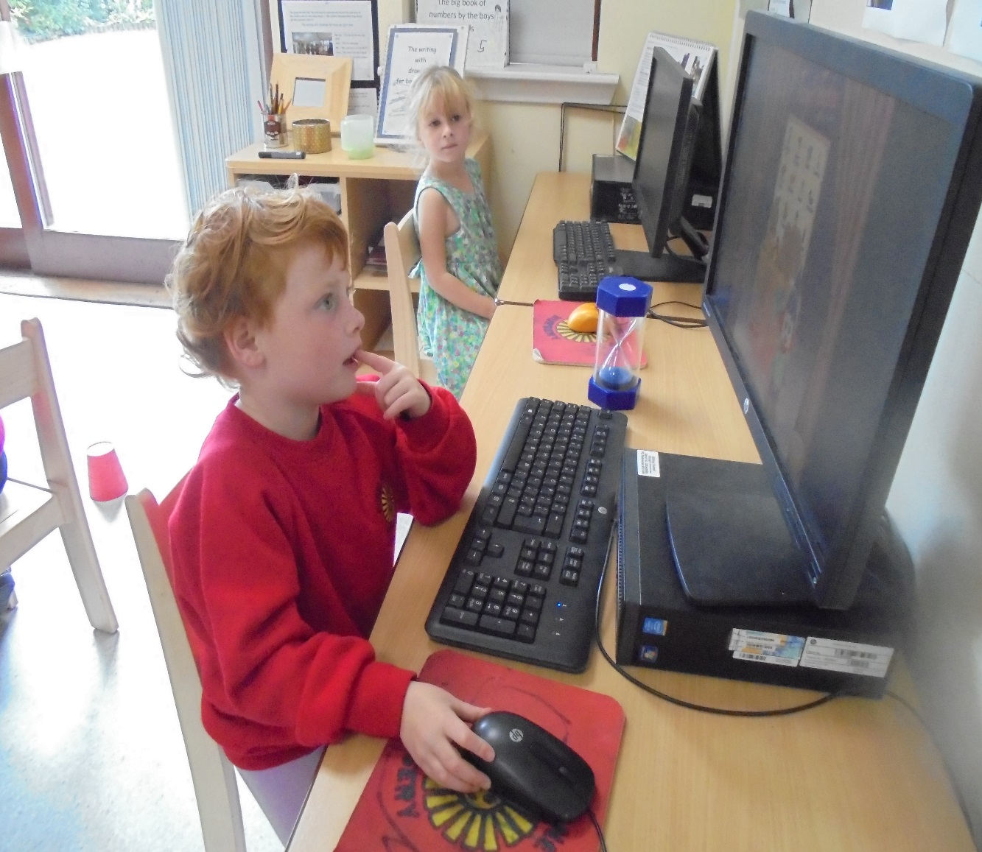
Just press buttons and then you be the winner.
Madison

Slide 9
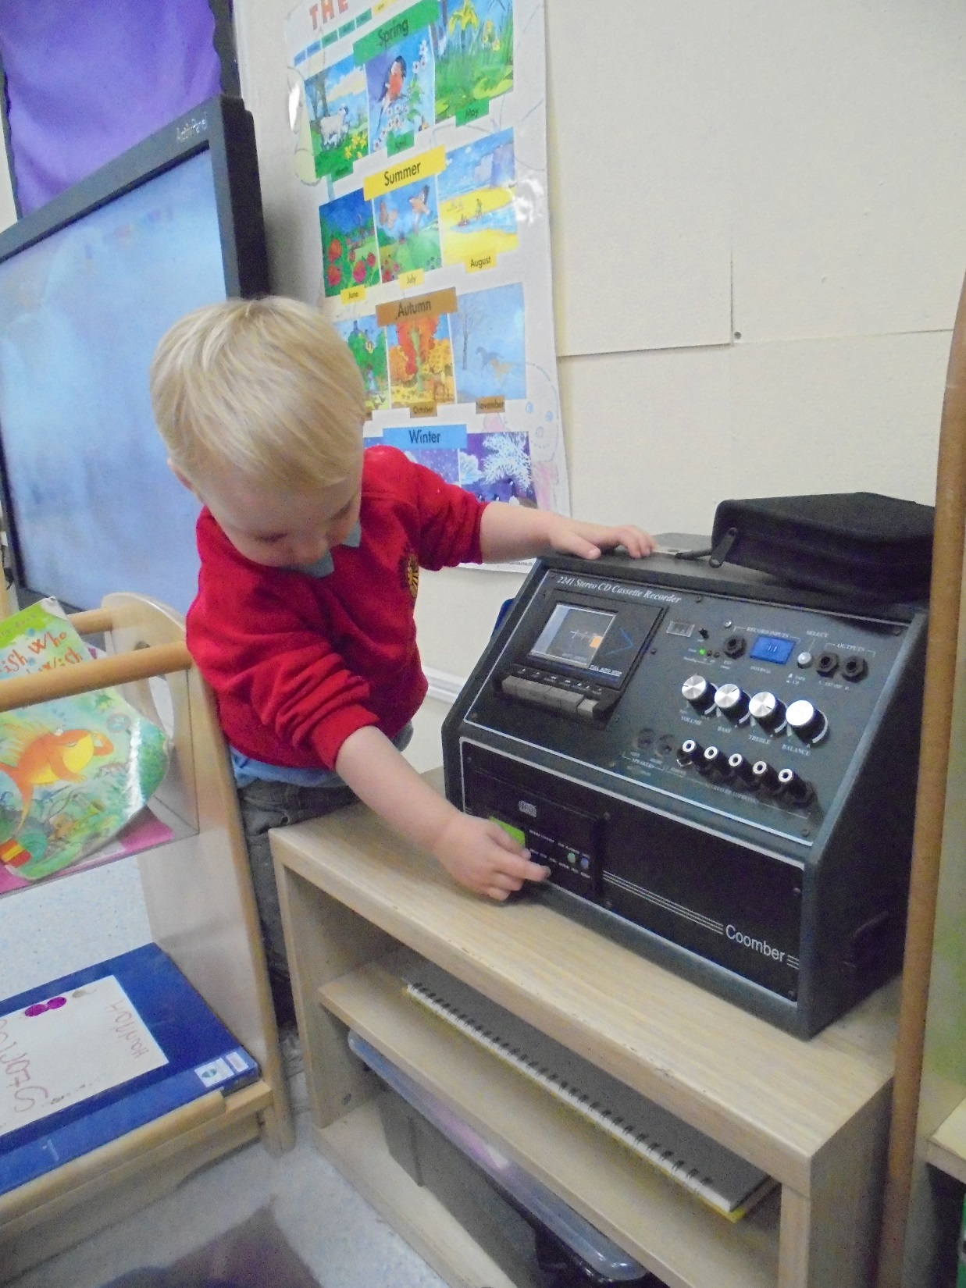
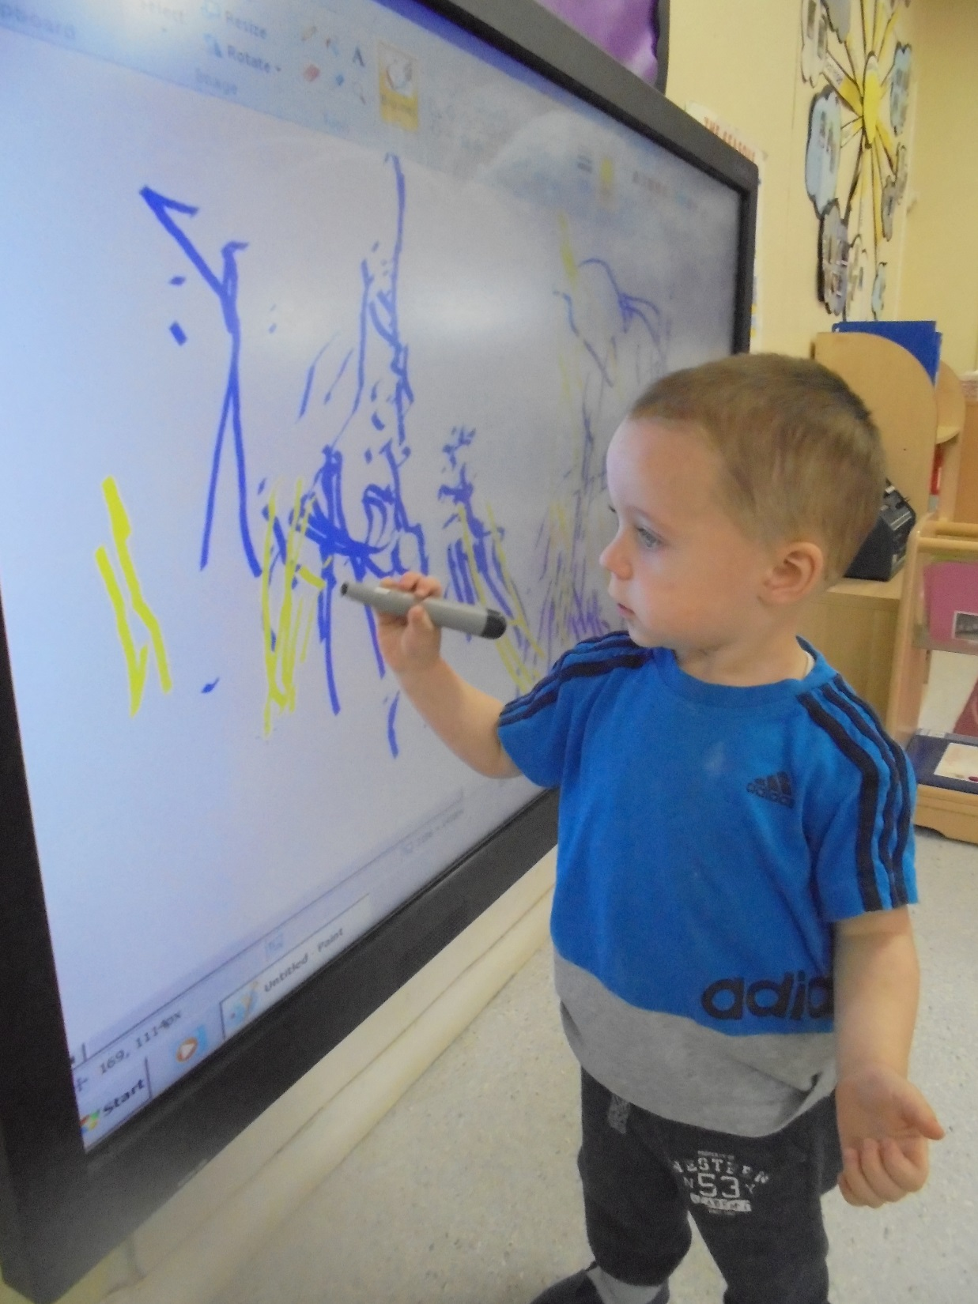

Slide 10
Apps – In the Nursery and Primary 1
Screen Chomp – Writing and drawing pad
Bee Bot – Enables children to improve their skills in directional language and programming through sequencing of forwards, backwards, left and right.
Drawing Desk – Draw, paint, doodle and sketch
Collins Big Cat – Different stories – Read to me
- Read by Myself
-Story Creator

Slide 11
Apps – Based on Parent requests
Cbeebies
- Play time
-Story Time
-Playtime Island
Music Sparkles – 14 different instruments
Lego Junior Create and Cruise (Age 4-7)
-Use your imagination to create lego vehicles and mini figures.
Jisgaws – Kids Puzzles age 3-9 years.
Kids Piano Sound Touch with Musical Instruments
- Listen to nursery rhymes
-Play the piano

Slide 12
Apps – Primary 1
Oxford Reading Tree – Meet the characters
- Reading Books with narration
-Phonics – I spy
Jolly Phonics Letter Sounds Apps and Meet the Alphablocks
-Get songs on You tube
Hit The Button – Primary 1 and older.
- Number bonds
- Doubles
- Multiplying and dividing
Collins Big Cat Story Creator
Number Jacks

Slide 13
GLOW from Primary 1
Glow is an award winning national intranet for education, developed exclusively for Scotland’s educational community.
Glow gives access to information and activities including interactive educational games, revision papers, links to other sites and news features. These resources support pupils to learn in innovative and exciting ways.
Each child is given unique logins to access this resource. The whole family have free access to Microsoft Office
For children, GLOW is:
A tool to access the benefits of the internet and a range of online resources and services via one log-in
A space for collaborating with other learners
A facility to connect with teachers about assignments and learning
A space to create and innovate as you learn

Slide 14
Use of Glow and websites
Top Marks – Educational Resources for all areas of the curriculum.
- Includes Interactive Games
Tig Tag Junior – Short Films for primary Science and Social Studies
Microsoft Office
Email

Slide 15
Use of the school website
https://blogs.glowscotland.org.uk/st/dunblaneprimary/
Use of Twitter
@Dunblane Primary
Communication with Parents

