Slide 1
Hill Walk Challenge
Drymen Primary School 2021

Slide 2
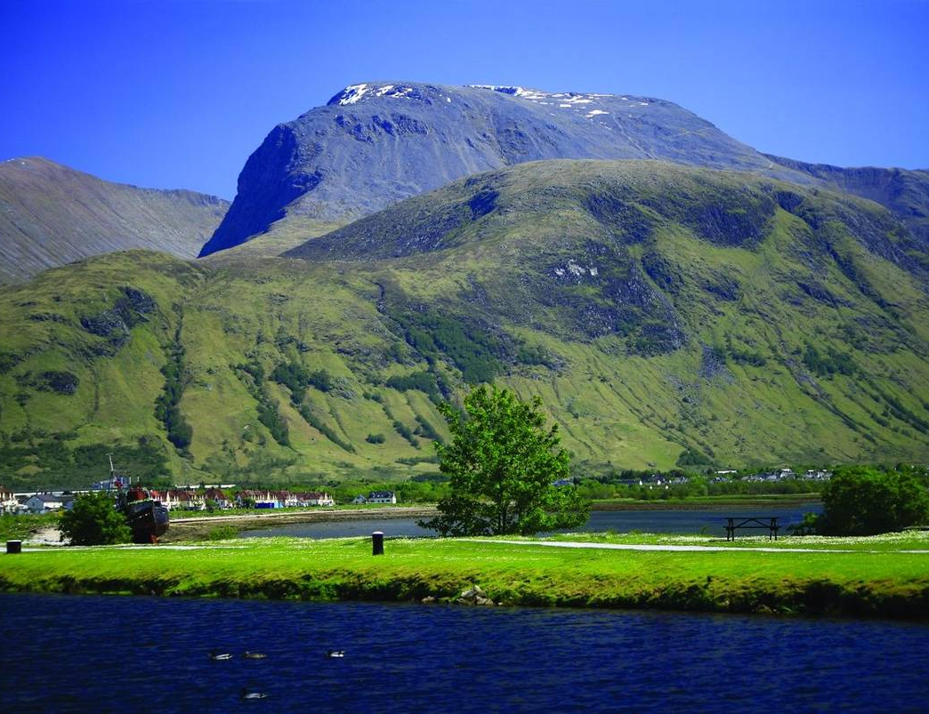
Ben Nevis
Uks highest mountain!
1345m above sea level
Its name means;
‘Mountain with its head in the clouds’

Slide 3
Fundraising Challenge
What do we want you to do?
  Walk the height of Ben Nevis!
  Lots of smaller hills
For example:
  You can fit 4 Conic Hills into the height of Ben Nevis

Slide 4
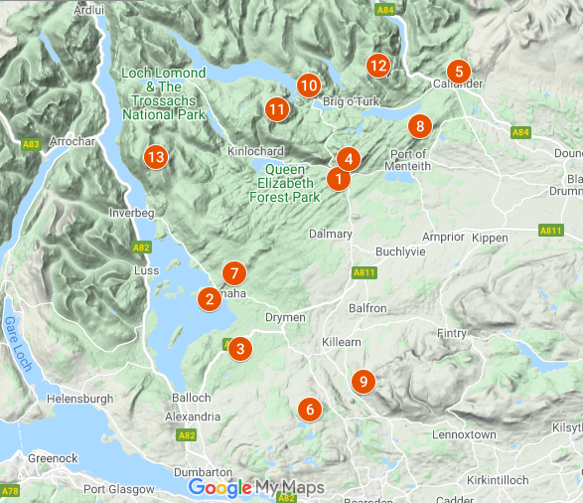
Local Hills
The Dumpling
The Conic
Dumgoyne
Ben A’an
Ben Lomond

Slide 5
The Challenge…..
What are we raising money for?
  Exciting resources for learning
  Outdoor classroom
When can you do it?
  6 weeks - 2nd April – 14th May
Your class will get a poster
Take your summit photos!
Class | Hill name | Height (m)
Sam | Ben Lomond | 974
Eilidh | Ben A’an | 461
Isla | Conic Hill | 361

Slide 6
The Challenge…..
Have fun
Get fit
Fundraise for our school
Stay safe
Take your time and remember your summit photos!

