Slide 1
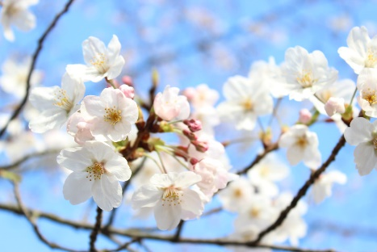
Cornton Nursery Newsletter April/May 22
Dear Parent/Carers
At last we are experiencing some lovely sunshine and there is lots of exciting learning taking part in our outdoor learning areas. One of our practitioners Dad has created some amazing planters for our garden out of palettes and an upcycled Mud kitchen for the Oak garden.
Children's Interests and Learning:
Acorn Room: Most of the children in the Acorn room children have been busy exploring how plants grow and how to look after them as well as observing the life cycle of frogs. The children have a small barrel with tadpoles and they are excited to start seeing changes over the weeks. Some children have also planted some trees in the garden which will grow over the years and develop some needed shade for the learning areas. The staff have been working hard to refurbish and set up out their outdoor Science and Nature Lab.
Willow Room: The staff and children and been changing some of the environment and bought new resources for the babies (heuristic play). As part of their age and stage developmental skills, children are demonstrating different schemas. Schematic play happens when babies, toddlers and young children are involved in repeated actions or certain behaviours as they explore the world around them and try to find out how things work. We call these specific actions or behaviours 'Schemas'. Have a look at Schema examples on the display at the Willow Room door or ask Susan for further information.
Oak Room: The Preschool children have been having lots consultation about Transition. We have children going to Cornton PS, Riverside PS and Bridge of Allan PS. There is much excitement and discussion about Primary School. They have been creating their Helicopter stories to support their transition and taking turns to take The Everywhere Bear home which has been very successful. It can be quite an anxious time so we are supporting children through different strategies to support Emotional resilience and what makes a good friend? Children are also exploring different interesting materials for writing and ways of recording their experiences but focussing on ‘writing for a purpose’. Through Maths and Numeracy, some children have been exploring and developing a sense of size and amount through observing things in their environment.

Slide 2
More information:
Staffing:
Caroline Martin who secured a permanent ECE post in March will start with us on Tuesday 3rd May and will be based in the Oak Room. We will also be interviewing next month for a full time permanent ECE who will join our team soon.
Covid:
Although there has been a change in some Covid protocols and you do not need to wear masks we have been are to continue to keep ourselves safe, you may want to wear a mask when coming in or leaving the nursery. Our staff are still wearing them going between rooms. The nursery staff are continuing to follow all Covid procedures e.g. cleaning and continuing to keep our children and staff safe.
Different Weather Conditions:
Now that we are coming in to warmer weather, please ensure you have sun cream on your child and sunhats to keep them safe. Can you also check what sun cream you are using and it came to our attention that some of the new NIVEA formulas have almond oil within a certain line of Nivea Kids cream. It is not clear at all that this product contains nuts unless you know the latin name (Prunus Amygdalus Dulcis Oil). Please be aware as we have a child with a severe NUT ALLERGY. Thank you.
Parent link Meetings:
All keyworkers will have made contact with you to organise ’Chat’ on the phone to discuss if any of your child’s information has changed and discuss how their learning is developing at Nursery. If you have missed their call , please speak to your child’s keyworker and rearrange anew time that suits.
Dates for Information
Friday 29th: In service Day Nursery closed
Monday 2nd May: Holiday- Nursery closed
Wednesday 4th May – Nursery photographer in Nursery.
Tuesday 10th May – Eye screening This is a check for children were missed. Staff will speak to the children missed and organise a time that suits.
Kind regards
Sam & Lyndsay

