Slide 1
Balfron Primary School Organisation of P1
12th March 2024
Notes:
Any text in red should be completed by each individual school

Slide 2
Projected School Roll/Class Structure
P1 > 18; <30
P2 20
Projected P1-P7 school roll for next session 158 all 7 classes
Notes:
You may wish to insert a slide/slides illustrating your projected numbers for stages and/or classes for next session.
Also you may decide to share your proposed class structure via another slide/slides here too.

Slide 3
How are classes structured?
Changes in school roll; starting with new P1 intake
Allocated teaching staff required based on school roll
National Requirements of maximum numbers in classes
Notes:
Organising classes requires careful and effective planning.
In reaching an initial decision to restructure classes and/or form a composite class, headteachers are required to staff the school following Stirling Council Schools, Learning and Education’s annual staffing exercise.
The staffing exercise looks at roll analysis alongside other information about movement of children in and out of the school over the course of a school year, patterns of late enrolments and placing requests into and out of the school, as well as any planned new building in the catchment area of the school.
Following this staffing exercise there is an analysis of teaching staff, and headteachers are then allocated the appropriate number of teaching staff.
The national requirements for the organisation of classes are maximum of 25 learners in P1; 30 learners for each single stage class in P2 and P3, and 33 in P4-P7.
The maximum number for any composite class is 25 learners.
Where there is a change in pupil roll, class sizes or staffing levels, a restructuring of classes, including the formation of composite classes, may be required.
It is also likely, when composite classes are formed, that the population of single stage classes may also require to change. It may also be necessary for stages to be split across classes.

Slide 4
National Maximum Class Sizes are:
P1 – 25 Pupils
P2 and P3 – 30 Pupils
P4 to P7 – 33 Pupils
Maximum pupils for Composite Class - 25 pupils

Slide 5
What is a composite class?
National Maximum Class Sizes are:
When two or more stages are taught together in one class e.g. P1/2 or P5/6 or P1-3
P1 – 25 Pupils
P2 and P3 – 30 Pupils
P4 to P7 – 33 Pupils
Maximum pupils for Composite Class - 25 pupils
Formed as a result of school roll/staffing allocation

Slide 6
Why do schools have composite classes?
National
Local
Balfron PS
PICTURE OF YOUR SCHOOL/CLASSROOM
Projected P1-P7 school roll for next session 158 all 7 classes
Notes:
Learning in multi age groups or composite classes is standard practice in the vast majority of both small rural schools and larger primaries across Stirling and across Scotland.
Moving to and from single stream classes to composite classes and back again throughout a child’s primary education is common within almost all of Stirling’s primary schools.

Slide 7
Stirling Council’s Policy for the Organisation of Learning
Date of birth
A reasonable balance of gender where possible
The additional support needs of children
How are composite classes formed?
Notes:
Stirling Council has a clear policy and guidelines on the structuring of classes.
Provides consistency across all settings
Provides clear criteria for HTs
Policy went through a full review and thorough consultation process during 2022 and from this was updated and finalised via committee in Feb 2023.

Slide 8
How do composite classes work?
Curriculum for Excellence – Flexible to meet the needs of every child.
Within any class there is a range of ability and need.
Robust transition to new class.
Teachers planning together:
Opportuntites to be together
Same opportunities for progression
Notes:
Outline the fact that all classes are composite classes with a range of learning needs and that teachers are trained to manage this.
Outline how Curriculum for Excellence is designed to allow for meeting needs of every child, flexibility, progression etc.
Outline strength of school’s transition information and tracking and monitoring procedures.
Outline the variety of learning approaches, social groups, whole class, ability groups, individual teaching/learning, independent learning etc.
Outline how peers will meet each other – including plans for working together and social opportunities to meet.
Mention that the school would also encourage parents to seek other social opportunities outside of school.

Slide 9
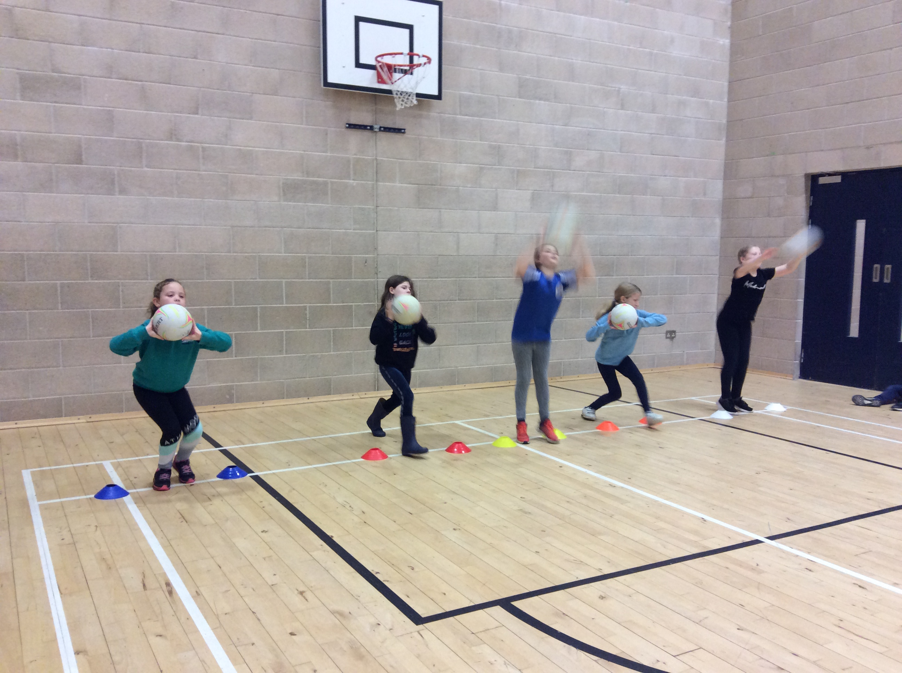
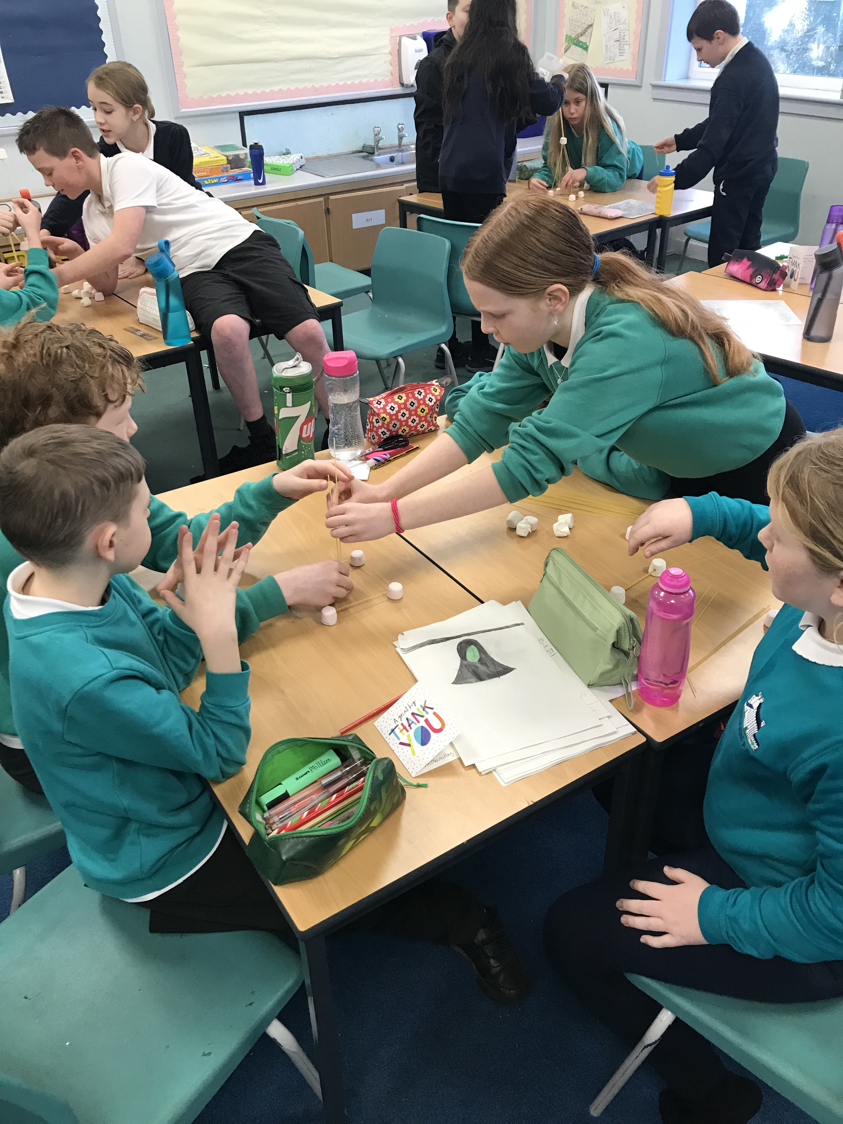
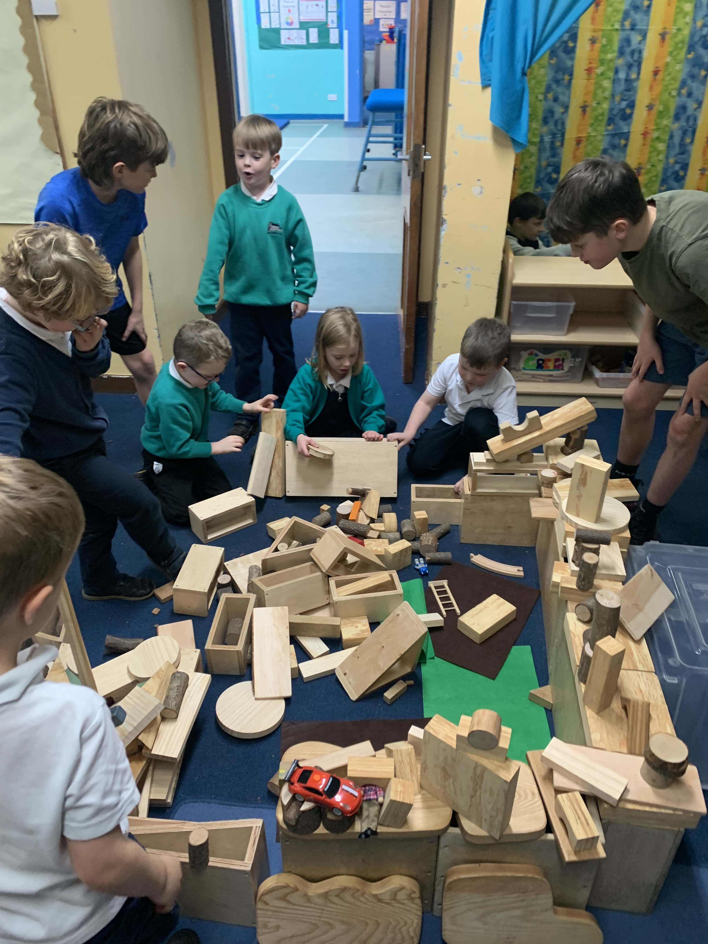
Photo of Learning
Photo of Learning
Photo of Learning

Slide 10
What happens now?
Letter about next year’s P1 class & teachers will be shared before the summer holidays.
Any questions
Notes:
Outline transition arrangements for children and for teachers. Emphasise the passing on of information re children’s progress to ensure continual progress
Emphasise SLT continue to monitor progress
What to do if parents want further information.

