Slide 1
Thinking About P1
Information Evening

Slide 2
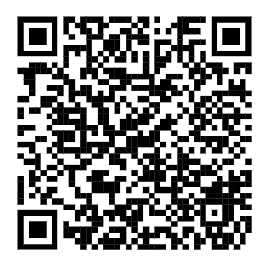
Introduction
Mr Black Headteacher
Mrs Macmillan Depute Headteacher

Slide 3
Session Outline
Progression to Primary 1 at Balfron Primary
A snapshot of Primary 1 at Balfron PS
Composite Class Structure
Infant Department Tour
Opportunity to look at our some new
literacy resources

Slide 4
Transition – Oral Storytelling
The Effect of Weaknesses in Oral Language on Reading Growth
Notes:
Oral language development plays a critical role in early literacy because it provides the foundation for reading and writing.
As children acquire more words and learn to use them in meaningful ways, they are better able to understand and use written language.

Slide 5
Building Blocks of Language
Building Blocks of Language, A. Williams and J. Woodcock (2008)
Notes:
Listening underpins all language development.
This image details that learning to listen is vital in developing ability to play and interact with other successfully.
It underpins the development of understanding language and talking.
Listening skills are necessary to acquire all the speech sounds we need to use when talking.
Later, when your child is in P1 & P2 all these foundation blocks need to be in place for children to successfully develop literacy skills.

Slide 6
Stories we will explore

Slide 7
Visual Prompts

Slide 8
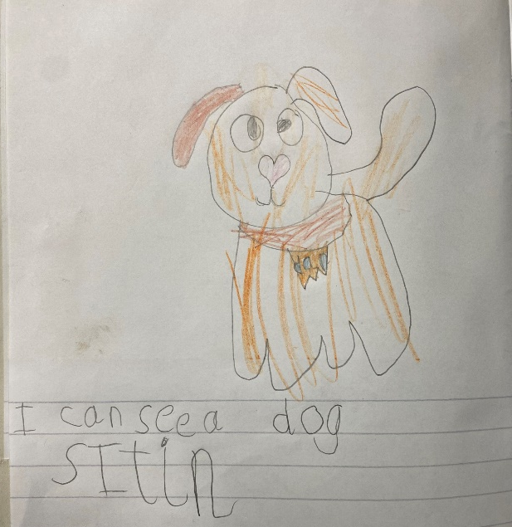
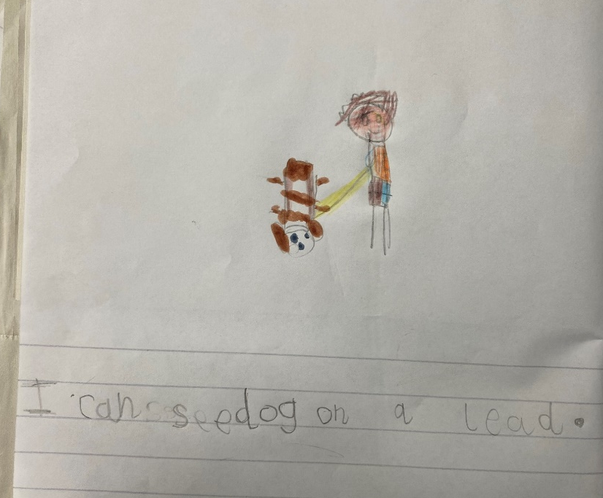
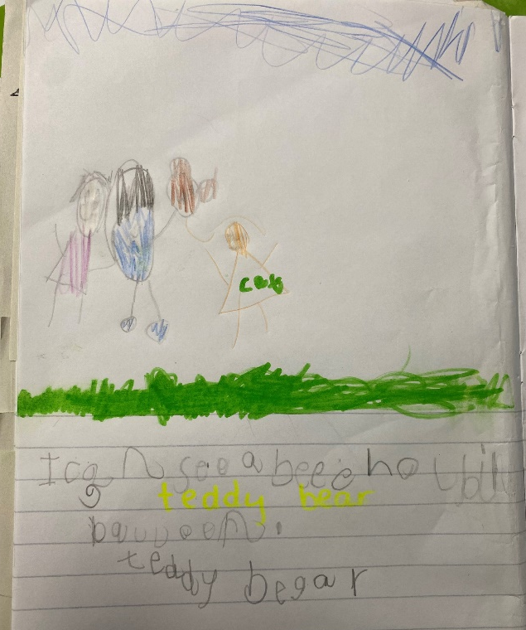
Building into P1 Writing

Slide 9
Journey to Primary 1
Tuesday 26th March 2024
Second Early Level Assembly – new entrant P1s & Current P1s
Week Beginning 15th April
Storytelling Transition Experience – small groups working with Mrs Macmillan and visiting P1 across the week
Week Beginning 29th April
Storytelling Transition Experience – small groups working with Mrs Macmillan and visiting P1 across the week
Week Beginning 13th May
Storytelling Transition Experience – small groups working with Mrs Macmillan and visiting P1 across the week
Wednesday 15th August 2024
New Session begins – first day of P1

Slide 10
Journey to Primary 1
Tuesday 28th May 2024
New Primary 1 lunch experience at Balfron High School 11.15am
Wednesday 5th June 2024
New Primary 1 Induction Morning 9.30 – 11.45 at Balfron PS
Parent Information Session – All About Primary 1 9.45am in Balfron PS
Wednesday 15th August 2024
New Session begins – first day of P1

Slide 11
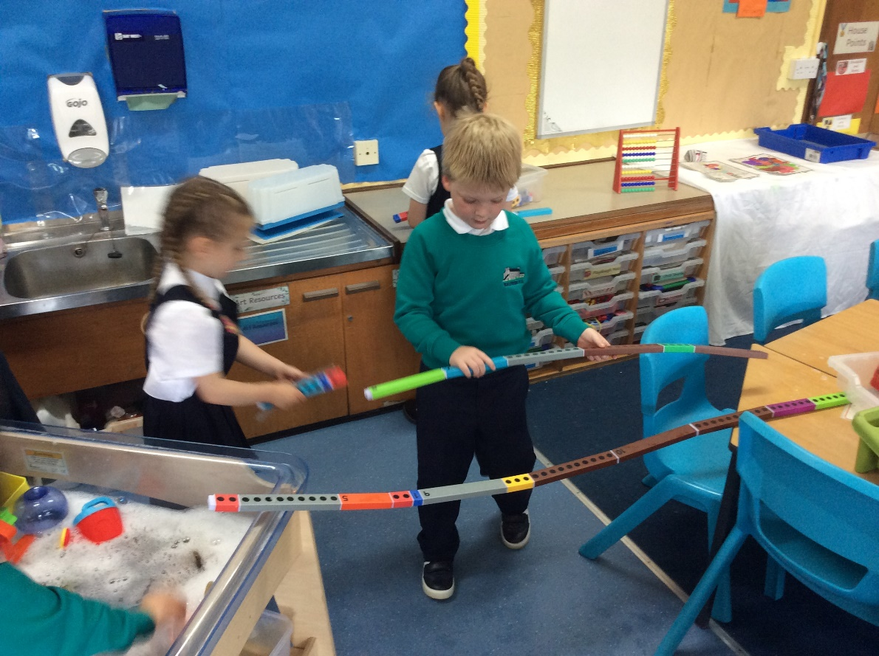
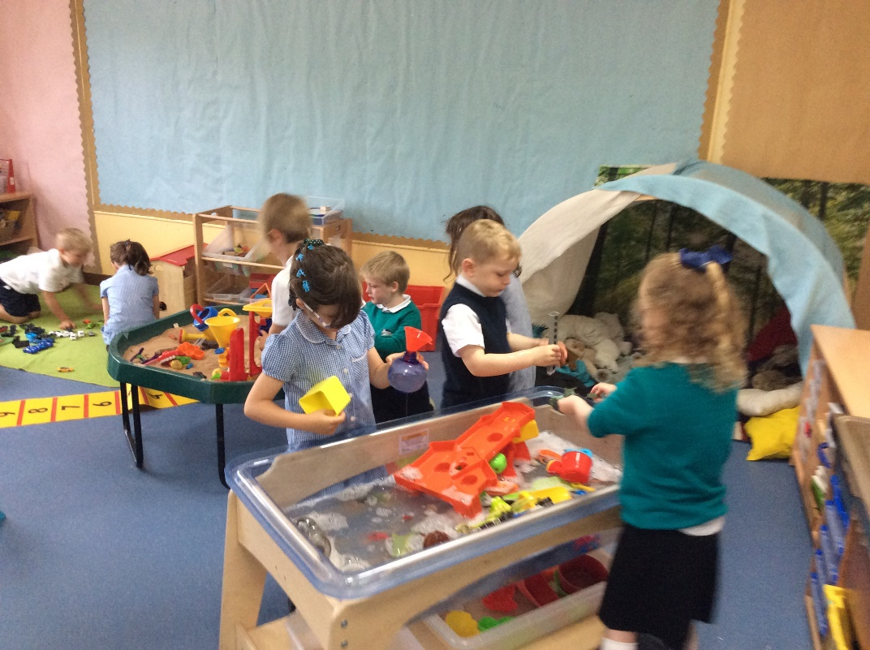
Primary 1 at Balfron PS

Slide 12
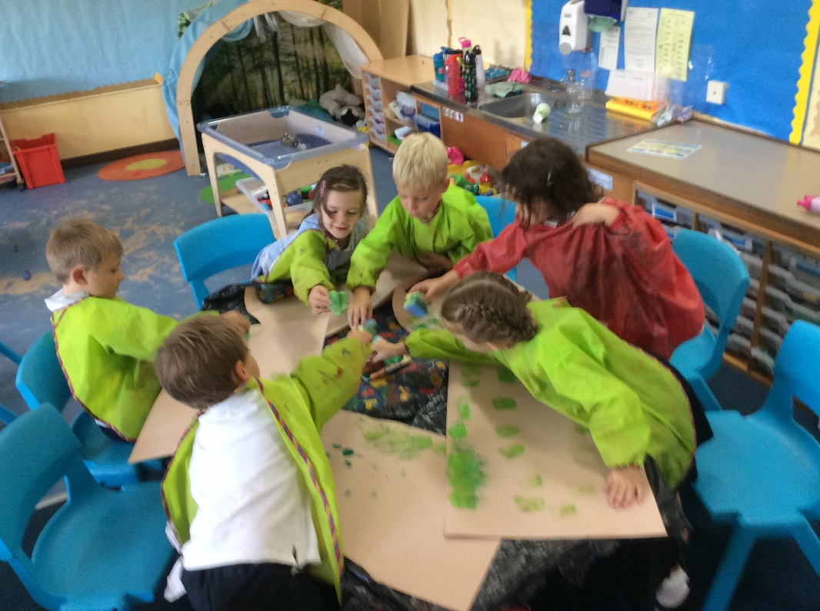
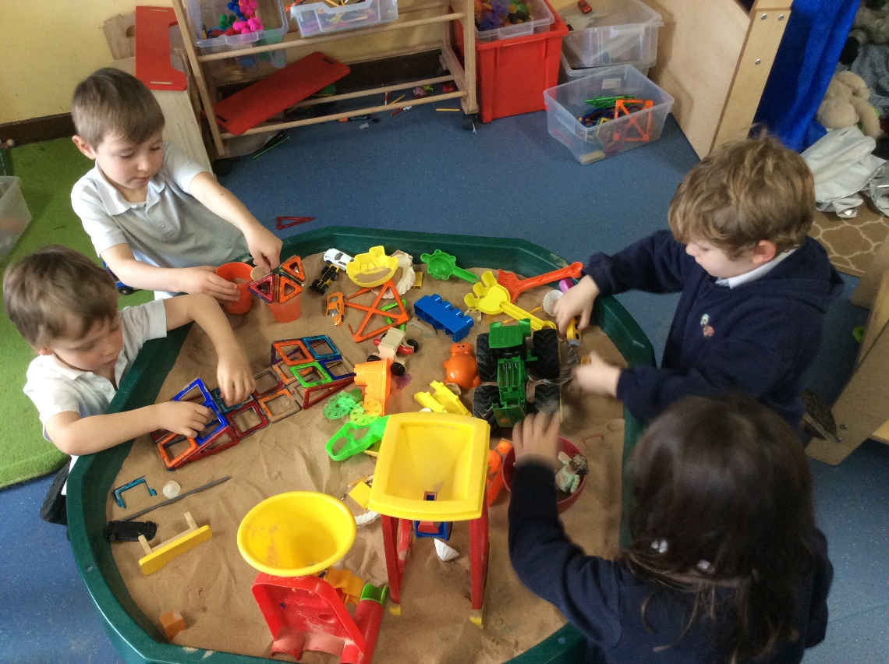
Primary 1 at Balfron PS

Slide 13
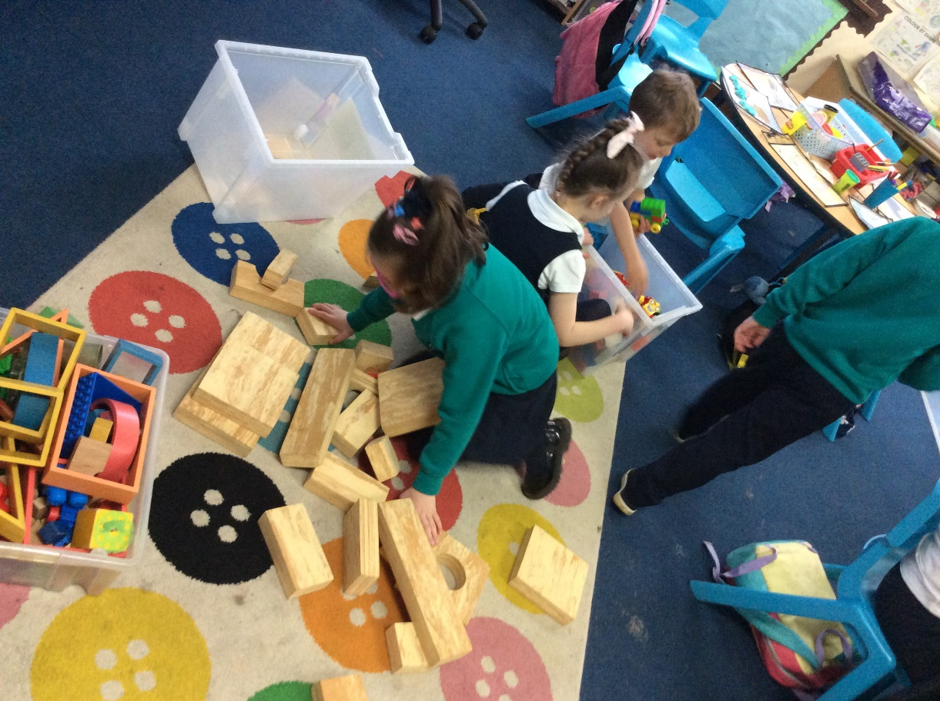
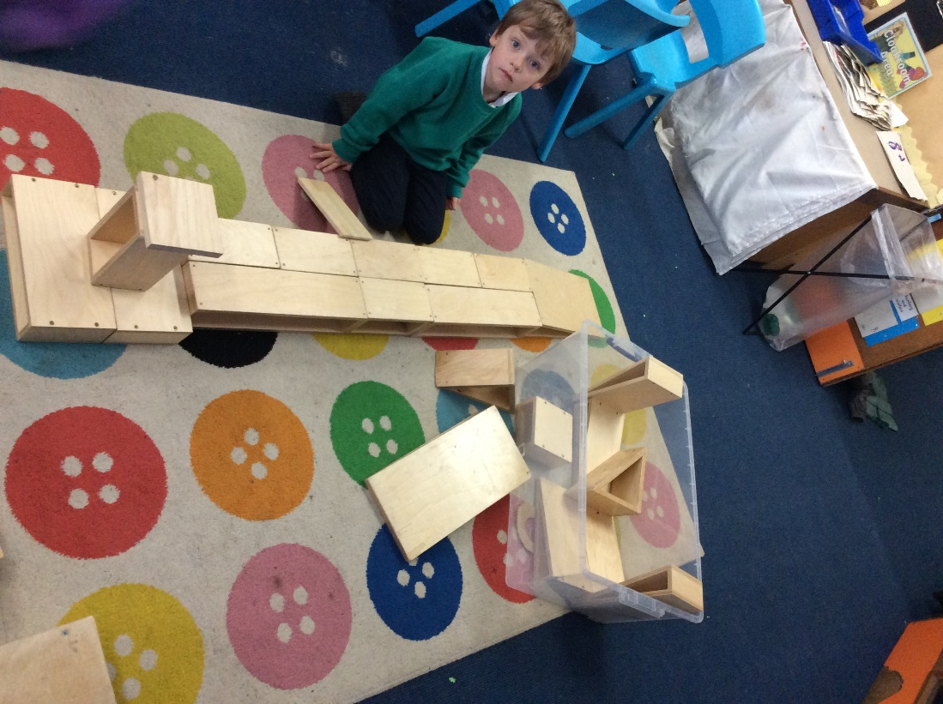
Primary 1 at Balfron PS

Slide 14
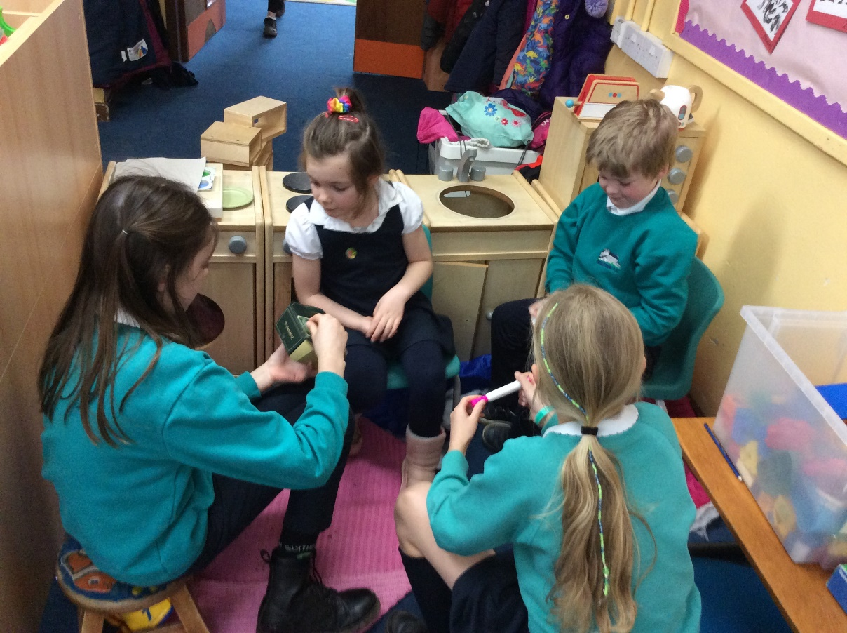
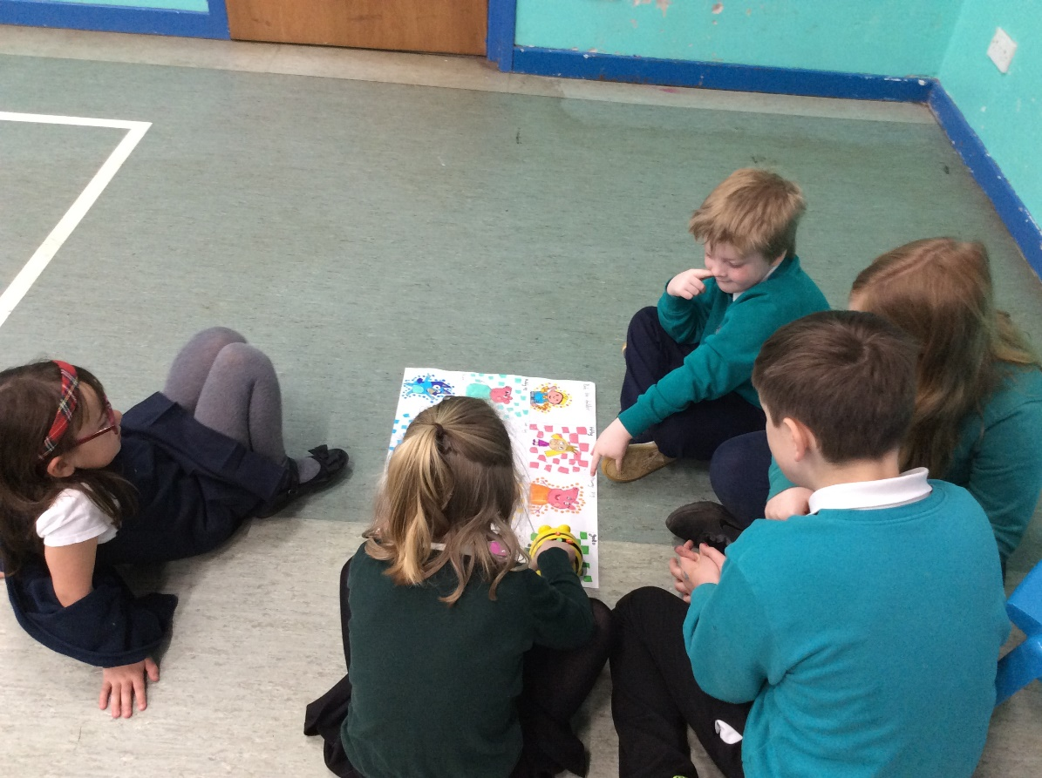
Primary 1 at Balfron PS

Slide 15
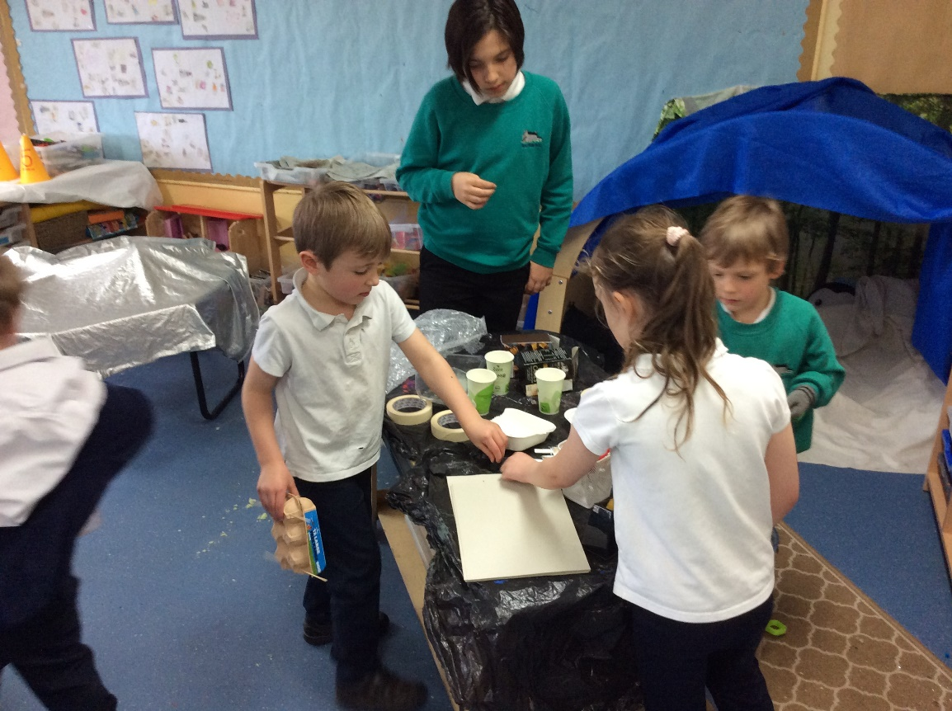
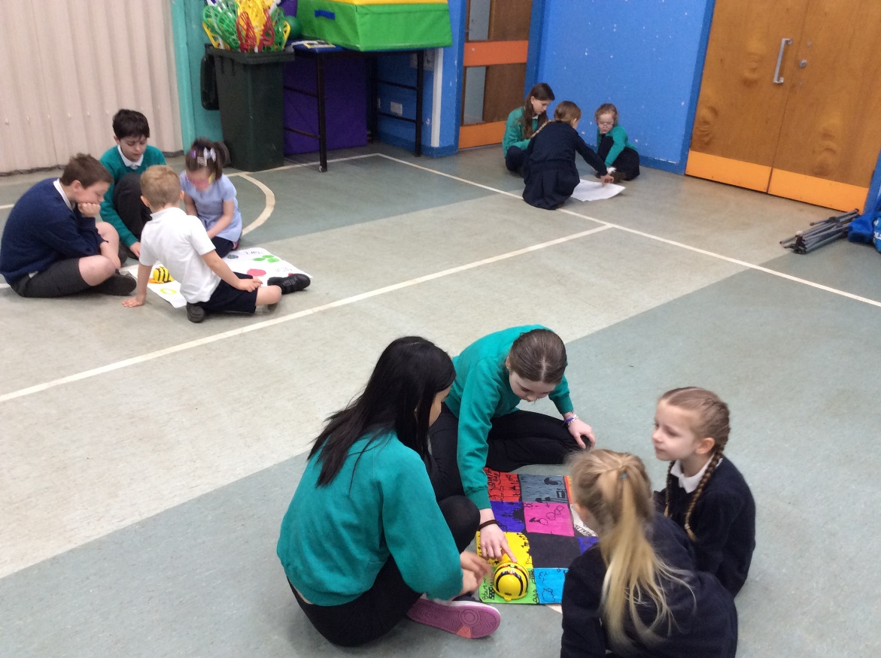
Primary 1 at Balfron PS

Slide 16
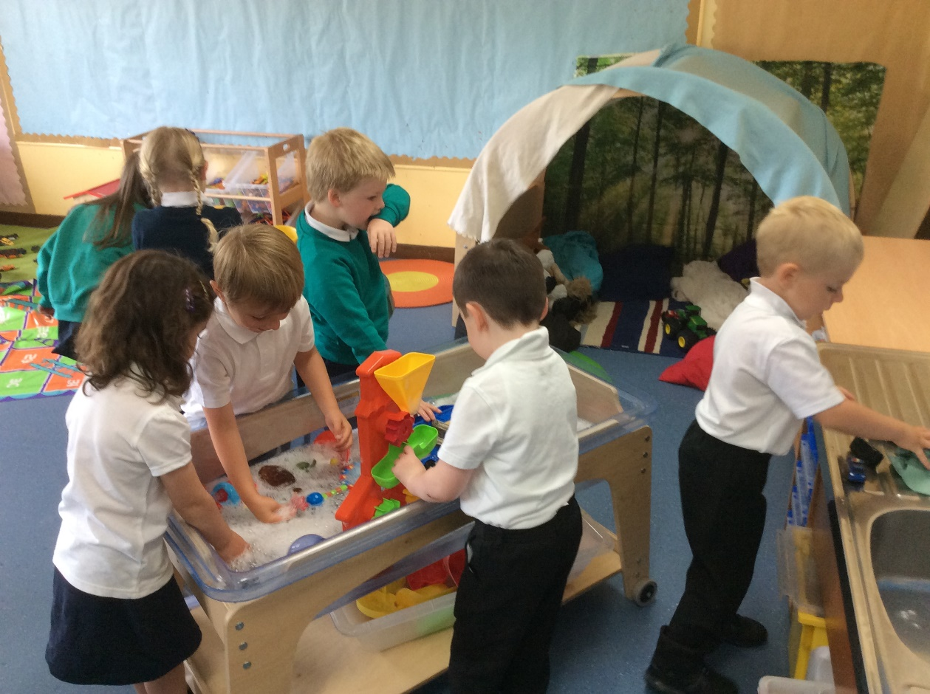
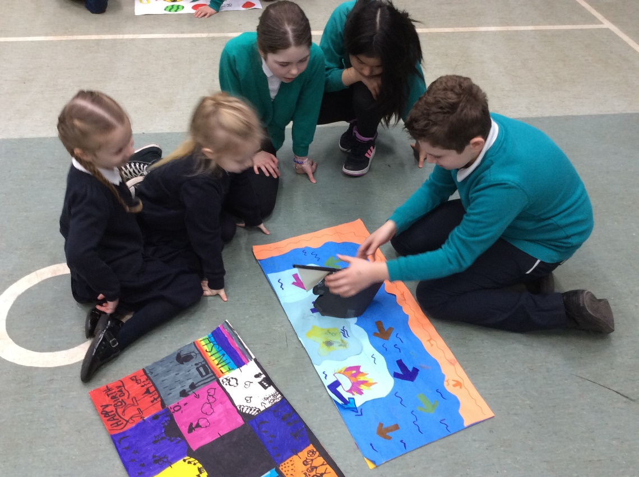
Primary 1 at Balfron PS

Slide 17
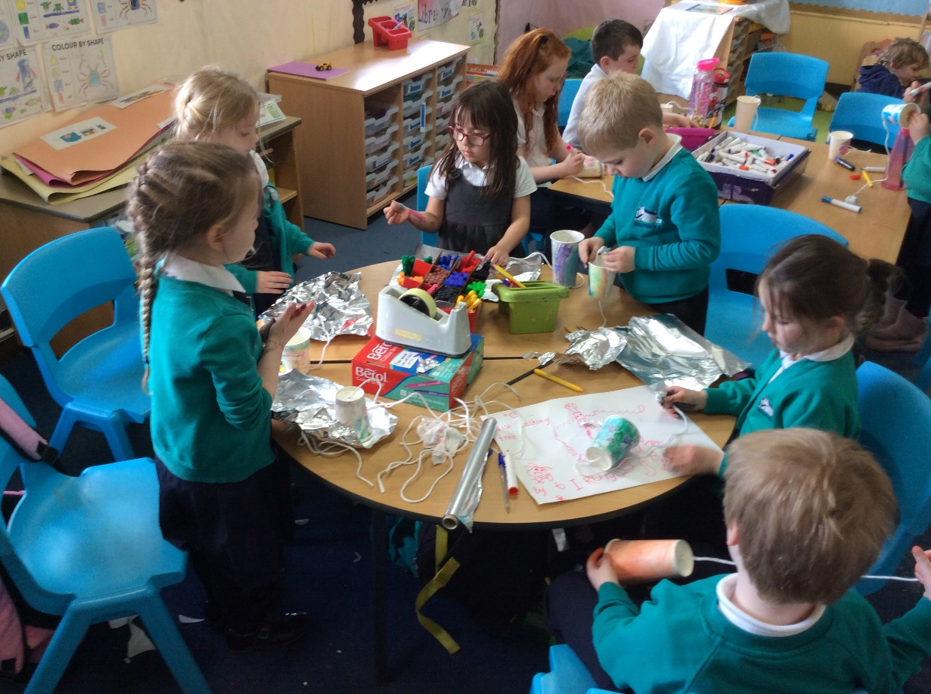
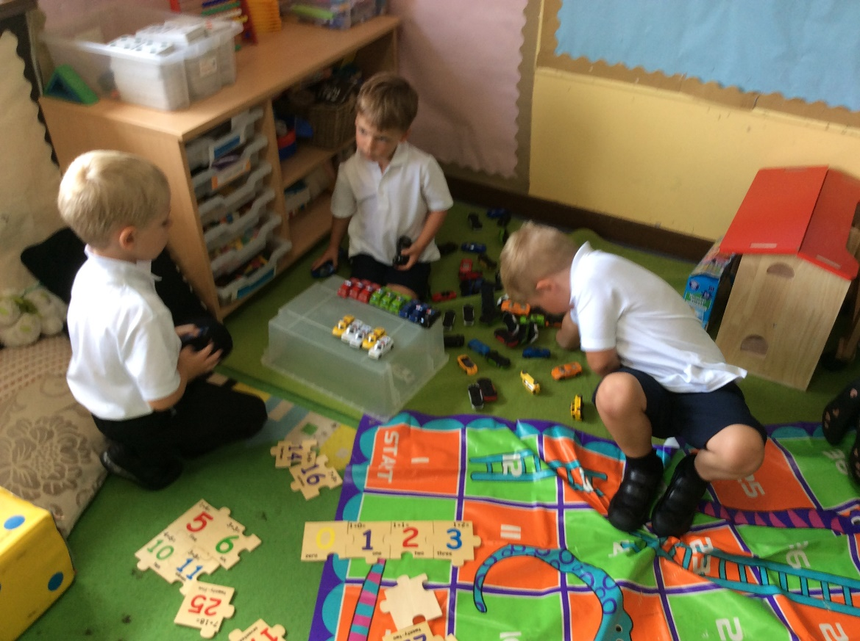
Primary 1 at Balfron PS

Slide 18
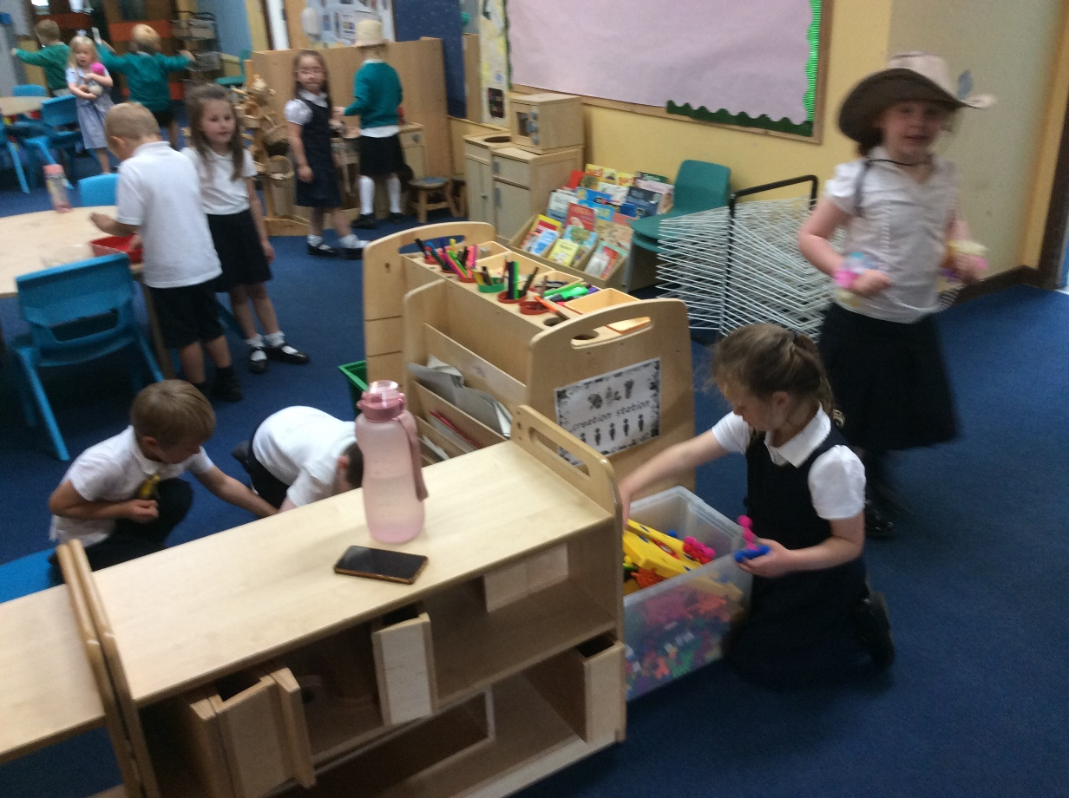
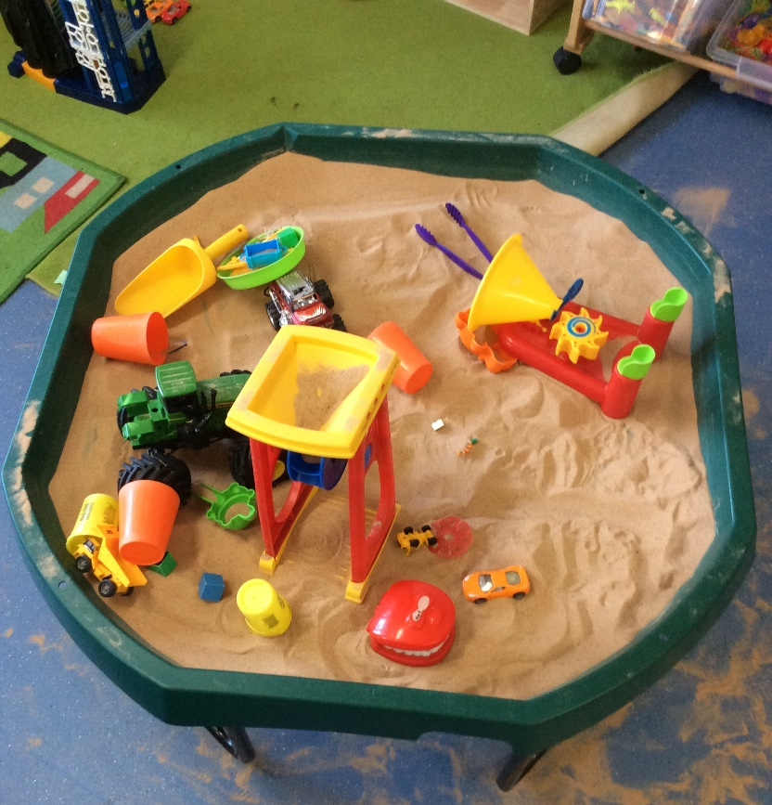
Primary 1 at Balfron PS

Slide 19
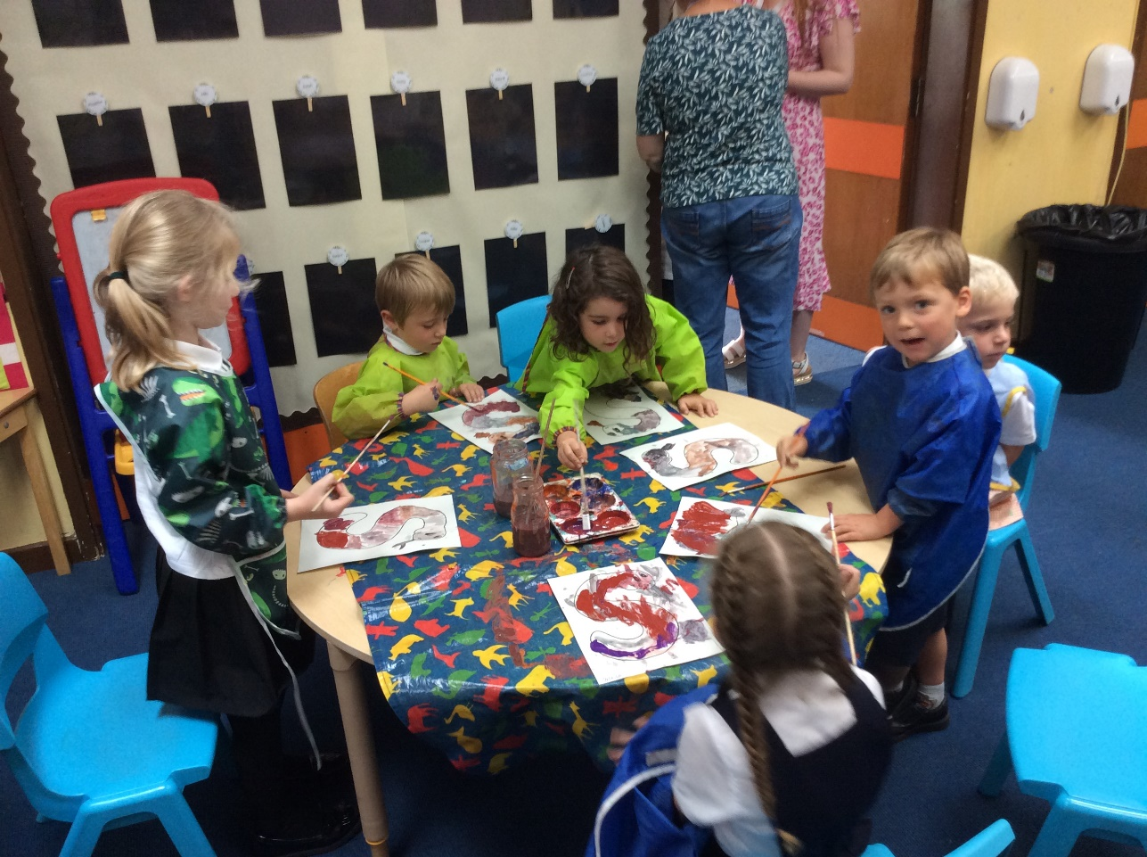
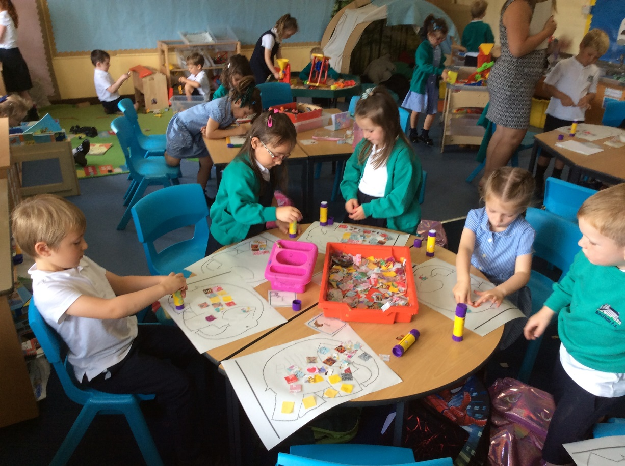
Primary 1 at Balfron PS

