Slide 1
Hydrosphere

Slide 2
Hydrosphere
The hydrosphere unit is about the interactions caused by the water on the planet.
We will study three main concepts
  The hydrological cycle
  Drainage basins
  Hydrographs

Slide 3
Lesson 1. Hydrological Cycle

Slide 4
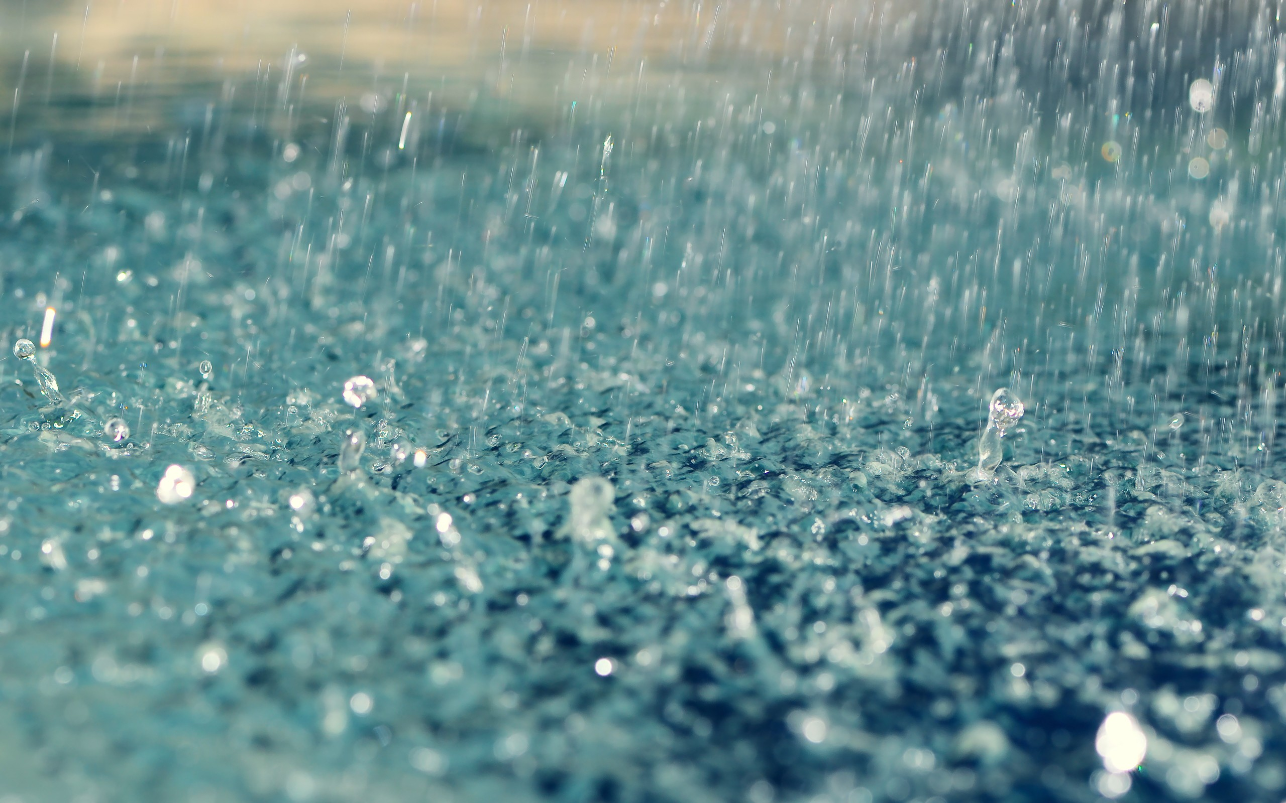
The Hydrological Cycle
The earth is a closed system which means that water is not lost or gained from space
The hydrological cycle describes the storage and movement of this water throughout the planet.

Slide 5
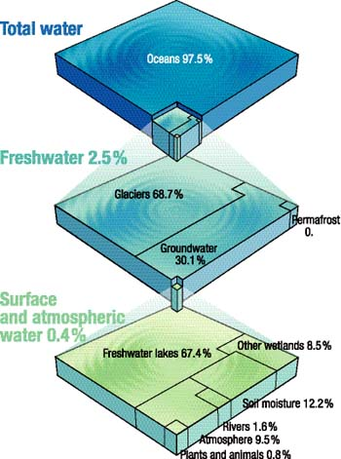
Water Storage
99% of the water in the hydrological cycle is in storage. The remaining 1% is circulating.
Water can spend long amounts of time in these storage areas.
  9 days, in the atmosphere
  2-6 months in rivers,
  50-100 years in lakes
  3,200 years for the oceans
  10,000 years in groundwater
  20,000 years, in the Antarctic ice-cap.

Slide 6
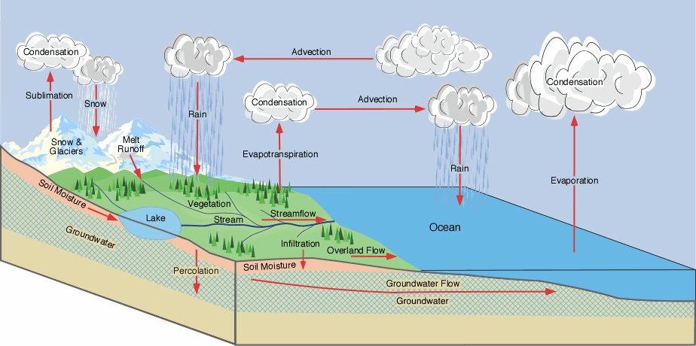

Slide 7
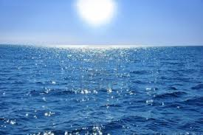
1. Evaporation
The cycle begins with energy from the sun heating the oceans.
This causes evaporation.
As the warm moist air rises it cools causing condensation which forms clouds.

Slide 8
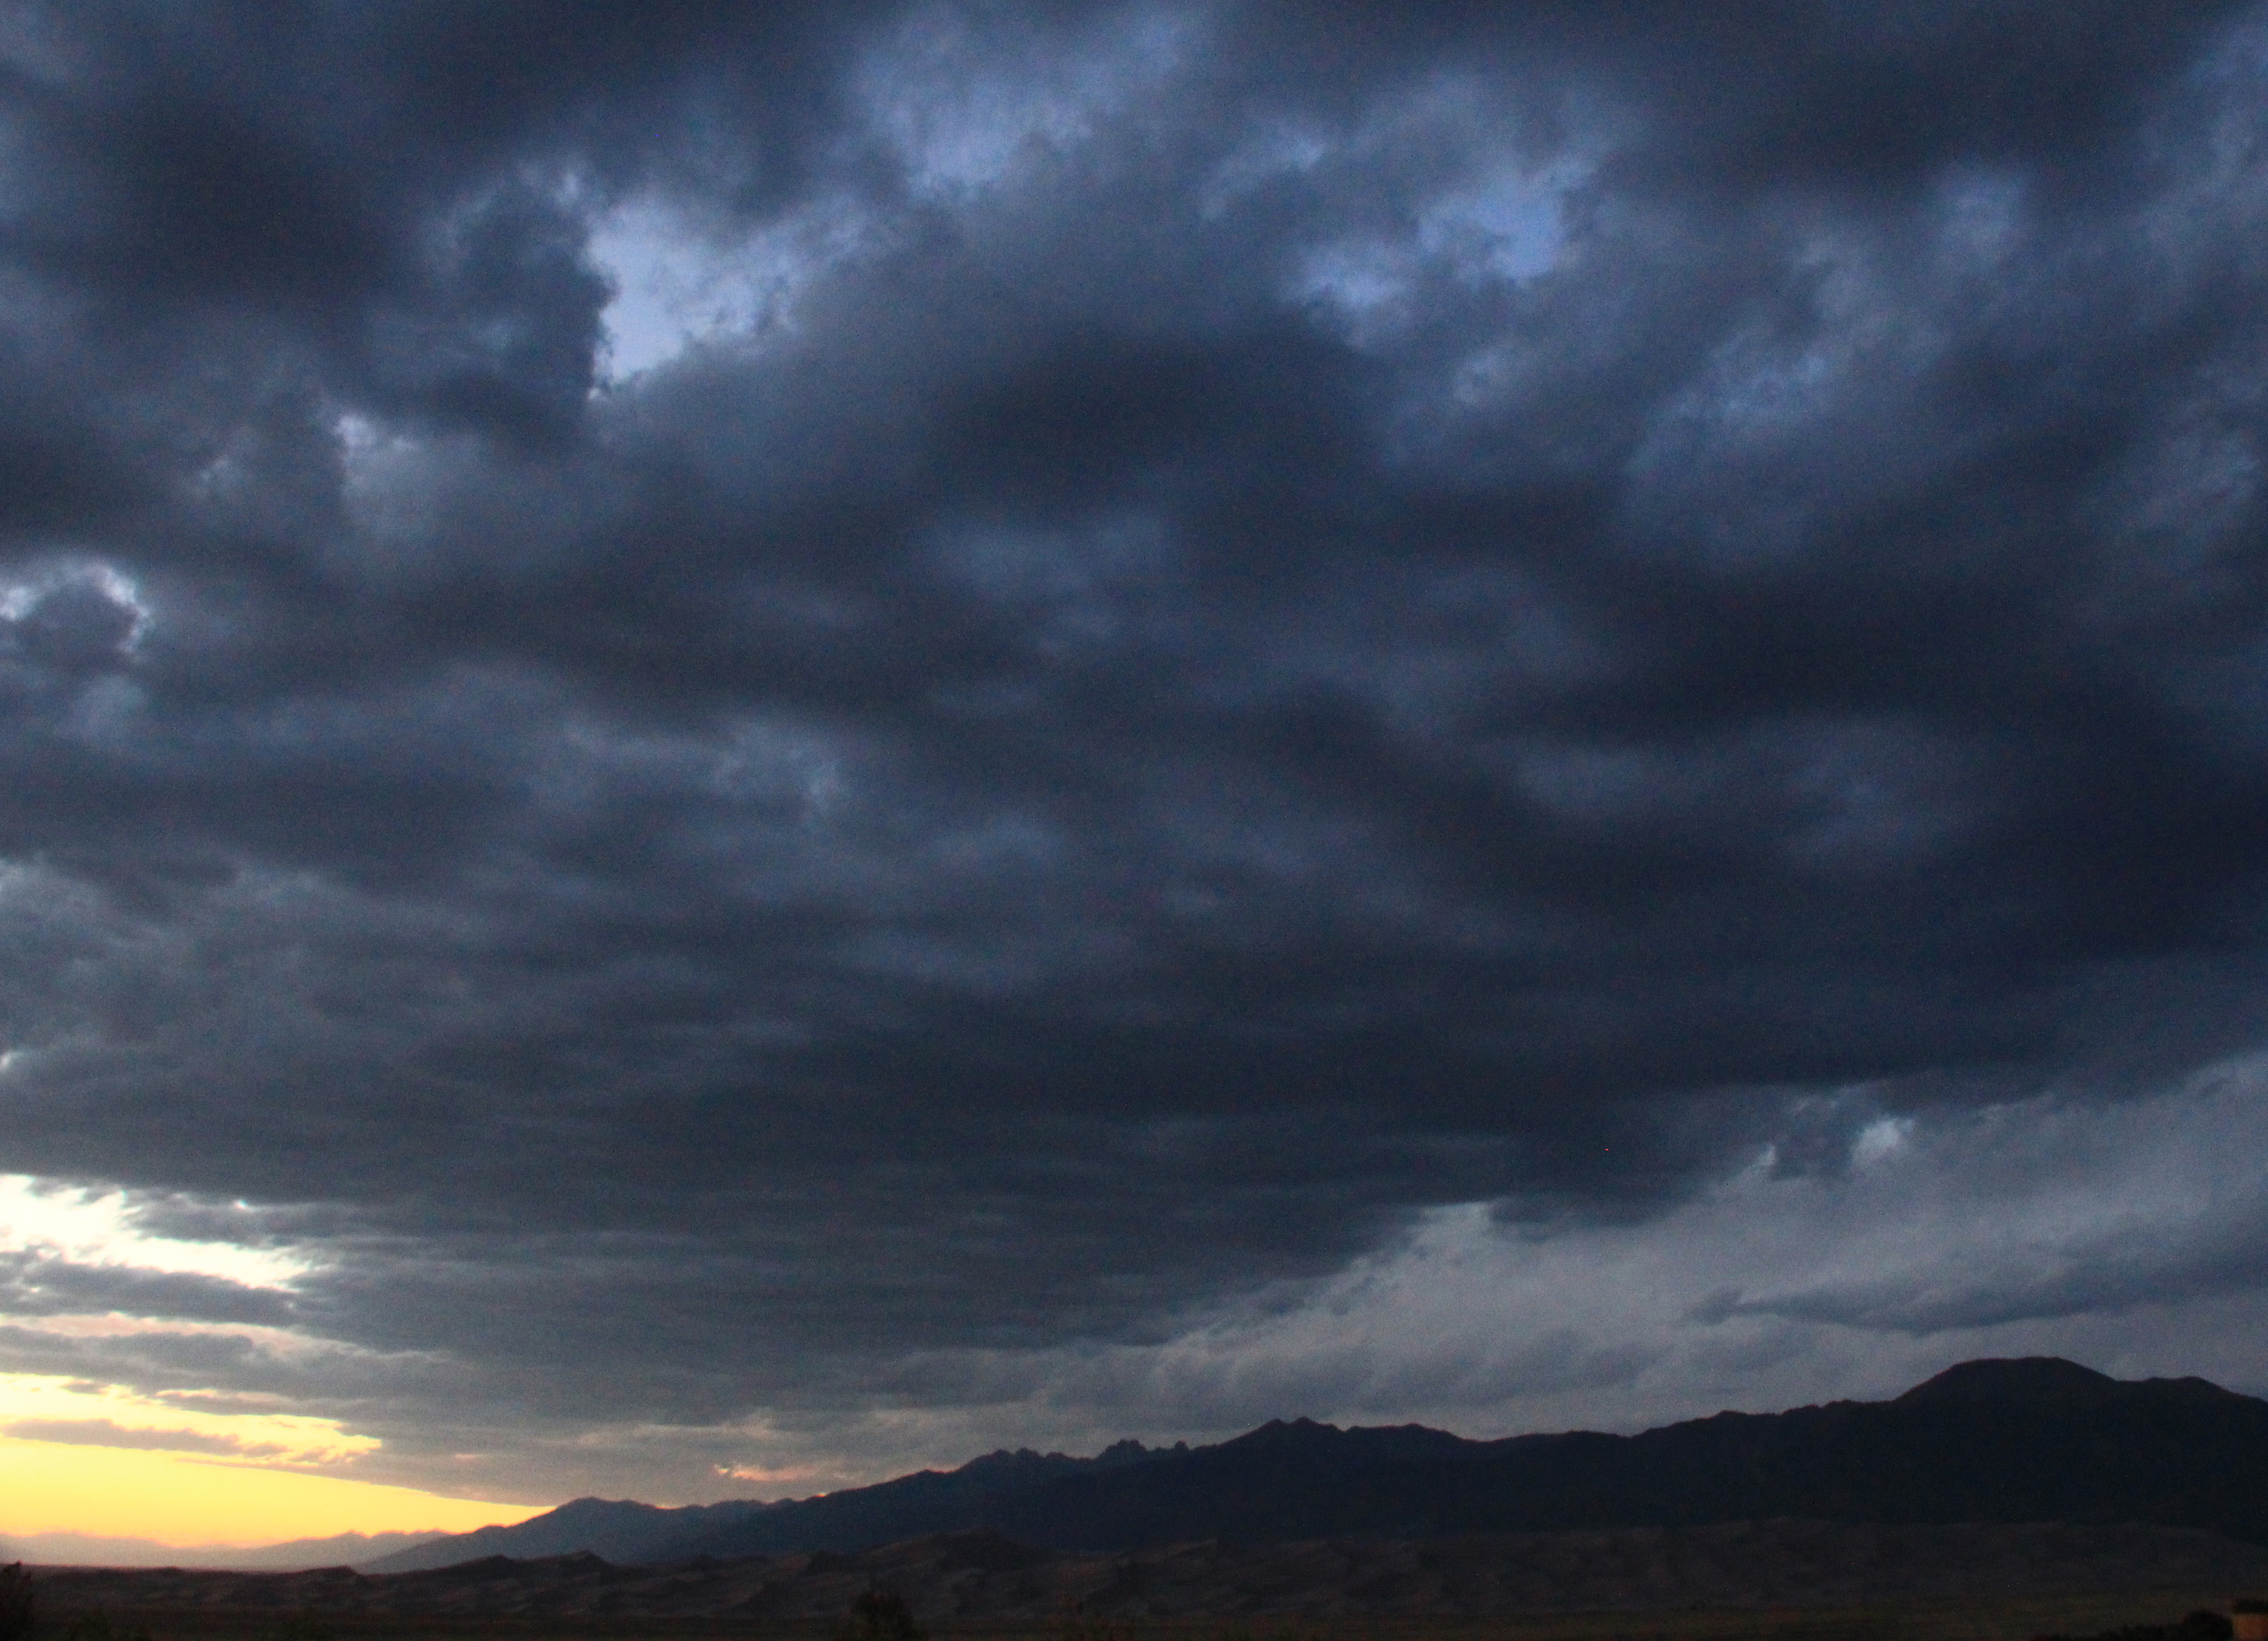
2. Advection
Advection occurs – this is the process whereby the clouds are moved towards land.
Once these clouds reach land then precipitation can occur.

Slide 9
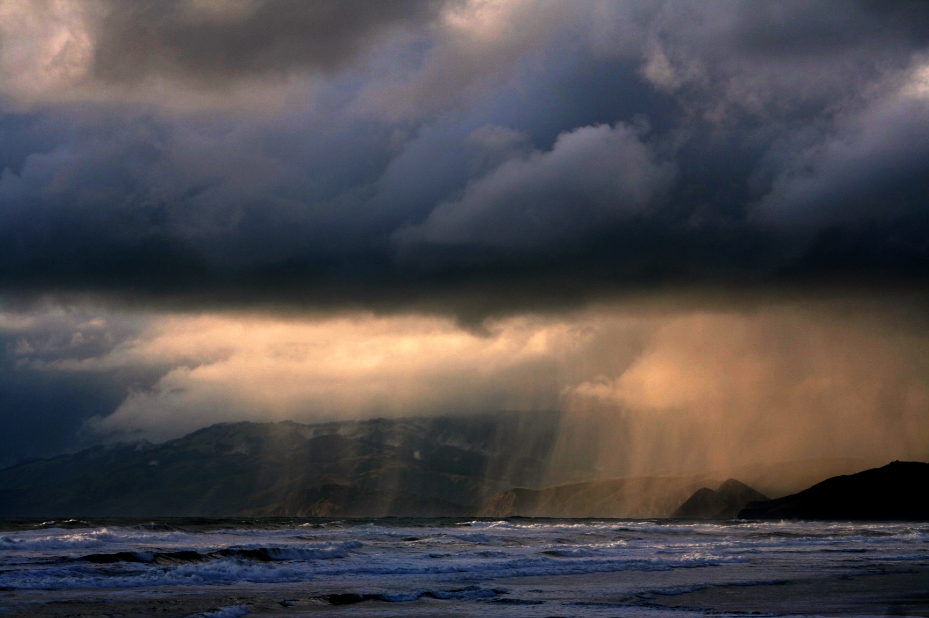


3. Precipitation
Sometimes this is a easy as rain falling on the oceans, then it has returned to its original starting position.
Sometimes it can fall on plants, trees, soil, houses, peoples hair, cars, drains… etc…

Slide 10
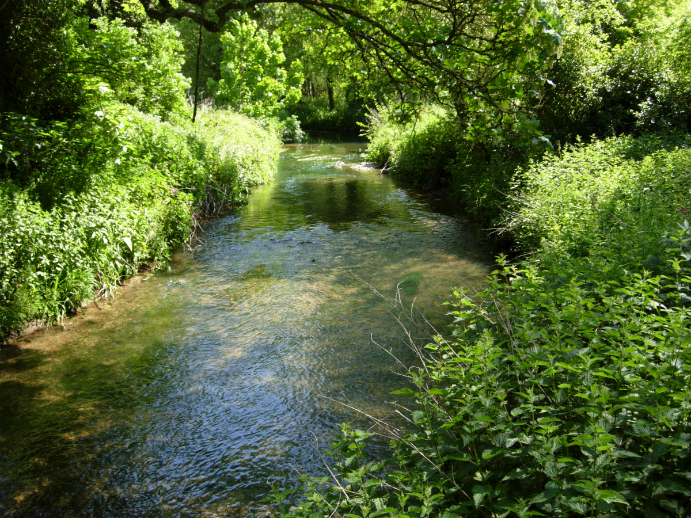
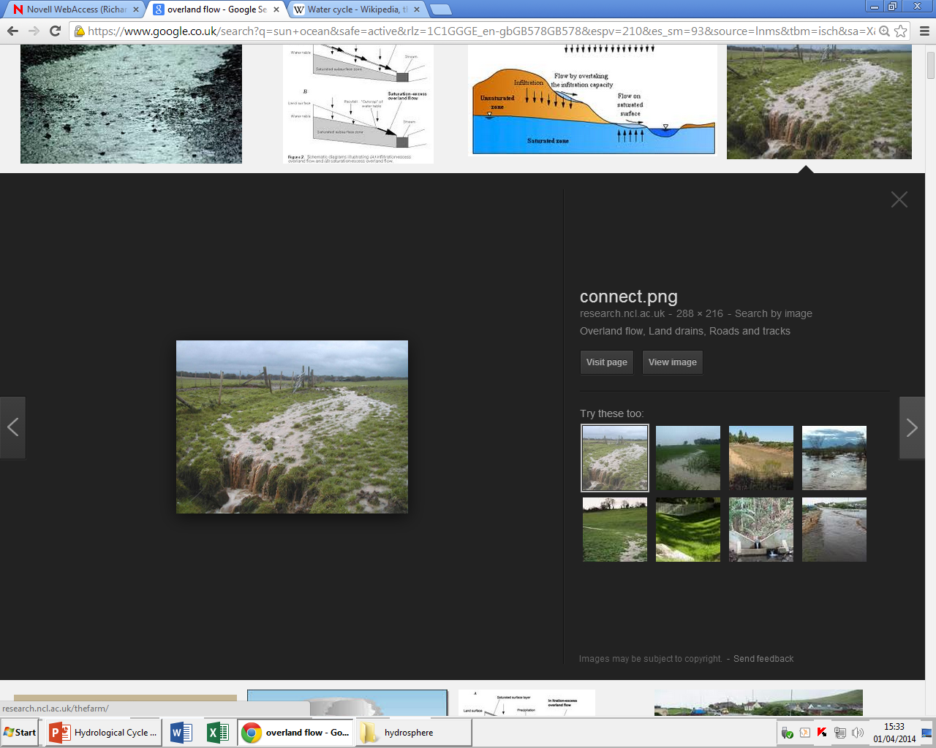
4. Surface Run Off
The precipitation can then form overland run-off and channel flow which travels back to the sea starting the cycle again.
(a) EVAPORATION can occur from any surface water as heat from the sun causes it to turn into water vapour and return to the atmosphere.

Slide 11
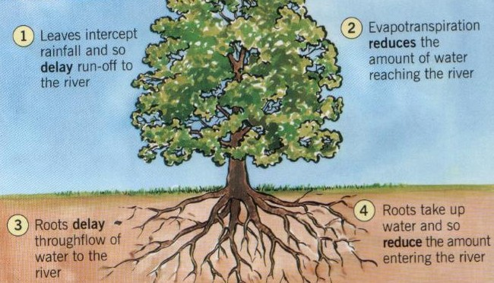
5. Interception
Interception by vegetation can occur:
  The leaves of the trees can intercept the precipitation.

Slide 12
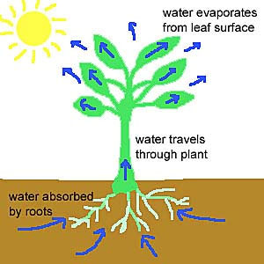
6. Transpiration
Sometimes the water does not make it back to the ocean and gets used by plants and trees.
EVAPOTRANSPIRATION is the combined name for the evaporation and transpiration taking place.

Slide 13
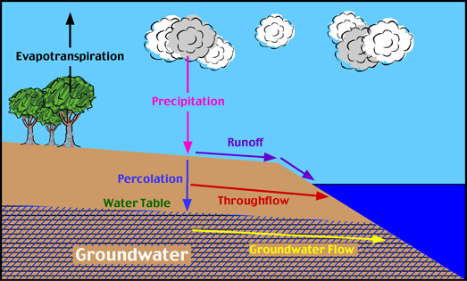
7. Through flow
Water moving
horizontally though
the soil layers
(percolation) then
back to the sea

Slide 14
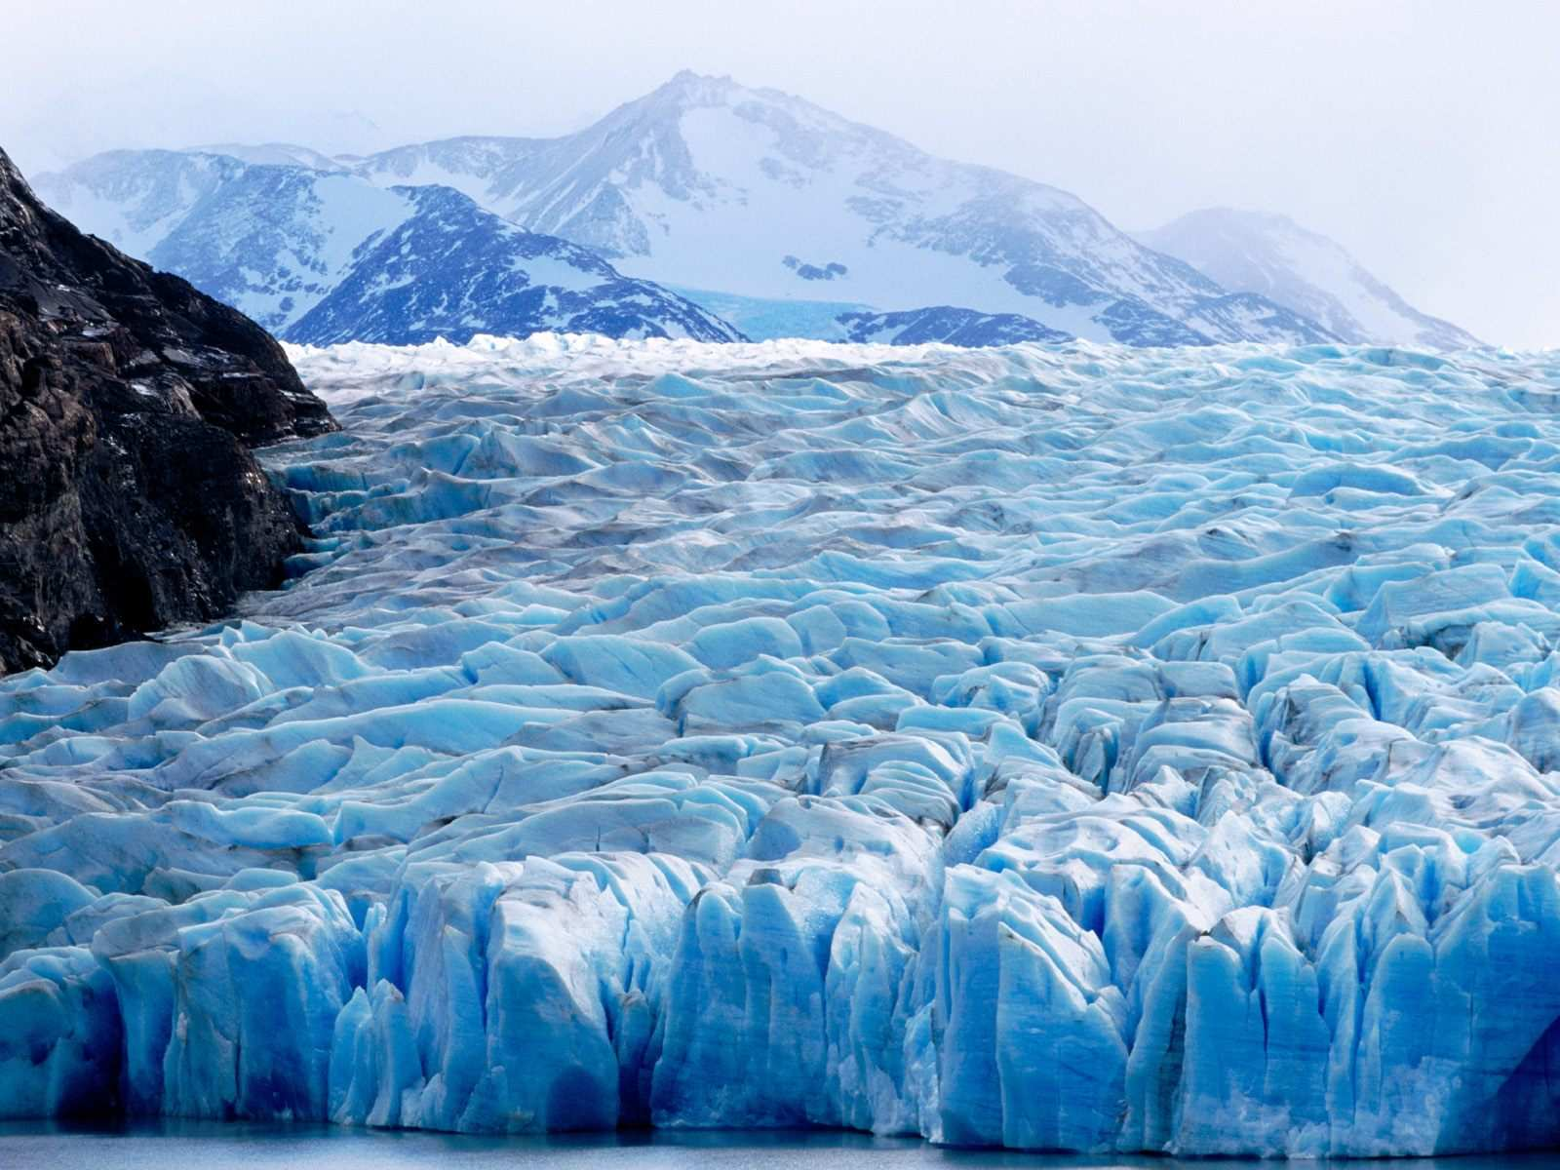
8. Storage
Along its route water can become stored:
  It can infiltrate into soils
  Percolate into rocks
  Become frozen into glaciers
  Flow into lakes
Although eventually it will return to the oceans.

Slide 16
Water Balance
99% of water in the hydrological cycle is in storage. The remaining 1% is in circulation
Of all the water in the water in circulation, 84% is evaporated from oceans while 16% is evaporated or transpired from the land.
76% of all precipitation falls on the oceans, 23% falls on land
This results in a transfer at the surface of 7% from land to sea, matched by a 7% transfer in the atmosphere.

Slide 17
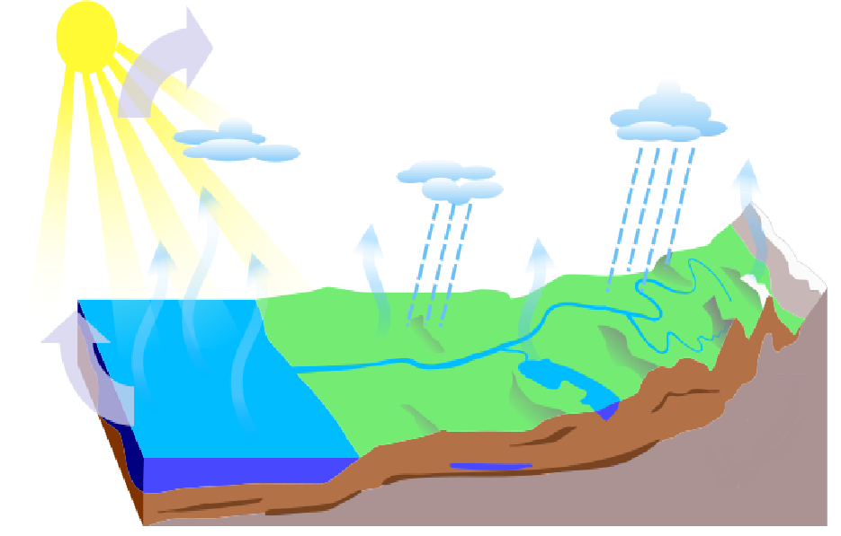
7%
23%
16%
77%
84%
7%

Slide 18
Glossary – Know the definitions of these words
Evaporation
Transpiration
Precipitation
Condensation
Advection
Sublimation
Water table
Infiltration
Percolation
Interception
Surface run-off
Ground water flow
Through flow
Storage
Quiz,
Quiz,
Trade!!

Slide 19
Lesson 2. Human Impacts on the Hydrological Cycle

Slide 20
Human Inputs to the Hydrological Cycle
Although the hydrological cycle is a closed system there is a natural balance maintained between the exchange of water within the system.
However, human activities have the potential to lead to changes in this balance which will have knock on impacts.
These activities include:
  Urbanisation
  Industry
  Deforestation

Slide 21
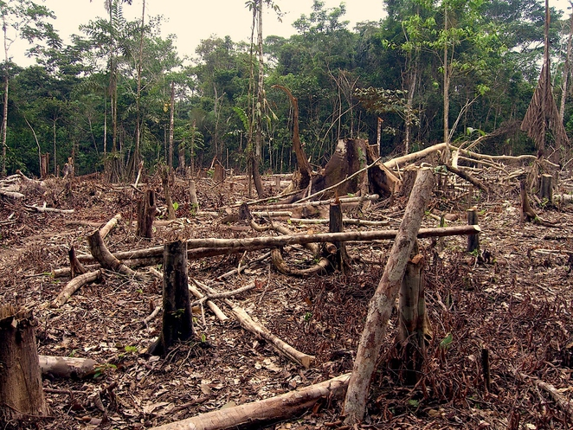
1. Deforestation
If trees are cut down then there will be a decrease in interception and storage. Therefore, run-off will increase.
Cutting down trees also decreases evapo-transpiration and therefore reduces cloud formation.

Slide 22
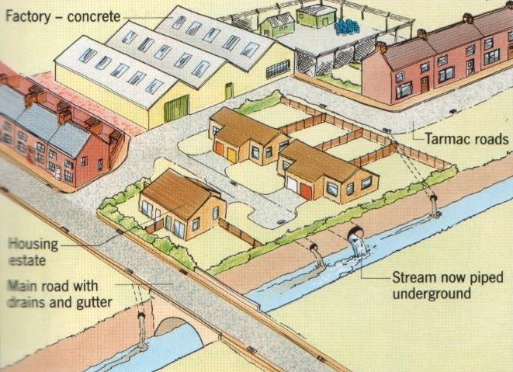
2. Urbanisation
By removing natural vegetation and replacing it with impermeable surfaces and drains can speed up overland flow and can lead to higher river levels.
It also decreases the amount of water which returns to groundwater storage, possibly reducing the water table.

Slide 23
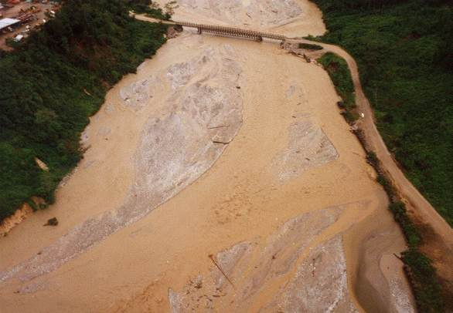
3. Mining
Mining can silt up lakes, rivers and reservoirs leading to reduced storage capacity in these areas.
Mining may also lead to reduced vegetation cover leading to increased run-off.

Slide 24
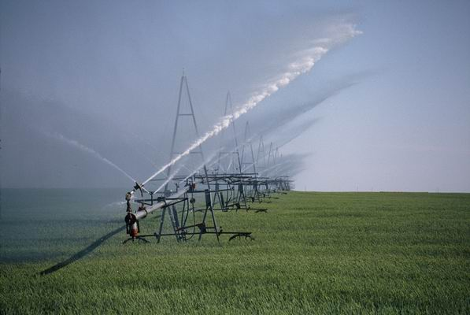
4. Irrigation
By using irrigation for agriculture water is taken from a river or underground store which can:
  Reduce river flow
  Lower water tables
  Increase evaporation/evapo-transpiration by placing water in surface stores (ditches/canals)
  By crops removing water from the cycle as they grow.

Slide 25
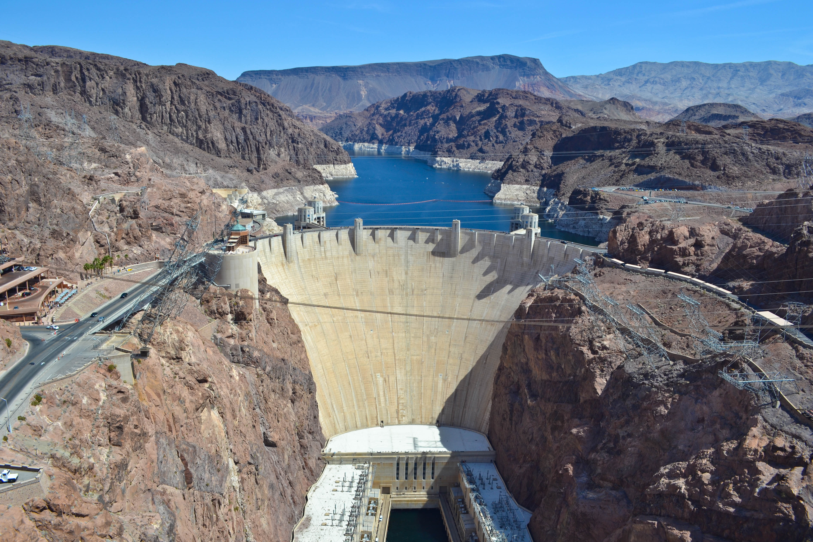
5. Reservoirs and Dams
Dams and reservoirs add additional storages to the hydrological cycle
This slows run-off rates from channel flow
Increases evaporation and cloud formation altering the rainfall pattern

Slide 26
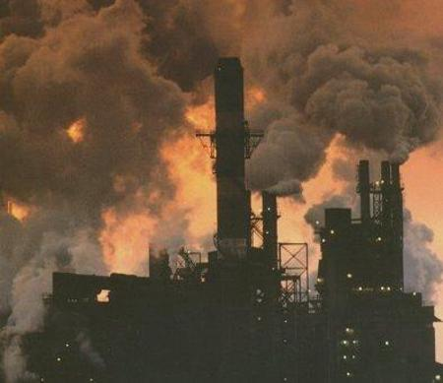
6. Other Human Activities
Large amounts of water vapour are released into the atmosphere from industrial process which increases cloud formation altering the hydrological cycle.
Soil compaction (mainly due to agriculture) creates an impermeable surface which increases run-off and reduces infiltration into underground storages.

Slide 27
Impacts
These human activities can lead to increase chances of flooding
Increases in soil erosion
Notes:
A cooling effect on the north west of Europe (climate change) Higher precipitation levels in the Arctic but less in the Tropics

Slide 28
Lesson 3. Drainage Basins

Slide 29
Drainage Basins
Within the global water cycle there are smaller compartmentalised zones, these are known as drainage basins.
A drainage basin is an area of land which is drained by a river and its tributaries.
Within these areas miniature versions of the global water cycle take place, whereby water falls as precipitation and moves towards the basin output, on the way it can be stored, evaporated or transpired.

Slide 30
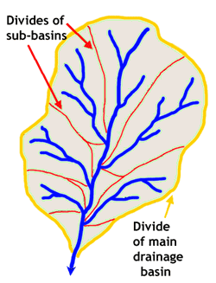
Drainage Basins
Drainage Basin
The land within a drainage basin is called the catchment area, any precipitation falling within this region flows through tributaries into a single main river where it exits the catchment area.
Drainage basins are separated from each other by high areas of land knows as watersheds.
Water Shed
Tributaries
Outside edge of catchment area

Slide 31
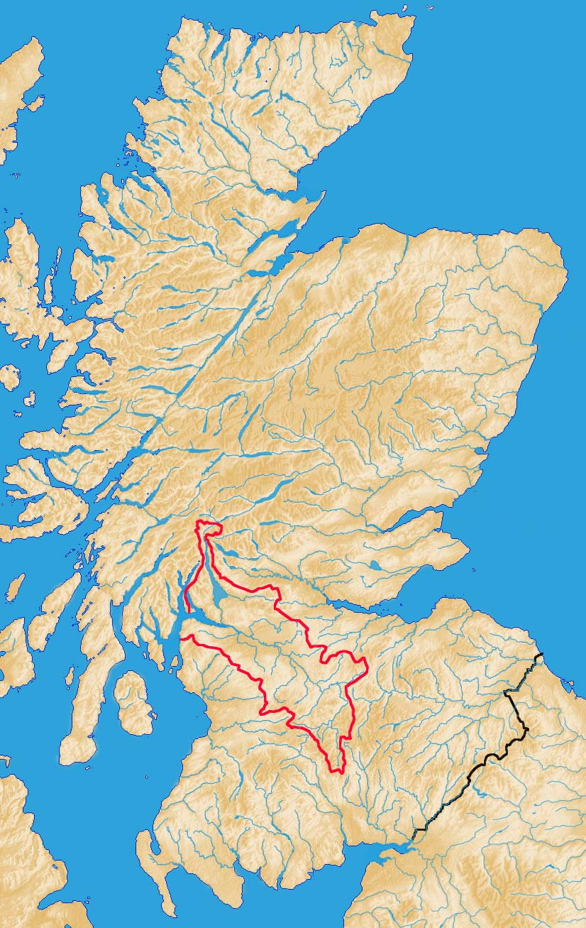
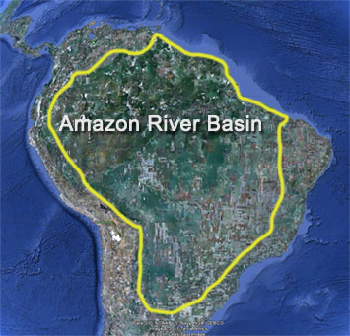
Drainage Basin Size
The size of drainage basins can vary.
Most drainage basins contain many sub-catchment areas.
Most drainage basins eventually lead to a sea or ocean.

Slide 32
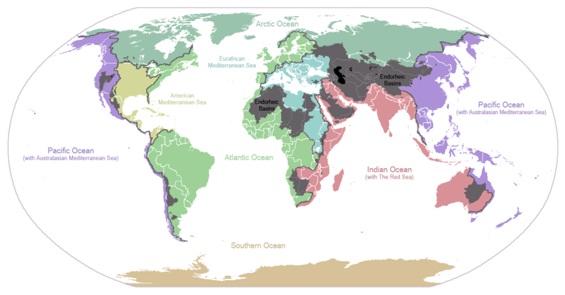
Drainage Basins of the World

Slide 33
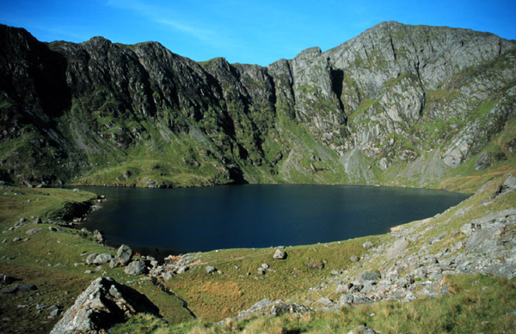
Drainage Basins
Unlike the hydrological cycle drainage basins are not a closed system
They lose water via outputs
  Such as channel flow and evapo-transpiration.
They also gain water from inputs
  Such as precipitation

Slide 34
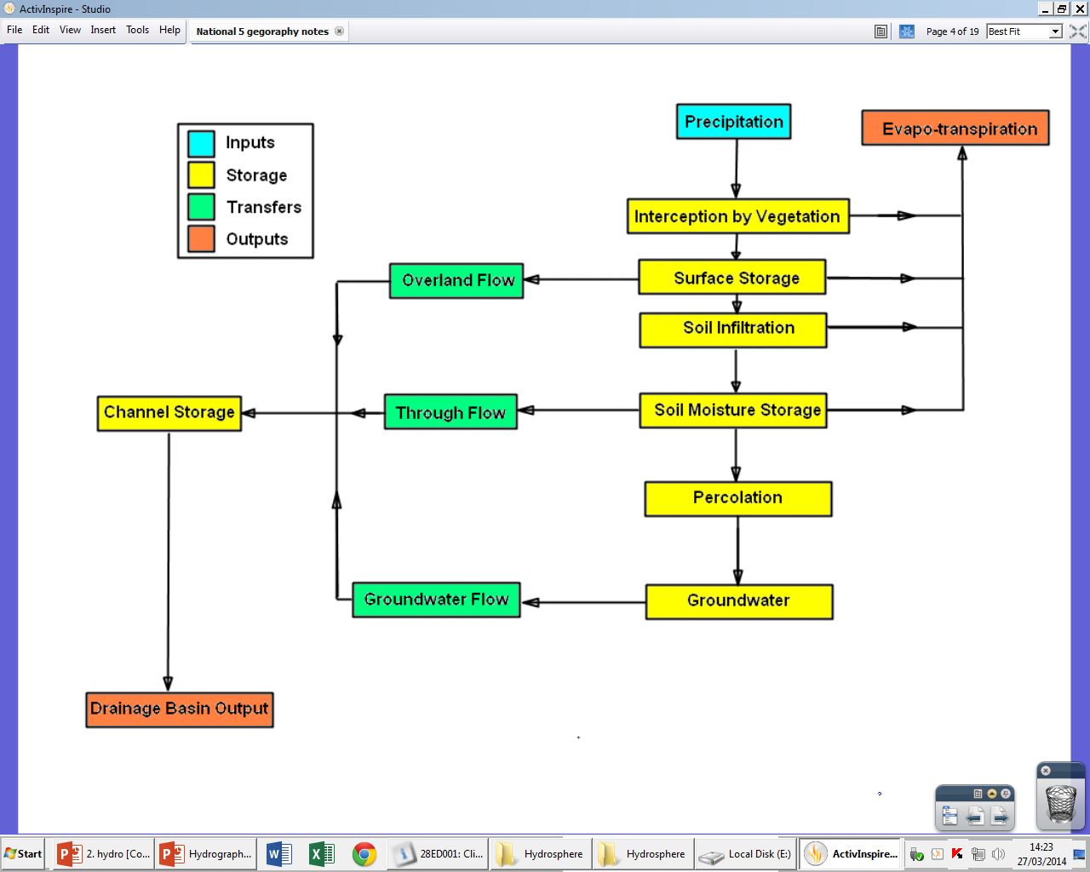

Slide 35
Inputs and Outputs
Input:
  Precipitation
    The main input to the river basin system – the type of precipitation (rain, snow, hail and sleet), intensity, duration and frequency are all important.
Outputs:
  Evapo-transpiration
    Water can be lost from a drainage basin back into the atmosphere.
  Channel flow
    Once the water has reached a river it will flow downhill until it reaches the basin output

Slide 36
Storages and Transfers
Interception
  When it rains, most water droplets are intercepted by trees and plants. Interception is greatest in summer.
    Light rain - little water will reach the ground – it will be stored on leaves and then evaporated back into the system.
    Heavy Rain - water will drip from the vegetation (Throughfall) onto the ground or will run indirectly via branches and trees back to the ground (Stemflow).
Surface storage
  The moisture may form pools on the surface or fall directly into lakes
    This may be evaporated directly into the atmosphere
Infiltration
  The downwards movement of water through tiny pores in the soil.
    Will be greatest in porous soils such as chalk or sand.

Slide 37
Storage and Transfers
Soil moisture
  The water will either be stored in the soil or slowly transferred sideways or downways.
Throughflow
  The movement of water sideways – may form a spring on a valley side or enter a river or lake
Percolation
  The movement of water downwards in rocks.

Slide 38
Storage and Transfers
Ground water
  When the infiltrated and percolated water collects
Surface Run-off
  The fastest process of water movement and occurs when rainfall is too heavy for the water to infiltrate the ground, when soil is impermeable or when the soil has become saturated.
Although some water may fall directly into the river, most water reaches it by a combination of surface runoff, through flow and ground water flow.

Slide 39
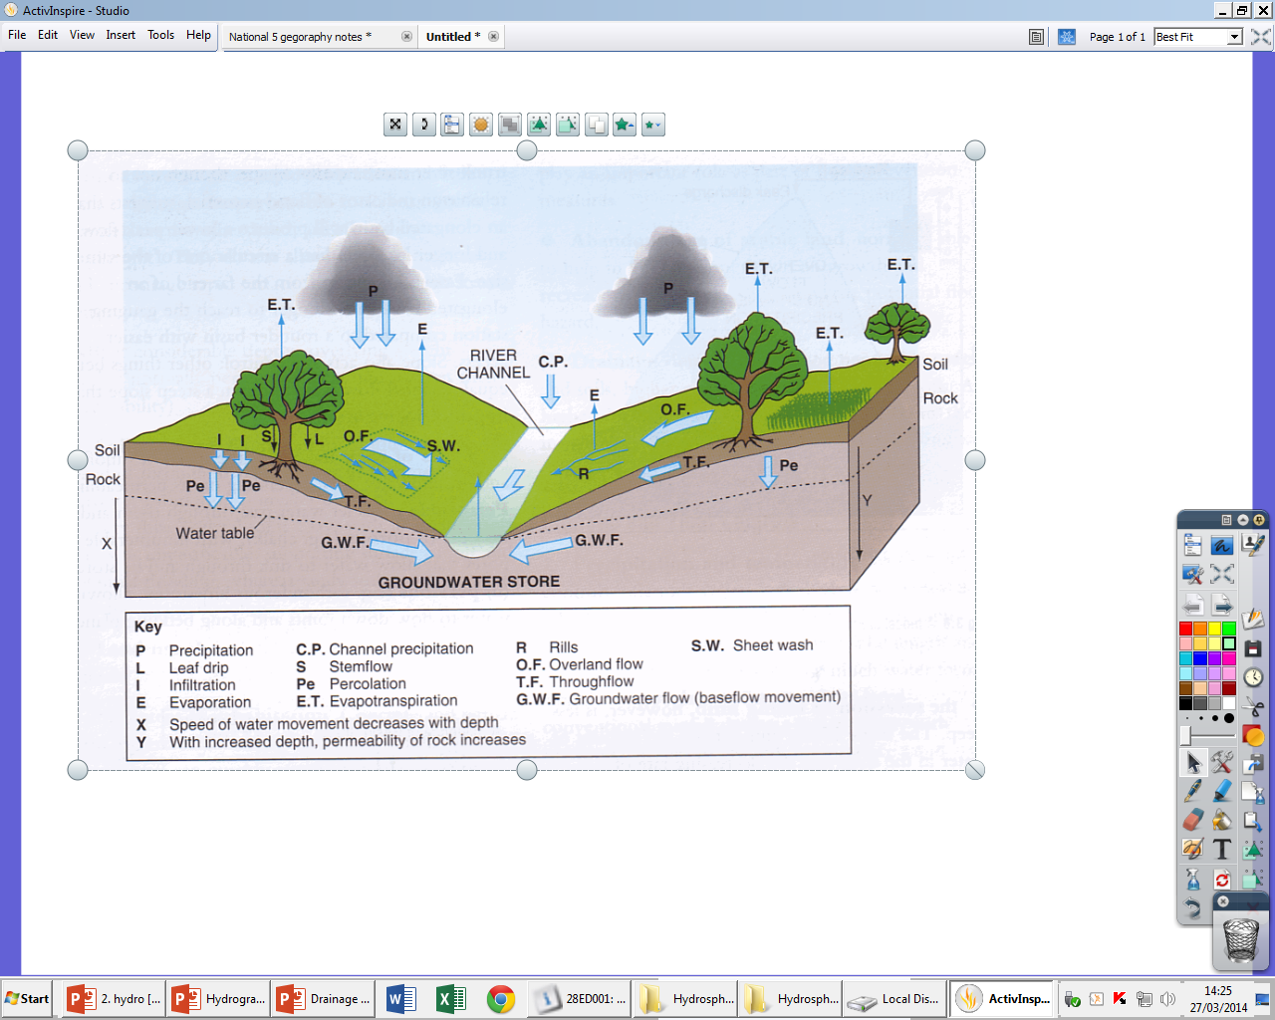
Processes within a drainage basin

Slide 40
Hydrographs
A hydrograph is used to show how the water flow in a drainage basin responds to a period of precipitation.
They are used in flood and river management.
3
Discharge (m³/s)
2
4
1
3
2
0 12 24 36 48 60 72
Hours from start of rain storm

Slide 41
Glossary
Discharge
Lag Time
Peak Flow
Rising Limb
Recession Limb
Base Flow
Through Flow
Overland Flow
Storm Flow

Slide 42
Constructing Hydrographs
3
2
Discharge (m³/s)
1
0 12 24 36 48 60 72
Hours from start of rain storm

Slide 43
Precipitation is shown in mm, as a bar graph
3
2
mm
Discharge (m³/s)
4
1
3
2
0 12 24 36 48 60 72
Hours from start of rain storm

Slide 44
Discharge in m³/s, (cumecs), as a line graph
3
2
mm
Discharge (m³/s)
4
1
3
2
0 12 24 36 48 60 72
Hours from start of rain storm

Slide 45
Rising limb
The rising of the flood water in the river
3
Rising limb
2
mm
Discharge (m³/s)
4
1
3
2
0 12 24 36 48 60 72
Hours from start of rain storm

Slide 46
Peak flow
Peak flow
3
Maximum discharge in the river
Rising limb
2
mm
Discharge (m³/s)
4
1
3
2
0 12 24 36 48 60 72
Hours from start of rain storm

Slide 47
Peak flow
Recession limb
3
Falling flood water in the river
Rising limb
2
Recession limb
mm
Discharge (m³/s)
4
1
3
2
0 12 24 36 48 60 72
Hours from start of rain storm

Slide 48
Basin lag time
Basin lag time
Peak flow
Time difference between the peak of the rain storm and the peak flow of the river
3
Rising limb
2
Recession limb
mm
Discharge (m³/s)
4
1
3
2
0 12 24 36 48 60 72
Hours from start of rain storm

Slide 49
Basin lag time
Peak flow
3
Base flow
Normal discharge of the river
Rising limb
2
Recession limb
mm
Discharge (m³/s)
4
1
3
2
Base flow
0 12 24 36 48 60 72
Hours from start of rain storm

Slide 50
Basin lag time
Peak flow (of storm flow)
Overland flow*
3
+
Through flow*
Rising limb
+
Overland flow
Recession limb
=
2
mm
Storm Flow
Discharge (m³/s)
4
Through flow
1
3
2
Base flow
0 12 24 36 48 60 72
Hours from start of rain storm
*See next slide for definitions

Slide 51
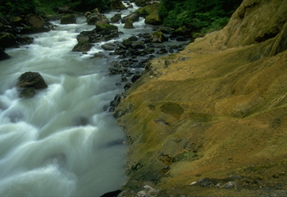
Overland flow
Through flow
Volume of water reaching the river from surface run off
Volume of water reaching the river through the soil and underlying rock layers

Slide 52
Basin lag time
Peak flow (of storm flow)
Overland flow
3
+
Through flow
Annotate your own Hydrograph
Rising limb
Overland flow
Recession limb
=
2
mm
Storm Flow
Discharge (m³/s)
4
Through flow
1
3
2
Base flow
0 12 24 36 48 60 72
Hours from start of rain storm

Slide 53
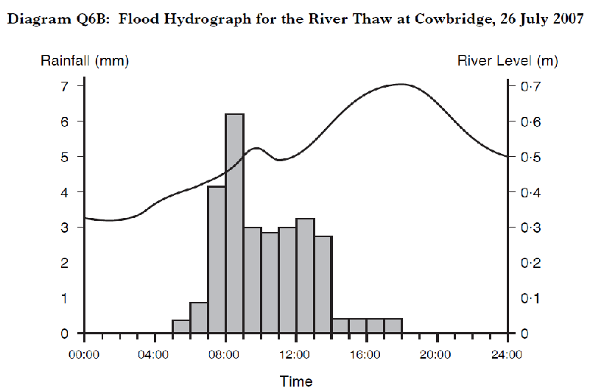
Hydrograph 1
PRECIPITATION
When did it start raining?
How long did it rain for?
When/what is the peak rainfall?
DISCHARGE
What is the flow/level at start of period?
What and when was the peak flow?
What is the lag time?
How steep is the rising limb?
How steep is the recession limb?

Slide 54
Draw your own hydrograph
When did it start raining?
  5 hours
How long did it rain for?
  10 hours
What is the total rainfall?
  101mm
When was the peak rainfall?
  11 hours
What is the peak rainfall?
  22mm
What is the flow rate to start?
  0.5m³s⁻¹
How long is the river above base flow?
  30 hours
When was the peak flow?
  21 hours
What was the peak flow?
  4.5m³s⁻¹
What is the lag time
  10 hours
How steep is the rising limb?
  steep
How steep is the recession limb?
  steep
Hours | 5 | 6 | 7 | 8 | 9 | 10 | 11 | 12 | 13 | 14 | 15
Precipitation (mm) | 2 | 5 | 7 | 11 | 12 | 16 | 22 | 14 | 8 | 3 | 1

Slide 55
Different shapes of Hydrographs

Slide 56
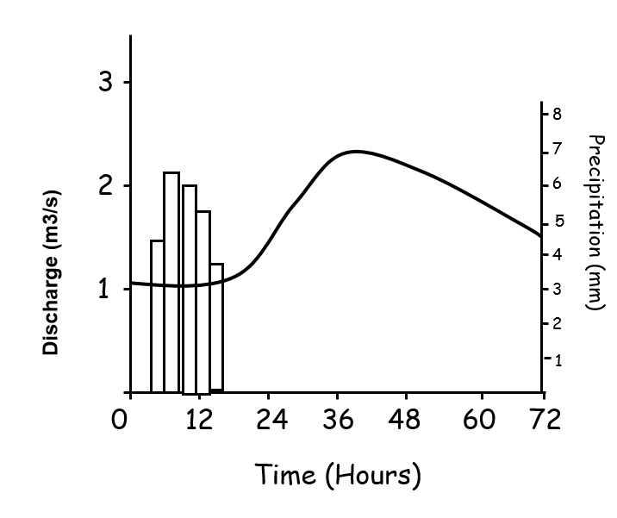
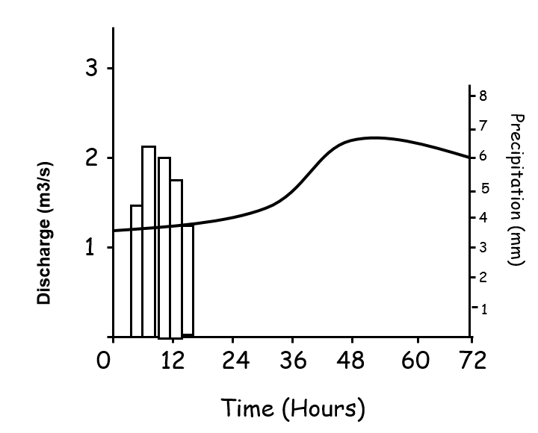
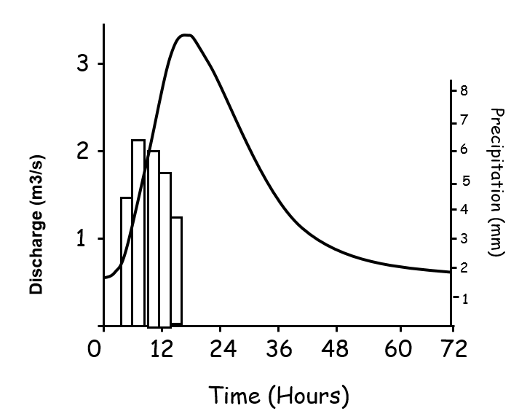
Medium lag time
Medium peak discharge
Long lag time
Low peak discharge
Short lag time
High peak discharge

Slide 57
Factors Affecting Hydrograph Shape
Total volume of precipitation
Length of precipitation
Volume of run-off
  Vegetation
  Bedrock
  Soil
  Climate/season
  Land-use
  Stream network density
  Water table
  Relief
  Basin size
  Basin shape

Slide 58
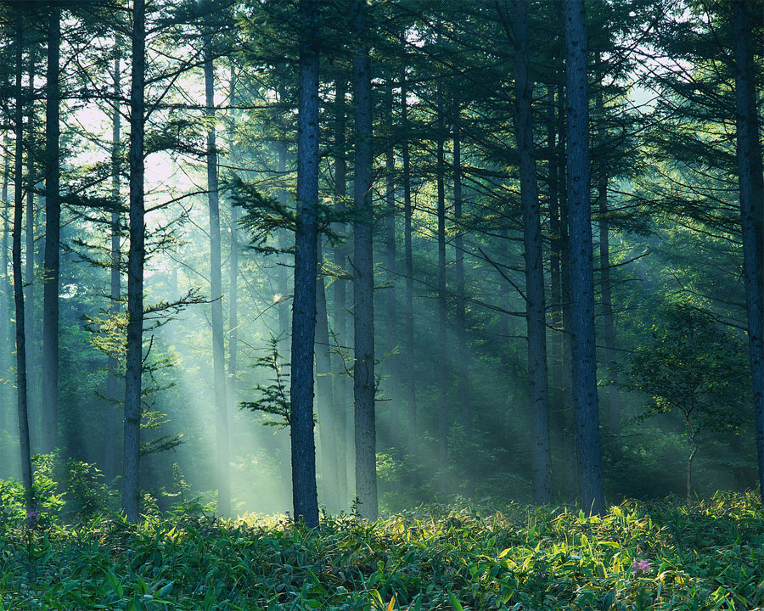
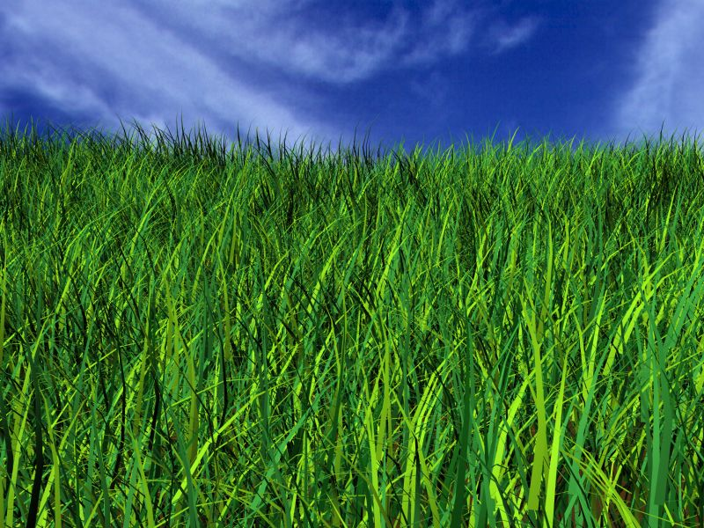
Land cover - Vegetation
Different types of vegetation cause changes in interception and evapo-transpiration.
Forested areas:
  Intercept more precipitation.
  Evaporation occurs from leaves.
  Trees use more water and transpire.
  Coniferous trees use more water than deciduous.
  Cause less run-off and longer lag time.

Slide 59
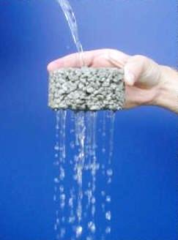
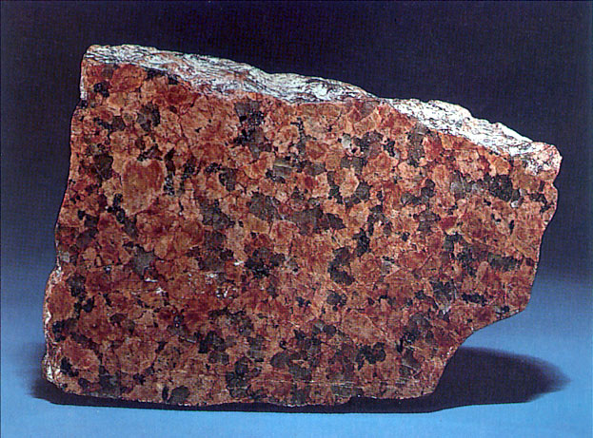
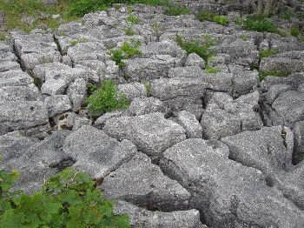
Bed Rock
Rocks can be:
  Porosity is a measure of how much of a rock is open space. This space can be between grains or within cracks or cavities of the rock.
  Permeability is a measure of the ease with which a fluid (water in this case) can move through a porous rock.
This will either increase or decrease the speed of run-off.

Slide 60
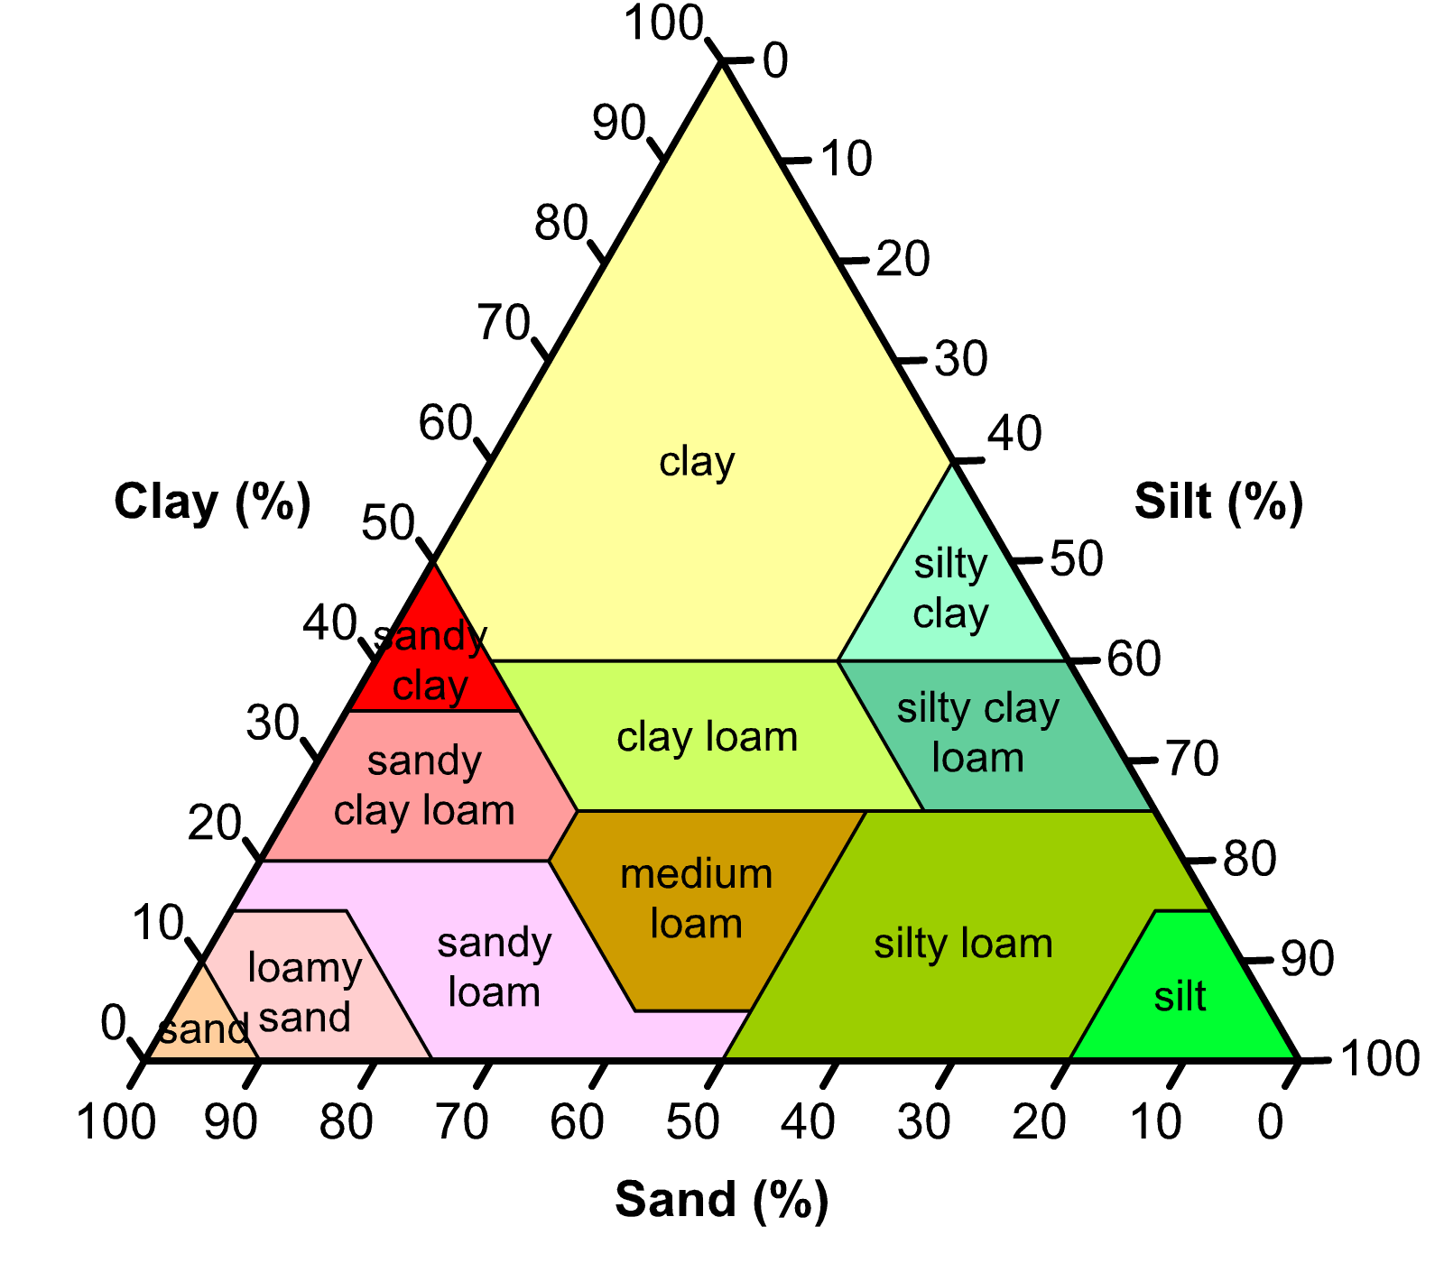
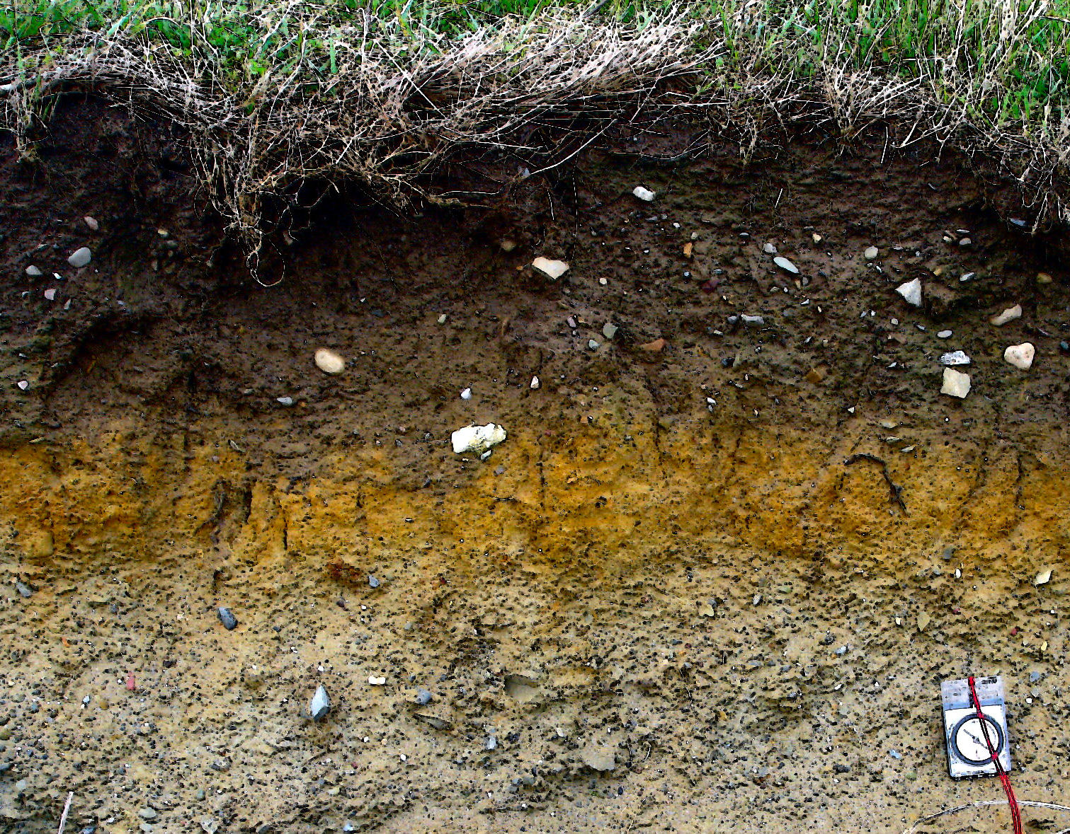
Soil
Soil depth
  Deeper soils can store more water.
  Long time for groundwater flow to reach channels.
Soil type
  Soils with high sand content are very free draining.
  Clay based soils can often become impermeable.
Soil moisture content
  As more rain falls soils become saturated causing overland run-off.

Slide 61
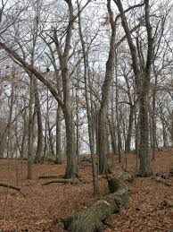
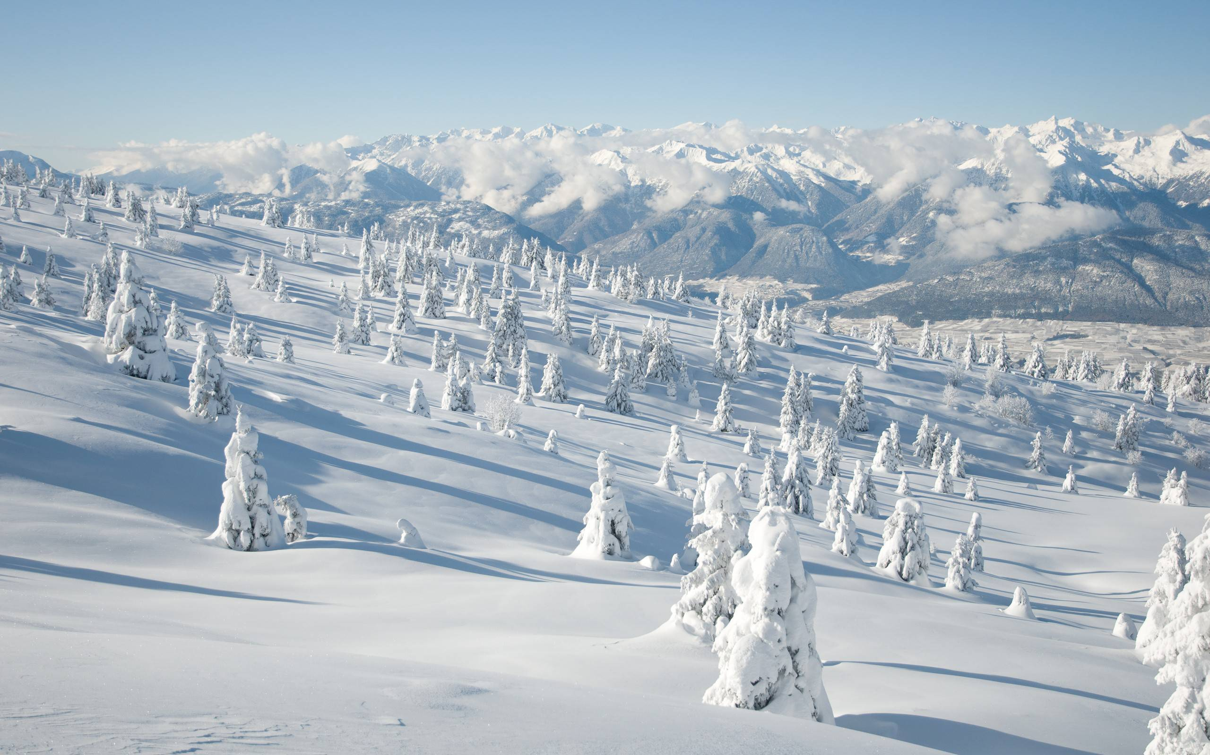
Climate and Season
Seasonal changes in vegetation cover
  Increases and decreases in interception and storage
Harvest time on farms
  Less interception and storage
Snow cover
  Producing a long lag time and shallow rising limb. Once a thaw sets in, the rising limb will become steep
Frozen ground
  Causing rapid surface run off
Evaporation rates
  Due to warmer weather in summer there will be more evaporation of surface water

Slide 62
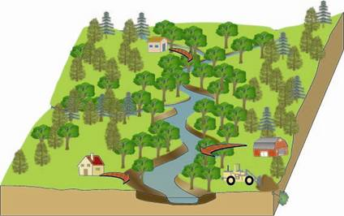
Land Use – Rural
  Lots of storage in vegetation, soils and rocks.
  Greater potential for evapo-transpiration.
  Water takes longer to infiltrate soils and percolate rocks
  Decreases run-off and increases lag time.

Slide 63
Land Use – Urban
Mainly impermeable surfaces
No infiltration/percolation
Increased run-off volume
Little storage
Increases run-off and reduces lag time.

Slide 64
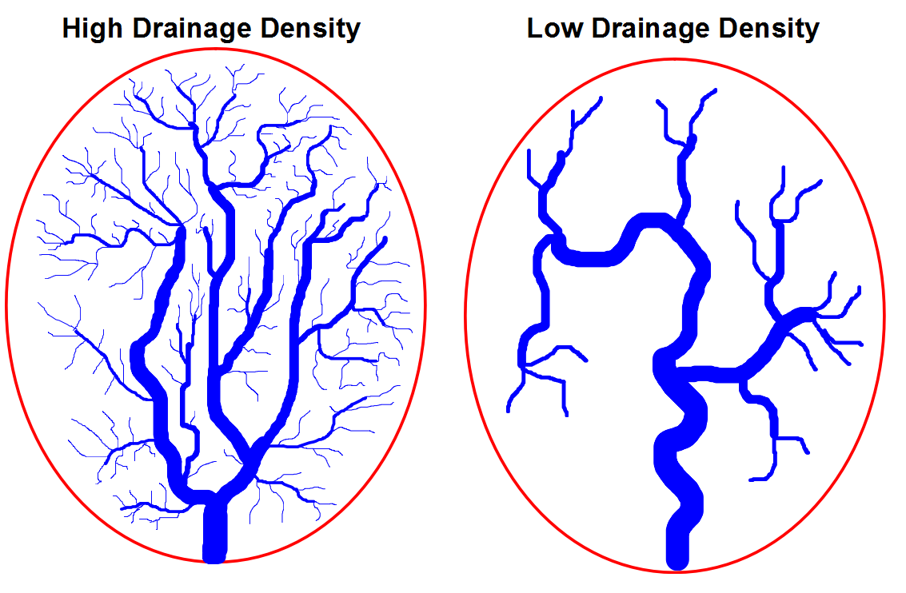
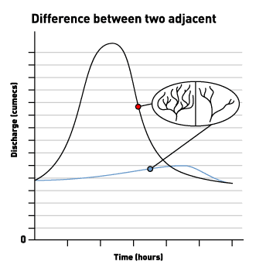
Drainage Density
A higher drainage density means that water will reach the river faster
This means that the lag time will be reduced and there will be a higher peak flow.

Slide 65
Water Table
Overland Flow
Saturated Soil/Rock
The height of the water table determines how much water can infiltrate/percolate into the soil/rocks
The height of the water table can change during the course of a storm due to saturation.
Impermeable Soil/Rock
Unsaturated Soil/Rock
Unsaturated Soil/Rock
Saturated Soil/Rock
Saturated Soil/Rock
Impermeable Soil/Rock
Impermeable Soil/Rock

Slide 66
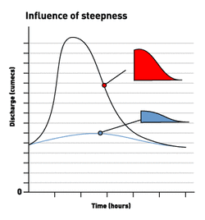
Relief
Relief determines the speed with which the runoff will reach a river.
Run-off will travel more quickly on steep slopes therefore reaching the river faster.

Slide 67
Basin Size
River Clyde River Amazon
Size will help determine the amount of water reaching the river
The larger the catchment the greater the potential for run-off

Slide 68
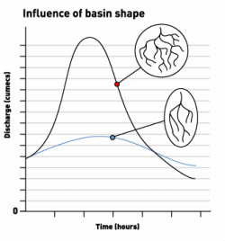
Basin Shape
Shape will contribute to the speed with which the runoff reaches a river.
A long thin catchment will take longer to drain than a circular catchment.

Slide 69
Factors Affecting Hydrograph Shape
Most Important
In groups of three rank these factors from most important to least important
  Total volume of precipitation
  Vegetation
  Bedrock and Soil
  Climate
  Land-use
  Stream network density
  Water table
  Relief
  Basin size and shape
Least Important

Slide 70
Past Paper Questions

Slide 71
Practice SQA Question
Explain the movement of water throughout the water cycle.
8 marks

Slide 72
Past Paper Questions
With the aid of a diagram describe the Global Hydrological Cycle (6)
Explain how balance is maintained in the Global Hydrological Cycle (6)

Slide 73
Model Answer - 1
The global hydrological cycle describes the distribution and movement of water in our environment. The sun provides the energy to wet surfaces to cause evaporation, this moist air then rises to form clouds. Advection will allow the clouds to move across the land picking up more moisture from surface storage such as lakes and transpiration from plants. As the moist air moves upwards into the atmosphere it may be unable to hold any more moisture when this happens the water will return to the Earth’s surface as precipitation. The water will then make its way back to the sea as either surface run-off or it will infiltrate down and make its way back as through groundwater flow. The cycle will then repeat itself. The hydrological cycle is a closed system.

Slide 74
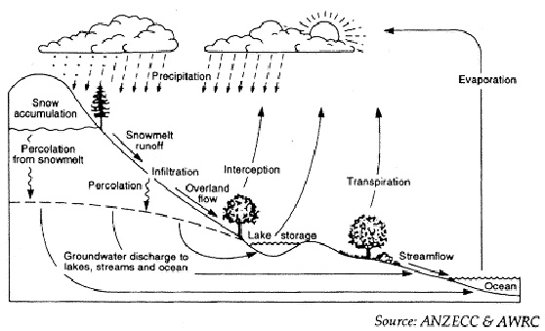
Model Answer - 1

Slide 75
Model Answer - 2
Most water is stored (99%) within the cycle, leaving approximately 1% in circulatory flow. Solar energy powers a continuous circulation that maintains the hydrological cycle in balance. The rate of evaporation is also dependent upon winds, which are needed to replace moist air with dry air, in order that the air does not become saturated and therefore unable to hold any more moisture. Water vapour may condense and remain suspended in the air (cloud, fog) or it may be returned as precipitation. The most simplistic ‘circularity of flow’ is evaporation over the sea, condensation into rain clouds and a direct return to its source. On land, surface water will mainly be returned to the oceans by way of river flow. Again another simple ‘circularity of flow’ exists: evaporation from the ocean, precipitation over land, surface flow back to the oceans. As a result the initial losses from the ocean are compensated for and the hydrological system will tend towards a condition of equilibrium or steady state balance. Longer ‘circulations of flow’ occur when water is stored as ice or when it percolates into either soil (making water available for plant roots and therefore transpiration) or moves into deeper groundwater supplies. In these situations the water will eventually be returned to the oceans.

Slide 76
Past paper question
Describe how water moves through a drainage basin (8)
Extension:
  How might the flow chart change if the drainage basin was man made?
    Can water infiltrate or percolate through roads and pavements?
    Would evaporation and storage increase?
    How would run-off be affected?

Slide 77
Model answer
Evapo-transpiration
Precipitation
Inputs
Storage
Transfers
Outputs
Interception
Surface storage
Overland flow
Soil moisture
Through flow
Ground water
Groundwater flow
Channel Flow

Slide 78
Model answer
Drainage basins are an open system. They have 4 main charactaristics. These are: Inputs, storage, transfers and outputs.
Inputs - This is any type of precipitation (rain, snow, hail etc.) that enters the system
Storage – This can happen in 5 ways:
    Interception – water is stored on the leaves of plants and trees
    Surface storage – water stored in puddles, pool and lakes.
    Soil moisture – water stored in the gaps of the soil..
    Ground water – water which is stored in permeable rock.
    Channel – water which is in rivers and streams.

Slide 79
Model answer
Transfers – Water is transferred through the system in 3 ways:
    Overland flow or run-off - The movement of water over the surface. It occurs when the ground cannot absorb all the rain falling on it.
    Through flow – water that has collected in the soil moves sideways
    Groundwater flow – water that is stored in the rock flows towards channel storage.
Outputs – This is when the water is lost to the system. It happens either through evapo-transpiration or channel flow (which is when water flows though rivers into the sea).

Slide 80
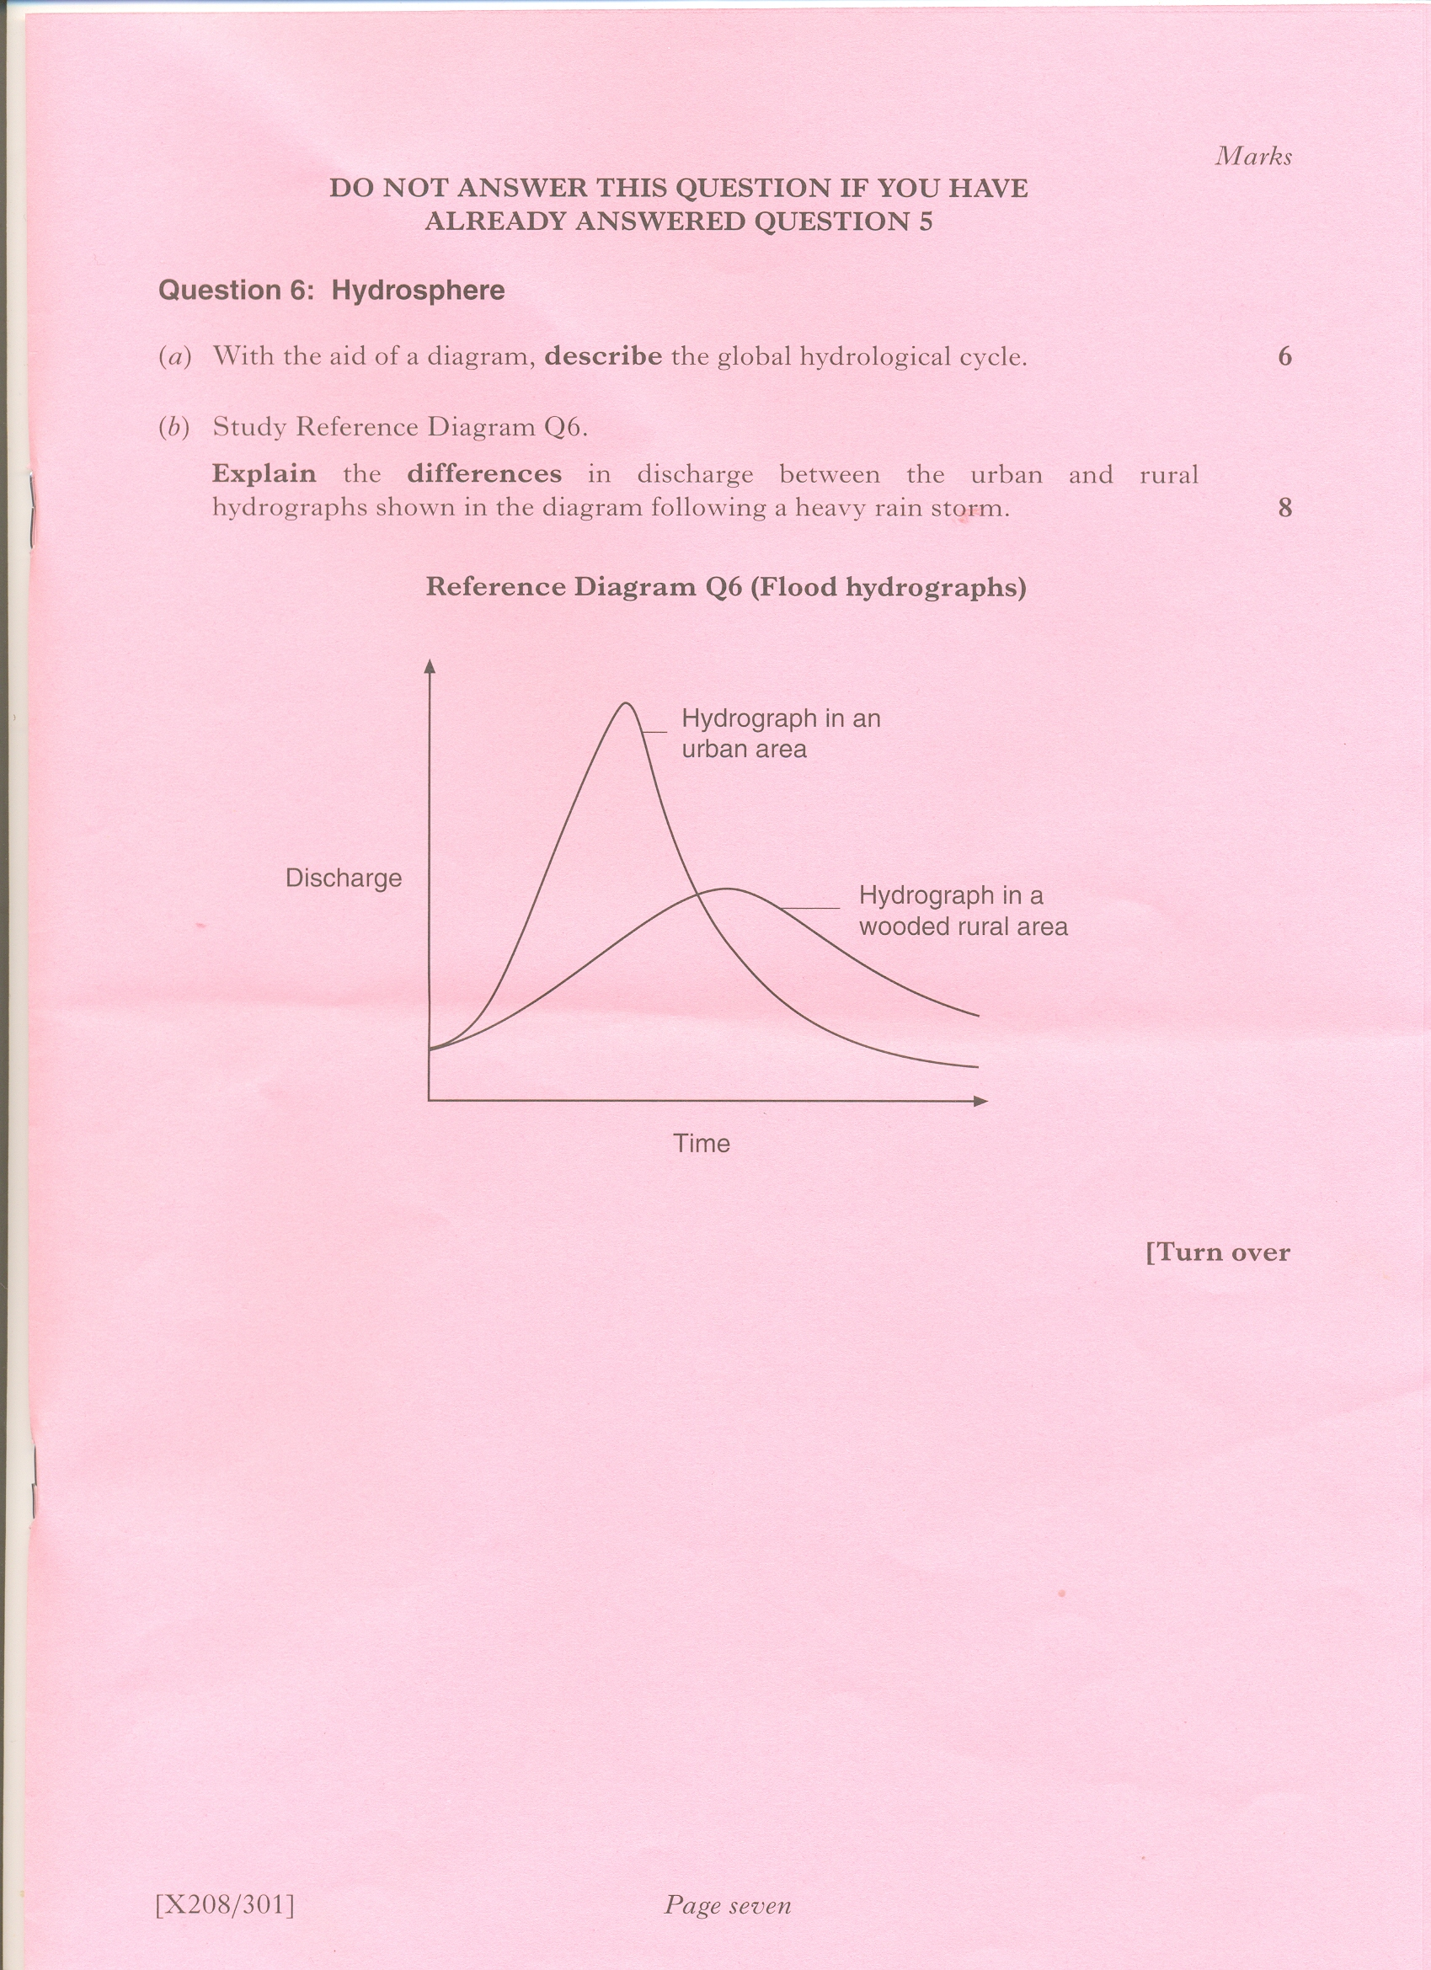

Slide 81
Answer
In the Rural hydrograph there is a longer ‘lag time’ between the rainfall and peak discharge
  Vegetation (eg woodland) will intercept precipitation and store/absorb or alow it to be evapo-transpired
  This will preventing the water reaching the soil/ground water/river quickly.
However in the Urban hydrograph, concrete, tarmac and buildings will channel the precipitation.
  Into gutters/drains and straight into the sewer/river system with a correspondingly shorter ‘lag time’.

Slide 82
Answer
The rising limb is less steep in the rural hydrograph natural water courses will overflow and drain into marshy areas and fields on the flood plains in times of flood
Urban water courses will be lined and embanked to contain and speed up the flow of water leading to a steeper rising limb.
The falling limb on the urban hydrograph is much steeper due to the lack of infiltration/percolation/underground storage of water.
In rural areas water will continue to flow into the river many hours after the rainstorm through underground and through flow via the soil and rocks. The return of the river to the base flow will therefore be much slower with a more gentle falling limb.

Slide 83
A
B
3
3
8
8
7
7
2
6
2
6
Discharge (m3/s)
Discharge (m3/s)
5
5
Precipitation (mm)
Precipitation (mm)
4
4
1
3
1
3
2
2
1
1
0 12 24 36 48 60 72
0 12 24 36 48 60 72
Time (Hours)
Time (Hours)
Describe and explain the differences between the discharge in A and B and why these might occur.

Slide 84
Answer
Vegetation
Rock type
Slope
Ground cover
Depth of water table
Precipitation
Evaporation
Seasonal
Soil
Density

Slide 86
