Slide 1
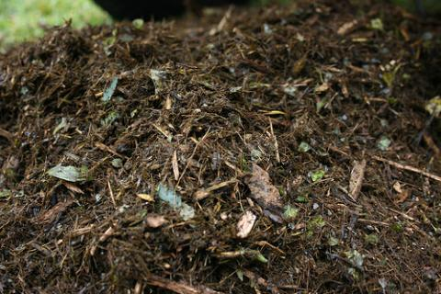
What is soil?
Soil is a combination of four main components:
Minerals – this a combination of clay, silt and sand.
Gases – these fill the space between the soil.
Water – held within the spaces in the soil.
Organic matter – the remains of animals and plants which are being broken down into humus.
Inorganic
Organic

Slide 2
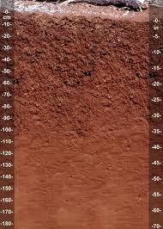
Soil profile
Below the surface all soils are made up of several layers.
These layers and their composition varies between different soil types.
Some soils can be very deep (several metres) with many layers others can be one very shallow layer.
The composition of the soil determines the land-cover above and the organisms that are able to survive.

Slide 3
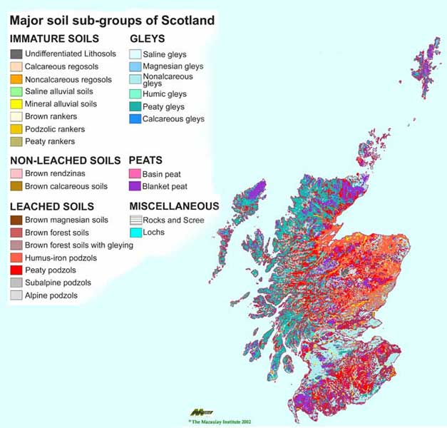
Soil Forming Factors
In Scotland we have many different types of soil.
However, they have all formed in the same basic manner.
There are five main factors which affect how a soil will form:
Climate
biota
Relief
Parent material
Time

Slide 4
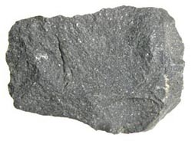
Parent Material
Parent material is material from which all soil is formed. It can consist of:
Consolidated bedrock
Unconsolidated deposits:
River/lake sediment
Glacial tills/moraine
Volcanic ash
Talus
This material is then weathered to form smaller particles of sand/slit/clay which make up a soil
It is the parent material that determines the initial type of soil and its mineral composition:
Granite – a coarse, loamy (sand/slit) soil texture and promotes the development of E horizons.
Basalt – a loam or clay-loam texture and hinders the development of E horizons.

Slide 5
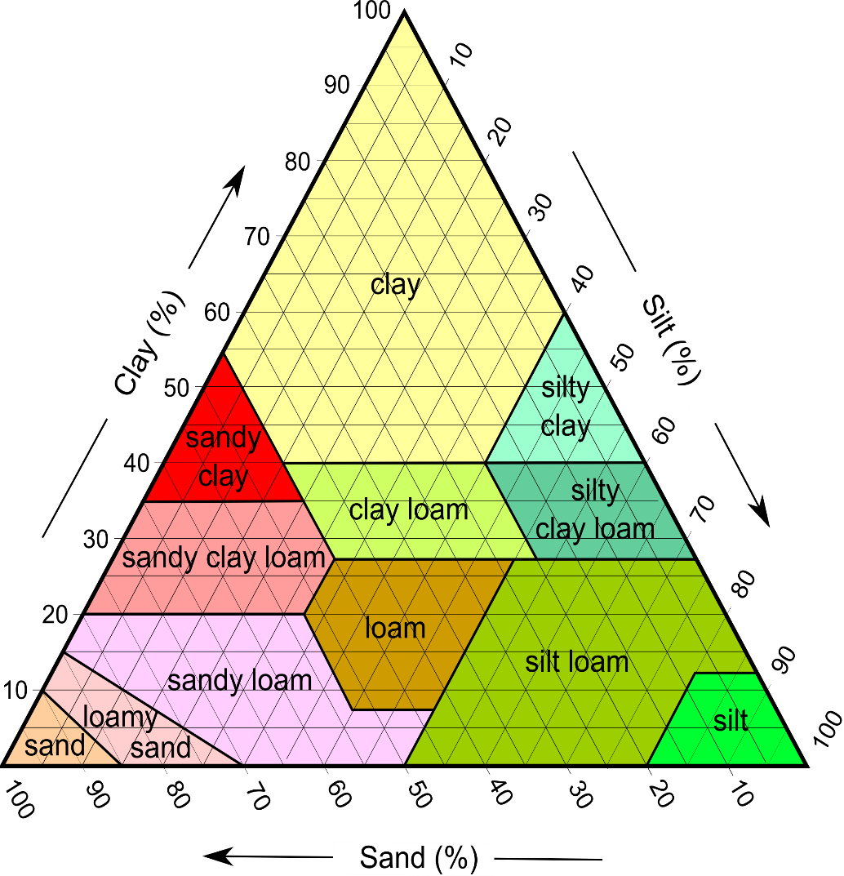
Parent Material
Rate of weathering
The hardness of rocks affects its rate of weathering
Hard rocks such as granite and schist weather slowly
Soft rocks such as shale and sandstone weather quickly
Texture
Is important as it determines how well drained a soil is and how much pore space it contains for water and air.
Soils high in clay (basalt, shale) form poorly drained soils and do not contain many air pores.
Soils high in sand/silt (granite, schist) form well drained soils which leach easily.

Slide 6
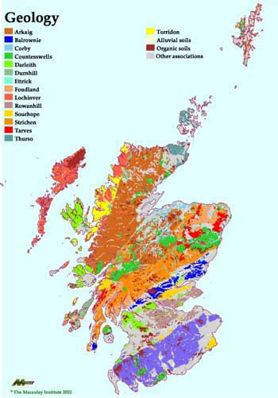
Parent Material

Slide 7
Climate
Climate, more specifically precipitation, has a large influence on soil formation.
The temperature can change the rate at which erosion occurs (e.g. freeze thaw)
Large volumes of precipitation also increase the rate of chemical weathering that can occur.
Climate also directly affects the type of organisms present.

Slide 8
Climate
Eluviation – when minerals are dissolved in water and move vertically through the soil (downwards movement is called leaching)
Illuviation – when the dissolved minerals are deposited (often in a different horizon)
Evaporation > precipitation
Precipitation > evaporation
If the climate is warm then surface moisture will evaporate quickly causing water to be drawn up from underground through capillary action.
As it does this it brings dissolved minerals to the surface which are deposited when the water evaporates.
If the climate has high precipitation levels then water will percolate downwards through the soil. Leaching
As it does this material such as iron and aluminium is leached downwards and deposited in the B horizon

Slide 9
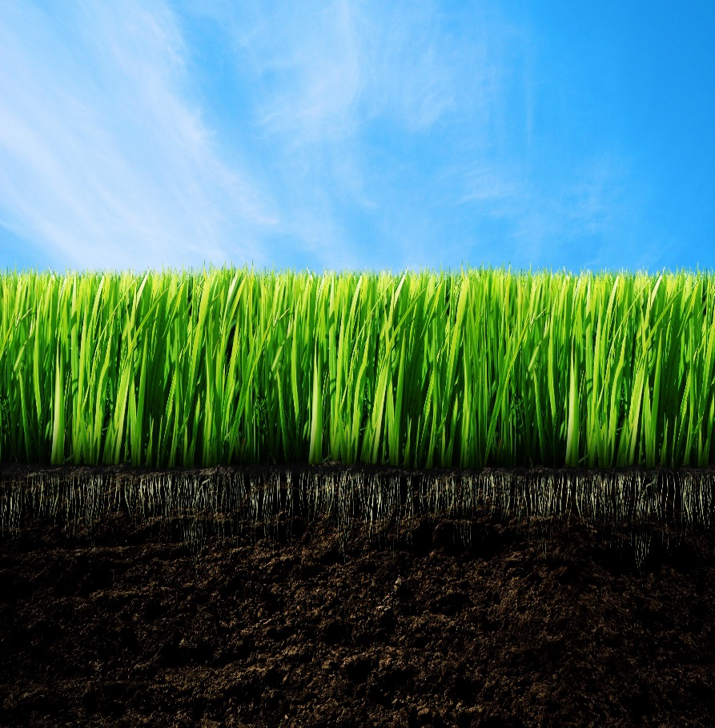
Biota
Living organisms, including plants, microbes, soil animals, and humans, are collectively referred to as biota.
Soil development is affected by both the type and number of organisms that live in and on the soil.
Vegetation influence the amount of organic matter build-up in the soil, e.g.
Grassland vegetation has organic matter accumulations on the surface.
Forest soils organic matter accumulates from the surface down to the roots.
Organisms are based on site
Macro-organisms like rabbits and mole aerate and mix the soil layers.
Smaller organisms like fungi, insects, bacteria and earthworms eat and break down organic matter releasing plant nutrients. Some change certain elements, such as sulfur and nitrogen, into usable forms for plants.
Human activity also influences soil formation.
Destruction of natural vegetation by changing the frequency and extent of natural fires or by agriculture abruptly modifies the soil forming factors.

Slide 10
Biota – Types of Humus
L - Litter
F – fermentation
H - Humus
O
Mor
Largely occur under coniferous forest soils and the moorlands soils.
Below this surface-litter layer is a distinct, strongly compacted humus layer; a layer of mineral soil underlies the humus.
Few micro-organisms or animals, such as earthworms, to decompose the organic matter that lies on the soil surface.
pH is low (acid)
Moder
An intermediate humus between Mor and mull.
Mull
Found under hardwood forests, deciduous forests, or grasslands in warm, humid climates.
It is a porous, crumbly humus rapidly which decomposes and becomes well mixed into the mineral soil, so that there are no distinct layers
Bacteria, earthworms, and larger insects are abundant
pH is neutral to slightly acid/alkaline

Slide 11
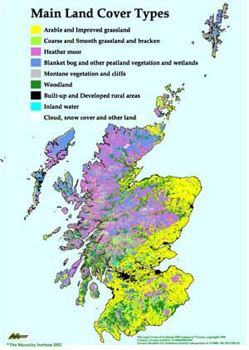
Biota

Slide 12
Relief
Slope steepness, shape, and length of slope are important
they influence the rate at which water flows into or off the soil.
Soils on slopes are more susceptible to erosion. Eroded soils tend to be less fertile and have less available water than non-eroded soils.
Aspect influences the angle at which the sun’s rays strike the earth’s surface. e.g.
in the Northern Hemisphere cooler north-facing slopes are usually forested with slower soil development than on warmer south-facing grasslands .
Slope and aspect together influence soil temperature, soil water content and vegetation, which in turn affects soil formation.
Elevation influences vegetation and soil type.
Climate becomes cooler and more wet as elevation increases from valley bottoms to mountain tops.

Slide 13
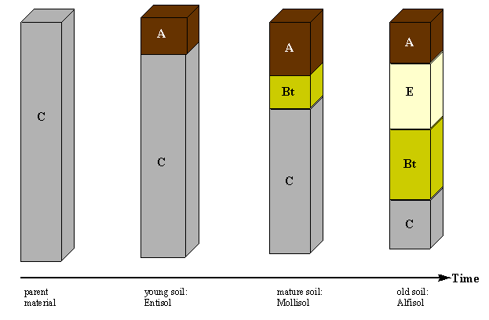
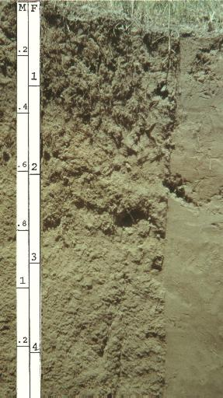
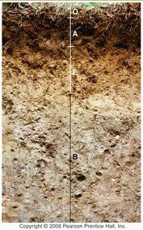
Time
All soils begin as parent material. It is only though time that they become soils.
Longer timescales allow for more erosion of the parent material and accumulation of organic matter. But they also mean that more leaching is possible.
Soil formation processes are continuous. Floods can deposit new material which causes the previous soil surface and underlying horizons to become buried.

Slide 14
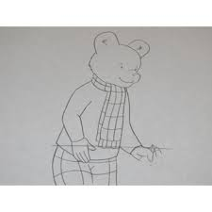
Rupert Bear Has Come To Play
Soil Forming Factors
R – Relief
B – Biota
H – Human Activity
C – Climate
T – Time
P – Parent material

Slide 15
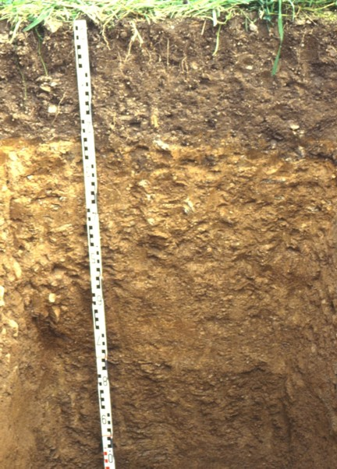
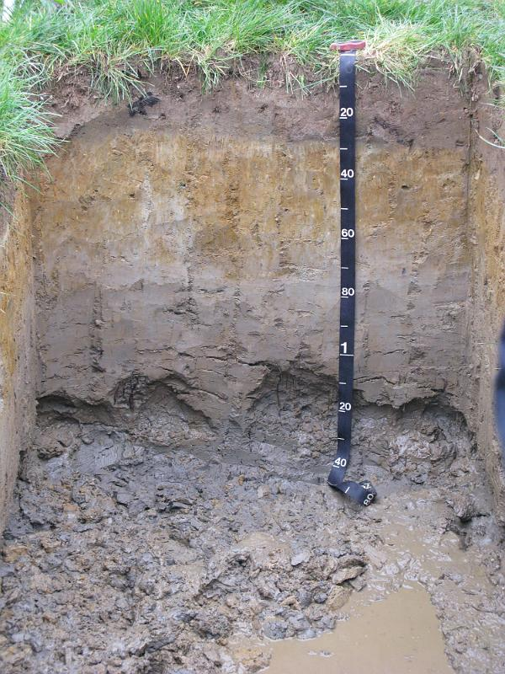
Soils of Scotland
There are three major soil sub-groups in Scotland.
Brown Earth
Podzol
Gley

Slide 16
Brown Earth Soils
Free draining
Well mixed undefined layers
Deciduous woodland
Litter rich in nutrients
Intense biological activity e.g. earthworms
Mull humus

Slide 17
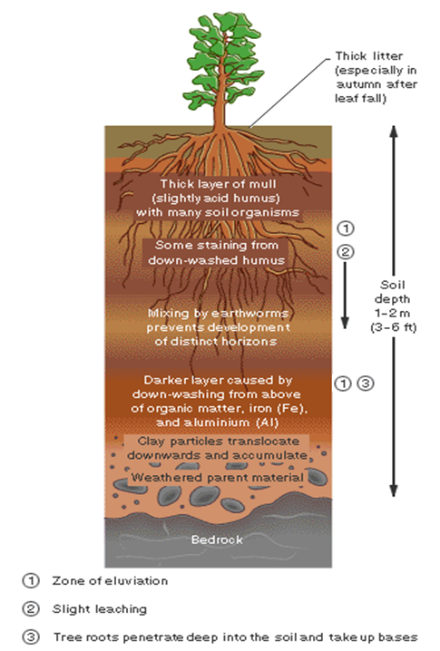
Brown Earth Profile
Oa
Thick, well decomposed mull humus
Ah
topsoil dark coloured enriched with mull humus, variable depth
AB
no defined boundary between A and B horizons
Leaching occurs in wetter months but capillary action from roots when warmer.
B
subsoil with distinctive brown/red brown colours
Lightening in colour as organic matter/iron content decreases with depth
C
Permeable free draining and unconsolidated.
Broken up by deep tree roots
Texture
Loamy throughout equal amounts of clay, silt and sand with many pores
Oa
Ah
AB
B
C

Slide 18
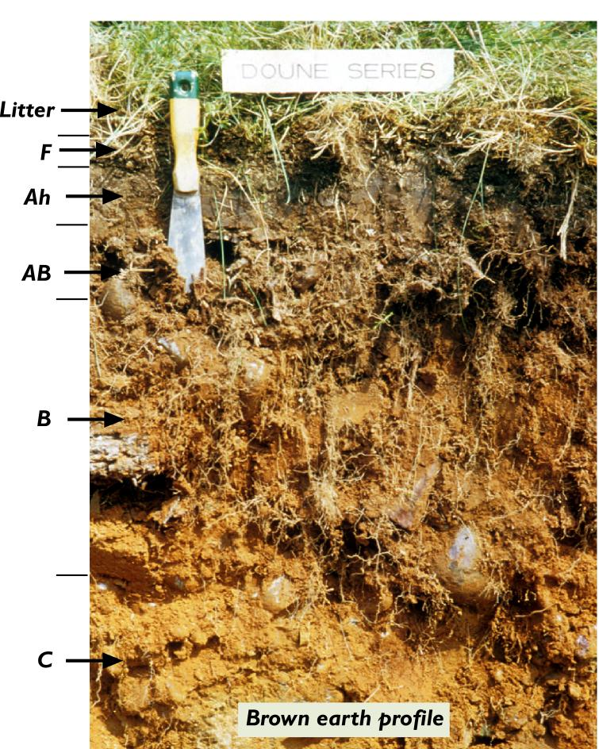
Soil Forming Factors
Parent Material
Permeable
Non/slightly acidic
Climate
Mild/warm temperatures with moderate rainfall
Biota
Broadleaf woodland
Mull humus
Many earthworms and other mixers
Topography
Generally low lying
Time
Since the end of the last ice-age c10,000 ya
O

Slide 19
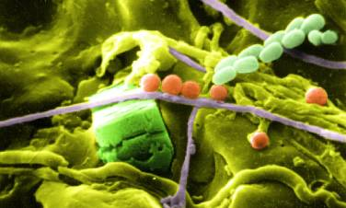
Organisms in Brown Earths
Soil fungi and bacteria
Earthworms
Moles/rabbits
They help to create a good and well aggregated, aerated and fertile crumb structured soil
Soil fungi and bacteria
Earthworm activity is important in soil mixing
Notes:
Thin section of soil showing enchytraeid faecal matter

Slide 20
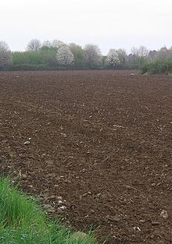
Uses of Brown Earths
Amongst the most fertile soils in Scotland
Used extensively for agriculture e.g. winter vegetables
Fertilisers required to maintain nutrient levels under agriculture
Used extensively for settlement and industry
Sheltered sites suit growth of trees

Slide 21
Gley Soil
Poorly drained
Periodic or permanent waterlogging
Lack of oxygen in pore space so anaerobic conditions
Well defined profile layers
Gleying and orange/yellow coloured mottling in sub-soil
Horizons generally rich in organic matter – Mor humus

Slide 22
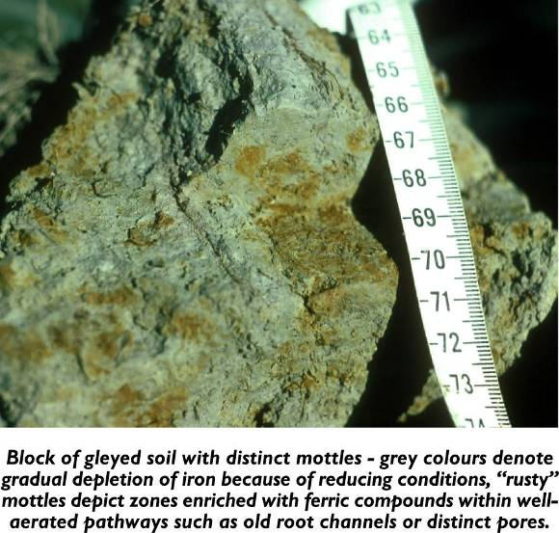
Gleying/mottling
Gleying is the process of waterlogging and reduction in soils.
In waterlogged soils where water replaces air in pores, oxygen is quickly used up by microbes feeding on soil organic matter.
Iron is reduced from its oxidised (ferric) Fe³⁺ state to its reduced (ferrous) Fe²⁺ state, which is soluble in the soil water.
The removal of iron leaves the soil a grey or bluish colour.
Orange/red mottling appears when soil layer is exposed to oxygen due to the oxidisation of remaining iron.

Slide 23
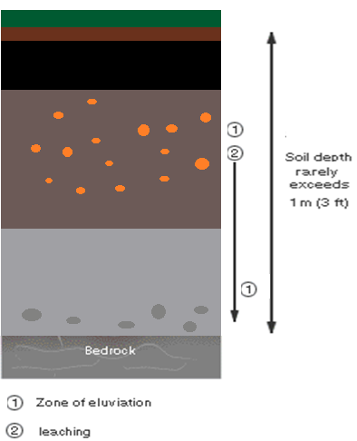
Gley profile
O
Ah
O
slowly decomposing organic layer.
Thin Mor humus
Ah
Build-up of organic matter in anaerobic layer
Peat formation
Bg
Evidence of gleying
Sometimes waterlogged
Orange/red mottling of Fe oxides
Cg
Evidence of gleying
Always waterlogged
Texture
Ah – silty
Bg – Clayey
High water table
Bg
Low water table
Cg

Slide 24
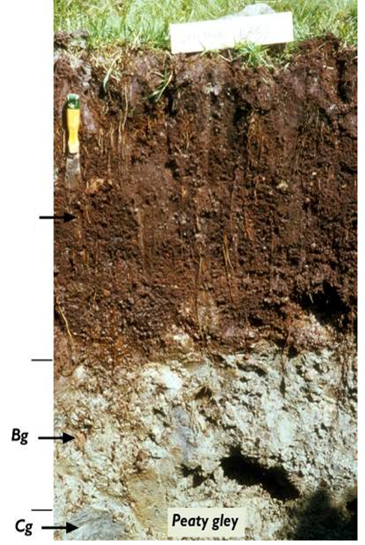
Gley: Soil forming factors
O
Parent Material
Coastal sands to glacial till
Climate
Relatively mild
Precipitation>evaporation
Biota
Anaerobic organisms found
Topography
Where groundwater is high with an impermeable layer below
Time
Since the end of the last ice-age c10,000 ya
Ah

Slide 25
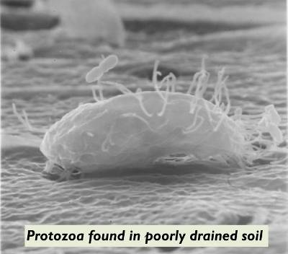
Anaerobic Organisms in Gleys

Slide 26
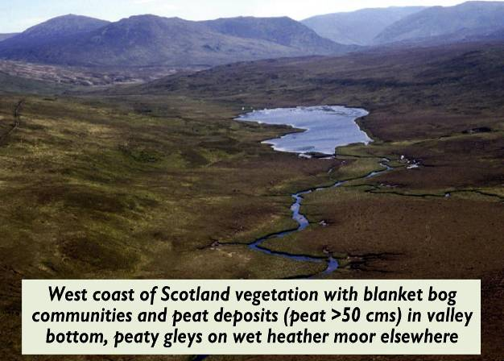
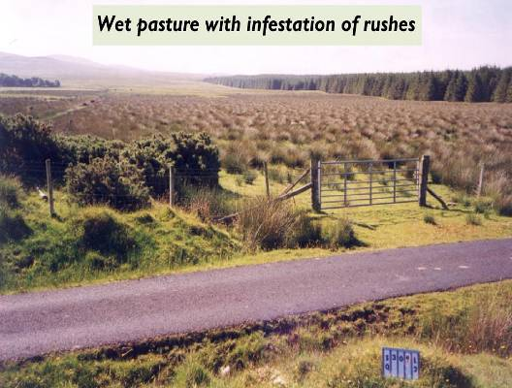
Uses of Gleys
In their natural state they can support wet plants species and are used for rough grazing and forestry
When drained, the better gley soils can be used for animal agriculture; usually productive grassland for dairy or beef cattle

Slide 27
Podzol Soils
Extensive group of leached, acidic soils
Free draining
Well defined layers
Coniferous woodland/ heather moorland
Litter low in nutrients
Little biological activity e.g. earthworms
Mor humus

Slide 28
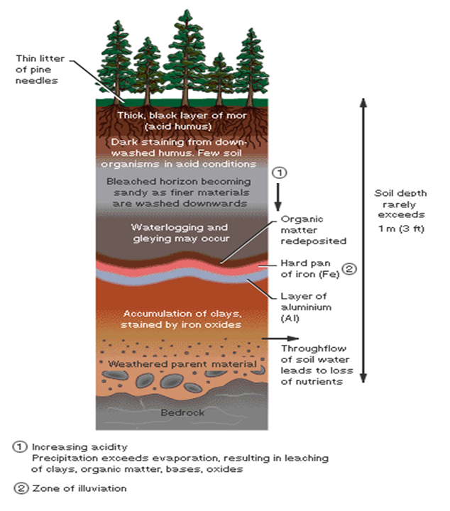
Podzol Profile
O
Mor humus with no recognisable plant remains
Slow decomposition of needles and pine cones
Ah
Stained darker by illuviation of humus
No mixing due to lack of soil organisms
E
Distinctive light coloured horizon found immediately below organic debris
Eluvial horizon formed due to loss of iron/ aluminium by leaching
Bs
darker zone of organic deposition
brightly coloured zone of iron/aluminium deposition - illuvial horizon
Iron pan layer can create waterlogging above
B
Orange/red layer due to leaching of Fe and Al oxides from pan layer above.
C
Relatively unaltered at variable depth
Texture
Sandy loam to loam sand throughout must be coarser than clay
O
Ah
E
Bs
B
C

Slide 29
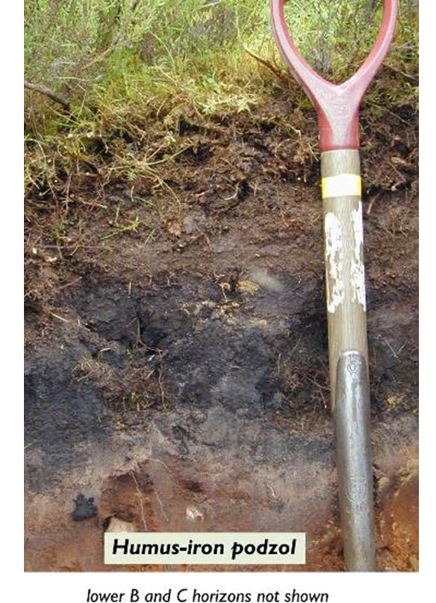
Podzol: Soil Forming Factors
Parent Material
Acid rock often granite or schist
Climate
Cool with high precipitation rates
Biota
Coniferous wooland/heather moorland
Limited mixing by organisms
Slow organic matter breakdown
Relief
Varying from sea level to mountainous.
Time
Since the end of the last ice age 10,000ya
O
Ah
E
Bs

Slide 30
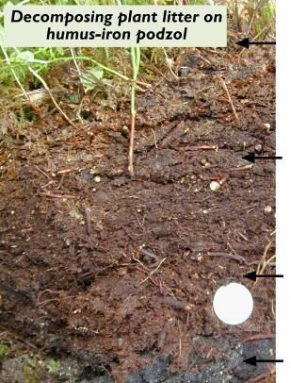
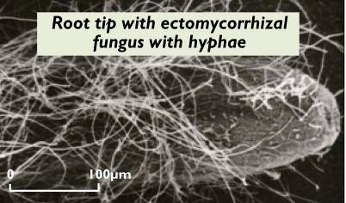
Organisms in Podzols
Fresh Vegetation
Litter
Fermenting litter
Illuvial Mor humus

Slide 31
Uses of Podzols
Generally infertile, non-productive
Principally used for forestry and recreation
In Scotland also used for grass production and stock rearing
Where used for agriculture the top soil is often limed (to decrease acidity) and artificially fertilised (to increase nutrient status)
Continual fertilisation and liming necessary to maintain adequate yields

Slide 32
Exam Questions

Slide 33
SQA – Practice Question
Draw and fully annotate a soil profile of your choice. Be sure to include, horizons, colour, texture, drainage and vegetation.
5 marks

Slide 34
Coniferous woodland
O
Mor humus with no recognisable plant remains
Slow decomposition of needles and
A
Stained darker by illuviation of humus
No mixing due to lack of soil organisms
E
Distinctive light coloured horizon found immediately below organic debris
Eluvial horizon formed due to loss of iron/ aluminium by leaching
B
darker zone of organic deposition
brightly coloured zone of iron/aluminium deposition - illuvial horizon
Iron pan layer can create waterlogging above
Orange/red layer due to leaching of Fe and Al oxides from pan layer above.
C
Relatively unaltered at variable depth
O
A
E
B
C
Weathered parent material

Slide 35
O
slowly decomposing organic layer.
Thin Mor humus
A
Build-up of organic matter in anaerobic layer
Peat formation
B
Evidence of gleying
Sometimes waterlogged
Orange/red mottling of Fe oxides
C
Evidence of gleying
Always waterlogged
O
A
Orange/red mottling
B
Weathered parent material
C

Slide 36
Deciduous woodland
O
Thick, well decomposed mull humus
A
topsoil dark coloured enriched with mull humus, variable depth
No clear definition between A and B horizons
B
subsoil with distinctive brown/red brown colours
Lightening in colour as organic matter/iron content decreases with depth
C
Permeable free draining and unconsolidated.
Broken up by deep tree roots
O
A
B
Weathered parent material
C

Slide 37
