Slide 1

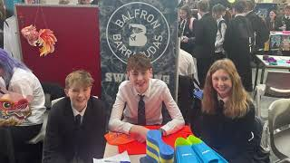
Parent Council Meeting
9th September 2025
#buildingfuturestogether

Slide 2

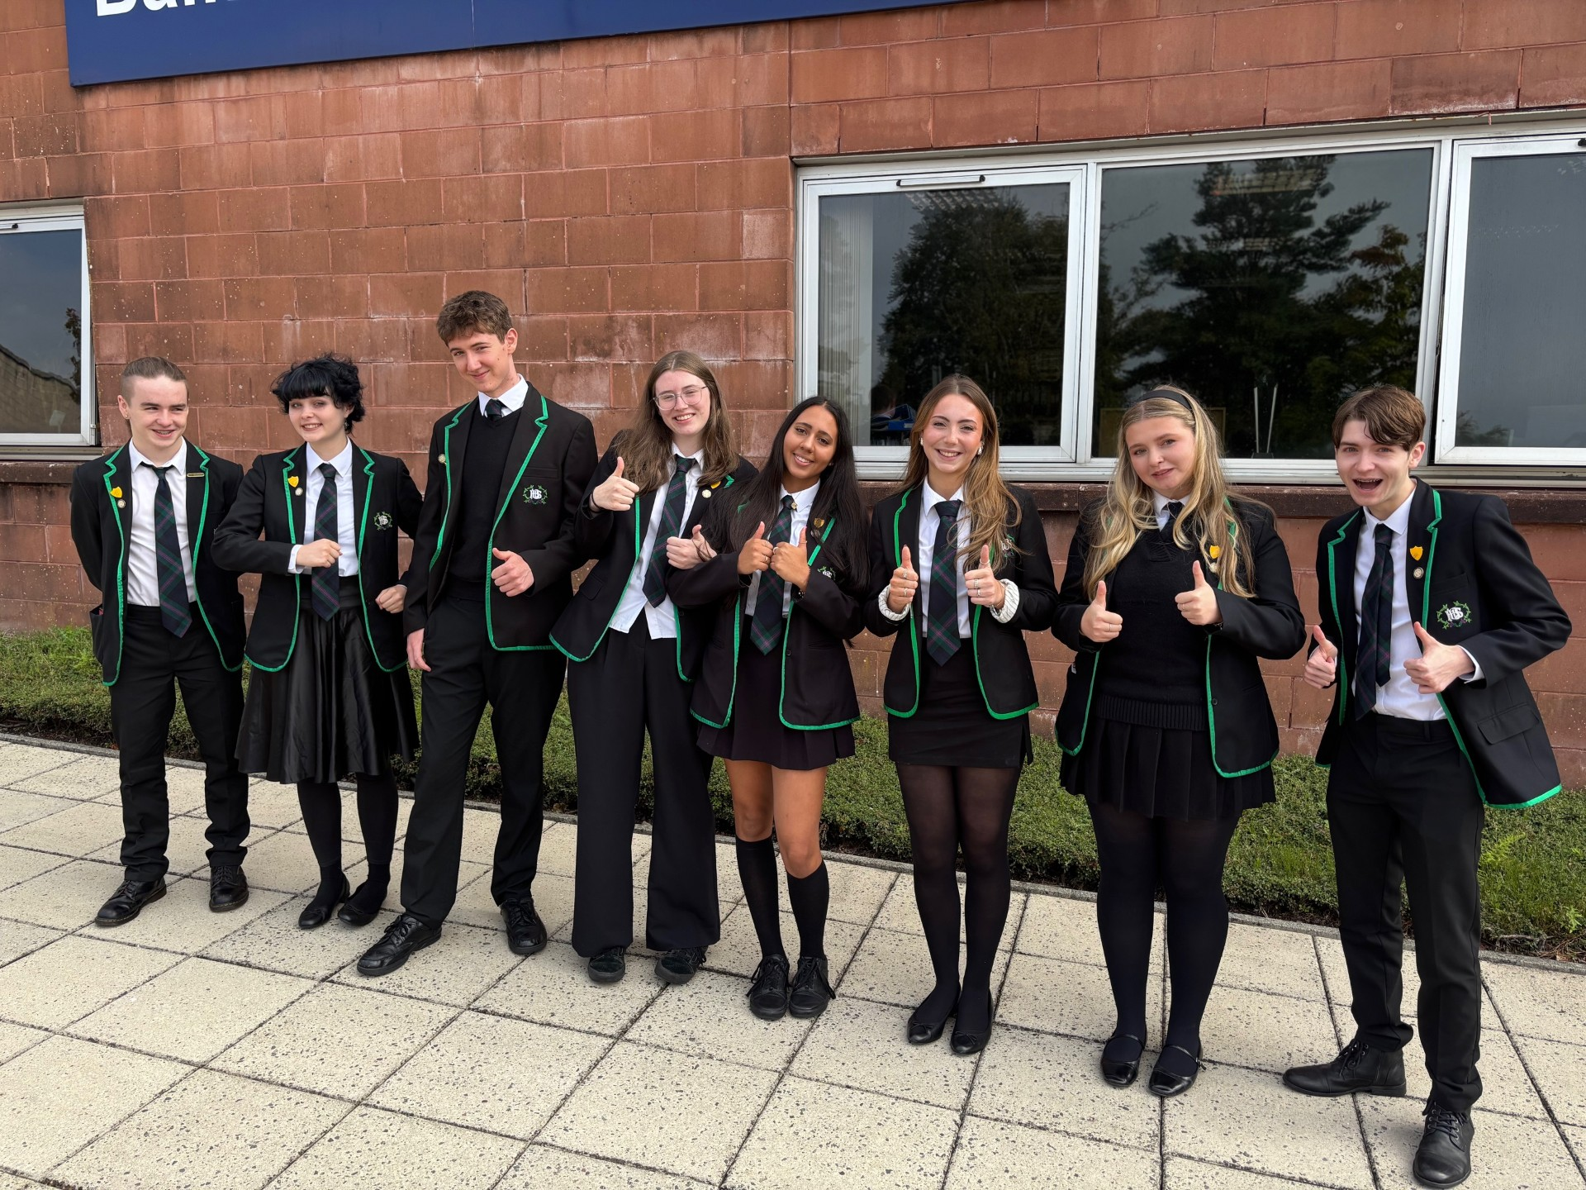
Introducing our Head Prefects 25-26
Rowan Coleman (S1)
Izzy Griffith (s3)
Alex Ryan (s1)
Lucy Bowie (s2)
Zahra Sheikh (s5)
Kara Dawson (s6)
Fearne Condron (s4)
Reece Young (s6)

Slide 3
Welcome Back Everyone
Welcome Back
Stephanie Holbein
Emma McCann
Alastair Shearer (PE)
Lauren McGuigan (ASN)
New staff - welcome
Ashley Montgomery (DHT)
Andy Murphy (PT ASN)
Monica Nunes (HE)
Newly Qualified staff - welcome
Grace Murdock (History)
Lindsay Bowie (Modern Studies & History)
Joanne Caruthers (Business)
Beth Clark (PE)
Ruaraidh Stark(PE)
Conner Allen (English)
Ellis Grandison (French & Spanish)
Nicole Gear (Chemistry)

Slide 4
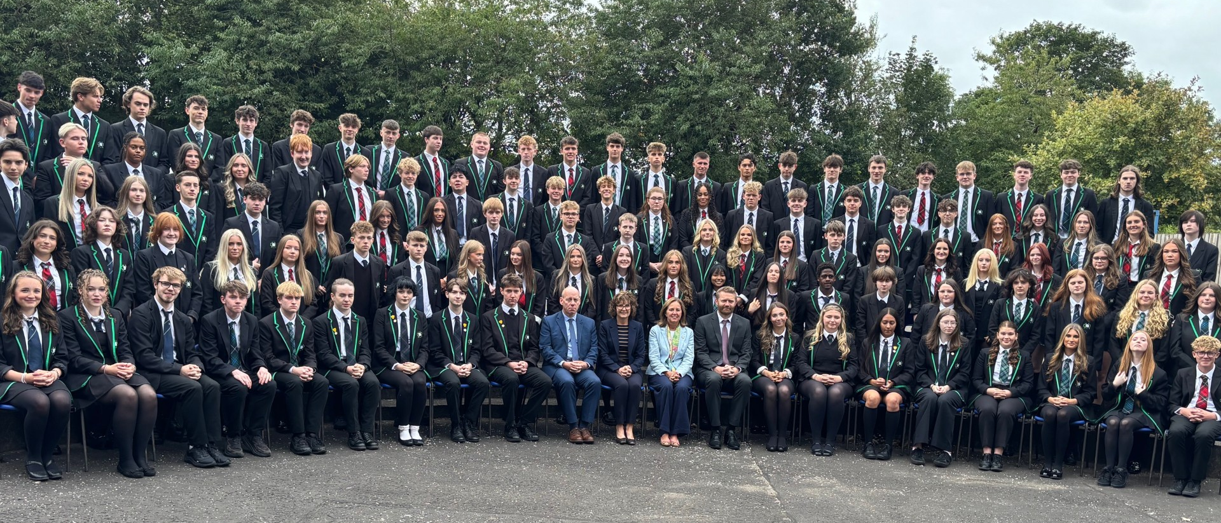
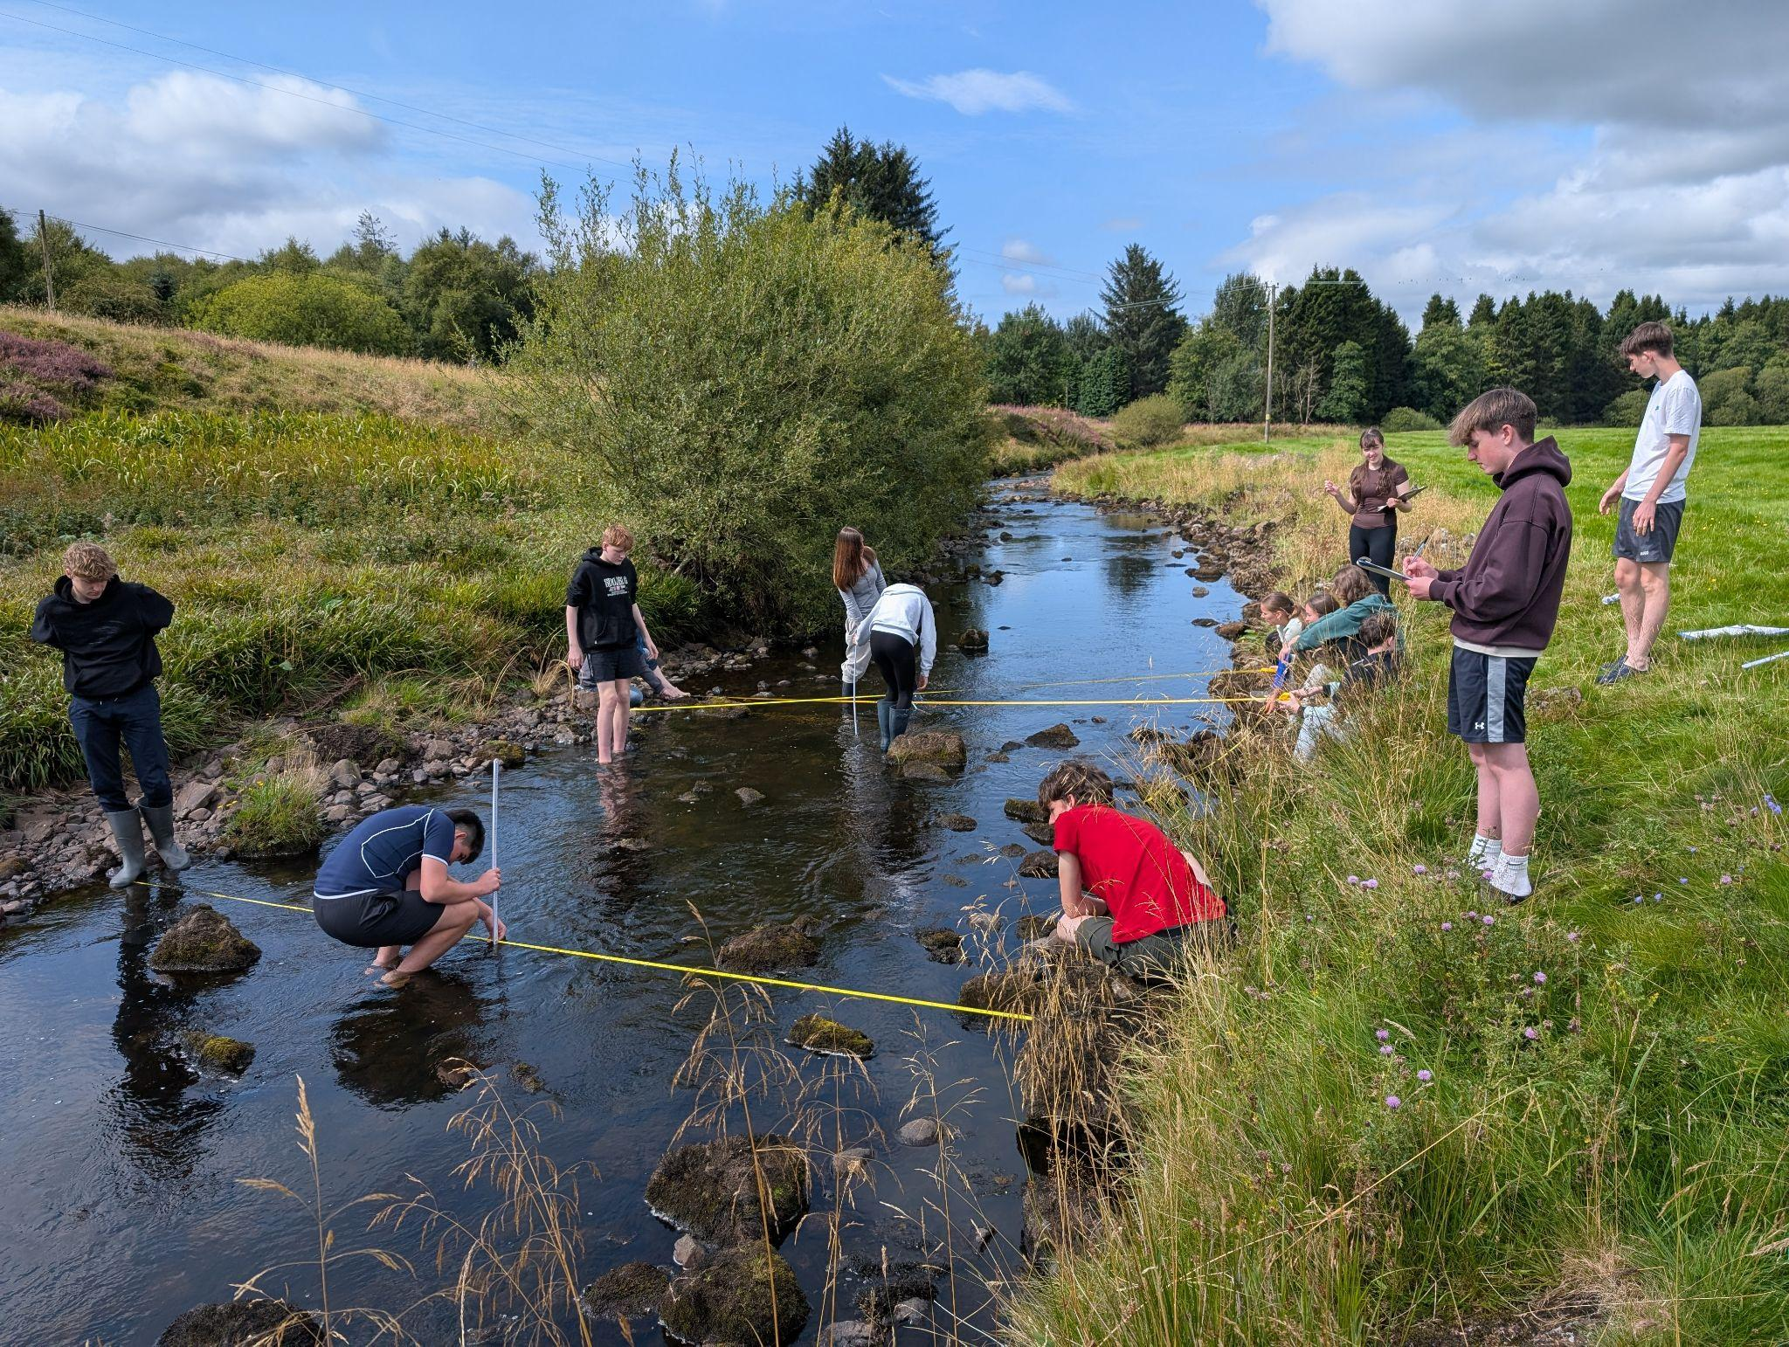
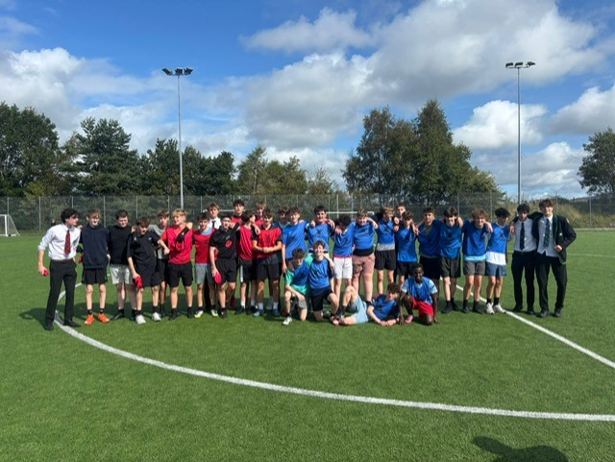
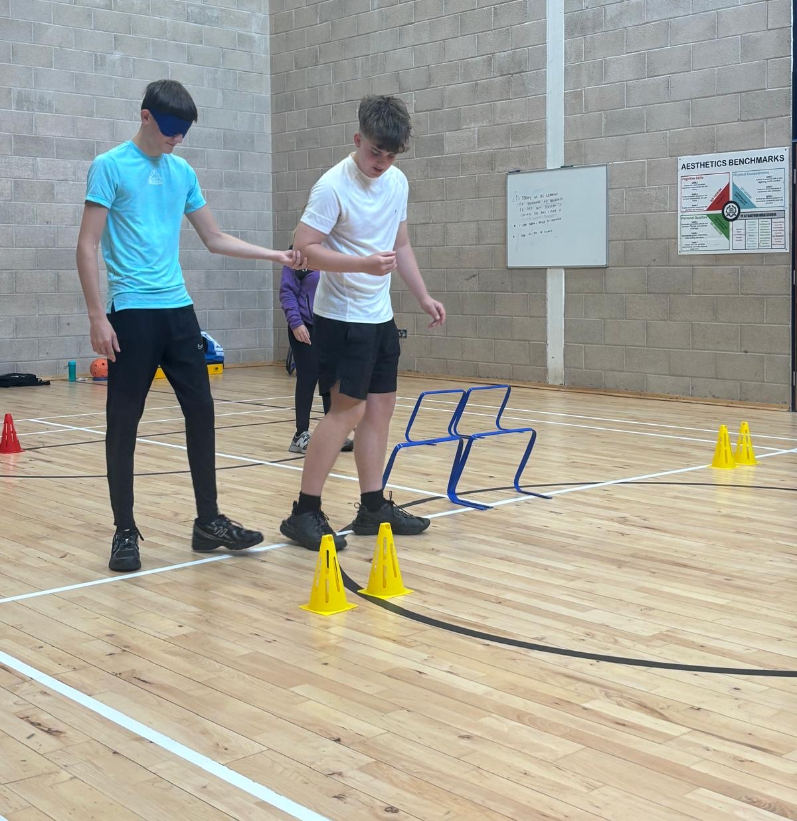
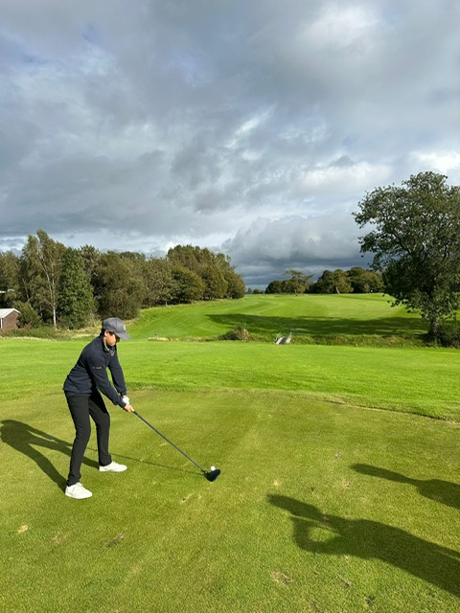
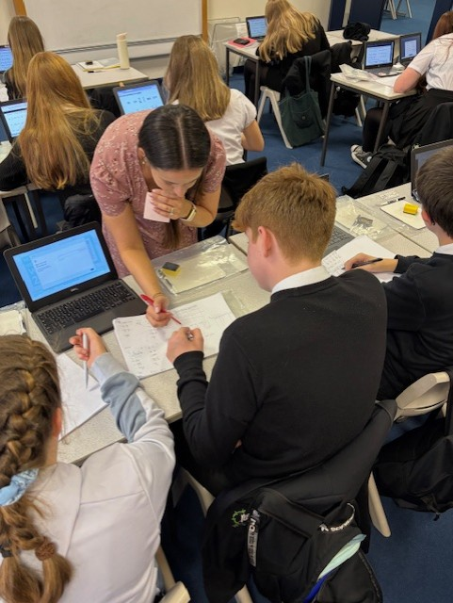
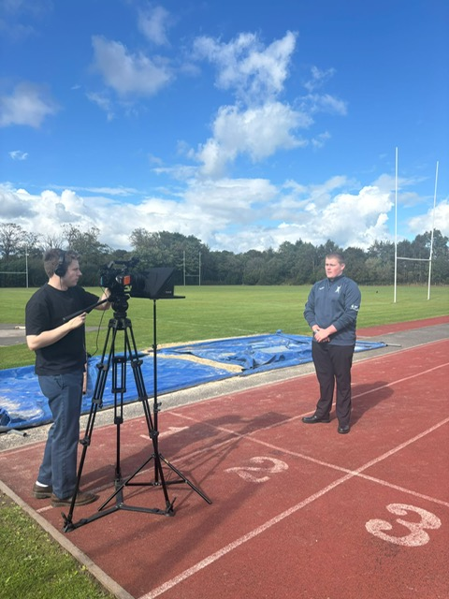
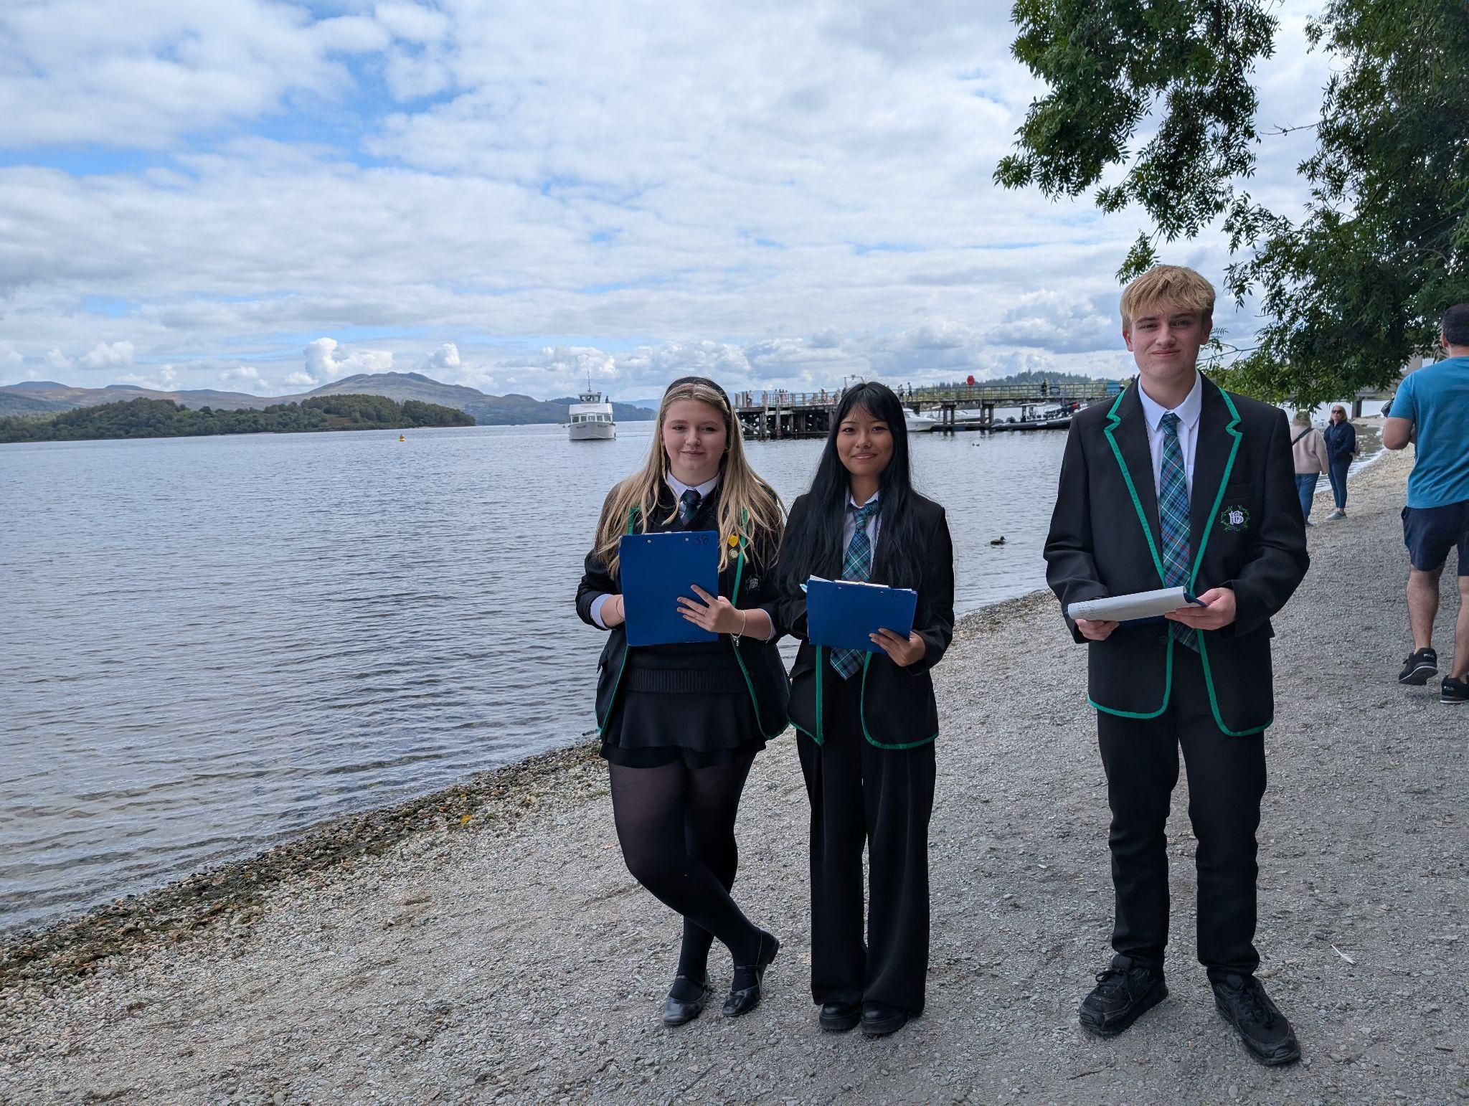
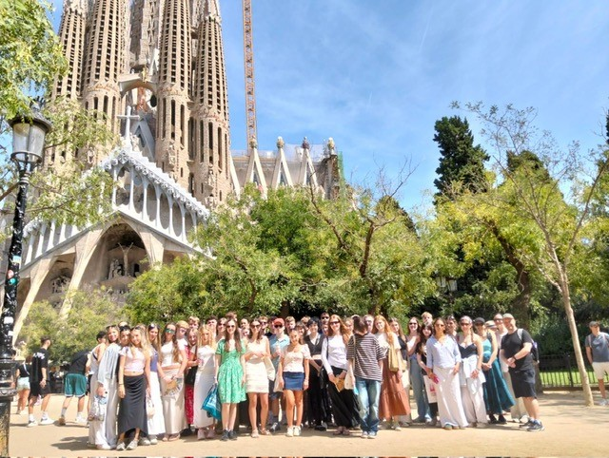
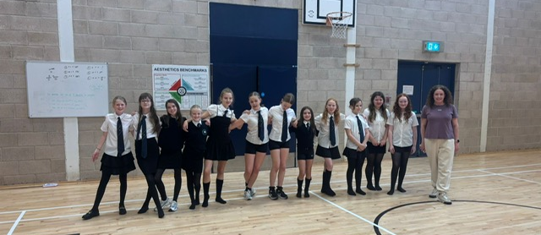
Some of what’s been
going on…

Slide 5
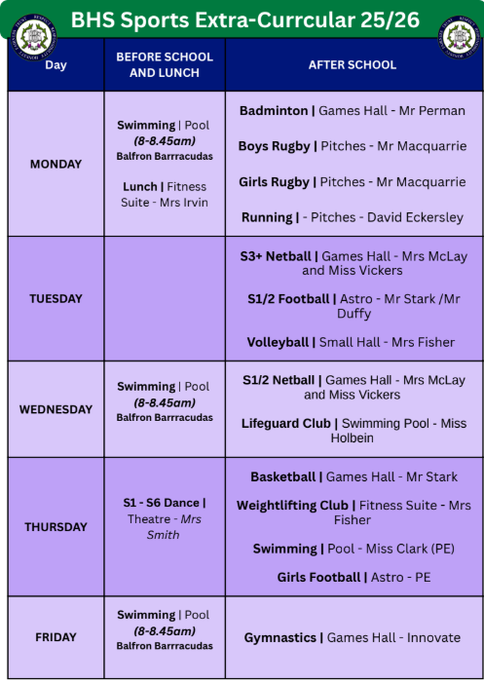
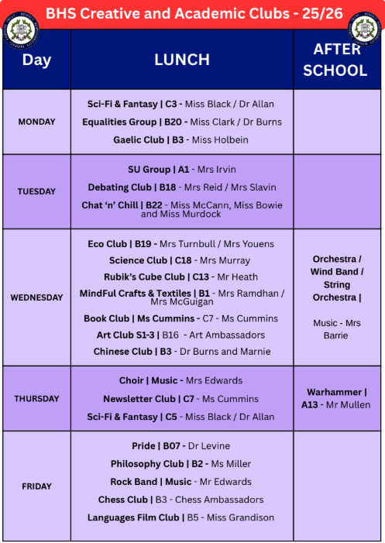
General Update - Our offer & what’s going on…
#Findyourthing

Slide 6


SQA Exam Results 2025 - Breadth & Depth by year

Slide 7
High level messages 2025 - breadth & depth
S6 results in breadth and depth are stable
S5 results (5@) are down compared to previous year group but in line with cohort attainment at S4
S4 results are back up

Slide 8
SQA Results 2025 - S6
2025 2024 2023 2022 2021 2020 2019 2018
(ACM) (PJ)
1+ at AH 34% 35% 30% 30% 41% 35% 35% 40%
2+ at AH 18% 19% 17% 16% 22% 13% 19% 22%
3+ at AH 5% 8% 5% 6% 7% 1% 6% 9%
5+ Higher 54% 54% 48% 57% 60% 55% 56% 57%
(accumulate)
Notes:
Steady

Slide 9
SQA Results 2025 - S5
2025 2024 2023 2022 2021 2020 2019 2018
(ACM) (PJ)
5 + Highers 32% 35% 38% 30% 36% 42% 37% 39%
3 + Highers 58% 69% 61% 59% 65% 67% 62% 59%
1 + Higher 74% 74% 83% 75% 81% 83% 78% 78%
Notes:
61% got 5 N5s (poorer attaining S4)

Slide 10
SQA Results 2025 - S4
2025 2024 2023 2022 2021 ACM 2020 PJ 2019 2018 (7 courses) (6 courses)
5 + level 5 68% 61% 67% 74% 65% 79% 61% 64%
4 + level 5 73% 70% 77% 80% 75% 84% 71% 69%
4 + level 3 96% 89% 93% 95% 91% 96% 93%
5+ level 3 92%

Slide 11
So what next? Focus on 5 Higher Candidates
S5 Group 1 (45 pupils): These learners are doing 5 Highers from A at N5 and should be secure
S5 Group 2 (20 pupils): These pupils are doing 5 Highers from 4 As. The subject that is coloured yellow or blue, denotes a crash
(blue) or progressing from a B at N5 (yellow)
S5 Group 3 (21 pupils): These learners are the least secure of our 5 Higher candidates. They will need the most support and intervention from the start. Where your subject is red, the learner is progressing from a C pass at N5.
There were 158 pupils in this cohort at census time in S4 - all passing would be 54% of cohort attaining 5 Highers.
Interventions:
In class monitoring and support by teacher
Regular retrieval quizzes
Carefully consider the groupings/ pairs that these learners are in
Peer mentoring (S6 pupils with Higher passes and time)
Regular past paper homework to guide revision
Supported Study: £15,000 funding is available for targeted out of school hours study sessions.

Slide 12
Digital Event for Parents & Carers
Learning Community Approach to supporting parents & carers
Event at BHS likely March 2026
What would be helpful to parents?
https://forms.gle/mLG5KeJciWDWhvmH6

Slide 13
Stirling Council Consultation on Admissions Policy
Online Survey for Parents & Carers
Schools, Learning and Education are currently consulting on the creation of the Education Admissions Policy. As part of this process, we are keen to hear the views of young people of all ages.
Do you enjoy being in your school?
Tell us what you enjoy about your school.
When you started your school was there anything that helped to make the move/transition better for you?
Did you have information about the school before you started? If not, what information would have been helpful for you to know about?
Is there anything about moving to a new school that you think is important for adults to know about that might make it easier for other children starting a new school?
Our draft admissions policy tells people how to apply for a school, a nursery, a specialist school, and how parents/carers make a placing request to a school - do you think it is important to have a policy like this?
Is there any information that you think would be helpful for you or your parents / carers to know about when applying for a school?

Slide 14
This term, coming soon…
SAMH Peer Support Assemblies this week
Professional Learning for teachers (Wednesday/Thursday)
Wednesday 17 September - Outstanding Achievement Ceremony
Friday 19 SEptember - Sandy Holroyd Rugby Event
Tuesday 23 September - HT Drop-in
23-25 September - S1 Team Building Days
25 September - Back Onside Counselling Support
7 October - S4 Parents Evening
8 October - Progressive Masculinity Assemblies & Online Meeting for Parents (6pm)
10 October - Battle of the Bands (lunchtime)
End of term!

