Slide 1
Balfron High School
S4/5 Course Choice
Information Evening
Thursday 7th February 2019

Slide 2
Welcome & Introductions
Elaine Bannatyne Head Teacher
Phil Slavin DHT, SQA, (Campsie)
Claire Appelquist DHT, Pupil Support, (Endrick)
Amanda Short DHT, Timetable (Lomond)
Tracey Patrick DHT, Developing the Young Workforce
Principal Teachers & teaching staff in the atrium
Many other partners in the atrium

Slide 3

Workload
S5
5 subjects
+
Up to 5 Prelims
+
Up to 5 External Exams

Slide 4
Expectations of our young people
Take responsibility
Attendance and Timekeeping
Be prepared and ready to learn
Growth mindset and resilience
Actively participate
Complete homework and meet deadlines

Slide 5
SQA Exams
Mrs Short

Slide 6
SQA Examinations – when?
All SQA exams take place from:
Thursday 25 April to Friday 31 May 2019
Each pupil will receive an individual exam timetable in April.
This must be checked, signed and returned by the pupil asap after issue
Notes:
6

Slide 7
Exam Leave
Study leave for S4-5 pupils starts on Wednesday 24th April 2019
Study leave is for all S5 & S6 pupils and those S4 pupils doing 3 or more exams
Pupils doing 1 or 2 exams, will get 2 clear study days before each exam
Individual timetables will be issued for pupils who do not require study leave, with opportunities for certification.

Slide 8
SQA Examinations
Exams will be held in the theatre and in various classrooms around the school
Lists of exam rooms, times and candidates names will be displayed on the SQA Information Notice Board in the atrium
It is essential that candidates check lists prior to the exam and note their seat number
Notes:
8

Slide 9
SQA Exams - Supporting Your Child
Know the days and times their exams are on.
Encourage them to study…..
If your child is unable to sit an exam due to illness, it is important that parents/carers telephone the school as early in the day as possible (from 8:00am)
As soon as possible thereafter, obtain a Doctor’s Certificate / letter which should be handed in or sent to the school

Slide 10
SQA Results and after ….
Tuesday 6th August 2019
Staff in on Wednesday 7th August 2019 to support with post results service, and to support course choice changes

Slide 11
Course Choice Information
Mrs Short

Slide 12
Timetable in S5/6
All pupils must study 5 or 4 subjects
These subjects should be listed in order of priority
At this stage you have a free choice, BUT…….
Timetabling columns must then be constructed
Problems can occur – choose an alternative subject
Notes:
12
Half-way through a NQ course in English
80% of pupils take Maths – limit to other choices to be set against it.

Slide 13
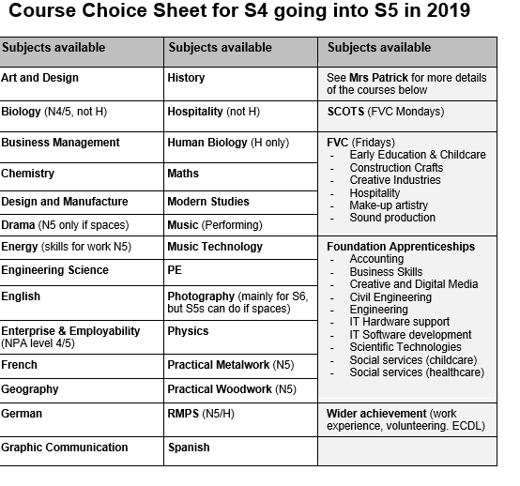
The Course Choice Form

Slide 14

The Course Choice Form

Slide 15
The Course Choice Form
 | Subject choice | Level? N5 / H | Office only
Subject Choice 1 (Highest Priority)
Subject Choice 2
Subject Choice 3
Subject Choice 4 (Lowest priority)
Alternative subject Choice
Forth Valley College (Friday)
Foundation Apprenticeship

Slide 16
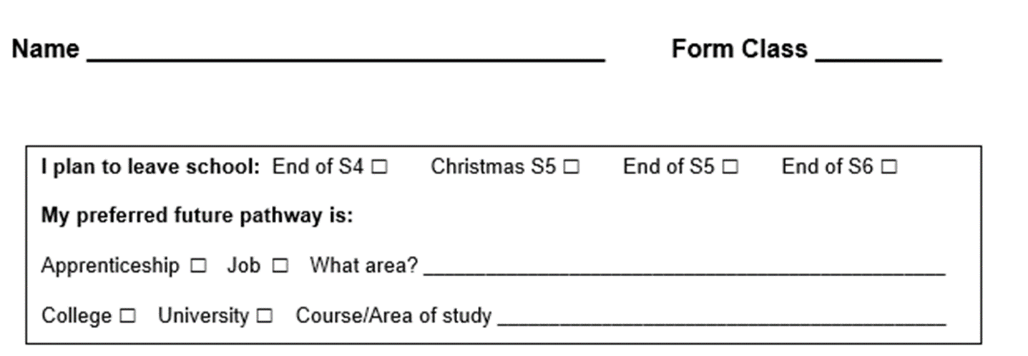
Course Choice Form

Slide 17
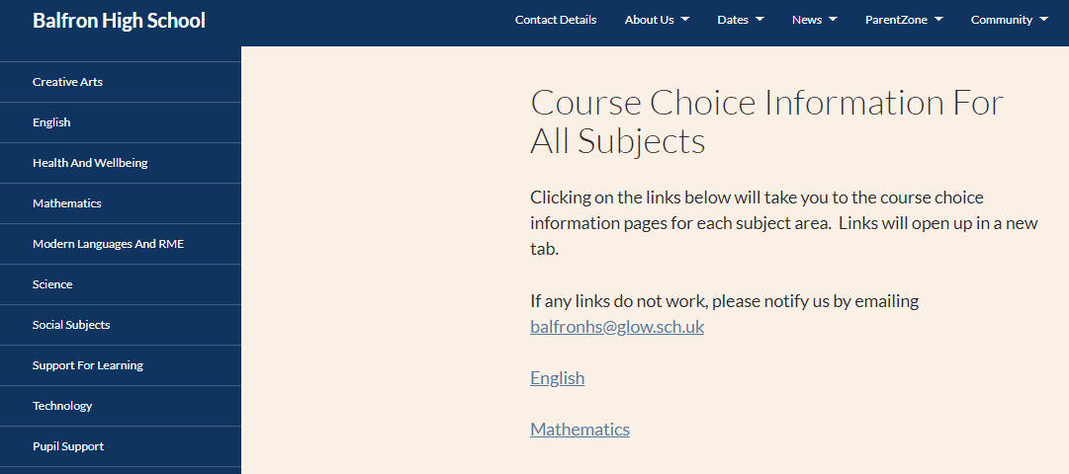
Course choice Advice: Subjects
Speak to teachers/PTs
Subject information
Link:

Slide 18
Proviso…
A subject can only run if we have
enough pupils in the class
a subject specialist to teach the class

Slide 19

Mrs Patrick

Slide 20

Future Pathways
S4/5 Course Choice Advice and Support
Destination planning
Learning Pathways
How to stand out
Support

Slide 21
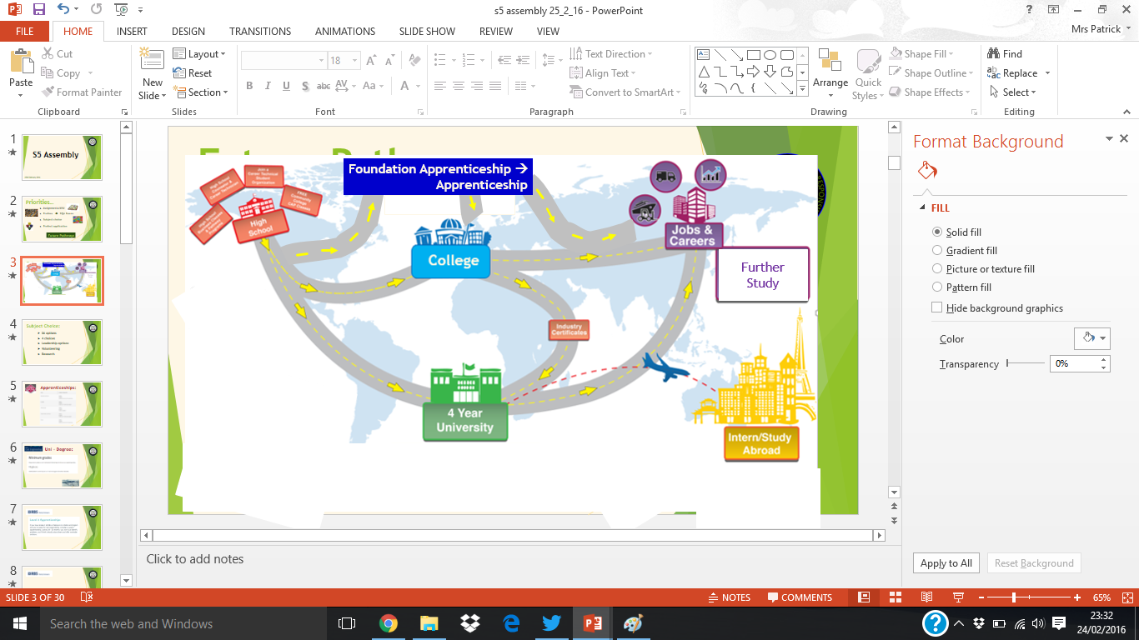


Future Pathways - Destination planning:
You are here
Destination/Career
what career?
Own Business
College
what pathway?
GAP year
what opportunities?
what support?

Slide 22


Future Pathways - Destination planning:
S3 Course Choice Advice
What are your interests?
What are your skills?
What job/career area?
Choose a variety of subjects
→Research

Slide 23
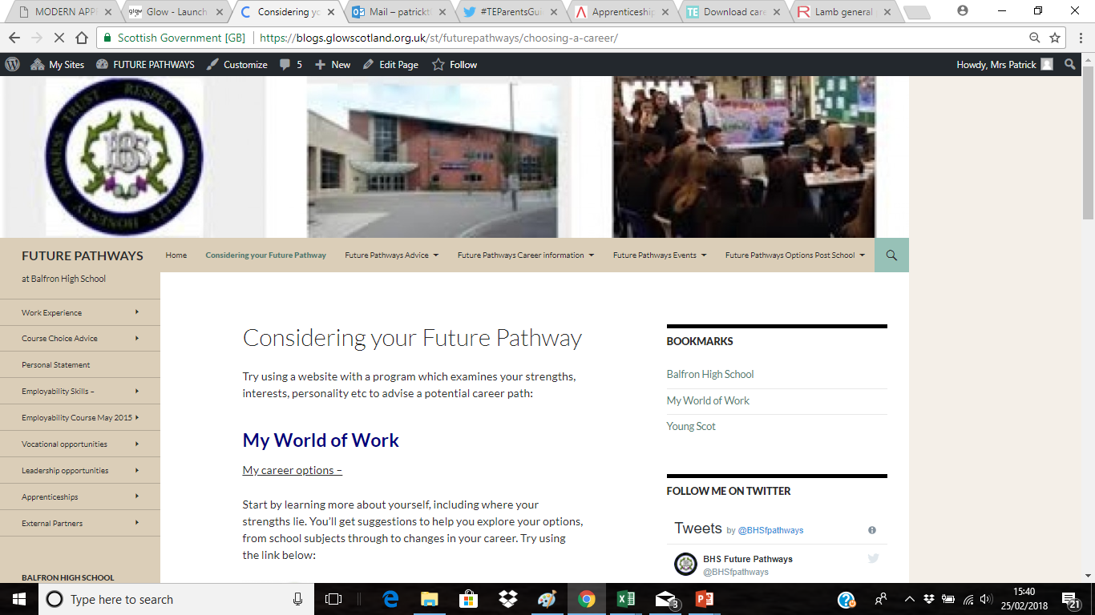
Future Pathways - Destination planning:
S3 Course Choice Advice
Future Pathways website:

Slide 24
Future Pathways - Destination planning:
Career/
Career area
Pathways
Research
Courses
Destinations

Slide 25

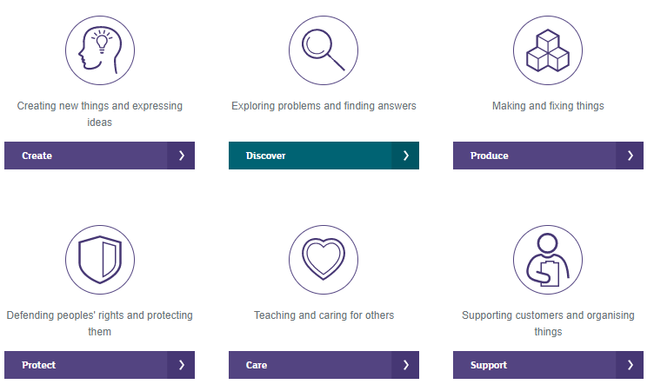


Research – Career/Career Areas
Future Pathways - Destination planning:
My Career Options

Slide 26
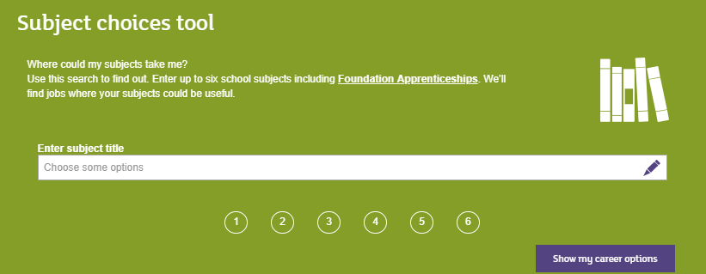
Research – Career/Career Areas
Future Pathways - Destination planning:
My Career Options

Slide 27
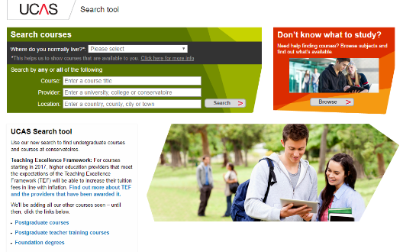

Research – Destinations
Future Pathways – Learning Pathways:
College/University
- own website, UCAS
Employment
- INDEED,
Apprenticeships

Slide 28


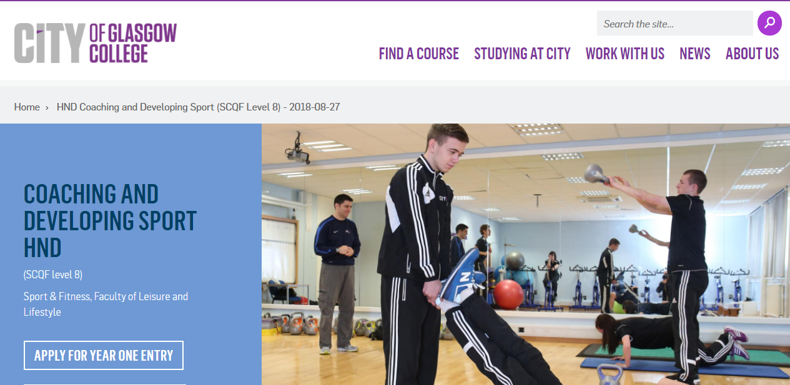
Research – Destinations
Future Pathways - Destination planning:
Entry requirements
minimum, usual, *CHANGES*
Subjects
essential, approved

Slide 29
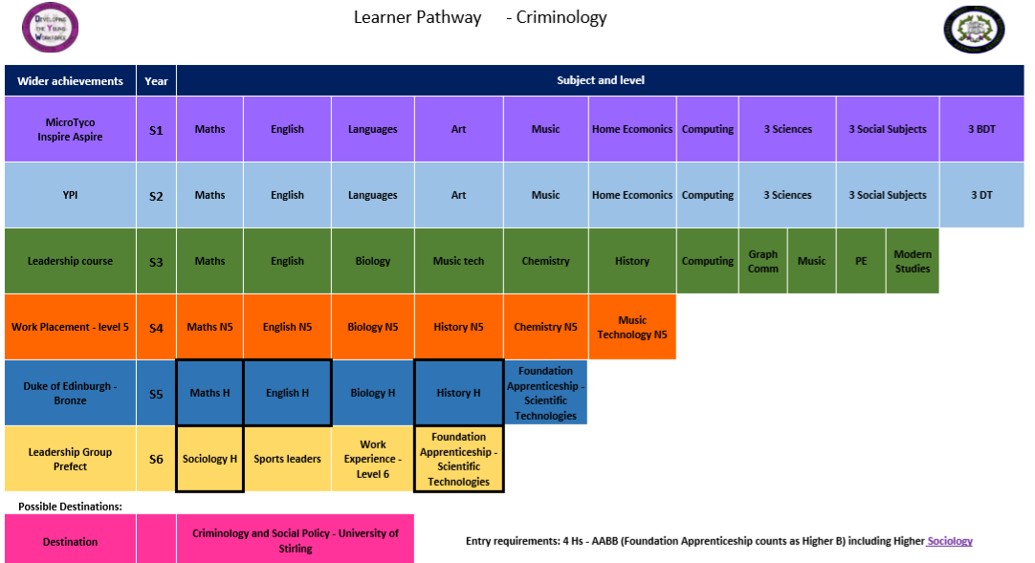
Research - Pathways
Future Pathways - Destination planning:

Slide 30
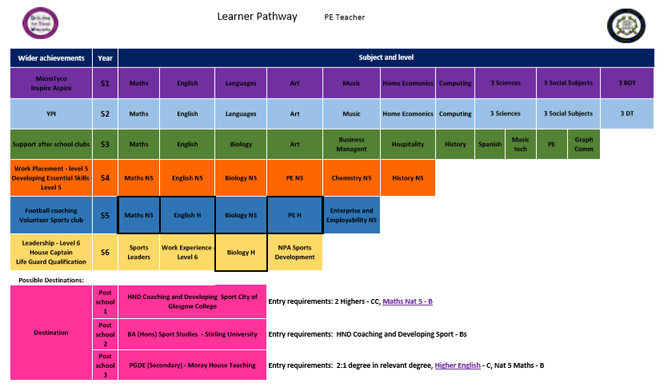
Research - Pathways
Future Pathways - Destination planning:

Slide 31
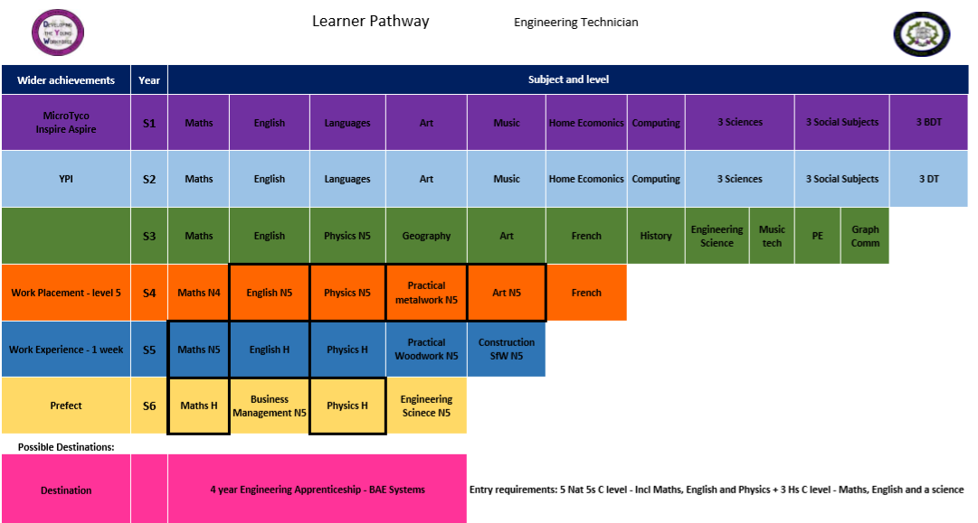
Research - Pathways
Future Pathways - Destination planning:

Slide 32
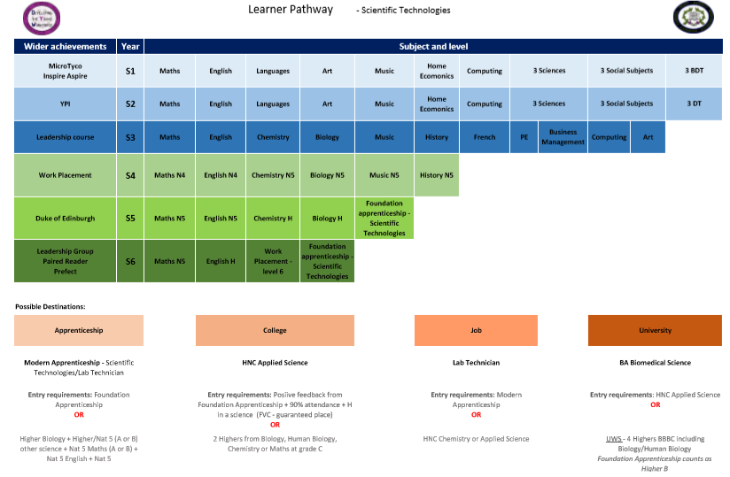
Future Pathways – Learning Pathways:

Slide 33
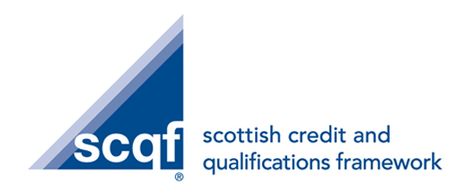
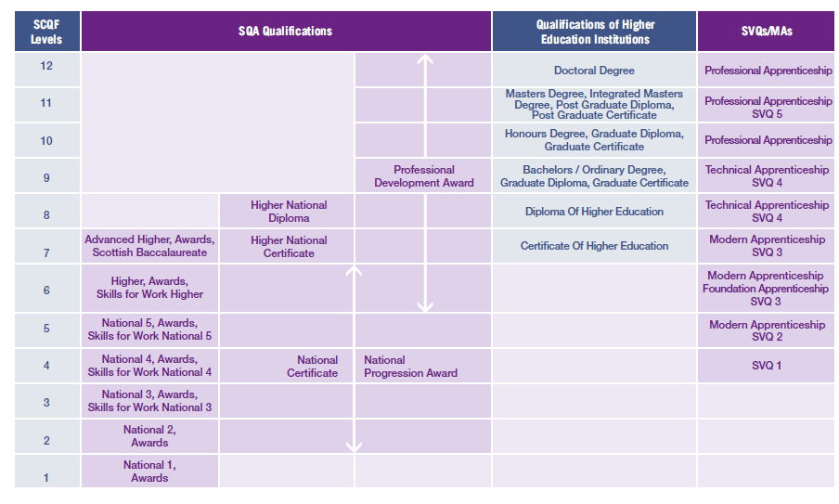
Research - Courses

Slide 34
Research – Courses
Future Pathways - Destination planning:
Wider Achievements
Teaching English as a Foreign Language £75
Volunteering – SCQF level 5
Animal Care – Distance Learning
ECDL - SCQF level 5
BTEC Sound Engineering placement – SCQF level 6
YASS – Young Applicants in Schools

Slide 35
Research – Courses
Future Pathways - Destination planning:
S4/5 Course choice: College Options
SCOTS (taster – Monday am)
Foundation apprenticeship
1 or 2 year course (S5/6)
Column (Monday+Wednesday afternoon)
Friday College Course – one column, miss every Friday P1-5, Transport Cost

Slide 36
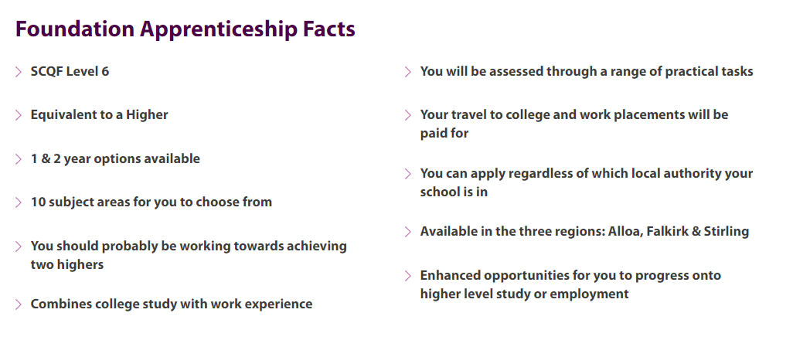
S4/5* Course choice: FAs
FVC Stirling OR a Stirling school

Slide 37

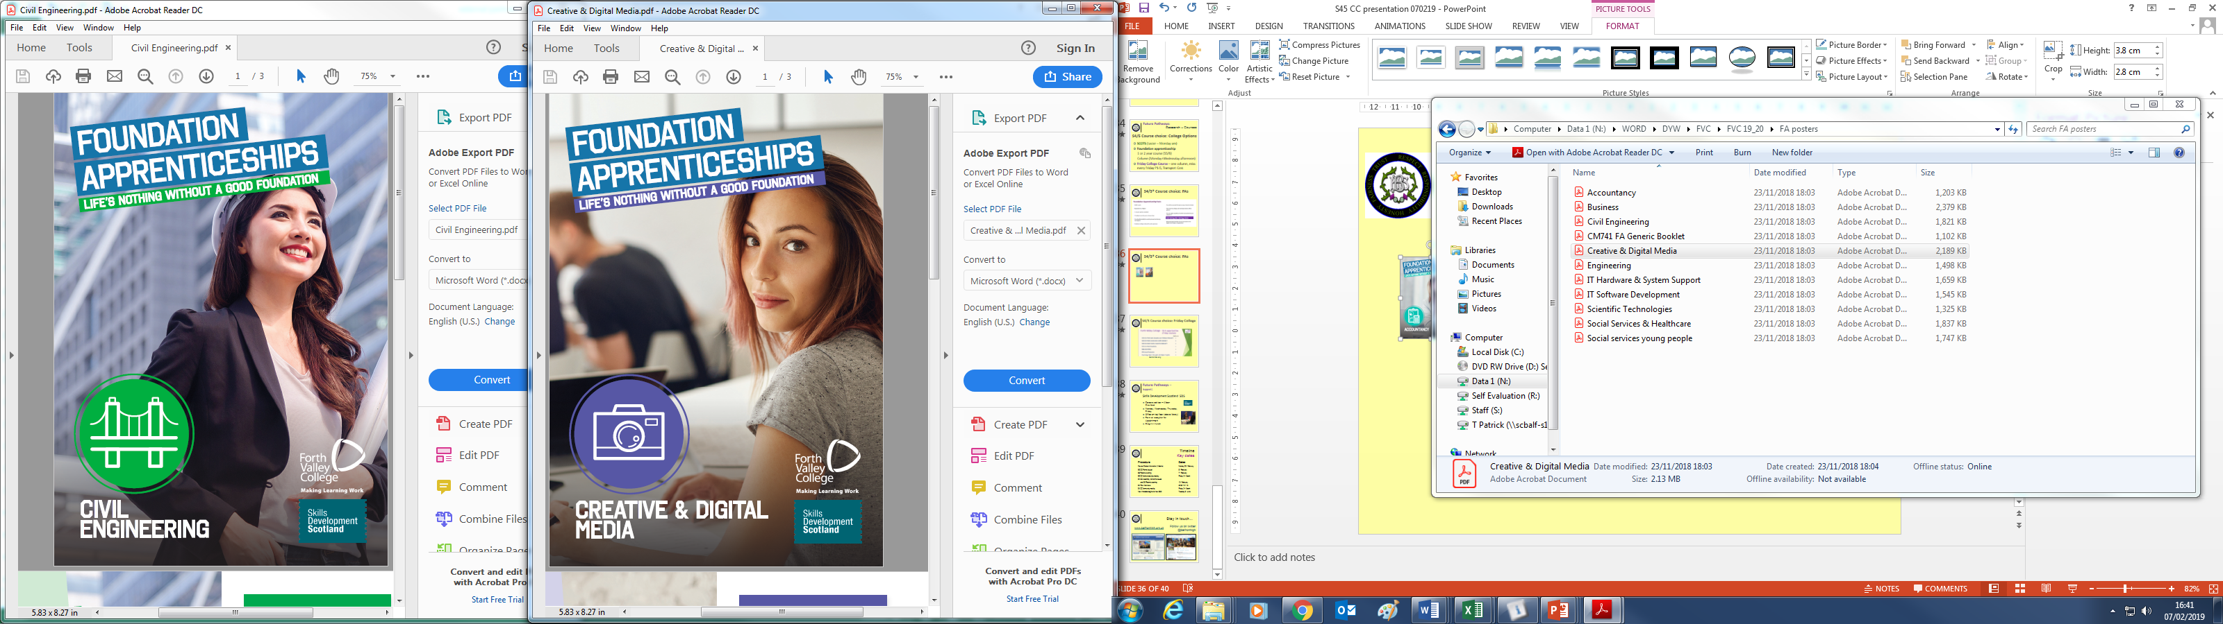

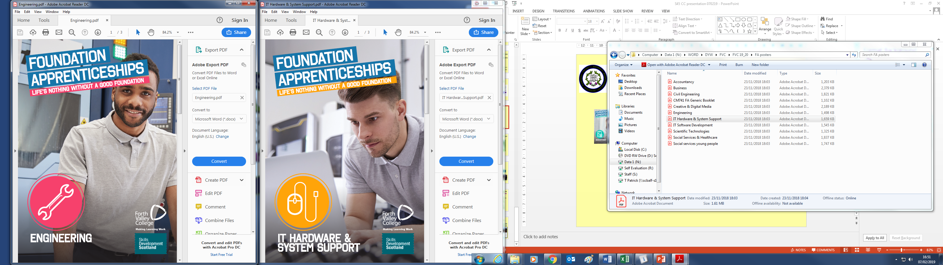
S4 - 1 year FAs
Foundation Apprenticeships

Slide 38
S5 - 1 year FAs
Foundation Apprenticeships

Slide 39
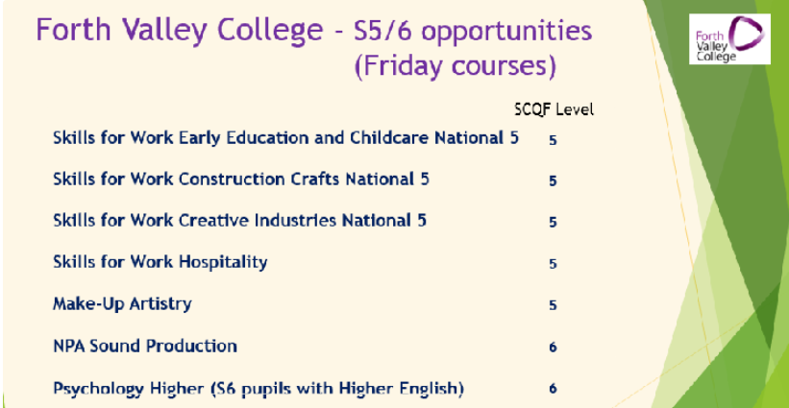
S4/5 Course choice: Friday College
Current S5 only

Slide 40

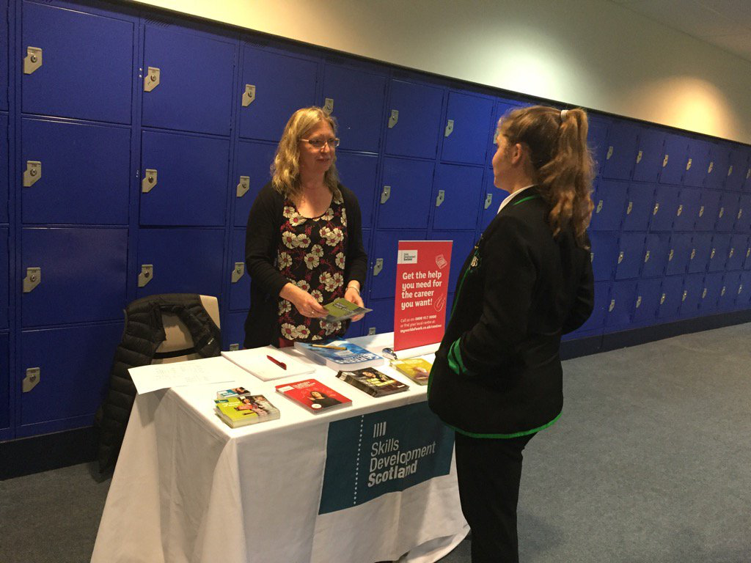
Skills Development Scotland SDS
Future Pathways –
Support:
Careers adviser – Aileen Crawford
Monday, Wednesday, Thursday, Friday
Office on top floor (above library)
Form at reception for Appointment
Drop-in – lunch

Slide 41
Timeline
Key dates 2019
Procedure Dates
Course Choice Information 7th February
S5 Parents evening 18th February
S5 course choice interviews 19/2 – 8/3
S4 Parents evening 25th February
S4 course choice interviews 26/02 – 08/03
S4 and S5 CC forms returned by Friday 22nd March
New timetable begins for new S5/6 Monday 3rd June
Notes:
41

Slide 42


Stay in touch…
Follow us on twitter
@balfronhigh
www.balfronhigh.org.uk

