Slide 1
Balfron High School
S2 Course Choice
Information Evening
Thursday 7th February 2019

Slide 2
Welcome & Introductions
Elaine Bannatyne Head Teacher
Phil Slavin DHT, SQA, (Campsie)
Claire Appelquist DHT, Pupil Support, (Endrick)
Amanda Short DHT, Timetable, (Lomond)
Tracey Patrick DHT, Developing the Young Workforce
PTs & other teaching staff in the Atrium
Many other partners in the Atrium

Slide 3
Purpose of this evening
Equip parents and carers with the information required to work with us in best supporting young people
  Curriculum, course choice and timelines
  Support and communication
  Course information

Slide 4
Rationale for our curriculum
21st century learners
Skills
Academic pathways
Vocational pathways
Modern world
Knowledge
Partnerships
Rural context

Slide 5
Curriculum and Course Choice
Mrs Short

Slide 6
Period Allocation in S3
11 Subjects (inc English & Maths) 26 Periods
PSE 1 Period
RME 1 Period
PE 2 Periods
Leadership 1 Period
Total 31 Periods

Slide 7
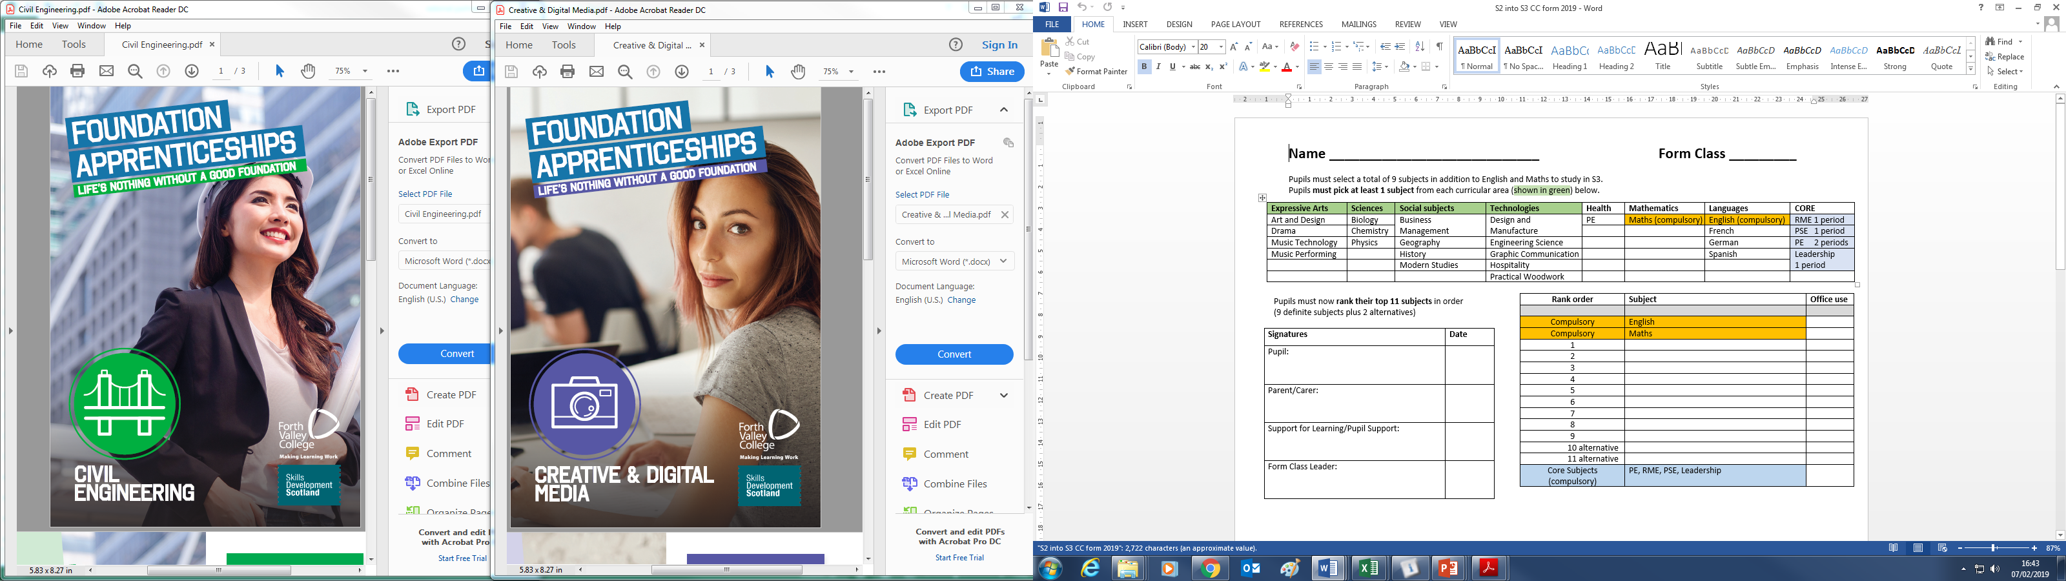
The Course Choice Form

Slide 8
Front of form, continued …

Slide 9
The Course Choice Form

Slide 10
Proviso …
A subject can only run if we have
enough pupils in the class
a subject specialist to teach the class

Slide 11
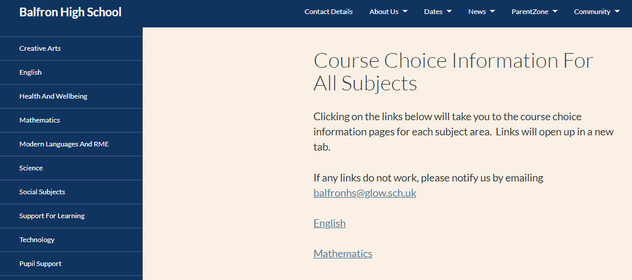
Course choice Advice: Subjects
Speak to teachers/PTs
Subject information
Link:

Slide 12

Mrs Patrick

Slide 13

Future Pathways
S2 Course Choice Advice
Destination planning
Learning Pathways
How to stand out
Support

Slide 14
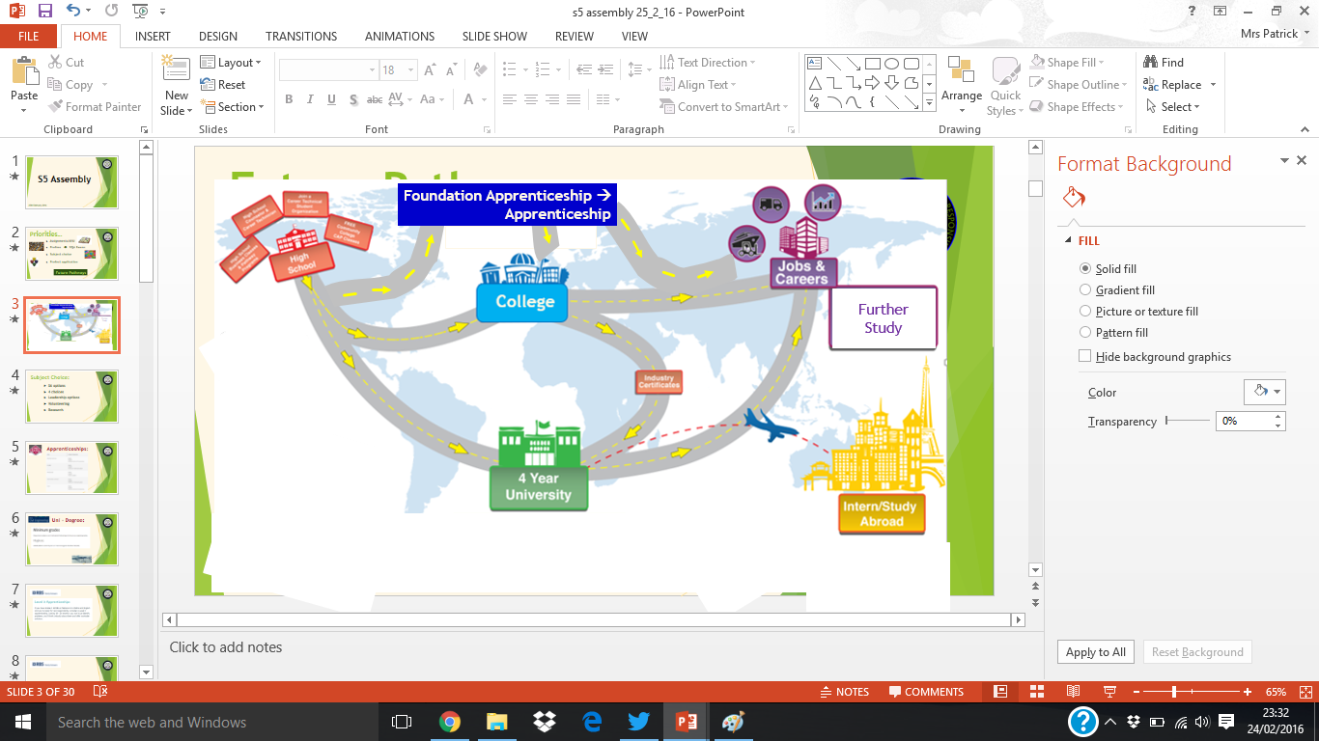


Future Pathways - Destination planning:
You are here
Destination/Career
what career?
Own Business
College
what pathway?
GAP year
what opportunities?
what support?

Slide 15


Future Pathways - Destination planning:
S2 Course choice: Advice
What are your interests?
What are your skills?
What job/career area?
Choose a variety of subjects?
→Research

Slide 16
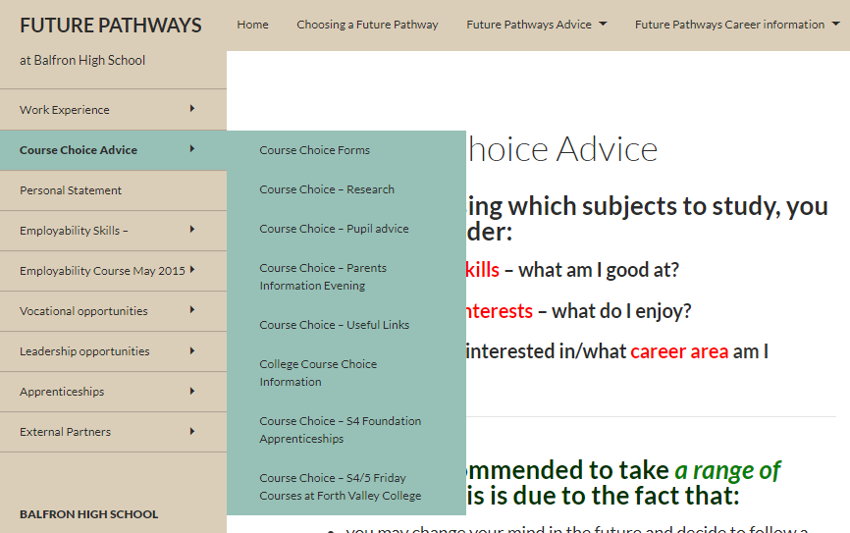
Future Pathways - Destination planning:
S2 Course choice: Advice
Future Pathways website:

Slide 17
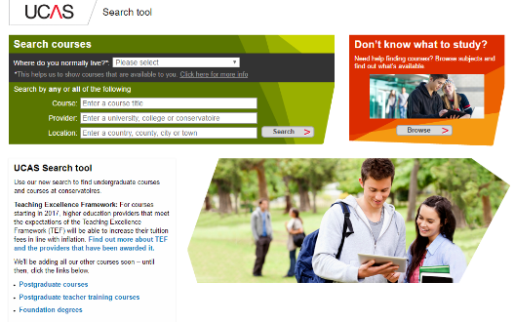
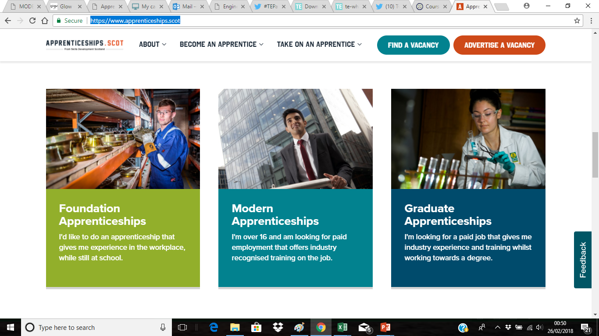
Research – Destinations
Future Pathways – Learning Pathways:
College/University
- own website, UCAS
Employment
- INDEED,
Apprenticeships

Slide 18
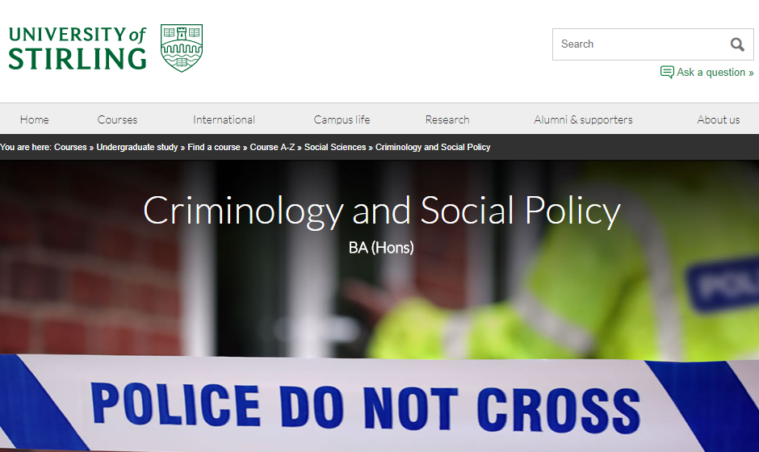
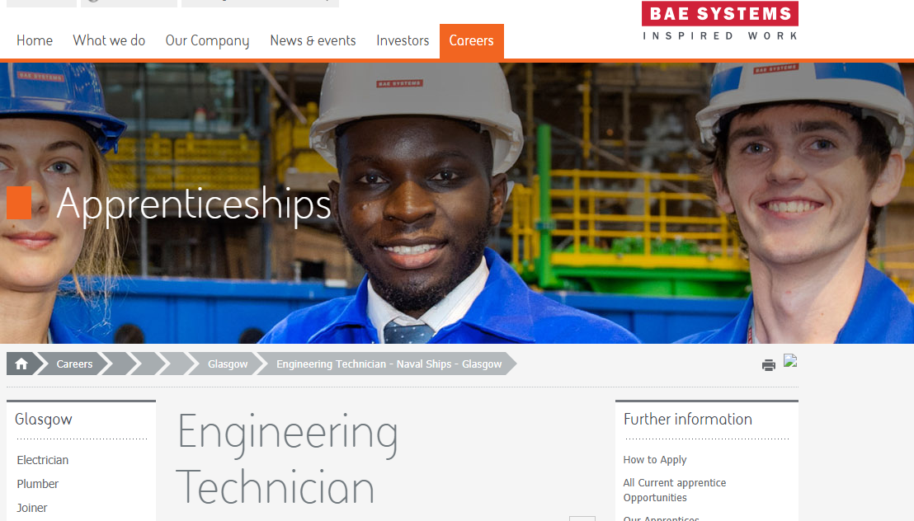
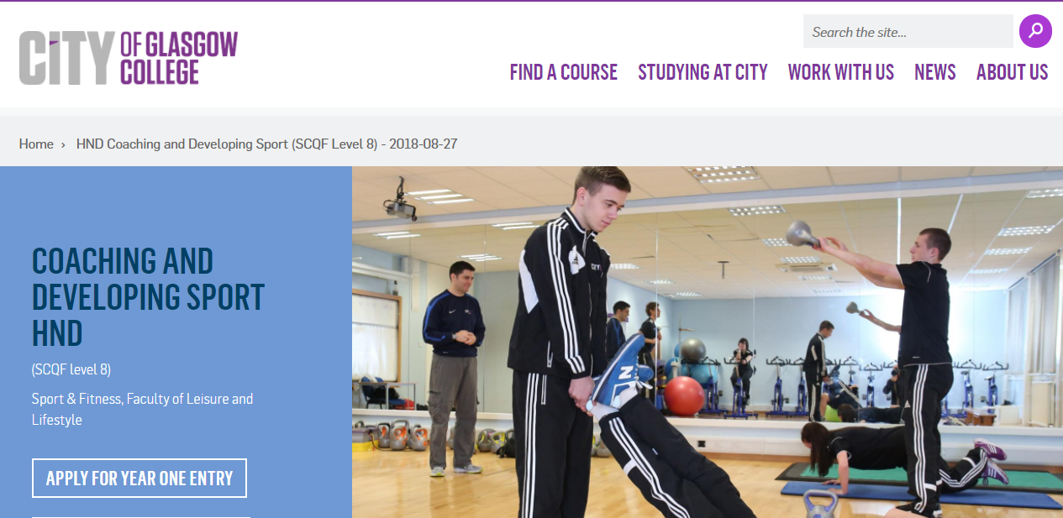
Research – Destinations
Future Pathways - Destination planning:
Entry requirements
minimum, usual
Subjects
essential, approved

Slide 19

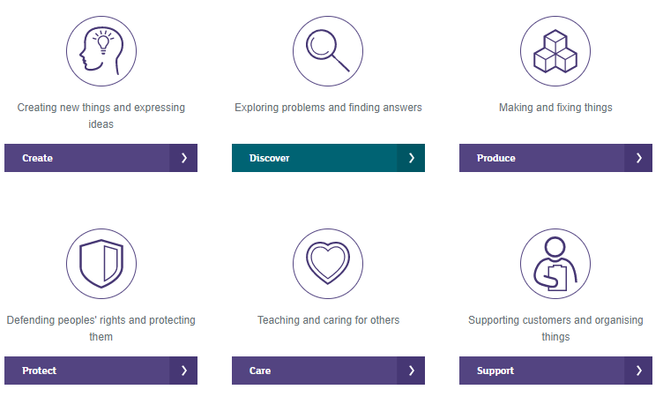
Future Pathways - Destination planning:
My Career Options

Slide 20
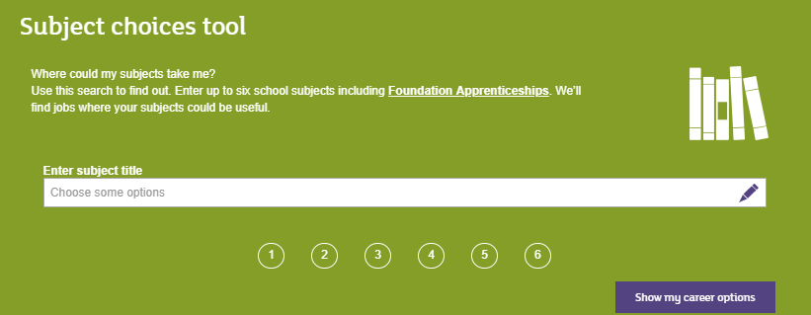
Future Pathways - Destination planning:
My Career Options

Slide 21
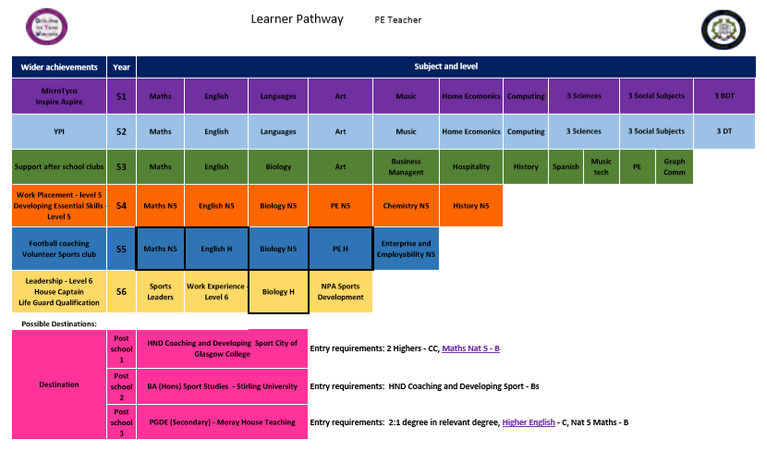
Future Pathways - Destination planning:
Research - Pathways

Slide 22
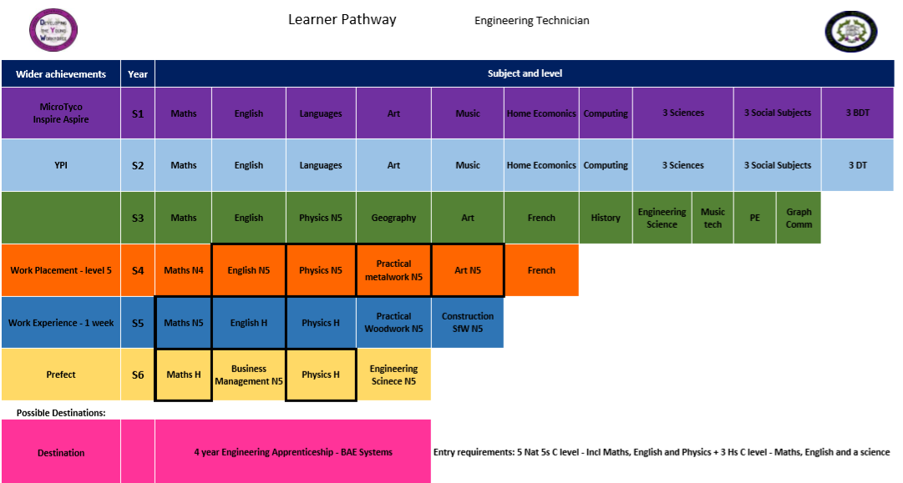
Future Pathways - Destination planning:
Research - Pathways

Slide 23
Future Pathways – Learning Pathways:
Apprenticeships:
S4 course choice

Slide 24

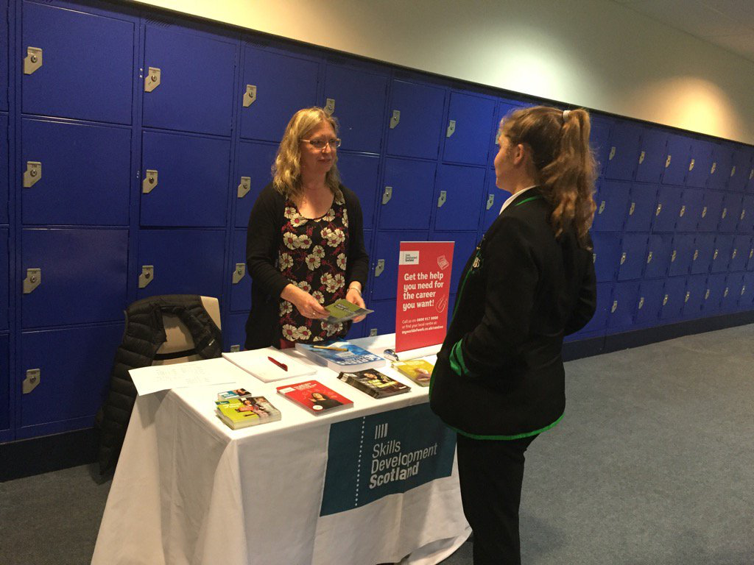
Skills Development Scotland SDS
Future Pathways – Support:
Careers adviser – Aileen Crawford
Monday, Wednesday, Thursday, Friday
Office on top floor (above library)
Form at reception for Appointment
Drop-in – lunch

Slide 25
Timeline
Key Dates
Procedure Dates
Course Choice Information pm 7th February
S2 Reports issued 18th February
FCL Interviews 19-28th February
Course Choice Form return by Deadline 22nd March
New timetable begins Monday 3rd June

Slide 26
STALLS
curricular tables (incl SfL)
Further and Higher Education
- College and Univ
Apprenticeship providers
Skills Development Scotland

Slide 27
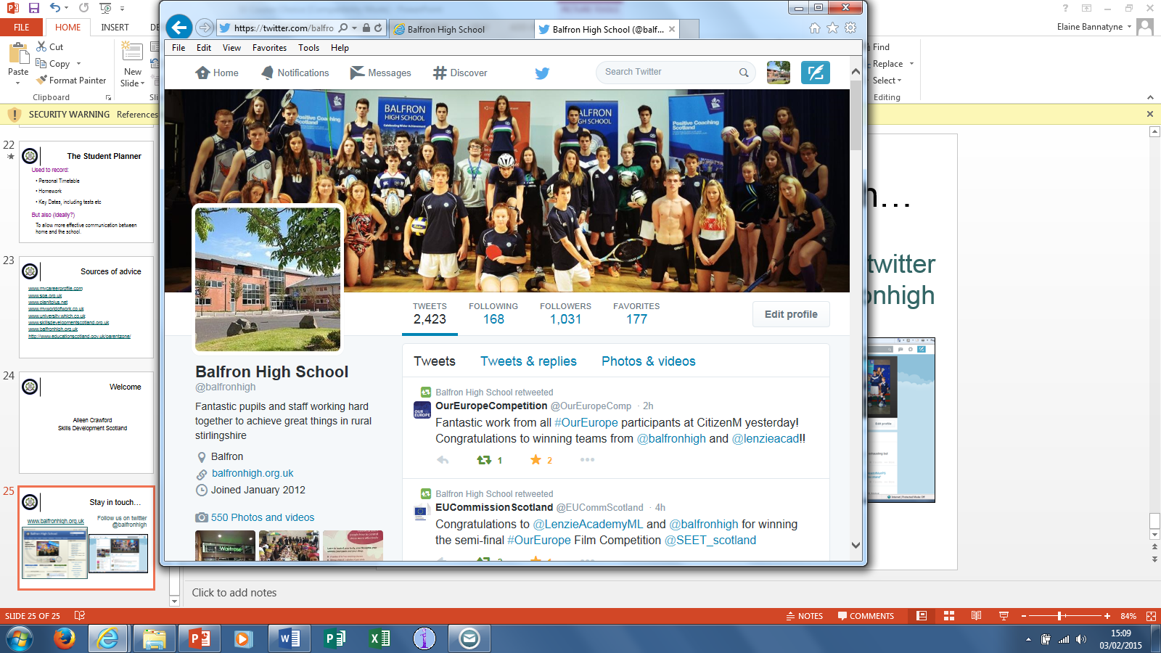
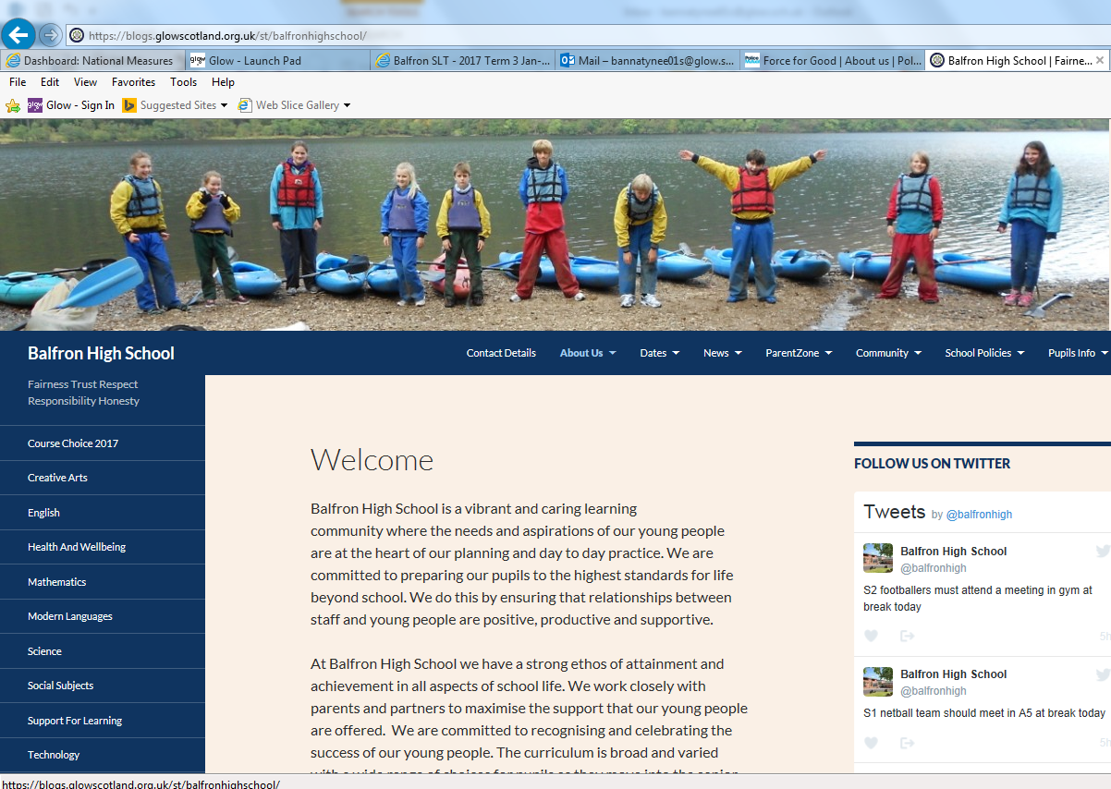
Stay in touch…
Follow us on twitter
@balfronhigh
www.balfronhigh.co.uk

