Slide 1

Woodhead Primary School
Lockerbie Manor 2022 – Parent/Carer Information Session
Please switch off your camera and microphone.
The presentation will start shortly.
This meeting is being recorded.

Slide 2
Agenda
Official Lockerbie Manor presentation.
‘Bargain Special’ Details
    Activities
    Cost
    Itinerary
    Room Allocations
Student Code of Conduct
Kit Required
COVID Secure Arrangements
Questions

Slide 3
Official Lockerbie Manor Presentation

Slide 4

Scotland
ACTIVITY COURSES
FOR THE
DEVELOPMENT OF YOUNG PEOPLE
We provide an introduction to outdoor pursuits in a cotton wool environment

Slide 5
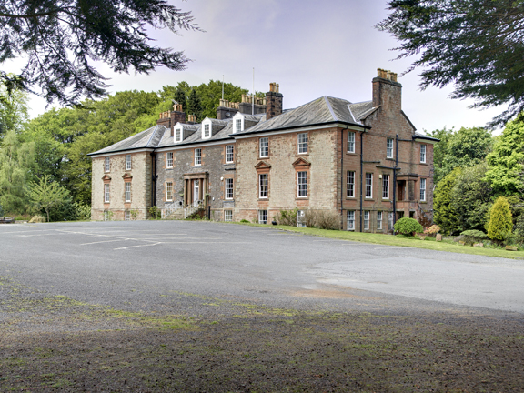

Slide 6
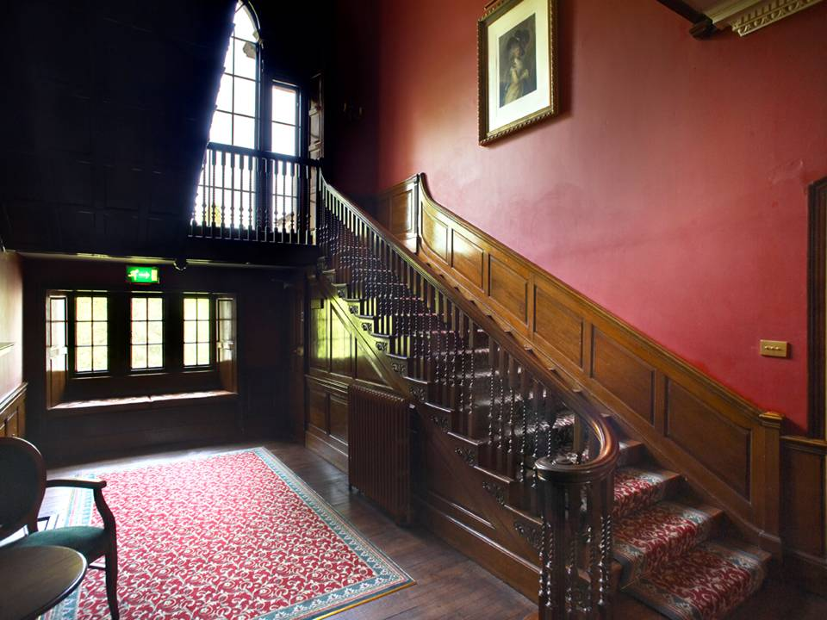

Slide 7
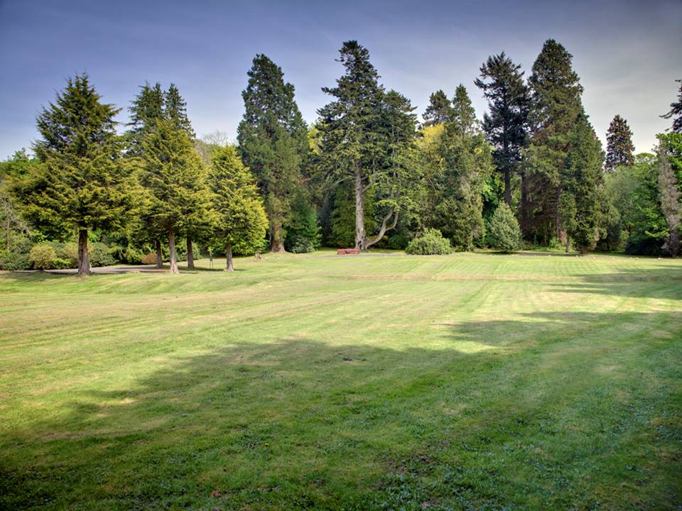

Slide 8
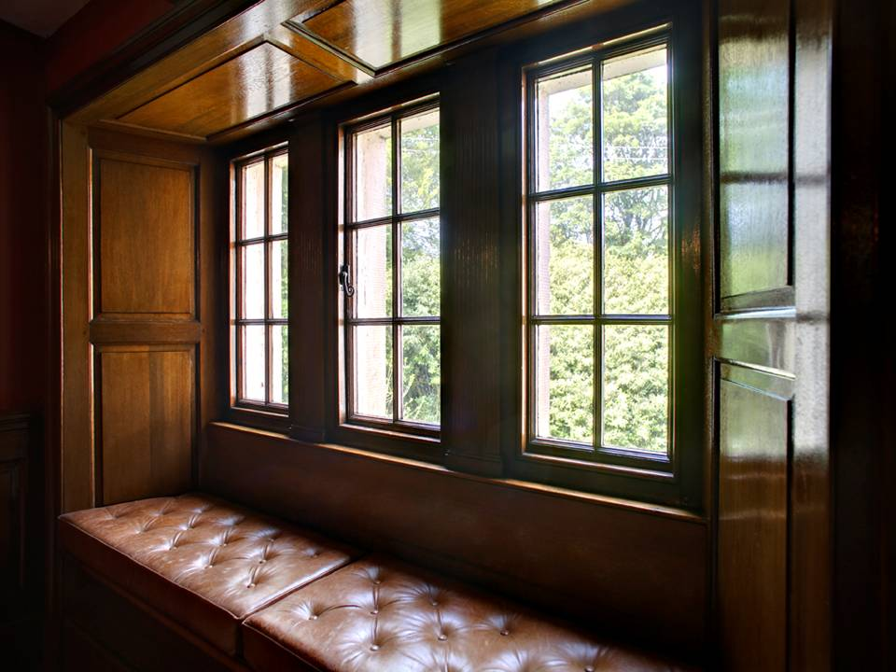

Slide 9
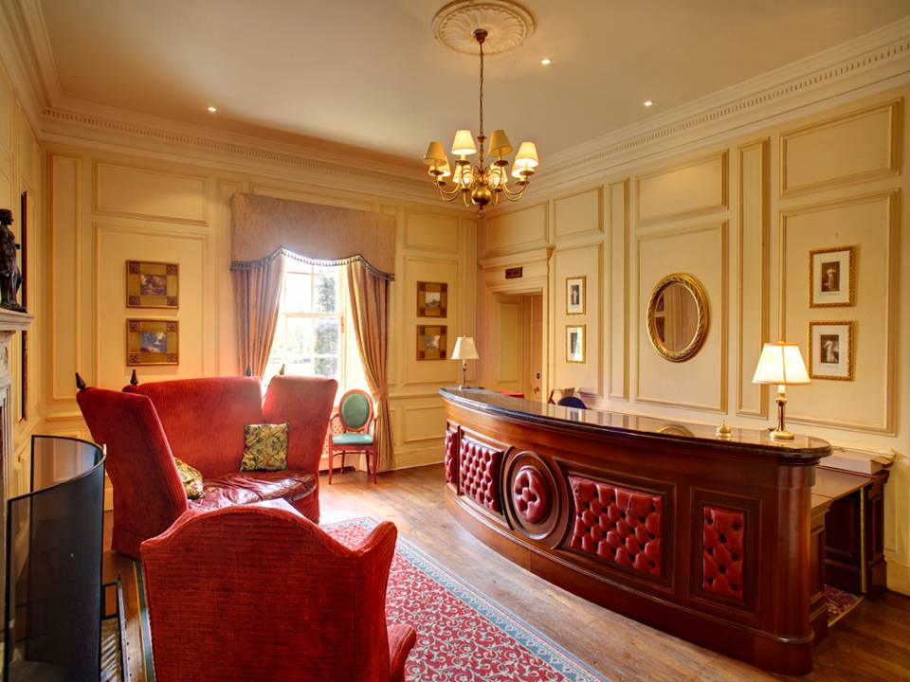

Slide 10

Manor Adventure:
● Established in 1991
● Handles over 27,000 students + 500 families each year
● The quality operator in the school market
● Owns Culmington Manor, 100 acre estate in Shropshire
● Owns Lockerbie Manor, 78 acre estate in Scotland
● Owns Abernant Lake Hotel - 55 acre estate in Mid Wales
● Owns Le Château du Broutel, Somme, Northern France

Slide 11
Manor Adventure has a capacity of 120 students:
● En suite bedrooms for 4-8 pupils
● Teachers rooms adjacent to students rooms
● Duty Instructor (24 hours)
● Schools stay together: eat, sleep and do activities

Slide 12
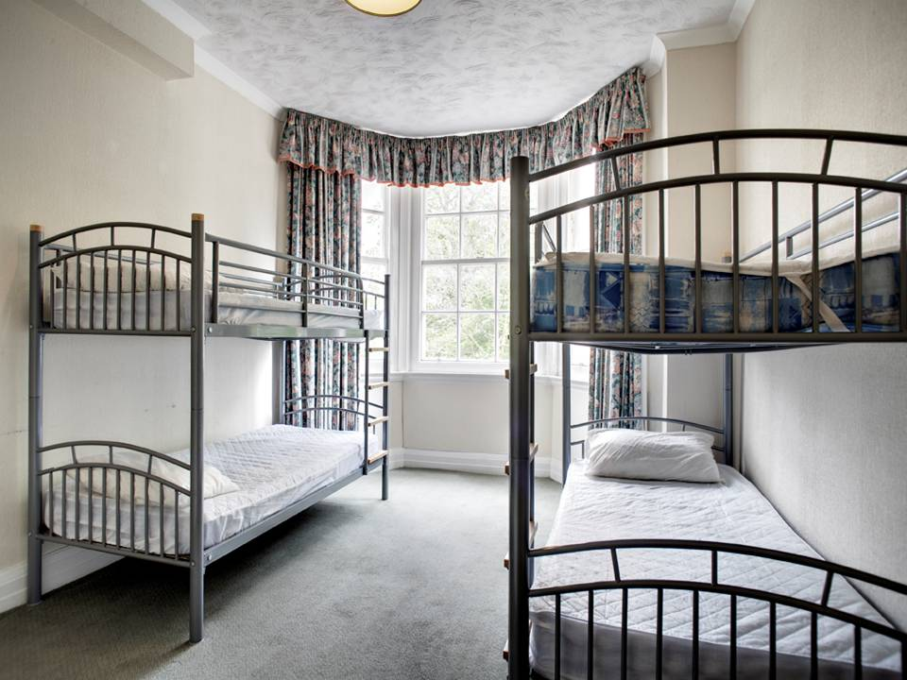

Slide 13
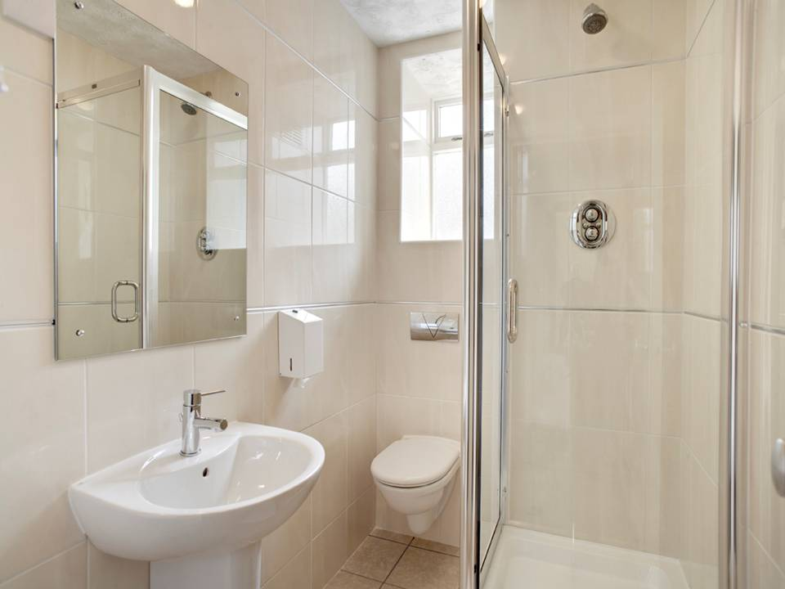

Slide 14
The food is child friendly, plentiful and nutritious:
● Full Scottish breakfast
● Substantial lunch
● Excellent cooked dinner
● Vegetarians, Vegans and special diets catered for
● Plenty of choice

Slide 15
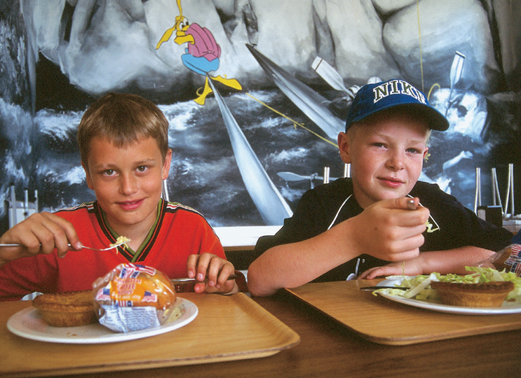

Slide 16
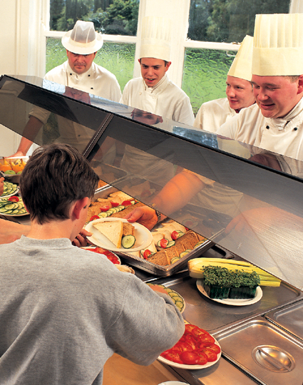

Slide 17
The food is child friendly, plentiful and nutritious:
● Full Scottish breakfast
● Substantial lunch
● Excellent cooked dinner
● Always plenty of choice
● Vegetarians, Vegans & special diets catered for

Slide 18
Health & Safety our No 1 Priority:
● AALS Licence
● Regularly inspected by Health & Safety Executive
● Approved centre status
● Each outdoor pursuit risk assessed
● 4x4 rescue vehicle
● Radio linked outdoor pursuits
● Outdoor pursuits, equipment and instructors continually assessed and monitored

Slide 19
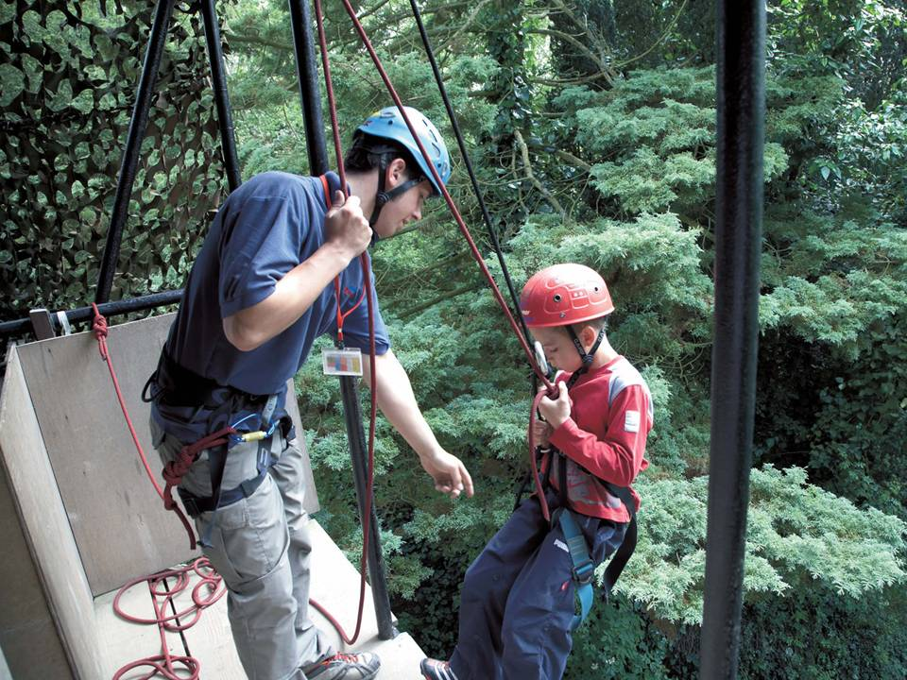

Slide 20
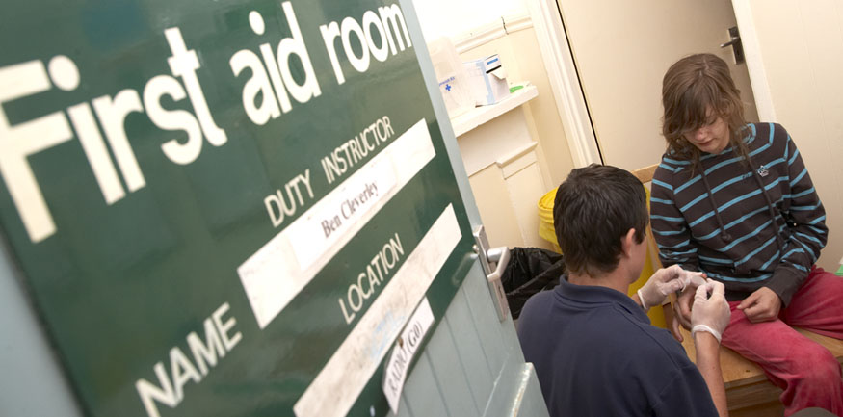

Slide 21
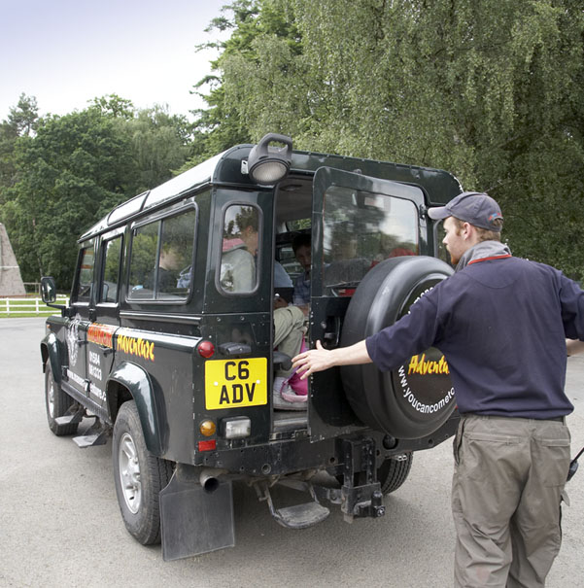

Slide 22
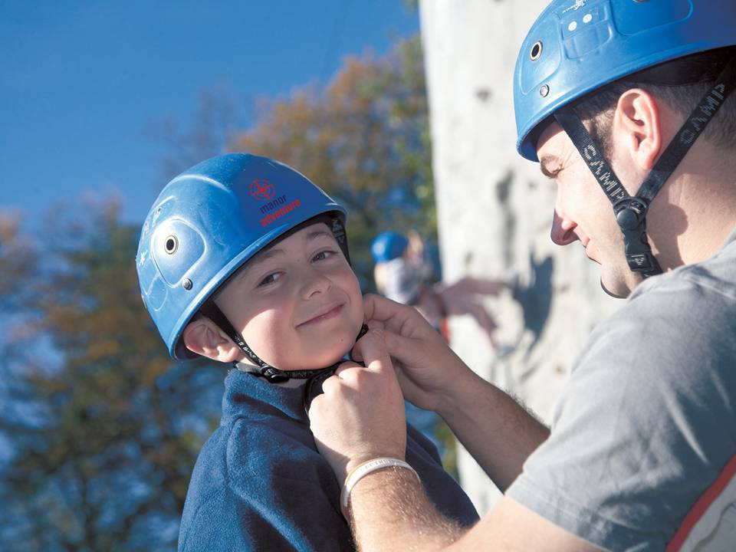

Slide 23
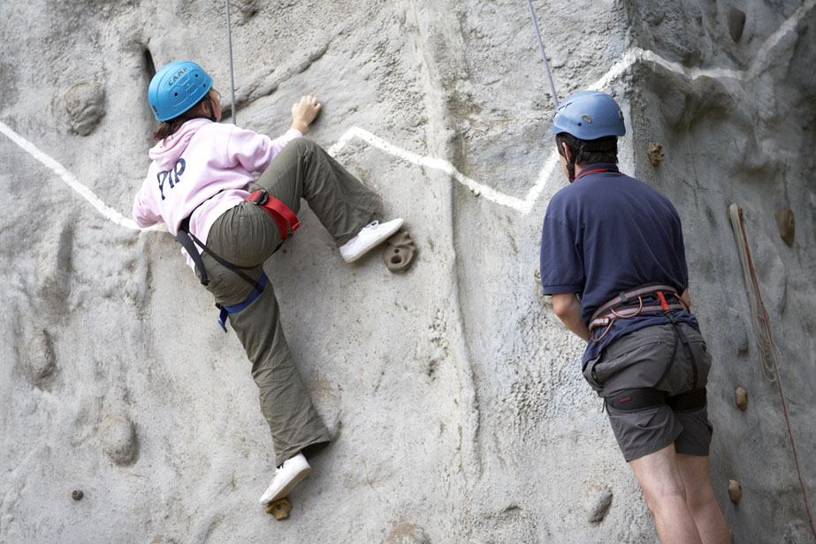

Slide 24
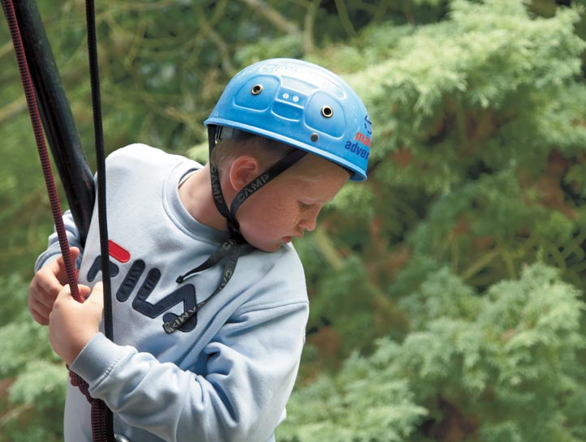

Slide 25
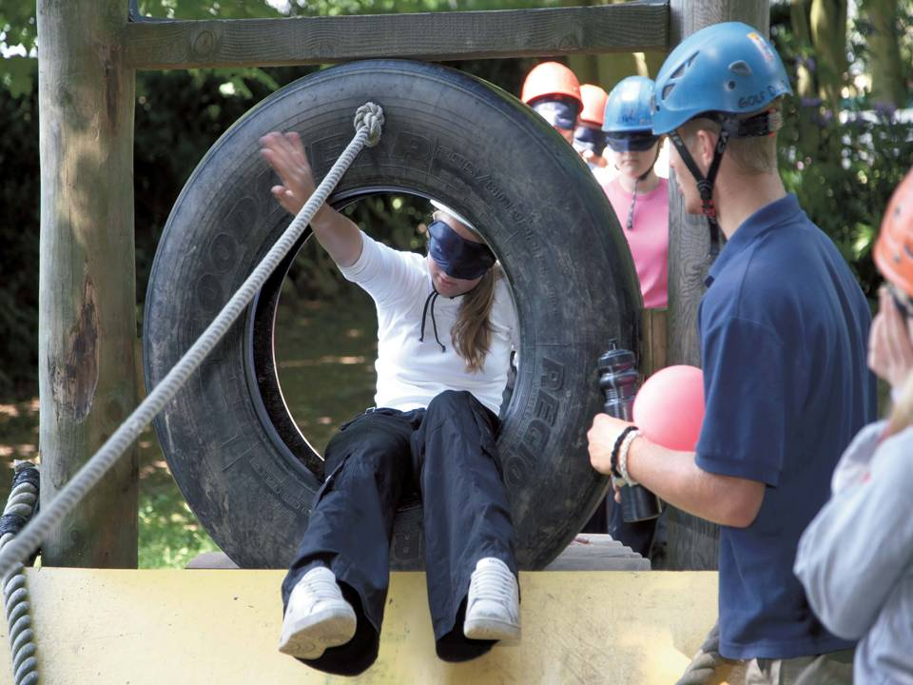

Slide 26
Child Perception:
● Dangerous
● Exciting
● Demanding
● Unnerving
● Experiencing the unknown
● Away from security of Mum and Dad

Slide 27
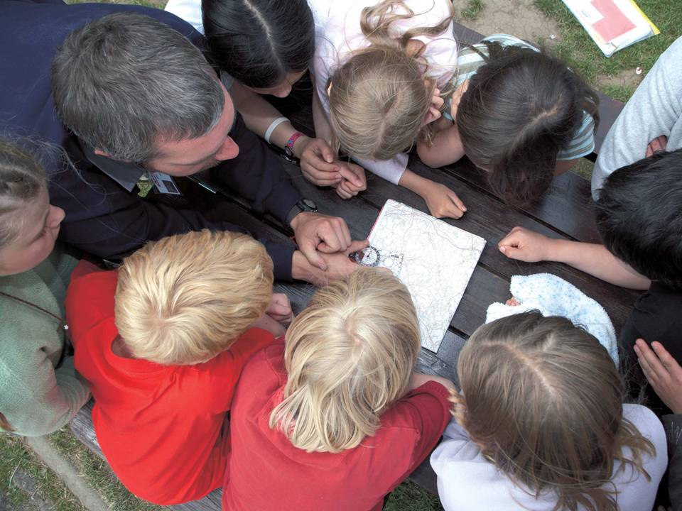

Slide 28
Course benefits; for each and every child:
● Education outside the classroom
● Develop an inner confidence
● Personal achievement
● Develop self esteem
● Develop social skills
● Develop team building skills
● Experience new / exciting activities
● Learn respect for others
Every Child benefits enormously from the course especially children who are not necessarily academic or sporty.

Slide 29
Activity programme:
● Leave school to arrive at 14.30
● Students shown to dormitories
● Fire drill
● First activity at 15.30
● Each activity lasts 1.5 hours
● Second activity at 19.00
● 5 Activities per day
● Depart after lunch at 13.30

Slide 30
Activities may include:
Zip wire
Rifle shooting
Climbing
Bivouac Building
Archery
Fencing
Abseiling
Blind Trail
Obstacle course
Wide games
Low ropes
Mountain bike training
Survival skills
Team games

Slide 31
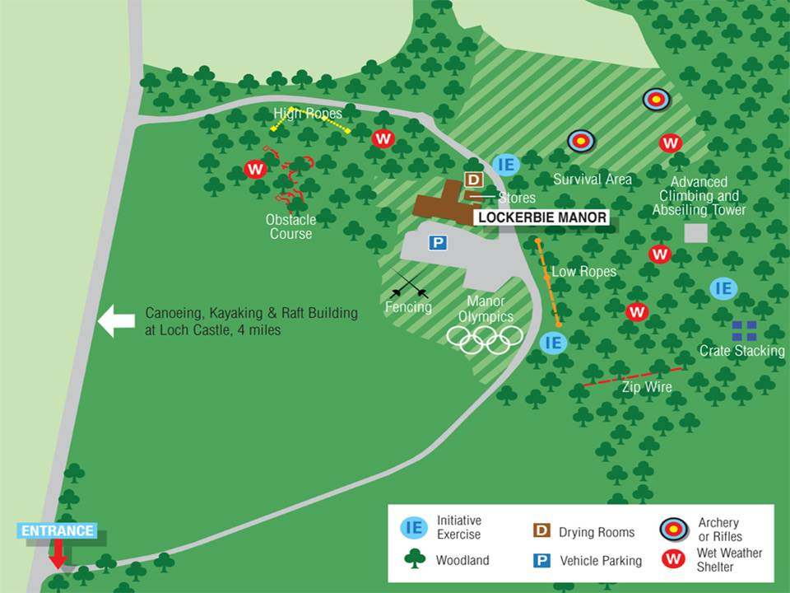

Slide 32
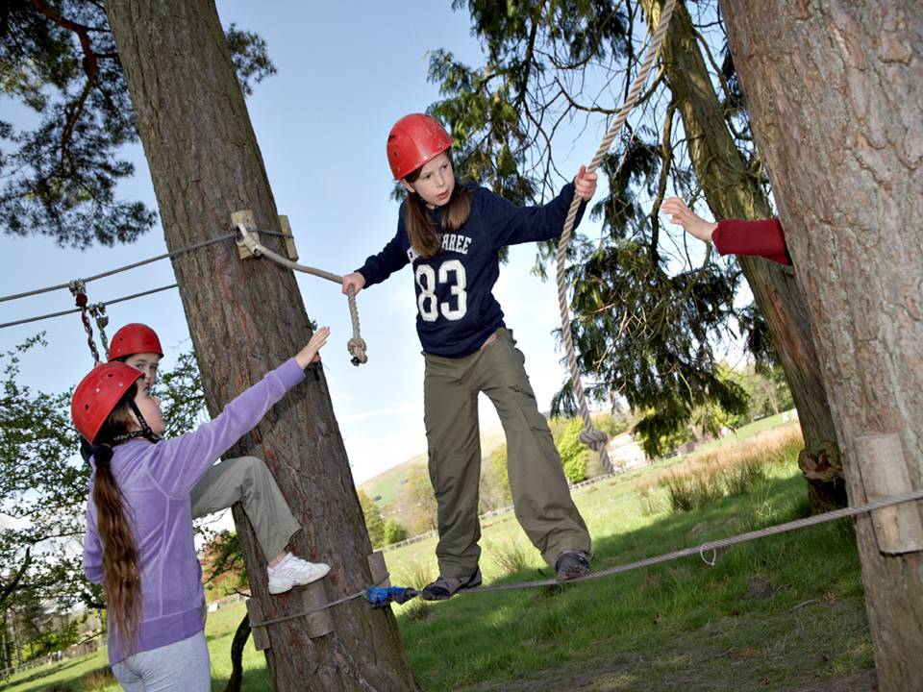

Slide 33
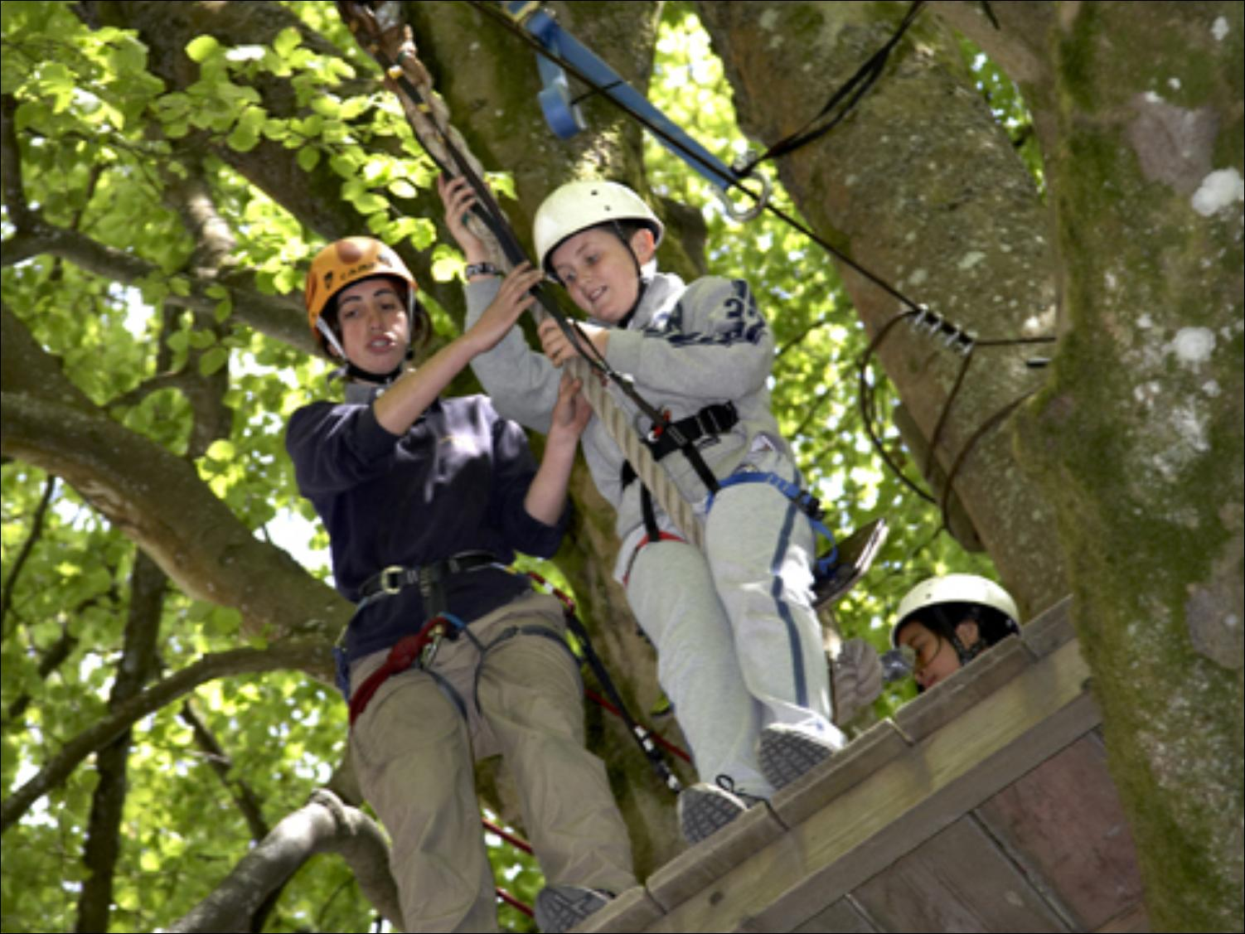

Slide 34
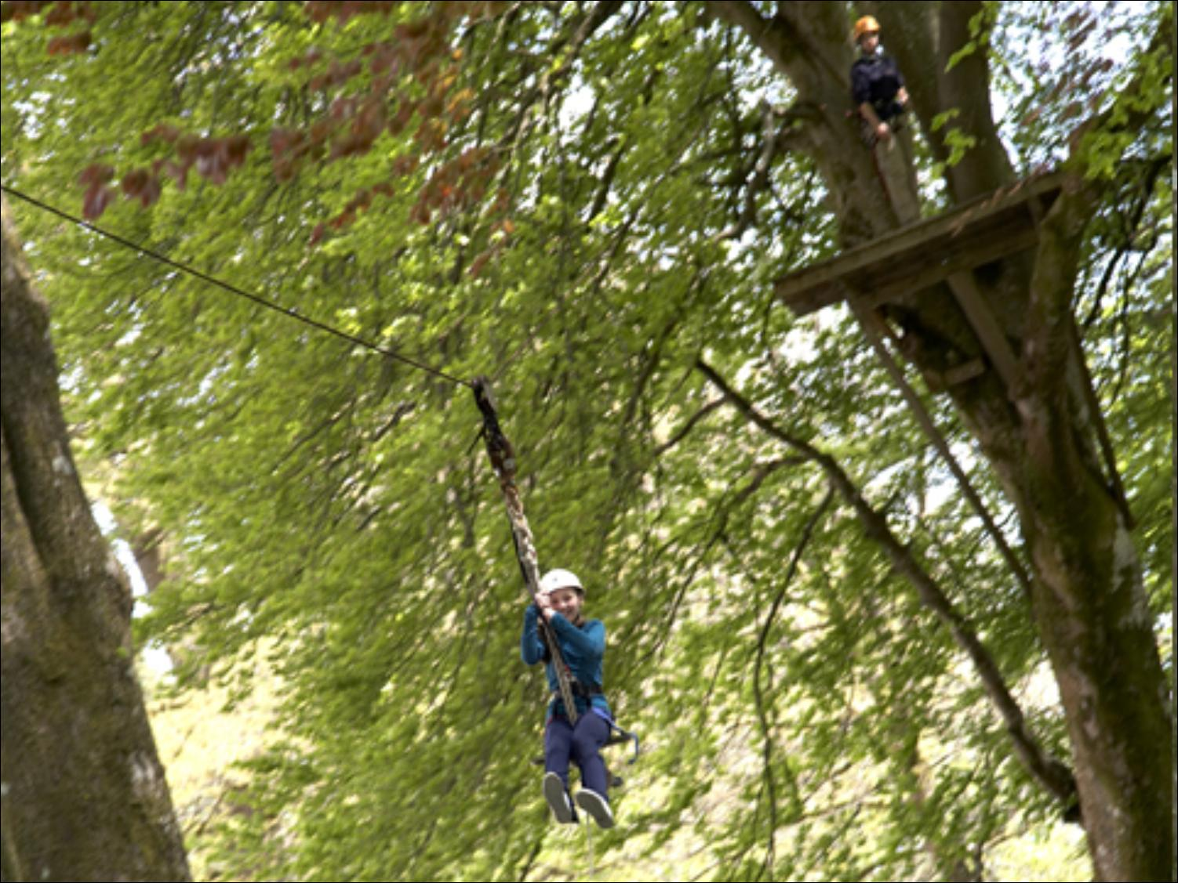

Slide 35
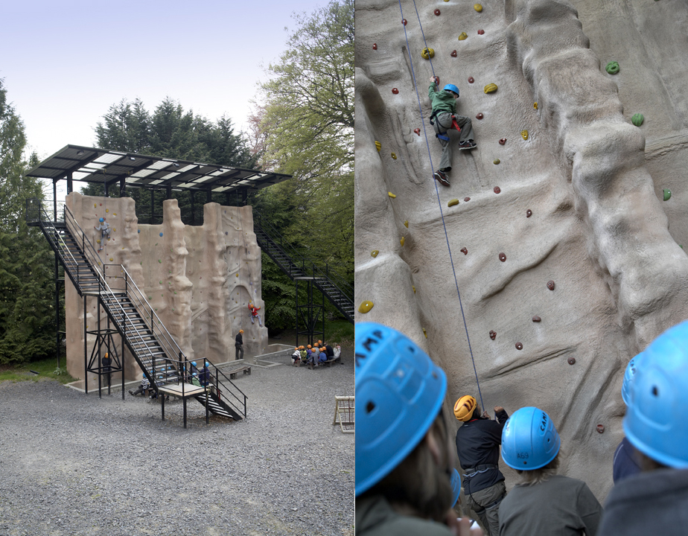

Slide 36
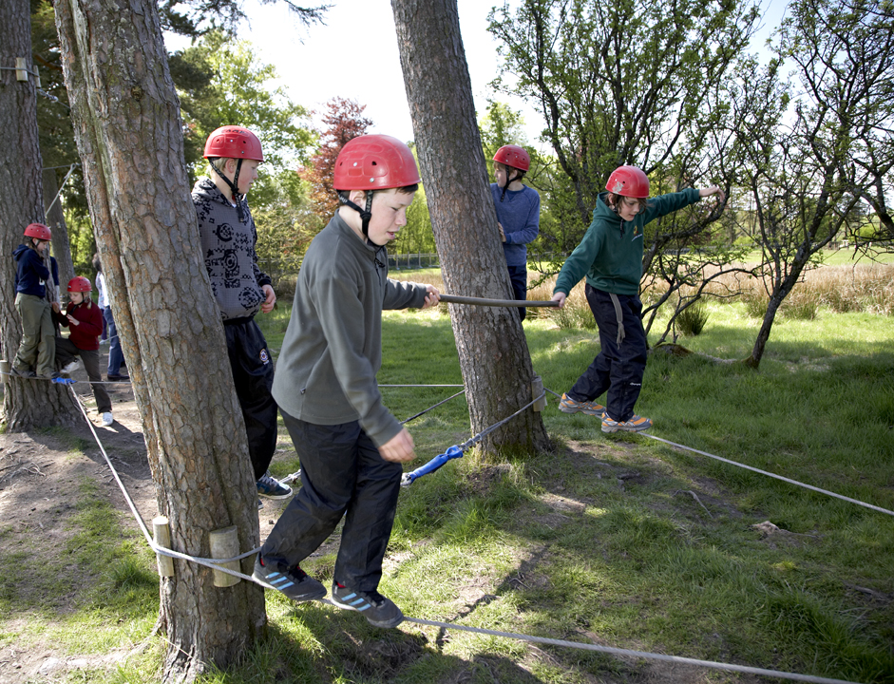

Slide 37
MANOR ADVENTURE IS SERIOUS,
STRUCTURED, SAFE, CHALLENGING AND
HELPS DEVELOP AN INNER CONFIDENCE AND SELF ESTEEM

Slide 38
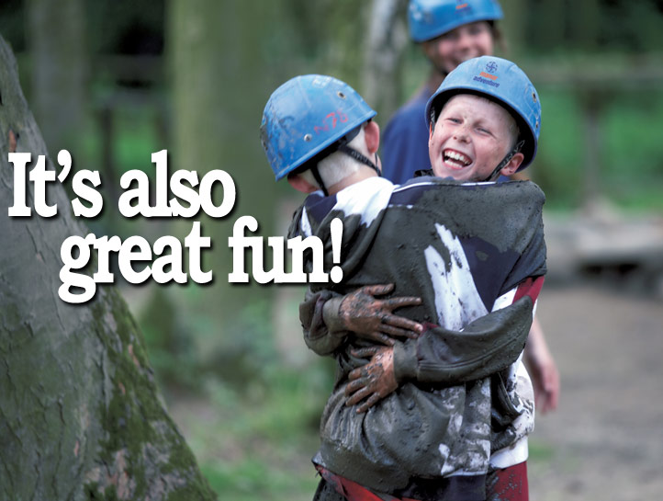

Slide 39
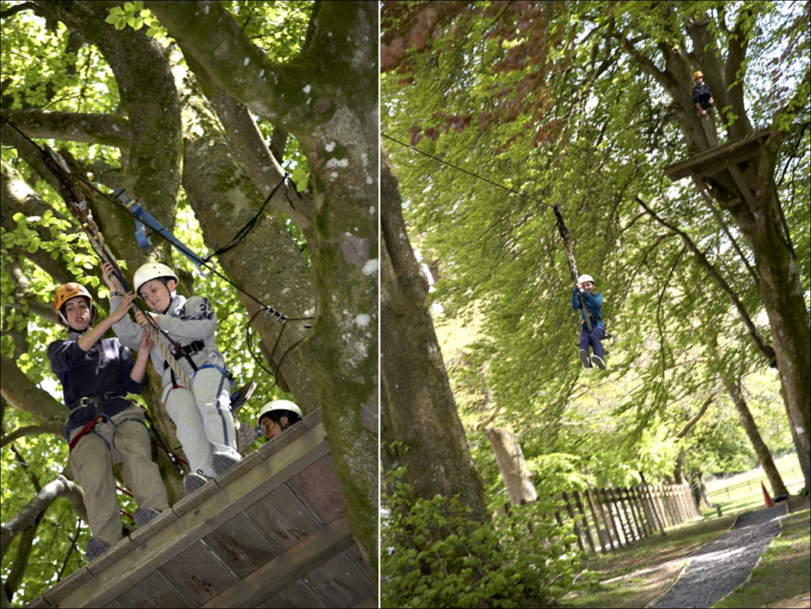

Slide 40
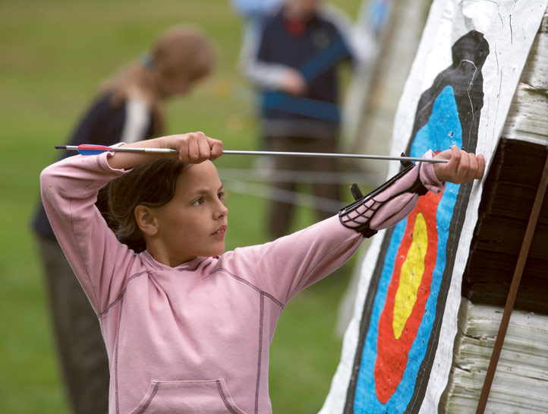

Slide 41
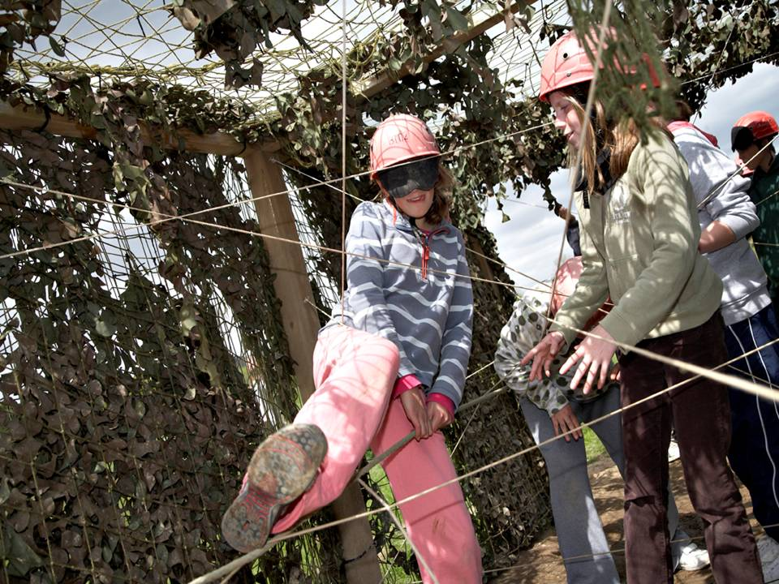

Slide 43
3 Day Bargain Special Details

Slide 44
Activities
Set by Lockerbie Manor due to the shorter timescale of the trip.
Will take account of pupil’s preference as much as possible
P7’s have been asked to select those they would like already. The most popular are:
  Blind Trail Survival Skills
  Archery Climbing
  Rifle Shooting Paddleboarding
  Zip Wire
  Canoe/Kayak
  Fencing

Slide 45
Costs
3 Day Bargain Special £252
Transport £18
Tuck Shop Included
Total £270
Deposit -£50
Outstanding Balance £220
Payment in full required via ParentPay by Friday 22nd April 2022
Payments can be made (in full or instalments) from 8th March 2022)

Slide 46
Itinerary
Monday 30th May 2022
  Pupils arrive at school at 12pm*
  Packed Lunch required to eat in school before leaving.
  Bus departs at 1pm
  Arrive at Annandale Water Services at approx. 2pm
  Arrive at Lockerbie at approx. 2.30pm.
  First meal provided is evening meal – buy a snack at services.
Wednesday 2nd June 2022
  Students vacate their room by 9am on the day of departure.
  Lunch around 12pm.
  Depart between 1pm-1.30pm
  Arrive back at Woodhead between. 2.15pm-3pm**
  *If required, pupils may come to school at normal time.
  **Pupils can be collected at normal time if required.

Slide 47
A Typical Day
7am Rise and Shine
7.30am Breakfast
9-10.30 Outdoor Pursuit Session 1
10.30am-10.50am Break
10.50am-12.20pm Outdoor Pursuit Session 2
12.20pm-1.40pm Lunchtime
1.40pm-3.10pm Outdoor Pursuit Session 3
3.10pm-3.30pm Break
3.30pm-5pm Outdoor Pursuit Session 4
5.15pm-7pm Evening Meal/Free Time
7-8.30pm Outdoor Pursuit Session 5
9.30pm Lights Out

Slide 48
Room Allocations
Room allocations between 4-8 children.
Boys and Girls dormitories in different corridors.
Staff rooms in the same corridor.
Pupils will be asked to identify children they would and would not like to share with.
Ensure a minimum of one friend sharing the dorm.
School staff will allocate rooms.
Children will be consulted and changes made to ensure all children are comfortable with the arrangement.

Slide 49
Staff Attending
Mr. Clark
Miss Ianniello
Mrs. Primas
Miss Harkness

Slide 50
Student Code of Conduct

Slide 51
Student Code of Conduct
Outside
NOT to use any of the outdoor pursuits during free time, as these are potentially dangerous areas without safety equipment or correct instruction
TO listen to the instructions and advice of the instructors during the outdoor pursuits
TO arrive at the assembly point on time and be correctly dressed for each outdoor pursuit
TO keep the site tidy for the duration of your stay
Inside
NOT to take drinks into the dormitories
NOT to go into other peoples dormitories
TO keep the dormitories tidy and attend room inspection each morning at 8.50am
TO take care when using the bunk beds
TO make no noise that can be heard outside the dormitory after lights out
TO enter buildings through the boot rooms and take outside footwear off before entering the buildings

Slide 52
Kit Required

Slide 53
Kit Required
Luggage – please restrict this to one case plus one piece of hand luggage.
• A freshly laundered sleeping bag and pillow with pillowcase
• A drink bottle (essential in the summer)
• Torch (for evening walk)
• Rucksack
• Toiletries etc (please note deodorants must be roll-on, no aerosols)
Suncream
• Old clothes for activity sessions – (long-sleeved shirts/jumpers, trousers / jogging bottoms (Not denim jeans), T-Shirts and closed-toe shoes are required for nearly all sessions so bring plenty). Triple layers often asked for at activities.
Plenty of clothes, shoes and underwear for other times.
Hair ties – Long hair must be tied back for activities.
• Waterproof clothing (jacket / trousers)
• Large plastic bag for dirty clothes
• Bath towels x 2
• Hat & Gloves in the winter
• Sunglasses, sun cream and hat in the summer
• Pyjamas and slippers

Slide 54
Kit Required
Useful items
• Books, playing cards and other quiet activities
• Money for the stop at the services.
Pocket sized hand sanitiser.
Useful notes
• No jewellery (including piercings), except for stud earrings
• No wellies
• Please label all clothing
• Denim jeans are not ideal for outdoor use.
No mobile phones or other electronic devices

Slide 55
Medication
All medication must be handed in to school in the week prior to departure.
Provided in a zip-wallet or bag with the child’s name on it.
Parents/carers will be asked to sign a consent form for this.
All medication will be stored and administered by staff.
Inhalers need to be carried by children themselves.
Epi-pens are carried by staff and given to the instructor.
Calpol etc. can be handed in if you think your child is likely to need it.
Let us know of any illness, allergies or intolerances that we are not already aware of.

Slide 56
COVID Secure Arrangements

Slide 57
COVID Secure Arrangements
*Based on current guidance, which may change prior to the visit.
Lateral flow test evening before or morning of the excursion.
Children displaying 3 main symptoms may not attend without a negative PCR test result.
Children who display symptoms of COVID-19 during the excursion will be requited to isolate and be collected by an parent/carer.
Manor Adventure have guaranteed a full refund to any child who cannot attend the excursion due to self-isolation.

Slide 58
Any Questions?

