Slide 2
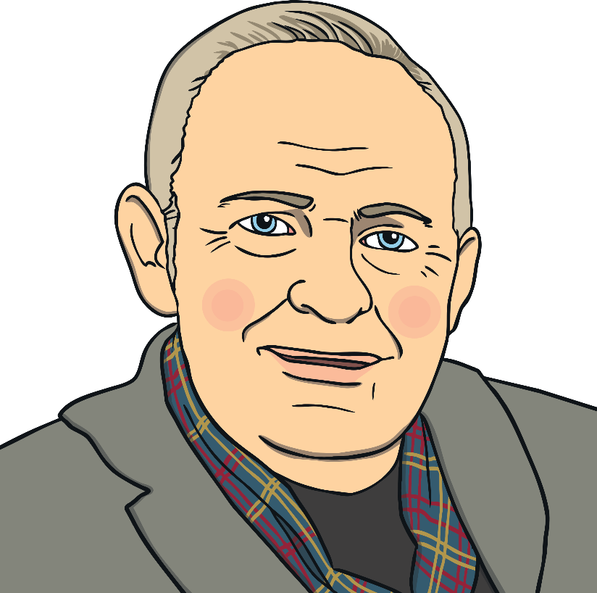
Who is Steven Brown?
Steven Brown is a Scottish artist.
His McCoo paintings are instantly recognisable for their bold and bright colours. They are said to be the artist’s most popular collection.
Each McCoo has unique characteristics and of course, a Scottish name.
Click on the link to see some examples.
https://www.stevenbrownart.co.uk/pages/mccoos

Slide 3
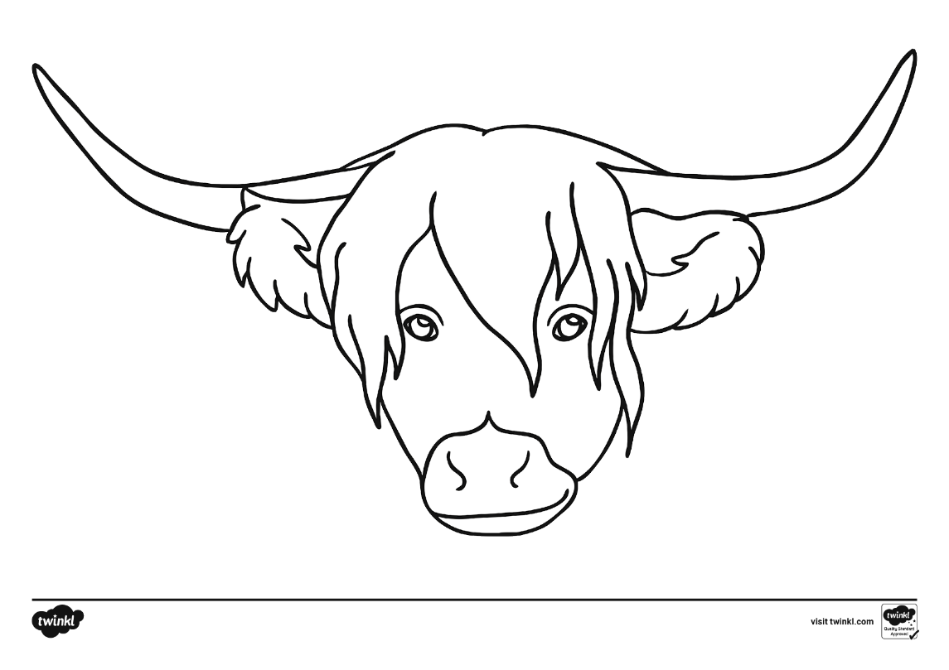
Create Your Own McCoo
Today, you are going to create your own McCoo.
First, you are going to experiment with line and colour.
You will need the highland cow template and six different colours of felt-tip pens. Pens work best because they are bolder than crayons or colouring pencils. Remember to choose bright colours.

Slide 4
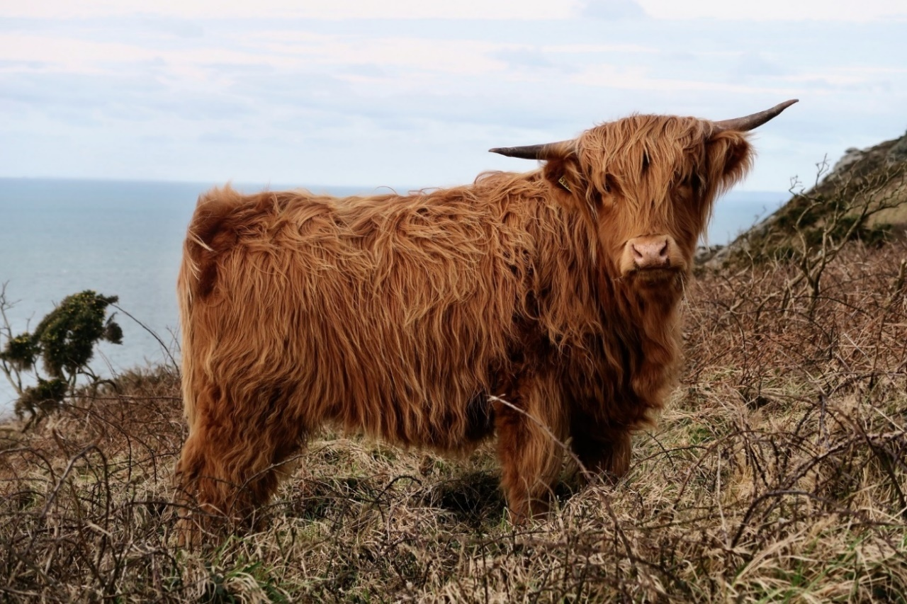
Highland Cow
Look at the image of the highland cow below.
How would you describe its coat?

Slide 5
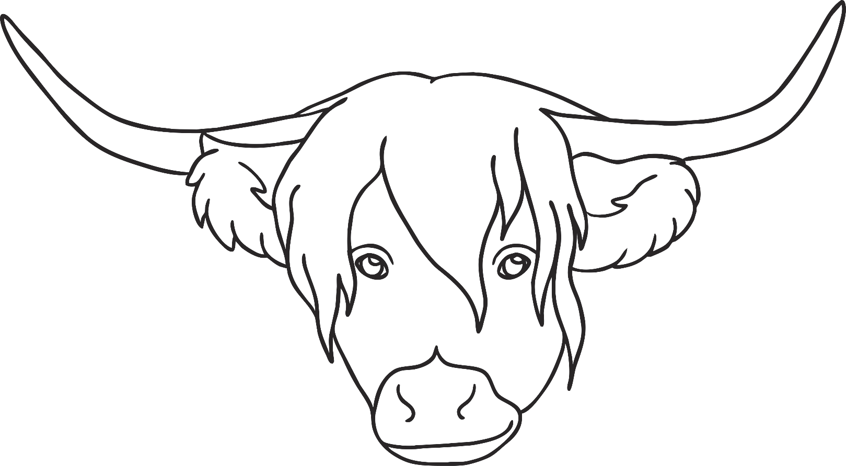
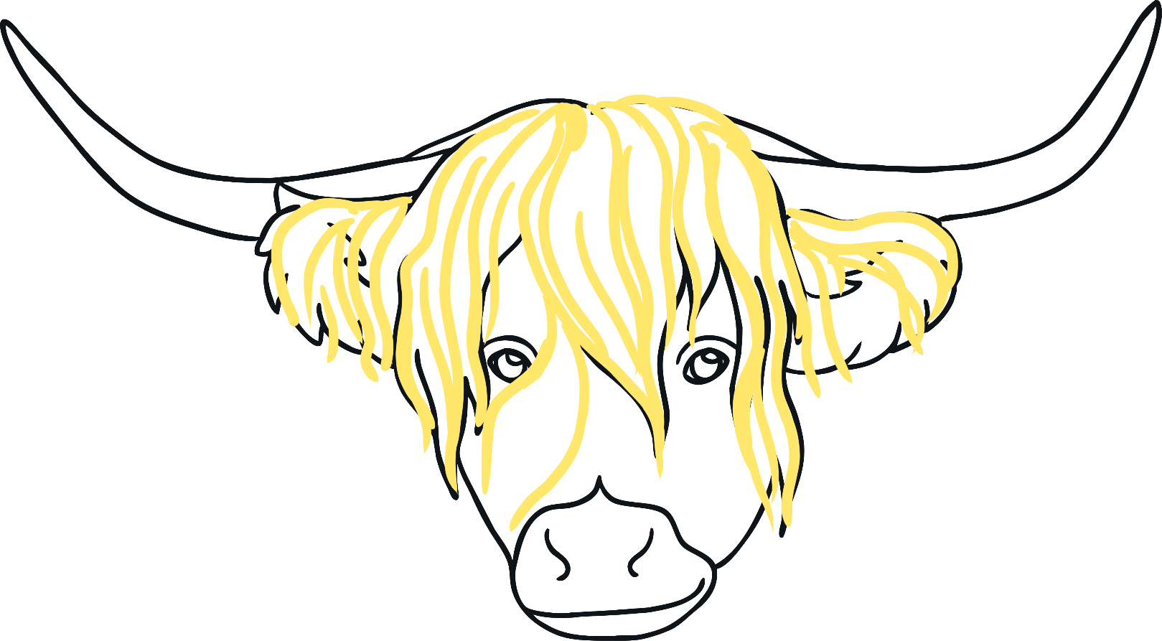
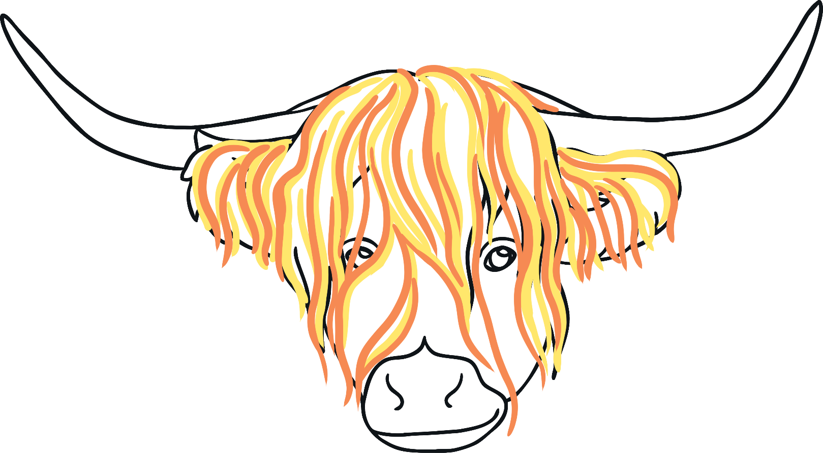
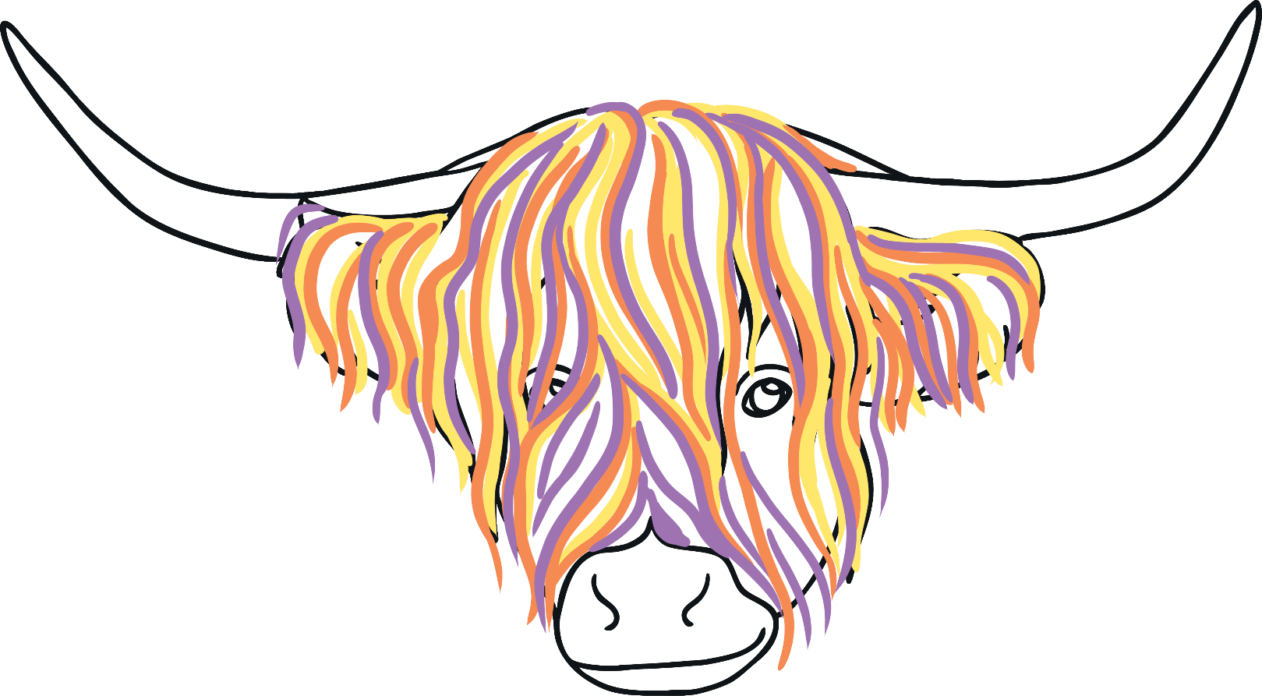
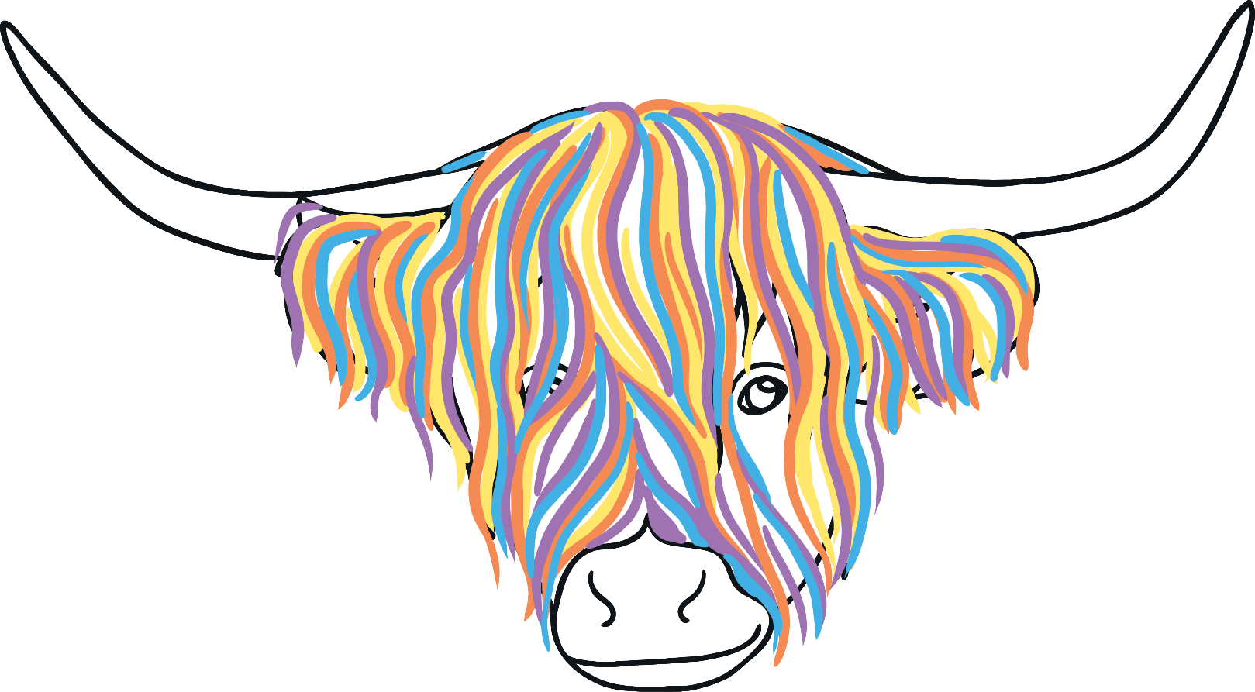
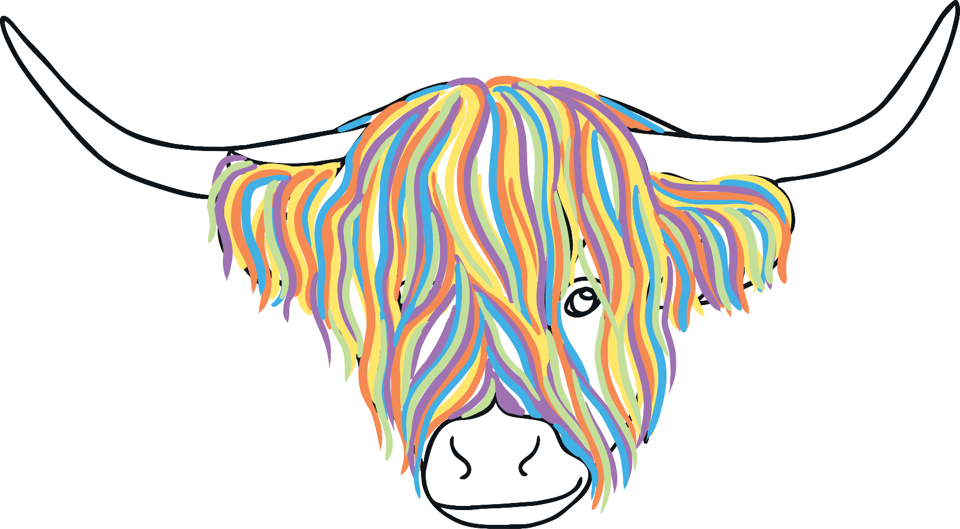
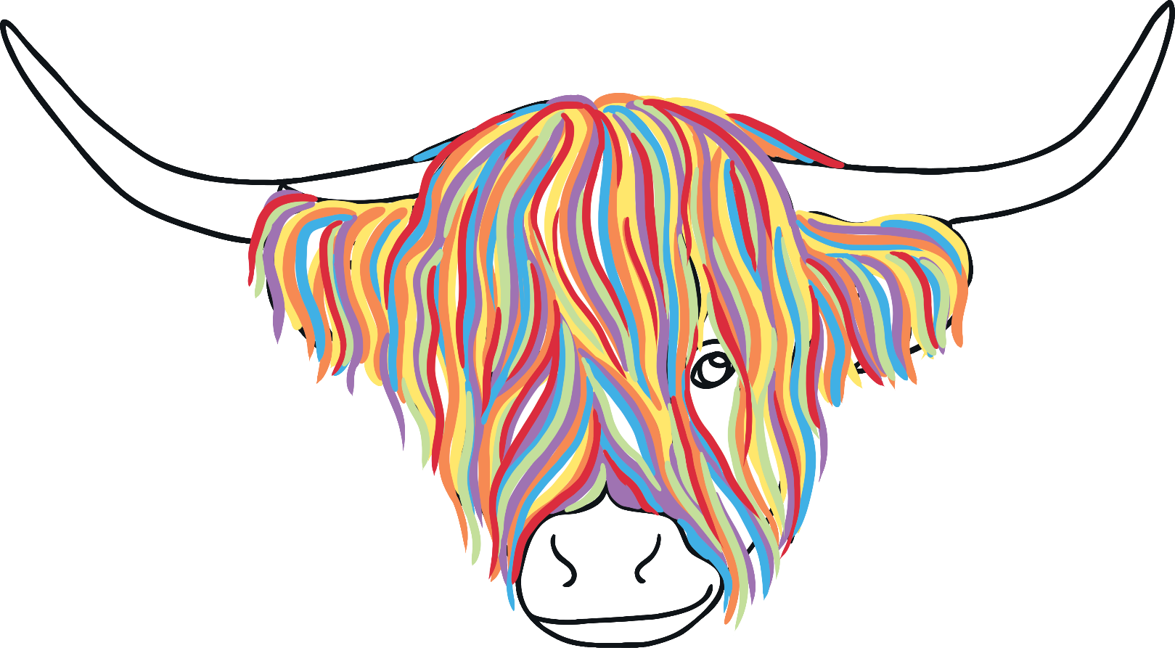
Over to You
One colour at a time, you are now going to draw a series of lines on the highland cow template. The lines represent the highland cow’s shaggy hair.
Try to keep the thickness of your lines the same but avoid drawing them as straight lines.

Slide 6
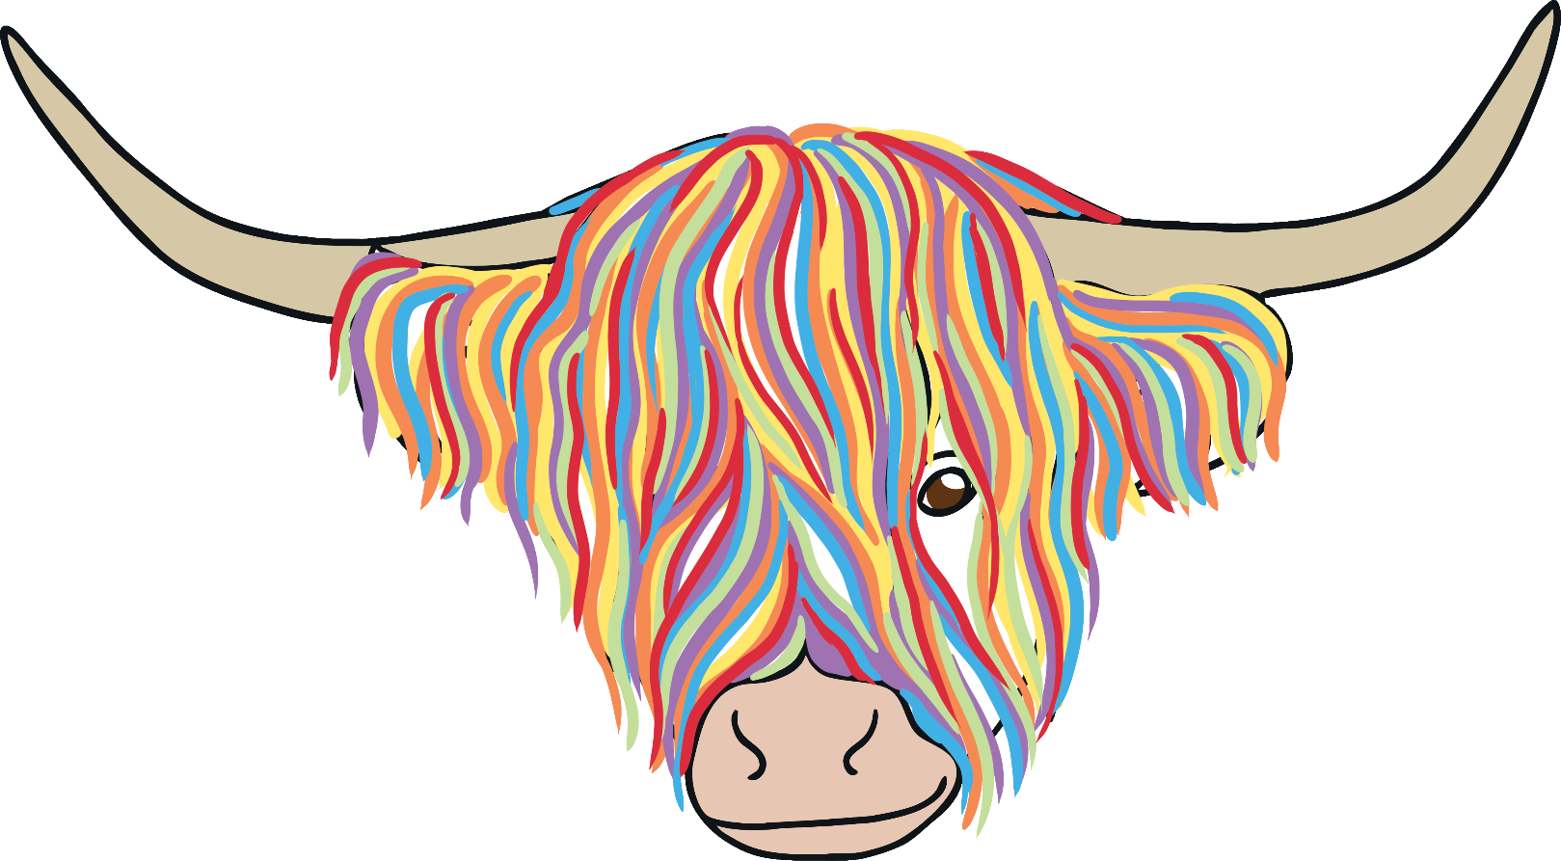
Over to You
Next, choose a neutral colour for the horns and nose.

Slide 7
Over to You
Add an accessory to make your highland cow unique.
Finally, give your McCoo a name!

