Slide 1
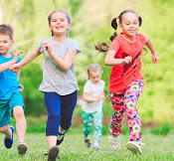
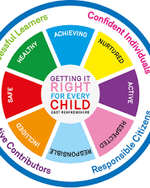
Woodhead Primary School and Nursery present... Family Fit Planet Week Virtual Home Challenges 8th-12th June 2020

Slide 2
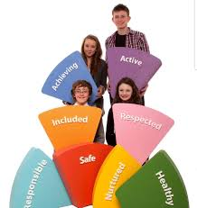
This year our annual Fit Planet Week will be a bit different due to lockdown. We are inviting your whole family to take part in our fun challenges which are aimed at looking after your health, fitness and wellbeing. You can join in all of our challenges no matter what your age. Remember to share all your healthy fun with us on our Twitter page and in our Google Classrooms. We can’t wait to see what you get up to!

Slide 3
Feedback
Once you have completed the challenges, please take time to let us know how you got on by completing the Google Form which you can access with this link:
https://docs.google.com/forms/d/1vYdCItXLJgIf2N8ku8VLJ0w9VPaGNQtEiRAIxAfSkXA/edit

Slide 4
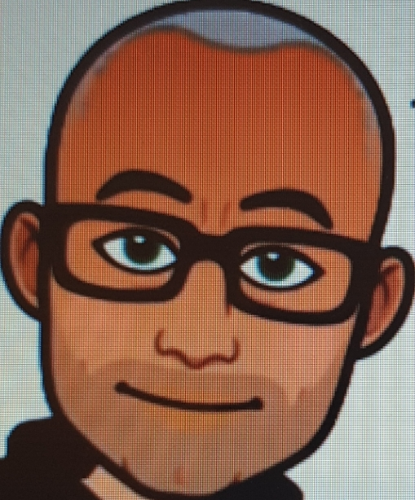
Challenge 1 Mr Archibald's Virtual Sports Day Challenges https://www.youtube.com/watch?v=fWES5dueVog https://www.youtube.com/watch?v=oaBOyrCL_Zc https://www.youtube.com/watch?v=loXBaCirMNs https://www.youtube.com/watch?v=CYaHHC1QLoY https://www.youtube.com/watch?v=5VXOfZsOaYo https://www.youtube.com/watch?v=9-ImQwdALK4 https://www.youtube.com/watch?v=1xGN3L3lTv4 https://www.youtube.com/watch?v=_QAP14yjcLY https://www.youtube.com/watch?v=b3dxuoUuqN0 https://www.youtube.com/watch?v=sBcWb-BMGa8
Over the course of the week, at a time when suits you, try these Sports activities created and modelled by Mr Archibald and Jennifer. ​ There are 10 challenges altogether. Please keep a note of your score for each event. Thank you Mr Archibald and Jennifer!
We are being Healthy, Active and Included

Slide 5
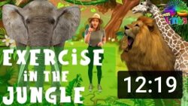
Challenge2 The Fitness Challenge Try a different one of these online fitness workouts every day this week then evaluate it afterwards with red, amber or green. Remember to get all the family involved. Which one did you like best and why?
www.nhs.uk › 10-minute-shake-up › shake-ups
https://www.youtube.com/watch?v=15BWn39QYY0
https://www.youtube.com/watch?v=EXt2jLRlaf8
https://www.youtube.com/watch?v=Imhi98dHa5w&list=RDImhi98dHa5w&index=1
We are being
Healthy, Active and Included
https://www.youtube.com/watch?v=pJGqlIa4Dbw

Slide 6
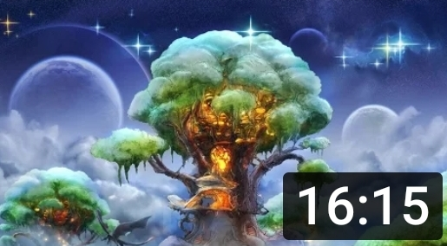
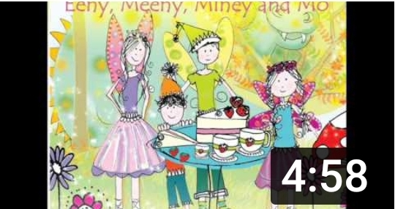
Challenge 3
https://www.youtube.com/watch?v=DWOHcGF1Tmc
https://www.youtube.com/watch?v=b57QvR1Ysyw
https://www.youtube.com/watch?v=Wsy2L9VvX90
The Mindfulness Challenge
Practicing mindfulness can help us learn to focus, manage stress, regulate emotions, and develop a positive outlook. Developing techniques can help you focus better in school and be less stressed out.
Try a different one of these mindfulness workouts every day this week then evaluate it afterwards with red, amber or green. Which one did you like best and why?
https://www.youtube.com/watch?v=64QzBuhsyuk
https://www.youtube.com/watch?v=aX9PUQcdQ2U
We are being Healthy, Achieving, Nurtured, Included and Responsible

Slide 7
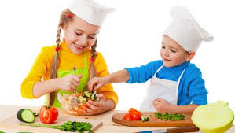
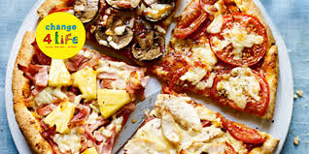
Challenge 4 The Cooking Challenge
Cooking from scratch helps us develop a mature palate and a taste for fresh, wholesome ingredients. The earlier children become accustomed to nutritious foods, the less likely they will acquire a taste for processed foods. Kids are much more likely to eat what they make.
Either chose a favourite family recipe or one from online and prepare a healthy meal or snack for your family to share. Ask everyone in your family to evaluate it and share what they thought with us on Twitter or your Google Classroom. Here are a couple of websites you might chose to explore:
https://www.bbc.co.uk/cbeebies/shows/my-world-kitchen
https://www.nhs.uk/change4life/recipes
We are being Safe, Healthy, Achieving,
Included, Responsible

Slide 8
Challenge 5 The Life Skills Challenge
Life Skills are important to learn so that we become confident and independent young people who demonstrate responsibility and respect for both ourselves and others. Over the course of the week, discuss with your parents how many of these important life skills you can tick off each day. Make sure you select ones that are suitable for your age.
Here are some ideas for helping your child learn about respect:
https://www.kidsofintegrity.com/lessons/respect/hands-options
Here is a fun song to learn about respect:
https://www.youtube.com/watch?v=TmRjyQlWyQg
We are being Responsible and Respectful

Slide 9
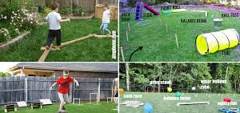
Challenge 6 The WAC Challenge
Every year we look forward to the MAC (Mobile Adventure Course) during Fit Planet Week. As we cannot all join in with it this year, we are challenging you and your family to make an exciting WAC (Woodhead Assault Course). This can be either indoors or outdoors. It should be challenging, interesting and fun! Here are some things you might wish to consider:
Obstacles to crawl through
Obstacles to climb over
Obstacles to travel along
Obstacles to balance on
Obstacles to swing or slide on
Where is the start and the finish?
You can look online to get lots of good tips too.
We are being Safe, Healthy, Achieving, Included,

