Slide 2
Aims
To understand what Earth Day is.
To understand how we can take action to support Earth Day’s aims.

Slide 3
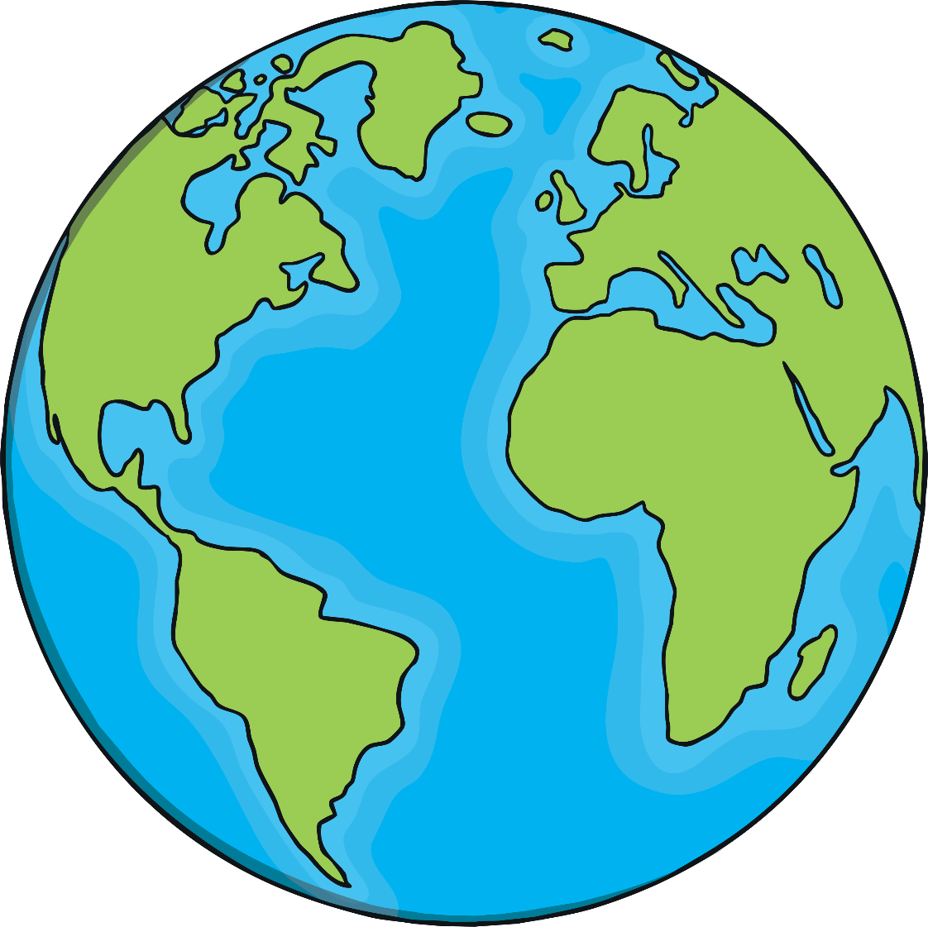
Today We Will Ask…
What is Earth Day?
Why is Earth Day important?
What is the theme for
Earth Day 2020?
Why is climate action important?
What are people saying
about climate change?
What can you
do to help?

Slide 4
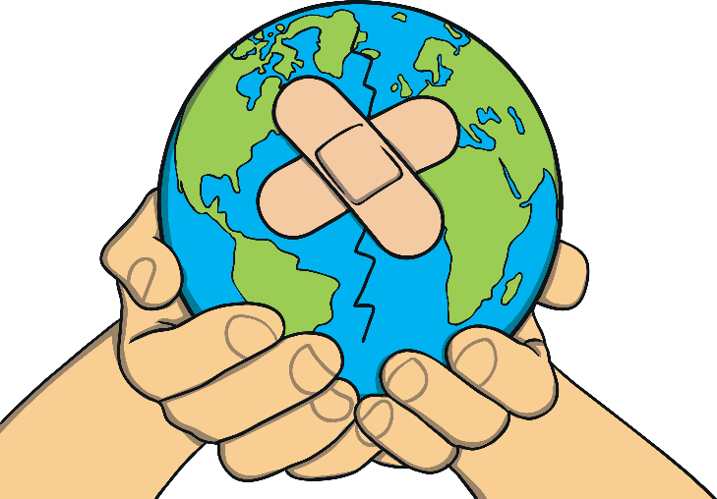
What Is Earth Day?
Earth Day is a global event which takes place every year on 22nd April.
1970 was the first year Earth Day was held and, since then, more and more people have shown their support for the environment by becoming involved.
This year will be the 50th anniversary of the first Earth Day, so it will be extra special.

Slide 5
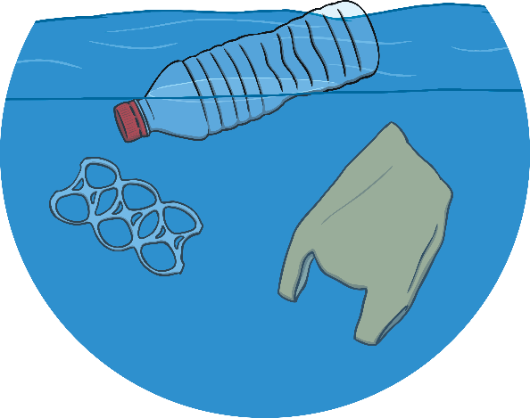
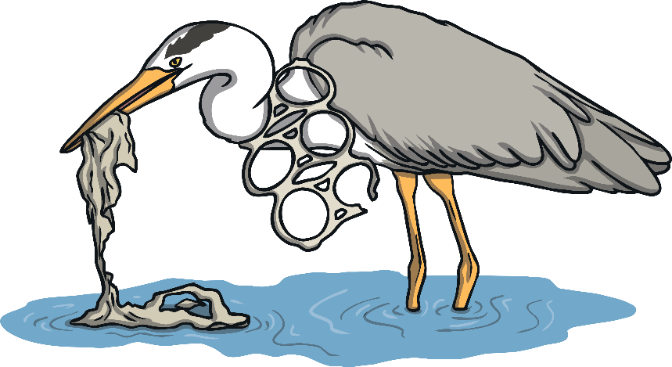
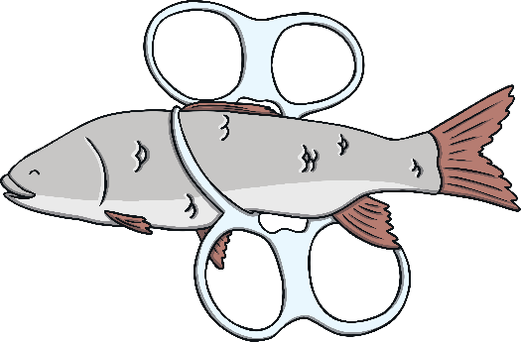
Why Is Earth Day Important?
We only have one planet Earth.
Some people say, “There is no Planet B.”
Can you explain what this means?
On this day, people across the world get together to raise awareness of climate change, plastic pollution, air pollution and other important climate issues that our Earth is facing.

Slide 6
What Is the Theme for Earth Day 2020?
Climate Action
Earth Day turns 50 in 2020 and its organisers are hoping to build the largest environmental event in history.
The aim is for at least a billion people worldwide to take part.
Climate change is one of the biggest challenges that humanity faces. How we cope with climate change will affect the future of our planet.
Did You Know…?
The Earth’s average temperature has risen by 1ºC since the Industrial Revolution due to the impact of human activity. This might not sound much, but such a little change is having a devastating impact worldwide.

Slide 7
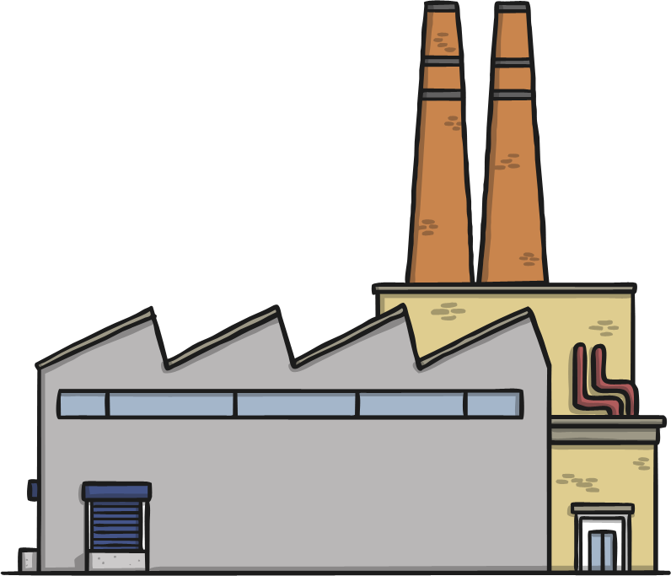
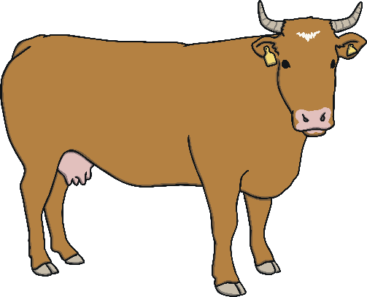
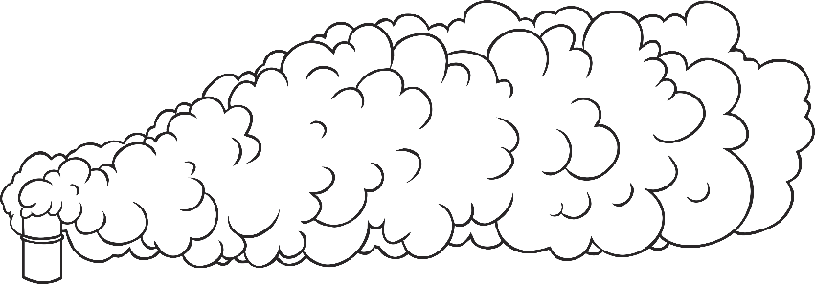

Why Is Climate Action Important?
According to the United Nations (UN), ‘There is no country that is not
experiencing the drastic effects of climate change’.
Greenhouse gas emissions from meat production, factories and vehicles around the world have increased by one half in the last 30 years.

Slide 8
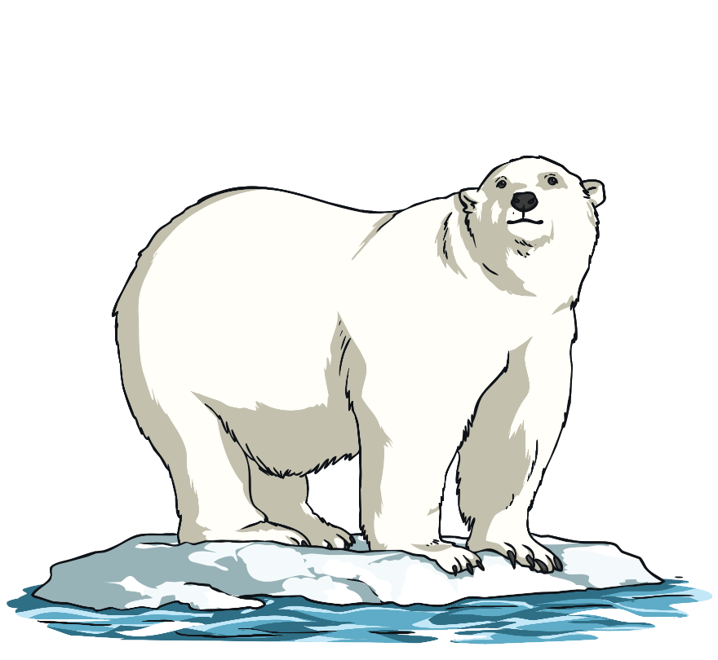
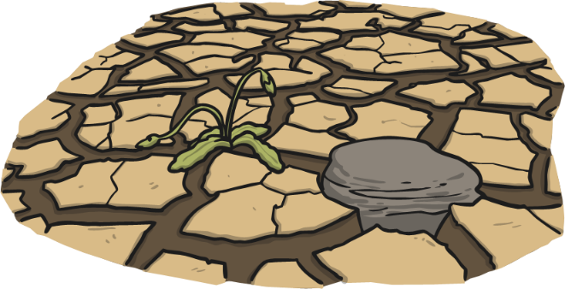
Why Is Climate Action Important?
As the temperature of the planet rises, sea ice melts. Consequently, sea levels have risen by about 20cm in the last 140 years. It is predicted that, unless governments around the world take action, sea levels will continue to rise another 30 – 122cm by 2100.
Our changing climate presents problems with flooding, droughts, wildfires, extreme weather, food production, habitat loss and animal extinction. What we do next is incredibly important.

Slide 9
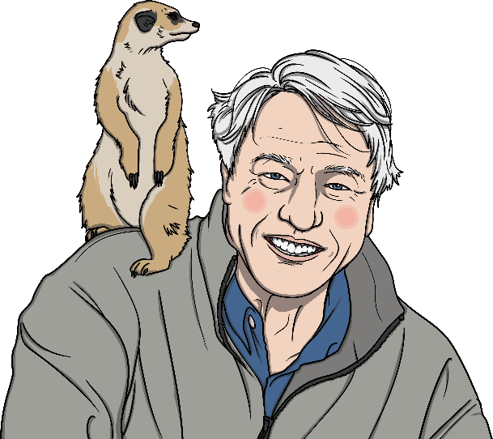
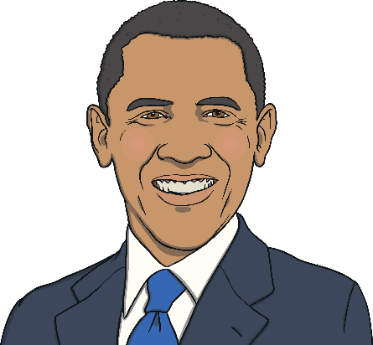
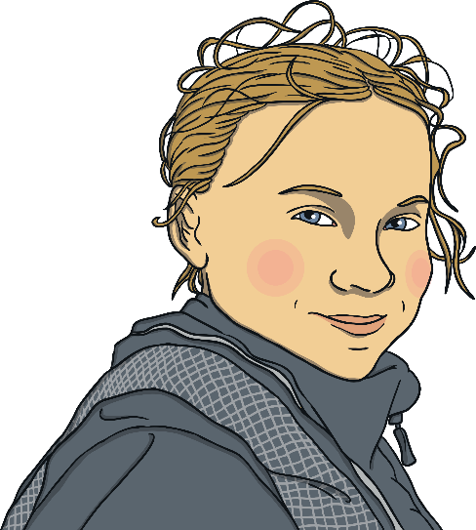
What Are People Saying About Climate Change?
“Climate change is no longer some far-off problem; it is happening here, it is happening now.”
Barack Obama
“Right now, we are facing a man-made disaster of global scale. Our greatest threat in thousands of years. Climate change.”
Sir David Attenborough
“The climate crisis has already been solved. We already have the facts and solutions. All we have to do is to wake up and change.”
Greta Thunberg

Slide 10

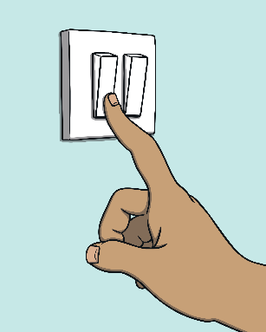
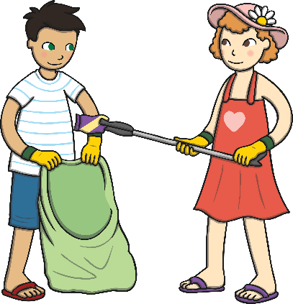

What Can You Do to Help?
Although it might feel impossible to reverse climate change, each of us can make changes to help our world.
Reduce consumption of unsustainable fossil fuels. Switch off lights when not needed. Unplug electronics not in use. Choose natural, sustainable materials such as bamboo or woods from FSC forests rather than plastics.
Reduce pollution. Walk or use a bike when possible. Put litter in waste bins or take it to recycling centres. Take a bag and some gloves and go on a litter-pick around your home or school.

Slide 11
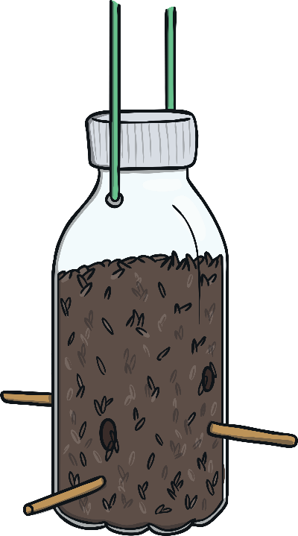
What Can You Do to Help?
Reuse and recycle. Find a different use for old things. If you can’t, take them to your local recycling centre.
Eat less meat and dairy. Meat production uses lots of resources and is linked to habitat destruction in special areas such as the Amazon rainforest. Farm animals produce methane, a harmful greenhouse gas.
Take action. Write to your local MP (Member of Parliament) to tell them your concerns and ask what they are doing to help reverse climate change. Join a local climate change march or protest to send a message to the government.

Slide 12
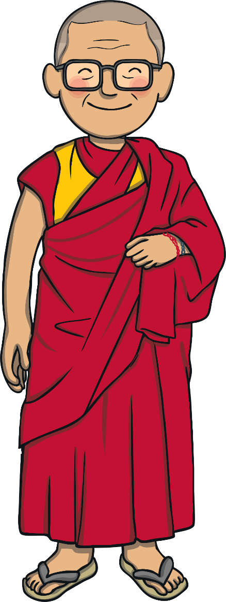
Climate Action
We all have a responsibility to look after our planet for future generations to enjoy.
What action will you take today?
‘We have a responsibility to look after our planet.
It is our only home.’ – Dalai Lama

