Slide 1
Animate a sprite on the Scratch website
By , R, M and E in P6

Slide 2
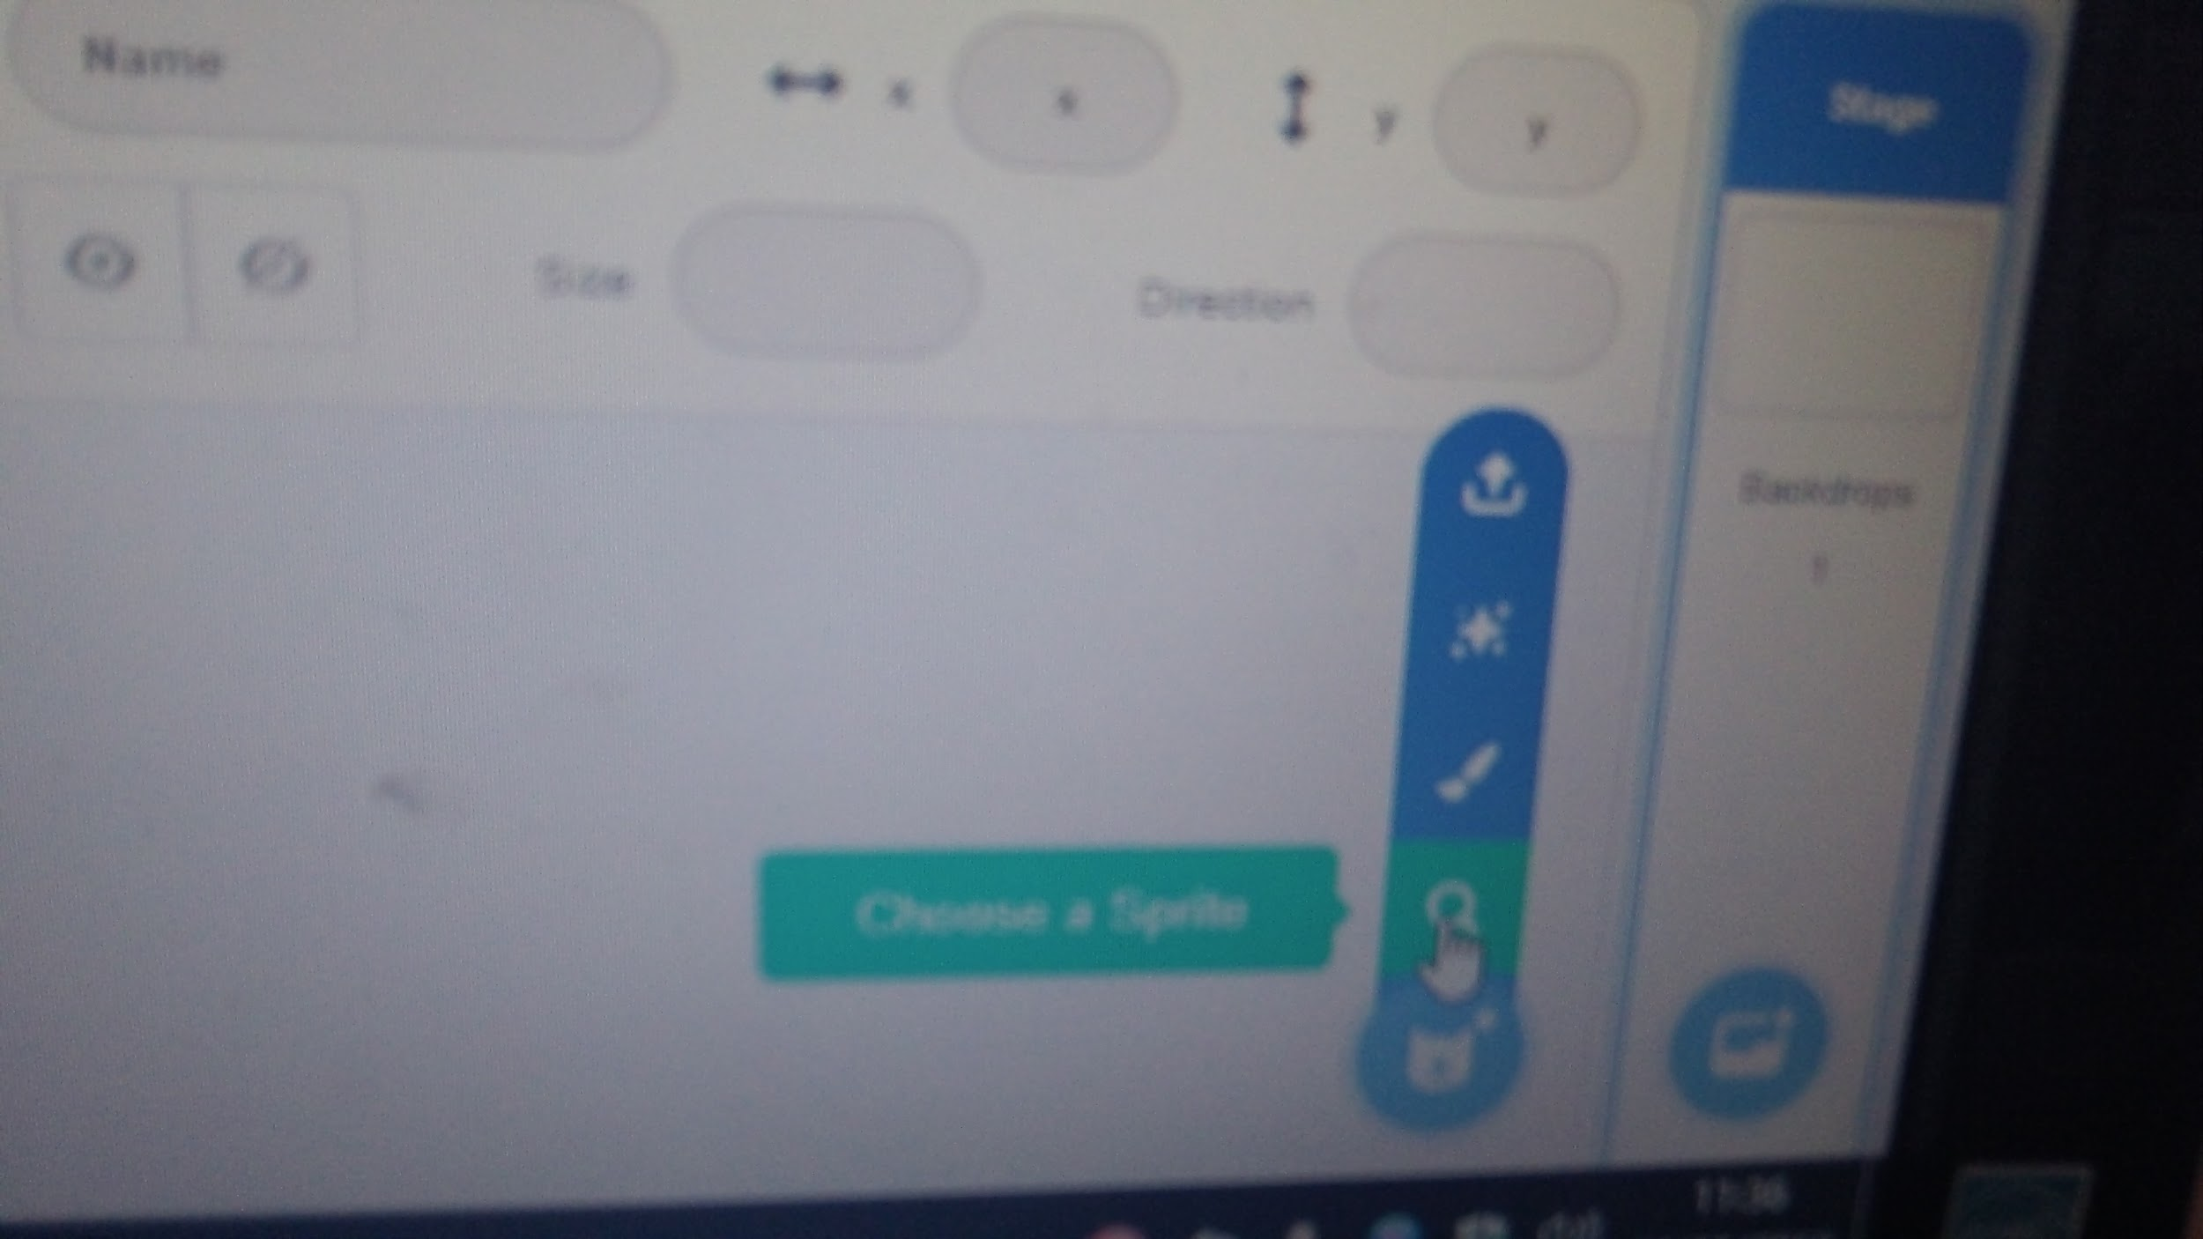
First step.
Choose a sprite

Slide 3
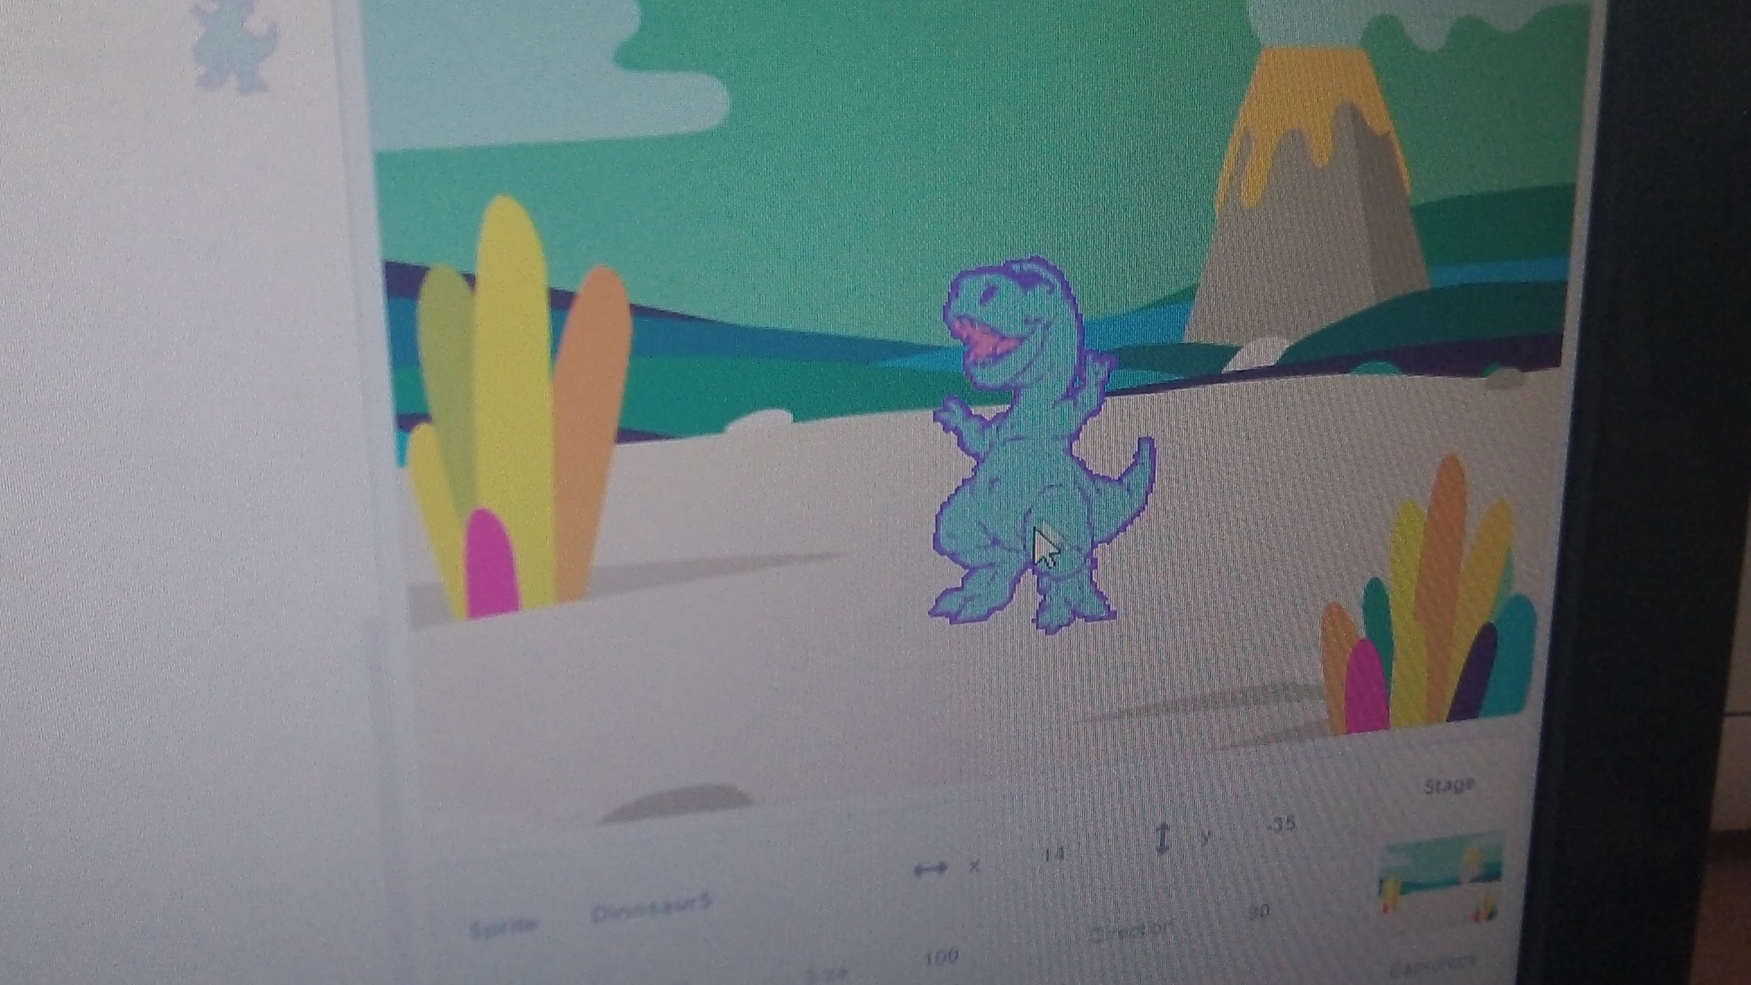
Then add a backdrop

Slide 4
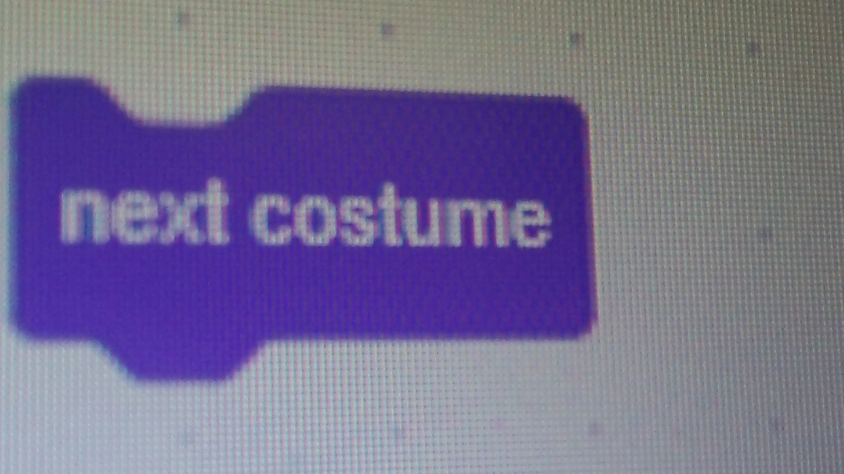
Next
Add a next costume block

Slide 5
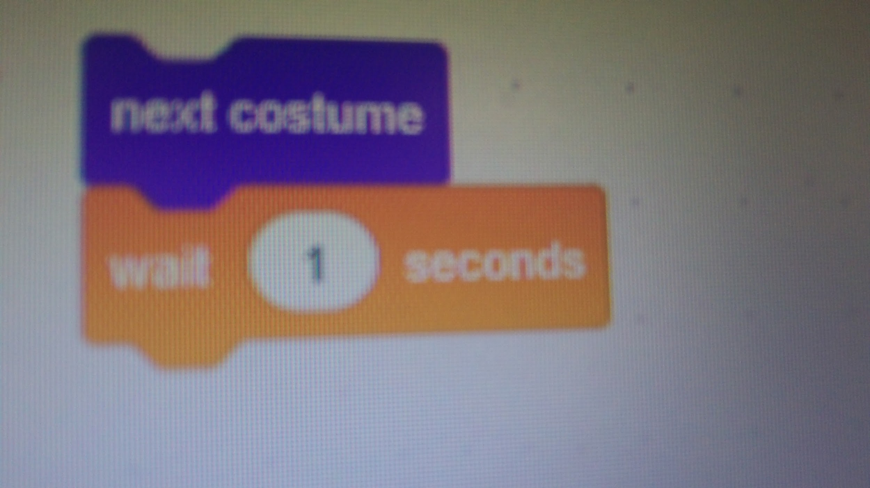
After That
Add a wait block

Slide 6
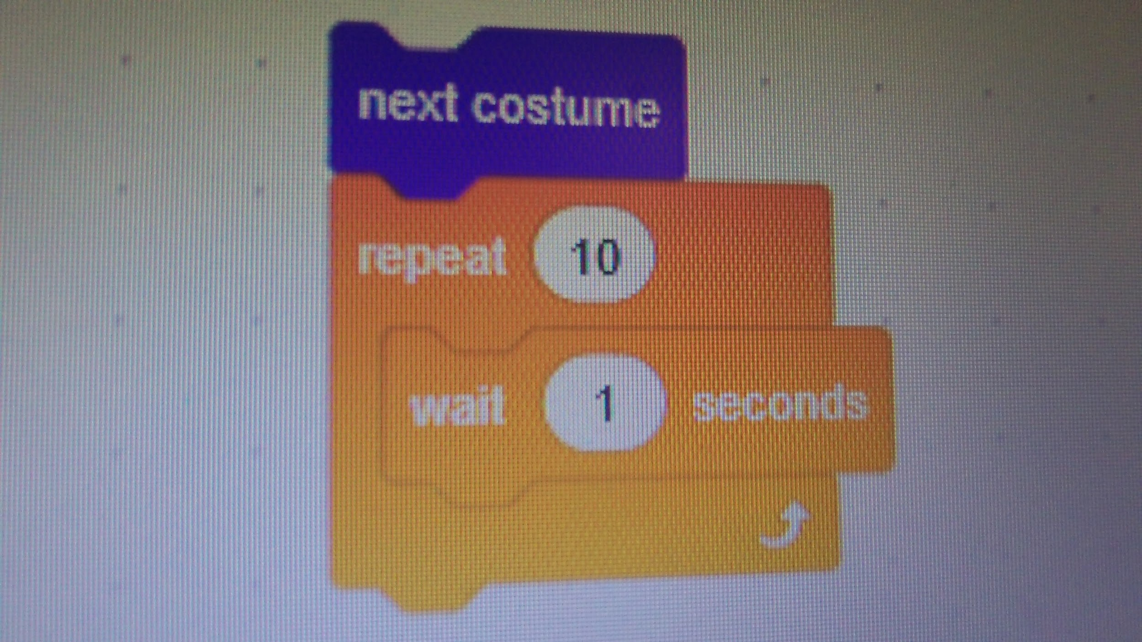
After
Add a repeat block

Slide 7
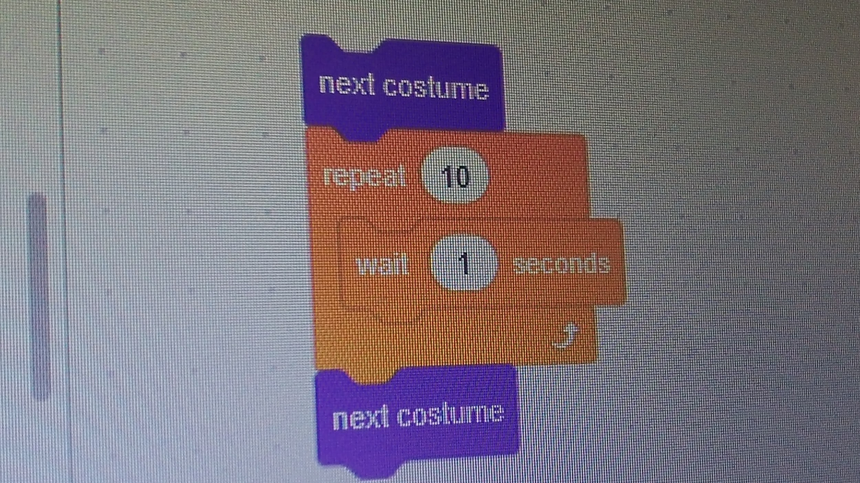
Then
Add another next costume block

Slide 8
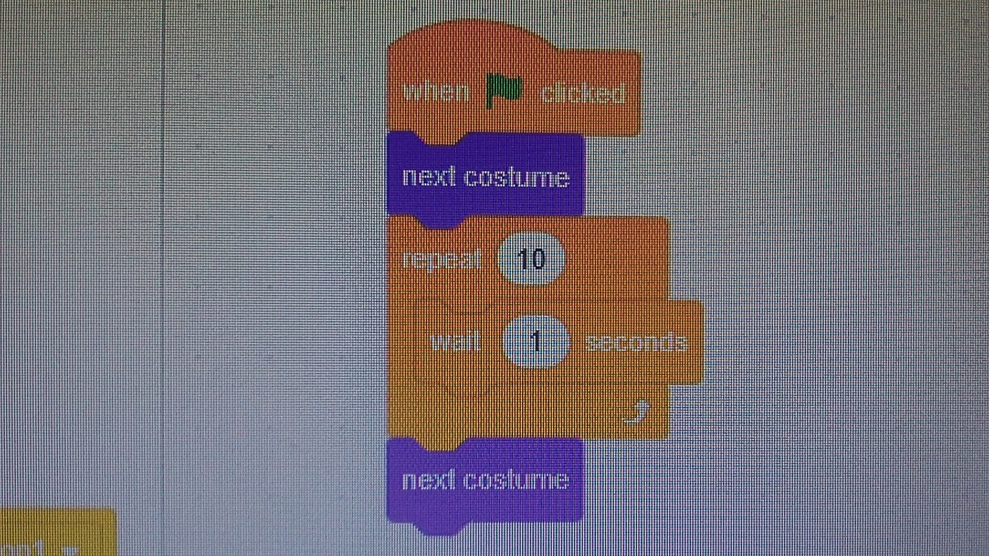
Finally
Add a when green flag clicked block

