Slide 1
How to make a sprite spin !!
By Animation crew

Slide 2
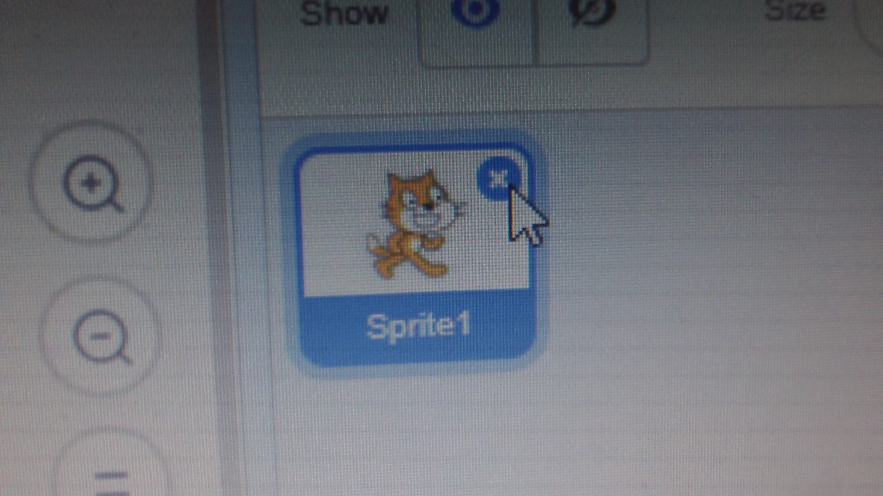
First choose a sprite

Slide 3
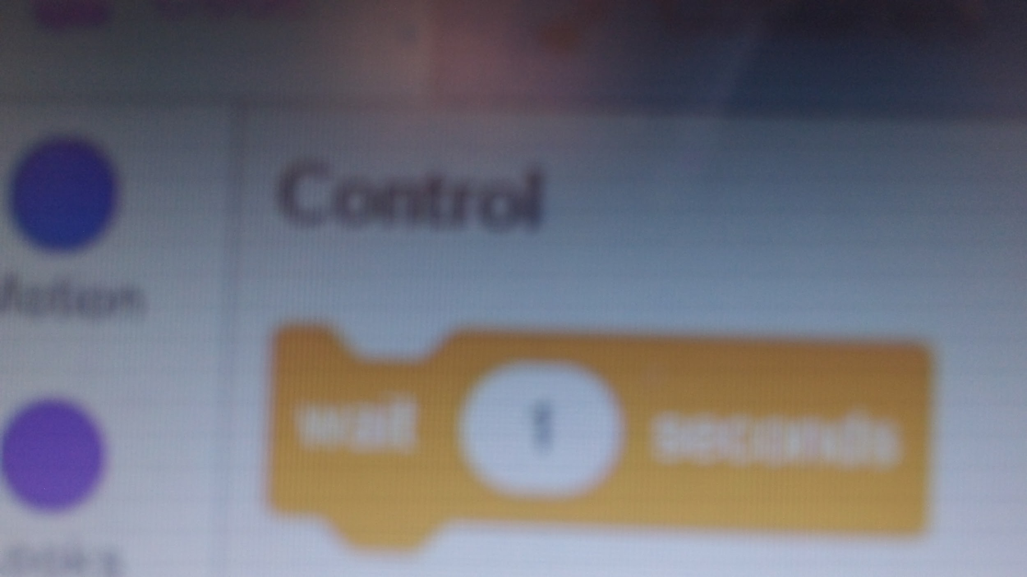
Go to Control and choose the wait 1 second block !

Slide 4
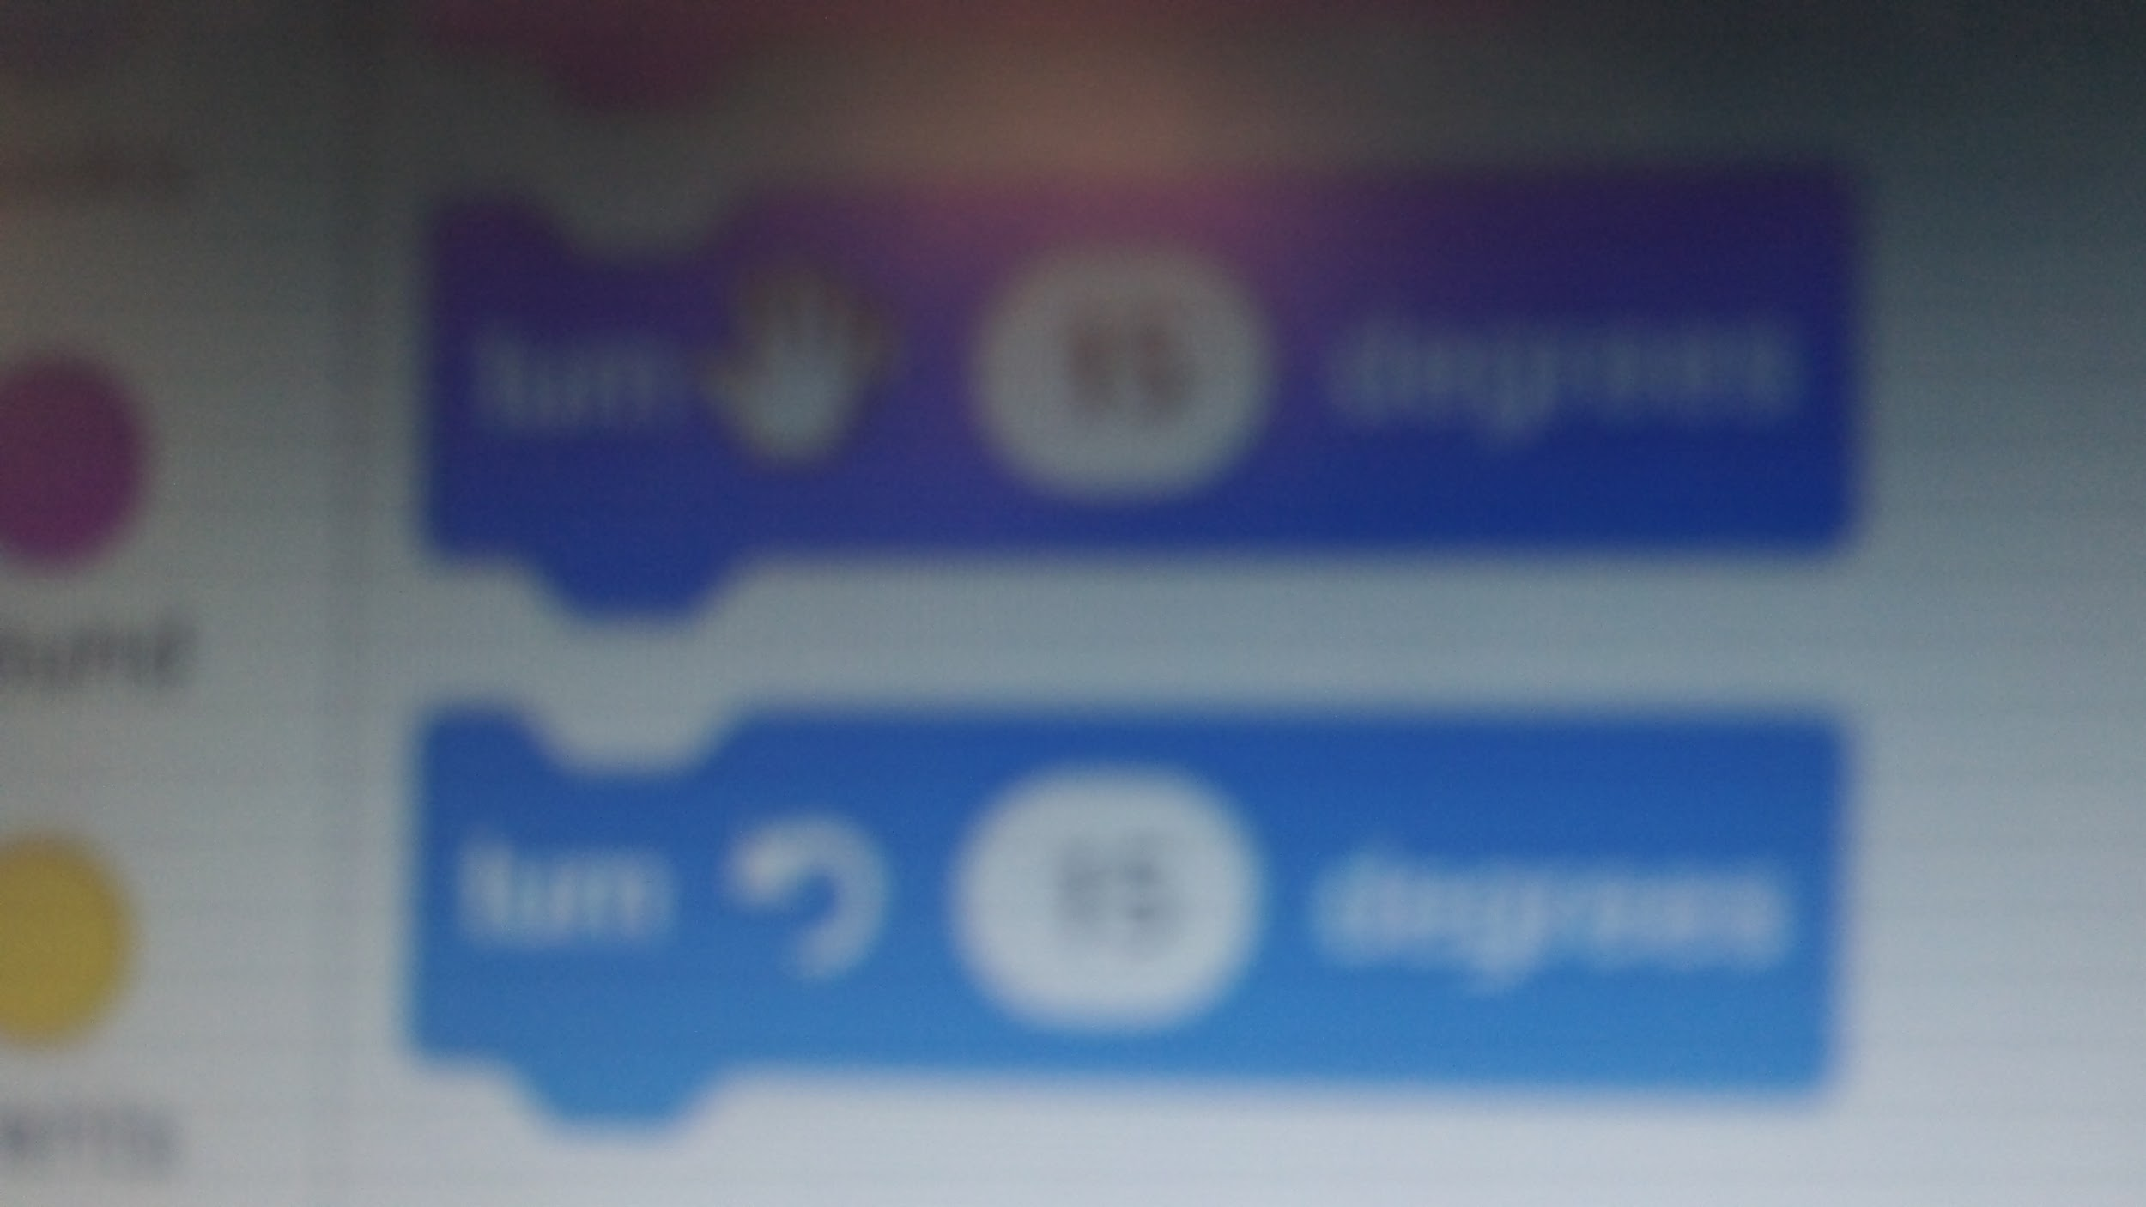
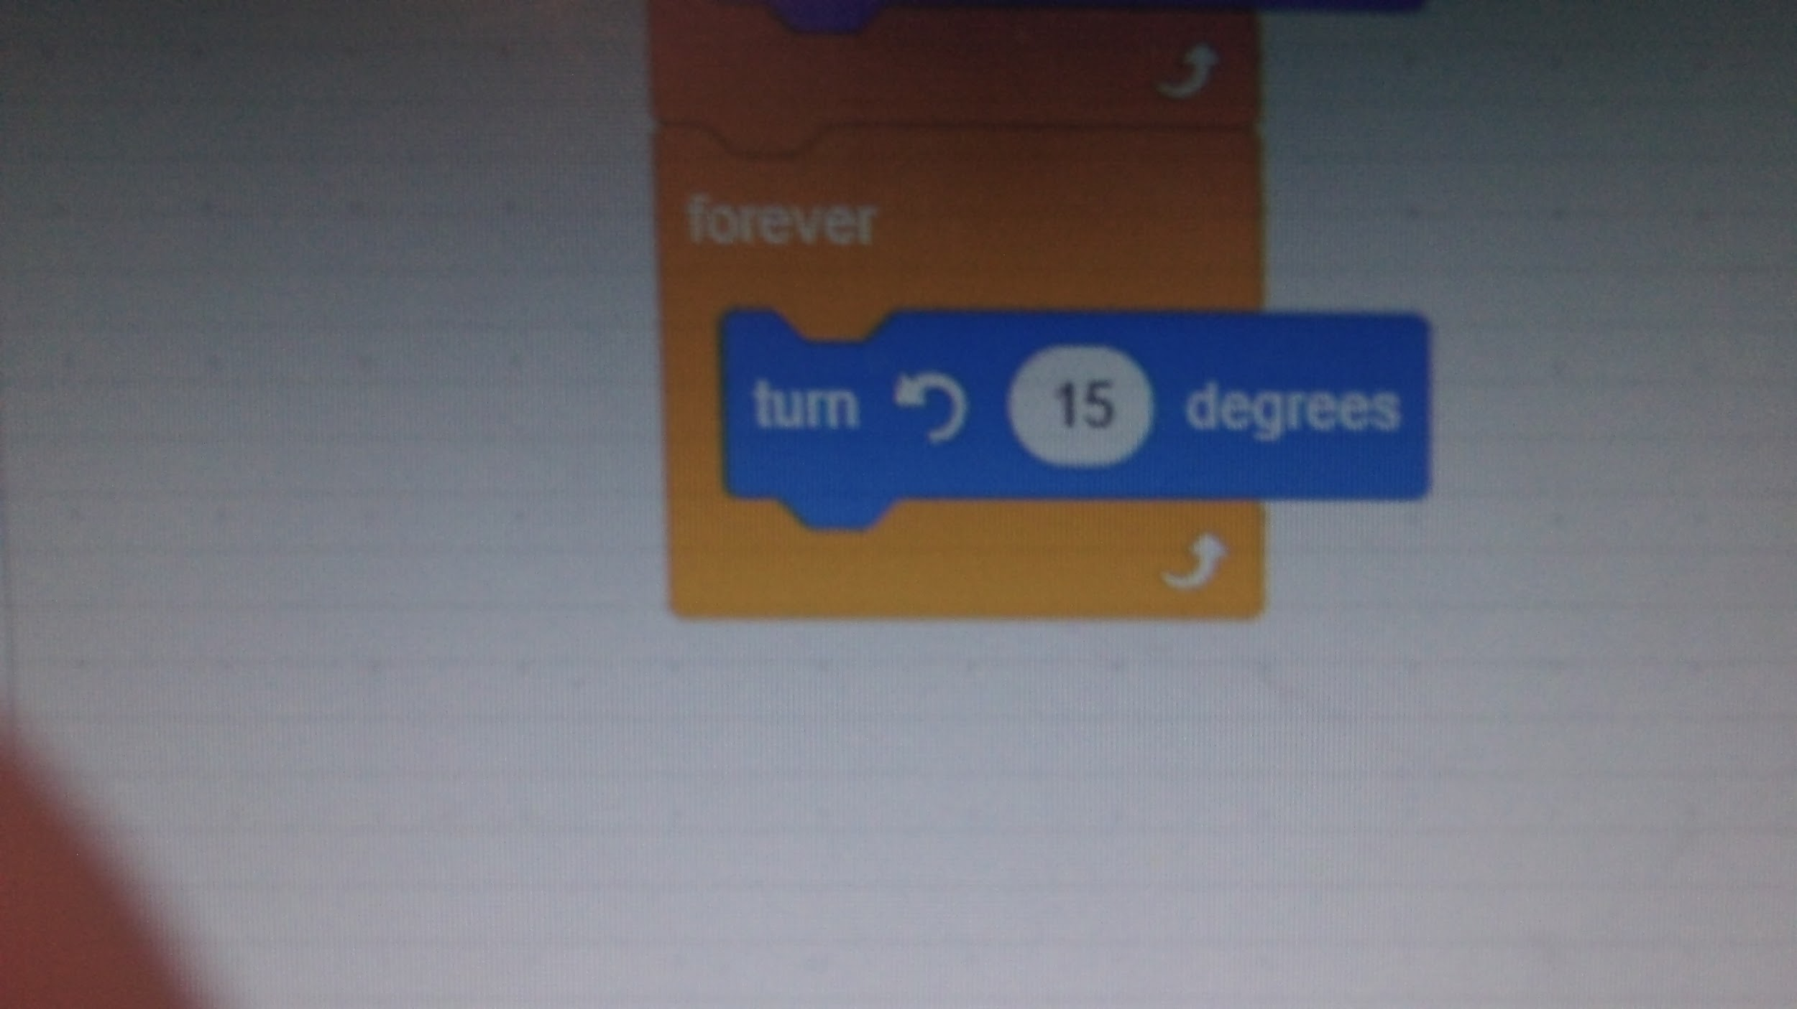
Use a turn block and a forever block

Slide 5
Thanks For Watching ! And well See Y'all Bye

Slide 6
By Animation Crue
Editor :Ellie
Photographer :Kirsty

