Slide 1
How to hide and show
By N, S and H P6

Slide 2
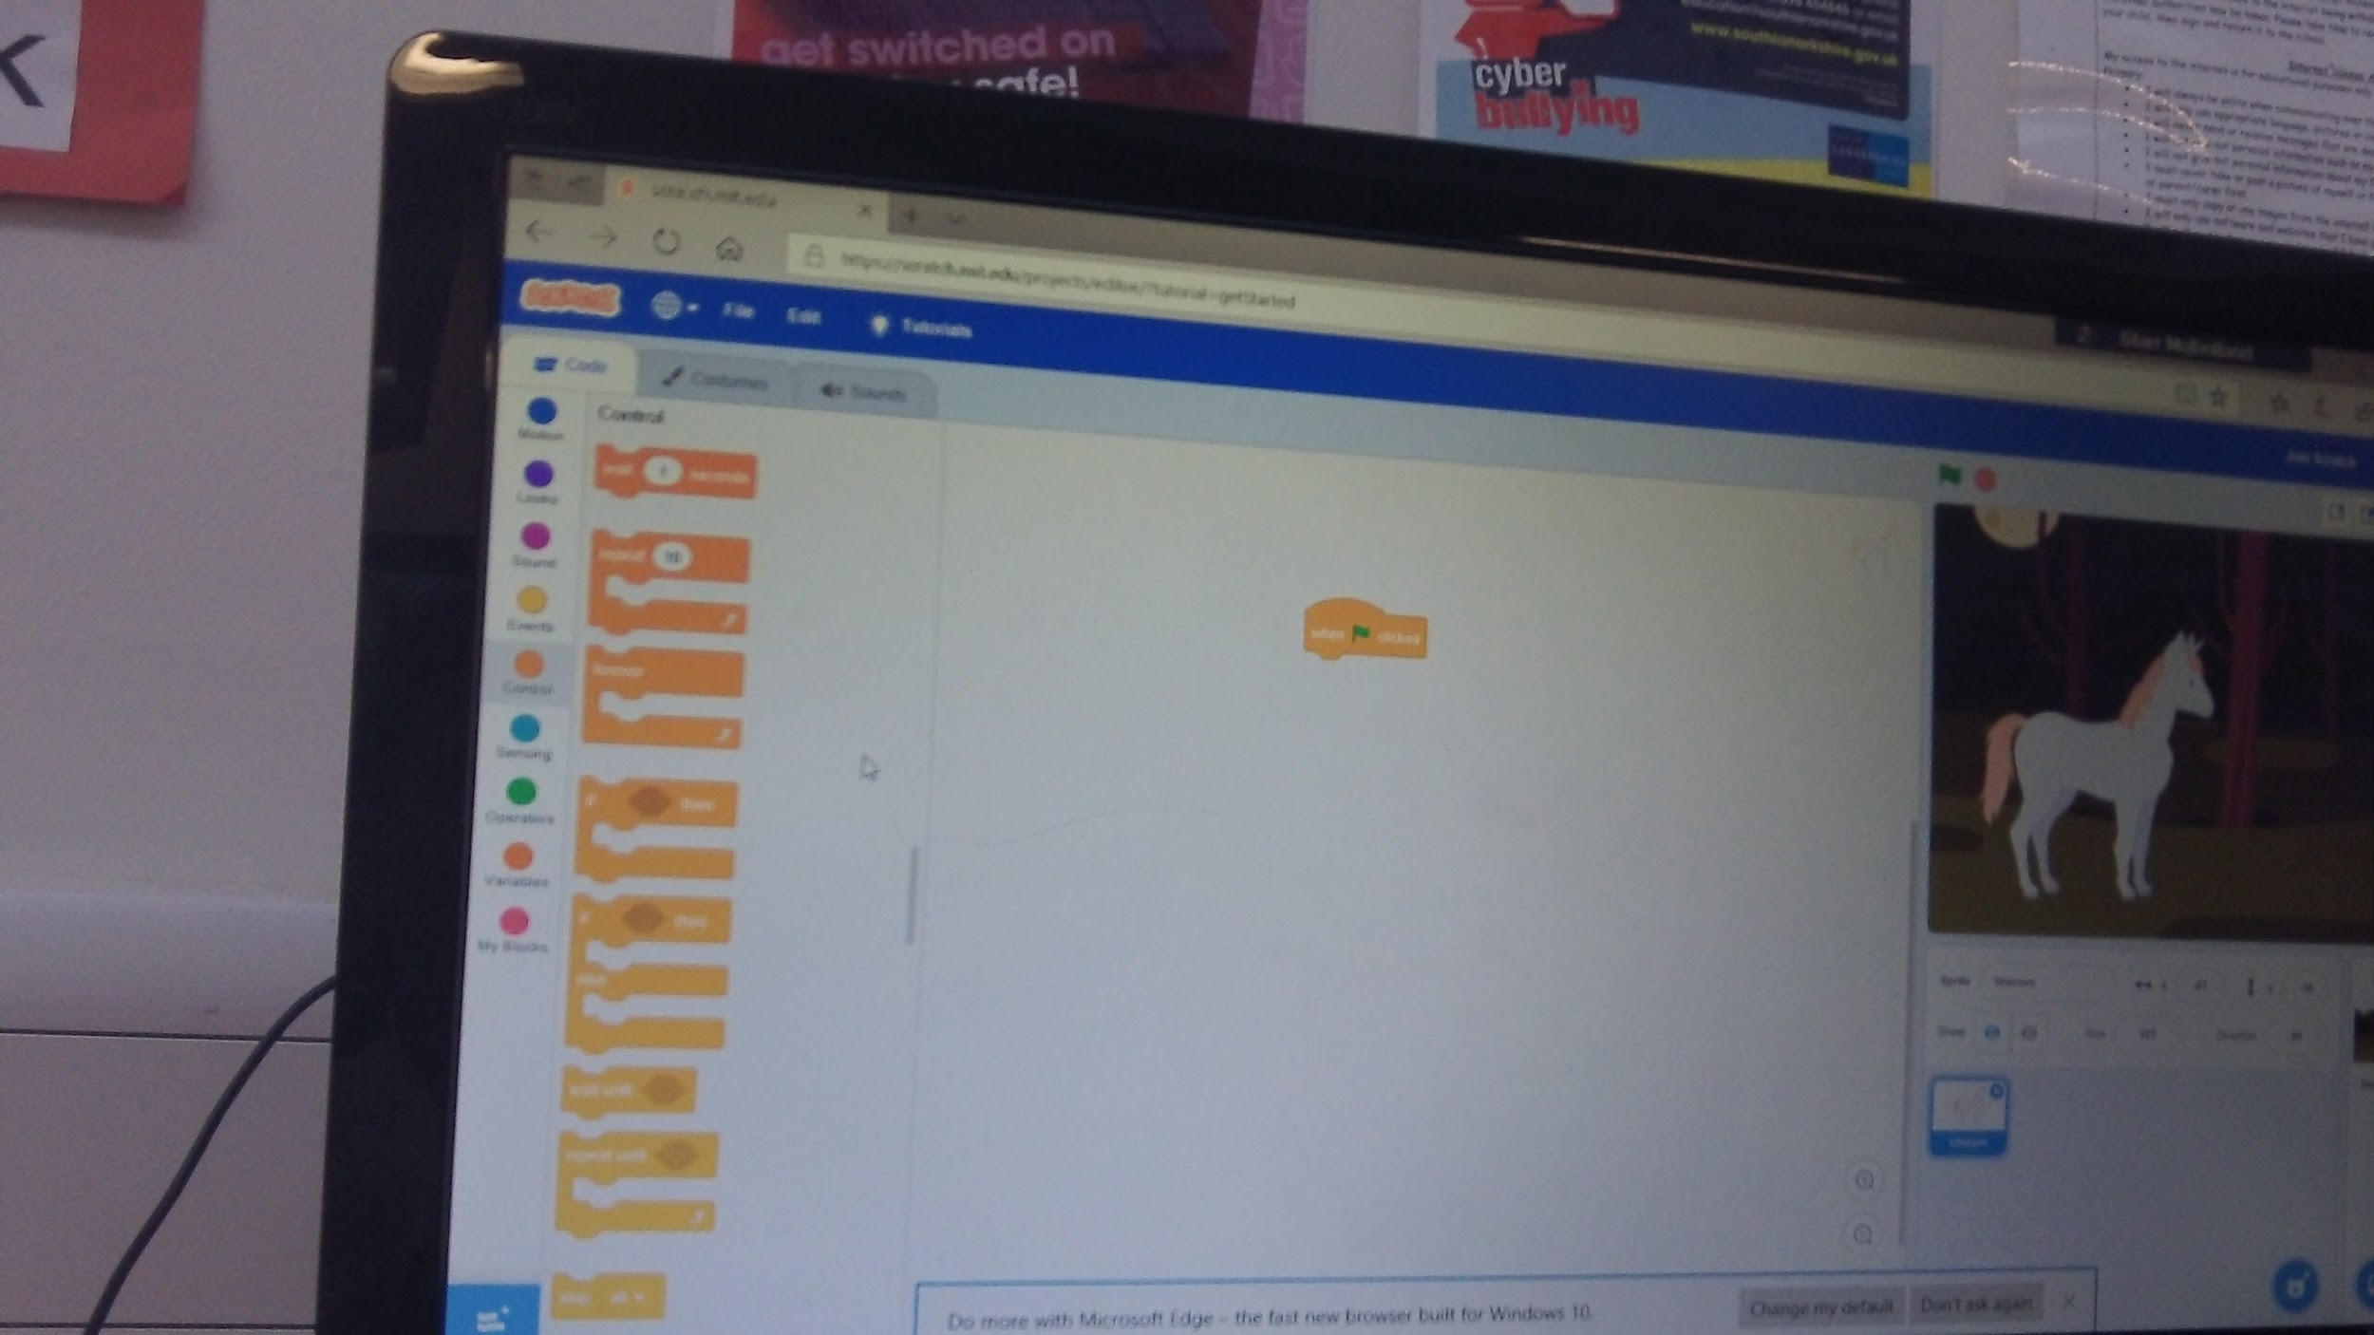
FIRSTLY YOU GET THE GREEN FLAG BUTTON FROM THE CONTROL SECTION

Slide 3
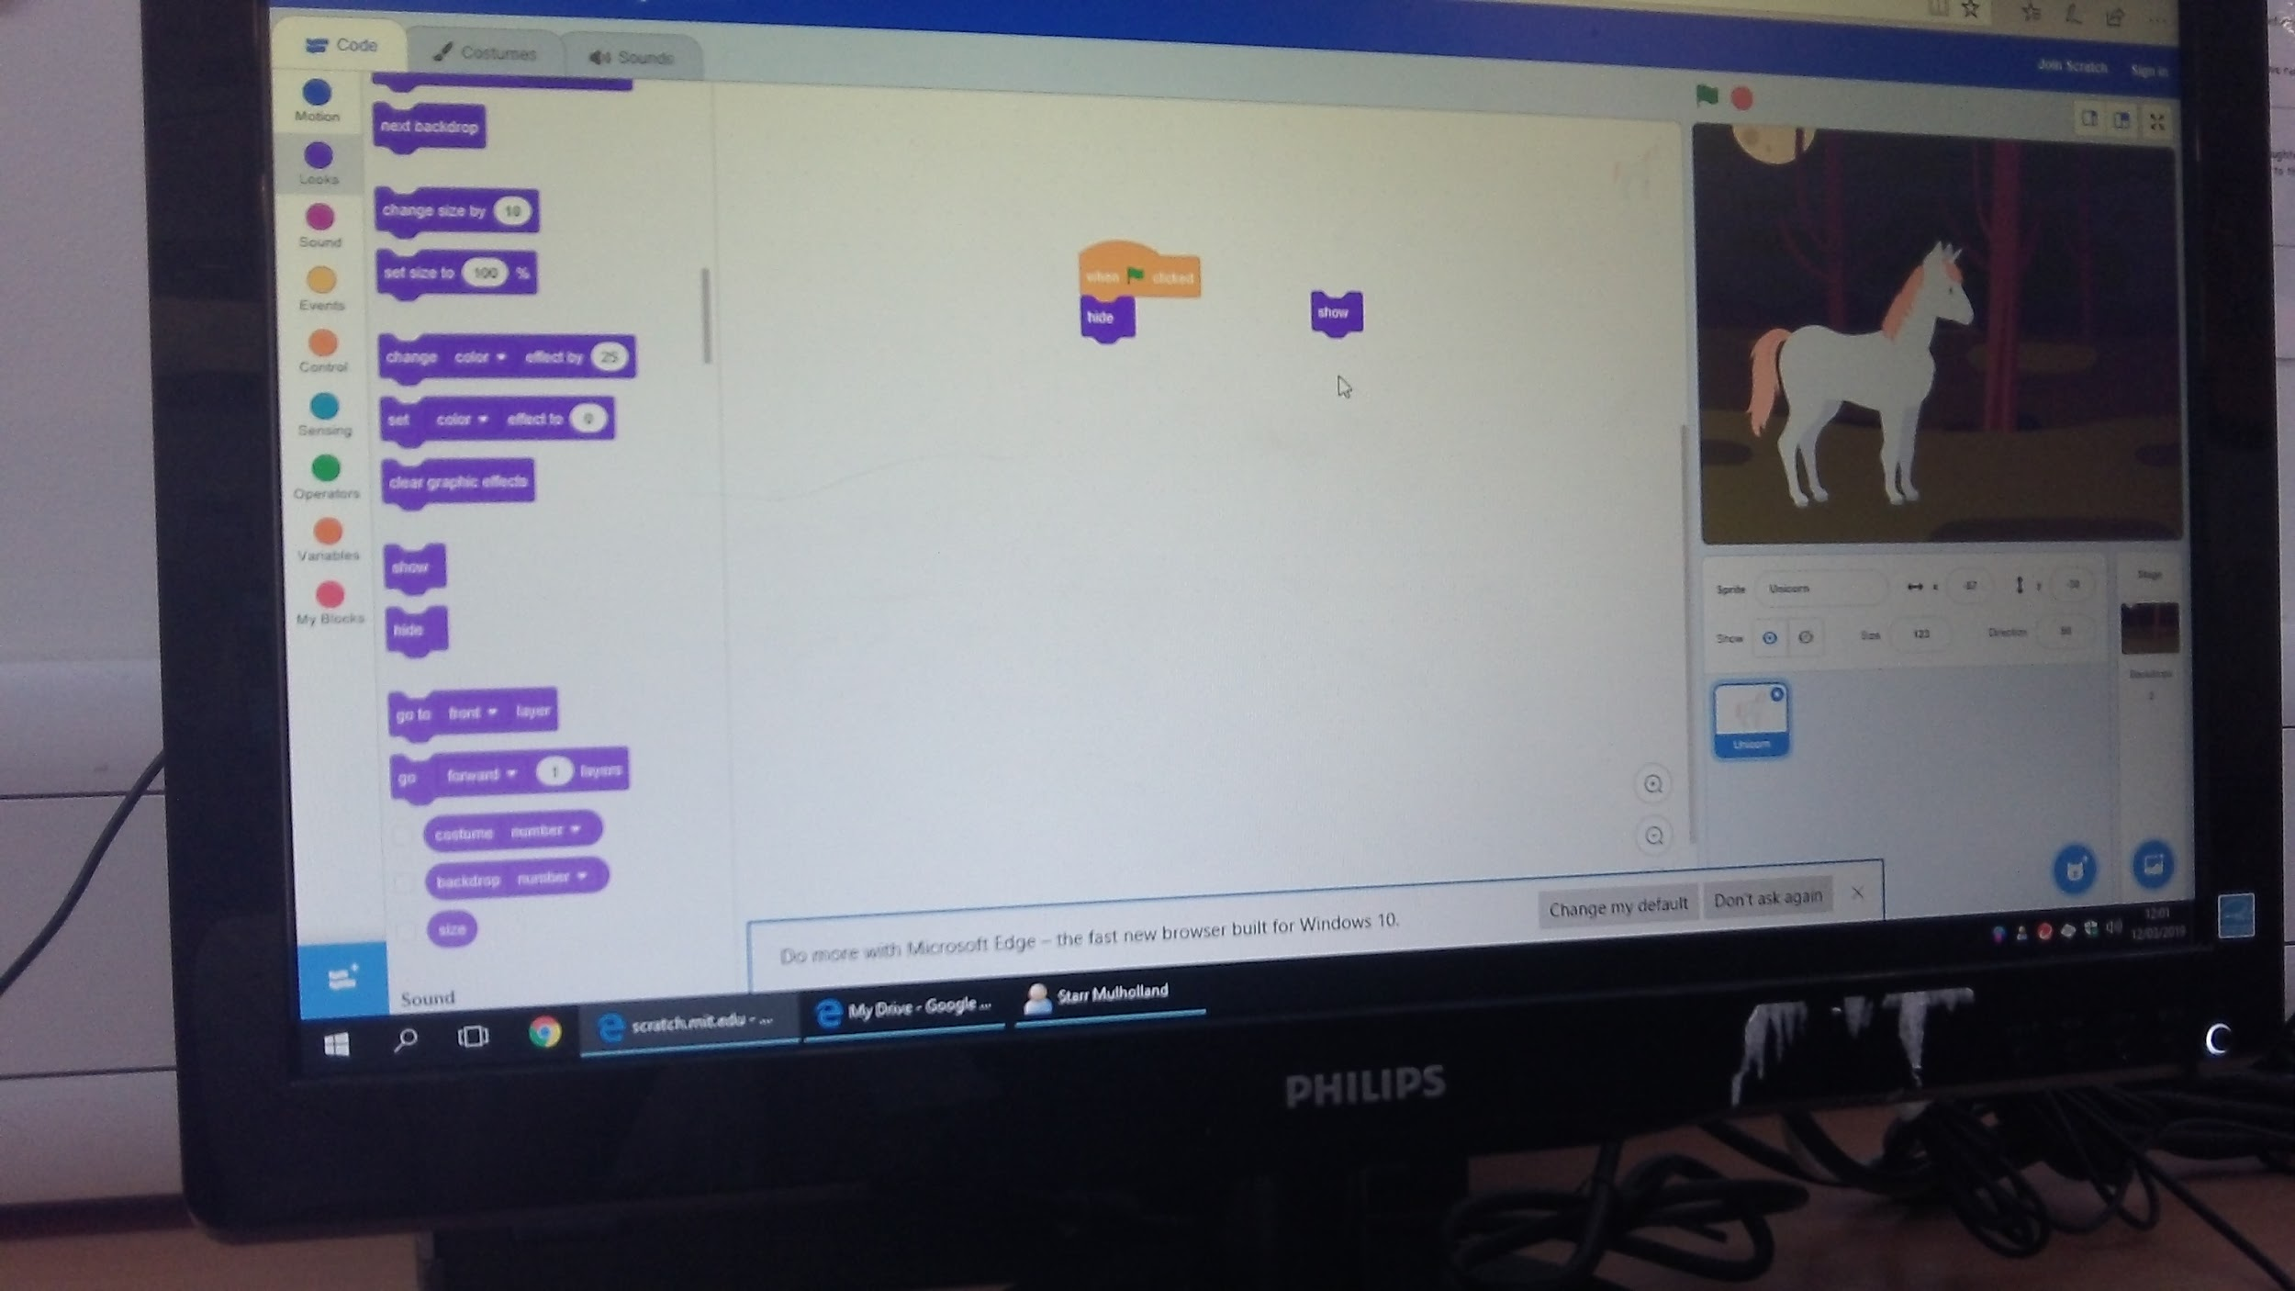
NEXT ADD YOUR HIDE AND SHOW BUTTONS FROM THE MOTION SECTION

Slide 4
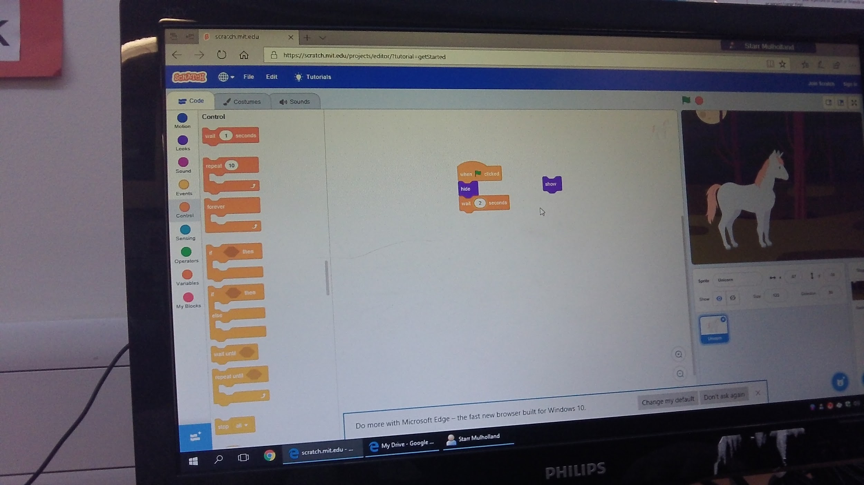
NOW IN THE MIDDLE OF THE LAST TWO BLOCKS, ADD THE WAIT - SECONDS BLOCK

Slide 5
NOW CHANGE THE NUMBER FOR HOW LONG YOU WANT TO HIDE YOUR SPRITE

Slide 6
NOW JOIN A PURPLE SHOW BLOCK ONTO THE ALGORITHM AND PRESS THE GREEN FLAG

Slide 7
THANKS FOR WATCHING
:D

