Slide 1
Animate a Sprite.
By M, M and C P6

Slide 2
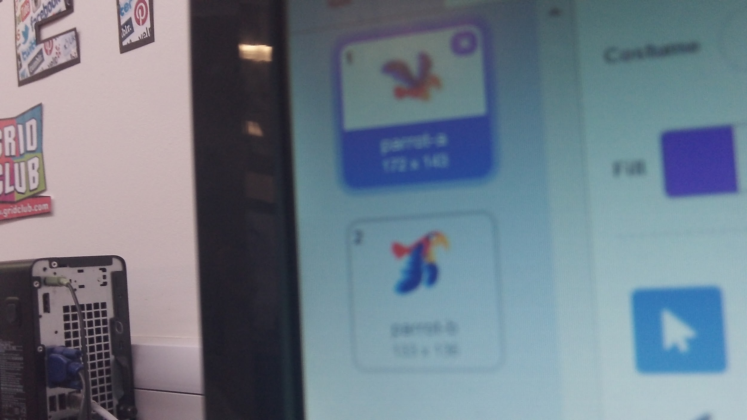
Animate a Sprite
Today we are going to show you how
To use coding blocks on the Scratch
Website to animate a sprite.
You can change costumes to animate
Your character.

Slide 3
Animate a Sprite
Every sprite has multiple costumes.
This bird has two : ‘wings up’ and
‘Wings down’

Slide 4
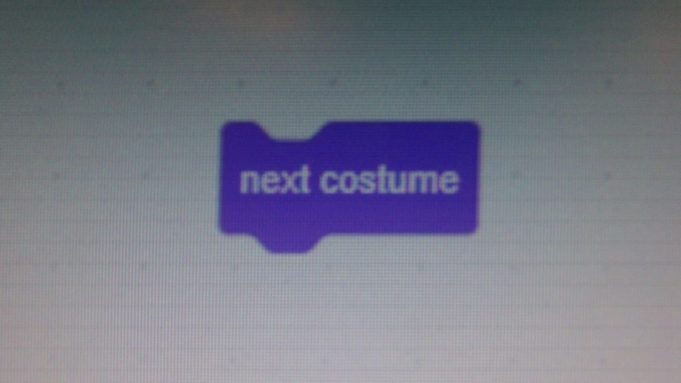
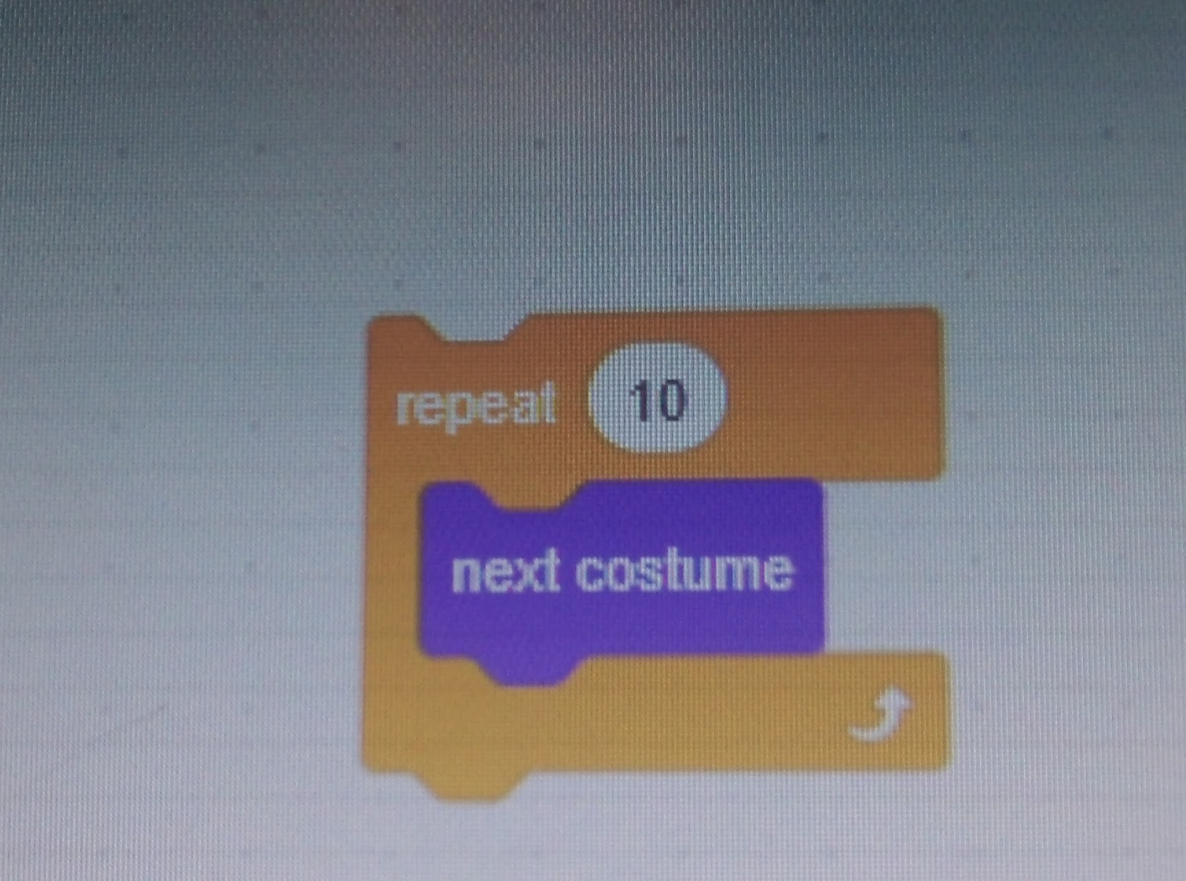
Animate a Sprite
Use the ‘next costume’ block to switch costumes
To keep going,you can use a repeat loop .

Slide 5
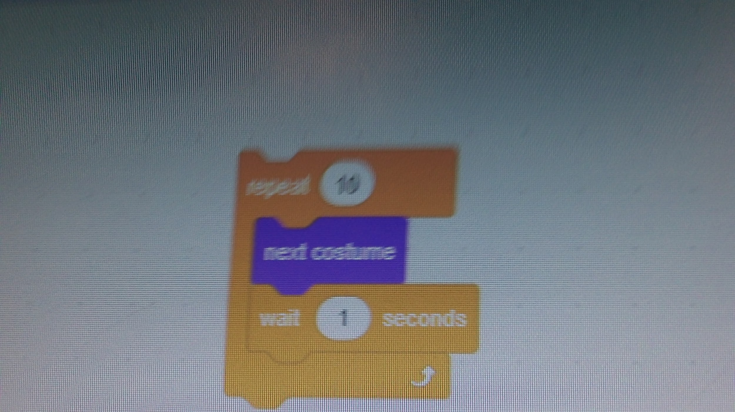
Animate a sprite
Add a wait block to slow it down.
If you want to use a specific costume use the ‘Switch
Costume’ block .
What will you create?

