Slide 1
Animate a Sprite!
By Kadi, Alex and Beth

Slide 2
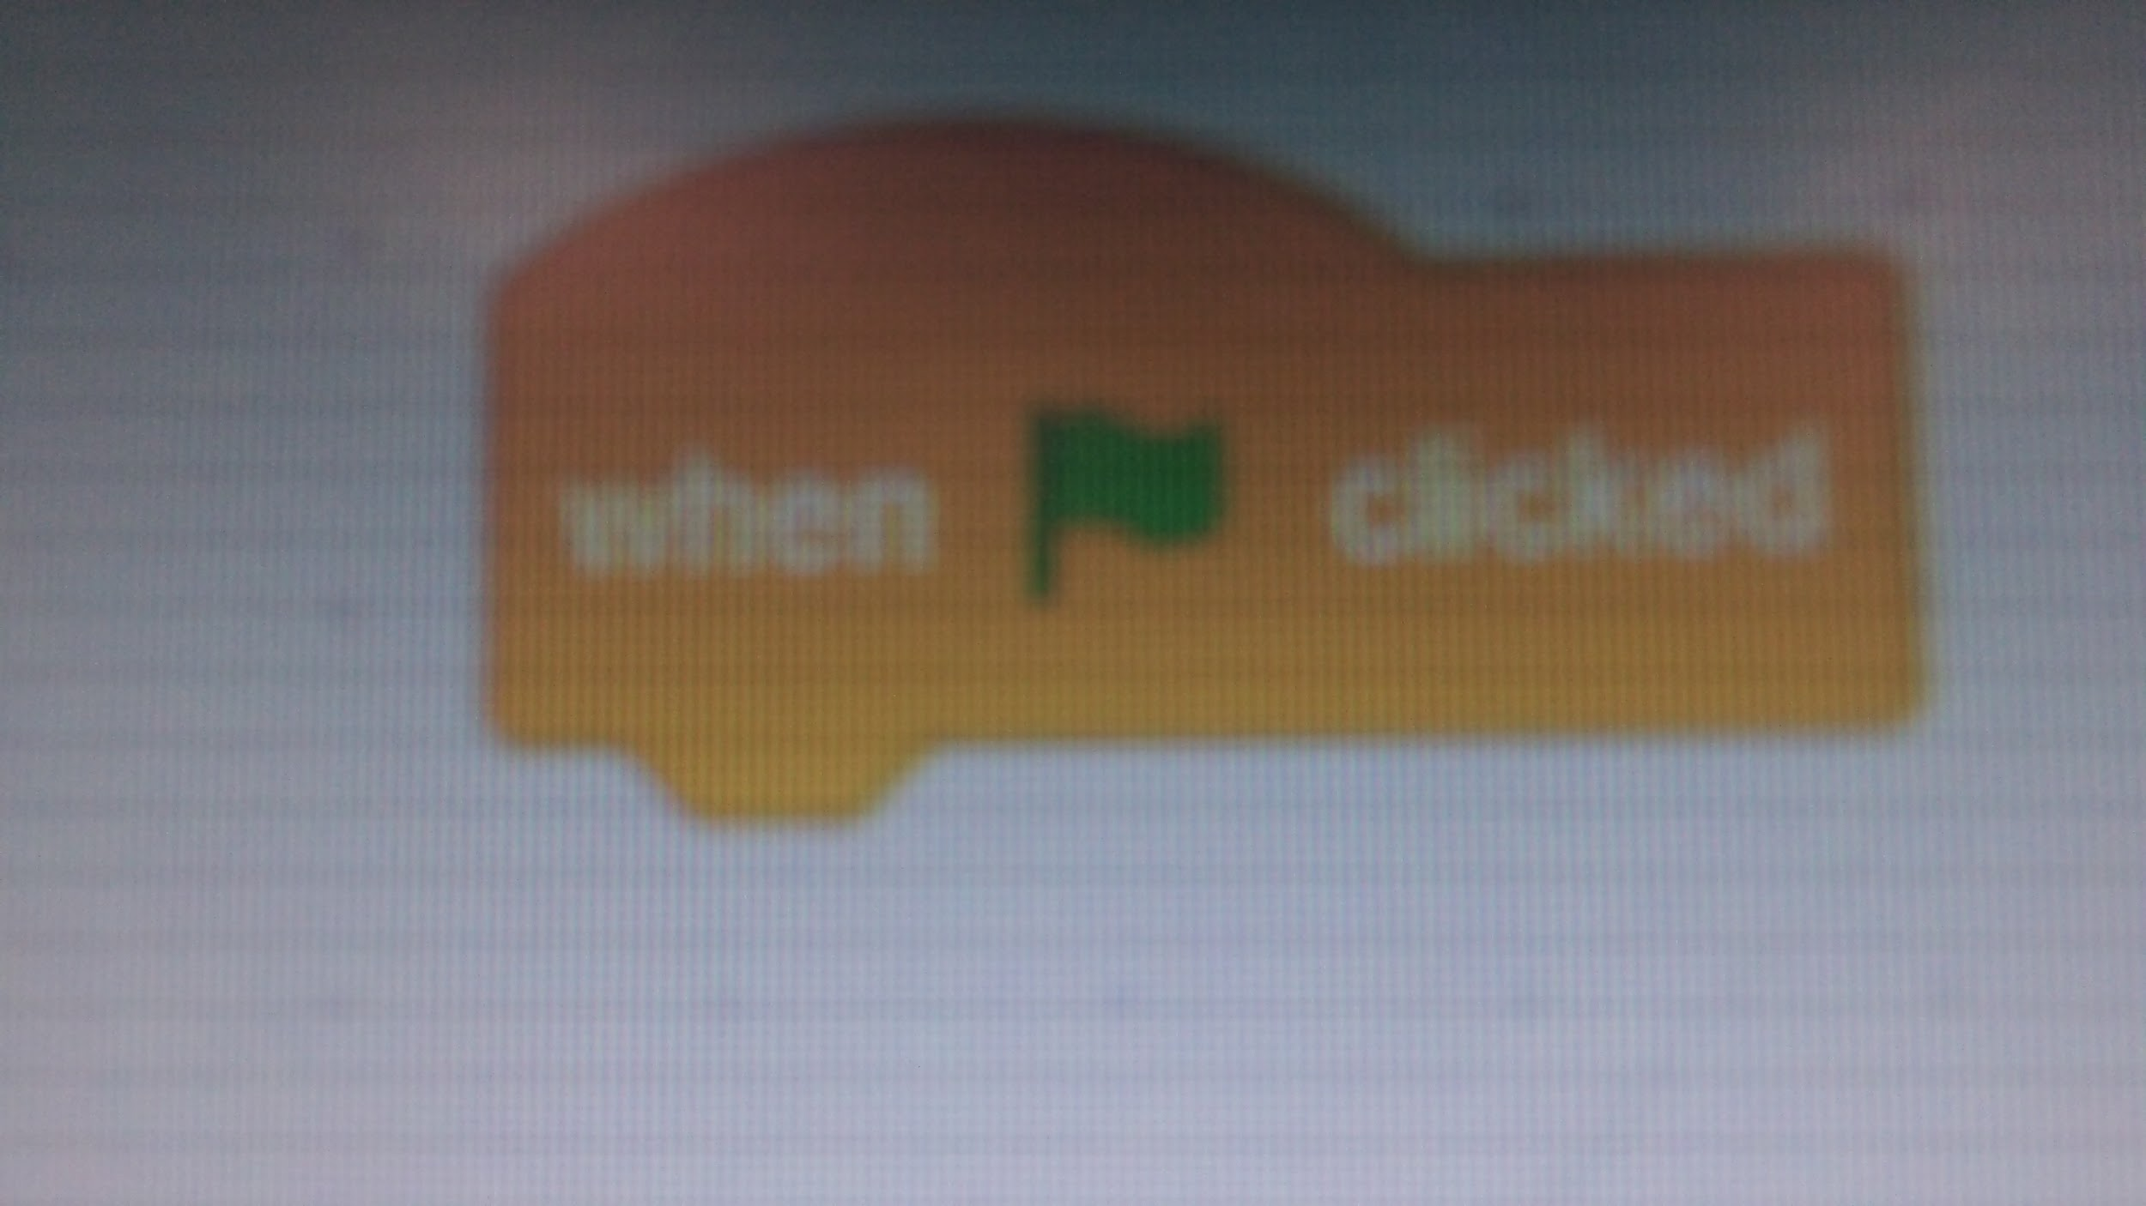
First,add a ‘when green flag clicked’ block from the yellow events section.
←

Slide 3
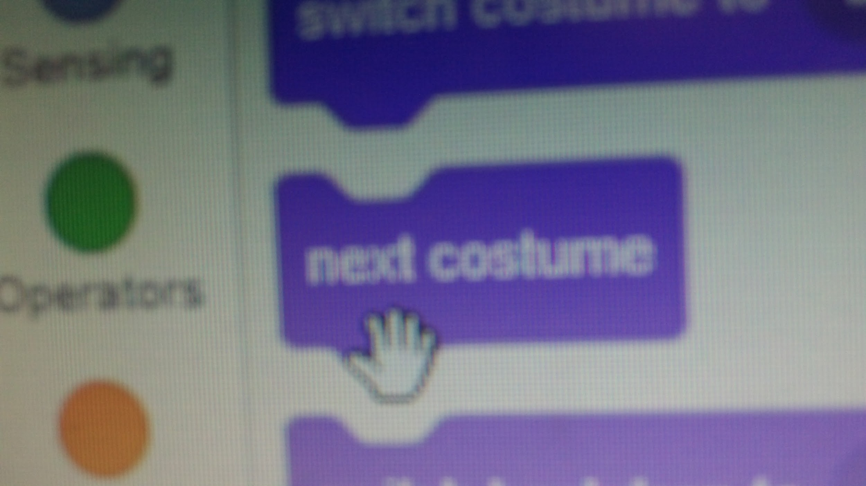
Secondly, go to the purple looks section, and get a ‘next costume’ block.

Slide 4
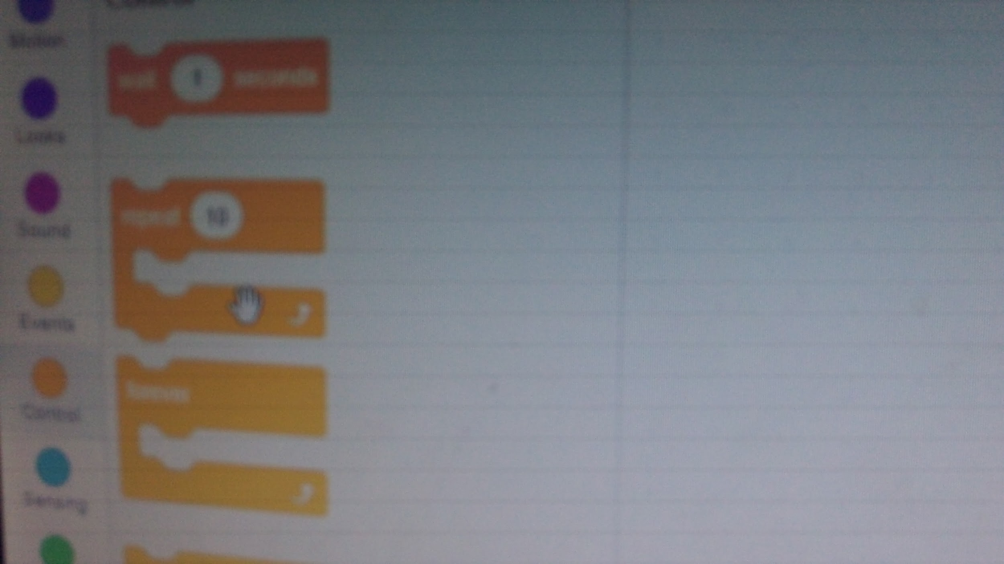
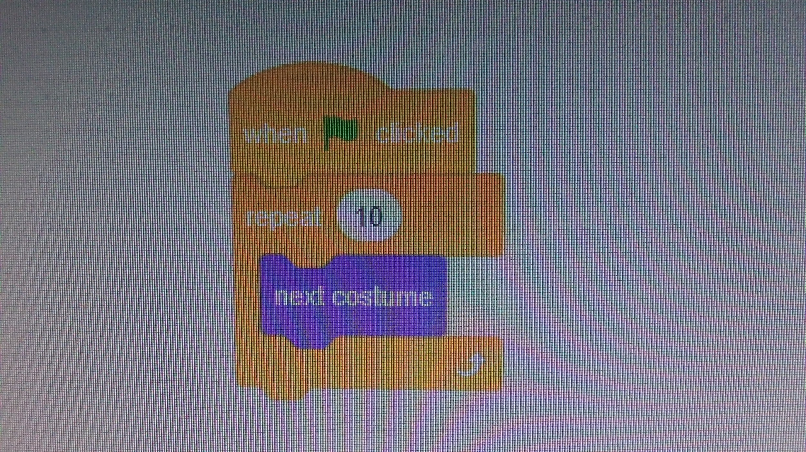
Next, take your mouse to the orange control section and get a ‘repeat’ block.

Slide 5
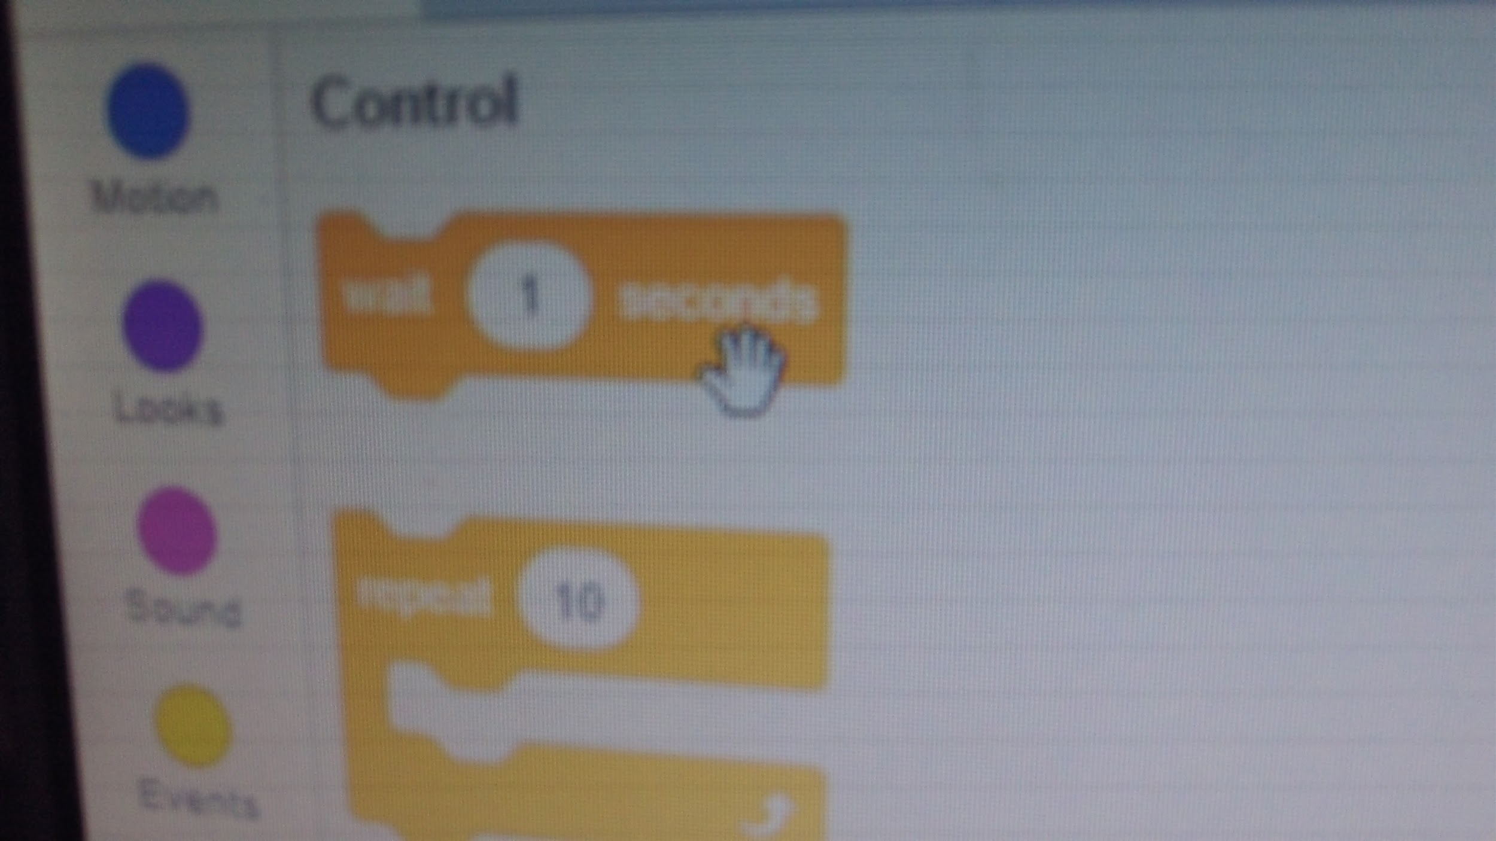
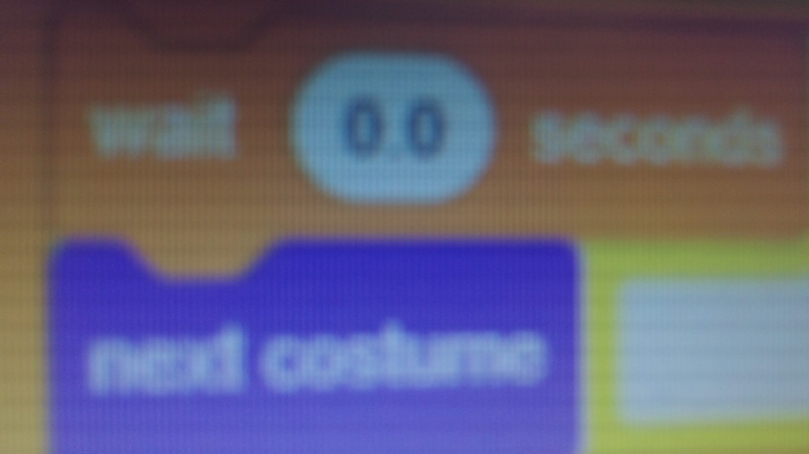
After,Stay in the orange control section and pick up a ‘wait’ block.

Slide 6
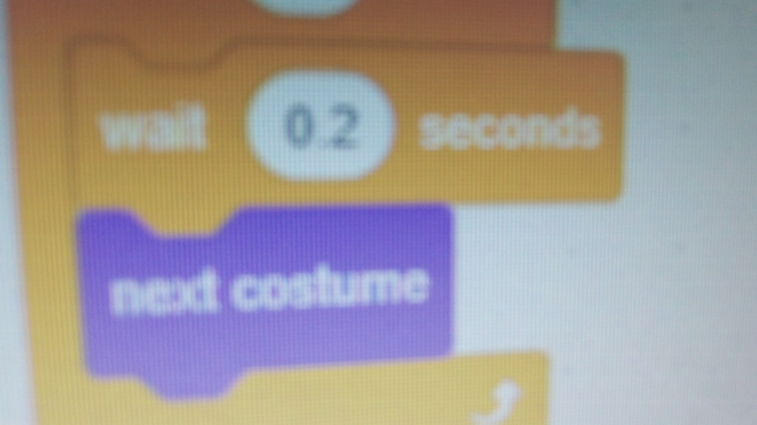
Change the ‘wait’ block to 0.2!

Slide 7
And you’re done! Click the green flag to start the animation!

