Slide 1
RRSA Committee
August 23-24

Slide 2
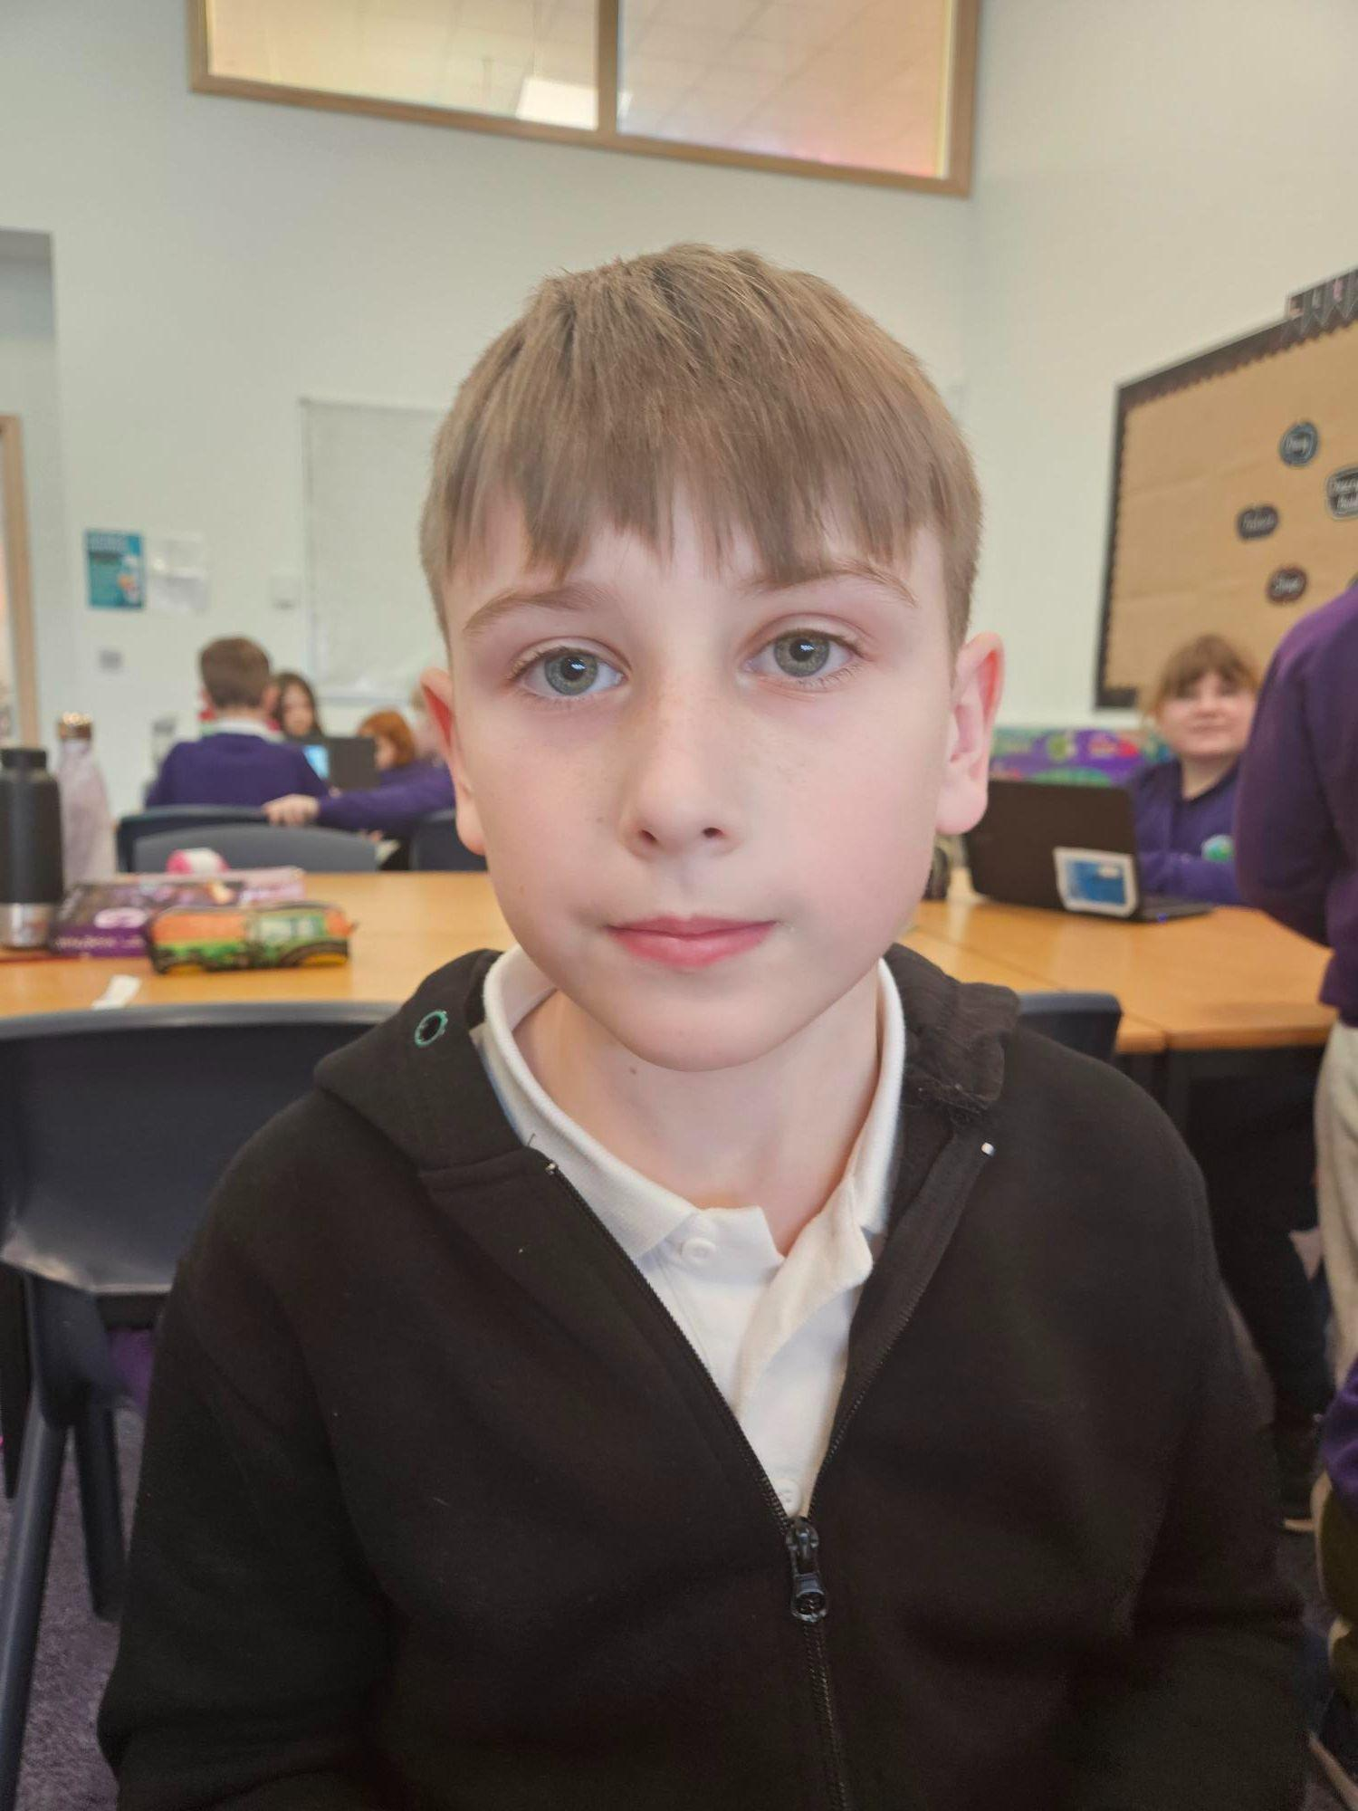
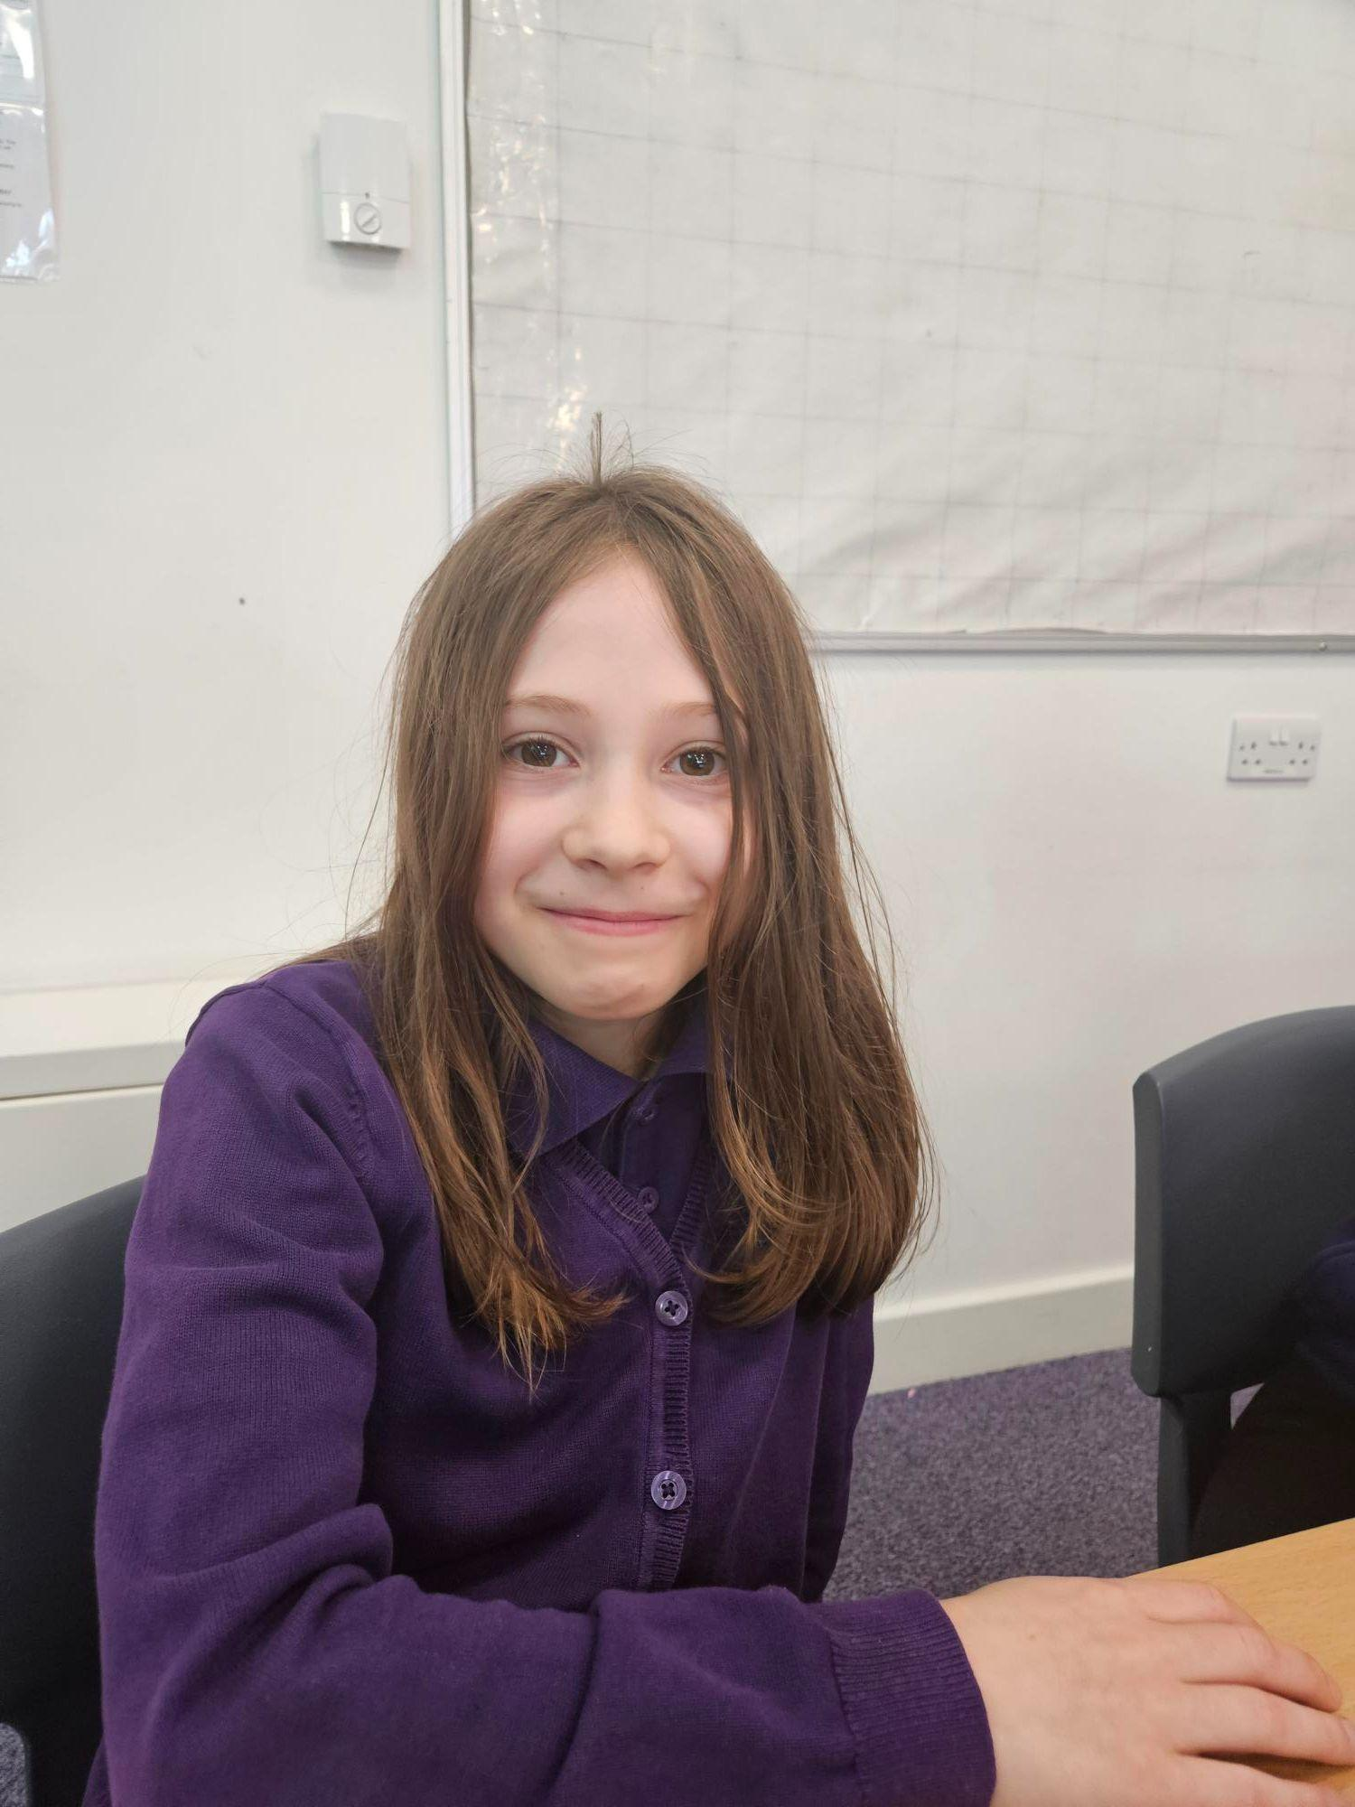
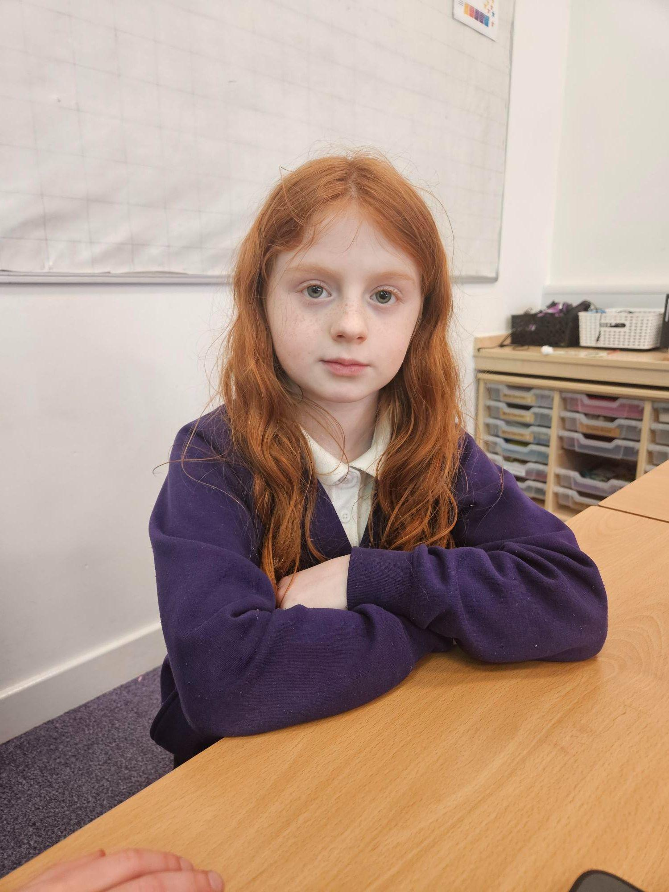
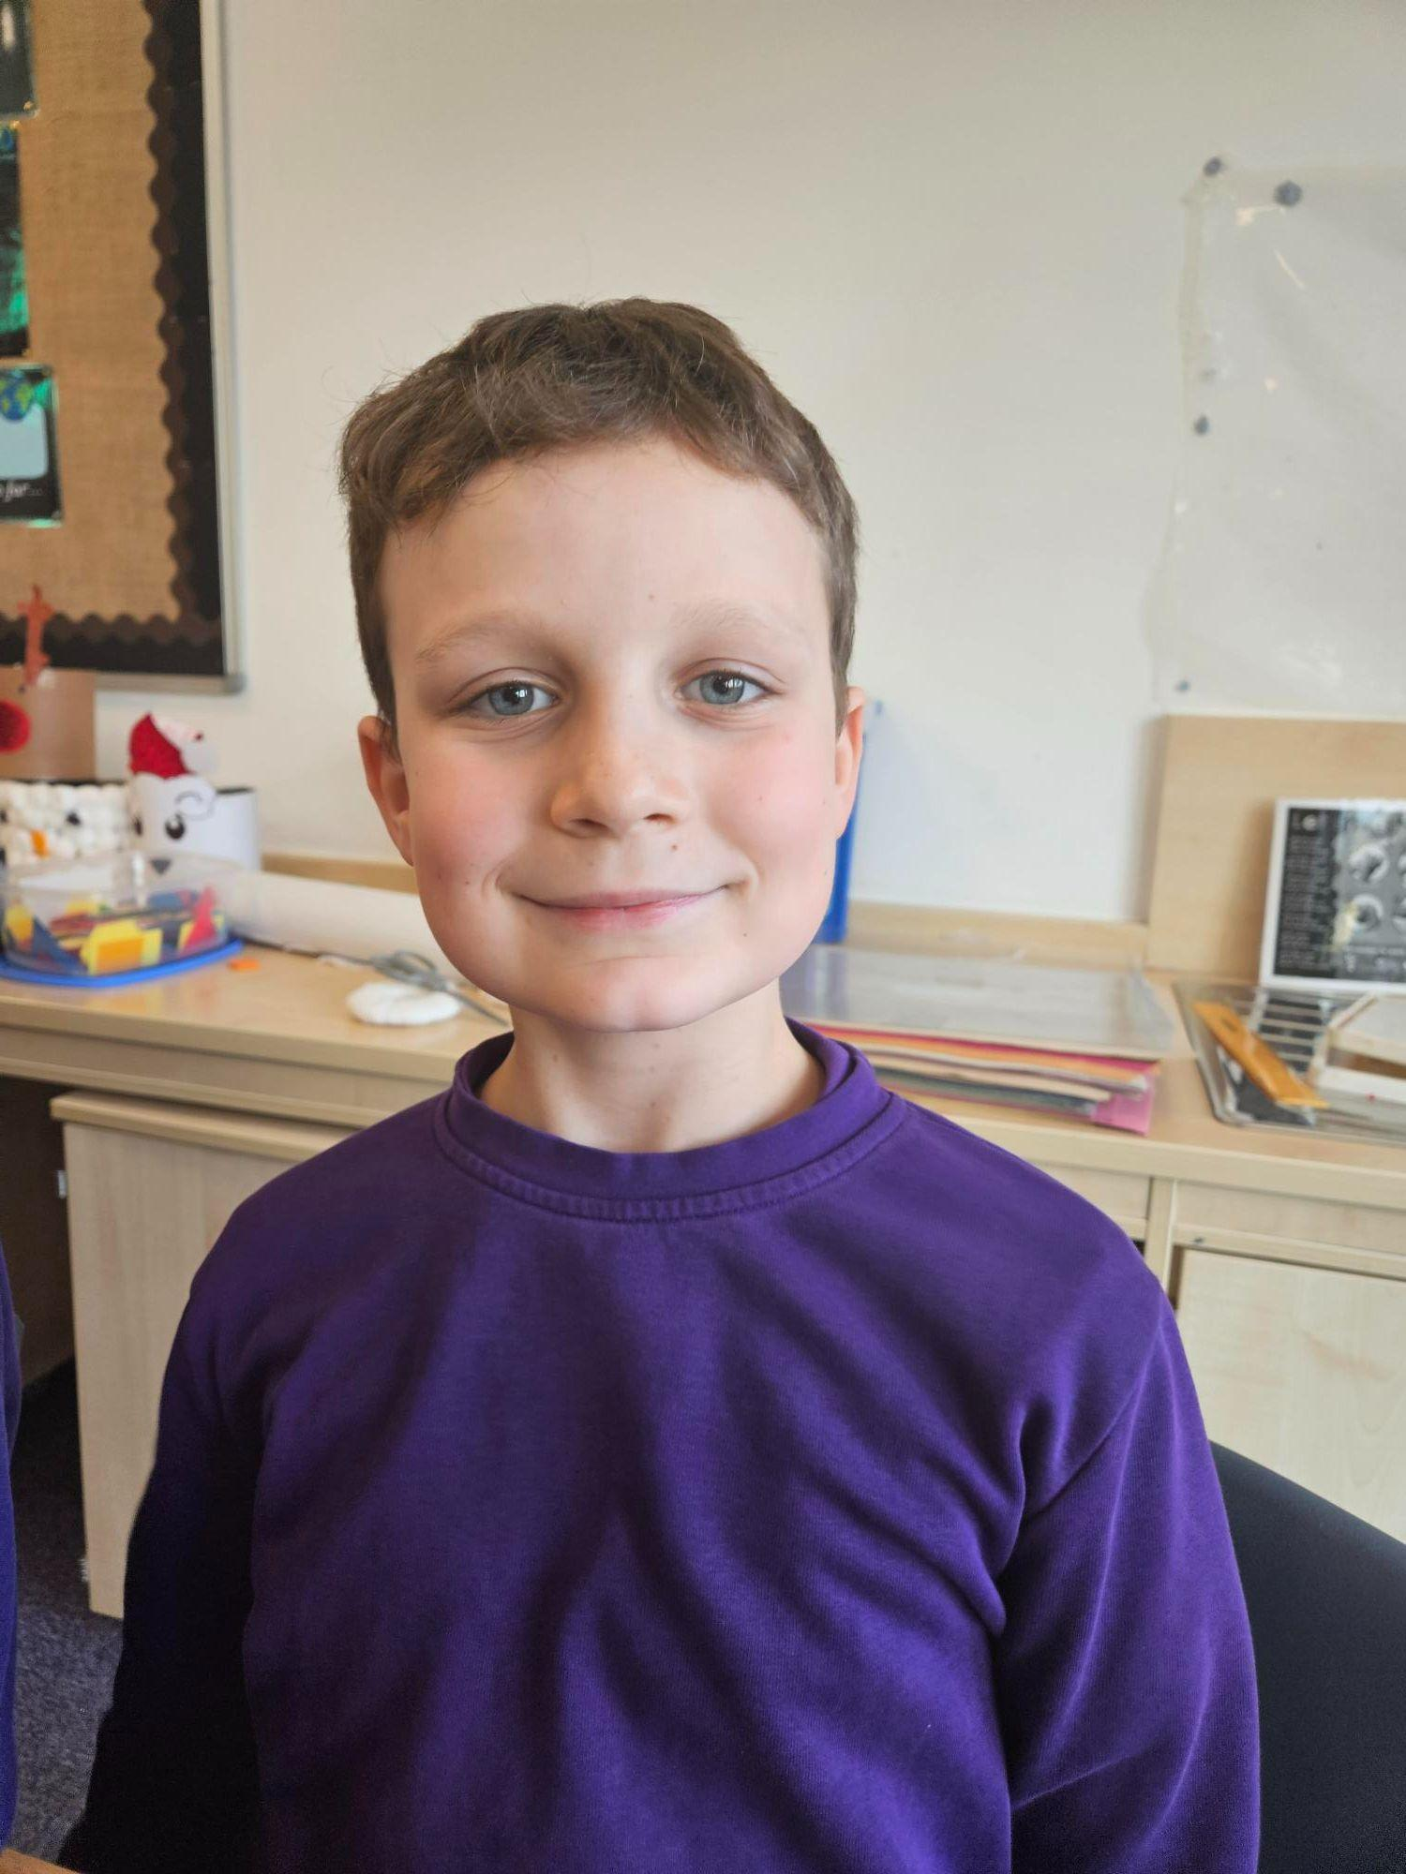
Our Members

Slide 3
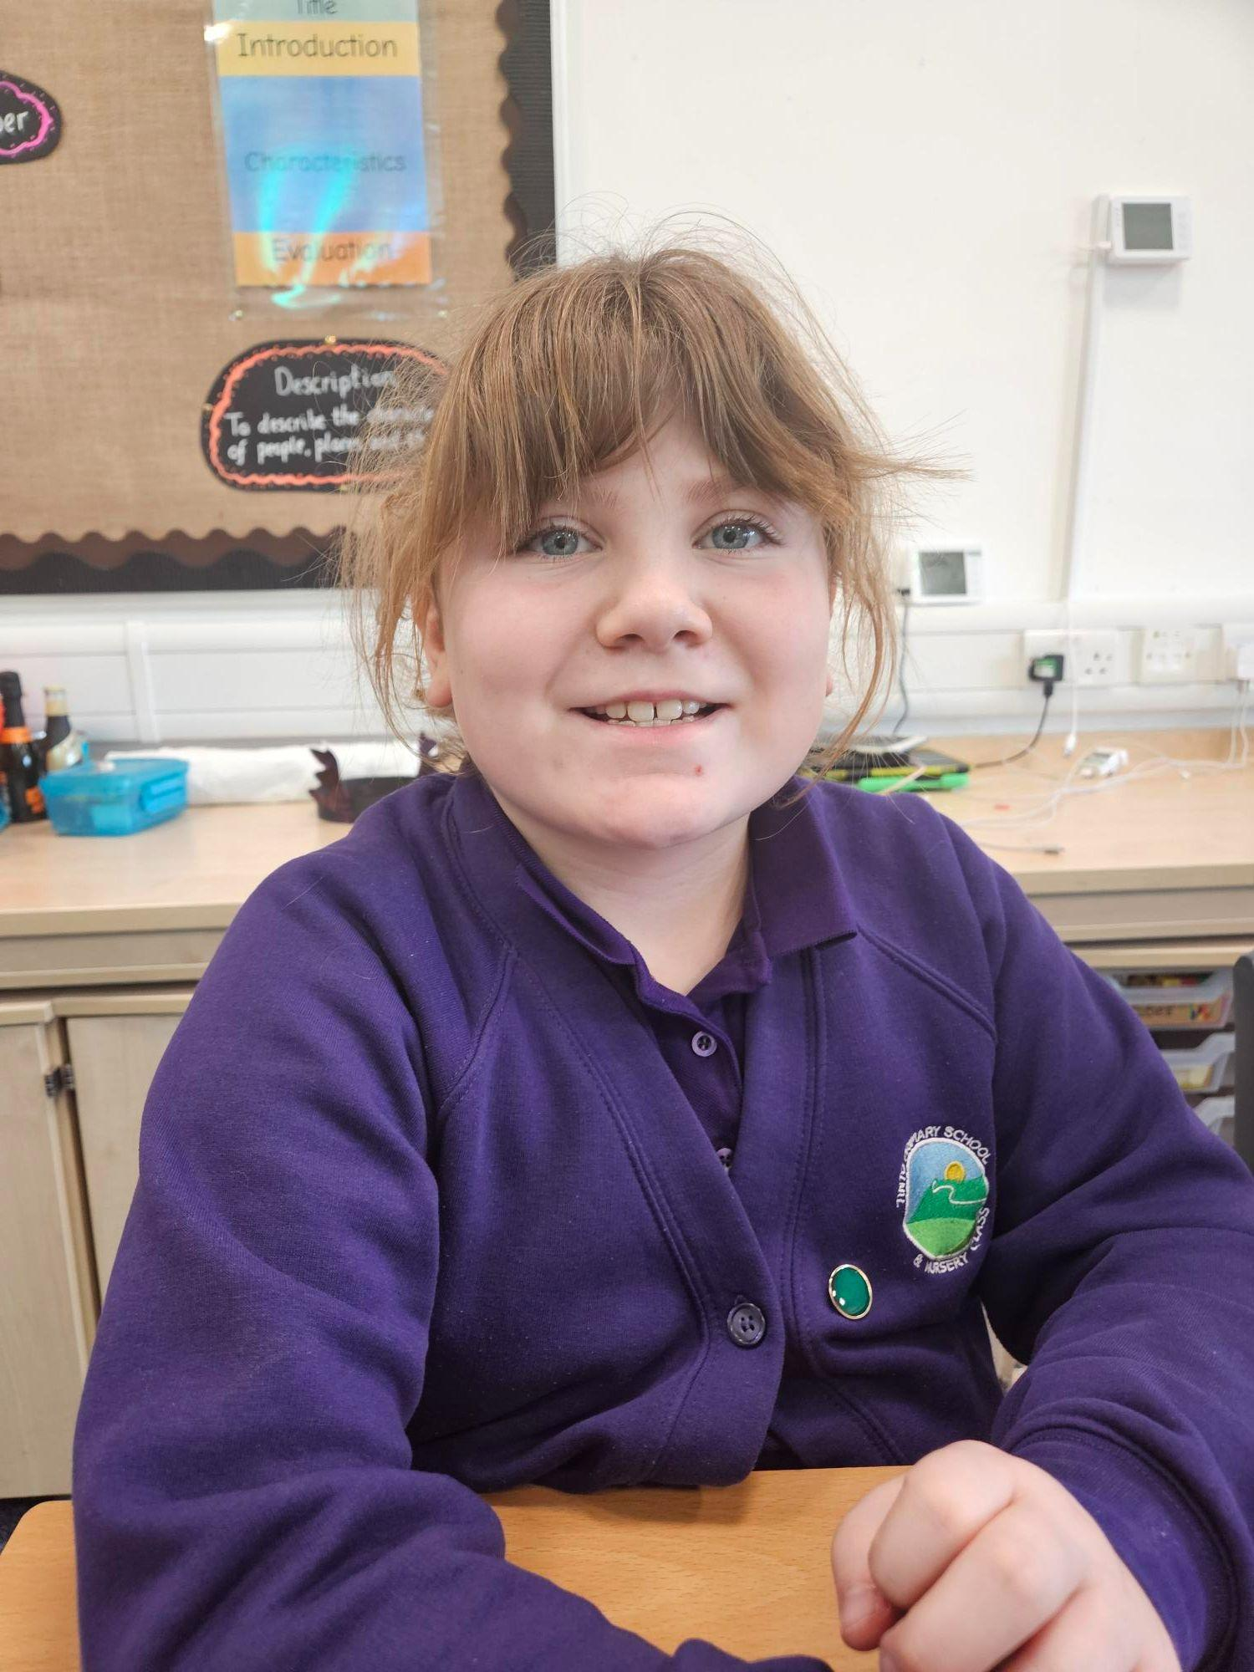
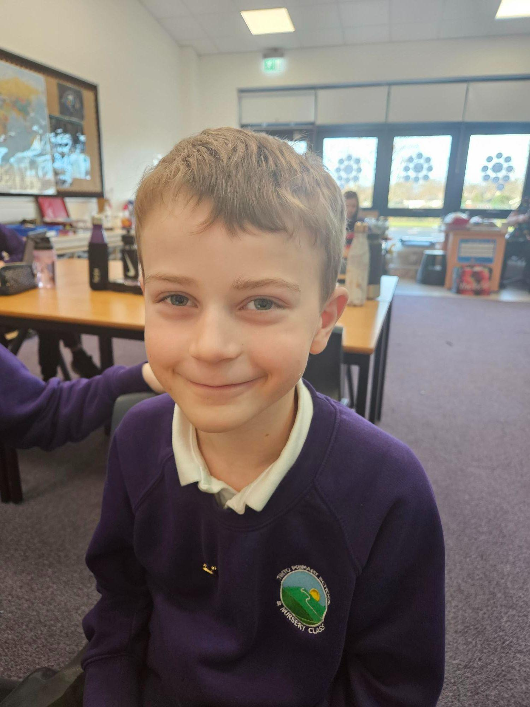
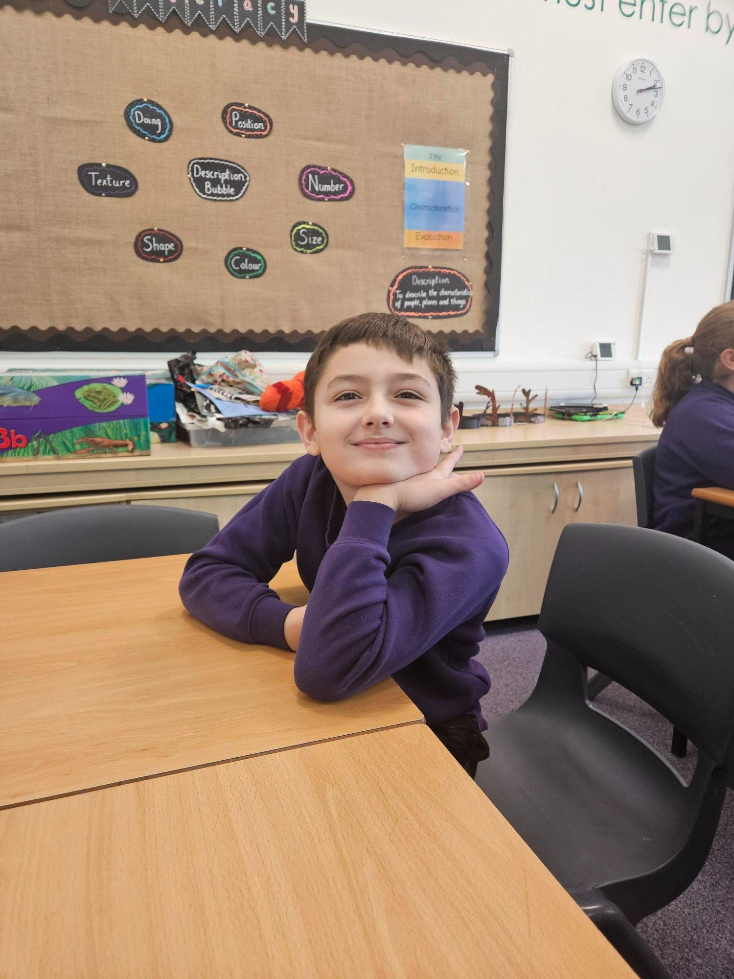
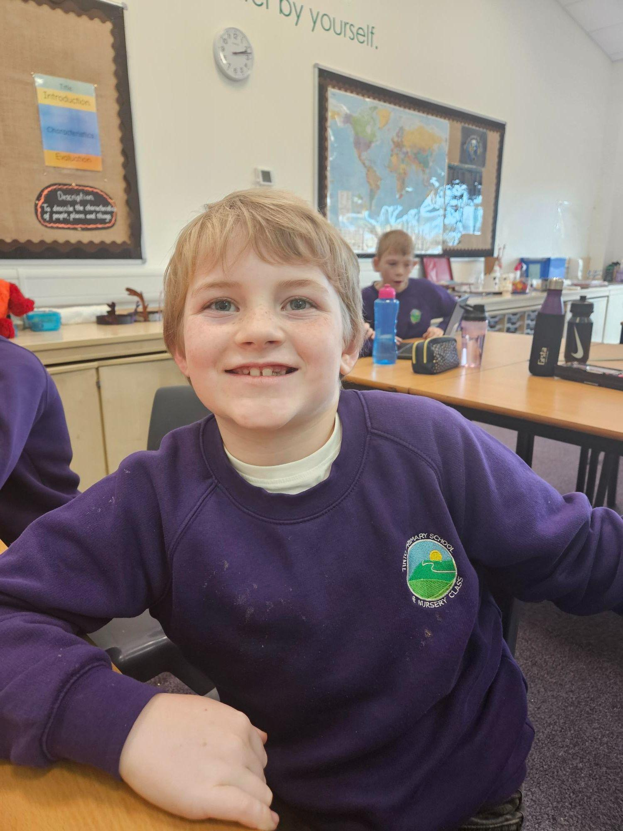
Our Members

Slide 4
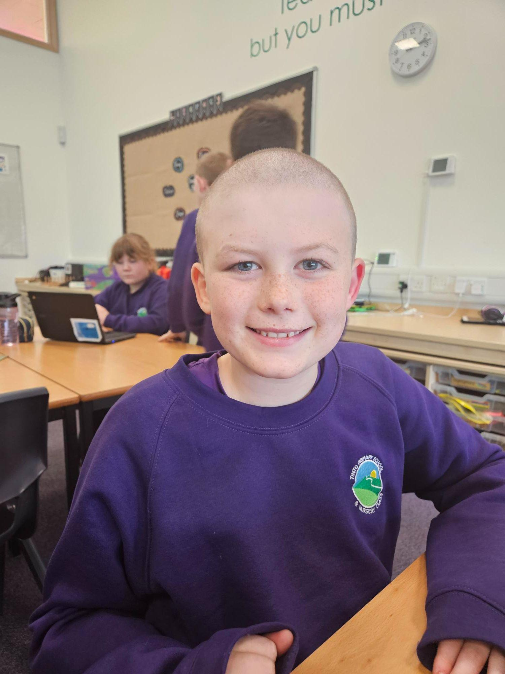
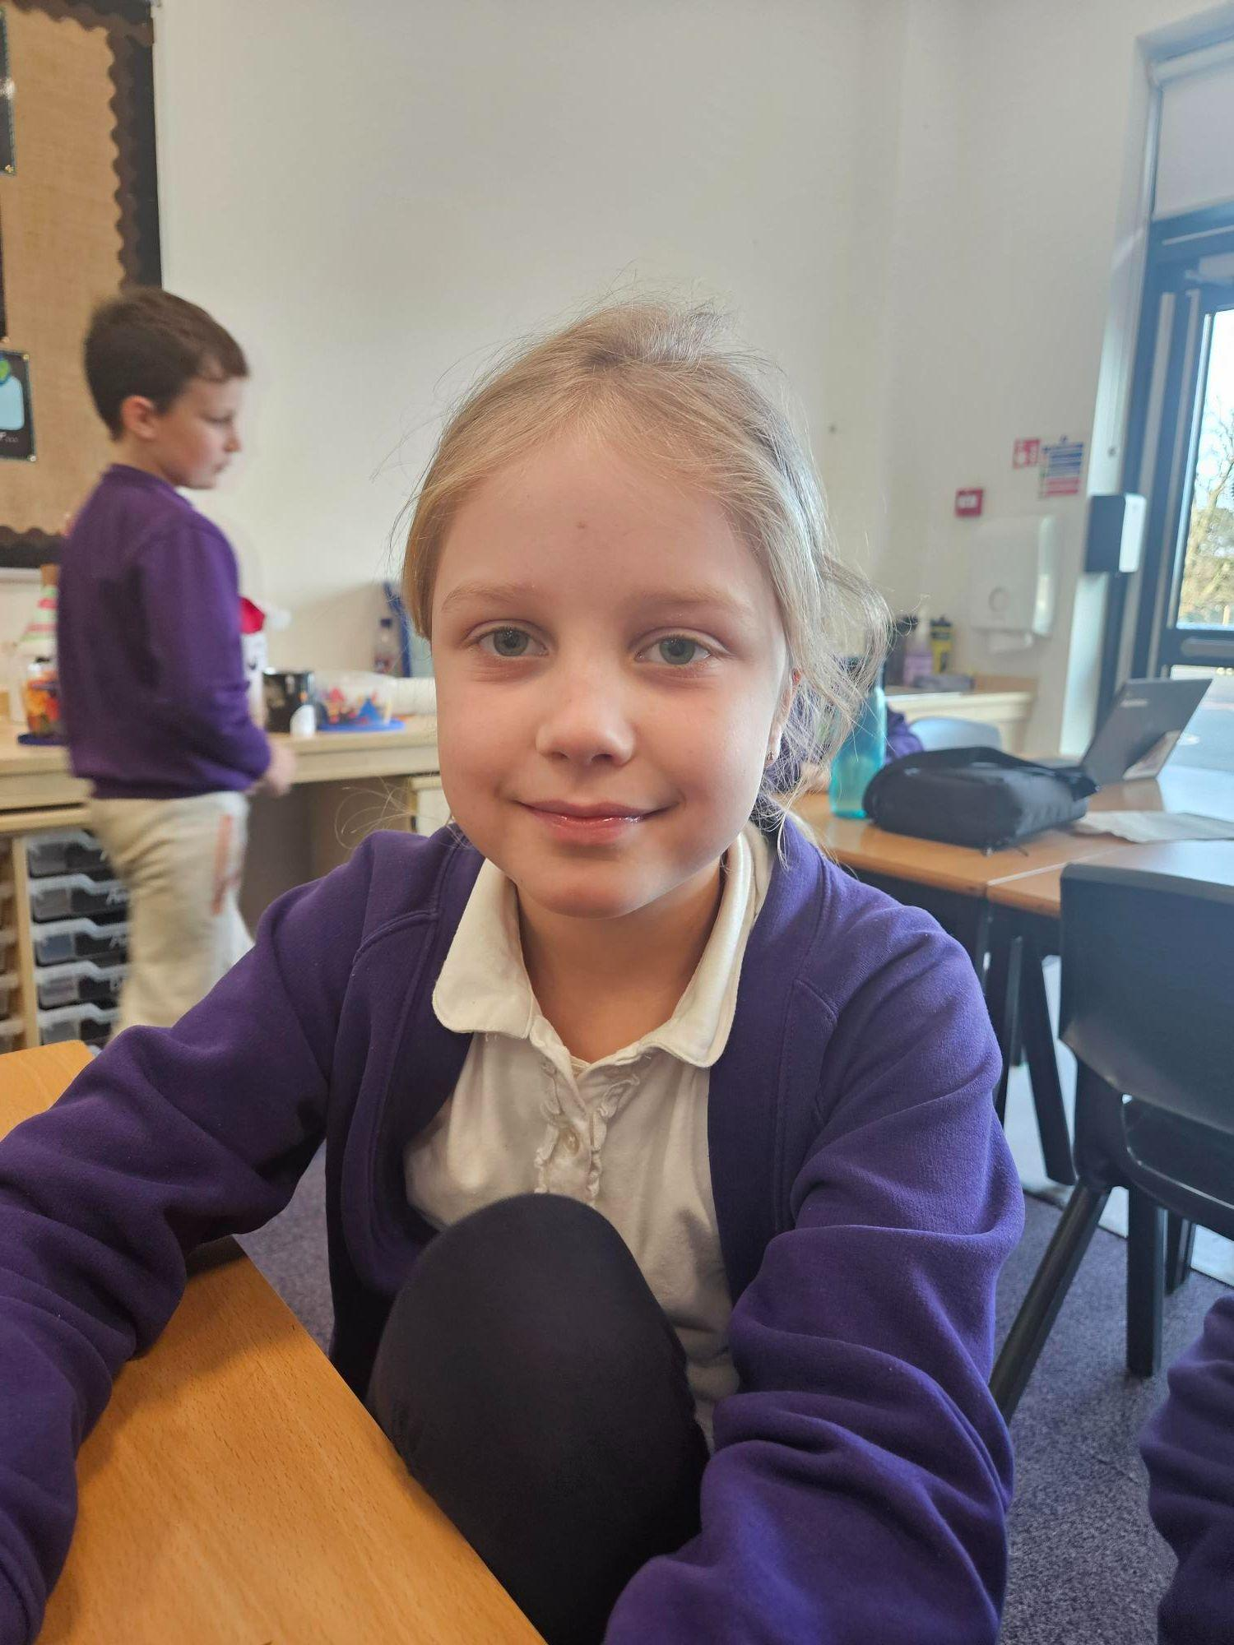
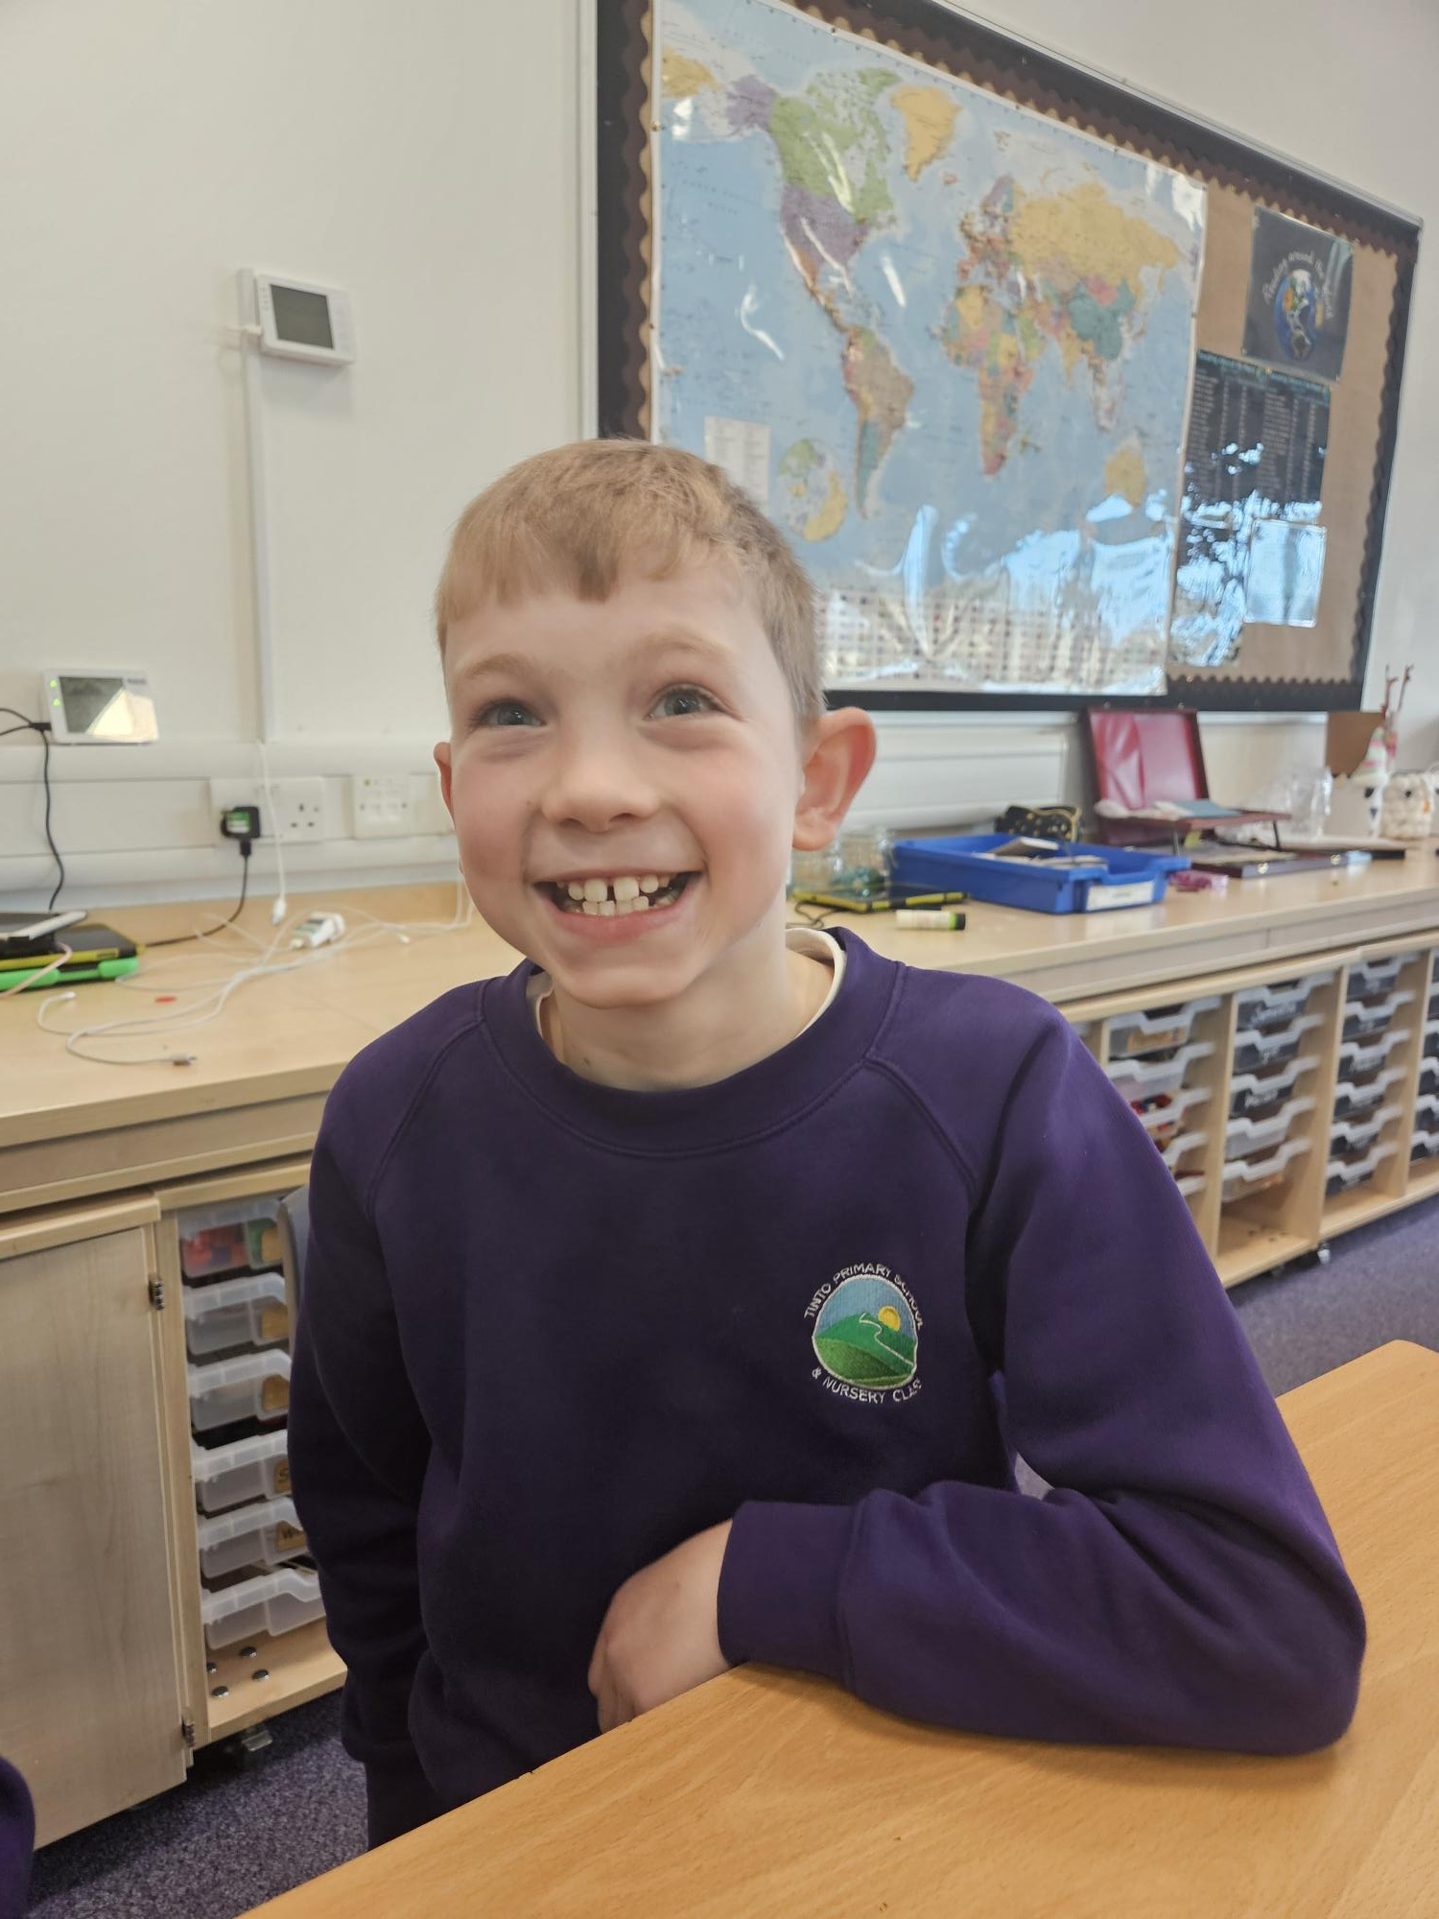
Our Members

Slide 5
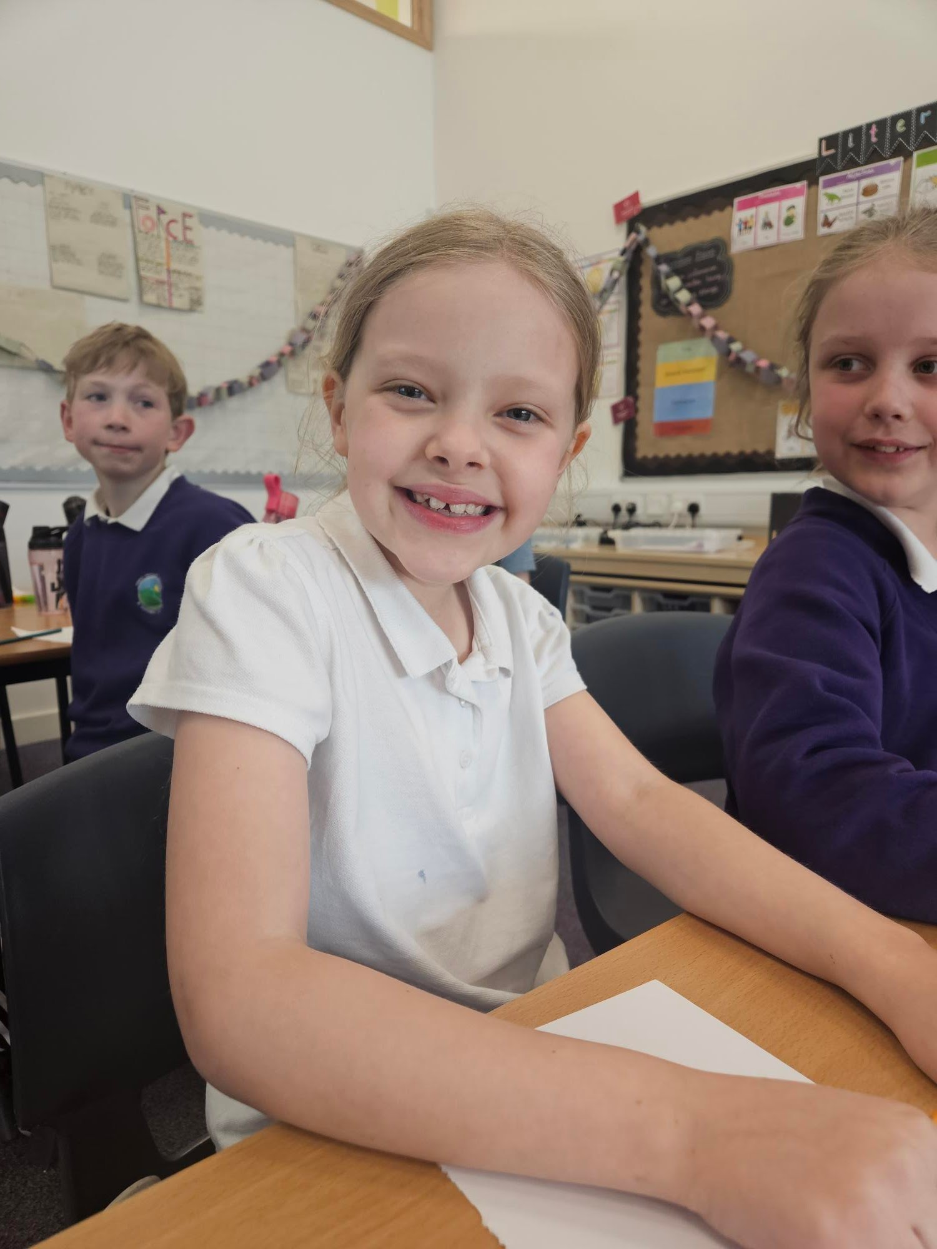
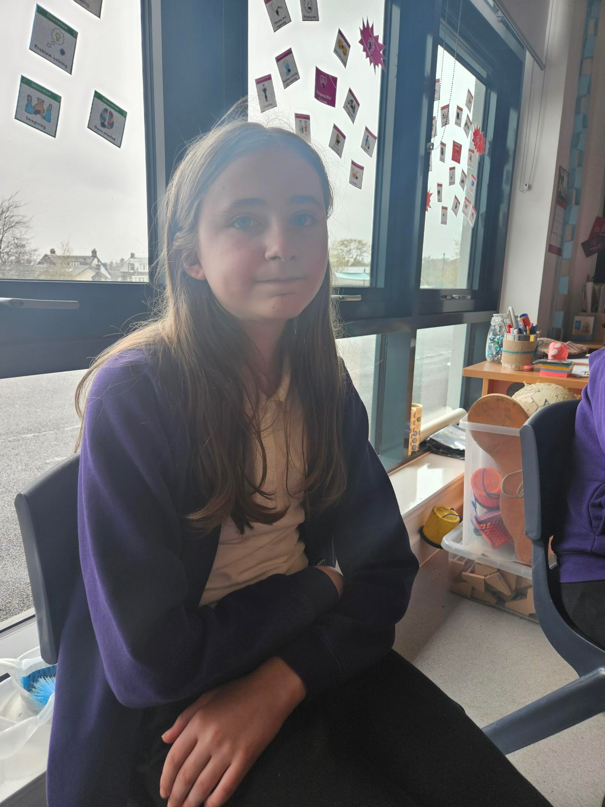
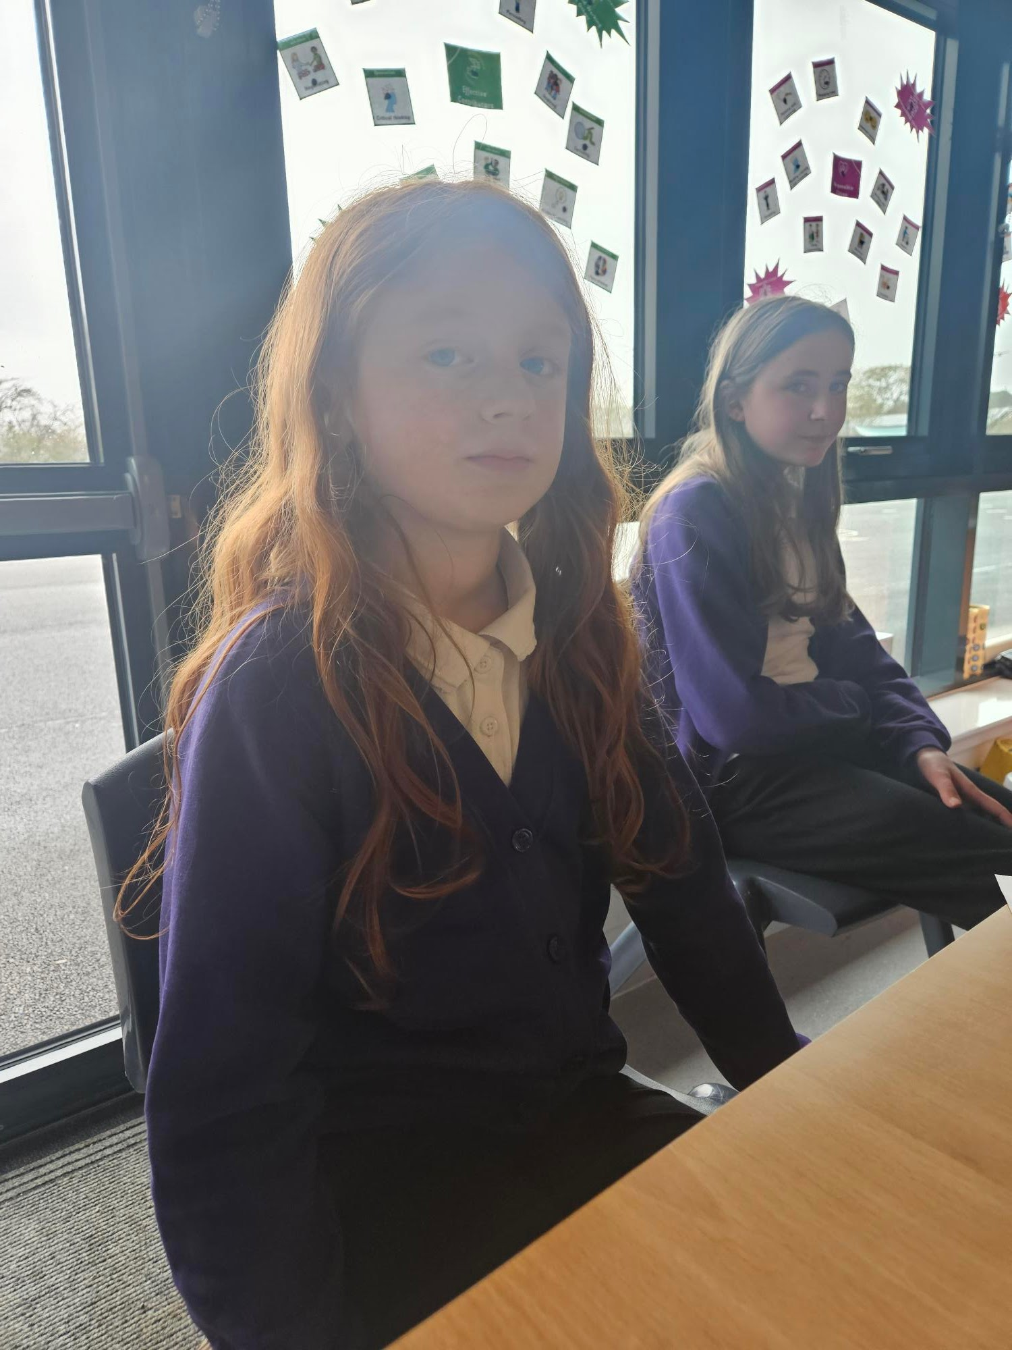
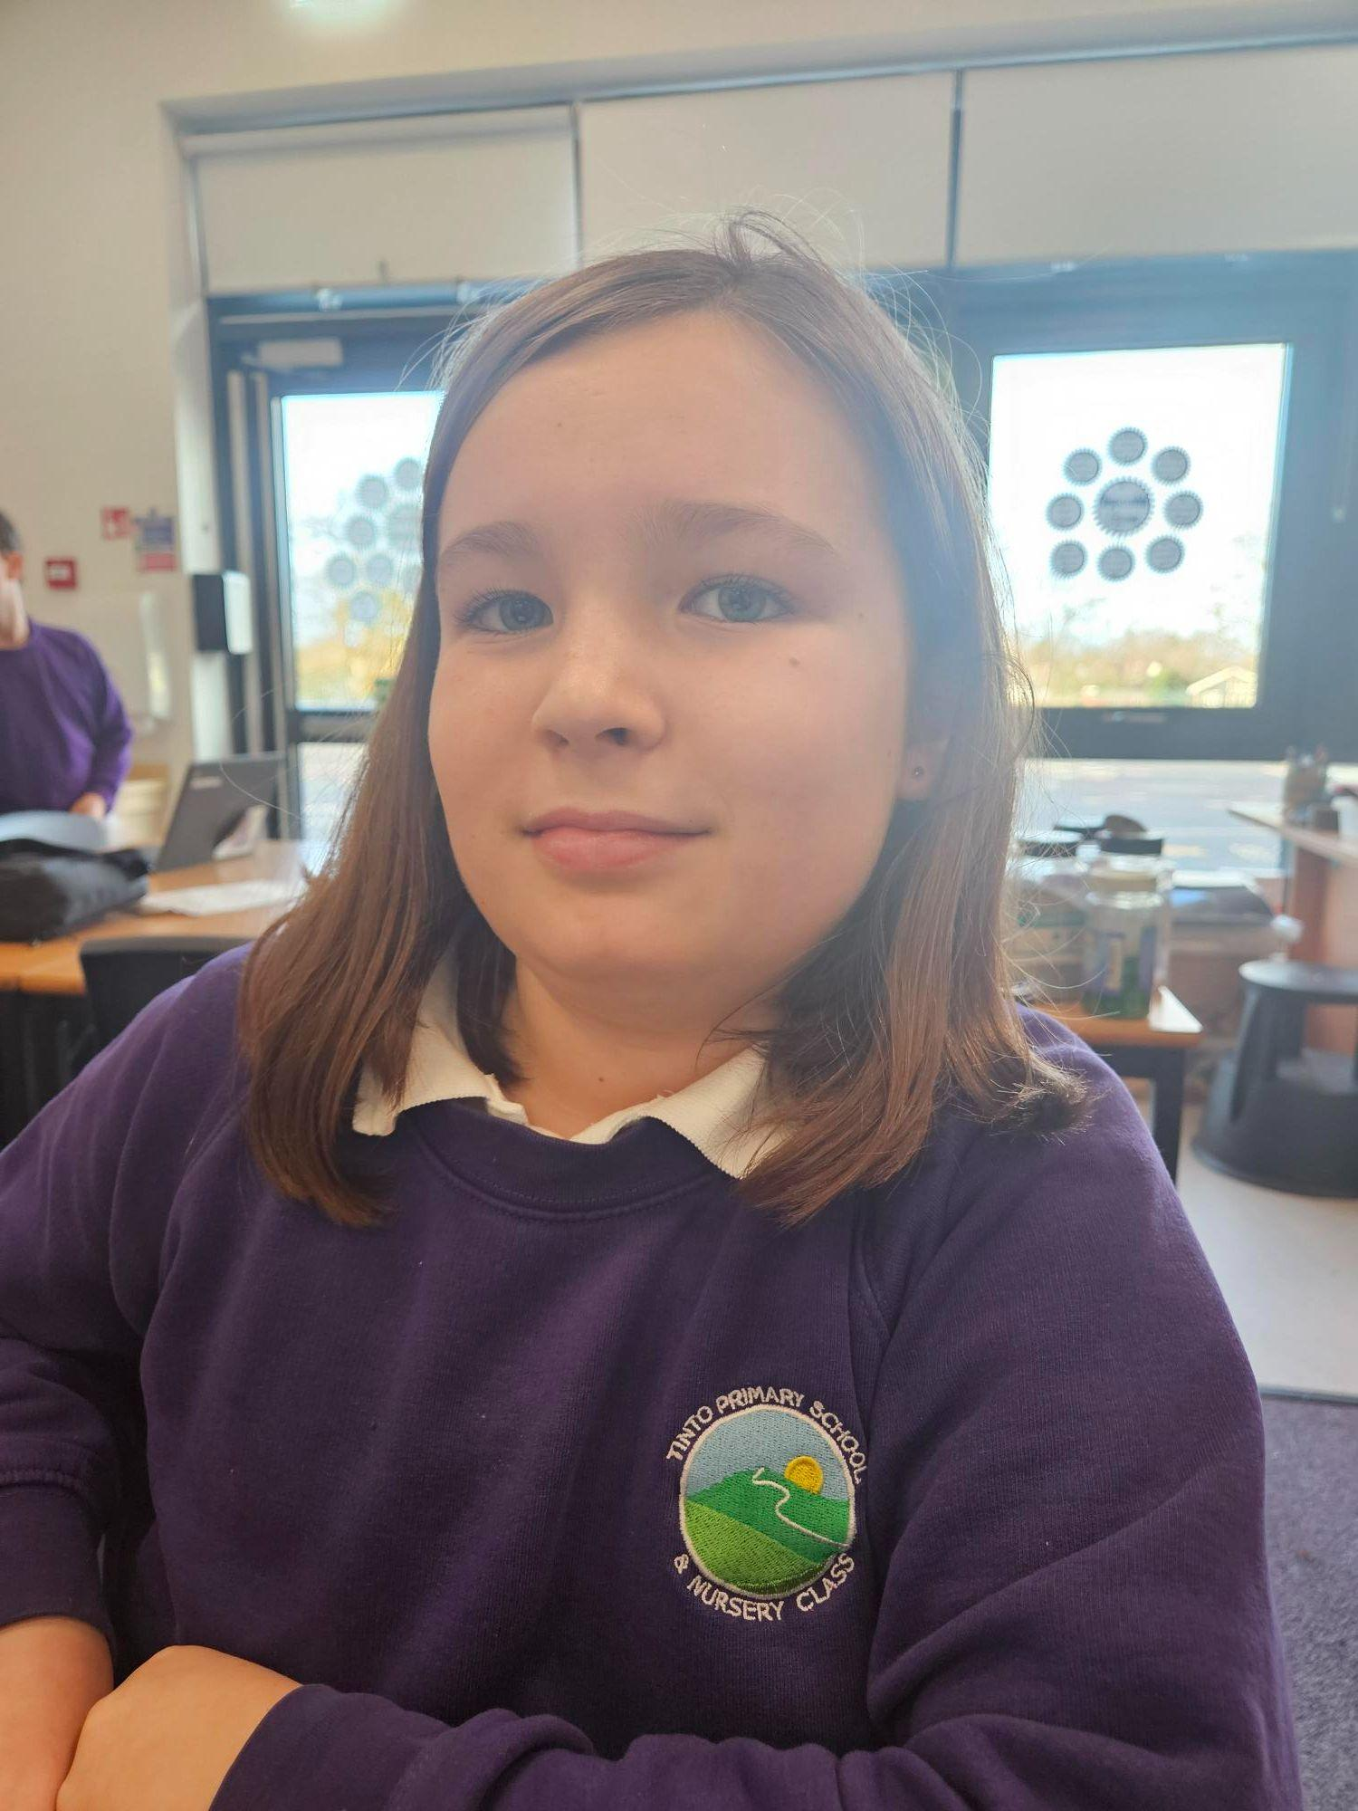
Our Members

Slide 6
Monday 28th August
We discussed going to achieve the bronze award by creating posters for the school.
We used last year’s research to narrow down the articles that we used. Article 2 (for everyone) and then Articles 12, 16, 19, 31 and 29.

Slide 7
Monday 11th September
Discussed the layout of posters that would work best and be most eye catching
Created templates for the committee to use
Committee got into teams of two and started discussing their poster

Slide 8
Monday 2nd October
Continued creating the posters
Discussed placement of the posters - committee suggested placing them in all the villages that our members live in (Symington, Thankerton and Pettinain) plus local shops

Slide 9
Thursday 23rd November
Committee completed their posters and submitted them to the Google Classroom.
Mrs Bowden and Mrs Devlin will research prices to have them printed.
The committee hope to put the posters up in their communities before Christmas.
The committee agreed that they worked very hard, collaboratively and professionally.

Slide 10
Monday 4th December
Reviewed posters.
RAG our Bronze Application towards Silver. Children discussed that they’d like to make our school even more aware of their rights and be able to talk about them and that adults reference them regularly in their teaching.
Children researched charities that help children who are not aware of their rights.

Slide 11
Monday 22nd January
Reviewed posters
Discussed children will be doing mini assembly sharing their poster and explaining the chosen important right.
Children prepared short talk.

Slide 12
Monday 19th February
Posters arrived - shared with children.
All went to symington community notice board and posted the posters to be put up for display.
Mrs Gallant & Jack to take one for Thankerton
Mrs Bowden, Owen and Hazel to take to Pettinain.
Ivor asking Mum if possible to take to Quothquan.
Children creating questions for questionnaire working towards silver award

Slide 13
Monday 11th March
Holly Louttit joined our committee.
Children explained to Holly what our committee is about and things we do i nour committee.
Children started to create their own rights respecting superhero.
FInal draft to be continued next time we meet.

Slide 14
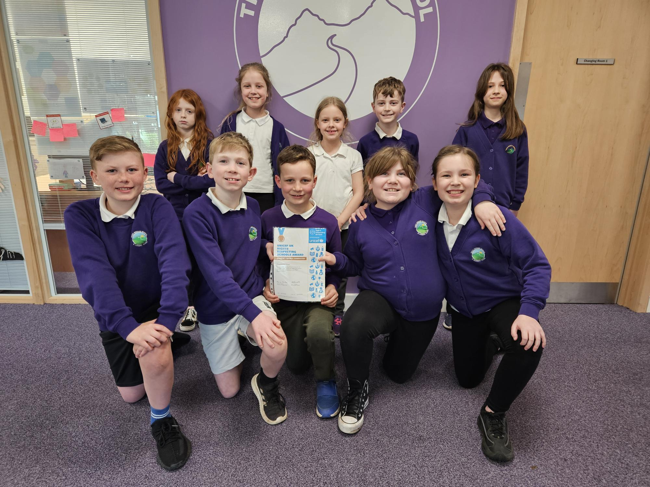
We achieved Bronze and received it in assembly 19.04.24

Slide 15
29.04.24
-Met and discussed our Bronze award - we’re so proud and excited to work towards silver.
- We recapped all we had done to get to Bronze and that, most recently, we’ve been designing a superhero to go up in the classrooms alongside our rights
- Children discussed attributes of a superhero and continued their designs that they are putting forward to the vote.

