Slide 1
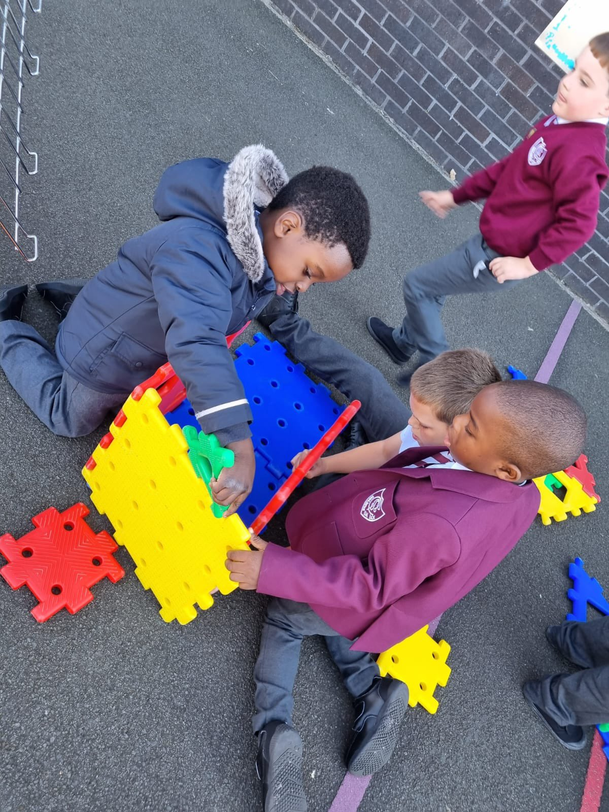
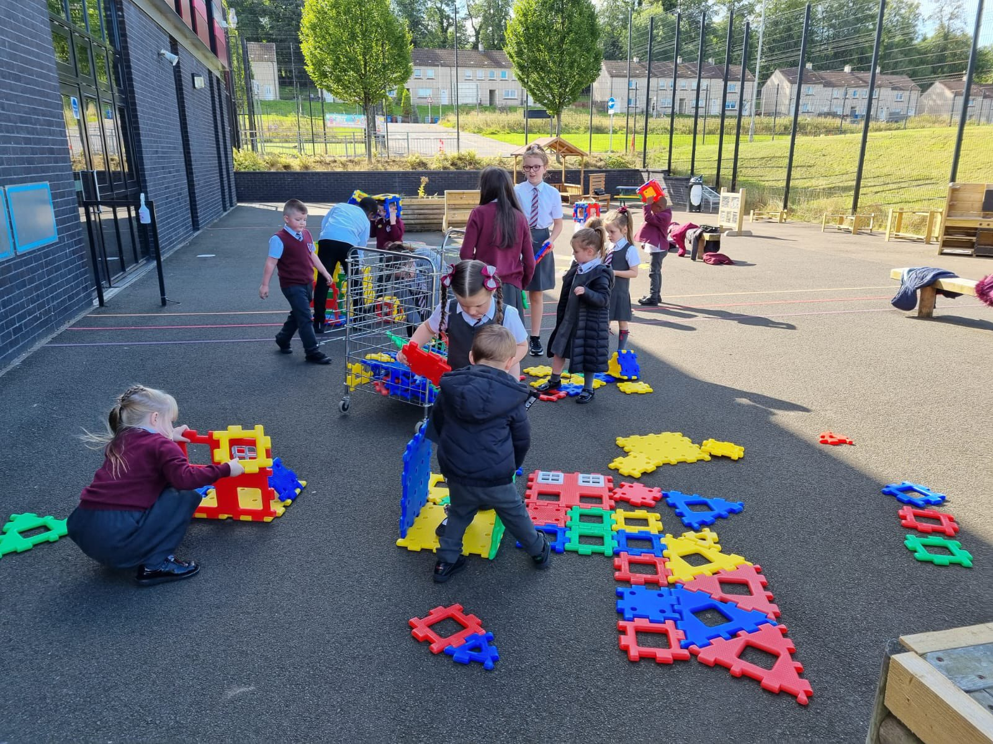


St Cadoc’s
Primary 1
Induction Handbook

Slide 2
Contents
Welcome
School Uniform
The School Day
Healthy Eating
Important Information
Preparing for School – Practical skills
Preparing for School-Educational Skills
Holding a Pencil/Using Scissors
The First Day
The Curriculum
Sharing Progress
Page
3
4
5
6
7
8
9
10
11
12
13

Slide 4


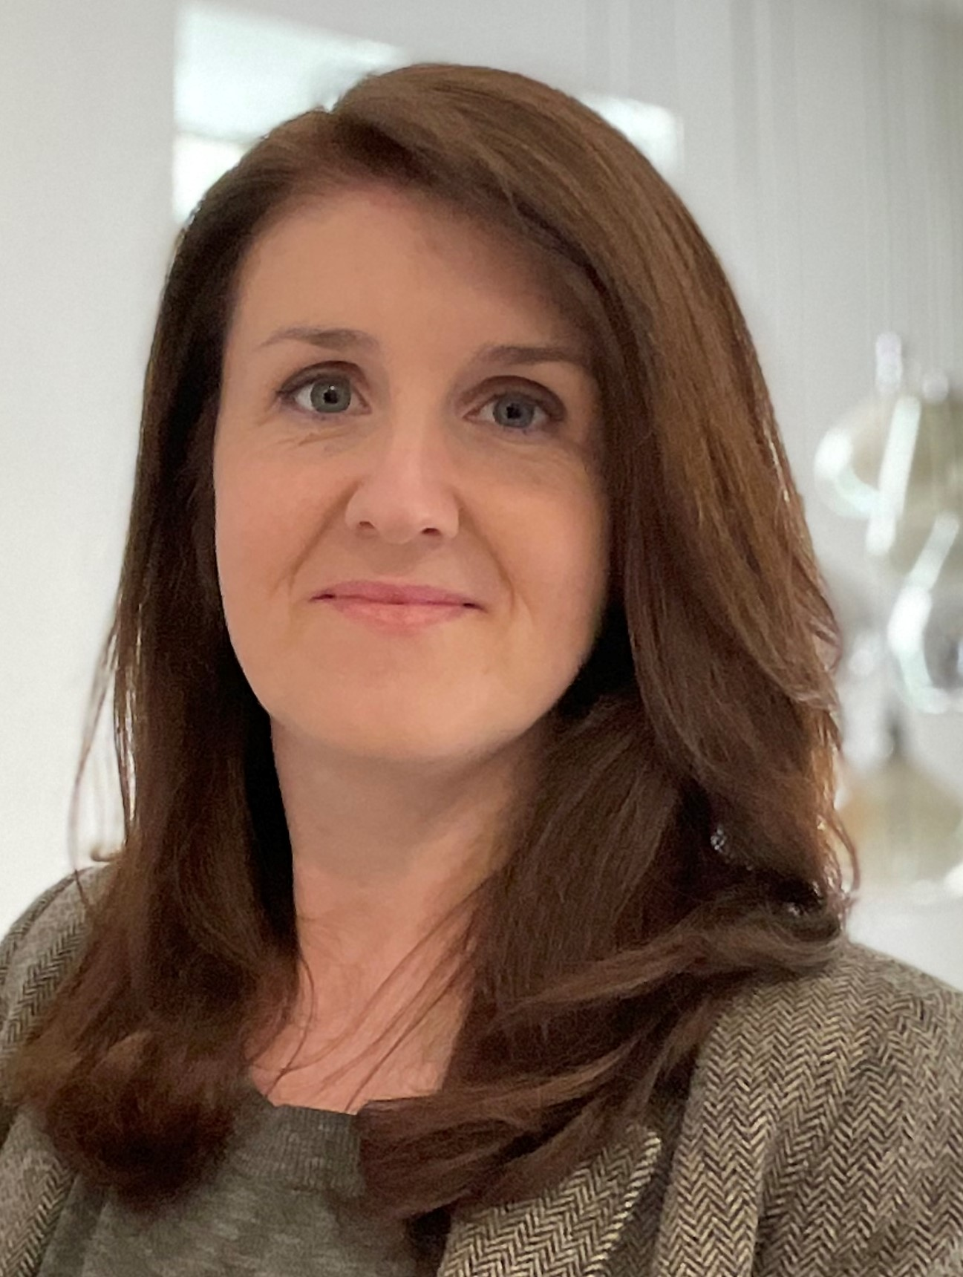
Welcome!
We are delighted that your child will be starting with us here at St Cadoc’s after the summer. It is a privilege to play our part in your child’s education and development and we look forward to getting know you and working in partnership with you.
We aim to make this a happy and positive experience for your child as they settle into the school and will do all we can to support them as they start this exciting new chapter in their lives. We want to reassure you that we will do all we can to make their transition from nursery to ‘big school’ an enjoyable and successful experience.
I look forward to you and your child joining us in August!
Kathleen Faloon
Head Teacher

Slide 5

School Uniform
Our school uniform is an important part of our identity and gives pupils a sense of pride and belonging.
St Cadoc’s Uniform:
Grey trousers/skirt
Burgundy sweatshirt/jumper/cardigan
White shirt with school tie
Uniforms are available from BE Uniforms next to the St Enoch Centre or Blossoms in East Kilbride (also online)
A selection of barely-used quality uniform items is available from our school office. Please feel free to email either the school office or the Parent Council to request items.
School office:
office@st-cadocs-pri.s-lanark.sch.uk
You can help your child prepare for school by encouraging them to practise putting on their own clothing, using zips and fastening buttons. With this in mind, please consider the types of fastenings when purchasing footwear. Velcro fastening shoes are most appropriate for starting school although we encourage pupils to learn to tie their laces as soon as possible.
Please make sure all items of property and clothing are clearly labelled with your child’s name.

Slide 6
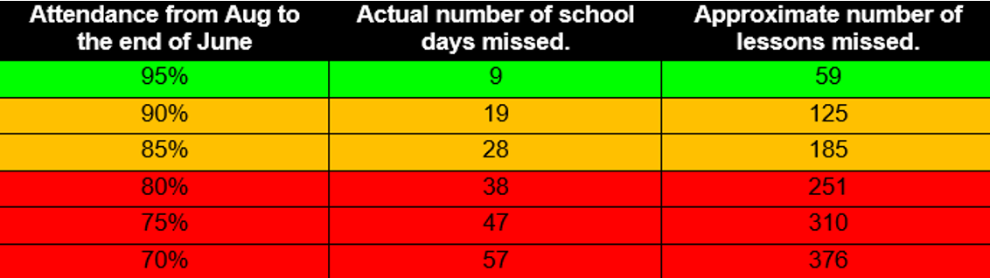

The School Day
9.00 | Morning session begins
10.30 | Interval
10.45 | Mid morning session begins
12.35 | Lunch
1.20 | Afternoon session begins
3.00 | End of the school day
Attendance
Attendance at school is extremely important. In Primary 1 the children develop the building blocks of all future learning so it is vital they are here! It is also important that they arrive at school on time as key literacy and numeracy learning takes place from 9am. Absence and late-coming can have a huge negative impact on progress.
If your child is going to absent for any reason please let the school office know as soon as possible.

Slide 7

Healthy Eating
We encourage children to make healthy choices at snack time and lunchtime. All children should bring a bottle of water with them each day.
Allergies
Please do not bring any nuts or food containing nuts to school. This includes popular brands of chocolate spreads.
We also ask that children do not bring fizzy drinks as part of their snack or lunch.
School Meals
Pupils can bring a packed lunch to school or can have a school dinner. Children in Primary One are entitled to a free school meal. This is funded by the Scottish Government for all pupils in Primary One to Primary Five. Halal and Vegetarian options are available. Milk can also be pre-ordered. Please let the school know as soon as possible of any specific dietary requirements.
A school breakfast club runs from 8.15 to 8.45 each morning. There is no cost for this service and it is open to all pupils.
Please help you child prepare for each school day by helping them to decide in advance which lunch option they would like to select from the menu.

Slide 8
Data collection and contact details
Medical Information
Please inform the school if your child has a medical condition or any allergies. This can be done by completing the relevant sections in the Data Collection form. You can also speak to a member of our leadership team to discuss any specific arrangements required to support your child. Medicine can also be administered at school following completion of the relevant forms.
It is important that all parents/carers complete and return the Data Collection forms that will be issued in August. This ensures that we can contact you in an emergency, for example, if your child is unwell, and can keep you up to date with information about our school. Please inform the school office by phone or email if there are any changes to these details so we always have the correct information .
Important Information
Grants
If you are eligible for a grant for free meals, milk and clothing you should apply through South Lanarkshire Council’s website:
https://www.southlanarkshire.gov.uk/forms/form/306/en/clothing_grant_and_free_school_meals_application
Parent Pay and Parentsportal
The school uses a cashless payment system called Parent Pay.
We communicate with you in a wide variety of ways Parentsortal is the quickest and most efficient way of getting information to you.
It is important that all parents sign up to these when you join the school in August

Slide 9
Preparing for school
Talk about starting school
Starting school is an exiting time in a little person’s life however it can also be a daunting one. It is a good idea to reassure your child and be enthusiastic about the fun things that are going to happen. Have a look at the Primary 1 induction section of the St Cadoc’s Website for stories to share with your child.
Visit the classroom
The transition programme for starting school will give your child an opportunity to get to know the school building and visit the Primary 1 classroom. Have a look on the school website too for a virtual tour and more school information to help your wee one become familiar with their new environment.
Practical Skills
Getting dressed and undressed independently
Maybe make a game of changing in and out of their PE kit (including shoes) and back again. You will soon find out which bits they need to practise.
Going to the toilet independently remembering to wash and dry their hands
Make sure your child is happy going to the toilet on their own, their uniform is easy to pull down and up (or up and down) and discuss with them the need to tell the teacher if they need to go.
Don’t worry if they have the odd accident as they’re settling in. It’s something teachers and support staff are used to and help is at hand when it's needed. It is worth packing a spare set of pants, trousers and socks in your child’s bag.
Eating with others and using cutlery
If they're having packed lunch, make sure your child can open cartons and packets and unwrap a sandwich. Help is always at hand but it helps if they are as independent as possible. They are usually in the dinner hall for around half an hour so it is a good idea to get them used to sitting at the table without getting up and down and using cutlery to eat their food.
Catching coughs or sneezes in a tissue or an elbow
It is good to encourage your child to use a tissue if they have a runny nose or if they sneeze. Good hygiene benefits everyone in the class.

Slide 10

Preparing for school
Educational Skills
Parents often worry that they should be teaching their child to read or write before they start school. There is no need to worry about this however there are some things that you can do to help them get off to the best possible start.
Help them to develop early literacy skills:
Reading to your child is one of the greatest things you can do to support their early learning. Reading to your child helps develop their vocabulary, concentration skills, imagination and develops thinking skills at an early age and is the best way to develop their language and literacy development. Enjoy talking about the story and encourage your child to join in with familiar parts of the book.
Play games like ‘Eye Spy’ to help them practise listening to the sounds in spoken words.
Recite nursery rhymes together.
Help them to recognise their own name
Your child will have been practising this at nursery however you can reinforce this at home too.
Help them to develop early numeracy skills:
Have fun counting fingers, toes, stairs and toys together
recognise numbers, shapes and colours on objects like clocks and phones or in books
compare things of different sizes – ‘big’, ‘small’ and ‘medium’
use words to describe where things are – ‘over’, ‘under’ and ‘next to’
help set the table
help with the shopping and use money to buy things

Slide 11
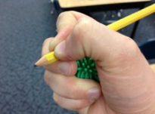
Holding a pencil and using scissors
It is a really good idea to try to encourage your child to have a good pencil grip before starting school.
It is worth making sure your child can identify and name their thumb, pointer finger and middle finger so they can use them together.
Children easily develop bad habits and it is much harder to break these habits once they become established. A tripod grip is what to aim for.
You can help your child develop a good pencil grip by:
encouraging them to make marks, colour in and draw as much as possible.
using shorter pencils or crayons to encourage them to only use their thumb, pointer finger and middle finger (triangular pencils also help.)
strengthen and refine their grip by encouraging the use of play dough, tweezers, peg boards and threading activities.
For any of the above ideas it can be helpful to encourage your child to hold a small cotton wool ball (or another small object) in the palm of their hand using their ring finger and pinkie as this will ensure these fingers do not become part of pencil grip.
You can help your child master the grasp-release motion for using scissors by:
playing games that involve opening and closing clothes pins to strengthen the muscles in the hand needed.
using spray bottles.
ensuring they use the correct fingers.
Engage in snipping activities with paper or play dough.

Slide 12
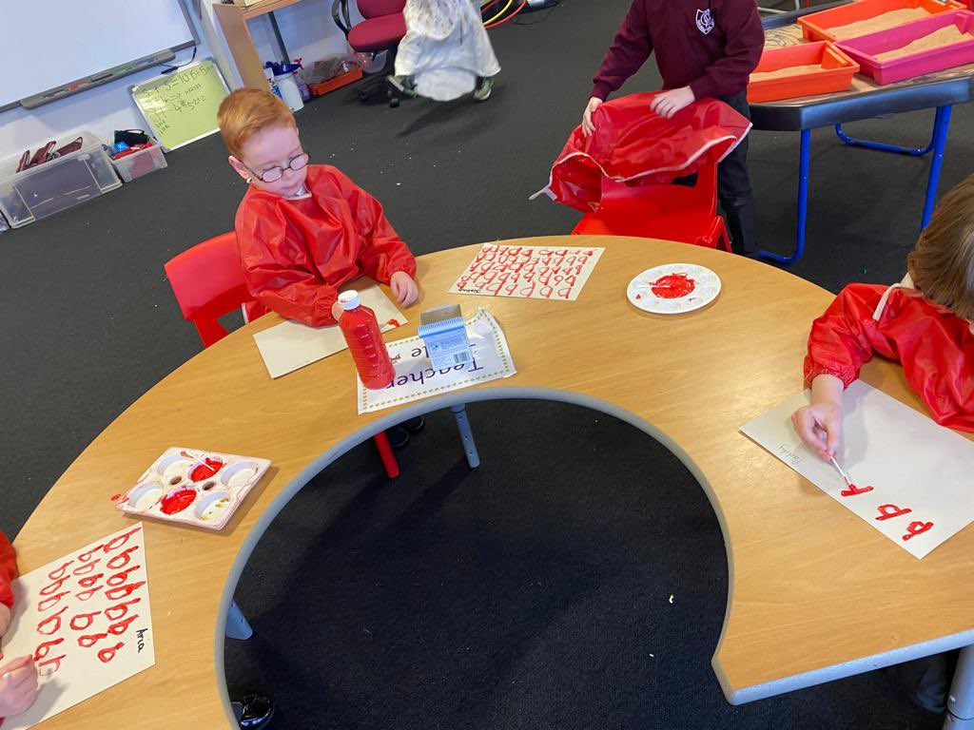
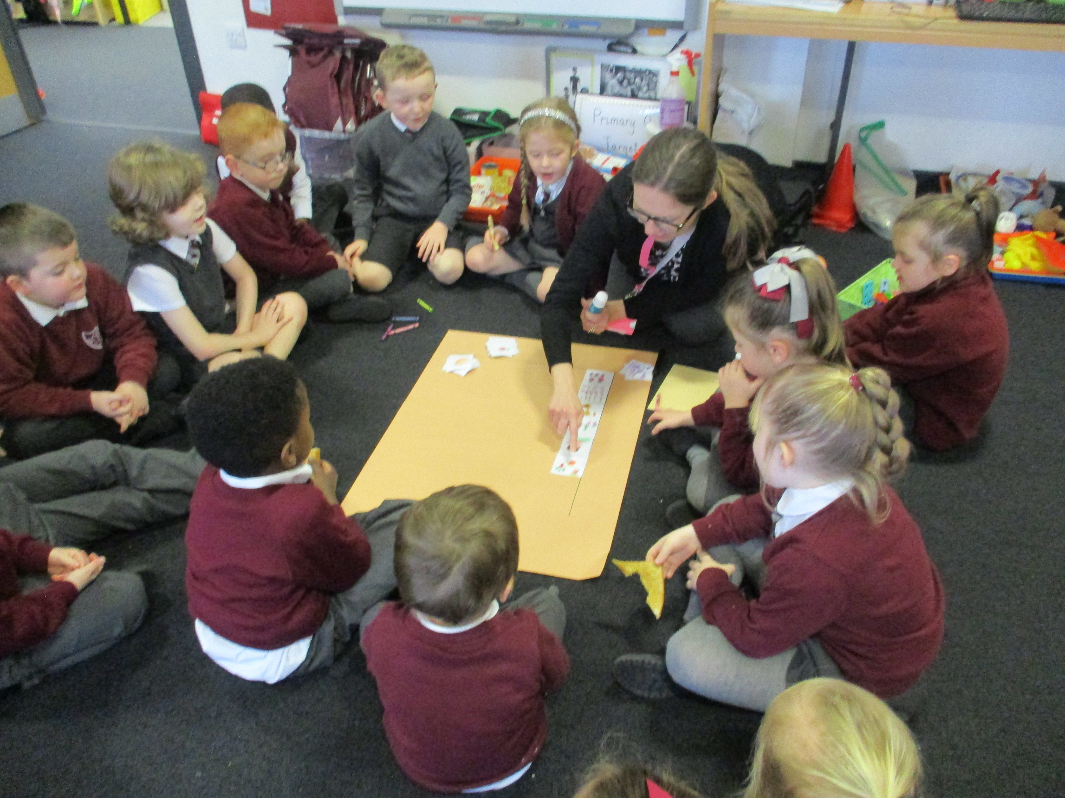
The First Day
We understand that the transition from the home environment to school represents a very big change for young children. You can make this easier by:
talking positively about what your child will experience on their first day
making sure all preparations for school have been made the night before so that no one feel rushed or stressed before coming to school
• making sure your child gets plenty of sleep the night before
• having a healthy breakfast
explaining to them in the morning who will collect them from school
On the first morning, once you have taken a wee photo and said goodbye, it is best to stay out of sight. A prolonged goodbye may upset some children (and parents too!) Please rest assured, the children always settle quickly and are distracted by lots of things to do and new friends to meet!

Slide 13
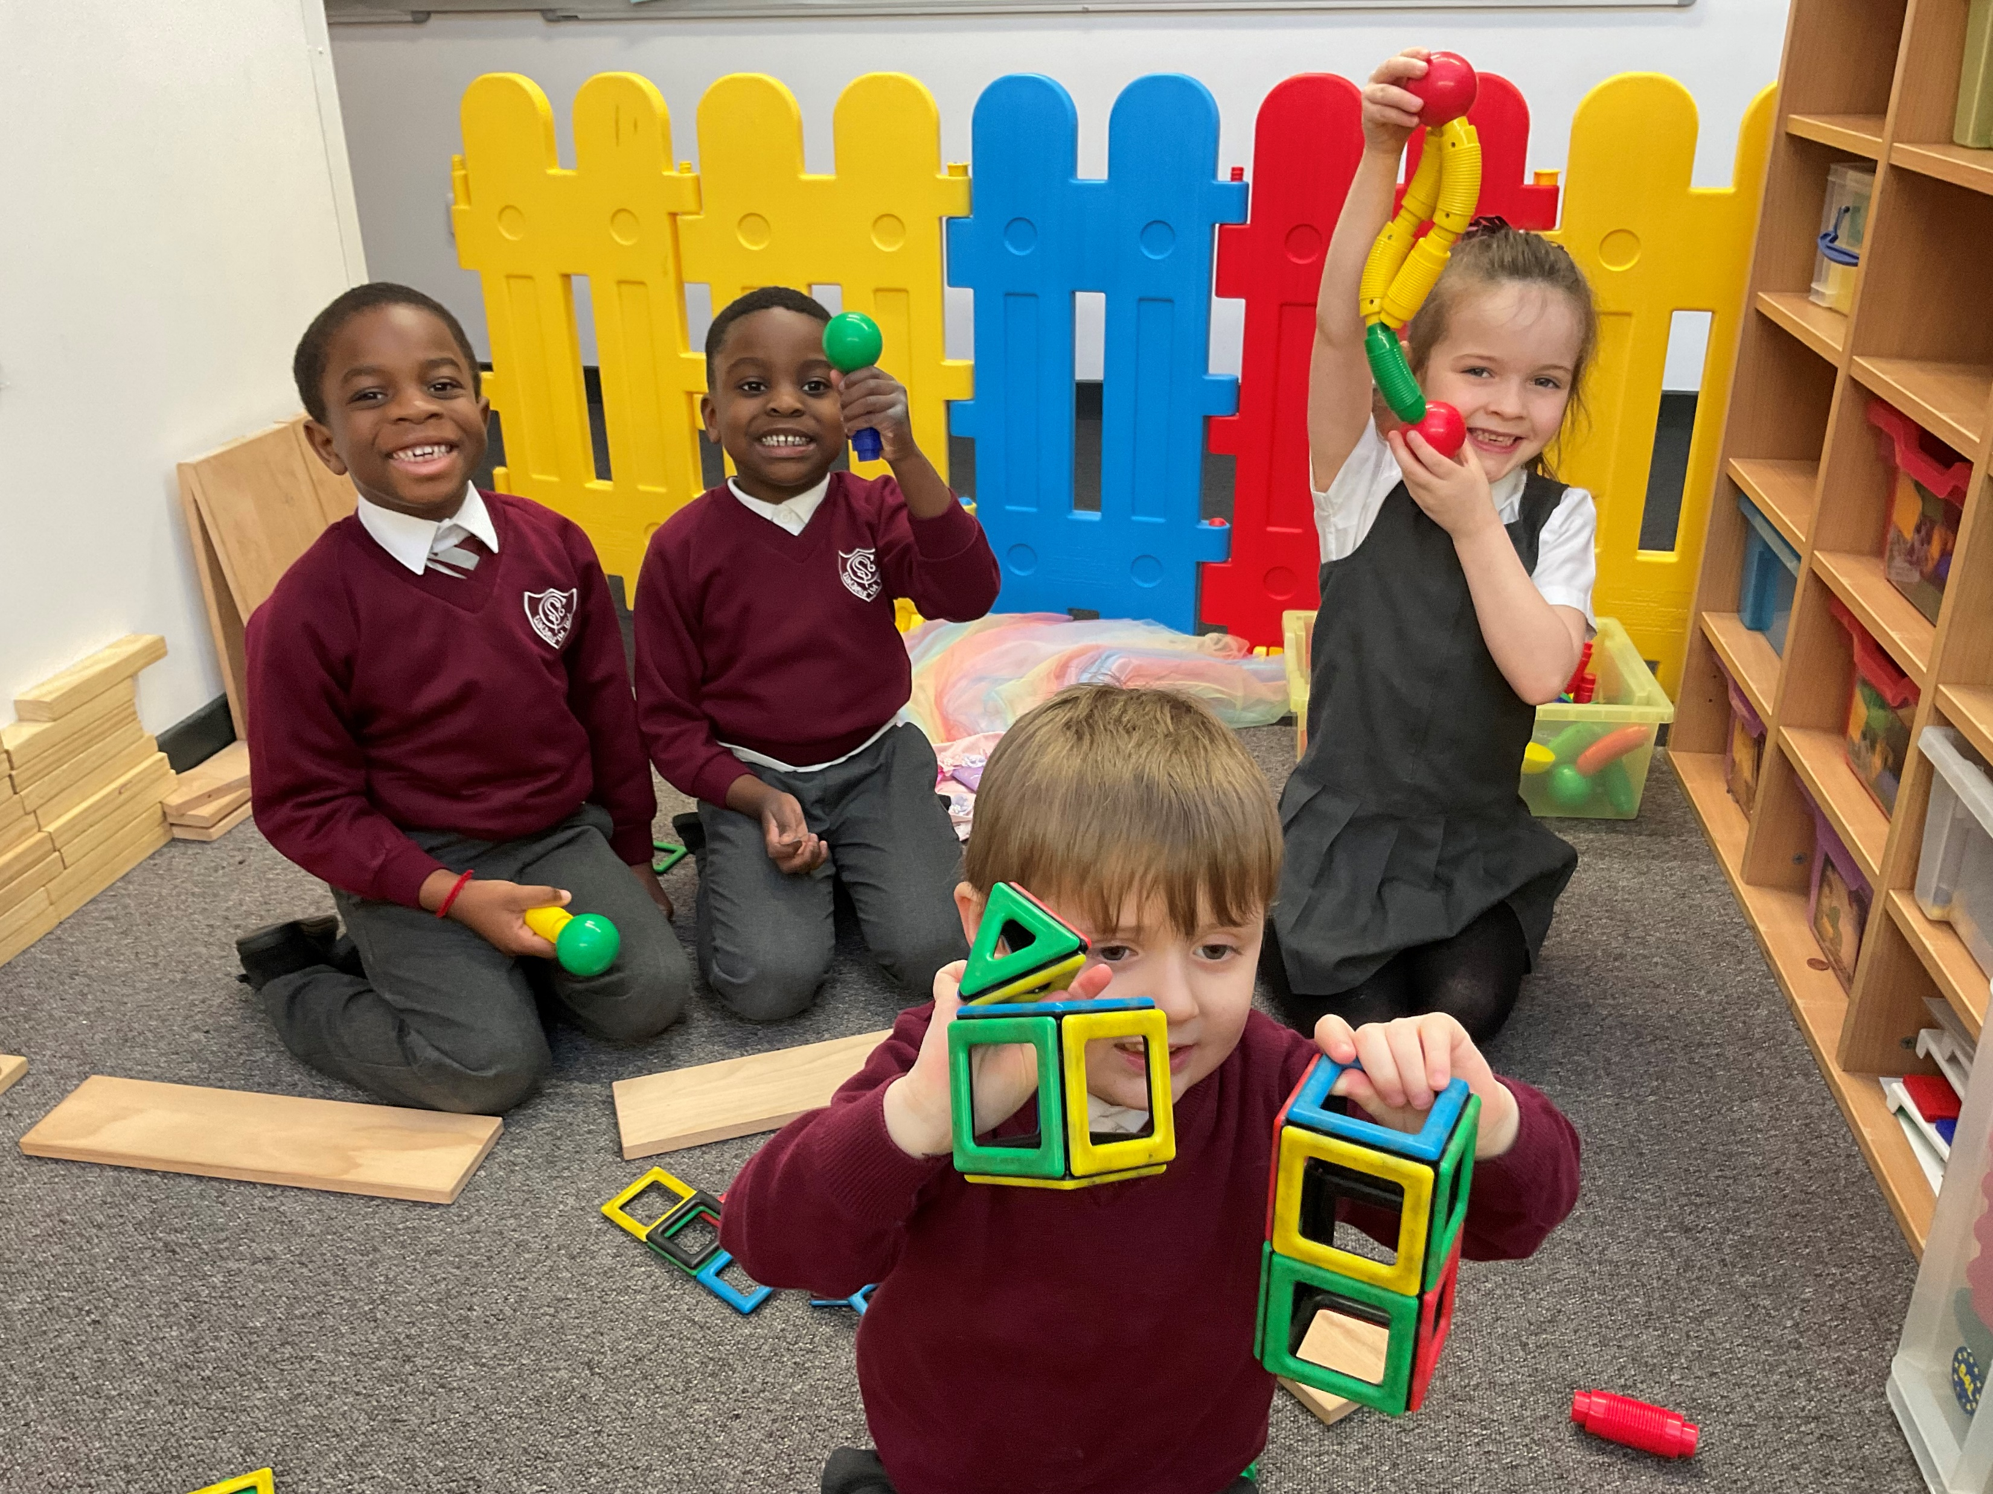
The Curriculum
At St Cadoc’s we follow the Scottish Curriculum for Excellence which is divided into eight subjects areas:
Expressive Arts
Health and Wellbeing
Languages and Literacy
Mathematics and Numeracy
Religious and Moral Education
Science
Social Studies
Technologies
The Early Level of Curriculum for Excellence was designed with the understanding of developmentally appropriate learning and teaching. The Early Level spans (for most children) Nursery to Primary 1.
“Real play is the freedom for children to engage with and learn from the world that surrounds them. By mentally and physically connecting children to the world, play empowers them to create and grow for the rest of their lives. It is a fundamental right for all children.”
World Economic Forum
At St Cadoc’s we use evidence-based approaches in Primary 1 and are committed to education being filled with joy for our young learners. We believe children should have a balance between directed high-quality teaching and play-based activity.

Slide 14
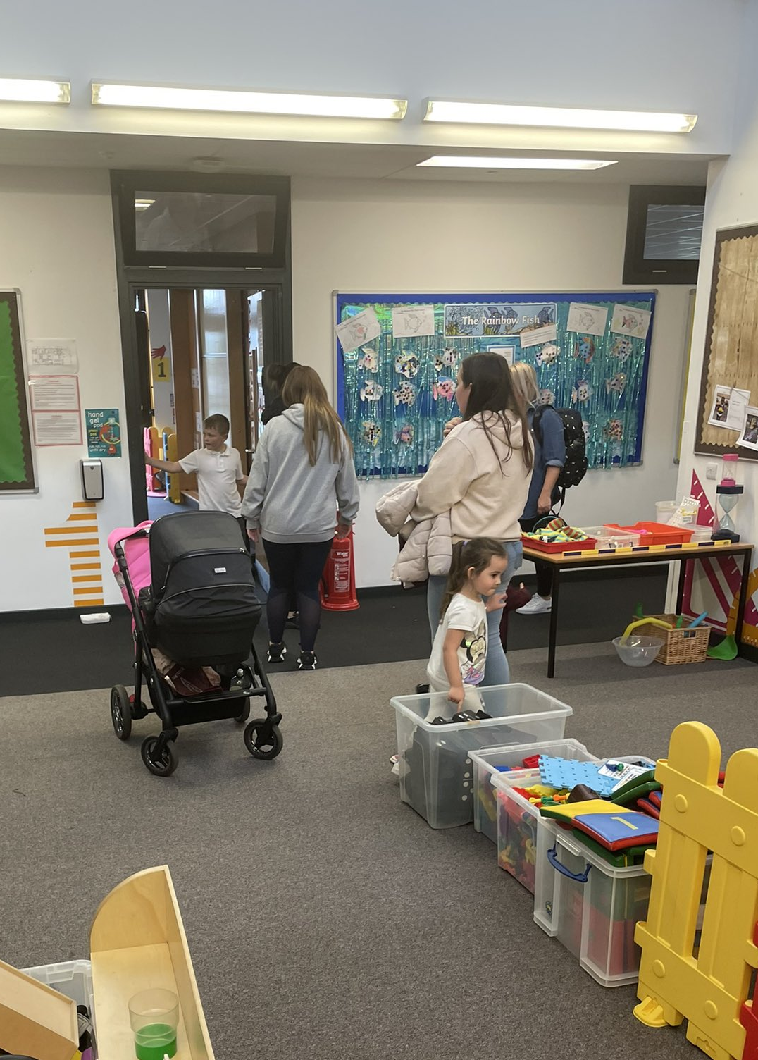
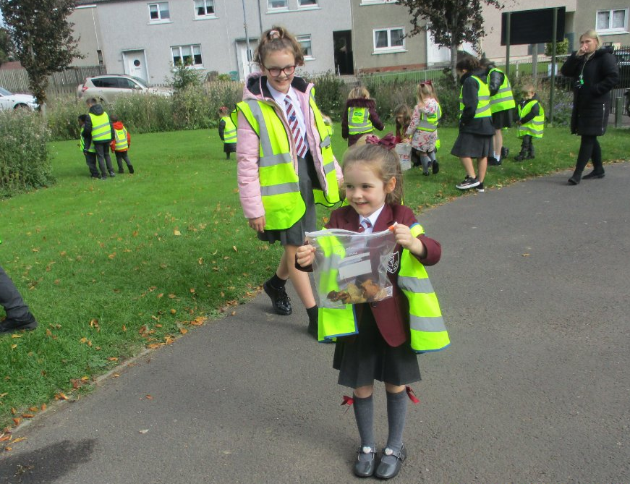
Sharing Progress
Teachers and Support Staff constantly observe, record and evaluate the children as they learn. Your child’s teacher will use a huge range of information to monitor your child’s progress and ensure they are receiving the right amount of support and challenge.
We will discuss your child’s progress with you, plan next steps accordingly, and ensure you understand how best to support your child’s learning at home on a regular basis.
You will have opportunities to discuss progress in a variety of ways through parents’ nights, phone calls, workshops and formal reports.
At St Cadoc’s we recognise and value the importance of working in partnership with all of our families and our wider community

Slide 15
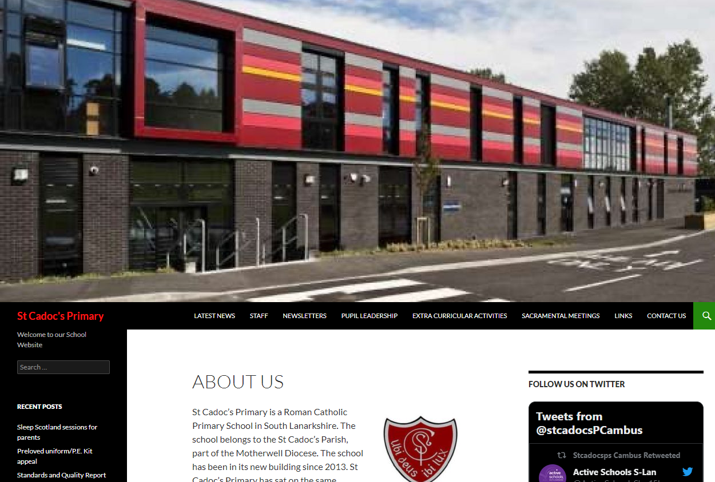
Website, Twitter and Parentsportal
Information, News and Events
Newsletter
Our newsletter is published each month giving updates and details of forthcoming events
Keep up to date with our latest news and events by
visiting our website:
https://blogs.glowscotland.org.uk/sl/stcadocsprimary/
and/or following us on Twitter:
@stcadocsPCambus

Slide 17
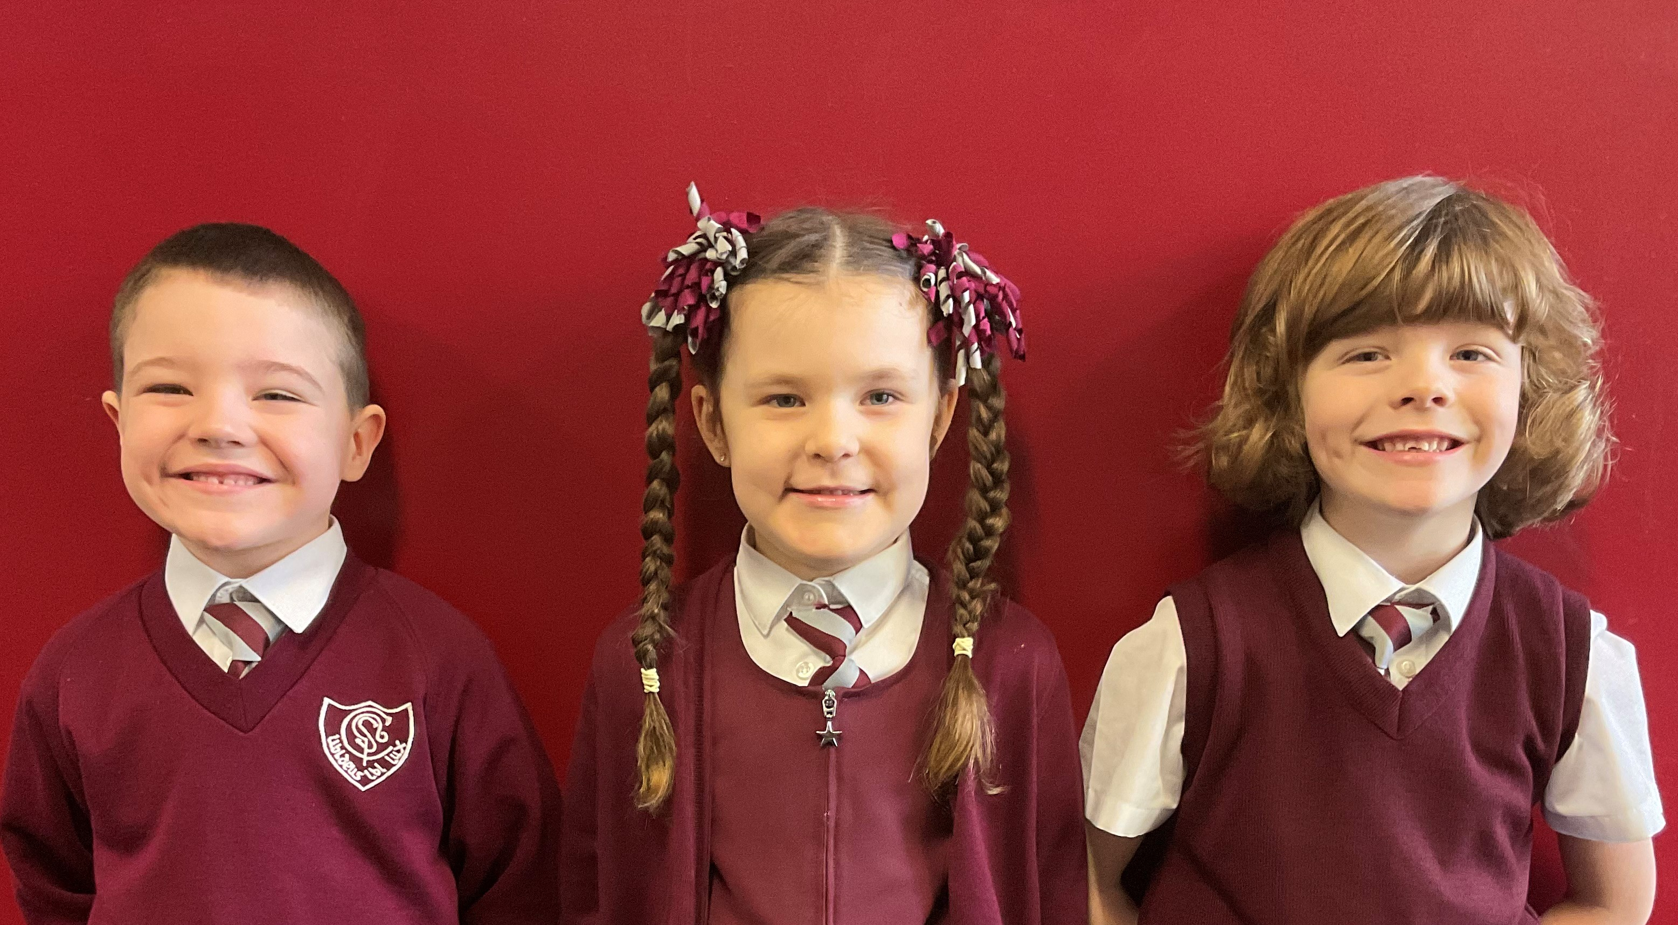
St Cadoc’s
Primary School
Telephone: 0141 641 3088
Email: office@st-cadocs-pri.s-lanark.sch.uk
St Cadoc’s Primary
Ivybank Avenue
Halfway
G728SQ

