Slide 1
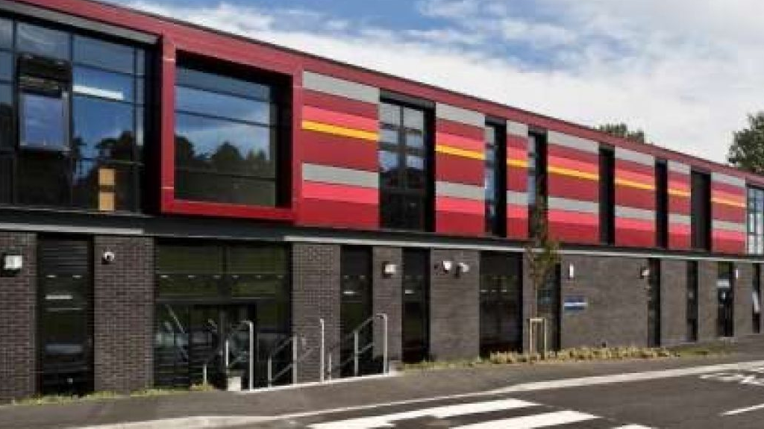
St Cadoc’s Open Evening
An Introduction for incoming P1 Parents

Slide 2
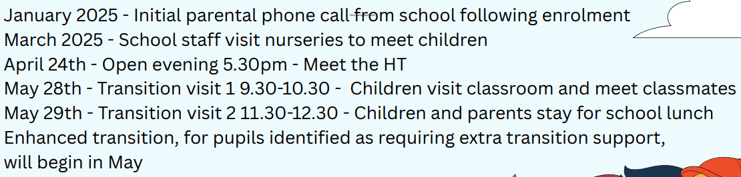

Slide 3
Our Vision
Guided by our faith and a commitment to excellence in learning, our school community will empower every pupil to reach their highest potential whilst nurturing compassionate, principled individuals who will make a positive impact on society.
Faith Aspiration Resilience Respect

Slide 4
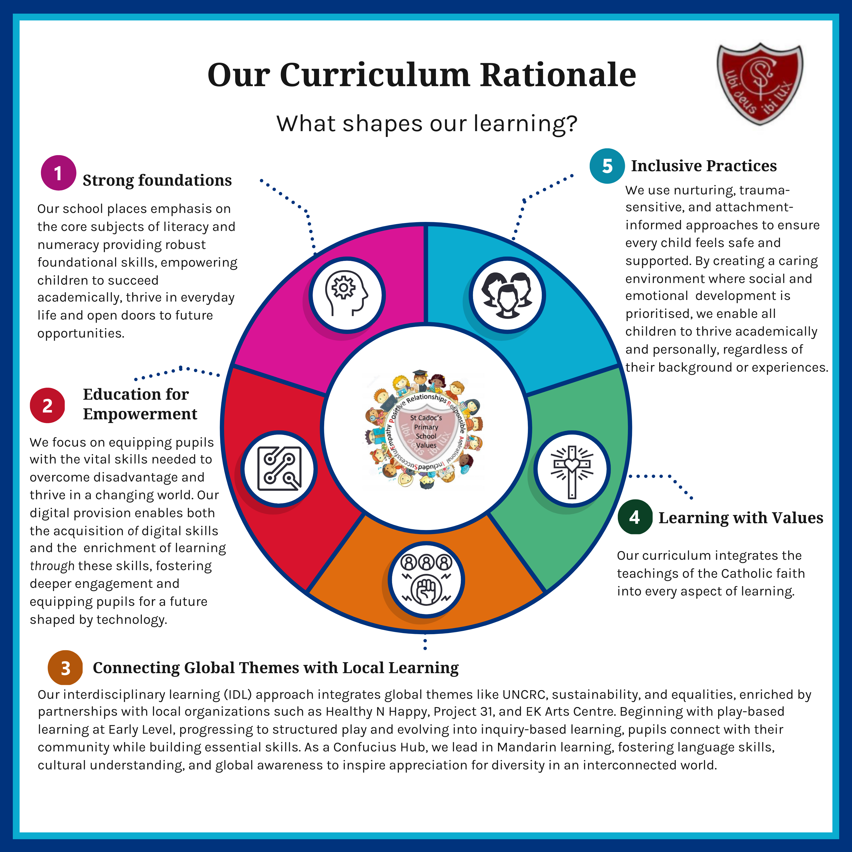

Slide 5
Literacy and Numeracy
Active Literacy – Phonics, spelling, reading
Decodable reading books initially
Foundations of Writing
Talk for Writing
Ark Maths

Slide 6
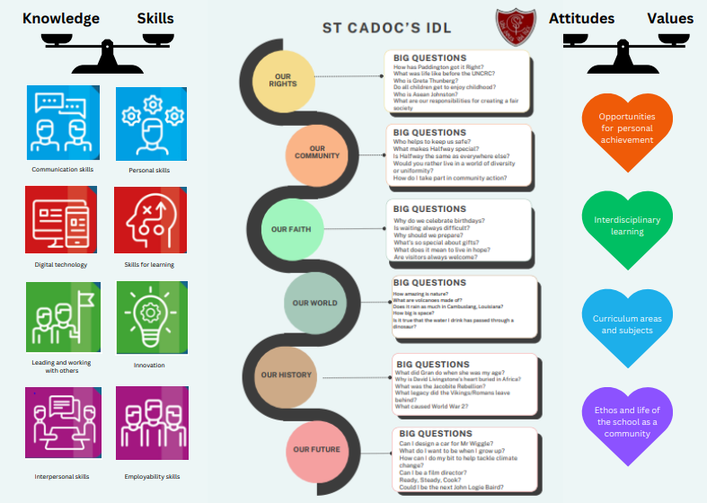

Slide 7
Discreet Subjects
Science
Spanish
Music
Mandarin (from P2)

Slide 8
Inclusive Practices
Nurture groups
Support groups
Forest School
Nurturing spaces – The Burrow, The Nest, The Den
Specialist Support Teacher – Brenda Clarke
Educational Psychologist – Elaine Robertson
Counselling Service – The Exchange
Buddy system
Attachment Ambassadors

Slide 9
Play
Structured play approach
OPAL project
Enquiry-based learning
Children’s engagement and enjoyment governing how and what we teach

Slide 10
Extra-curricular
Pupils voice groups
Pupil council
Breakfast club
Side-kicks
Active schools clubs
Pupil led groups

Slide 11
Next session’s numbers
Estimated role for next session 132
Next year’s Primary 1 estimated to be 15 pupils
6 Classes – no classes over 25
Straight Primary 1
Composite classes throughout the school

Slide 12
